Slide 1
Lab6: Logistic Regression and Metrics
DataLab
2023.10.19

Slide 2
Outline
Brief Review: Logistic Regression
Common Evaluation Metrics for Binary Classification
Confusion Matrix
Soft Classifiers – ROC Curve

Slide 3
Outline
Brief Review: Logistic Regression
Common Evaluation Metrics for Binary Classification
Confusion Matrix
Soft Classifiers – ROC Curve

Slide 4
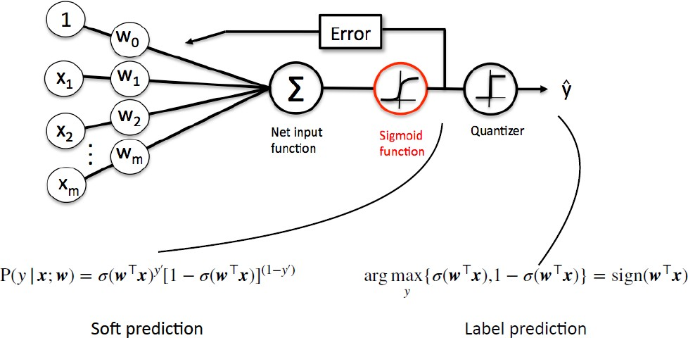
Logistic Regression

Slide 5

Logistic Regression + Regularization
把 regularization term 加到 loss 內，讓模型在學 weights 的時候，會傾向選擇比較簡單的模型。

Slide 6
Outline
Brief Review: Logistic Regression
Common Evaluation Metrics for Binary Classification
Confusion Matrix
Soft Classifiers – ROC Curve

Slide 7
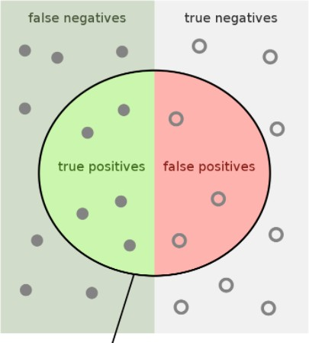
Confusion Matrix
It is important to know how the model make wrong prediction
In binary classification, confusion matrix is a common tool to analyze the predictions

Slide 8
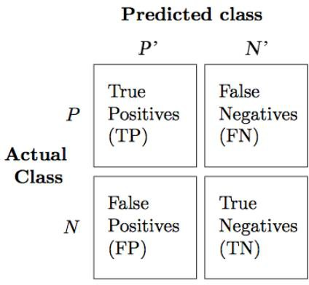

Confusion Matrix
It is important to know how the model make wrong prediction.
e.g. 檢測絕症
寧可讓多一點人到 TP & FP，也不要讓 FN 很高
i.e. TPR higher

Slide 9
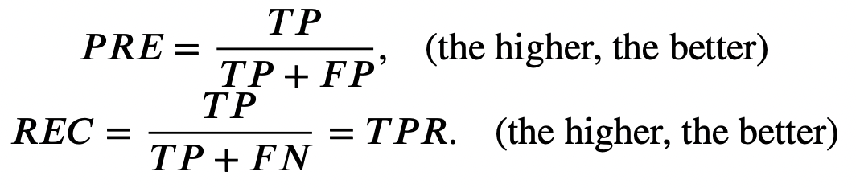
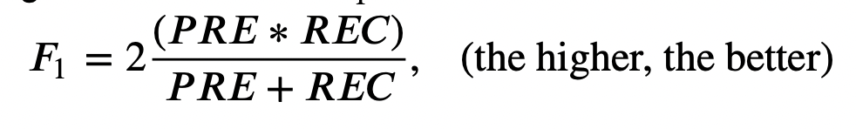
Confusion Matrix
Precision(PRE) & Recall Rate(REC)
F-1 Score

Slide 10
Confusion Matrix
Precision(PRE) & Recall Rate(REC)
F-1 Score

Slide 11
Outline
Brief Review: Logistic Regression
Common Evaluation Metrics for Binary Classification
Confusion Matrix
Soft Classifiers – ROC Curve

Slide 12
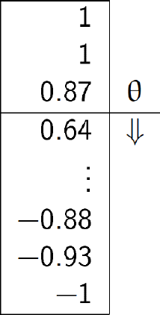


ROC Curve
ROC curve analyze the performance for every threshold in soft classifiers
In X-axis
In Y-axis

Slide 13
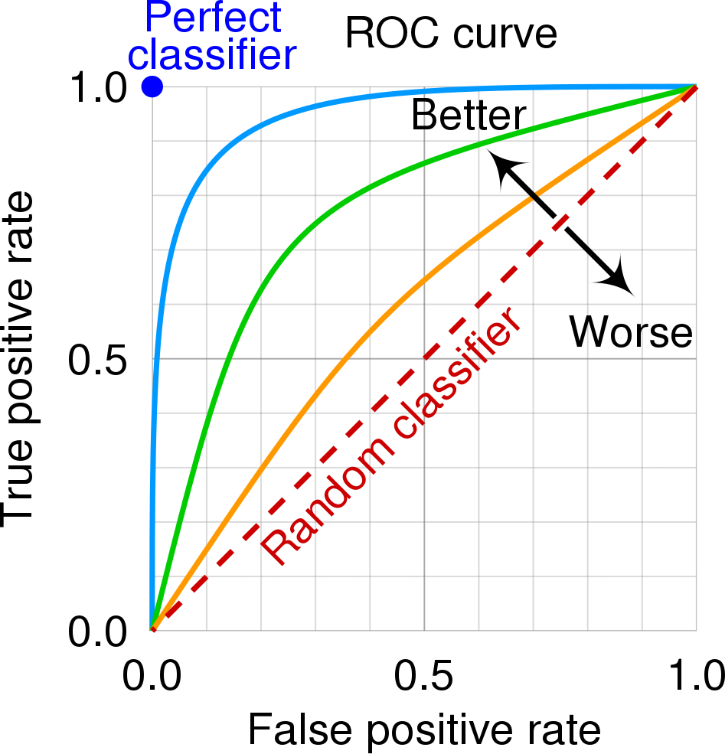
ROC Curve
ROC curve analyze the performance for every threshold in soft classifiers
In X-axis
In Y-axis
By cmglee, MartinThoma - Roc-draft-xkcd-style.svg, CC BY-SA 4.0, https://commons.wikimedia.org/w/index.php?curid=109730045

Slide 14
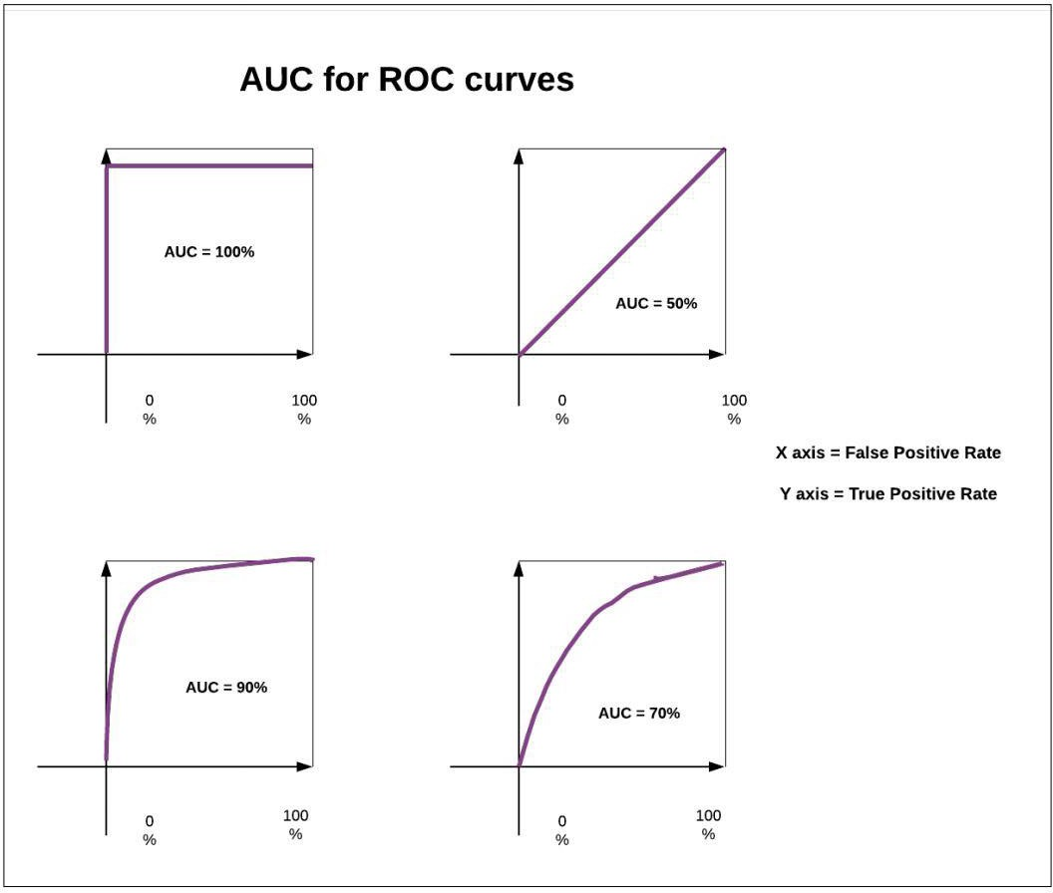
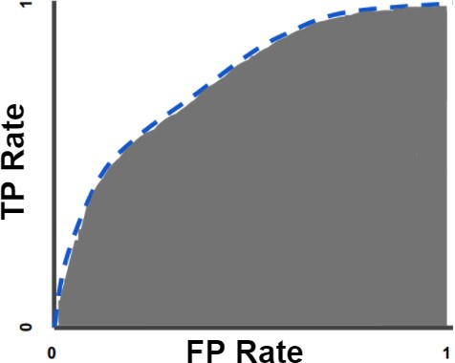
AUC
Random guess
AUC (Area Under the ROC Curve)
- ROC can be quantified using AUC
https://developers.google.com/machine-learning/crash- course/classification/roc-and-auc https://medium.com/acing-ai/what-is-auc-446a71810df9

Slide 15
Homework
Homework: Lab06
Lab06: Logistic Regression, Metrics

Slide 16
Reference
https://bookdown.org/ccwang/medical_statistics6/section-43.html
https://bookdown.org/ccwang/medical_statistics6/bernoulli.html
https://bookdown.org/ccwang/medical_statistics6/binomial.html
https://bookdown.org/ccwang/medical_statistics6/likelihood-definition.html
https://en.wikipedia.org/wiki/Sensitivity_and_specificity
https://commons.wikimedia.org/w/index.php?curid=109730045
https://developers.google.com/machine-learning/crash-course/classification/roc- and-auc
https://medium.com/acing-ai/what-is-auc-446a71810df9
https://github.com/dariyasydykova/open_projects/tree/master/ROC_animation

