Slide 1
Lab 14 Reinforcement Learning
Datalab
Department of Computer Science,
National Tsing Hua University, Taiwan

Slide 2
Outline
Homework
Markov Decision Process (MDP)
Value Iteration
Policy Iteration
Q-Learning & SARSA

Slide 3
Outline
Homework
MDP(value iteration & policy iteration)
Q-Learning & SARSA

Slide 4
Homework
Train an agent to play Flappy Bird game(SARSA)

Slide 5

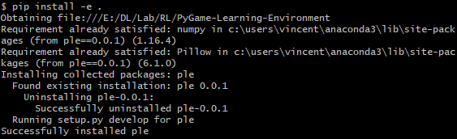
Install PLE and Pygame
Clone the repo
Install PLE(in the PyGame-Learning-Environment folder)
cd PyGame-Learning-Environment
pip install –e .
pip install pygame

Slide 6
Homework
What you should do:
Change the update rule from Q-learning to SARSA (with the same episodes).
Give a brief report to discuss the result (compare Q-learning with SARSA based on the game result).
Remind
Only need CPU resources.
It will take you more than 13 hours to train, please reserve enough time.

Slide 7
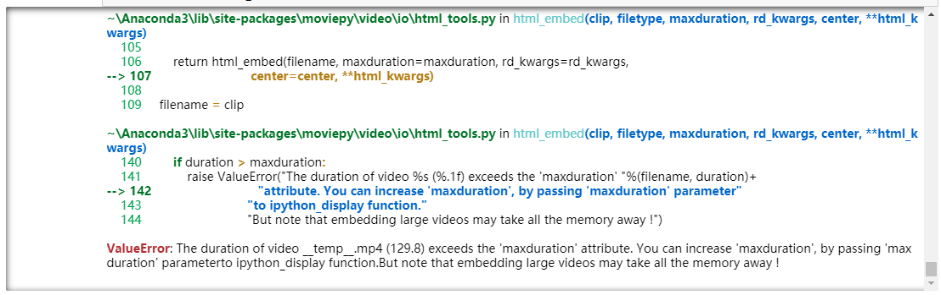
Homework
Precautions:
If you encounter this problem, just stop.
It means your bird plays well and the recorded frames is too long to save.

Slide 8
Homework
Requirements
Write a brief report in the notebook
Upload both ipynb and mp4 to google drive
Lab14_{student_id}.ipynb (90%)
Lab14_{student_id}.mp4 (10%)
Share your drive’s link via eeclass
Please make sure that TA can access your google drive!!! (Or you will get 0 on this lab!)
Deadline: 2023-12-11(Wed) 23:59
Notes:
Notebook cannot display videos

Slide 9
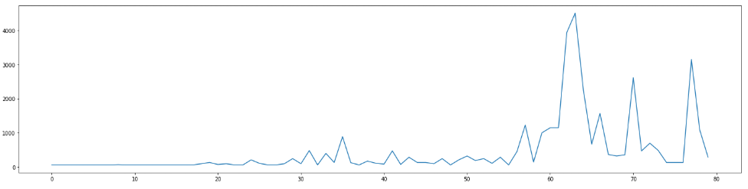
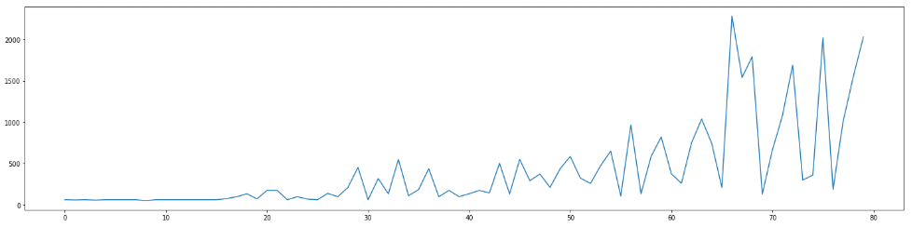
Homework
Requirement (report):
You can compare life time or reward against training episodes.
Q-learning
SARSA

Slide 10
Outline
Homework
Markov Decision Process (MDP)
Value Iteration
Policy Iteration
Q-Learning & SARSA

Slide 11
Markov Decision Process (MDP)
A MDP is defined by
A
γ
S
P
R
H
State space
Transition
Probability
Discount
Factor
Action space
Reward
Horizon

Slide 12


小吃 | 資電 | 排球
綜二 | 台達 | 籃球
總圖 | 工三 | 西門
S = { 小吃, 資電, 排球, 綜二, 台達, 籃球, 總圖, 工三, 西門 }
A = { 上, 下, 左, 右 }
P = no noise
R( 工三 ) = 0, R( others ) = -1
r = 1
H = inf

Slide 13
We have a MDP model, then?

Slide 14
Goal - Find the Optimal Policy
If the agent follow the optimal policy, it will get maximal total reward
We can solve it via these two algorithms
Value Iteration
Policy Iteration

Slide 15
Outline
Homework
Markov Decision Process (MDP)
Value Iteration
Policy Iteration
Q-Learning & SARSA

Slide 16
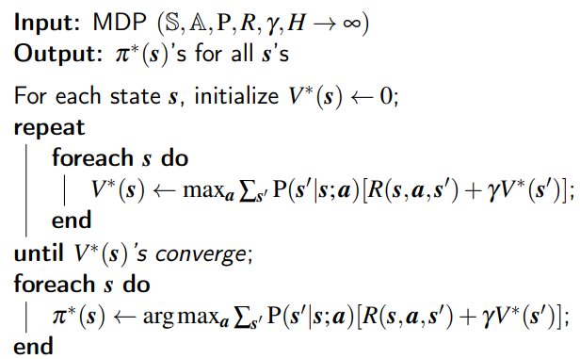
Value Iteration

Slide 17
小吃 | 資電 | 排球
綜二 | 台達 | 籃球
總圖 | 工三 | 西門
S = { 小吃, 資電, 排球, 綜二, 台達, 籃球, 總圖, 工三, 西門 }
A = { 上, 下, 左, 右 }
P = no noise
R( 工三 ) = 0, R( others ) = -1
r = 1
H = inf

Slide 18
After Initialization
小吃 0 | 資電 0 | 排球 0
綜二 0 | 台達 0 | 籃球 0
總圖 0 | 工三 0 | 西門 0

Slide 19
After Iteration 1
小吃 -1 | 資電 -1 | 排球 -1
綜二 -1 | 台達 -1 | 籃球 -1
總圖 -1 | 工三 0 | 西門 -1
V(台達) = Reward + V(資電) = -1 + 0
V(台達) = Reward + V(綜二) = -1 + 0
V(台達) = Reward + V(工三) = -1 + 0
V(台達) = Reward + V(籃球) = -1 + 0

Slide 20
After Iteration 2
小吃 -2 | 資電 -2 | 排球 -2
綜二 -2 | 台達 -1 | 籃球 -2
總圖 -1 | 工三 0 | 西門 -1
V(台達) = Reward + V(資電) = -1 + -1
V(台達) = Reward + V(綜二) = -1 + -1
V(台達) = Reward + V(工三) = -1 + 0
V(台達) = Reward + V(籃球) = -1 + -1
max_{a}

Slide 21
After Iteration 3
小吃 -3 | 資電 -2 | 排球 -3
綜二 -2 | 台達 -1 | 籃球 -2
總圖 -1 | 工三 0 | 西門 -1
V(小吃) = V(排球) = -1 + -2 = -3

Slide 22
After Iteration 4
小吃 -3 | 資電 -2 | 排球 -3
綜二 -2 | 台達 -1 | 籃球 -2
總圖 -1 | 工三 0 | 西門 -1
Iteration 4 = Iteration 3
Converge !

Slide 23

小吃 -3 | 資電 -2 | 排球 -3
綜二 -2 | 台達 -1 | 籃球 -2
總圖 -1 | 工三 0 | 西門 -1
Now we have the optimal policy!

Slide 24
Outline
Homework
Markov Decision Process (MDP)
Value Iteration
Policy Iteration
Q-Learning & SARSA

Slide 25
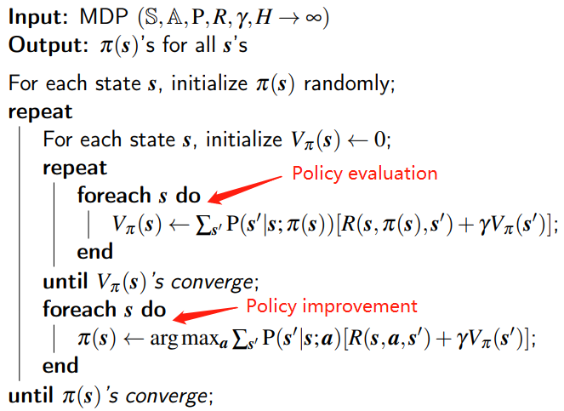
Policy Iteration

Slide 26
小吃 | 資電 | 排球
綜二 | 台達 | 籃球
總圖 | 工三 | 西門
S = { 小吃, 資電, 排球, 綜二, 台達, 籃球, 總圖, 工三, 西門 }
A = { 上, 下, 左, 右 }
P = no noise
R( 工三 ) = 0, R( others ) = -1
r = 1
H = inf

Slide 27
小吃 | 資電 | 排球
綜二 | 台達 | 籃球
總圖 | 工三 | 西門
Random initialize a policy Let’s say all goes down!

Slide 28
小吃 0 | 資電 0 | 排球 0
綜二 0 | 台達 0 | 籃球 0
總圖 0 | 工三 0 | 西門 0
After initialization of V_{π}

Slide 29
小吃 -∞ | 資電 -2 | 排球 -∞
綜二 -∞ | 台達 -1 | 籃球 -∞
總圖 -∞ | 工三 0 | 西門 -∞
After Policy Evaluation

Slide 30
After Policy Improvement
小吃 -∞ | 資電 -2 | 排球 -∞
綜二 -∞ | 台達 -1 | 籃球 -∞
總圖 -∞ | 工三 0 | 西門 -∞
V(籃球) = reward + V(西門) = -1 + -∞
V(籃球) = reward + V(台達) = -1 + -1
V(籃球) = reward + V(排球) = -1 + -∞
arg max_{a}

Slide 31
小吃 -3 | 資電 -2 | 排球 -3
綜二 -2 | 台達 -1 | 籃球 -2
總圖 -1 | 工三 0 | 西門 -1
Policy Evaluation Again!

Slide 32
小吃 -3 | 資電 -2 | 排球 -3
綜二 -2 | 台達 -1 | 籃球 -2
總圖 -1 | 工三 0 | 西門 -1
Policy Improvement. Nothing Changed!
Converge!!

Slide 33
Did agent Interact with the Environment?
No ! We model every transition and every reward
But it is impossible to solve more complex problems like Flappy Bird
We need model-free algorithms
Q-Learning
SARSA

Slide 34
Outline
Homework
Markov Decision Process (MDP)
Value Iteration
Policy Iteration
Q-Learning & SARSA

Slide 35
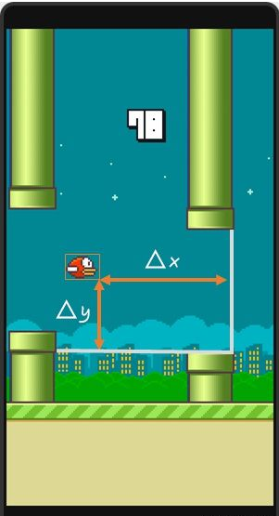
Q-Learning
Flappy bird

Slide 36
Q-Learning
Flappy Bird
States:
Actions: { fly, none }
Reward:
+1: pass through a pipe
-5: die
ref: https://www.zhihu.com/question/26408259

Slide 37
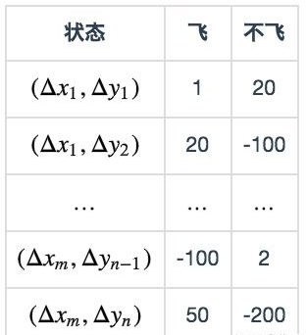
Q-Learning
Q-table(finite):
Update rule:
狀態
飛
不飛

Slide 38
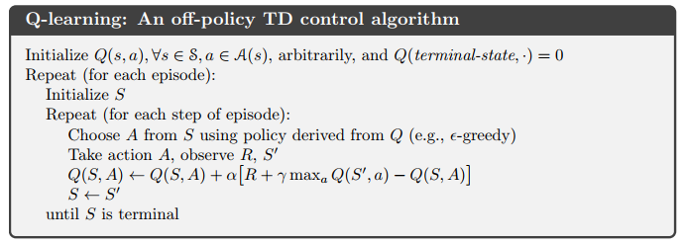
Q-Learning
Algorithm
flip coin
0.5
max_{a}
ε-greedy
Q(S’, Fly)
Q(S’, None)
S
A
S’
0.5
arg max_{a} Q(S, a)
Notes:
Q function 要解的問題是 model-free, TD 要解的問題是 MC 太久

Slide 39
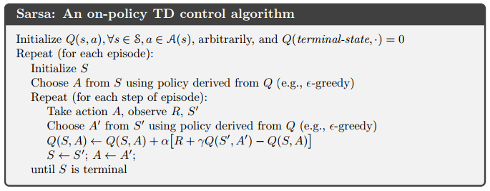
SARSA
Algorithm

Slide 40
SARSA
Q-table(finite):
Update rule:
狀態
飛
不飛

Slide 41
SARSA
Algorithm
flip coin
flip coin
0.5
0.5
ε-greedy
ε-greedy
S
A
S’
A’
0.5
0.5
arg max_{a} Q(S, a)
arg max_{a} Q(S, a)

Slide 42
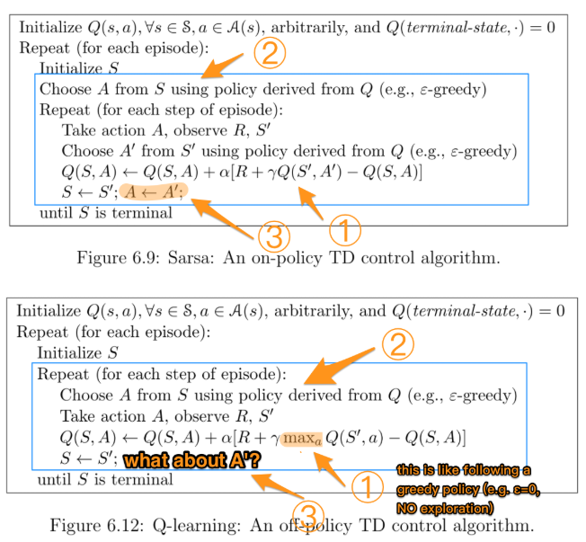
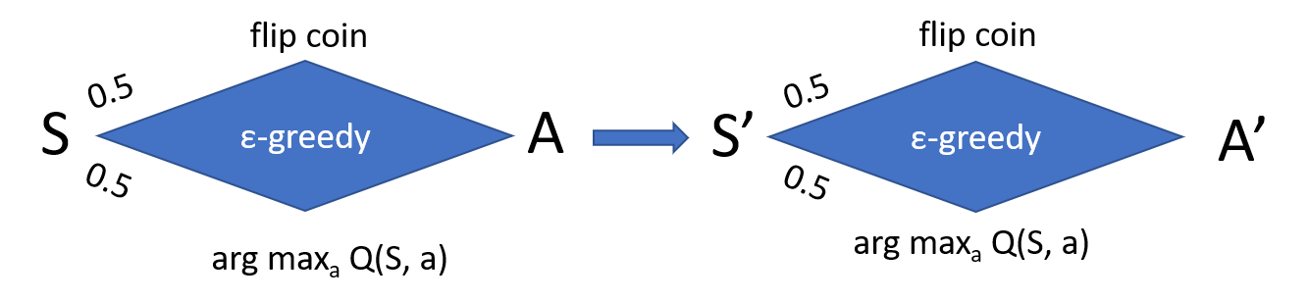
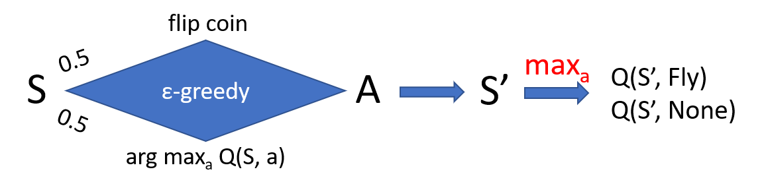
Q-Learning VS. SARSA
Difference

Slide 43
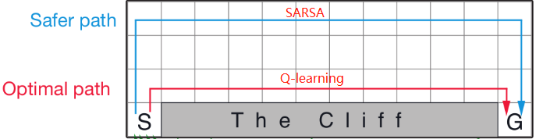
Q-Learning VS. SARSA
Cliff Walking

Slide 44
Thanks! Be a Happy Bird

