Slide 1
Lab 12-2:Image Captioning
Department of Computer Science,
National Tsing Hua University, Taiwan
2026

Slide 2
Outline
Encoder-Decoder Architecture
Image Caption
Image Caption with attention

Slide 3
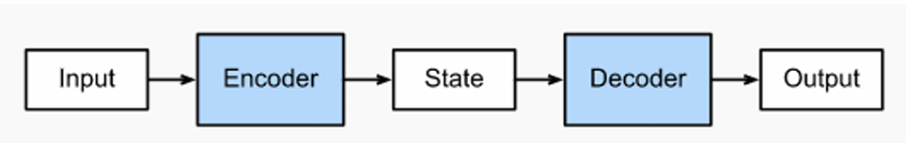
Encoder-Decoder Architecture
Encoder-decode architecture is a neural network design pattern.
The encoder’s role is encoding the input into hidden state or hidden representation
The decider’s role is to taking the hidden state and generate the outputs.

Slide 4
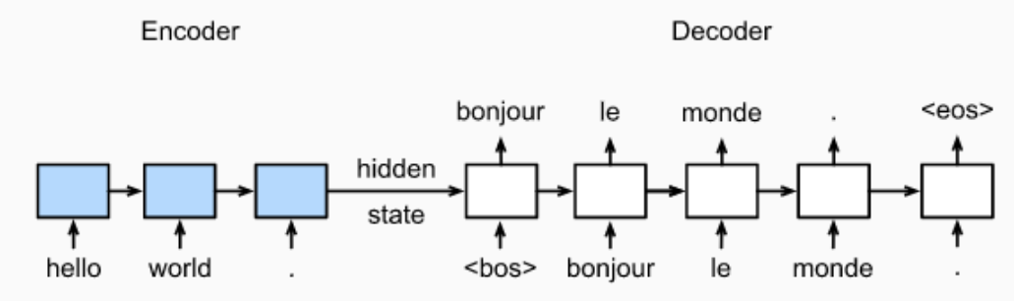
Encoder-Decoder Architecture
Recall in Lab12-2, we implement a Seq2Seq learning.
Encoder sequentially encode words into hidden state
Decoder sequentially decode the hidden state into words.
Both of encoder and decoder is a recurrent neural networks (RNNS)

Slide 5
Image Captioning
The encoder’s role is encoding the image into hidden representation
The decoder’s role is taking the hidden representation and generate the output
Decoder is a recurrent neural networks.
Image

Slide 6
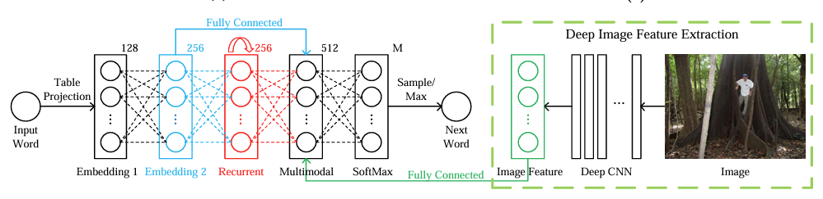
Image Caption m-RNN
Multimodal Recurrent Neural Network
First work that incorporate the RNN to deep multimodal architecture
Decoder
Encoder

Slide 7
Image Caption m-RNN
The image model contains a deep CNN which extracts image features.
Encoder(image model)

Slide 8
Image Caption m-RNN
The language model part learns feature embedding for each word
The multimodal part connects the language model and the deep CNN together by a one-layer representation
Decoder
Language model
Multimodal model

Slide 9
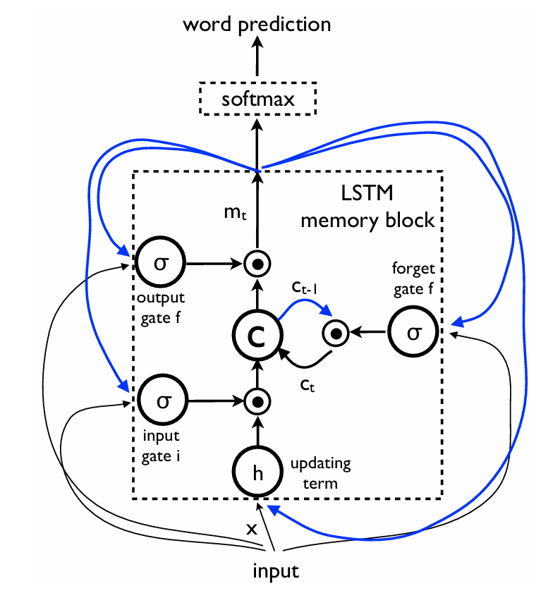
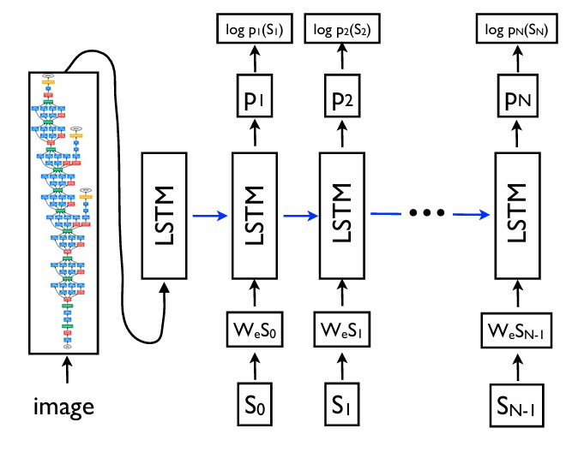
Image Caption
NIC
Neural image caption
Decoder
Encoder

Slide 10
Image Caption
NIC
The model uses a more powerful CNN in the encoder (Best performance on the ILSVRC 2014 classification competition)
To deal with vanishing and exploding gradients, LSTM was introduced on the decoder
The image is input once at t=-1, to inform the LSTM about the image contents
Empirically verified feeing the image once is better.

Slide 11
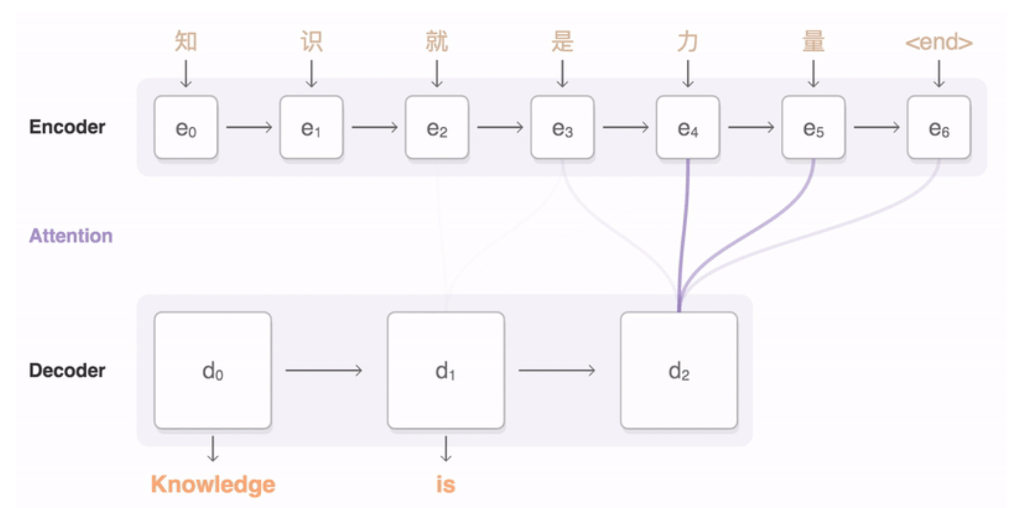
Image Capion with attention
Recall in Lab12-2, we implement attention machinism in Seq2Swq learning
Attention allow the model to focus on the relevant parts of the input sequence as needed

Slide 12
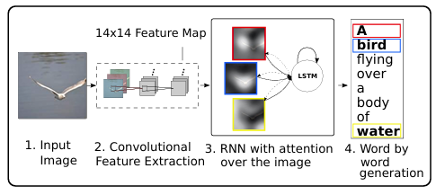
Image Caption with attention
Similarly, attention can allow the model to focus on the relevant part of the input image
Show, Attend and Tell: Neural image Caption Generation with Visual Attention.

Slide 13
Image Cation
Notebook implementation
The model architecture is inspired by the Slow, Attend, and Tell paper
Extract the feature from the lower convolution layer of InceptionV3, which give a vector of shape (8, 8, 2048)
Squash that to a shape of (64, 2048) (64 pixel locations)
This vector is passed through Encoder (reduce dimensionality)
The RNN (here GRU) attends over the image to predict the next word

Slide 14
Training: (teacher forcing)
[[<start>, target[0,1]],
[<start>, target[1,1]],
…
[<start>, target[I,1]]]
predict
predict
batch
FC2
FC2
Image tensor
(batch, 8,8, 2048)
reshape
Evaluating :
[[<start>, x[0,1]],
[<start>, x[1,1]],
…
[<start>, x[i,1]]]
reshape
FC1
FC1
output
batch
GRU
state
GRU
squash
(batch, 64, 2048)
Context vector
word embedding
Attention
Embedding
Attention
Embedding
[[<start>],
[<start>],
…
[<start>]]
hidden
(initialize with zero)
batch
dec_input
dec_input
Encoder
feature (batch, 64,embedding dim)

Slide 15
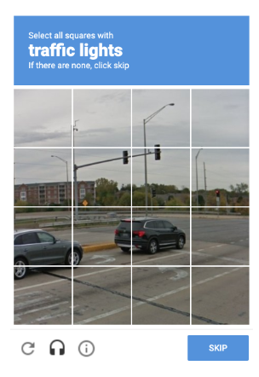
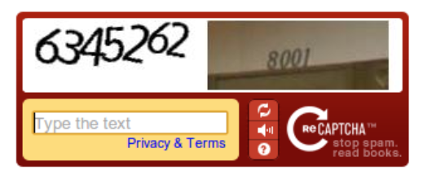
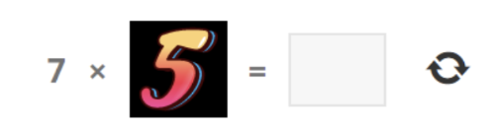
Assignment
CAPTCHA
An acronym for “Completely automated Public Turing test to tell Computes and Humans Apart ”
A type of response test used in computing to determine whether or not the user is human
Prevents spam attacks and protects websites from bots

Slide 16
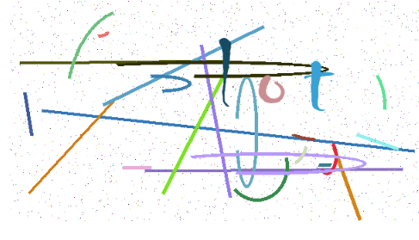
Assignment
We are going to train a captcha recognizer in this lab
Dataset
  140,000 CAPTCHA

Slide 17
Assignment
Requirement
  Use any model architectures you want
  Except the feature extractor part, do not load the model or any pre-train weights directly from other source.
  The first 100,000 as training data, the next 20,000 as validation data, and the rest as testing data
  Only If the whole word matches exactly does it count as correct
  Predict the answer to the testing data and write them in a fille
  Accuracy on validation set should be at least 90%
  Please submit your code file and the answer file

Slide 18
Assignment
Submit on eeclass
  Code file: Lab12-2_{student ID}.ipynb
  Answer file: Lab12-2_{student ID}.txt
  Answer file please follow the format as spec_train_val.txt
Give brief report for every parts you have done in the notebook
The deadline will be 2026/11/18 23:59

Slide 19
Assigment
Hints
  In captcha, we expect RNN would output on character at each step.
  Therefore, you need to preprocess the training data in a certain form (refer to the test description in the “Preprocess and tokenize the caption” section), so that we can correctly establish the mapping relationship between character and index by the Tokenizer
  Any pretrained feature extractor is okay to used, but image pattern in captcha is quite different then usually image.

