Slide 1
Deep Learning
Lab 5: Regularization
DataLab, 2026
Department of Computer Science,
National Tsing Hua University, Taiwan

Slide 2
Regularization
techniques that improve the generalizability of a trained model
Notes:
模型在訓練資料上表現好，不代表在沒看過的資料上也會好。我們要怎麼讓它在新資料上也表現好？
要怎麼提升模型的泛化能力

Slide 3
Outline
Scikit-learn
Learning Theory
  Error Curves and Model Complexity
  Learning Curves and Sample Complexity
Weight Decay
  Ridge Regression
  LASSO
Validation
Assignment

Slide 4
Outline
Scikit-learn
Learning Theory
  Error Curves and Model Complexity
  Learning Curves and Sample Complexity
Weight Decay
  Ridge Regression
  LASSO
Validation
Assignment

Slide 5

Scikit-learn
Scikit-learn is a free software machine learning library for the Python programming language
It features various classification, regression and clustering algorithms
  including SVM (support vector machines), Random Forests, gradient boosting, k-means and DBSCAN, and is designed to interoperate with the Python numerical and scientific libraries NumPy and SciPy
pip install scikit-learn / conda install scikit-learn

Slide 6
Outline
Scikit-learn
Learning Theory
  Error Curves and Model Complexity
  Learning Curves and Sample Complexity
Weight Decay
  Ridge Regression
  LASSO
Validation
Assignment
Notes:
Learning theory 主要在說模型在新資料上表現得好不好，主要受到模型複雜度和資料量的影響

Slide 7
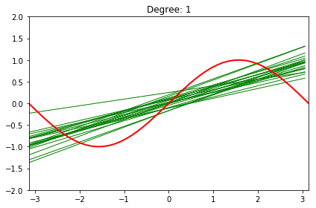
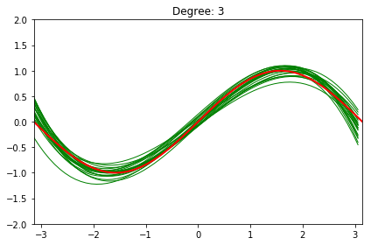
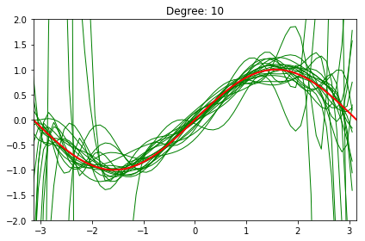
Learning Theory
Learning theory provides a means to understand the generalizability of the model
Model complexity plays a crucial role
  Too simple: high bias and underfitting
  Too complex: high variance and overfitting
Notes:
紅線是我們希望模型學到的東西
綠線是每次訓練後所 fit 出來的模型
Degree 1: 線幾乎疊在一起很穩定，但都是直線永遠畫不出紅線的那個樣子，這就是 high bias 模型太簡單，資料不管怎麼換，永遠學不到真正的趨勢
Degree 3: 綠線貼著紅線很接近，剛剛好的模型複雜度
Degree 10: 雖然有接近紅線的，但可以看到每條在亂飄，代表模型是有能力學到真正的趨勢但不穩定，這就是 high variance
模型太複雜，連訓練資料裡的雜訊都一起記下來了，所以換一批資料，結果就差很多。
這張圖的問題：現實中不會知道紅線長怎樣，所以沒辦法直接判斷模型好不好

Slide 8
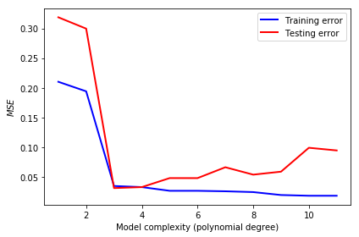
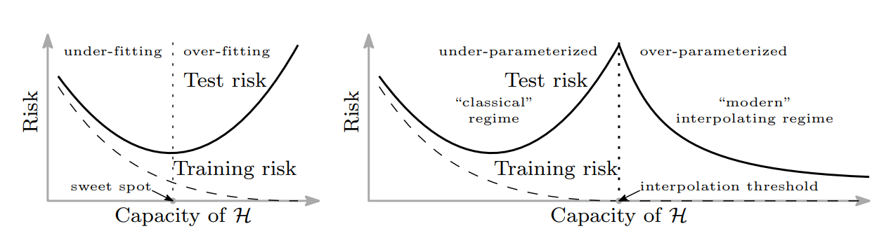
Error Curves and Model Complexity
It is relatively hard to observe the figures showed in the last slide, since normally we will never know the data distribution of ground truth (red line in the last slide)
Instead, we can get those information by observing the training and testing error curve
Notes:
所以可以用兩個替代的指標來看，分別是 training error 和 testing error
Training error：模型在訓練資料上的 MSE，代表模型把看過的資料記得多好。
Testing error：模型在沒看過的資料上的 MSE。
可以從途中看到一開始兩個 mse 都很高，可以判斷出是 underfit
中間兩個幾乎疊在一起的地方，可以判斷出是模型複雜度剛剛好的
後面可以看到 training error 很低，但 testing error 和他有差距，可以判斷出是 overfit

Slide 9
Double Descent Curves in Modern Machine Learning**
Reconciling modern machine learning practice and the bias-variance trade-off (PNAS’19)
Double-descent curves in neural networks: a new perspective using Gaussian processes (arXiv’21)

Slide 10
Error Curves and Model Complexity
Although the error curve visualizes the impact of model complexity, the bias-variance tradeoff holds only when you have sufficient training examples
Notes:
剛剛看的圖有個前提是資料量要夠多
如果資料太少，就算模型複雜度剛好，還是會 overfit。所以除了複雜度，我們還要看另一件事：資料夠不夠？

Slide 11
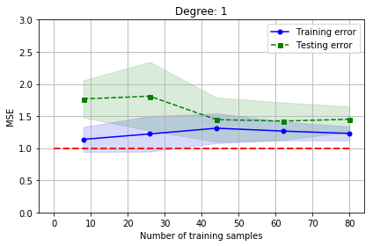
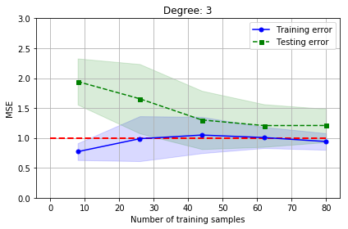
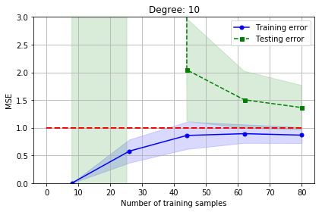
Learning Curves and Sample Complexity
The bounding methods of learning theory tell us that a model is likely to overfit regardless of its complexity when the size of training set is small. The learning curves are a useful tool for understanding how much training examples are sufficient
Notes:
現在 x 軸變成訓練樣本數，在複雜度固定的情況下，資料越來越多 error 會怎麼變化
Degree 1：資料變多後，兩條線很快靠在一起，但停在紅線上方，下不去。這代表多給資料也沒用，問題是模型太簡單（bias），應該換更複雜的模型。
Degree 3：兩條線最後都收斂到紅線附近，這是最理想的狀況。
Degree 10：樣本少的時候，training error 幾乎是 0，testing error 高到衝出圖外，這是嚴重的 overfit。資料變多後，兩條線慢慢靠近，但到 80 筆時還有差距。這代表再多給資料會有幫助，問題是 variance。

Slide 12
Outline
Scikit-learn
Learning Theory
  Error Curves and Model Complexity
  Learning Curves and Sample Complexity
Weight Decay
  Ridge Regression
  LASSO
Validation
Assignment
Notes:
解決 overfit 問題有兩種方法：增加資料或降低模型複雜度
Weight decay 是透過對模型中的權重參數施加懲罰，限制其數值的大小，從而降低模型的複雜度。

Slide 13
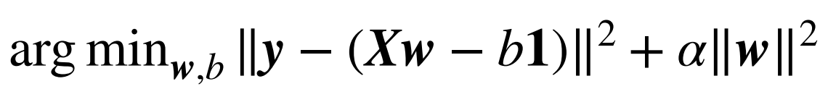
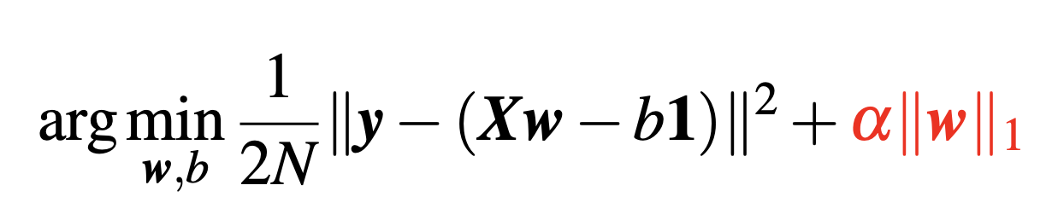

Weight Decay
A common regularization approach. The idea is to add a term in the cost function against complexity
  Ridge Regression ($L_{2}$)
  LASSO ($L_{1}$)
Notes:
Weight decay 就是在原本的 cost function 後面多加一個懲罰項
這邊會提到兩個分別是 ridge regression 和 lasso

Slide 14
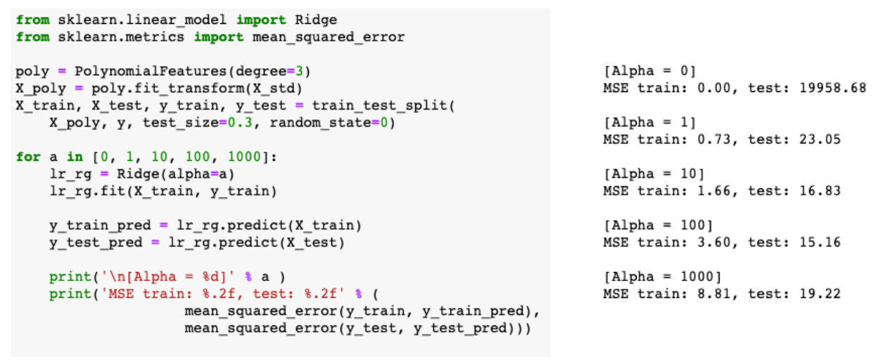
Ridge Regression
A small value α drastically reduces the testing error. Nevertheless, it's not a good idea to increase α forever, since it will over-shrink the coefficients of w and result in underfitting
Notes:
α = 0，也就是沒有懲罰。Training MSE 是 0，完全記住訓練資料；testing MSE 卻是將近 兩萬。這是非常嚴重的 overfit。
α = 1，只加一點點懲罰，testing MSE 就從兩萬掉到 23。
α = 10、100，testing MSE 繼續下降，在 α = 100 時最低，是 15.16。
α = 1000，testing MSE 又回升到 19。看 training MSE，從 3.6 升到 8.8，表示連訓練資料都學不好了，變成 underfit。

Slide 15
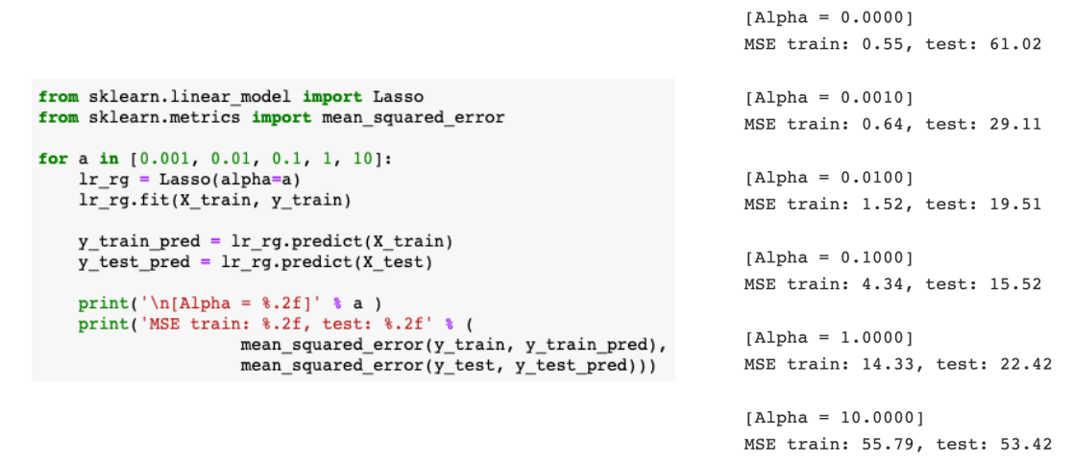
LASSO
An alternative weight decay approach that can lead to sparse w is the LASSO. Depending on the value of α, certain weights can become zero much faster than others
Notes:
第二種 weight decay 是 LASSO。公式跟 Ridge 幾乎一樣，只是懲罰項從 w 的平方和，換成 w 的絕對值和。
α = 0，沒有懲罰，test MSE 是 61，還是 overfit。
α 慢慢加大，0.001、0.01，test MSE 一路下降，在 α = 0.1 時最低，是 15.52，跟 Ridge 最好的 15.16 差不多。
再加大到 α = 1，test MSE 回升到 22，training MSE 也升到 14，開始 underfit。
到 α = 10，training MSE 55、testing MSE 53，兩個都很高，而且幾乎一樣。這就是 p.8 講的 underfit 特徵：兩條線都很高、靠在一起。

Slide 16
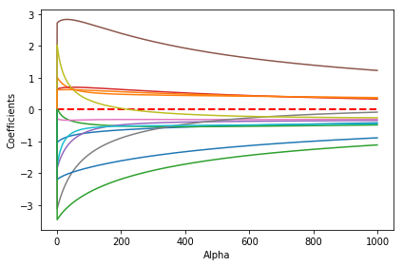
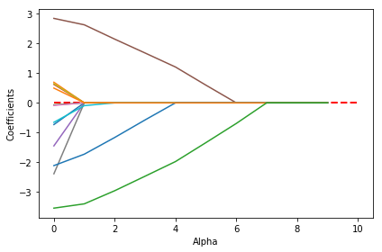
Ridge vs LASSO
Why is LASSO sparse?
Ridge: [0.5, 0.5, 0.5, 0.5]
Initial weights: [1, 0.5, 1, 0.5]
LASSO: [0.5, 0, 0.5, 0]

Slide 17
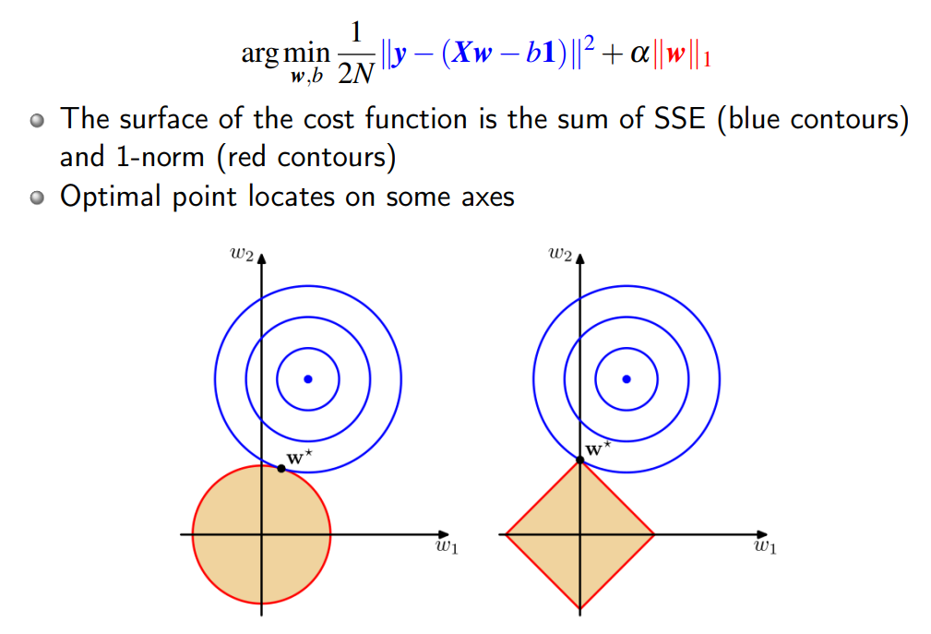
Ridge vs LASSO
Why is LASSO sparse?

Slide 18
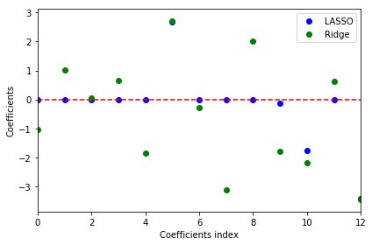
Ridge vs LASSO
LASSO can also be treated as a supervised feature selection technique when choosing a suitable regularization strength α to make only part of coefficients become exactly zeros

Slide 19
Outline
Scikit-learn
Learning Theory
  Error Curves and Model Complexity
  Learning Curves and Sample Complexity
Weight Decay
  Ridge Regression
  LASSO
Validation
Assignment

Slide 20
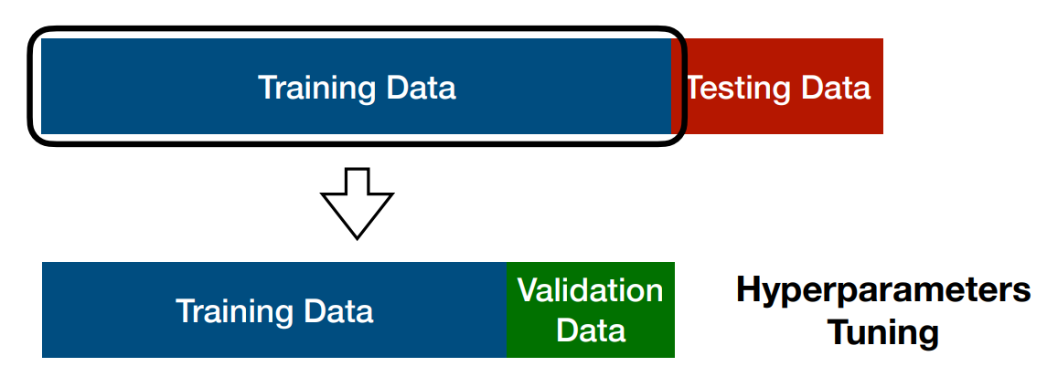
Validation
Another useful regularization technique that helps us decide the proper value of hyperparameters
The idea is to split your data into the training, validation, and testing sets and then select the best value based on validation performance
NOTE: It is important that we should never peep testing data during training
Notes:
前面有看到 ridge regression 和 lasso 跑了不同的 alpha，這個選的好不好會決定模型會不會 underfit 或 overfit
為什麼不能用 test set 選？
Test set 的用途，是模擬模型遇到『從沒看過的資料』時的表現。如果用它來挑 α，等於讓 test set 參與了決定，它就不再是『沒看過的資料』了。這樣回報出來的 test error 會太樂觀，模型真正上線時，表現可能沒這麼好。
比較好的方法是在 training data 中切分出一塊是 validation data，拿來挑 hyperparameter 用的

Slide 21
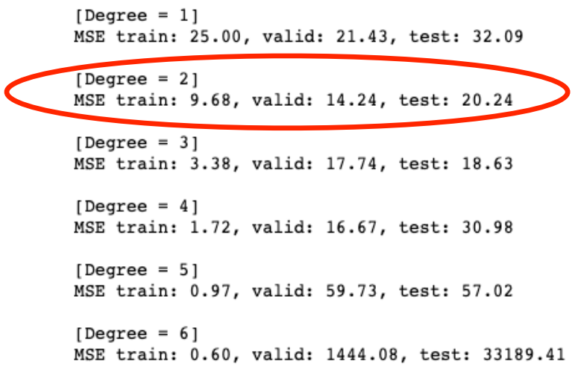
Validation

Slide 22
Outline
Scikit-learn
Learning Theory
  Error Curves and Model Complexity
  Learning Curves and Sample Complexity
Weight Decay
  Ridge Regression
  LASSO
Validation
Assignment

Slide 23
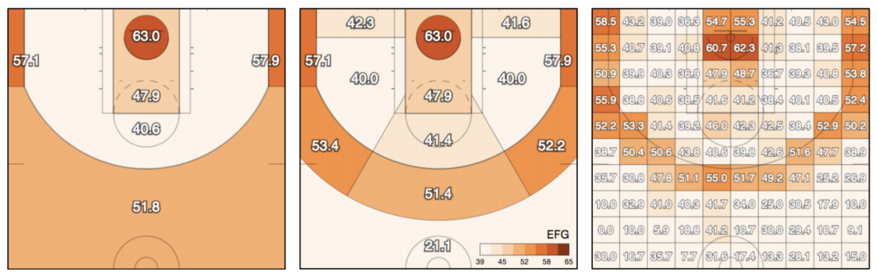
Assignment
In this assignment, we would like to predict the success of shots made by basketball players in the NBA

Slide 24
Assignment
In this assignment, we would like to predict the success of shots made by basketball players in the NBA
  y_test is hidden this time
  Allow to use any linear model in scikit-learn to achieve the best accuracy
  Select the best 3 features, and show the accuracy with only those
Hint
  Preprocess the data to help your training
  Since you don't have y_test this time, you may need to split a validation set for checking your performance
  It is possible to use a regression model as a classifier, for example RidgeClassifier

Slide 25
Assignment
Submit to eeclass with your:
  ipynb (Lab05_{student_id}.ipynb)
  Prediction (Lab05_{student_id}_y_pred.csv)
The notebook should contain
  How you evaluate your model
  All models you have tried and the results
  Plot the error curve of your best model and tell if it is over-fit or not
  The top-3 features you find and how you find it
  A brief report of what you have done in this assignment
  Please refer to the “Requirements” part in the notebook for more details
Deadline: 2026-09-30 (Wed) 23:59

