Slide 1
Deep Learning Competition 03:
Reverse Image Caption
DataLab
Department of Computer Science,
National Tsing Hua University, Taiwan

Slide 2
Outline
Reverse Image Caption
Evaluation
  Inception Score
  Cosine Similarity
Precautions

Slide 3
Outline
Reverse Image Caption
Evaluation
  Inception Score
  Cosine Similarity
Precautions

Slide 4
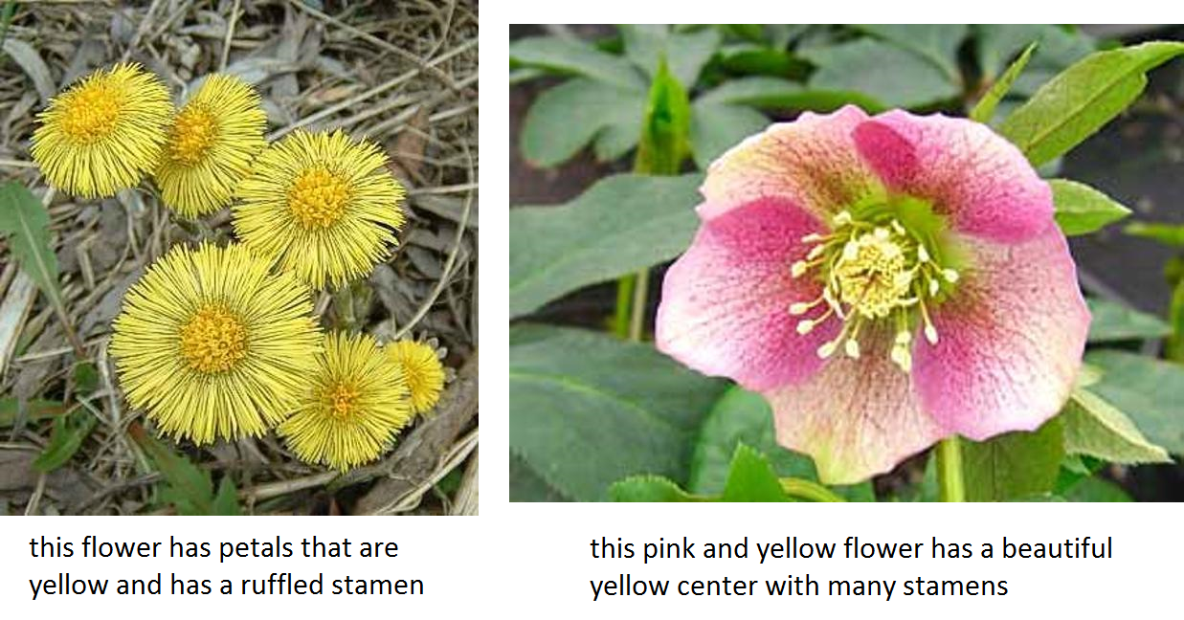
Reverse Image Caption
In this work, we are interested in translating text in the form of single-sentence human-written descriptions directly into image pixels

Slide 5
Reverse Image Caption
Here we use Oxford-102 flower dataset and its paired texts as our training dataset
Training
  Input: 7370 images as training set, where each images is annotated with at most 10 texts
  Output: image with size 64x64x3 conditioned on given text
Testing
  Input: 819 texts
  Output: image with size 64x64x3 conditioned on given text

Slide 6
Reverse Image Caption
Given a text, in order to generate the image which can illustrate it, what kind of model do we need? Or, more specifically, how many models are required?

Slide 7
Reverse Image Caption
Our model should have ability to understand and extract the meaning of given texts
  Use RNN or other language model, such as BERT, ELMo or XLNet, or Word2Vec, to capture the meaning of text
Our model should be able to generate image
  Use GAN to generate high quality image
GAN-generated image should illustrate the text
  Use conditional-GAN to generate image conditioned on given text

Slide 8
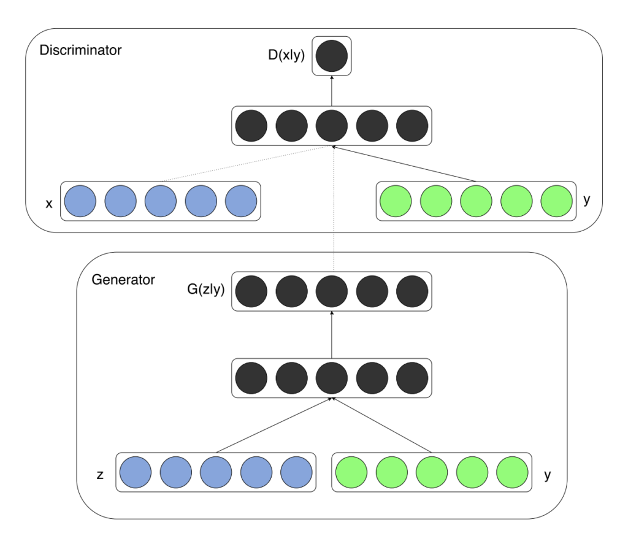
Conditional GAN
GANs can be extended to a conditional model if both the generator and discriminator are conditioned on some extra information 𝑦
We can perform the conditioning by feeding 𝑦 into both the discriminator and generator as additional input layer

Slide 9
Conditional GAN
There are two motivations for using some extra information in a GAN model
  Improve GAN
  Generate targeted image
Additional information that is correlated with the input images, such as class labels, can be used to improve the GAN
  This improvement may come in the form of more stable training, faster training, and/or generated images that have better quality

Slide 10
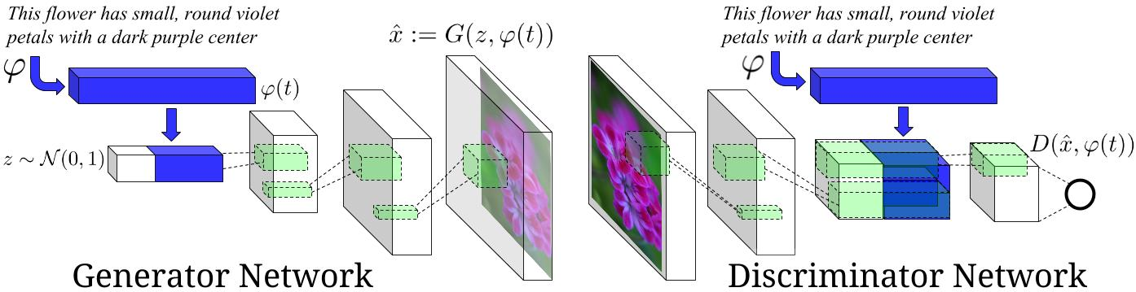
Conditional GAN
Therefore, we need three models in this task, they are
  Text encoder
  Generator
  Discriminator

Slide 11
Text Encoder
A RNN encoder that captures the meaning of input text
  Input: text, which is a list of ids
  Output: embedding, or hidden representation of input text

Slide 12
Generator
A image generator which generates the target image illustrating the input text
  Input: hidden representation of input text and random noise z with random seed
  Output: target image, which is conditioned on the given text, in size 64x64x3

Slide 13
Discriminator
A binary classifier which can discriminate the real and fake image
Real Image
  Input: real image and the paired text
  Output: a floating number representing the result, which is expected to be 1
Fake Image
  Input: generated image and paired text
  Output: a floating number representing the result, which is expected to be 0

Slide 14
Outline
Reverse Image Caption
Evaluation
  Inception Score
  Cosine Similarity
Precautions

Slide 15
Evaluation
In this competition, we use both inception score and cosine similarity as our final score to evaluate quality and diversity of generated images. The final score is based on:
  Similarity of images and the given contents. How similar are the generated images and the given texts?
  KL divergence of generated images. Are the generated images very diverse?
Score range:
  Lowest: 0
  Highest: 1.5

Slide 16
Outline
Reverse Image Caption
Evaluation
  Inception Score
  Cosine Similarity
Precautions

Slide 17
Inception Score
In this competition, we are going to use the Inception Score (IS) for judging the image outputs of Generative Adversarial Networks (GANs)

Slide 18
What is Inception Score?
Inception Score measures how realistic a GAN’s output is
  In the words of its authors,”we find [the IS] to correlate well with human evaluation of [image quality]”. It is an automatic alternative to having humans grade the quality of images.
The score measures two things simultaneously
  Images have variety (e.g. each image is a different breed of flower)
  Each image distinctly looks like something (e.g. one image is clearly a Lavender, the next a great example of a Jasmine)
If both things are true, the score will be high. If either or both are false, the score will be low

Slide 19
What is Inception Score?
A higher score is better. It means your GAN can generate many different distinct images
Score range:
  Lowest: 0
  Highest: ∞

Slide 20
How does Inception Score work?
The Inception score was first introduced in this paper in 2016, and has since become very popular
  The IS takes its name from the Inception classifier, an image classification network from Google, which takes images as input, and returns probability distribution of labels for the images

Slide 21
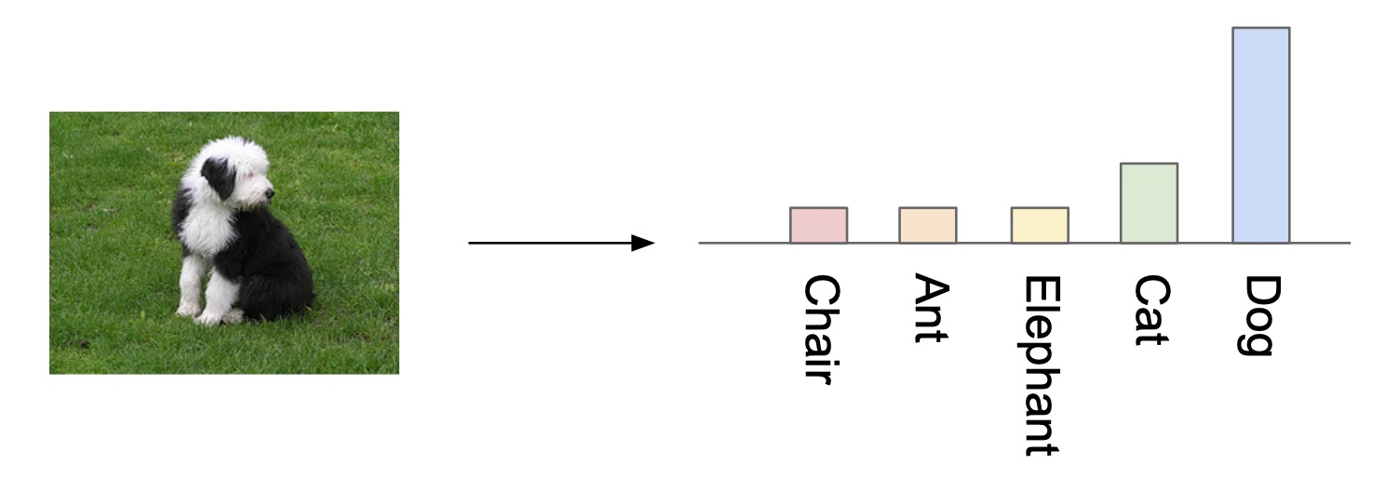
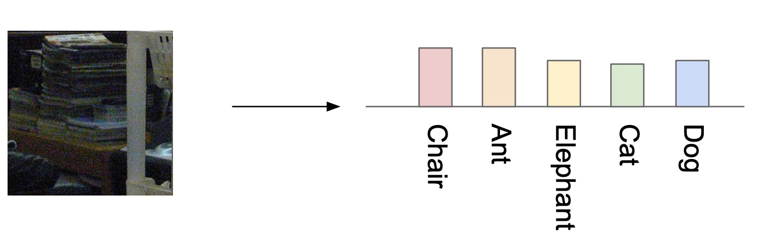
How does Inception Score work?
There are a couple useful things we can use this classifier for. We can detect if the image contains one distinct object (above), or not (below):

Slide 22
How does Inception Score work?
Based on the previous slide, we obverse that
  if the image contains just one well-formed thing, then the output of the classifier is a narrow distribution
  if the image is a jumble, or contains multiple things, it is closer to the uniform distribution of many similar height bars

Slide 23
How does Inception Score work?
The next trick we can do is combine the label probability distributions for many of our generated images
By summing the label distributions of our images, we create a new label distribution, the marginal distribution

Slide 24
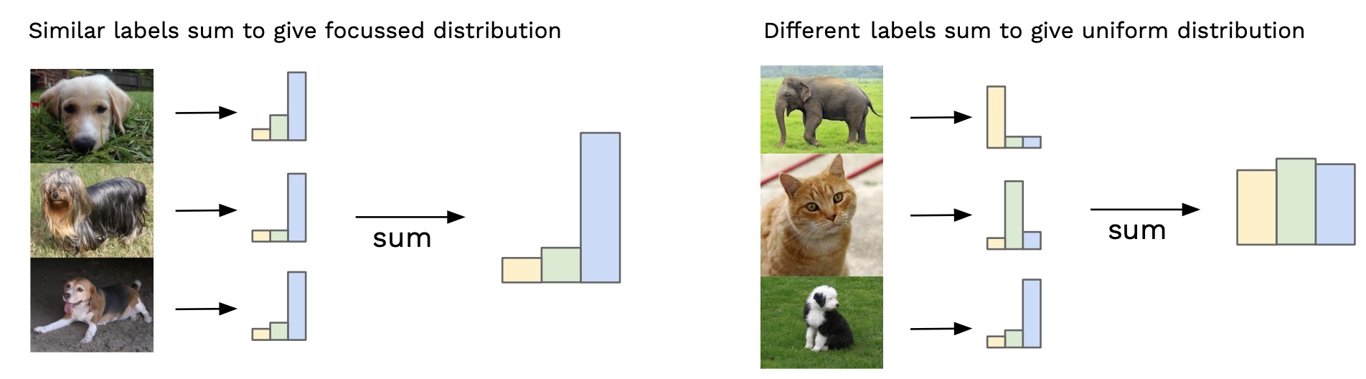
How does Inception Score work?
The marginal distribution tells us how much variety there is in our generator’s output:

Slide 25
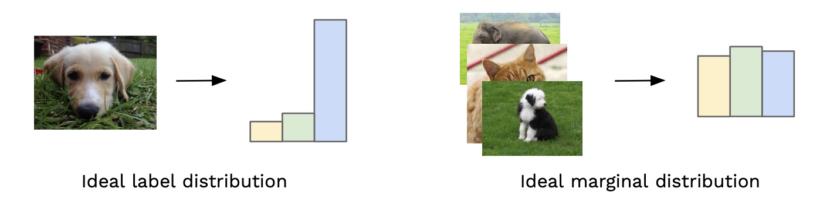
How does Inception Score work?
We want each image to each be distinct and to collectively have variety
Ideal distributions are opposite shapes, the label distribution is narrow, the marginal distribution is uniform

Slide 26
How does Inception Score work?
Therefore, by comparing each image’s label distribution with the marginal label distribution for the whole set of images, we can give a score of how much those two distributions differ. The more they differ, the higher a score we want to give, and this is our Inception score

Slide 27

KL Divergence
To produce this score, we use a statistics formula called the Kullback-Leibler (KL) divergence. The KL divergence is a measure of how similar/different two probability distributions are. KL divergence is high when distributions are dissimilar
To get the final score, we take the exponential of the KL divergence and finally take the average of this for all of our images. The result is the Inception score!

Slide 28
Outline
Reverse Image Caption
Evaluation
  Inception Score
  Cosine Similarity
Precautions

Slide 29
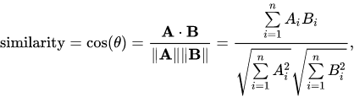
Cosine Similarity
Cosine similarity is a measure of similarity between two non-zero vectors of an inner product space that measures the cosine of the angle between them
Instead of cosine similarity, we use cosine distance in this task, which is 1 - cosine similarity
Score range:
  Lowest: 0
  Highest: 1

Slide 30
Evaluation
After generating images with given testing texts, you have to run evaluation script to generate score.csv file, and then upload it to Kaggle to get the final score

Slide 31
Evaluation
Open terminal and move to the folder containing inception_score.py. Otherwise you have to modify the path used in the file
Run python ./inception_score.py [argv1] [argv2] [argv3]
  argv1: directory of generated image (inference)
  argv2: directory of output file and its name
  argv3: batch size. Please set batch size to 1, 2, 3, 7, 9, 21, 39 to avoid remainder
  For example, run following commend python inception_score.py ../inference/demo ../score_demo.csv 39
It is better for you to know that evaluation needs to run on GPUs, please make sure the GPU resource is available

Slide 32
Outline
Reverse Image Caption
Evaluation
  Inception Score
  Cosine Similarity
Precautions

Slide 33
Precautions
Timeline
  2022/11/24(Thur) competition announced
  2022/12/22(Thur) 23:59(UTC) competition deadline
  2022/12/25(Sun) 23:59(TW) report deadline
  2022/12/29(Thur) winner team share (tentative)
Scoring
  Ranking of private leaderboard of competition (50%)
  Inference images (30%)
  Report (20%)

Slide 34
Precautions
The final report should contain following points:
  Pick 5 descriptions from testing data and generate 5 images with different noise z for each image respectively (25 images in total)
  Models you tried during competition. Briefly describe the main idea of the model and the reason you chose that model
  List the experiment you did. For example, data augmentation, hyper-parameters tuning, architecture tuning, optimizer tuning, and so on
  Anything worth mentioning. For example, how to pre-train the model

Slide 35
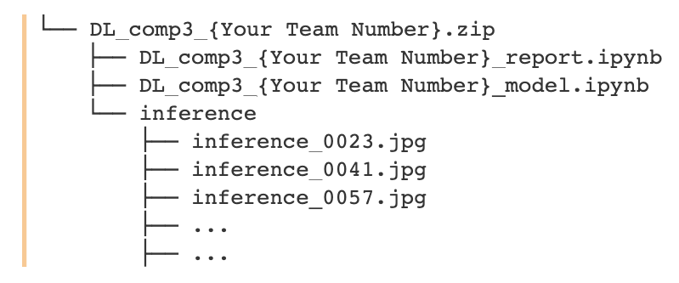
Precautions
Submit the link of Google Drive containing report, model and 819 inference images
  Name the report as DL_comp3_{Your Team number}_report.ipynb
  Name code of trainable model as DL_comp3_{Your Team number}_model.ipynb
  Place inference images under the folder called inference, compress that folder with the other two notebook, and then upload to Google Drive. The compressed file should be named as DL_comp3_{Your Team number}.zip.

Slide 36
Hints
You can find details about text to image in Generative Adversarial Text to Image Synthesis. This competition is based on this paper
Data augmentation might improve performance a lot
Use more complicated loss function to increase training stability and efficiency, i.e. creating more kind of training pair
Pretrained RNN might have better hidden representation for input text. Additionally, it might accelerate the training process, and also make training more stable
  Learning Deep Representations of Fine-Grained Visual Descriptions model proposes a better RNN architecture and corresponding loss function for text to image task. This architecture can encode text into image-like hidden representation

Slide 37
Hints
Different architecture of conditional GAN might generate the image with better quality or higher resolution
  You can try with simple GAN, DCGAN or WGAN first
  Generative Adversarial Text to Image Synthesis proposes another RNN architecture for text to image task. The author also propose another architecture of conditional GAN to generate the images with better quality
  StackGAN: Text to Photo-realistic Image Synthesis with Stacked Generative Adversarial Networks proposes two-stage architecture to generate more impressive images
  Improved Training of Wasserstein GANs improves WGAN loss on conditional GAN can improve training stability
  You can find other architecture of GAN in The GAN Zoo
Check GAN training tips to obtain some GAN training tricks, including how to generate diverse images and to prevent mode collapsing. It is worth knowing that GAN is not easy to train, and those tricks are quite helpful

Slide 38
What you can do
Pre-train text encoder on other dataset
Use pre-trained text encoder, like general purpose word embedding, pre-trained RNN or other language model, such as BERT, ELMo and XLNet. But you are not allowed to use any text encoder pre-trained on 102 flowers dataset
Reuse the data and model from previous competitions and labs
Use any package under tensorflow, but you cannot implement your model by tensorlayer API

Slide 39
What you should NOT do
Use categorical labels from flower dataset in any part of model
Use official Oxford-102 flower dataset and other image dataset to train your GAN. Pre-trained GAN and transfer learning are prohibited as well
Clone other’s project or use pre-trained model from other resources(you can only use general purpose word embedding or pretrained RNN, not pretrained GAN)
Use text encoder pre-trained on 102 flowers dataset
Access data or backpropagation signals from testing model in inception_score.py and eval_metrics.pkl
Plagiarism other teams' work

Slide 40
What part is allowed to use pre-trained model?
We need three models in this task, they are
  Text encoder
  Generator
  Discriminator

Slide 41
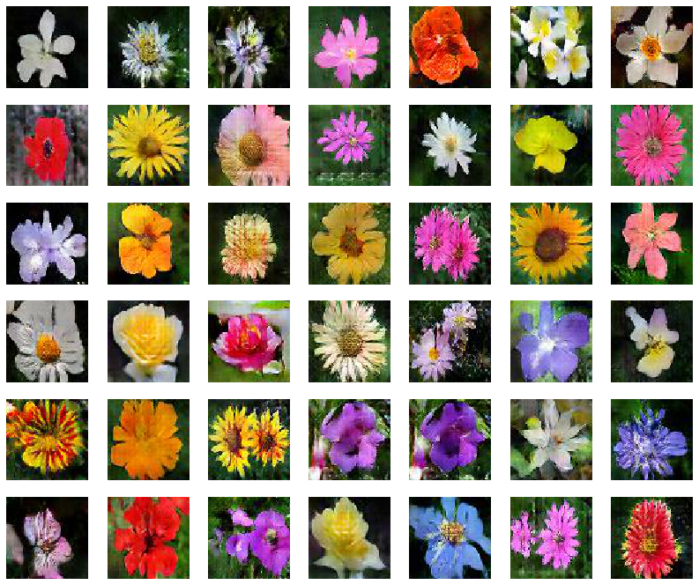
Demo (TA80)

Slide 42
Demo (TA80)
  This flower is white and yellow in color with petals that are rounded at the edges
  The flower has a several pieces of yellow colored petals that looks similar to its leaves
  This flower has several light pink petals and yellow anthers
  This flower has petals that are yellow with orange lines
1
2
3
4

Slide 43
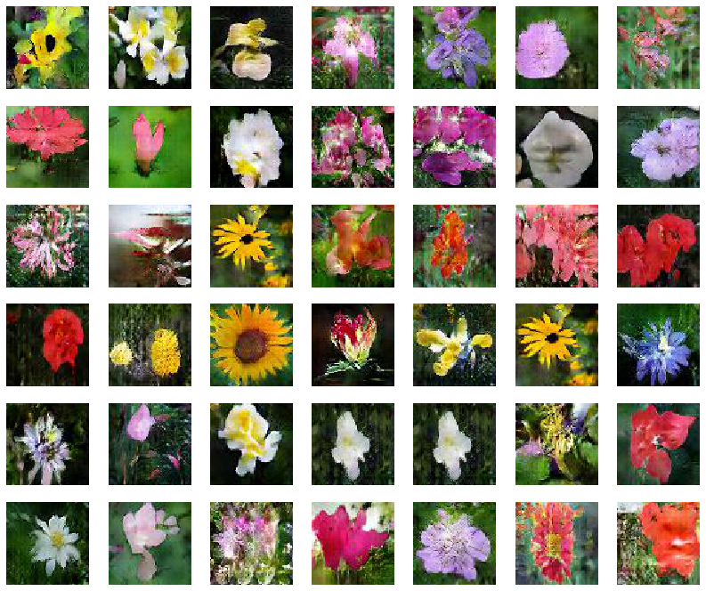
Demo (TA80)

Slide 44
Reference
Visualization of inception score is based on What is the Inception score? by David Mike
The code of inception score is based on How to Implement the Inception Score (IS) for Evaluating GANs by Jason Brownlee

