Slide 1
Deep Learning Lab 12-1: Seq2Seq Learning &
Neural Machine Translation
DataLab
Department of Computer Science, National Tsing Hua University, Taiwan

Slide 2
Outline
Encoder-Decoder Model
Sequence-to-Sequence (Seq2Seq)
Attention Mechanism
Teacher Forcing
Assignment
Reference

Slide 3
Outline
Encoder-Decoder Model
Sequence-to-Sequence (Seq2Seq)
Attention Mechanism
Teacher Forcing
Assignment
Reference

Slide 4

Encoder-Decoder Model
As we have seen in lab11-2 (AdaIN),
  Encoder: encode the inputs into hidden state/context/code
  Decoder: the hidden state is passed into the decoder to generate the desired output

Slide 5
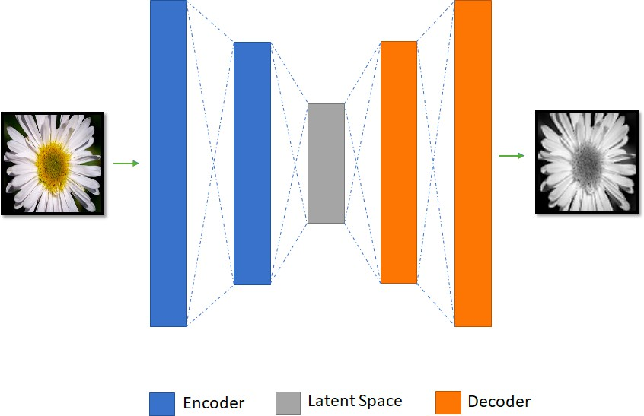
Encoder-Decoder Model
As we have seen in lab11-2 (AdaIN),
  Encoder: encode the inputs into hidden state/context/code
  Decoder: the hidden state is passed into the decoder to generate the desired output

Slide 6
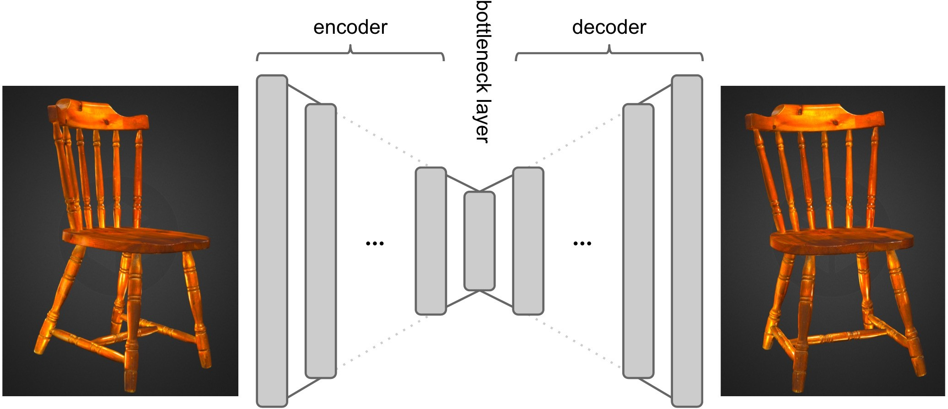
Encoder-Decoder Model
As we have seen in lab11-2 (AdaIN),
  Encoder: encode the inputs into hidden state/context/code
  Decoder: the hidden state is passed into the decoder to generate the desired output

Slide 7
Outline
Encoder-Decoder Model
Sequence-to-Sequence (Seq2Seq)
Attention Mechanism
Teacher Forcing
Assignment
Reference

Slide 8

Sequence-to-Sequence (Seq2Seq)
Sequence-to-Sequence (Seq2Seq) is an architecture based on the encoder-decoder, which transforms an input sequence to the target sequence
  Both sequences can have arbitrary lengths
  Have achieved a lot of success in tasks like machine translation, text summarization, and image captioning
  Google Translate started using such a model in production in late 2016

Slide 9

Seq2Seq
Sequence-to-Sequence (Seq2Seq) is an architecture based on the encoder-decoder, which transforms an input sequence to the target sequence
  The encoder processes each item in the input sequence, it compiles the information it captures into a vector, called the context. After processing the entire input sequence, the encoder sends the context over to the decoder, which begins producing the output sequence item by item

Slide 10

Seq2Seq
In neural machine translation, a sequence is a series of words, processed one after another. The output is, likewise, a series of words:

Slide 11
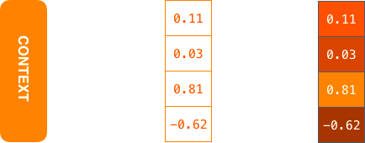
Seq2Seq
The context is a vector (an array of numbers, basically) in the case of machine translation. The encoder and decoder tend to both be recurrent neural networks (RNNs)
  You can set the size of the context vector when you set up your model. It is basically the number of hidden units in the encoder RNN

Slide 12
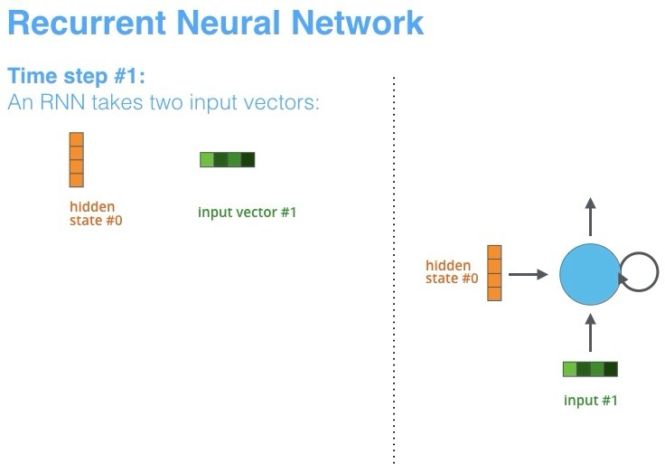
Seq2Seq
By design, a RNN takes two inputs at each time step: an input (in the case of the encoder, one word from the input sentence), and a hidden state

Slide 13
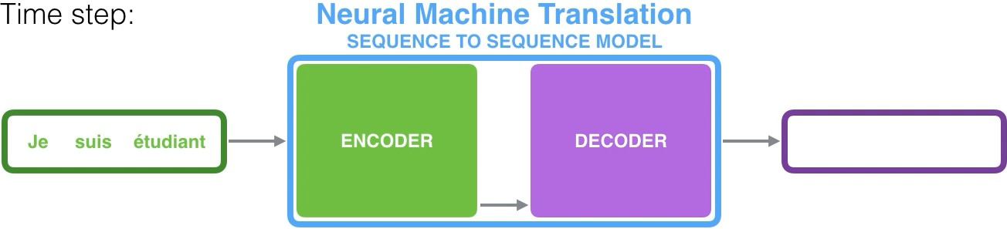
Seq2Seq
Since the encoder and decoder are both RNNs, each time step one of the RNNs does some processing, it updates its hidden state based on its inputs and previous inputs it has seen
  Notice the last hidden state is actually the context we pass along to the decoder

Slide 14
Outline
Encoder-Decoder Model
Sequence-to-Sequence (Seq2Seq)
Attention Mechanism
Teacher Forcing
Assignment
Reference

Slide 15
Why Attention?
The fixed-length context vector turned out to be a bottleneck for these types of models. It made it challenging for the models to deal with long sentences
  It is hard for the fixed-length context vector to store all information as the input sequence getting longer and longer
  It has often forgotten the earlier part of input once it processed the whole input sequence

Slide 16
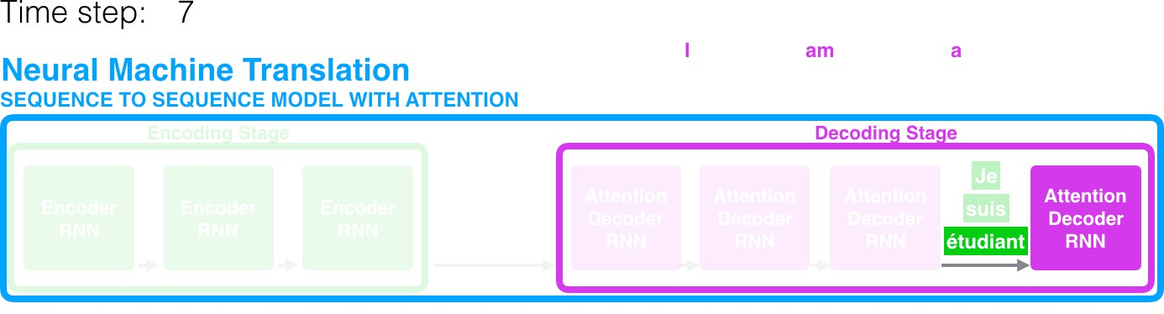
Attention Mechanism
Attention allows the model to focus on the relevant parts of the input sequence as needed
  The decoder can focus on different part of the input sequence at each time step, in order to make a better prediction

Slide 17
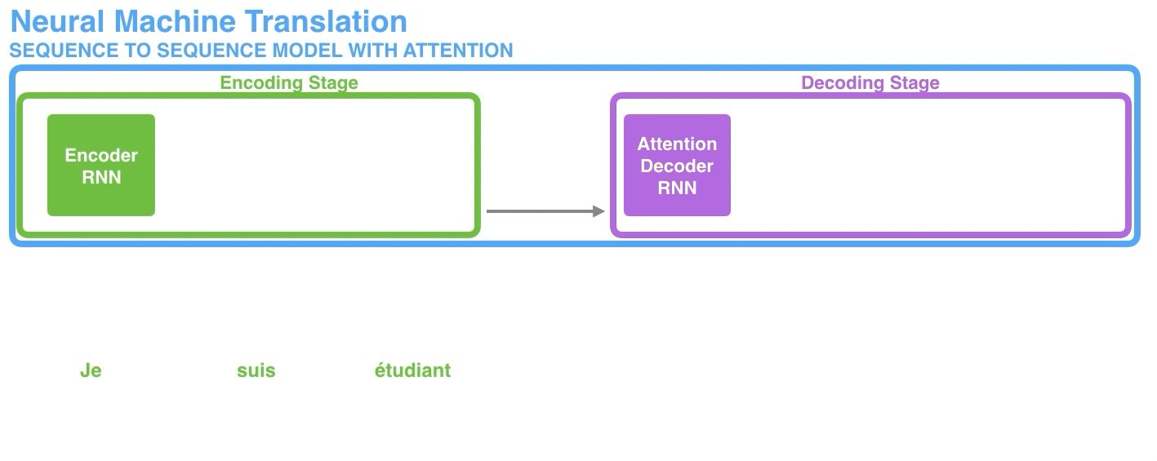
Attention Mechanism
1. First, the encoder passes a lot more data to the decoder. Instead of passing the last hidden state of the encoding stage, the encoder passes all the hidden states to the decoder:

Slide 18
Attention Mechanism
Second, an attention decoder does an extra step before producing its output. In order to focus on the parts of the input that are relevant to this decoding time step,
the decoder does the following:
  Look at the set of encoder hidden states it received – each encoder hidden states is most associated with a certain word in the input sentence
  Give each hidden states a score (let’s ignore how the scoring is done for now)
  Multiply each hidden states by its softmax score, thus amplifying hidden states with high scores, and drowning out hidden states with low scores

Slide 19
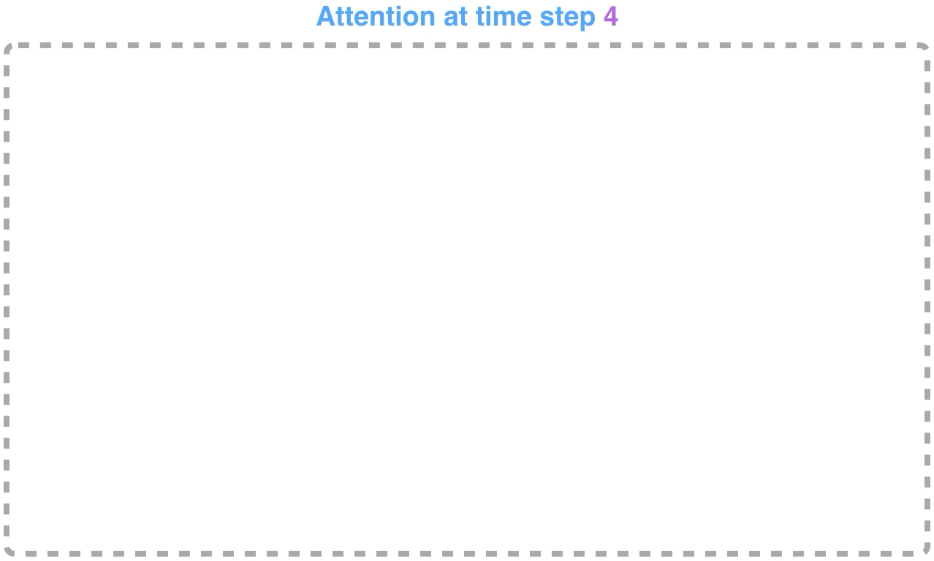
Attention Mechanism

Slide 20
Attention Mechanism
Let us now bring the whole thing together in the following visualization and look at how the attention process works:
  The attention decoder RNN takes in the embedding of the <END> token, and an initial decoder hidden state
  The RNN processes its inputs, producing an output and a new hidden state vector (h4). The output is discarded
  Attention Step: We use the encoder hidden states and the h4 vector to calculate a context vector (C4) for this time step
  We concatenate h4 and C4 into one vector
  We pass this vector through a feedforward neural network (one trained jointly with the model)
  The output of the feedforward neural networks indicates the output word of this time step
  Repeat for the next time steps

Slide 21
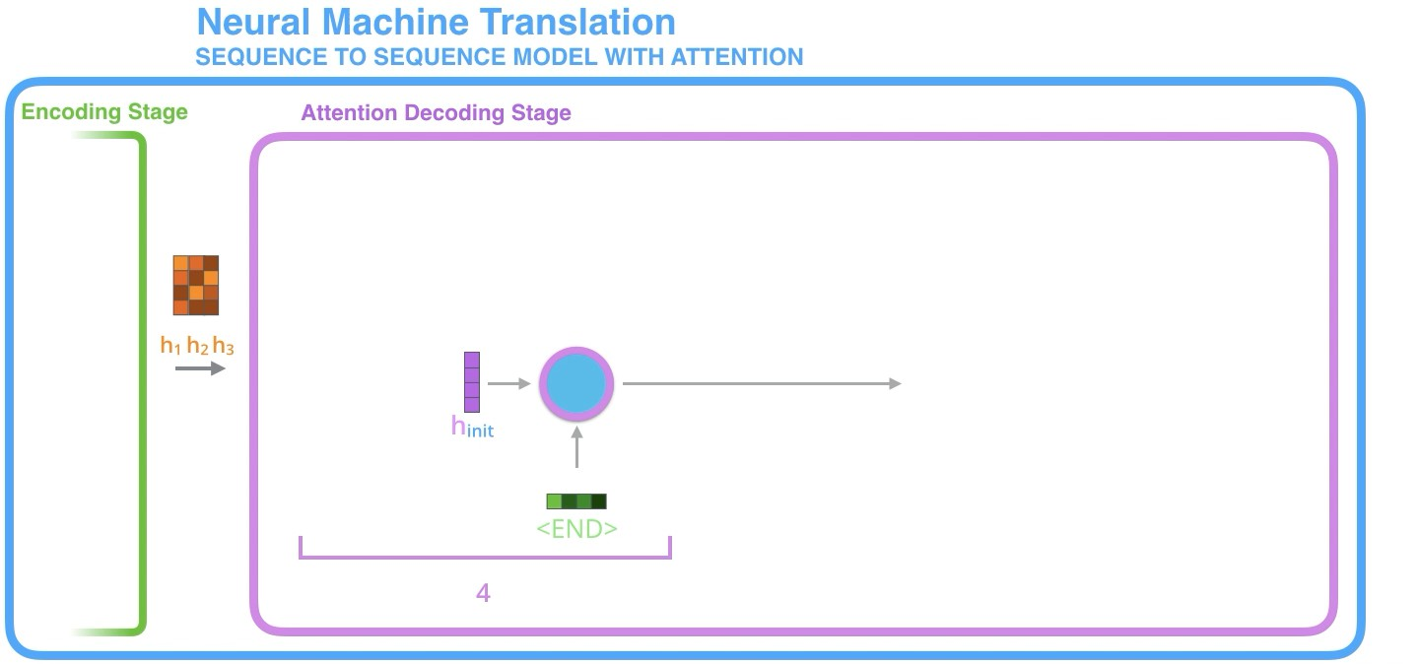
Attention Mechanism

Slide 22
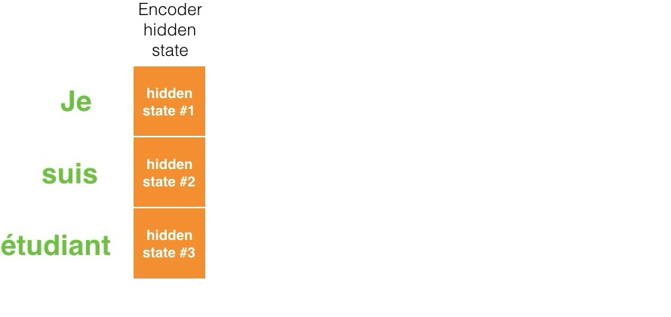
Attention Mechanism
This is another way to look at which part of the input sentence we’re paying attention to at each decoding step:

Slide 23
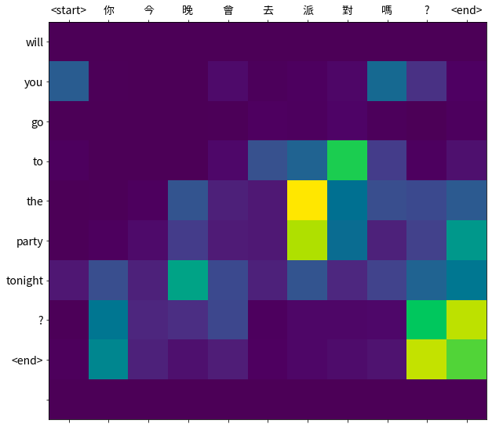
Attention Mechanism
It actually learned from the training phase how to align words in that language pair

Slide 24
Attention Mechanism
Let’s dive into math!
  Score: 𝑒_{𝑖j} = 𝑎(𝑠_{𝑖–1}, ℎ_{j})
Score after softmax: 𝛼_{𝑖j} =
exp(𝑒_{𝑖j})
∑𝑇_{𝑥}
exp(𝑒_{𝑖𝑘})
𝑘=1
𝑇_{𝑥}
Context vector: 𝑐_{𝑖} = ∑ 𝛼_{𝑖j}ℎ_{j}
j=1

Slide 25
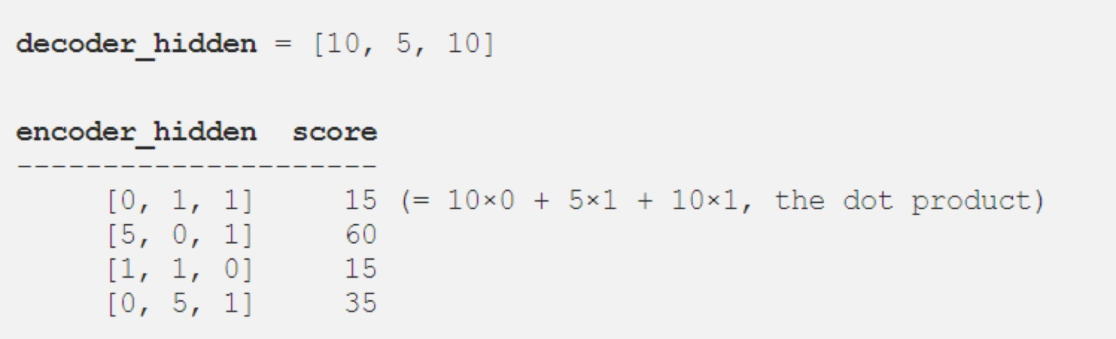
Attention Mechanism
How to calculate the score 𝑒_{𝑖j} = 𝑎(𝑠_{𝑖–1}, ℎ_{j})?
  , where 𝑎(⋅) is the dot product in the following example

Slide 26
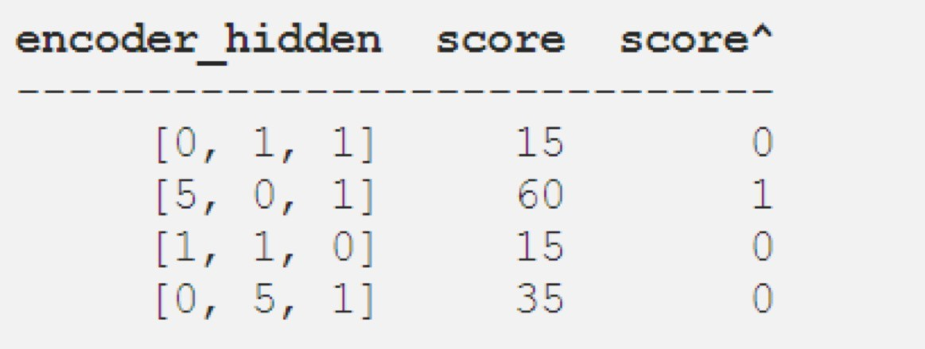
Attention Mechanism
exp(𝑒_{𝑖j})
Score after softmax 𝛼 =
is straightforward
𝑖j ∑𝑇_{𝑥}
exp(𝑒_{𝑖𝑘})
𝑘=1

Slide 27
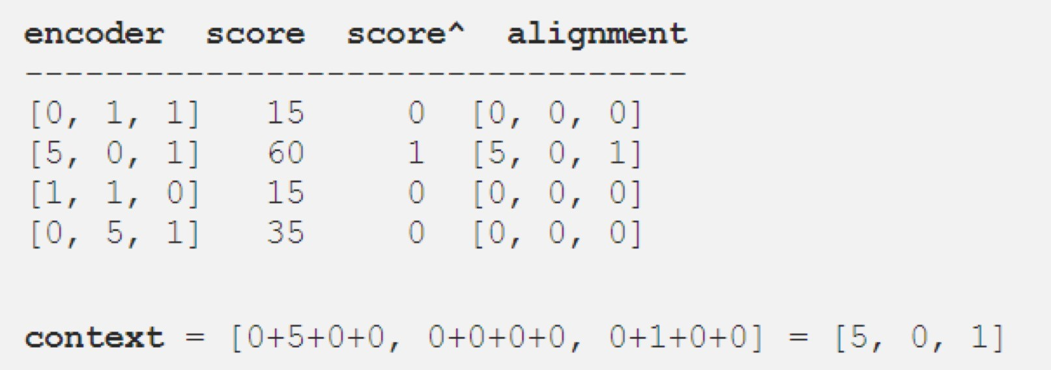
Attention Mechanism
Finally, we can multiply each hidden state of encoder by its score and sum up the alignment vectors to get the context
𝑇_{𝑥}
vector: 𝑐_{𝑖} = ∑ 𝛼_{𝑖j}ℎ_{j}
j=1

Slide 28
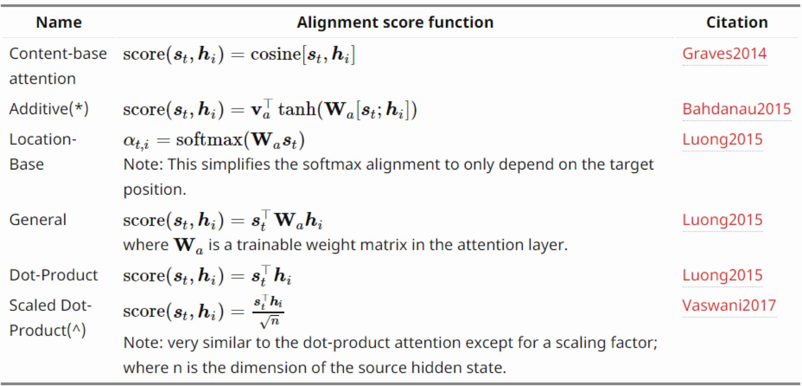
Attention Mechanism
There are many well-known score functions as follows
  ℎ represents hidden state of encoder
  𝑠 represents decoder hidden states

Slide 29
Attention Mechanism
Attention mechanism allows the decoder to focus on various part of input sequence, instead of forcing it to encode all information into one fixed-length vector
  Pros: model interpretability, better performance
  Cons: computationally expensive

Slide 30
Outline
Encoder-Decoder Model
Sequence-to-Sequence (Seq2Seq)
Attention Mechanism
Teacher Forcing
Assignment
Reference

Slide 31
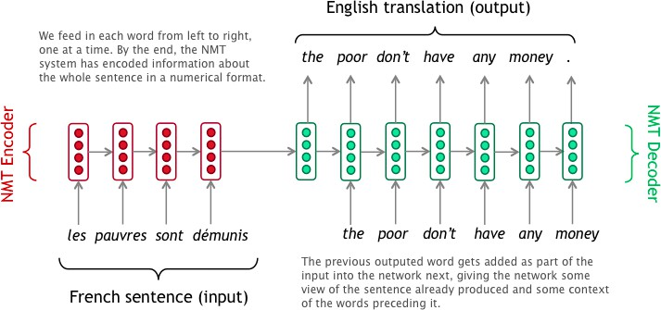
Teacher Forcing
Teacher forcing is a method for quickly and efficiently training recurrent neural network models that use the ground truth from a prior time step as input
  Accelerate the convergence speed
  Stabilize the training process
Ground truth

Slide 32
Outline
Encoder-Decoder Model
Sequence-to-Sequence (Seq2Seq)
Attention Mechanism
Teacher Forcing
Assignment
Reference

Slide 33
Assignment
There are two parts in the notebook
  Part I: neural machine translation
  Part II: sentiment analysis (assignment)

Slide 34
Neural Machine Translation
Overview
  Task: translate the sentence from Chinese to English
  Dataset size: 20289
  Encoder: RNN with GRU cell
  Decoder: RNN with GRU cell
  Attention machanism: Bahdanau Attention
score(𝑠_{𝑡}, ℎ_{𝑖}) = 𝑣^{𝑇}tanh(𝑊_{𝑎}[𝑠_{𝑡}; ℎ_{𝑖}])
𝑎
It is worth noticing that in GRU, the hidden state and the output are same

Slide 35

Neural Machine Translation
It’s a toy model with toy dataset. Here we focus on the main idea behind the model

Slide 36
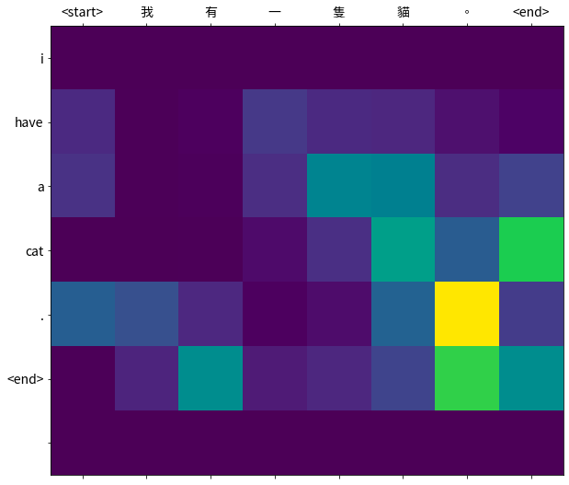
Neural Machine Translation
It’s a toy model with toy dataset. Here we focus on the main idea behind the model

Slide 37
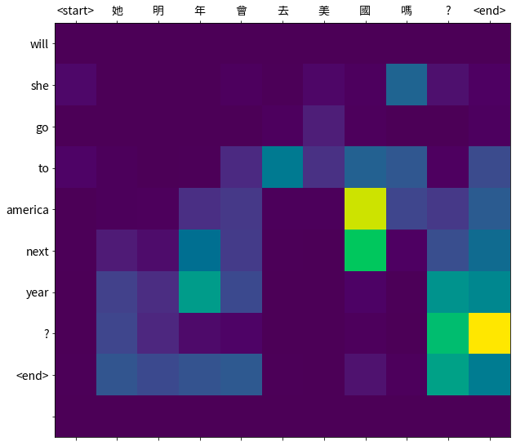
Neural Machine Translation
It’s a toy model with toy dataset. Here we focus on the main idea behind the model

Slide 38
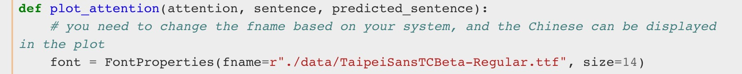
Neural Machine Translation
In the plotting function, you need to change the path of the Chinese font. Otherwise, the Chinese character will not be displayed in the plot

Slide 39
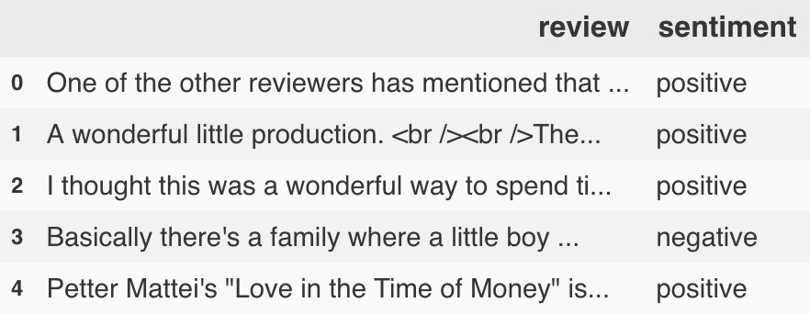
Sentiment Analysis
Overview
  Task: predict whether the comment is positive or negative
  Dataset: IMDB
  Dataset size: 50000
  Encoder: RNN with GRU cell
  Decoder: 4 fully-connected layers
  Attention machanism: Luong Attention

Slide 40
TODO
Implement the Luong Attention, where the formula of the score function is:
score(𝑠_{𝑡}, ℎ_{𝑖}) = 𝑠^{𝑇} 𝑊_{𝑎}ℎ_{𝑖}
𝑡
ℎ_{𝑖}: hidden state of the encoder
𝑠_{𝑡}: hidden state of the decoder
𝑊_{𝑎}: the trainable weights

Slide 41
Demo
This simple model achieves ~84.5% accuracy with only 10 epochs! Not bad at all!
Besides the nice accuracy, let's try to do some more fascinating things. How about visualizing our results?

Slide 42
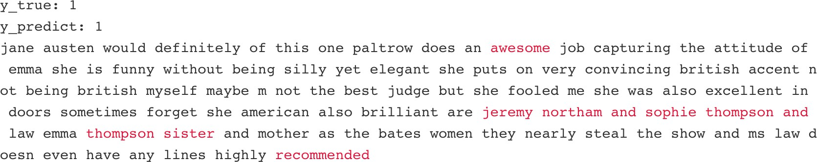
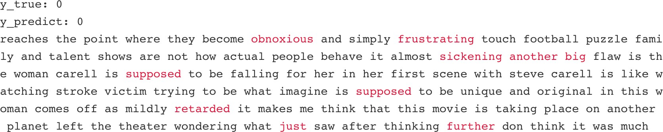
Demo
Positive
Negative

Slide 43
Requirement
The accuracy should be at least 0.80
Show the 10-most-focused words in the sentence
Only need to show the first 10 results in the test data
Submit on eeclass your code file Lab12-1_{student id}.ipynb
No need to submit the checkpoints file, but you should show the results in the notebook
Deadline: 2026-11-11 (Wed.) 23:59

Slide 44
Outline
Encoder-Decoder Model
Sequence-to-Sequence (Seq2Seq)
Attention Mechanism
Teacher Forcing
Assignment
Reference

Slide 45
Reference
Sequence to Sequence Learning with Neural Networks, I. Sutskever et al., NeurIPS’14
Learning Phrase Representations using RNN Encoder–Decoder for Statistical Machine Translation, K. Cho et al., EMNLP’14
Neural Machine Translation by Jointly Learning to Align and Translate,
D. Bahdanau et al., ICLR’15
Effective Approaches to Attention-based Neural Machine Translation,
M. T. Luong, EMNLP’15
Attention Is All You Need, Google Brain, NeurIPS’ 17
Visualizing A Neural Machine Translation Model
The Illustrated Transformer

