Slide 1
Deep Learning Lab 11-2
Visualization & Style Transfer
Datalab
Department of Computer Science,
National Tsing Hua University,
Taiwan

Slide 2
Outline
Visualization
Neural Style Transfer
  A Neural Algorithm of Artistic Style
  AdaIN (Adaptive Instance Normalization)

Slide 3
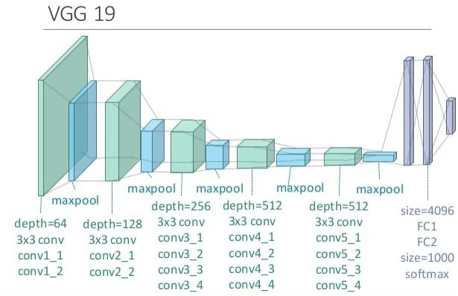
VGG19
VGG19 is known for its simplicity, using only 3×3 convolutional layers stacked on top of each other in increasing depth.

Slide 4
VGG19
CNN learns how to create useful representations of the data to differentiate between different classes.

Slide 5
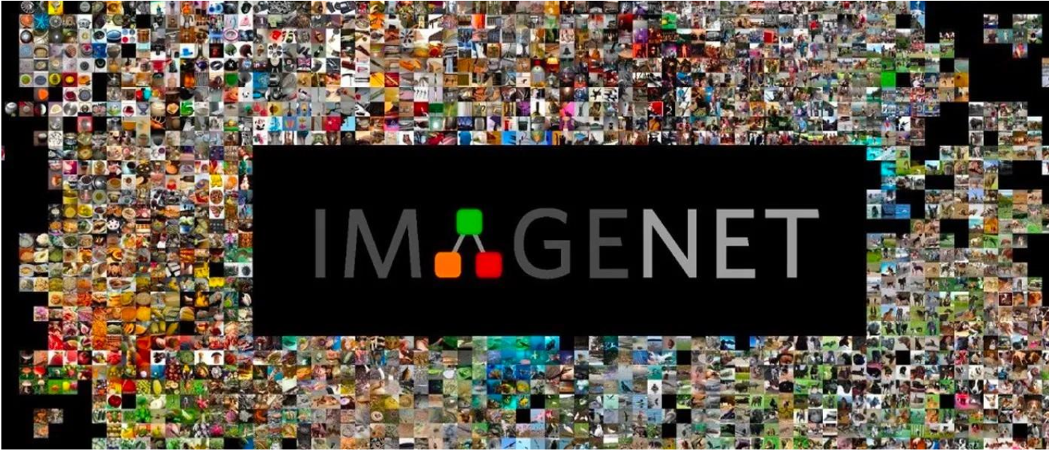
VGG19
In this tutorial, we are going to use VGG19 pretrained on ImageNet for visualization.
ImageNet is a large dataset used in ImageNet Large Scale Visual Recognition Challenge(ILSVRC). The training dataset contains around 1.2 million images composed of 1000 different types of objects

Slide 6
More about Pretrained Networks...
Pretrained network is useful and convenient for several further usages, such as style transfer, transfer learning, fine-tuning, and so on.
Generally, using pretrained network can save a lot of time and also easier to train a model on more complex dataset or small dataset.

Slide 7
Outline
Visualization
Neural Style Transfer
  A Neural Algorithm of Artistic Style
  AdaIN (Adaptive Instance Normalization)
Save and Load models (Checkpoints)

Slide 8
Visualize Filters
Visualize the weights of the convolution filters to help us understand what neural network have learned.
Learned filters are simply weights, yet because of the specialized two-dimensional structure of the filters, the weight values have a spatial relationship to each other and plotting each filter as a two-dimensional image is meaningful (or could be)

Slide 9
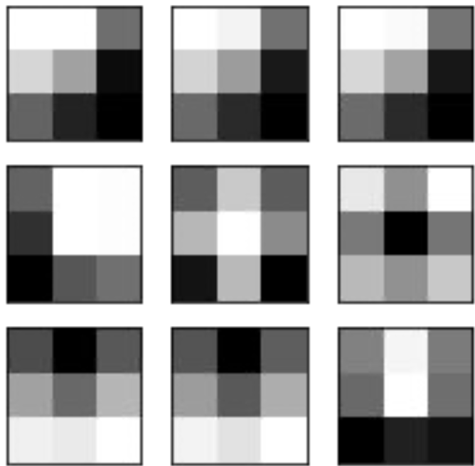
Visualize Filters
Let's look at some filters in the first convolutional layer.
The dark squares indicate small or inhibitory weights and the light squares represent large or excitatory weights.

Slide 10

Visualize Feature Maps
Activation maps, called feature maps, capture the result of applying the filters to input, such as the input image or another feature map.
The idea of visualizing a feature map for a specific input image would be to understand what features of the input are detected or preserved in the feature maps

Slide 11
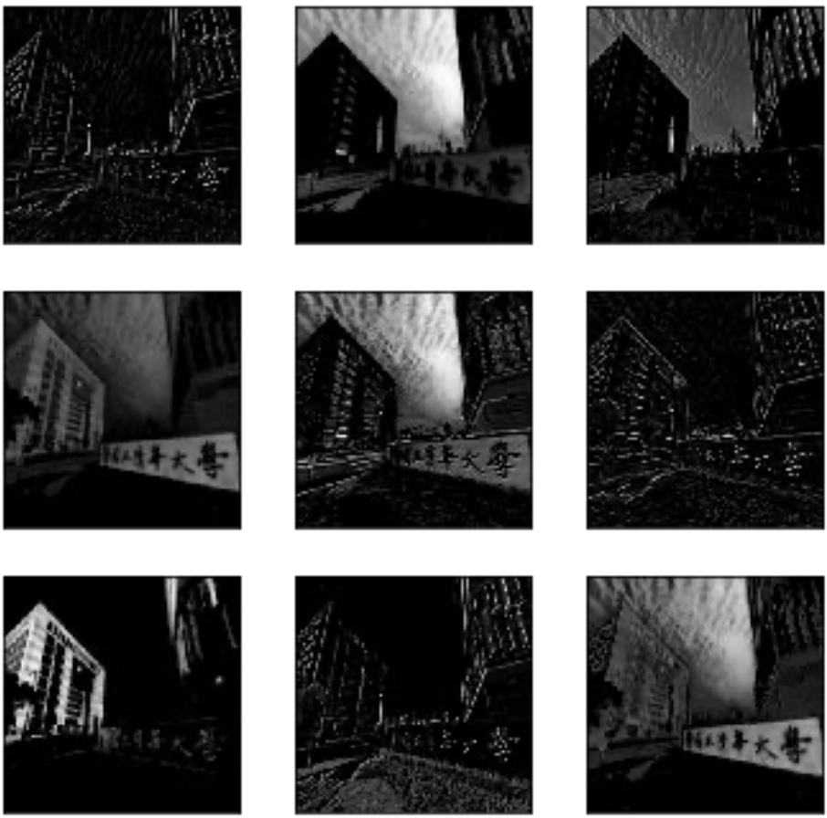
Visualize Feature Maps
Result of applying the filters in the first convolutional layer is a lot of versions of the input image with different features highlighted.

Slide 12
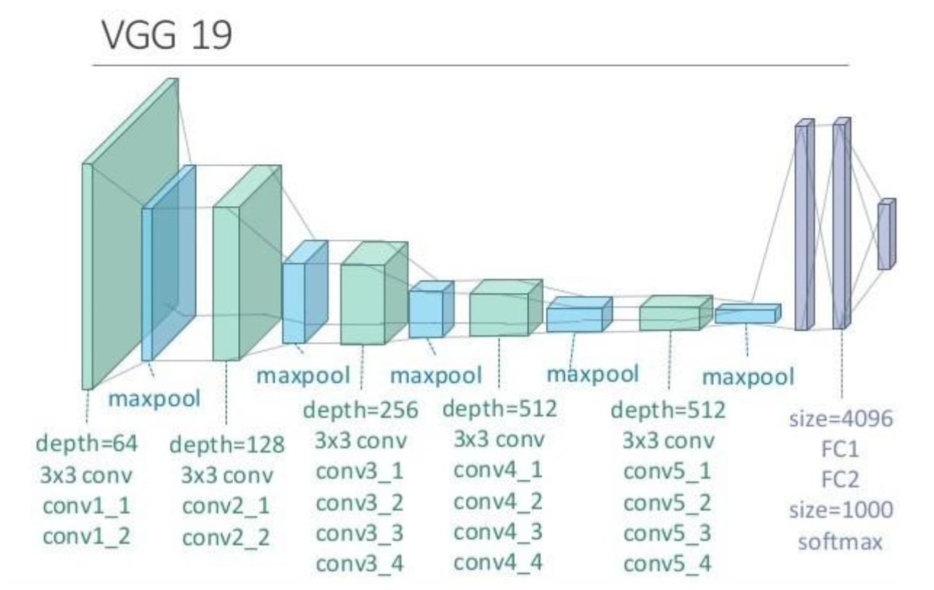
Visualize “Deeper” Feature Maps
Let's visualize the feature maps output from each block of VGG19.

Slide 13
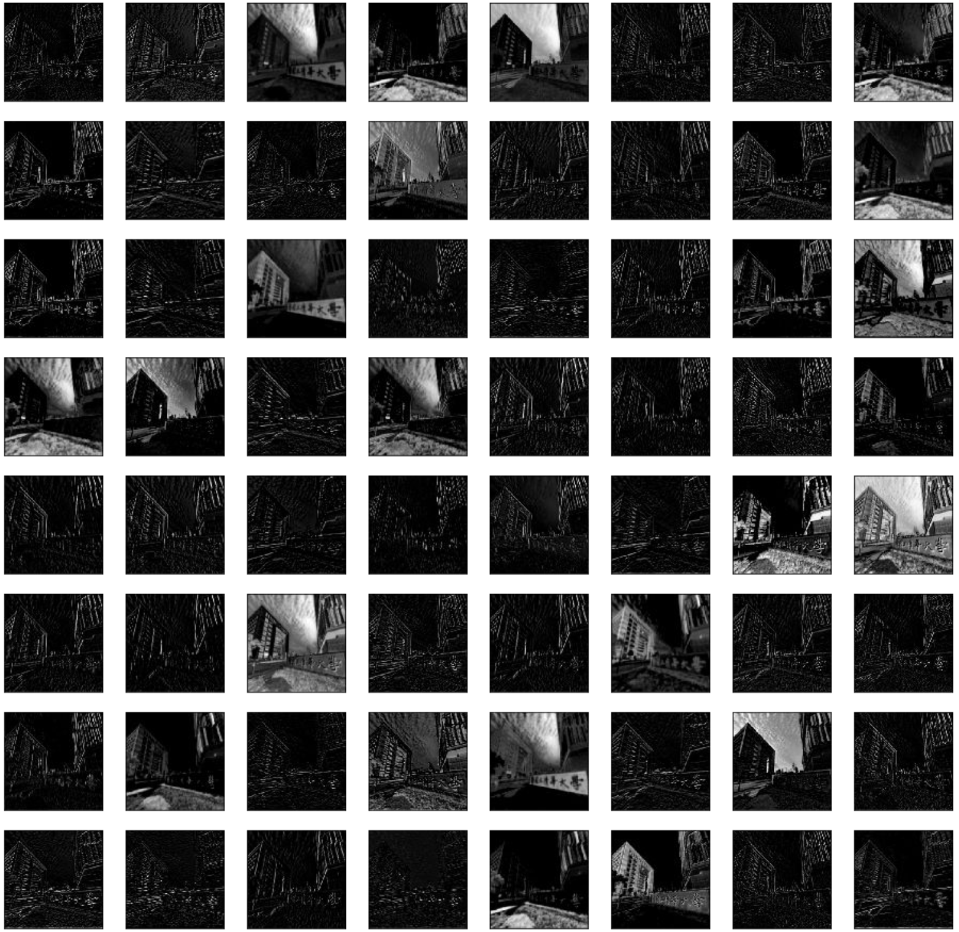

Slide 14
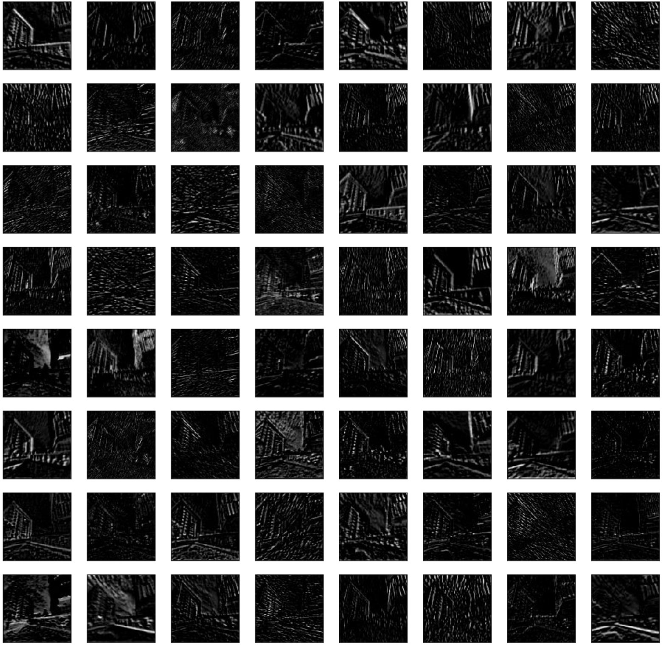

Slide 15
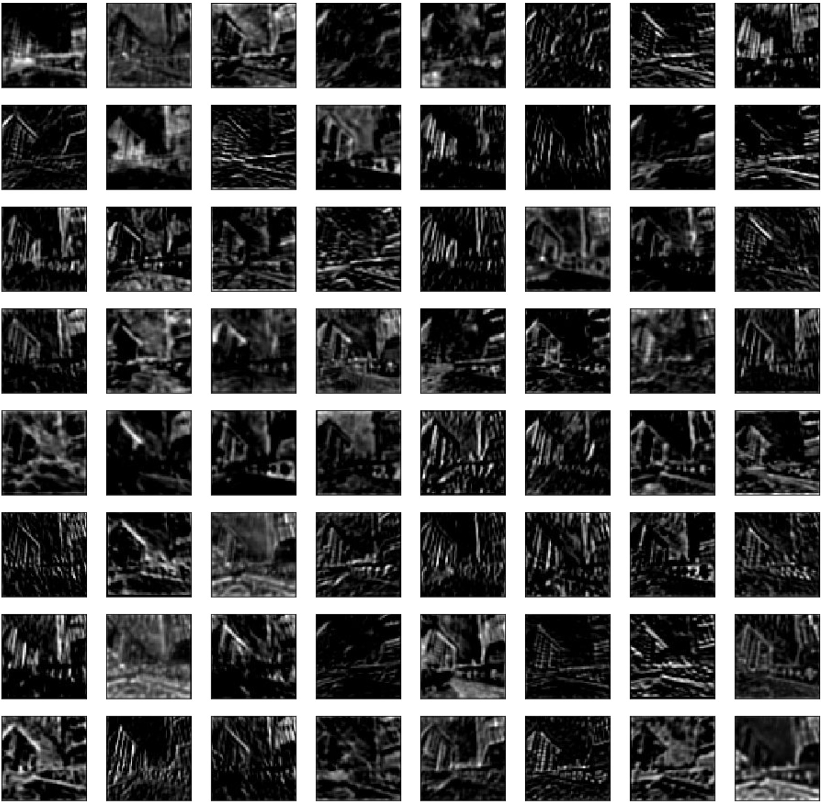

Slide 16
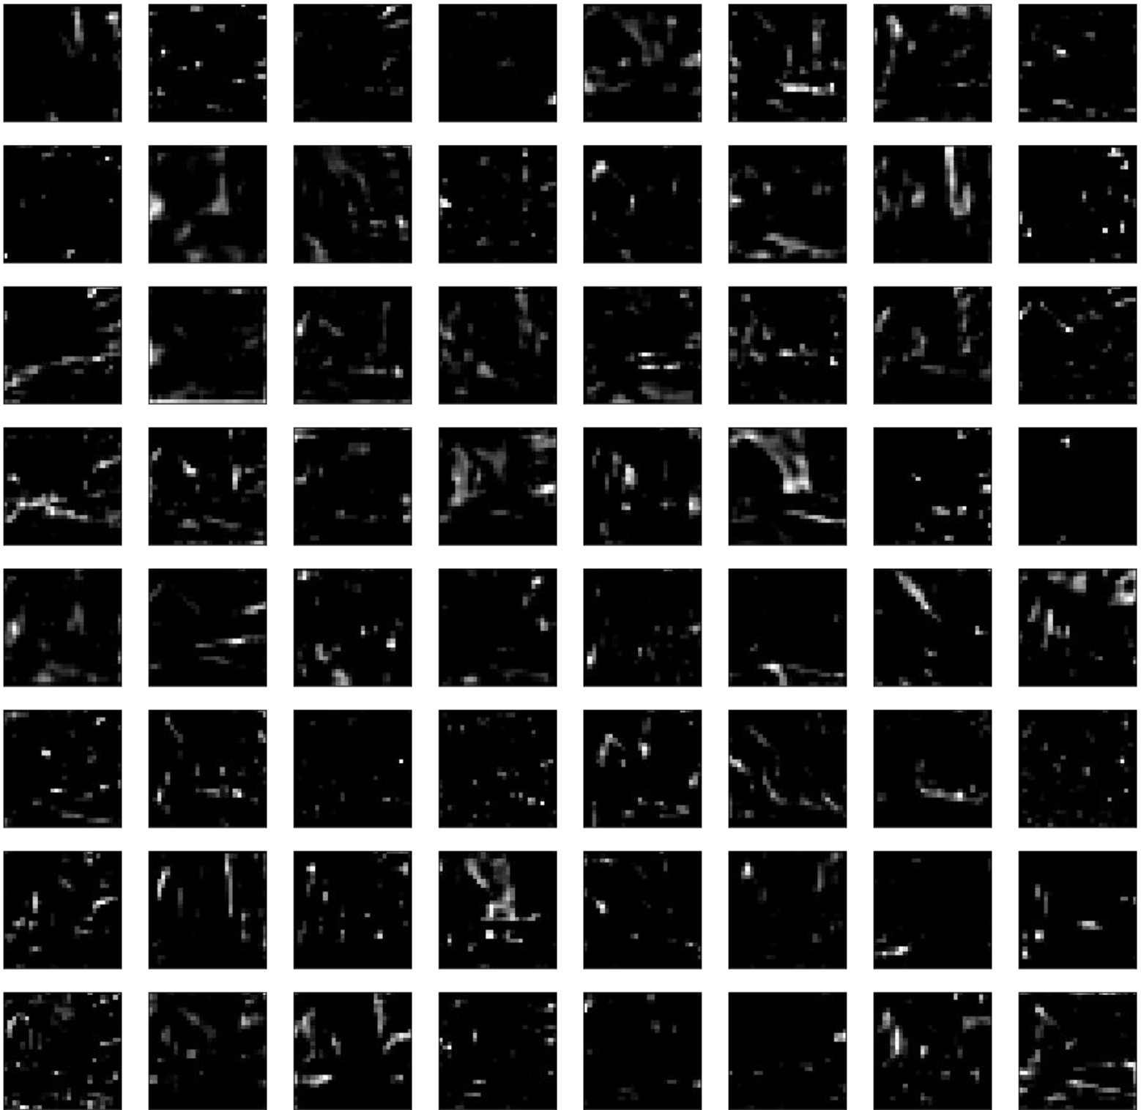

Slide 17
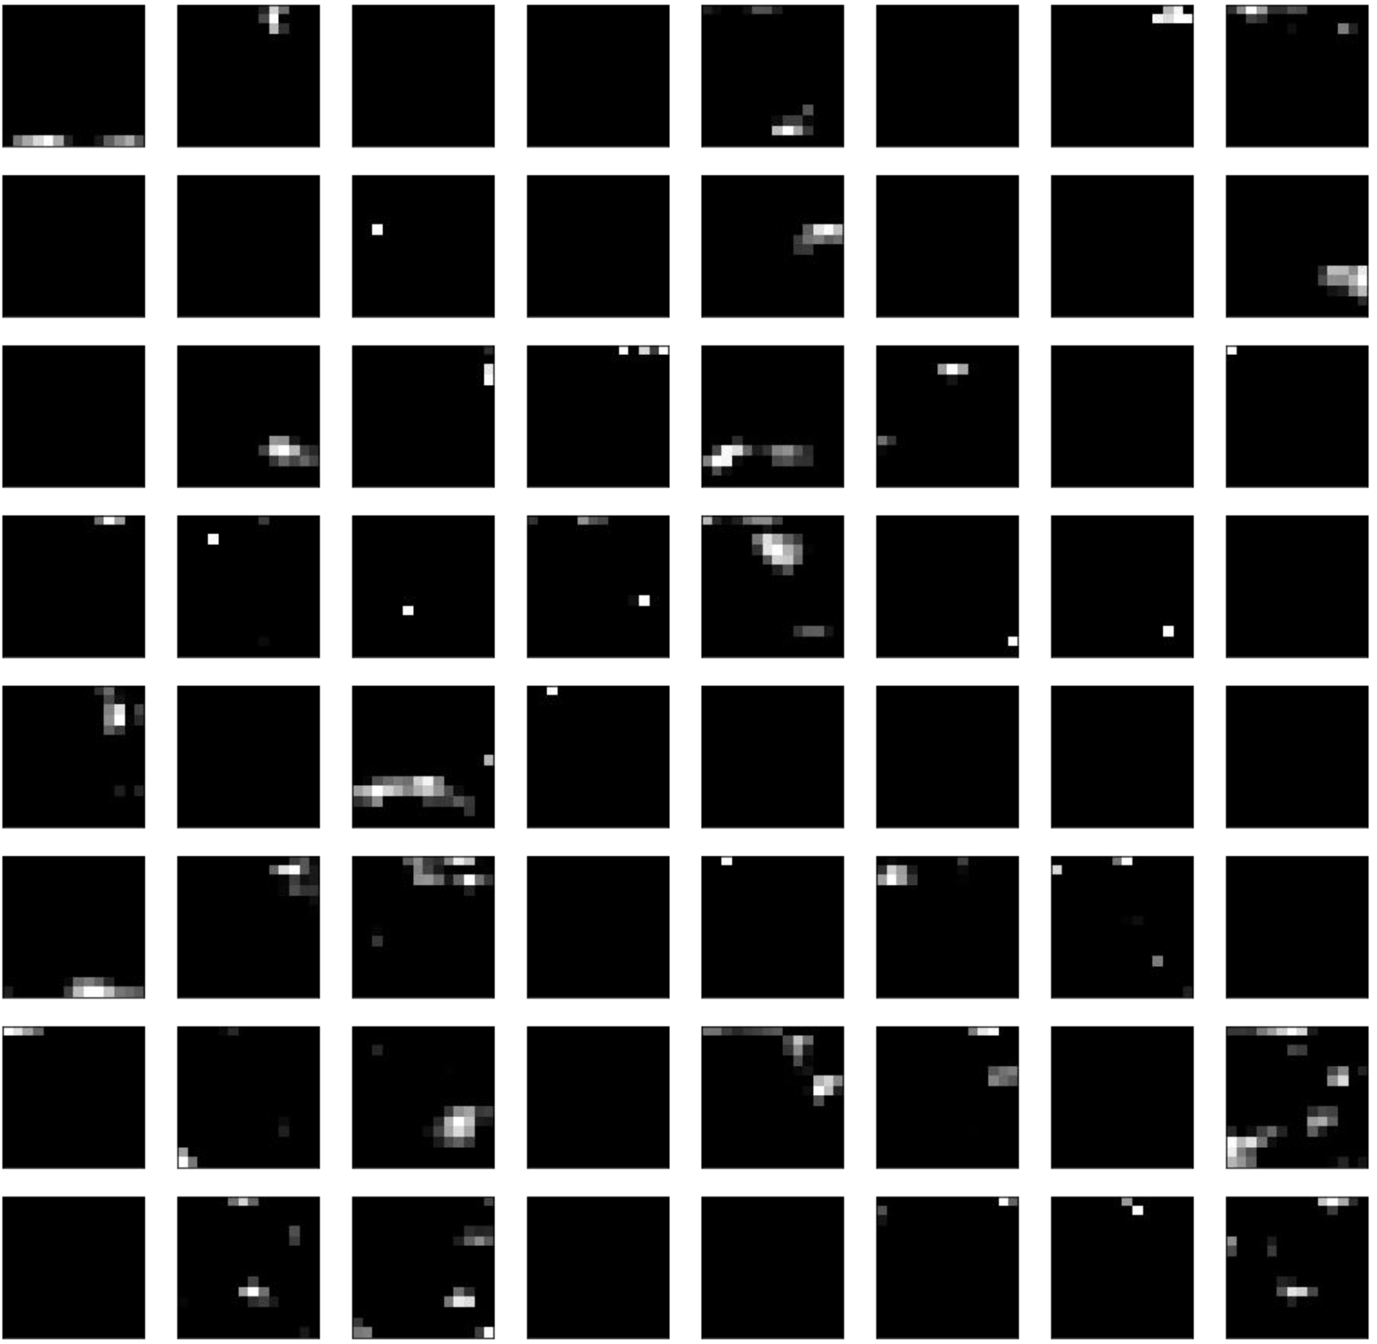

Slide 18
Visualize “Deeper” Feature Maps
Feature maps closer to the input of the model capture a lot of fine detail in the image and that as we progress deeper into the model, the feature maps show less and less detail.
This pattern was to be expected, as the model abstracts the features from the image into more general concepts that can be used to make a classification.
block 1 block 2 block 3 block 4 block 5

Slide 19
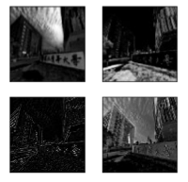
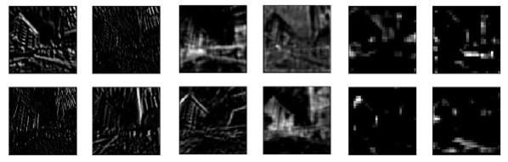
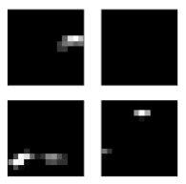
Visualize “Deeper” Feature Maps
block 1 block 2 block 3 block 4 block 5

Slide 20
Visualize Gradients
Visualizing convolutional output is a pretty useful technique for visualizing shallow convolution layers.
Unfortunately, when we get into the deeper layers, it’s hard to understand them just by just looking at the convolution output.

Slide 21
Visualize Gradients
If we want to understand what the deeper layers are really doing, we can try to use backpropagation to show us the gradients of a particular neuron with respect to our input image, which is called saliency map.
We will make a forward pass up to the layer that we are interested in, and then backpropagate to help us understand which pixels contributed the most to the activation of that layer.

Slide 22
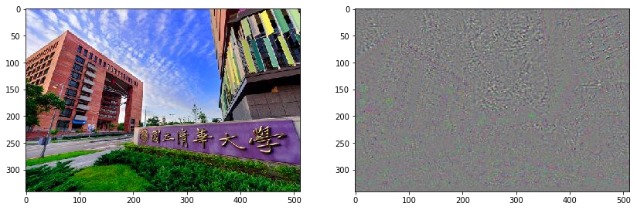
Visualize Gradients
Compute the gradient of maximum neurons among all activations in the required layer with respect to the input image.

Slide 23

Visualize Gradients
We can also visualize the gradient of any single feature map.

Slide 24
Guided-Backpropagation
As we can see above, the results are still hard to explain and not very satisfying.
Ideally, neurons act like detectors of particular image features. We are only interested in what image features the neuron detects, not in what kind of stuff it doesn’t detect.
Therefore, when propagating the gradient, we set all the negative gradients to 0.

Slide 25
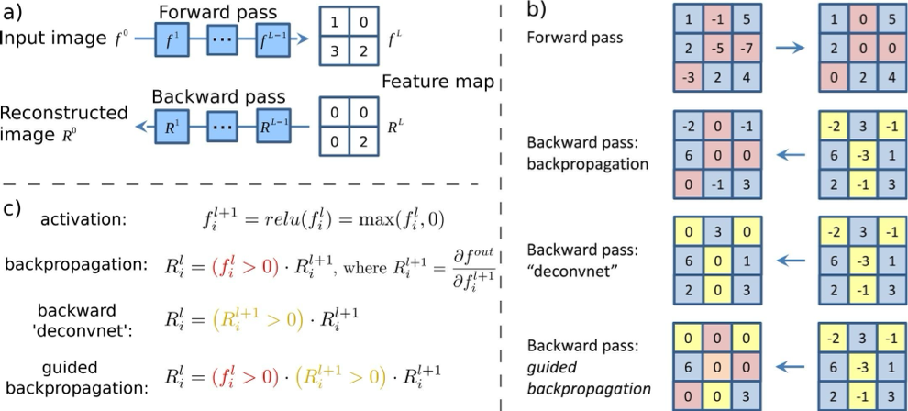
Guided-Backpropagation
Thus, the gradient is “guided” by both the input and the error signal.

Slide 26
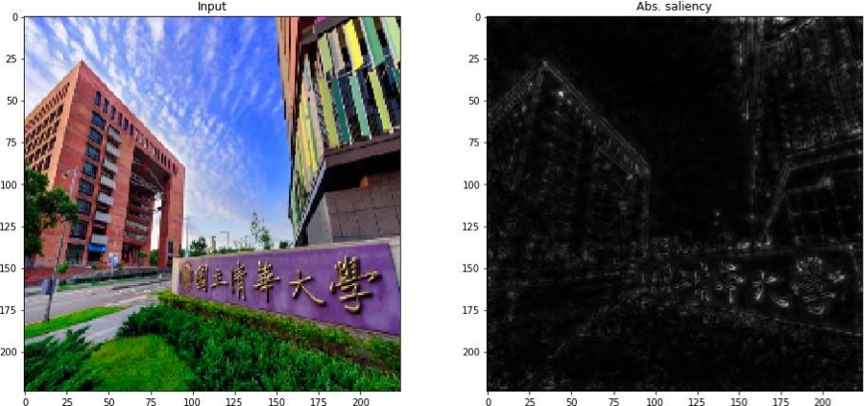
Guided-Backpropagation
Thus, the gradient is “guided” by both the input and the error signal.

Slide 27
Guided-Backpropagation
Thus, the gradient is “guided” by both the input and the error signal.

Slide 28
Outline
Visualization
Neural Style Transfer
  A Neural Algorithm of Artistic Style
  AdaIN (Adaptive Instance Normalization)

Slide 29

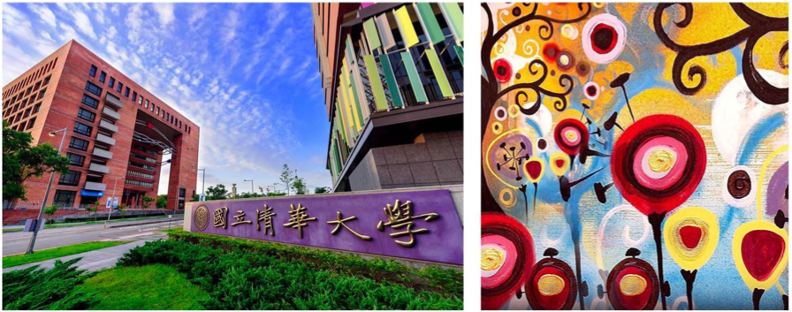
Neural Style Transfer
Leon Gatys and his co-authors has a very interesting work called "A Neural Algorithm of Artistic Style" that uses neural representations to separate and recombine content and style of arbitrary images, providing a neural algorithm for the creation of artistic images

Slide 30
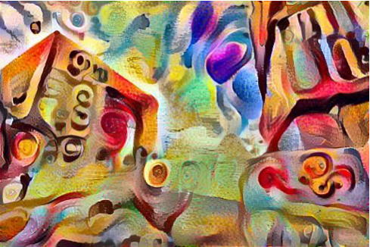
Neural Style Transfer

Slide 31
Outline
Visualization
Neural Style Transfer
  A Neural Algorithm of Artistic Style
  AdaIN (Adaptive Instance Normalization)

Slide 32
A Neural Algorithm of Artistic Style
At a high level, in order for a network to perform image classification, it must understand the image.
This requires taking the raw image as input pixels and building an internal representation that converts the raw image pixels into a complex understanding of the features present within the image.

Slide 33
A Neural Algorithm of Artistic Style
Use the intermediate layers of the model to get the content and style representations of the image.
Content representation
Style representation

Slide 34
A Neural Algorithm of Artistic Style
Use the intermediate layers of the model to get the content and style representations of the image.
Content representation
  Content features of the content image is calculated by feeding the content image into the neural network, and extract the activations of those.
  content_layers
Style representation

Slide 35
A Neural Algorithm of Artistic Style
Use the intermediate layers of the model to get the content and style representations of the image.
Content representation
Style representation
  For style features, we extract the correlation of the features of the style-image layer-wise (gram matrix). By adding up the feature correlations of multiple layers, which corresponding to style_layers, we obtain a multi-scale representation of the input image, which captures its texture information instead of the object arrangement in the input image

Slide 36
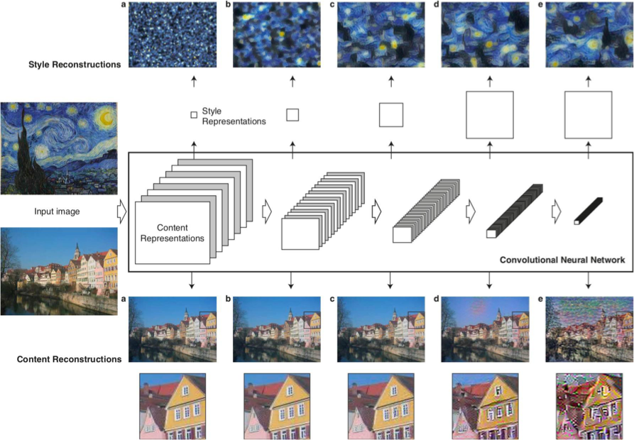
A Neural Algorithm of Artistic Style

Slide 37
A Neural Algorithm of Artistic Style
Our goal is to create an output image which is synthesized by finding an image that simultaneously matches the content features of the photograph and the style features of the respective piece of art.
We can define the loss function as the composition of the dissimilarity of:
  The content features between the output image and the content image.
  The style features between the output image and the style image .

Slide 38

A Neural Algorithm of Artistic Style
Content loss
  Minimize squared-error loss between two feature representations, where F and P are the representations of original and the generated image respectively.

Slide 39



A Neural Algorithm of Artistic Style
Style loss
  Use Gram matrix to calculate style loss, consisting feature correlations between the different filter responses. Minimize the mean-squared distance between two Gram matrices. A and G represents original and generated image respectively, and w are weighting factors

Slide 40
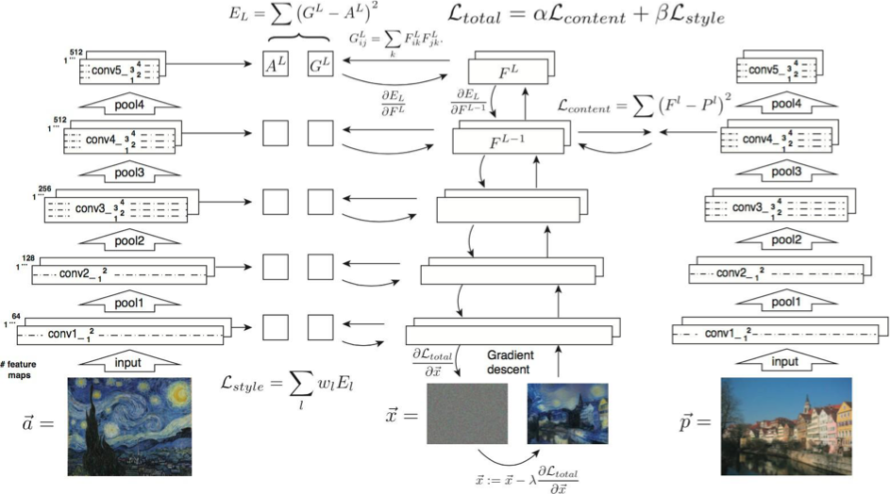
A Neural Algorithm of Artistic Style

Slide 41
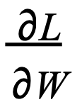
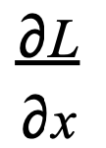
A Neural Algorithm of Artistic Style
So far, we have learned how to train a neural network by using gradient descent to update the weights.
How to use the loss function we have defined?
  We have to update our input image!

Slide 42
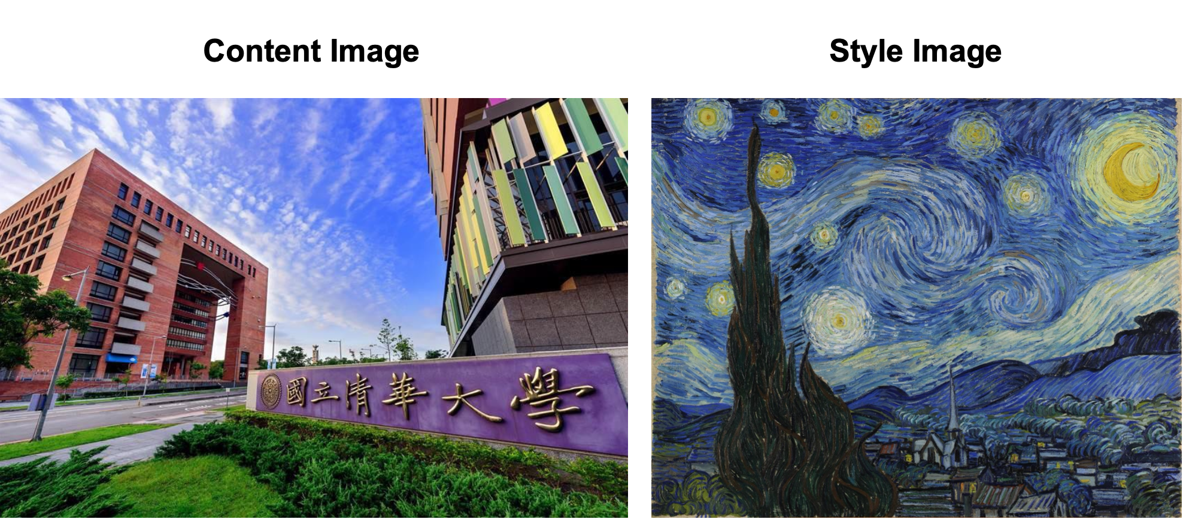
A Neural Algorithm of Artistic Style

Slide 43
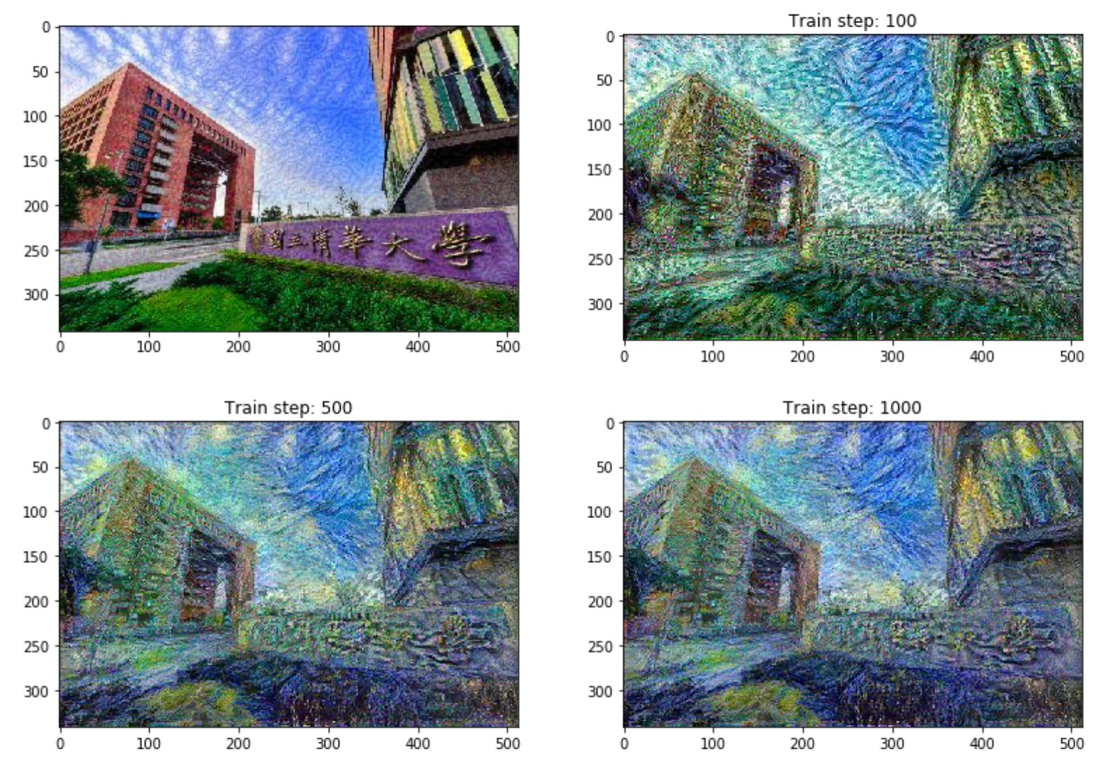
A Neural Algorithm of Artistic Style

Slide 44
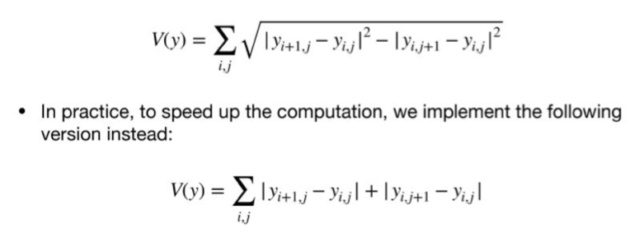
A Neural Algorithm of Artistic Style
Decrease these using an explicit regularization term on the high frequency components of the image. In style transfer, this is often called the total variation loss.

Slide 45
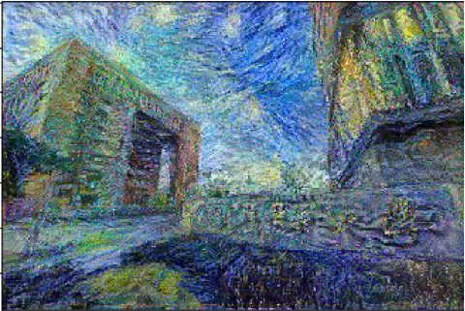
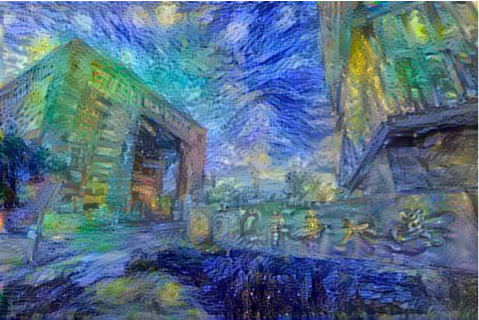
A Neural Algorithm of Artistic Style
w/ total_loss w/o total_loss

Slide 46
Outline
Visualization
Neural Style Transfer
  A Neural Algorithm of Artistic Style
  AdaIN (Adaptive Instance Normalization)
Save and Load models (Checkpoints)

Slide 47
AdaIN (Adaptive Instance Normalization)
The method we mentioned above requires a slow iterative optimization process, which limits its practical application.
Xun Huang and Serge Belongie from Cornell University propose another framework, which enables arbitrary style transfer in real-time, known as "Arbitrary Style Transfer in Real-time with Adaptive Instance Normalization”.

Slide 48
AdaIN (Adaptive Instance Normalization)
At the heart of this method is a novel Adaptive Instance Normalization (AdaIN) layer aligning the mean and variance of the content features with those of the style features.
Instance normalization performs style normalization by normalizing feature statistics, which have been found to carry the style information of an image in the earlier works.

Slide 49
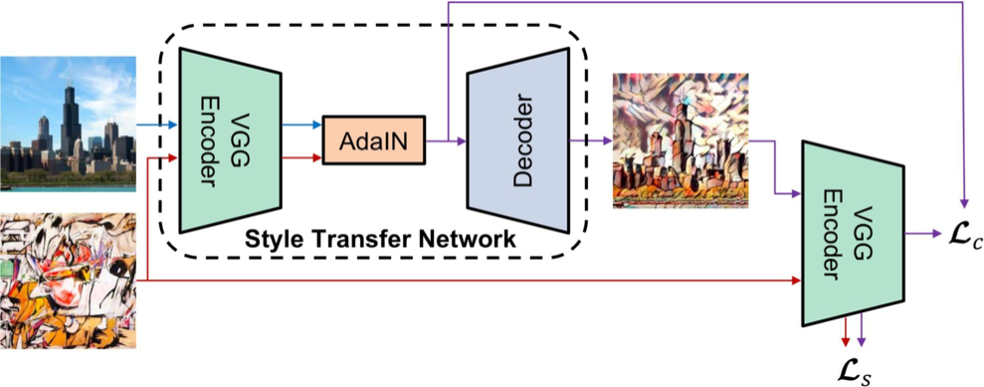
AdaIN (Adaptive Instance Normalization)

Slide 50
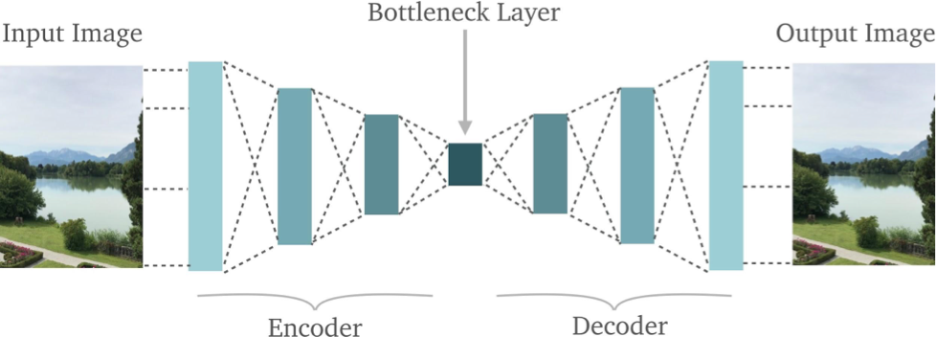
AdaIN (Adaptive Instance Normalization)
What are encoder and decoder?
  Take autoencoder as an example:

Slide 51
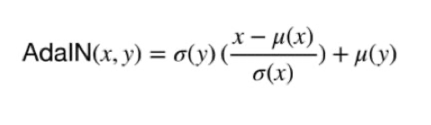
AdaIN (Adaptive Instance Normalization)
AdaIN receives a content input and style input, and simply aligns the channel-wise mean and variance of to match those of.
It is worth knowing that unlike BN(Batch Normalization), IN(Instance Normalization) or CIN(Conditional Instance Normalization), AdaIN has no learnable affine parameters. Instead, it adaptively computes the affine parameters from the style inputs:

Slide 52
