Slide 1
Deep Learning Lab 5: Regularization
DataLab, 2025
Department of Computer Science,
National Tsing Hua University, Taiwan

Slide 2
Regularization
techniques that improve the generalizability of a trained model

Slide 3
Outline
Scikit-learn
Learning Theory
Error Curves and Model Complexity
Learning Curves and Sample Complexity
Weight Decay
Ridge Regression
LASSO
Validation
Assignment

Slide 4
Outline
Scikit-learn
Learning Theory
Error Curves and Model Complexity
Learning Curves and Sample Complexity
Weight Decay
Ridge Regression
LASSO
Validation
Assignment

Slide 5

Scikit-learn
Scikit-learn is a free software machine learning library for the Python programming language
It features various classification, regression and clustering algorithms
including SVM (support vector machines), Random Forests, gradient boosting, k-means and DBSCAN, and is designed to interoperate with the Python numerical and scientific libraries NumPy and SciPy
pip install scikit-learn / conda install scikit-learn

Slide 6
Outline
Scikit-learn
Learning Theory
Error Curves and Model Complexity
Learning Curves and Sample Complexity
Weight Decay
Ridge Regression
LASSO
Validation
Assignment

Slide 7
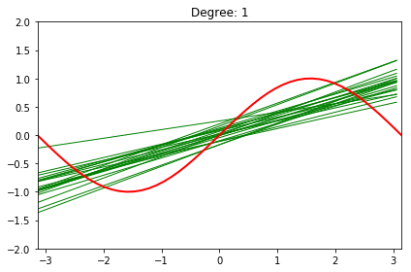
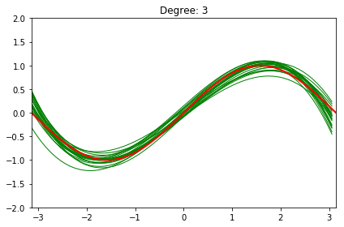
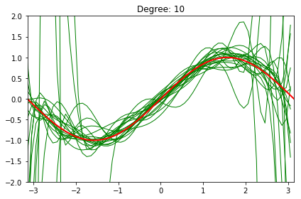
Learning Theory
Learning theory provides a means to understand the generalizability of the model
Model complexity plays a crucial role
Too simple: high bias and underfitting
Too complex: high variance and overfitting

Slide 8
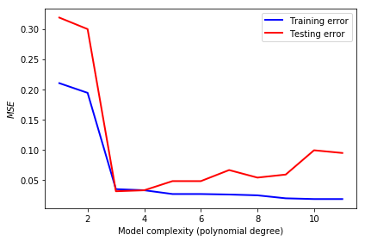
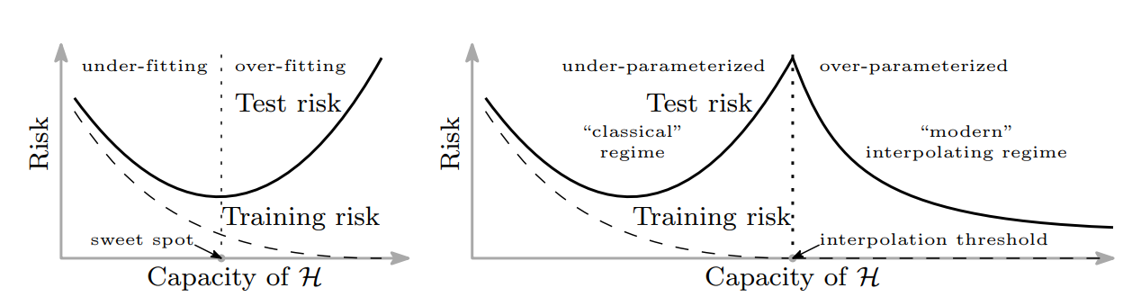
Error Curves and Model Complexity
It is relatively hard to observe the figures showed in the last slide, since normally we will never know the data distribution of ground truth (red line in the last slide)
Instead, we can get those information by observing the training and testing error curve

Slide 9
Double Descent Curves in Modern Machine Learning**
Reconciling modern machine learning practice and the bias-variance trade-off (PNAS’19)
Double-descent curves in neural networks: a new perspective using Gaussian processes (arXiv’21)

Slide 10
Error Curves and Model Complexity
Although the error curve visualizes the impact of model complexity, the bias-variance tradeoff holds only when you have sufficient training examples

Slide 11
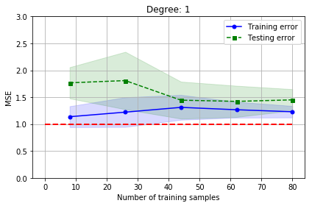
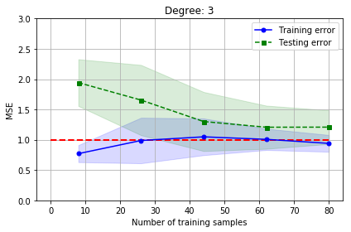
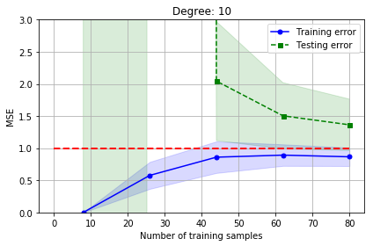
Learning Curves and Sample Complexity
The bounding methods of learning theory tell us that a model is likely to overfit regardless of its complexity when the size of training set is small. The learning curves are a useful tool for understanding how much training examples are sufficient

Slide 12
Outline
Scikit-learn
Learning Theory
Error Curves and Model Complexity
Learning Curves and Sample Complexity
Weight Decay
Ridge Regression
LASSO
Validation
Assignment

Slide 13
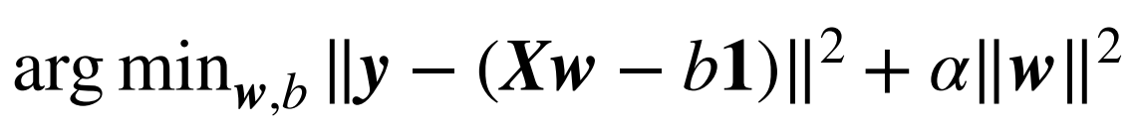

Weight Decay
A common regularization approach. The idea is to add a term in the cost function against complexity
Ridge Regression ($L_{2}$)
LASSO ($L_{1}$)

Slide 14
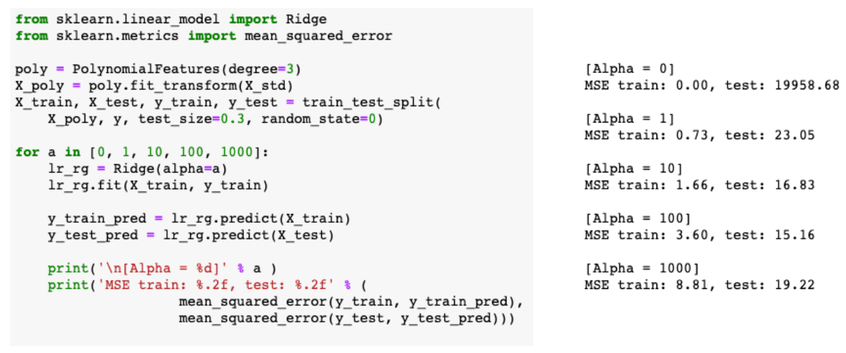
Ridge Regression
A small value α drastically reduces the testing error. Nevertheless, it's not a good idea to increase α forever, since it will over-shrink the coefficients of w and result in underfitting

Slide 15
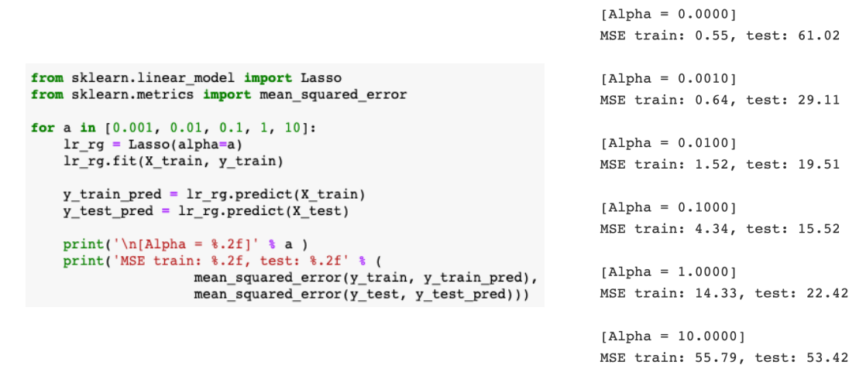
LASSO
An alternative weight decay approach that can lead to sparse w is the LASSO. Depending on the value of α, certain weights can become zero much faster than others

Slide 16
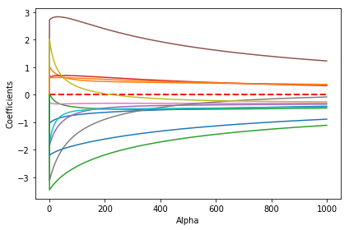
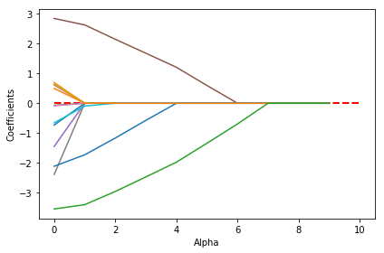
Ridge vs LASSO
Why is LASSO sparse?
Ridge: [0.5, 0.5, 0.5, 0.5]
Initial weights: [1, 0.5, 1, 0.5]
LASSO: [0.5, 0, 0.5, 0]

Slide 17
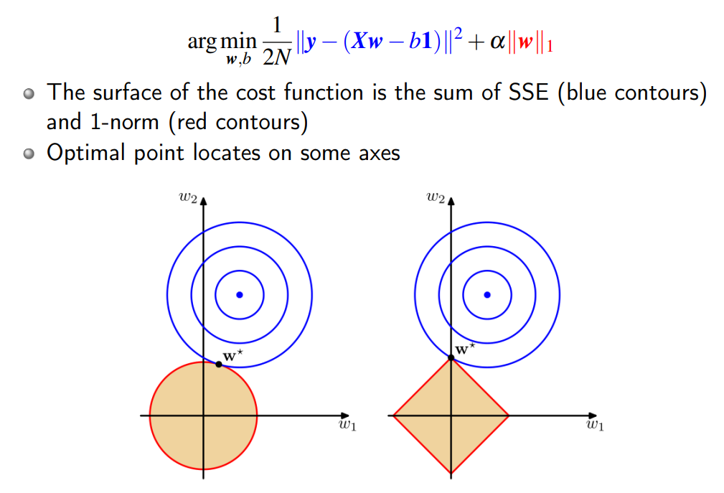
Ridge vs LASSO
Why is LASSO sparse?

Slide 18
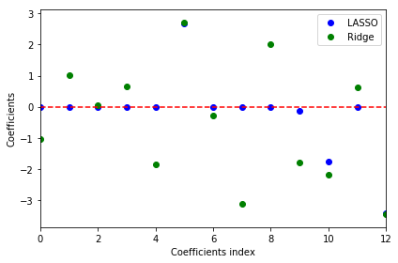
Ridge vs LASSO
LASSO can also be treated as a supervised feature selection technique when choosing a suitable regularization strength α to make only part of coefficients become exactly zeros

Slide 19
Outline
Scikit-learn
Learning Theory
Error Curves and Model Complexity
Learning Curves and Sample Complexity
Weight Decay
Ridge Regression
LASSO
Validation
Assignment

Slide 20
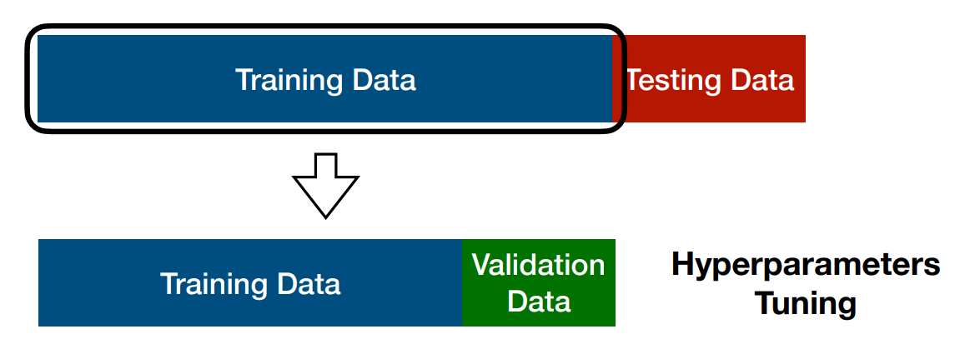
Validation
Another useful regularization technique that helps us decide the proper value of hyperparameters
The idea is to split your data into the training, validation, and testing sets and then select the best value based on validation performance
NOTE: It is important that we should never peep testing data during training

Slide 21
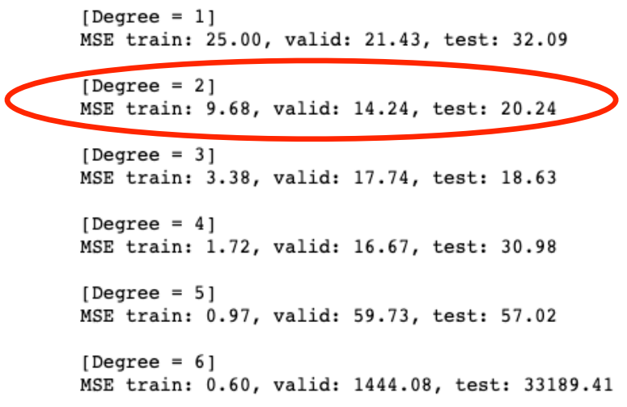
Validation

Slide 22
Outline
Scikit-learn
Learning Theory
Error Curves and Model Complexity
Learning Curves and Sample Complexity
Weight Decay
Ridge Regression
LASSO
Validation
Assignment

Slide 23
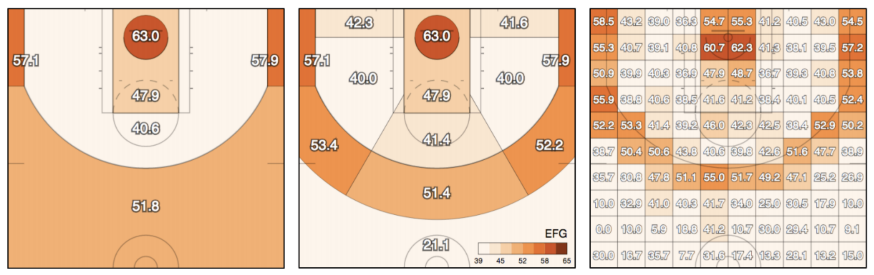
Assignment
In this assignment, we would like to predict the success of shots made by basketball players in the NBA

Slide 24
Assignment
In this assignment, we would like to predict the success of shots made by basketball players in the NBA
y_test is hidden this time
Allow to use any linear model in scikit-learn to achieve the best accuracy
Select the best 3 features, and show the accuracy with only those
Hint
Preprocess the data to help your training
Since you don't have y_test this time, you may need to split a validation set for checking your performance
It is possible to use a regression model as a classifier, for example RidgeClassifier

Slide 25
Assignment
Submit to eeclass with your:
ipynb (Lab05_{student_id}.ipynb)
Prediction (Lab05_{student_id}_y_pred.csv)
The notebook should contain
How you evaluate your model
All models you have tried and the results
Plot the error curve of your best model and tell if it is over-fit or not
The top-3 features you find and how you find it
A brief report of what you have done in this assignment
Please refer to the “Requirements” part in the notebook for more details
Deadline: 2025-09-24 (Wed) 23:59

