Slide 1
Word2Vec
Department of Computer Science, National Tsing Hua University, Taiwan
Deep Learning

Slide 2
Word embedding
How to represent words in machine learning?
My favorite pet is cat .
  Treat words as discrete atomic symbols, and therefore ‘cat’ may be represented as ‘1’ and ‘pet’ as ‘2.’
  However, this embedding includes no semantics. Tasks learning from this representation causes models hard to train.
  Better solutions?

Slide 3
Word embedding
Intuition: Modeling relationships between words.
  Semantics Similarity
    CBOW (Continuous Bag-of-Words model),
    Skip-Gram
  Grammar / Syntax

Slide 4
CBOW & Skip-Gram
Assumptions in CBOW & Skip-Gram:
- Words with similar meaning / domain have the close contexts.
My favorite pet is ___ .
cat, dog

Slide 5
CBOW & Skip-Gram
CBOW: Predicting the target words with context words.
Skip-Gram: Predicting context words from the target words.

Slide 6
CBOW & Skip-Gram
For example, given the sentence:
the quick brown fox jumped over the lazy dog.
CBOW will be trained on the dataset:
([the, brown], quick), ([quick, fox], brown), …
Skip-Gram will be trained on the dataset:
(quick, | the), | (quick, | brown), | (brown, | quick),
(brown, | fox)…

Slide 7
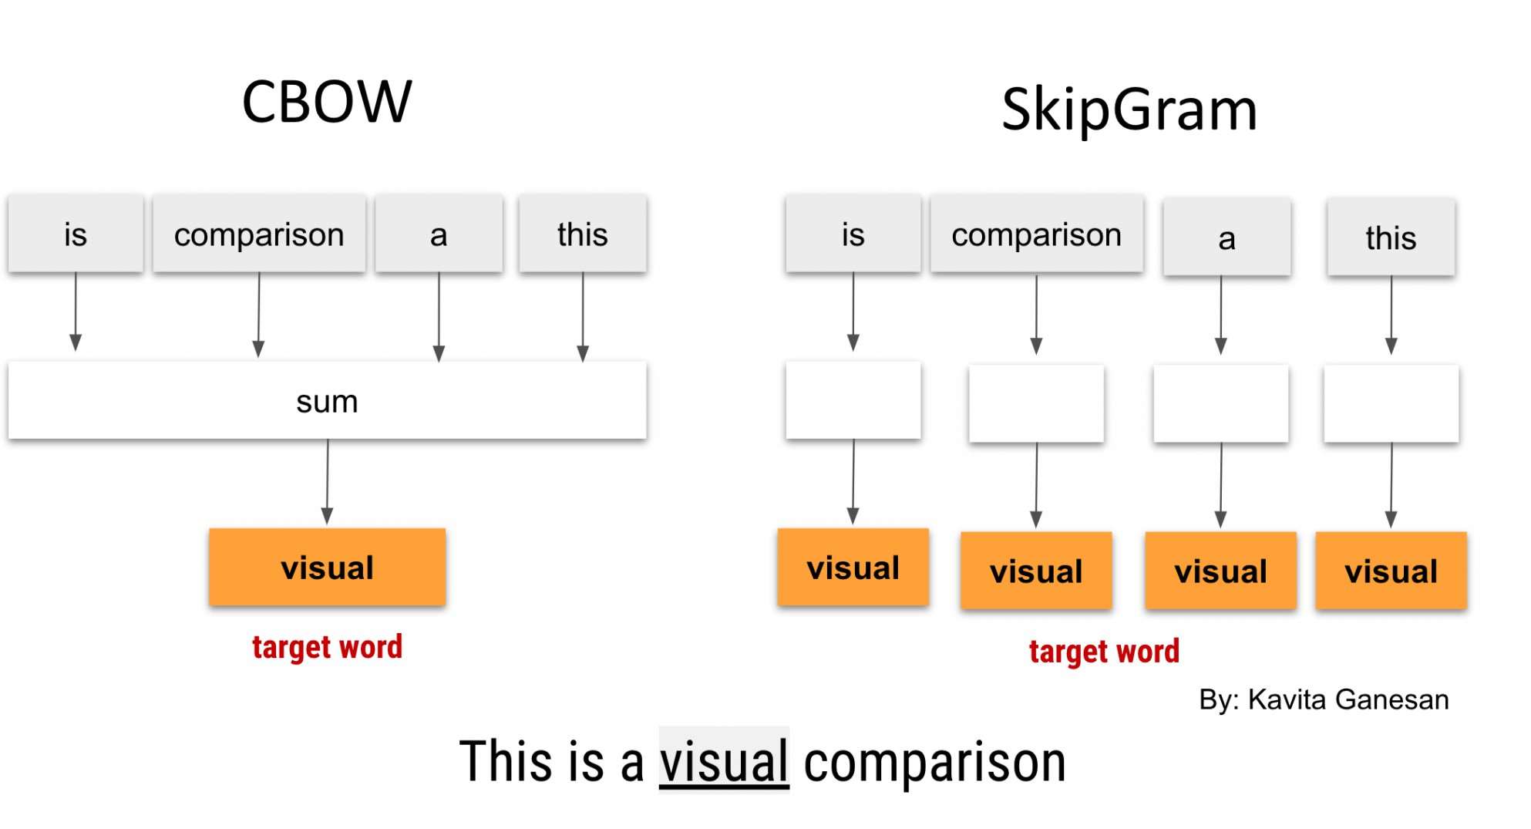
Picture from https://kavita-ganesan.com/

Slide 8
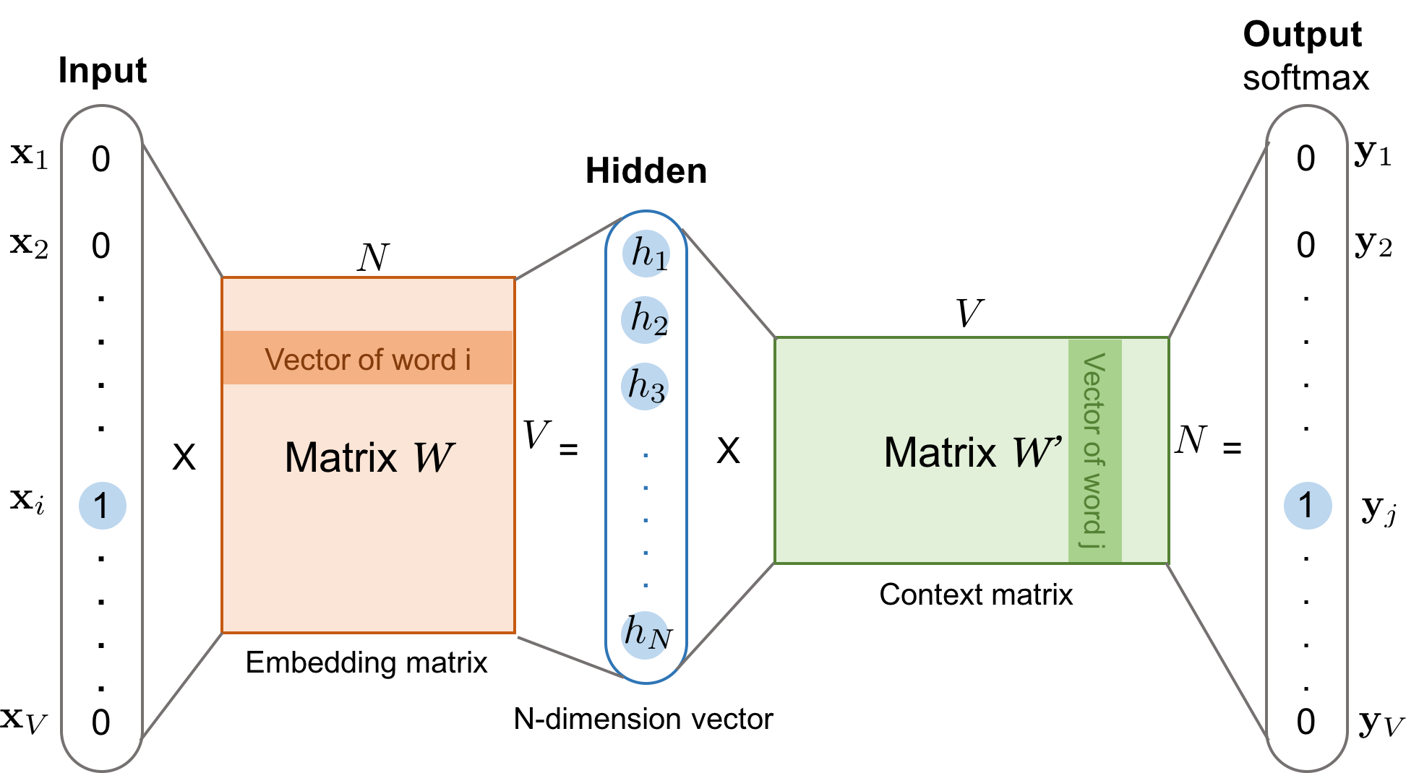
Skip-Gram
Picture from https://lilianweng.github.io/

Slide 9
Softmax & Words classification
Recap the softmax function:
_{e}z_{i}
σ(z)_{i} =
∑
K
e
z
j=1
j
While training the embedding, we need to sum over the entire vocabulary in the denominator, which is costly.
exp(h⊤v_{w′})
p(w = i | x) = ^{i}
∑_{j∈V} exp(h⊤v_{wj′})
V | (vocabulary size) is thousands of millions

Slide 10
Noise Contrastive Estimation
Intuition: Estimate the parameters by learning to discriminate
between the data
and some artificially generated noise ˜ .
maximum likelihood estimation → noise contrastive estimation
Objective function:
N
arg max log p(d = 1 | w_{t} , x) + ∑ log p(d = 0 | w˜_{i}, x)
Derive form:
w˜_{i}~Q
p(w_{t} | x)
N
∑
w˜_{i}~Q
Nq(w˜_{i})
arg max log
+
log
p(w | x) + Nq(w˜ )
p(w | x) + Nq(w˜ )
t
t
i

Slide 11
Noise Contrastive Estimation
Intuition: Estimate the parameters by learning to discriminate
between the data
and some artificially generated noise ˜ .
maximum likelihood estimation → noise contrastive estimation
After training: evaluate with softmax function.

Slide 12
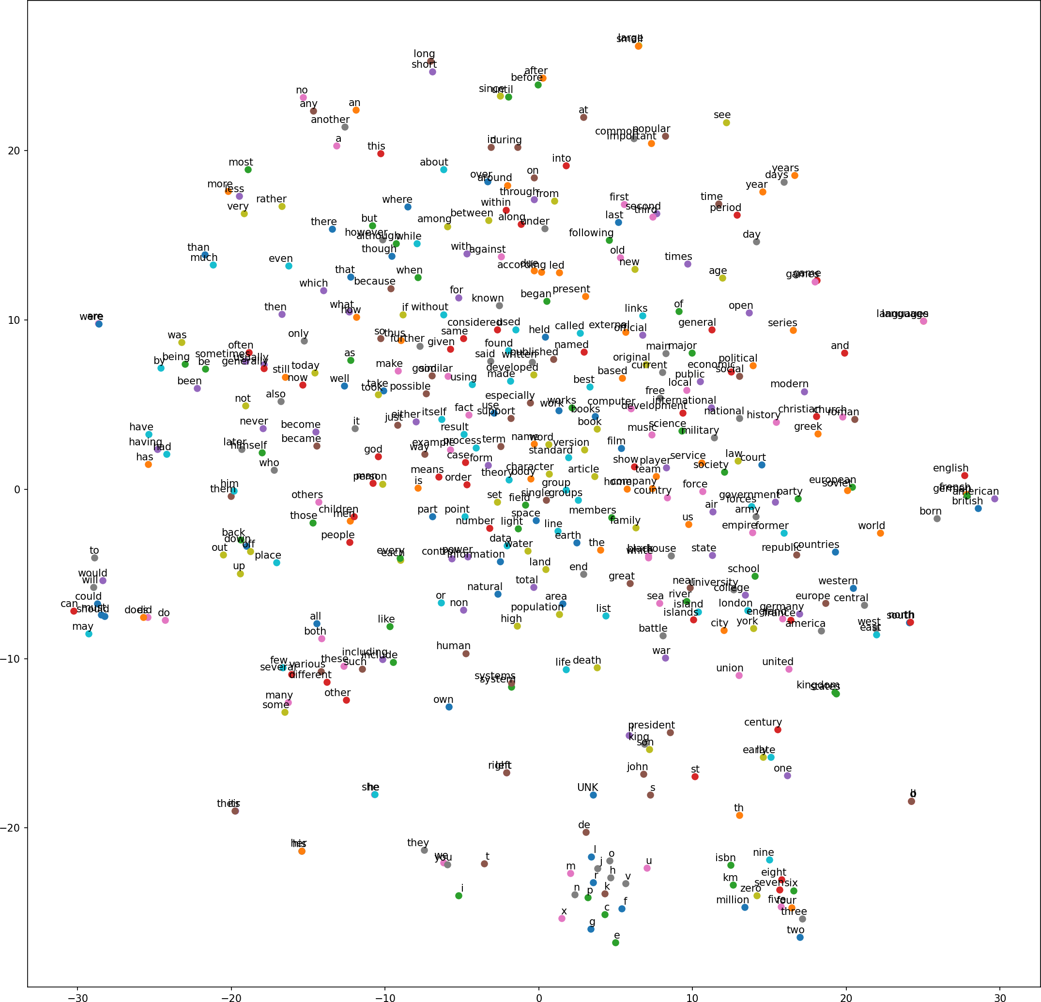

Slide 13
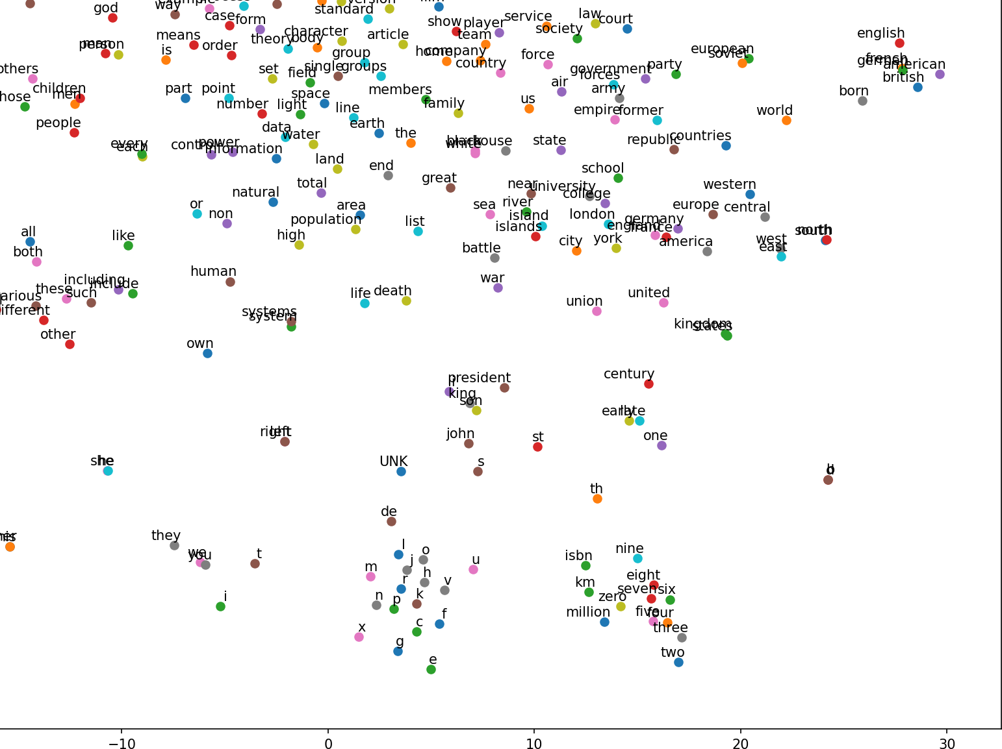

Slide 14
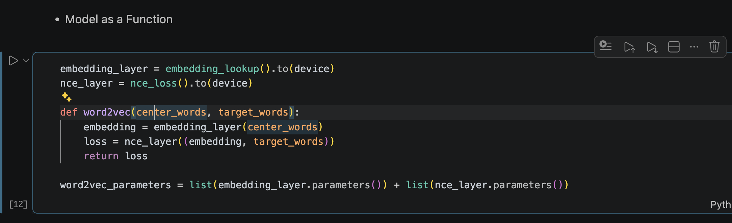
Homework

Slide 15
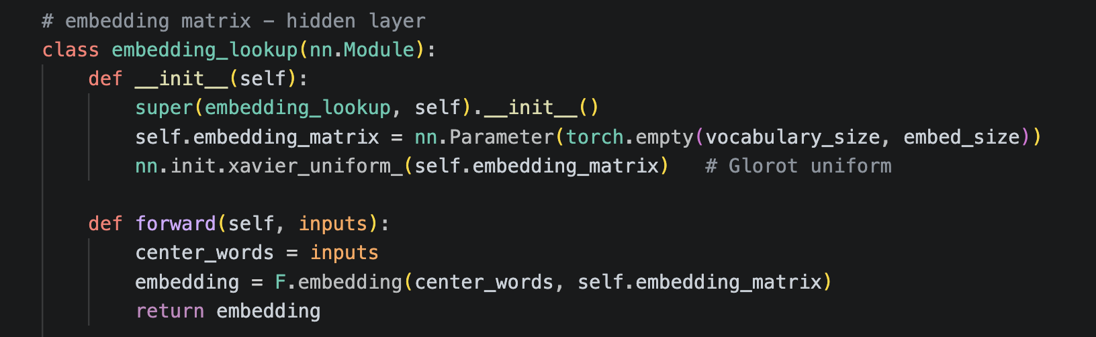
Homework
Model subclassing:

Slide 16
Reference
https://ruder.io/word-embeddings-softmax/ index.html#noisecontrastiveestimation
https://lilianweng.github.io/lil-log/2017/10/15/learning-word-embedding.html
https://aegis4048.github.io/optimize_computational_efficiency_of_skip- gram_with_negative_sampling
http://proceedings.mlr.press/v9/gutmann10a/gutmann10a.pdf
https://papers.nips.cc/paper/5165-learning-word-embeddings-efficiently-with- noise-contrastive-estimation.pdf
https://docs.pytorch.org/tutorials/beginner/basics/buildmodel_tutorial.html

