Slide 1
Git Installation
Software Studio DataLab, CS, NTHU

Slide 2
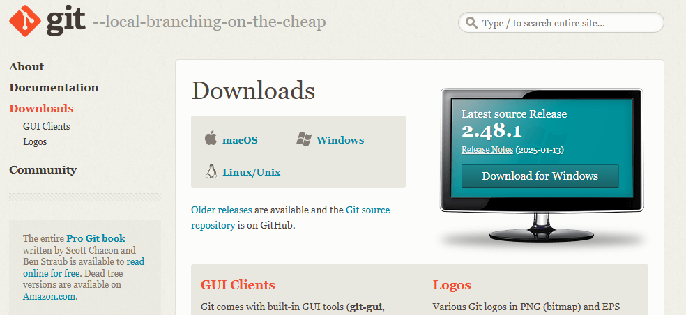
How to Install
Download from the link below and select the correct OS based on your requirements.
https://git-scm.com/downloads

Slide 3
How to Install
•
Ubuntu/Debian:
sudo apt-get install git
Centos:
sudo yum install git
Mac:
•
•
Might be installed if you have XCode, if not:
install Homebrew first
then type "brew install git" in terminal

Slide 4
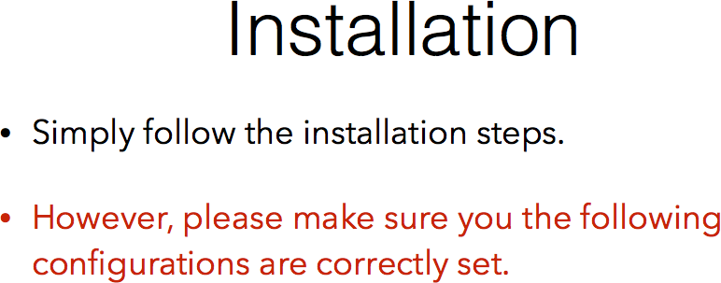

Slide 5
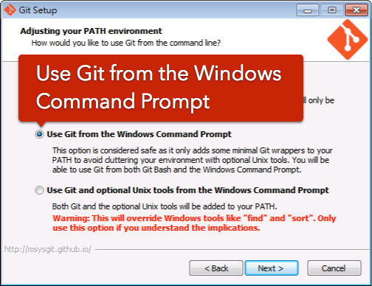

Slide 6
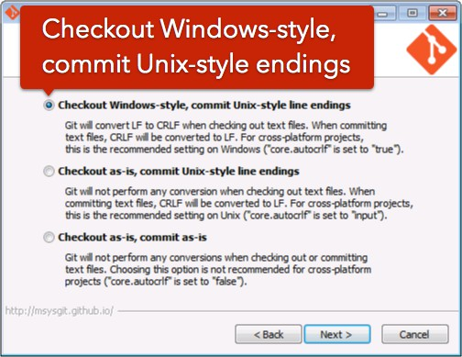

Slide 7
What‘s Next ?
Setup your information in Git
Your name
Your email
This is for identifying yourself in commits, allowing others to see who made each change in a repository.

Slide 8
