Slide 1
Lab 00 How to Survive &
Introduction to Git
Software Studio DataLab, CS, NTHU

Slide 2

Teaching Assistants

Slide 3
How to Find Us?
Office Hour (TAs)
- Thu. 10:10am-12:00pm at Delta 724
Email
‐ ssta2026@datalab.cs.nthu.edu.tw
Online Forum
- eeclass

Slide 4


If I have Question?

Slide 5

If I have Question?
Always Google or ask Chatgpt first!
Learn how to google and generative AI is important.
If you try your best but still can’t catch it.
Feel free to ask us on eeclass or office hour.

Slide 6
Today’s exercise
Install Git command line tool in your computer
Follow appendix “Git Command-line Tool Installation”.
Try to submit in GitLab.
Set up flutter environment (If we have time)

Slide 7
Outline
General Rule
Introduction to Git
Version control
Branch and merge
How to Submit Your Code to Gitlab
Tools & References

Slide 8
Outline
General Rule
Introduction to Git
Version control
Branch and merge
How to Submit Your Code to Gitlab
Tools & References

Slide 9
The Policy of Labs
All labs need to be submitted to GitLab.
Late submission will not be accepted.
Only whitelist website allowed (announce at the bottom of the lab page)
If we find you open the website not in the whitelist, you will get 0 point for that lab
Plagiarism will not be tolerated.
If we find you copy someone’s code, you will get
0 point for that lab.

Slide 10
The Policy of Labs
Grading
Submission before lab ends gets 100% score
Submission before 11:59pm gets 60% score

Slide 11
Grading Example
4 problems, 25% each
Solved 4 during the lab
- 100
Solved 3 during the lab, 1 before 11:59pm
- 75 + 25*0.6 = 90
Solved 4 after the lab, before 11:59pm
- 100 * 0.6 = 60

Slide 12
Outline
General Rule
Introduction to Git
Version control
Branch and merge
How to Submit Your Code to Gitlab
Tools & References

Slide 13
Why should we use version control?

Slide 14
We want to track what we did and when we did it.

Slide 15
Why use version control system?
Managing your projects - tracking your files and modifications.
Synchronization between modifications made by different developers.
Revision history is still very helpful even if you work alone.

Slide 16

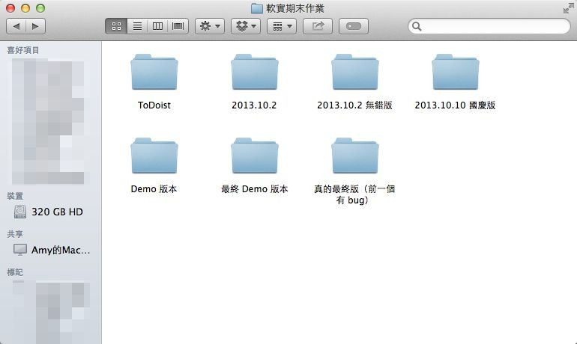
Students’ VCS

Slide 17

Git

Slide 18
Git
Git is a popular version control system which is
Fast
Easy to use
Distributed
A git repository is a mini database that tracks your files.

Slide 19


Be Professional

Slide 20
Outline
General Rule
Introduction to Git
Version control
Branch and merge
How to Submit Your Code to Gitlab
Tools & References

Slide 21
Git VCS (1/2)
With a local repository in your computer, you’ll need following operations to make git track your work:
Create/modify files
Let git monitor the files by adding them to staging files.
Commit your changes to and git will create snapshots (versions) of the files for you.

Slide 22



Git VCS (2/2)
Modifying Files
2. add
1. modify file
Staging Modified Files
Committing A Version
3. commit
Committing B Version

Slide 23
Basic Git Commands
git init
Initialize a repository at current directory.
git add [file_name] ( * git add . * → means add all files )
Add files to git repository and let git track them.
git commit -m "commit messages"
Save the changes to the git repository and create snapshots of the files.
git checkout [version]
Go to a specific version.

Slide 24
scenario
Create a project repository and initialize Git, and track the HelloGit.txt file for version control.

Slide 25
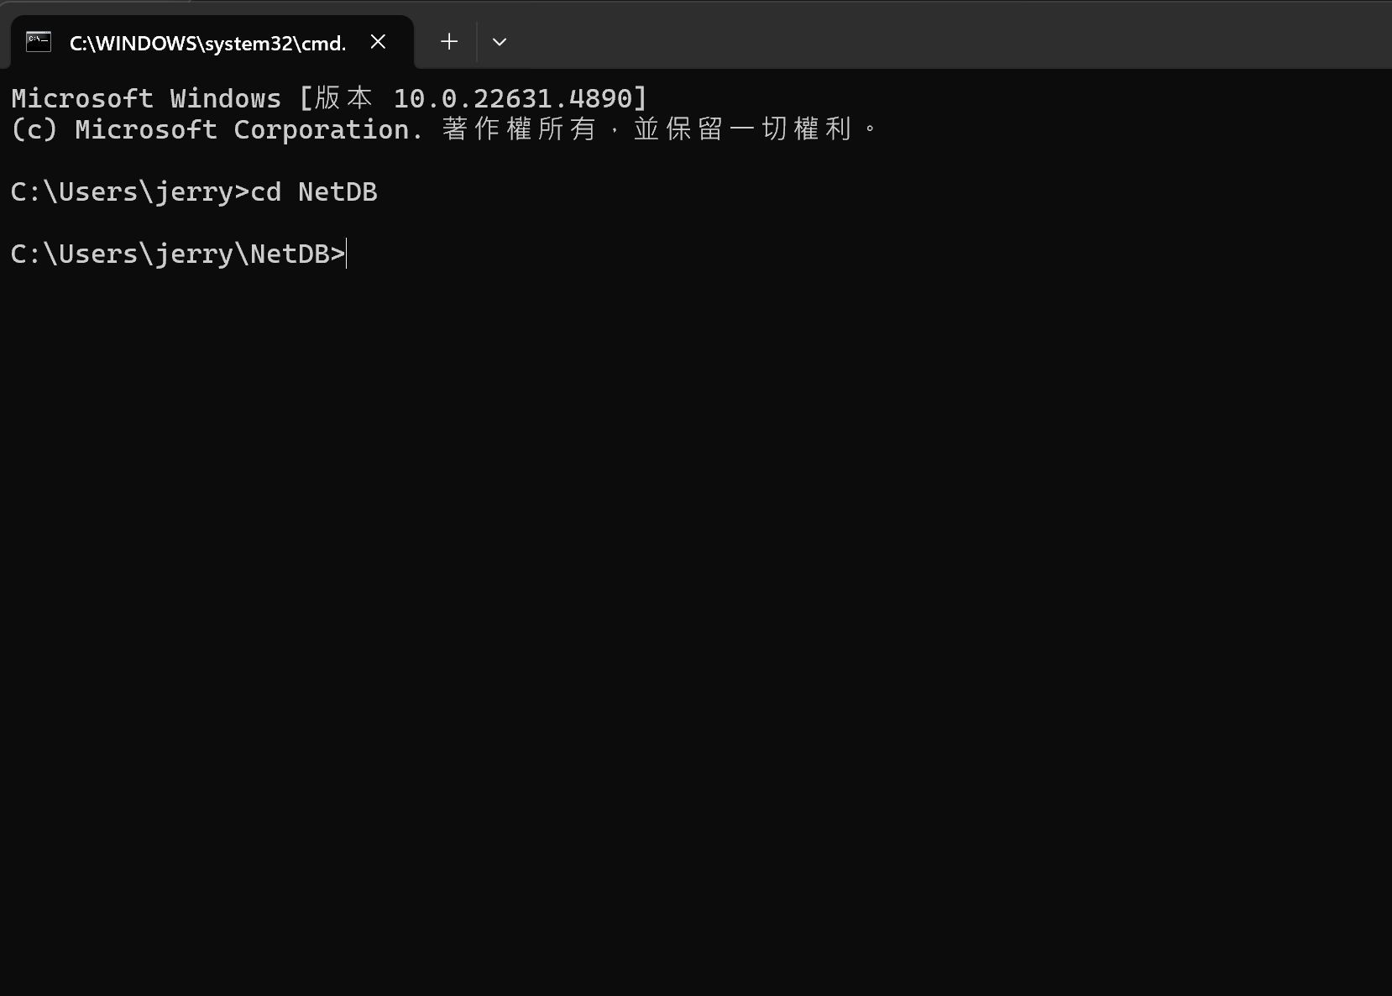
1. Navigate to the repository where you want to place the project.

Slide 26
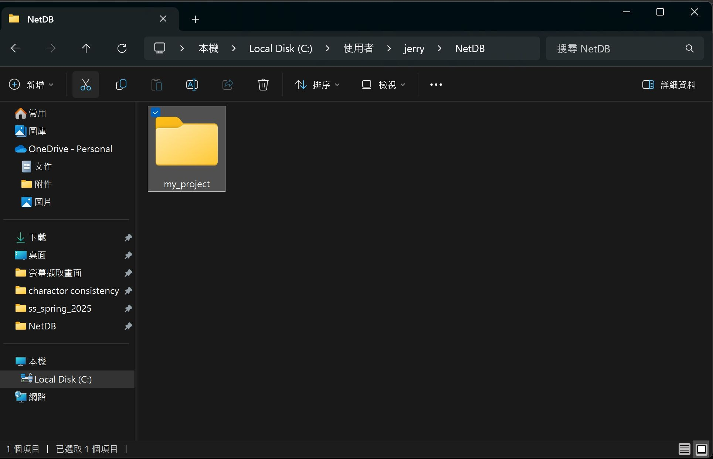
2. Create a folder for your project.

Slide 27
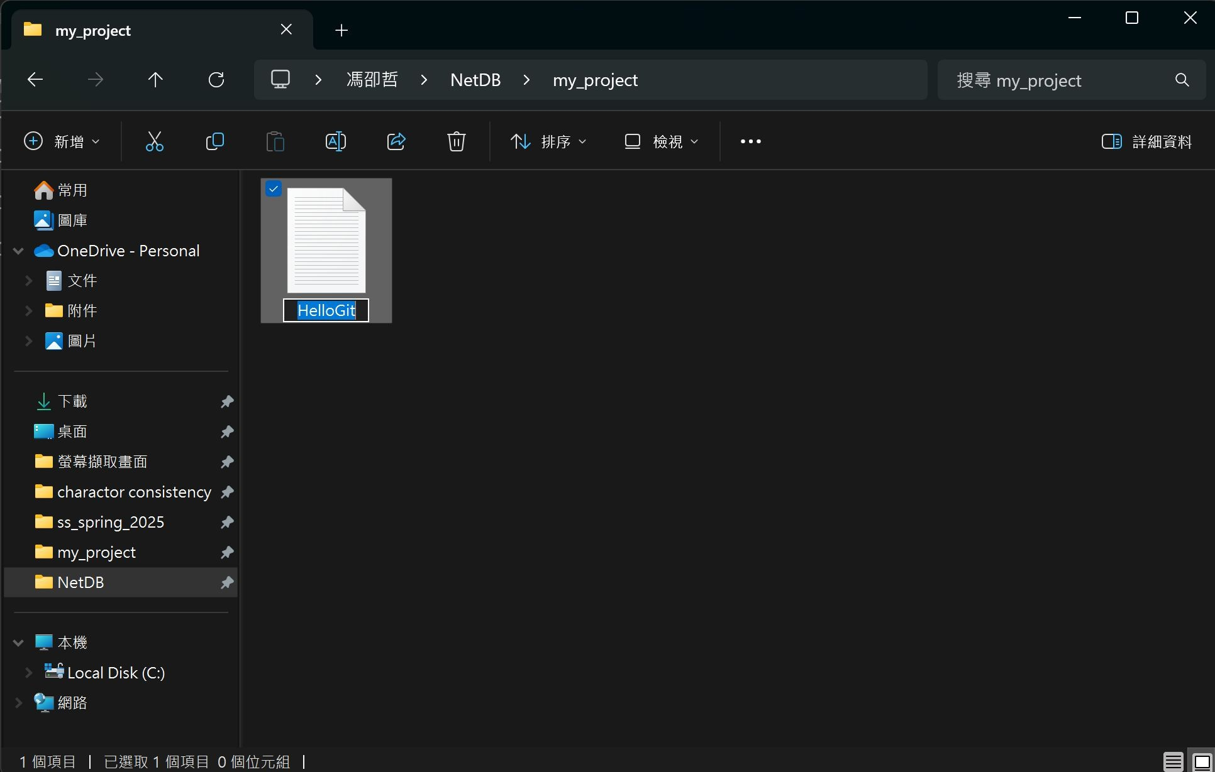
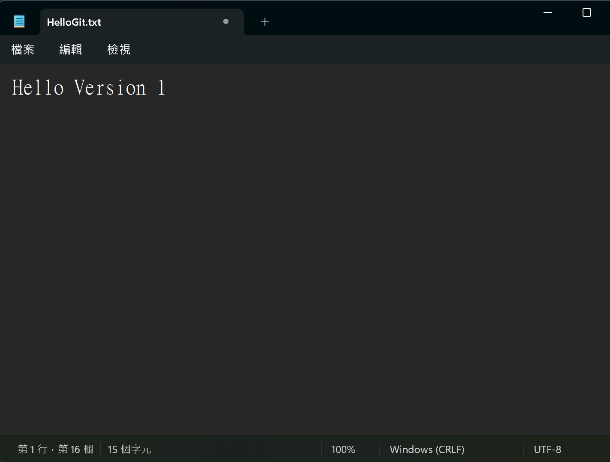
3. In your project folder create a HelloGit.txt file.
4. Write something in the HelloGit.txt file.

Slide 28
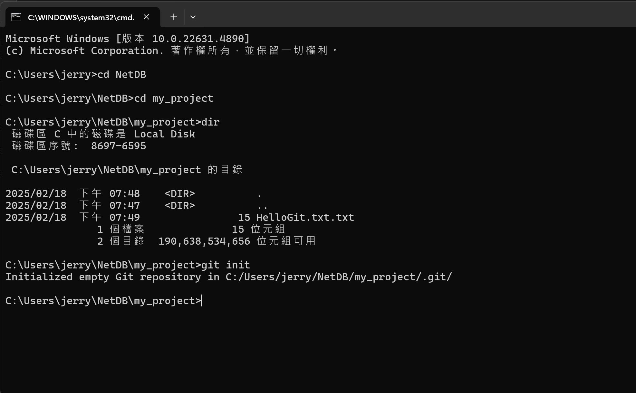
Navigate to the project fold.
Use the ‘’dir’’ command to list the contents of a folder. (if windows)
7. Use the ‘’git init’’ command to initialize a Git repository.

Slide 29
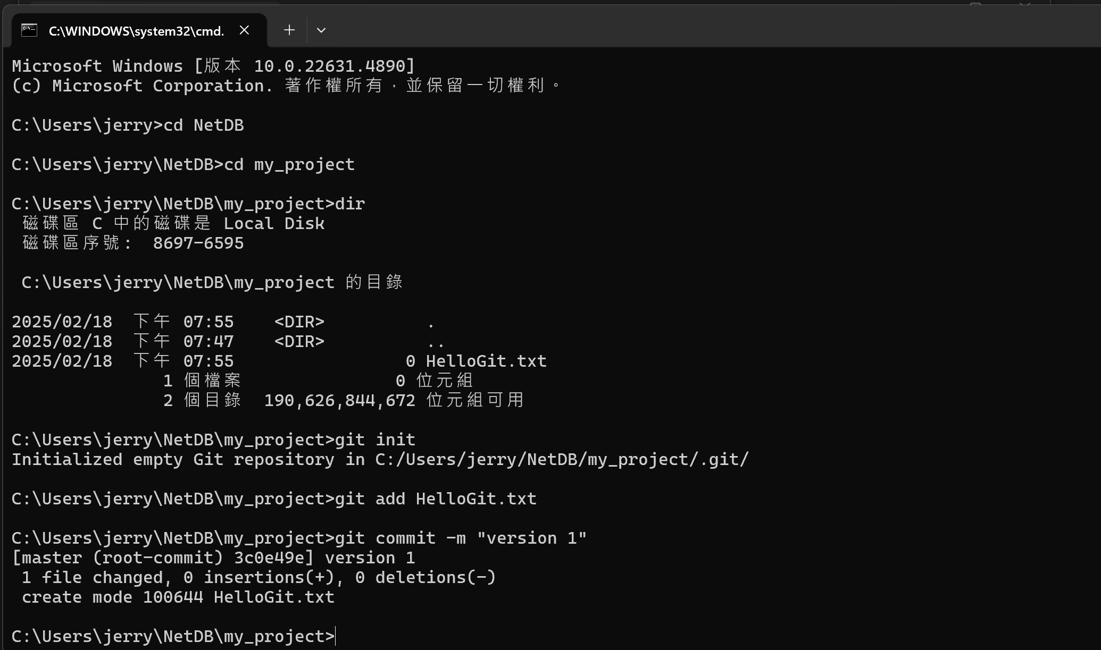
8. Use the ‘’git add’’ command to add HelloGit.txt to staging file.
9. Use the “git commit –m” command to commit the change.

Slide 30
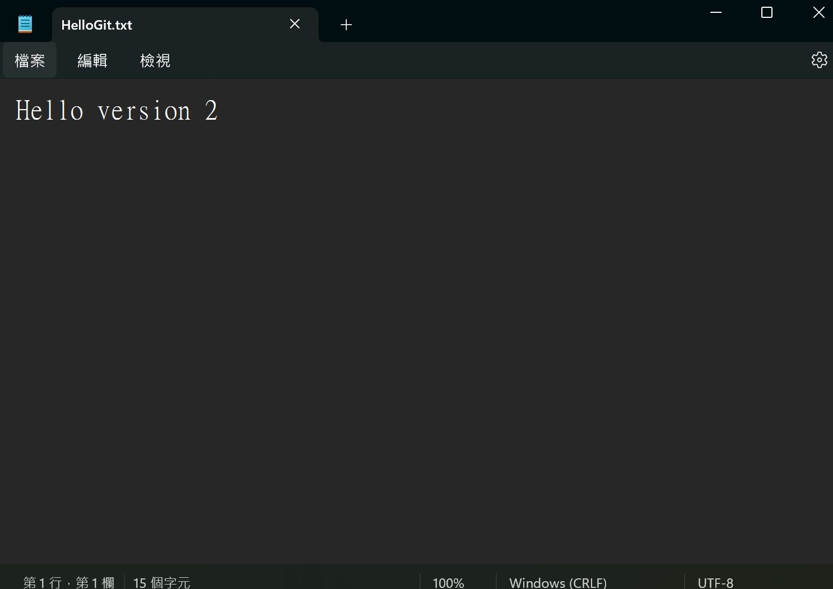
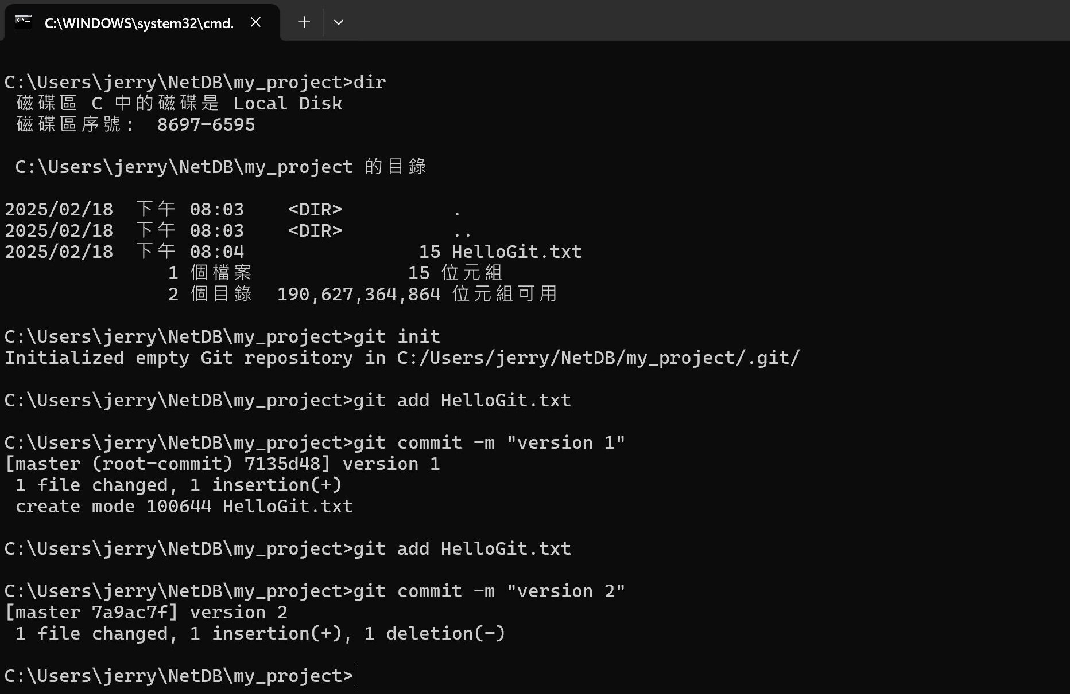
10. Modify the hello.txt and save the change.
11. Add It and commit again.

Slide 31
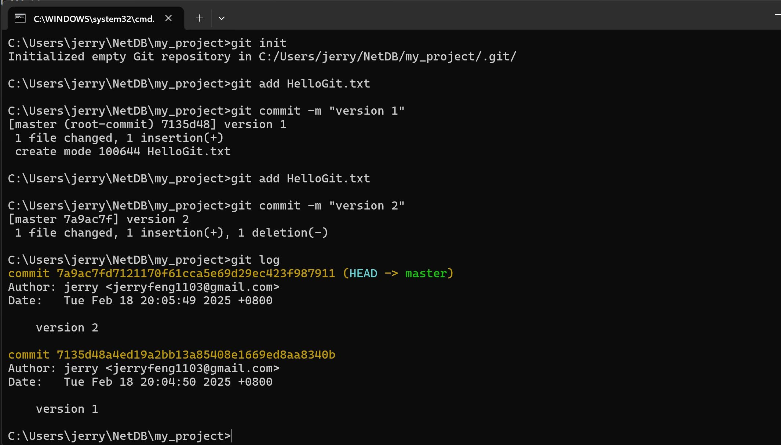
10.Use the ‘’git log’’ command to view your versions.
Head:
A reference to where you are currently working on.
Master:
The default branch in a Git repository, typically where the final, stable version of the project is maintained.

Slide 32
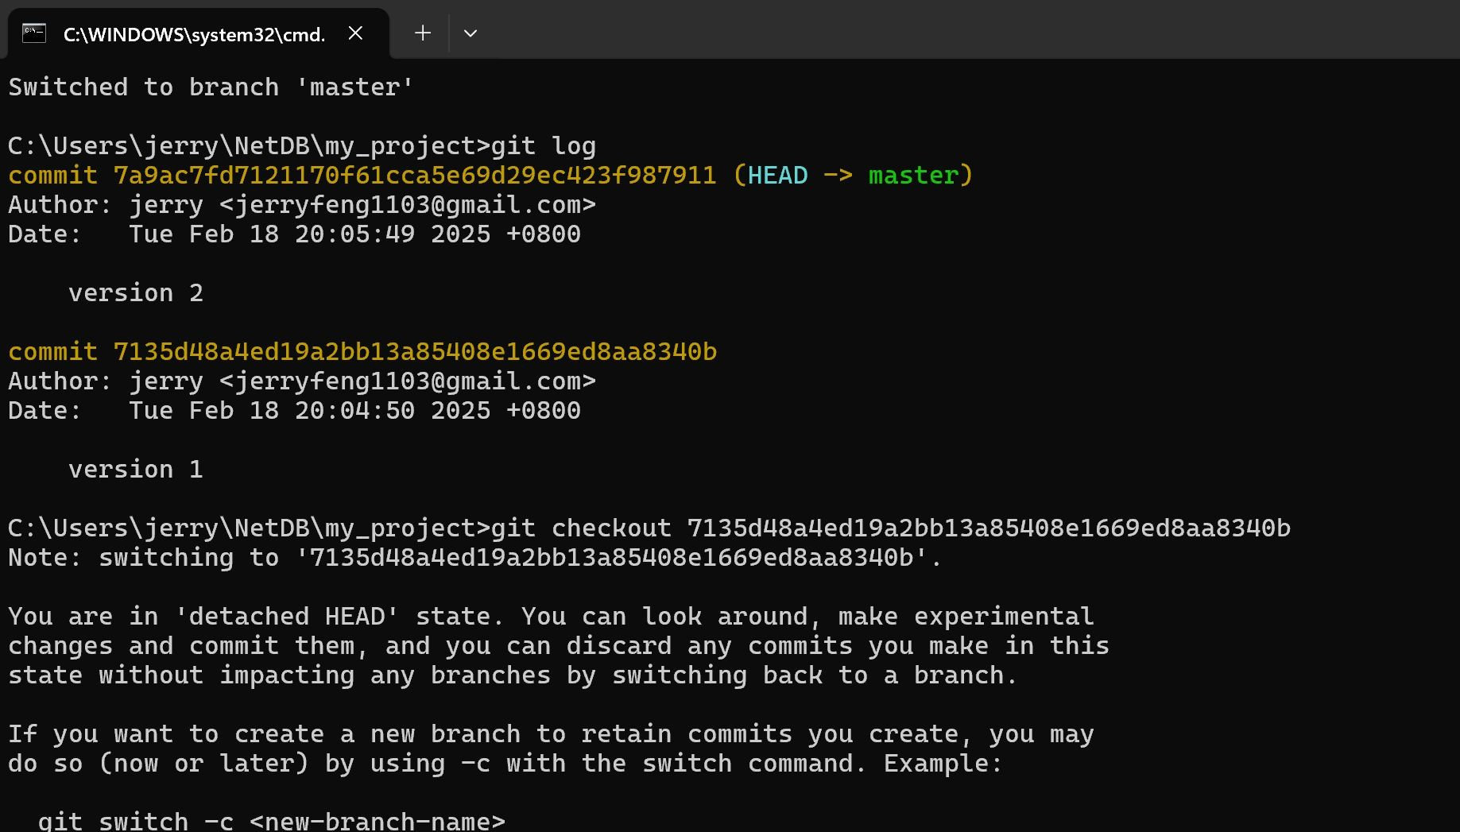
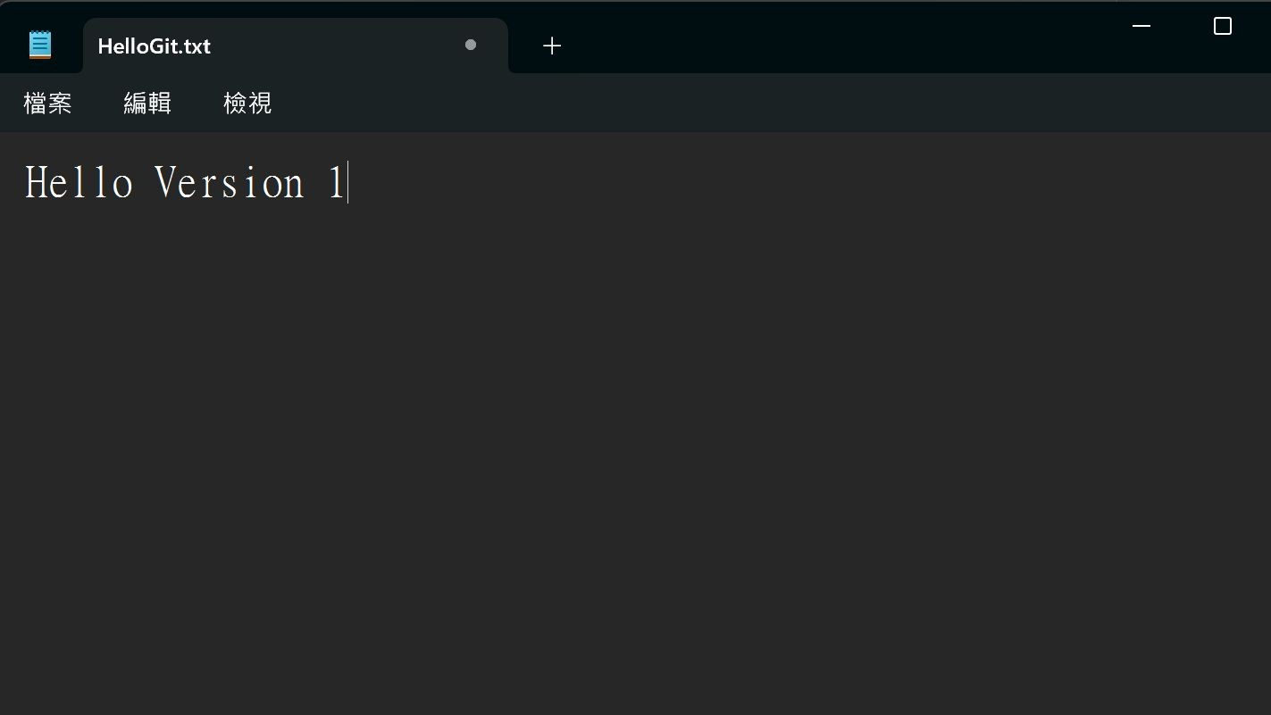
Version ID
11. Go to specific version with the ‘’git checkout’’ command and version ID
12. Reopen the HelloGit.txt find yourself back to version 1 !
31

Slide 33
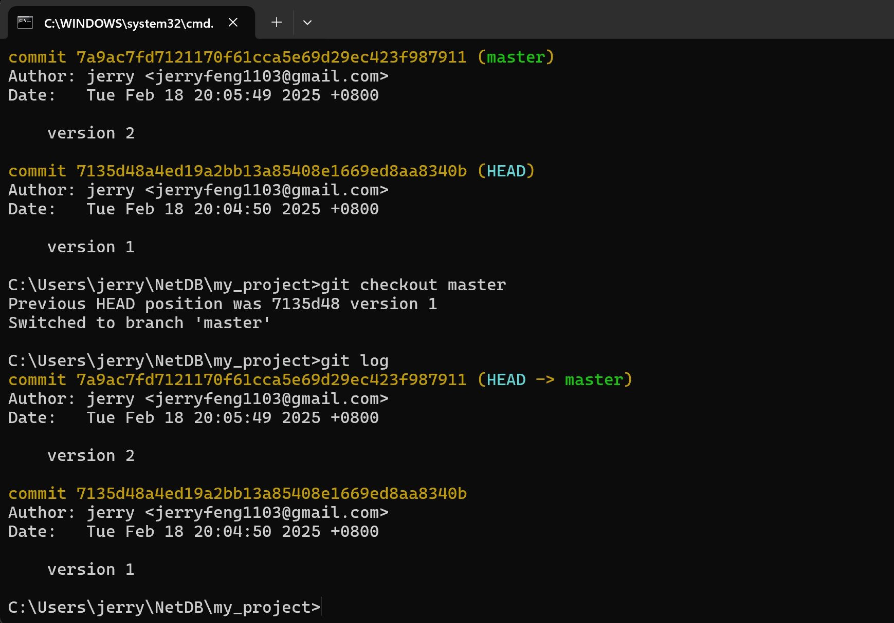
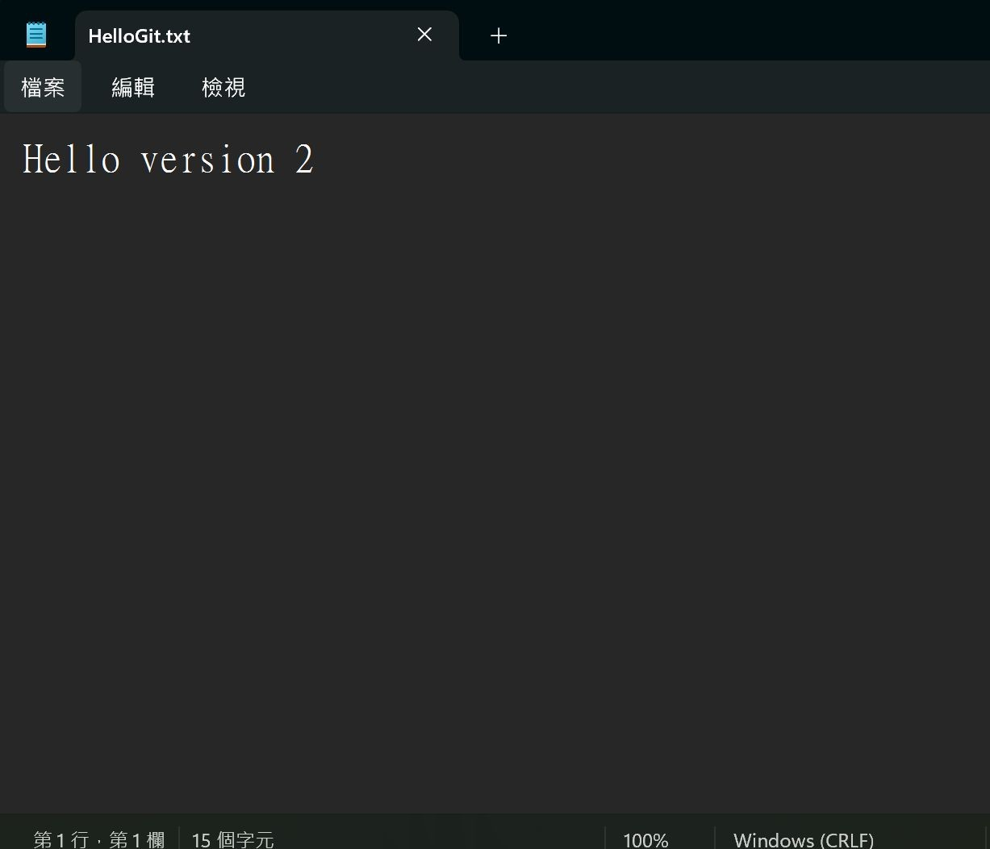
13. Use the “git checkout master” command to go back to the final vesion of your project
14. Reopen the HelloGit.txt again. Back to the lastest version.

Slide 34
LIFE IS
TOO SHORT TO TYPE THAT VERSION ID!
which is 40 characters long…

Slide 35
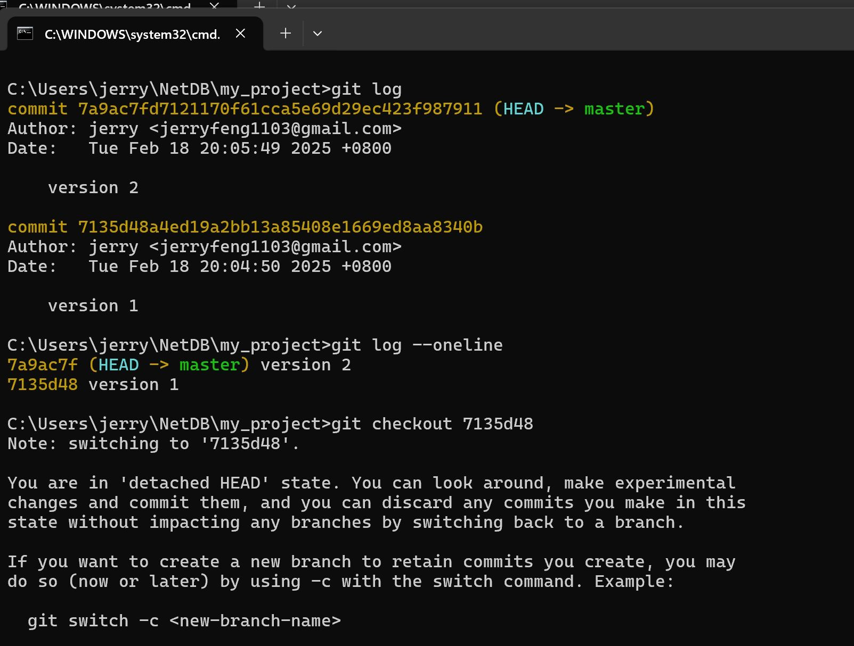
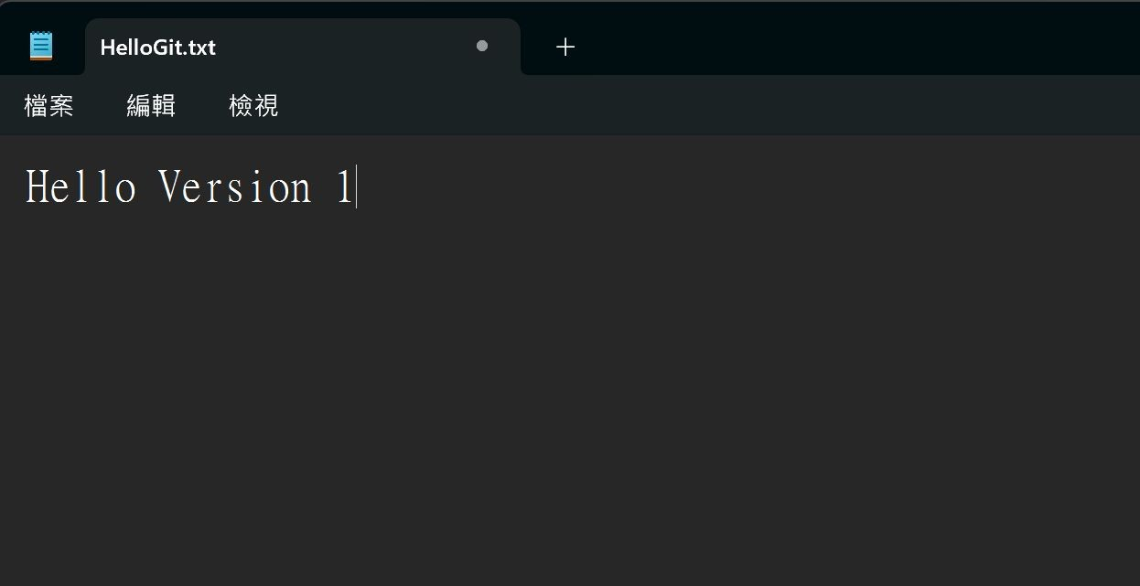
15. Use the ‘’git log --oneline’’ command to get the shorter version ID.
16. Use shorter version ID to check specific version.

Slide 36
Outline
General Rule
Introduction to Git
Version control
Branch and merge
How to Submit Your Code to Gitlab
Tools & References

Slide 37


Git Branch
Master
Branching
Merging
Develop

Slide 38
Git commands (1/2)
Branching steps
Creating a new branch
git branch [branch name]
Checking out the branch
git checkout [branch name]

Slide 39
Git commands (2/2)
Merging steps
Checking out a branch to merge
git checkout [branch 1 name]
Merging another branch
git merge [branch 2 name]

Slide 40
scenario
Assume you are working on a new feature in a Git repository and want to create a separate branch work on it and then merge it back into master branch
•

Slide 41
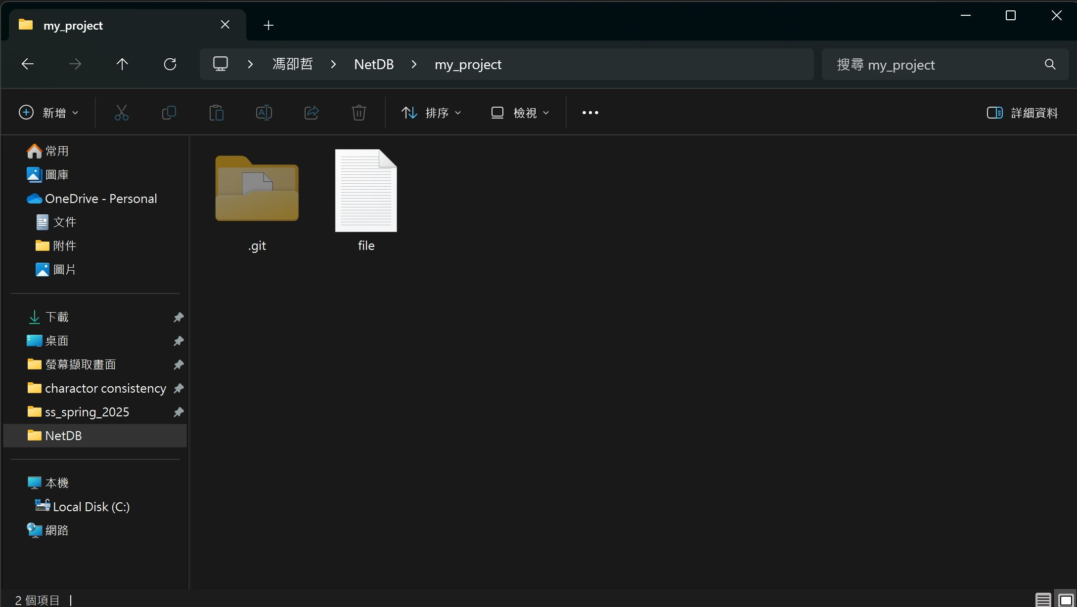
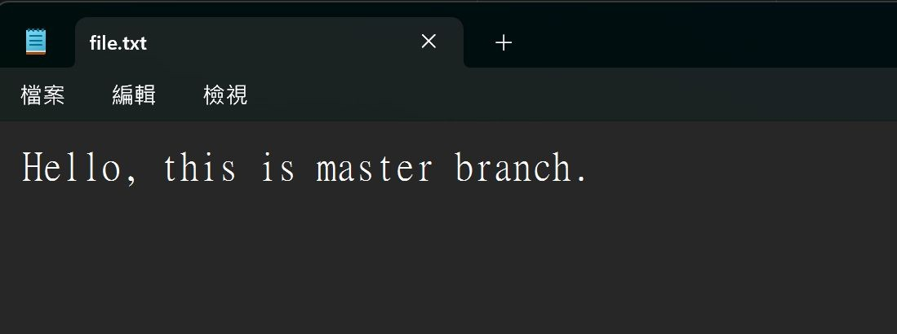
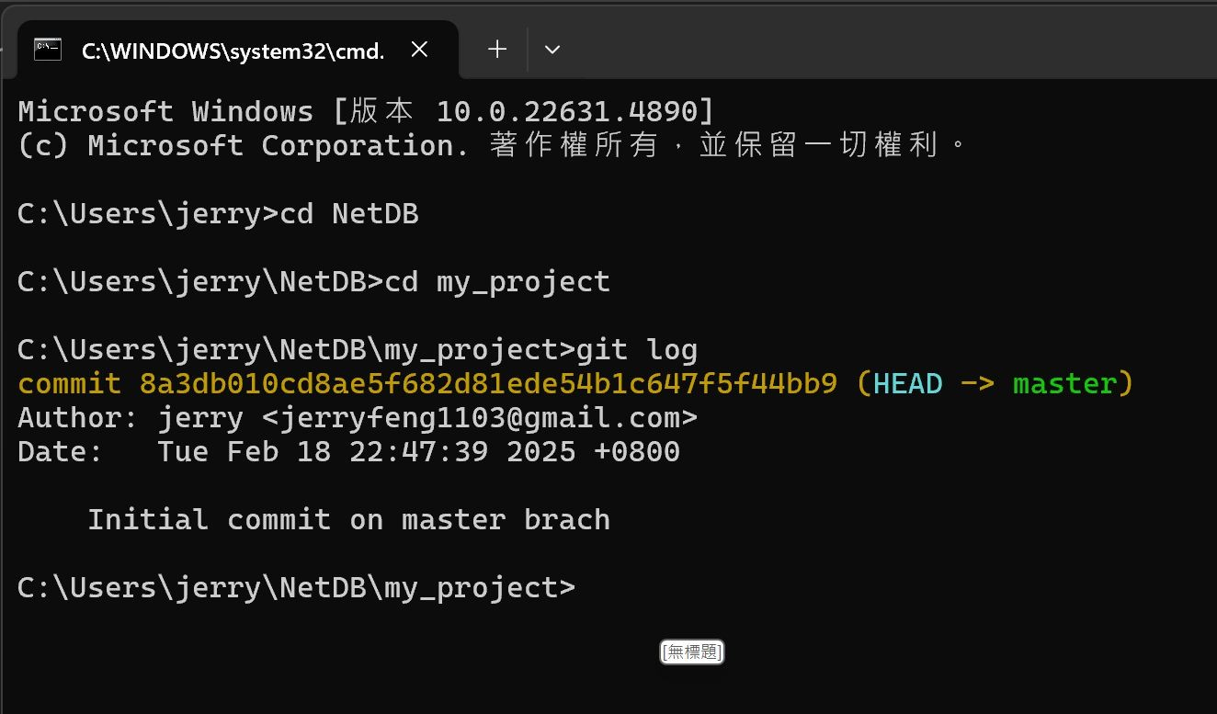
Initial content in file.txt
Initial log of master branch
1. Initially there is a file.txt in ~.\NetDB\my_project with git already initalized

Slide 42
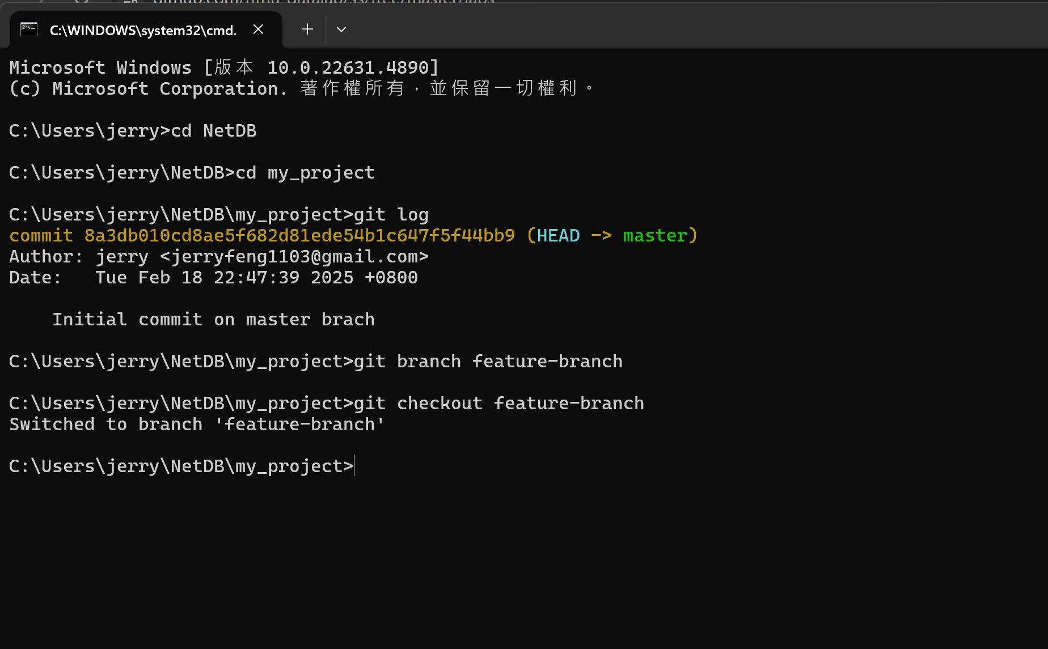
2. Create a new Branch using the “git branch [branch name] ” command
3. Switch to the new branch using the “git checkout [branch name] ” command

Slide 43
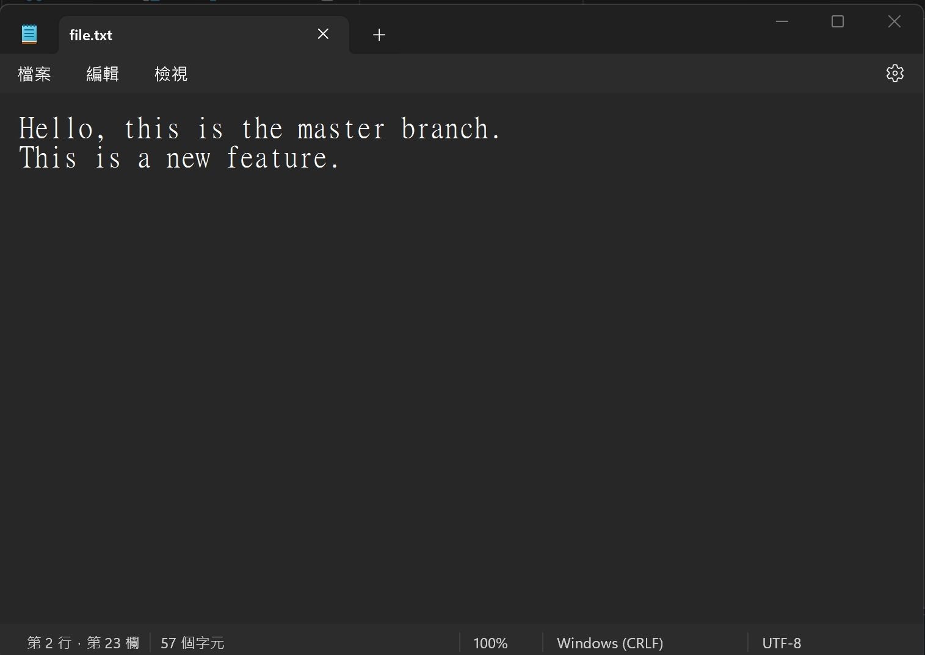
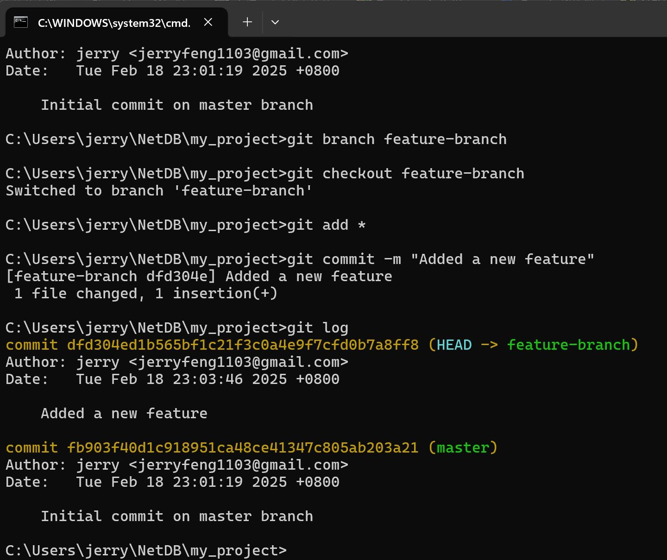

4. Make Changes in the feature branch
5. Add and commit the check in feature branch. (use ‘’git add *’’ to stage all files in the current directory)
Since we already switch to feature branch. ‘’git log” will show the log in feature branch

Slide 44
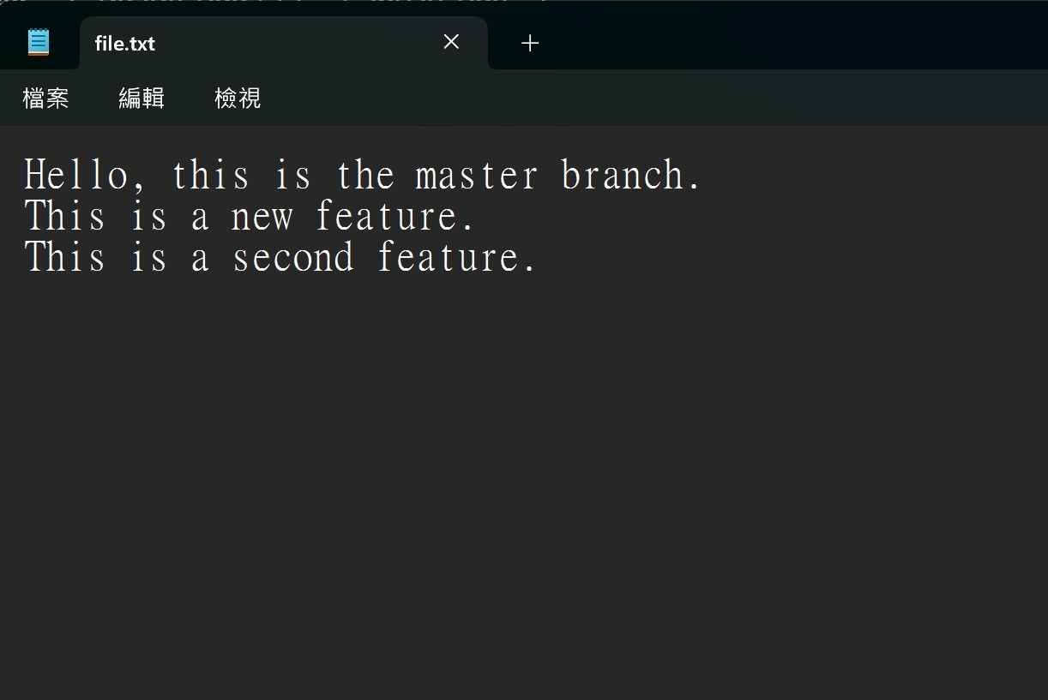
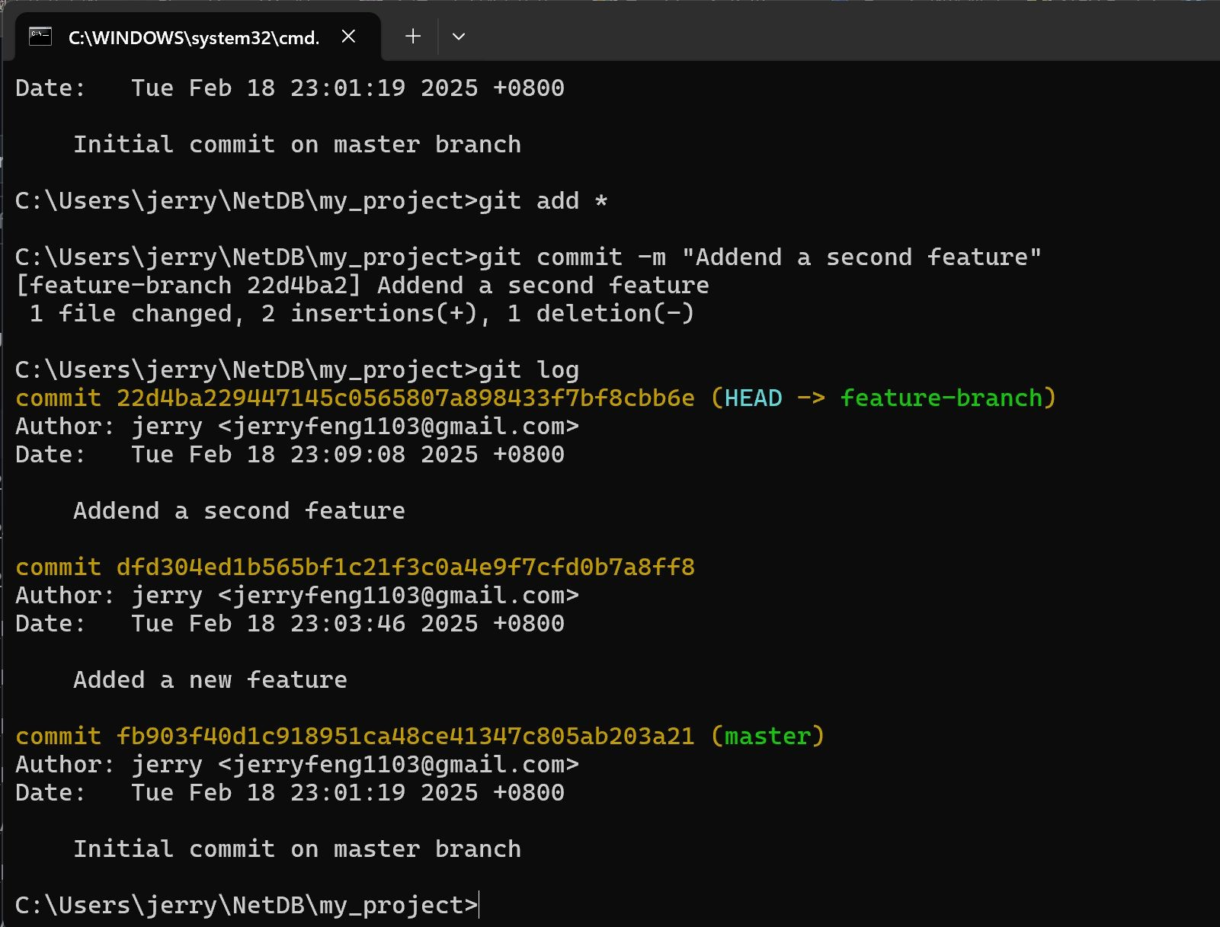
6. Perform another change, repeat the previous steps, and observe the Git log.
43

Slide 45
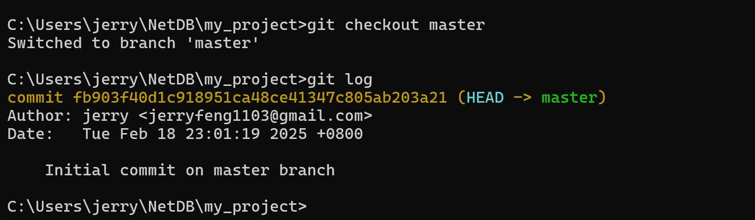
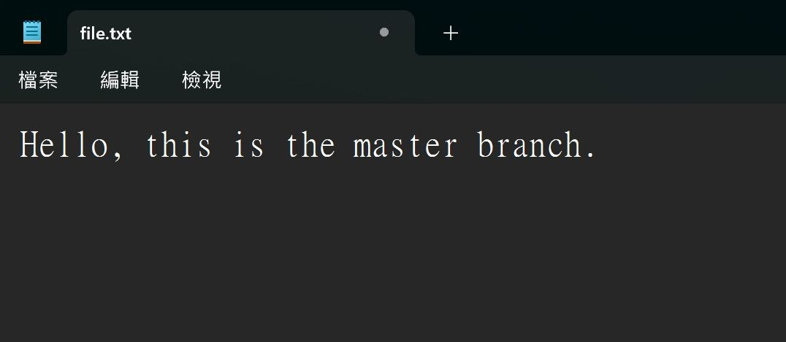
7. Switch Back to master branch
8. The log remains unchanged in the master branch."
9. Reopen the file.txt and the content go back to initial

Slide 46
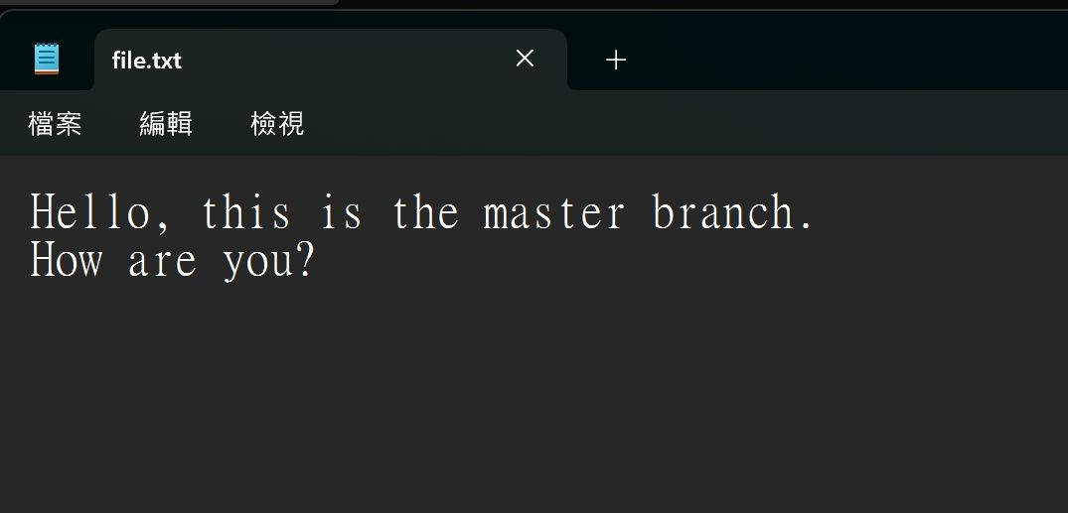
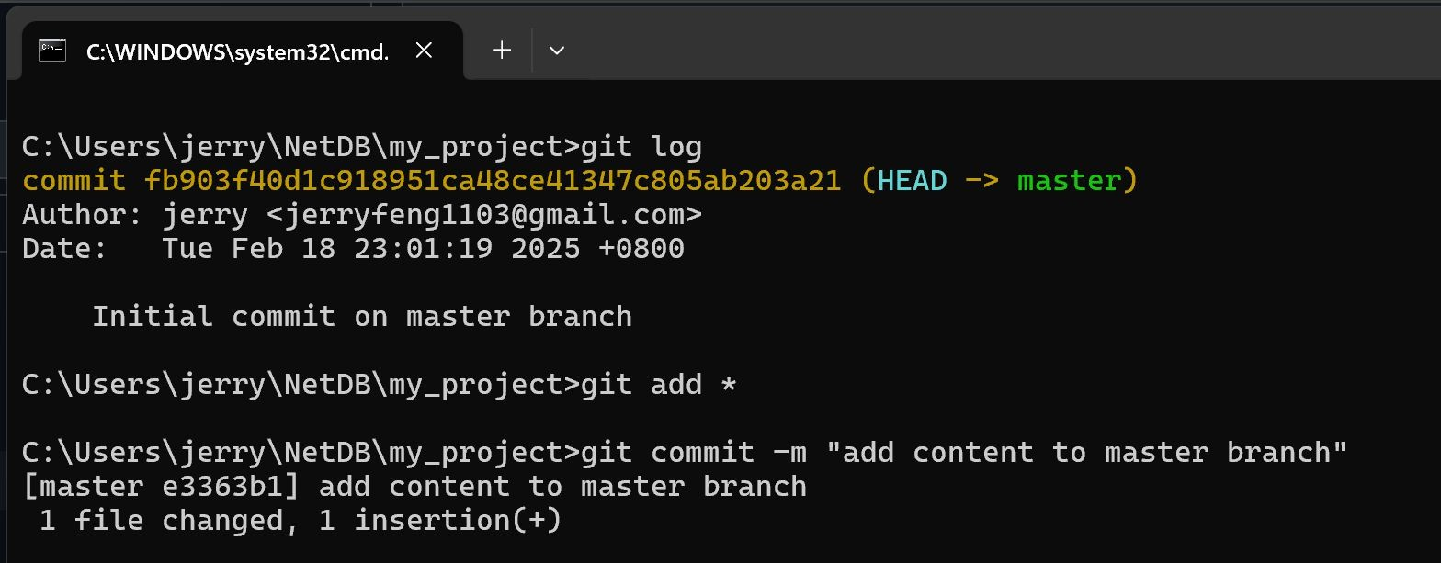
10. Try to also make change in master branch and commit the change

Slide 47
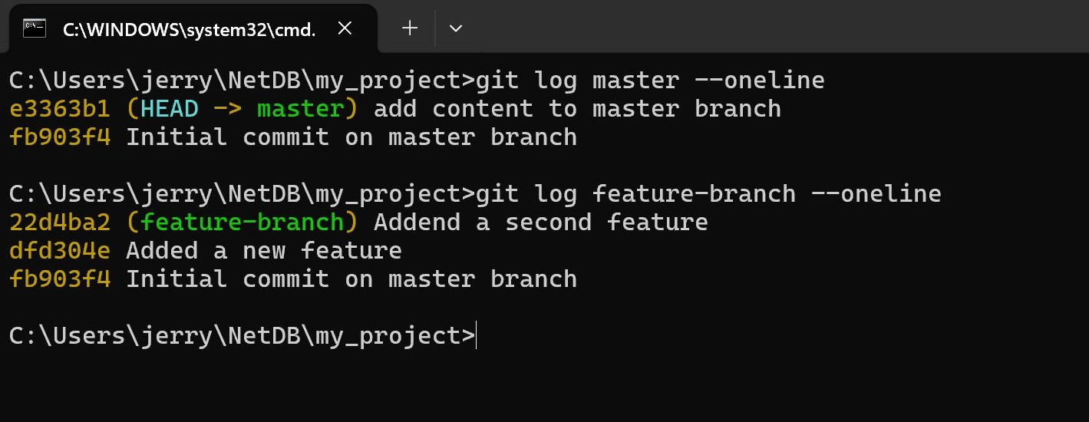
As observed in the log, a commit in one branch will not affect another branch.

Slide 48
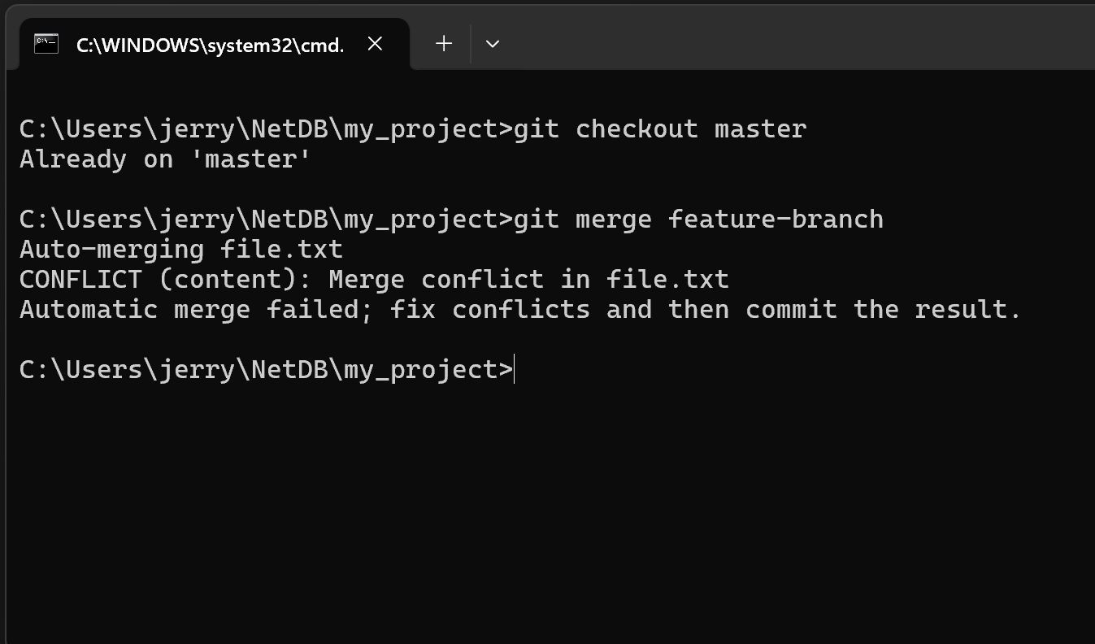
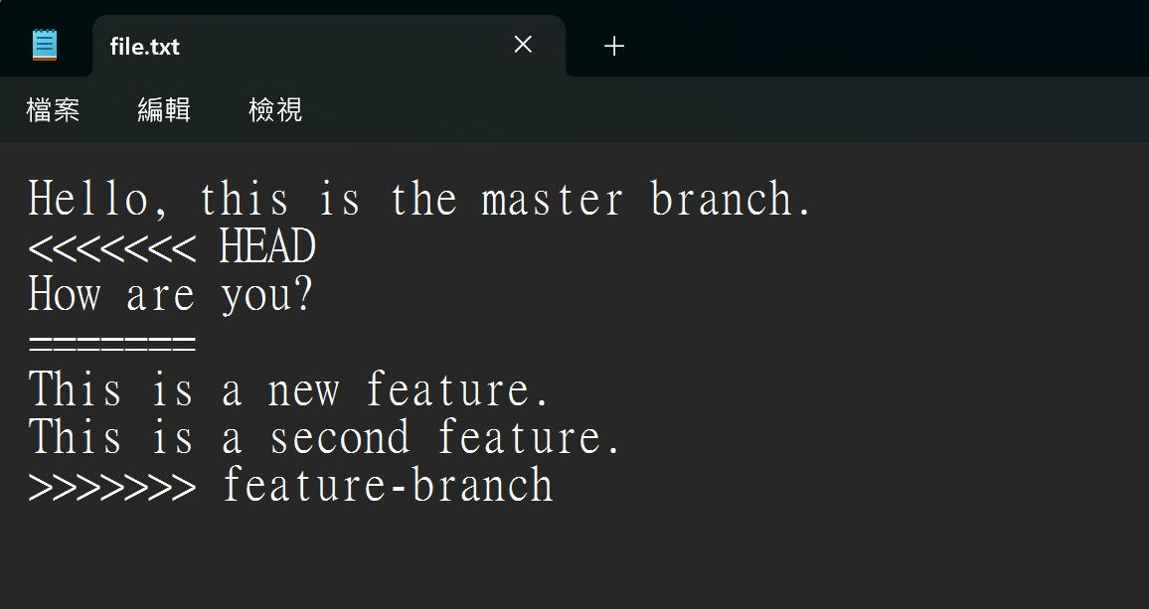
11. Ensure to move back to master branch (or any target branch you want to merge with)
12. Use the “git merge [branch name]” to merge the branch
Note that there is a merge conflict
13. Reopen the file.txt file then you found that there is merge conflict mark
<<<<<<<< HEAD:
Show the change from your target branch.
======:
Separator between the conflicting change
>>>>>>>> feature-branch
The changes from the branch you are trying to marge with the target branch

Slide 49
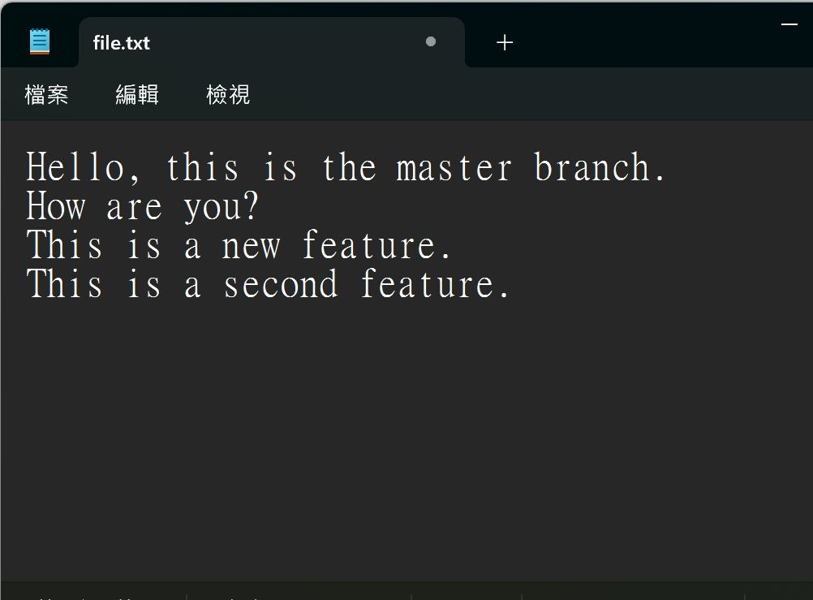
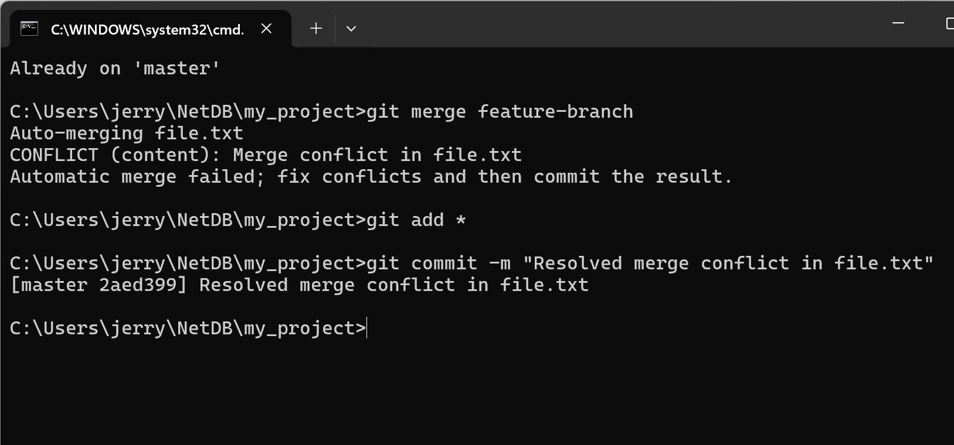
14. Decide which version to keep and edit the file to resolve a marge conflict and save the change. In this case I reserve all the version.
15. Add and commit again

Slide 50
Outline
General Rule
Introduction to Git
Version control
Branch and merge
How to Submit Your Code to Gitlab
Tools & References

Slide 51
Collaboration
To work with others using git, you’ll need a server that store the repository.
Git is distributed, which means
Everyone can store a copy of the repository downloaded from the server to their computer and do their jobs independently.

Slide 52
Collaboration Workflows (1/2)
If you don’t have the project, clone (download) the repository from the server.
Do your work and commit the changes at local. Once done, push (upload) the repository to the server.
If someone else modified the project, you can pull
(sync) the repository to get the updated project.
Repeat 2 and 3.

Slide 53

Collaboration Workflows (2/2)
Server
Clone
Clone
Local A
Local B

Slide 54


Collaboration Workflows (2/2)
Server
Commit
Version A
A
Local A
Local B

Slide 55


Collaboration Workflows (2/2)
Server
Push
Version A
A
A
Local A
Local B

Slide 56

Collaboration Workflows (2/2)
Version A
A
Server
Pull
A
Version A
A
Local A
Local B

Slide 57

Collaboration Workflows (2/2)
A
Server
Pull
A
A
A
Version A
Local A
Local B

Slide 58
Something went wrong.

Slide 59


Authentication Failed
Authentication Failed
Server
Push
Version A
A
A
Local A
Local B

Slide 60
Why Authentication Failed?

Slide 61
Collaboration Workflow
If you tried to clone the code template from a server and want to push the modified file.
You will get authentication failed.
It’s because it was a project of others, which means you are not able to save the changes back to the server.
So, how can I copy a project from others on a open source platform like Github?

Slide 62

Introducing
Fork

Slide 63



Author
Original Project
A
A2
Forked Project
Open a Merge Request
A
A1
A2
Forked from Red
Commit
Commit
Editor

Slide 64
Author
✔ Accept
A2
A
A
A1
A2
Editor

Slide 65

Author
A
A2
A
A1
A2
Editor

Slide 66


Forked from Red A2
A2
A
A2
A
A1
A2

Slide 67
Git Collaboration Workflow
Fork a repository to make a copy of it.
Clone the repository you forked to your workspace.
Do your work and commit the changes in your workspace.
Push the repository to the server to synchronize them.
Open a merge request to origin repository .

Slide 68
Basic Git Commands (2/2)
git clone [url]
Clone a repository from remote server
git push [url] [branch-name]
Push committed file to remote server

Slide 69
Outline
General Rule
Introduction to Git
Version control
Git Basics
Try Git!
Remote Repositories
How to Submit Your Code to Gitlab
Tools & References

Slide 70


Slide 71
Gitlab
We have created account for you
Account: Email (e.g. ssta2026@datalab.cs.nthu.edu.tw)
Password: student ID (e.g. 114012345)

Slide 72
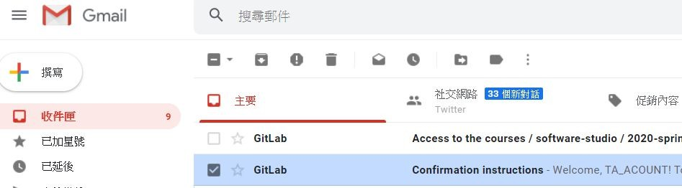
Gitlab

Slide 73
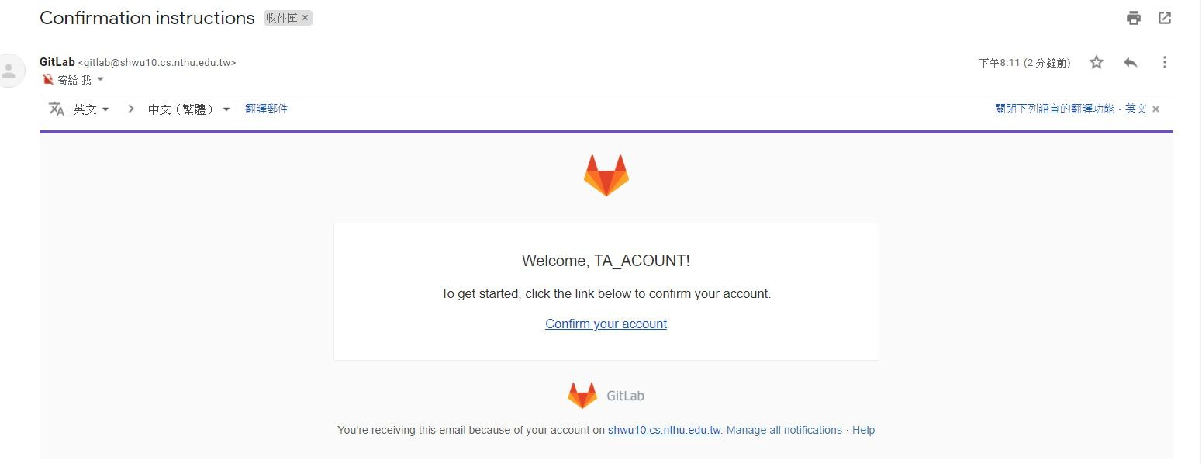
Gitlab

Slide 74
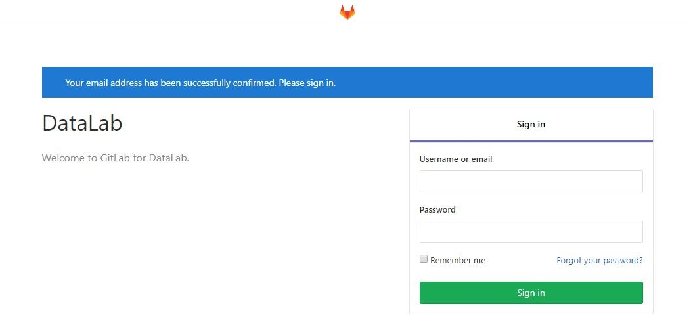
Gitlab
Email: your email Passward: studentID

Slide 75
Workflow
For each lab, you should follow the workflow below
Fork our template repository on Gitlab
Clone the forked repository to your computer
Finish your lab
Commit in your computer
Push to Gitlab
Send merge request of your branch to our template repository

Slide 76
Workflow
For each lab, you should follow the workflow below
Fork our template repository on Gitlab
Clone the forked repository to your computer
Finish your lab
Commit in your computer
Push to Gitlab
Send merge request of your branch to our template repository

Slide 77
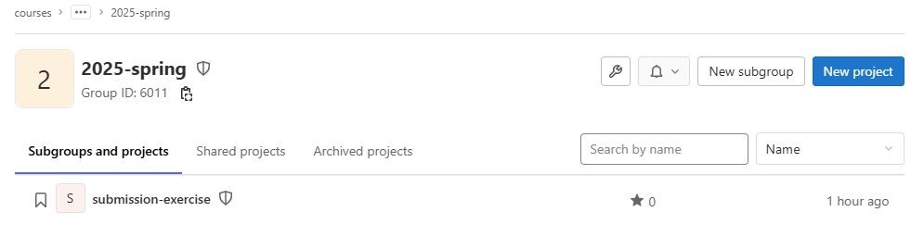
You can access course projects in this group
2026 - spring
2026 - spring

Slide 78
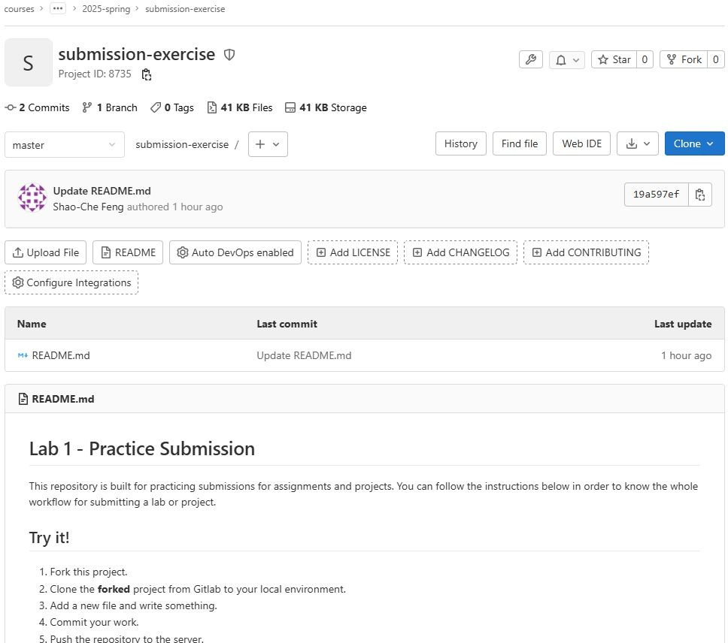

> 2026 – spring >
1. Click to fork

Slide 79
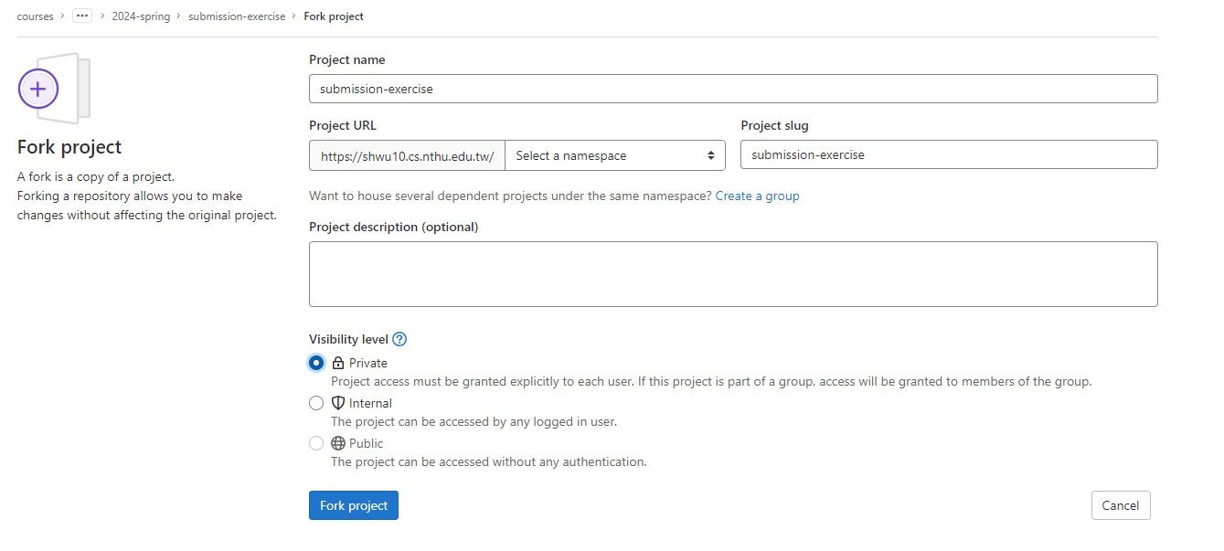


2. Select your name
3. Click Private
4. Click to fork

Slide 80
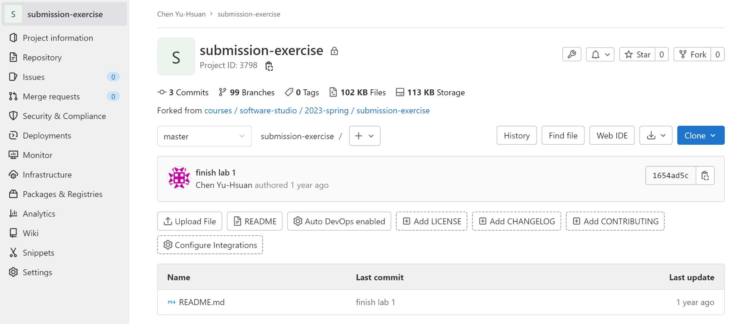

5. Check if this repository is under your account
6. Go to settings

Slide 81
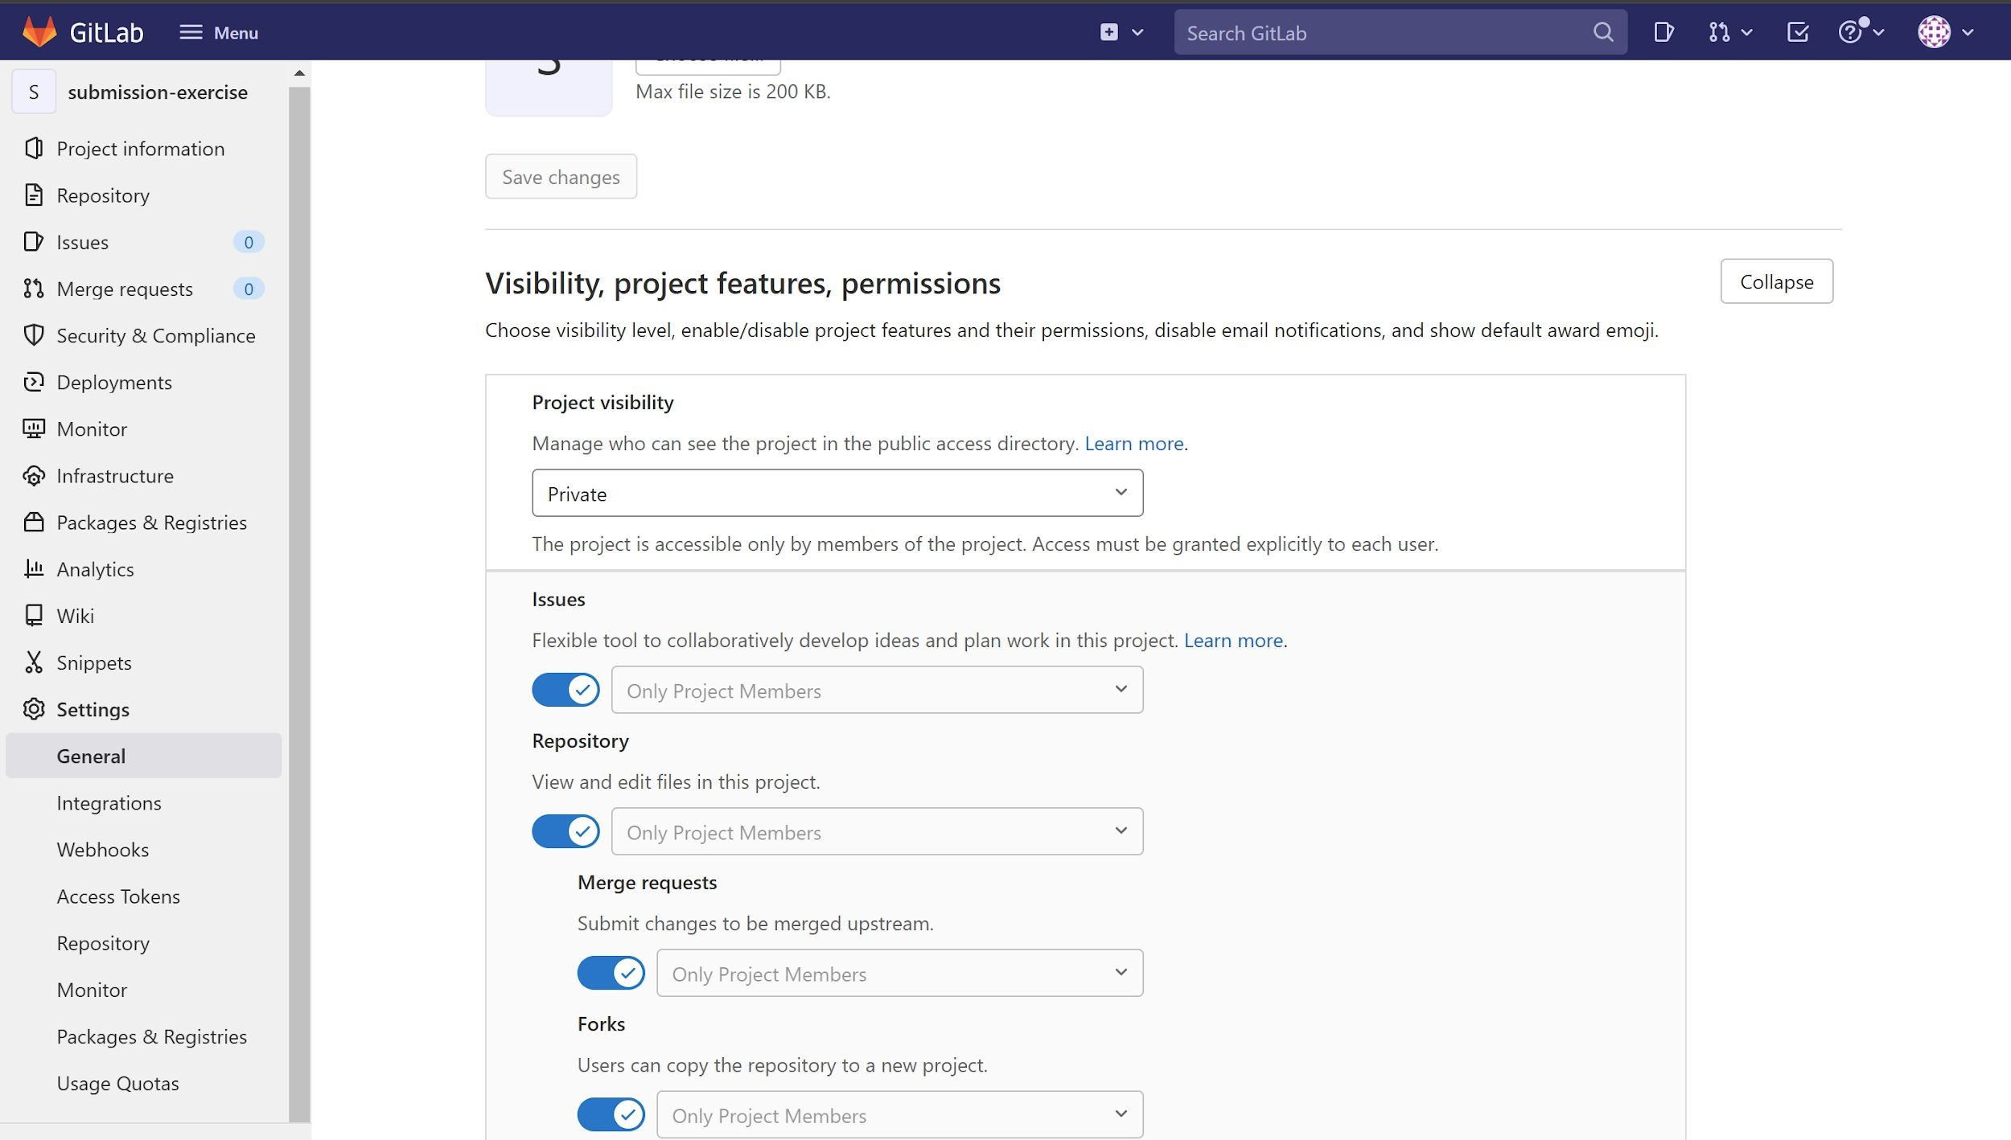

7. Set project to private

Slide 82
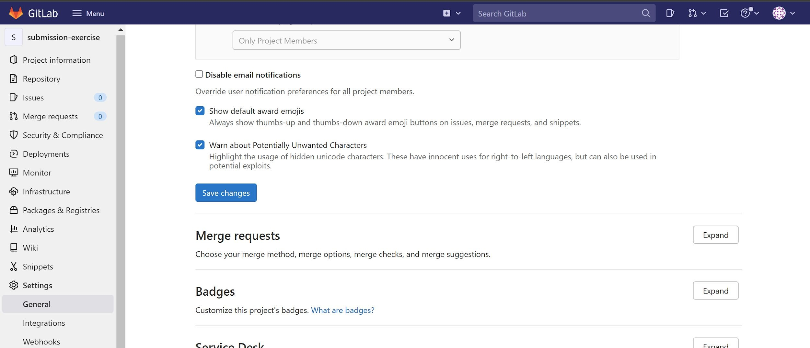

8. Scroll down and save changes

Slide 83
Workflow
For each lab, you should follow the workflow below
Fork our template repository on Gitlab
Clone the forked repository to your computer
Finish your lab
Commit in your computer
Push to Gitlab
Send merge request of your branch to our template repository

Slide 84
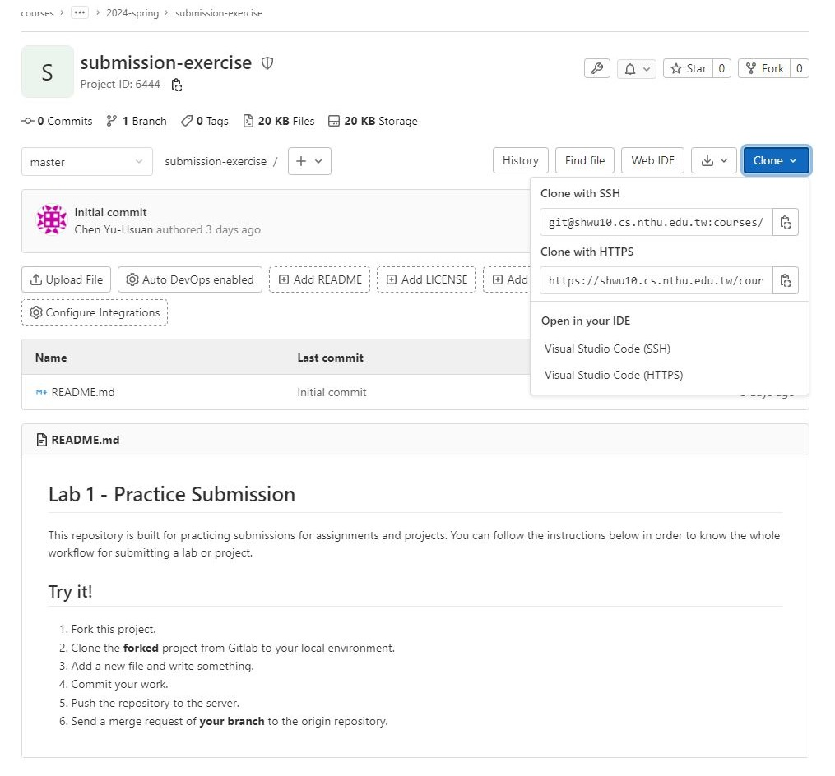


> 2026 – spring >
2. Copy the link
1. Choose HTTPS

Slide 85
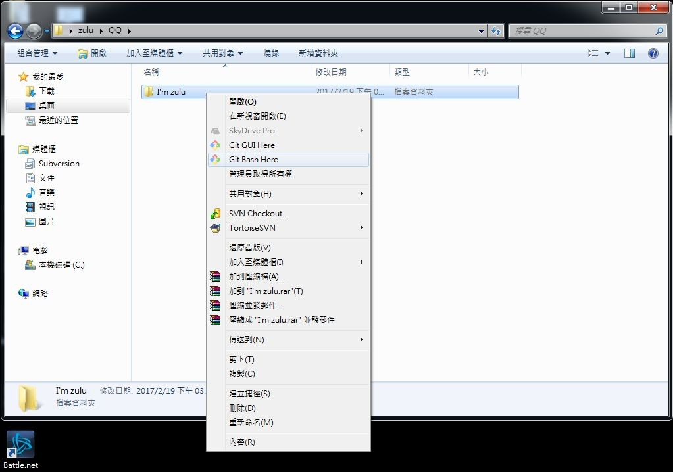

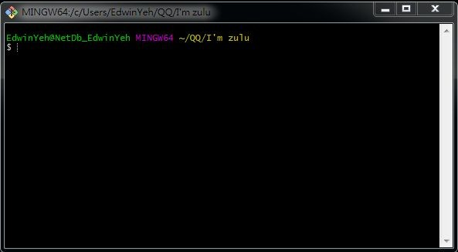
If You use Windows

Slide 86

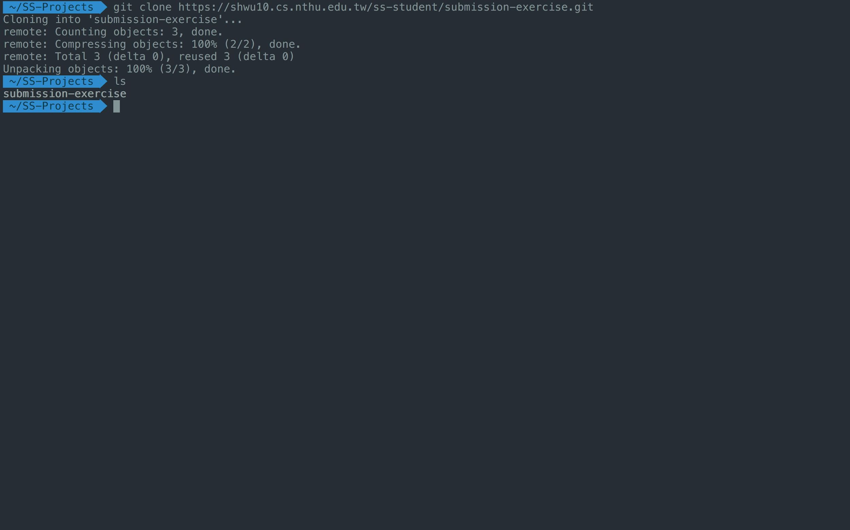


Create a folder to put your repos
Type "git clone {URL}"
The repo has been successfully cloned

Slide 87
Workflow
For each lab, you should follow the workflow below
Fork our template repository on Gitlab
Clone the forked repository to your computer
Finish your lab
Commit in your computer
Push to Gitlab
Send merge request of your branch to our template repository

Slide 88
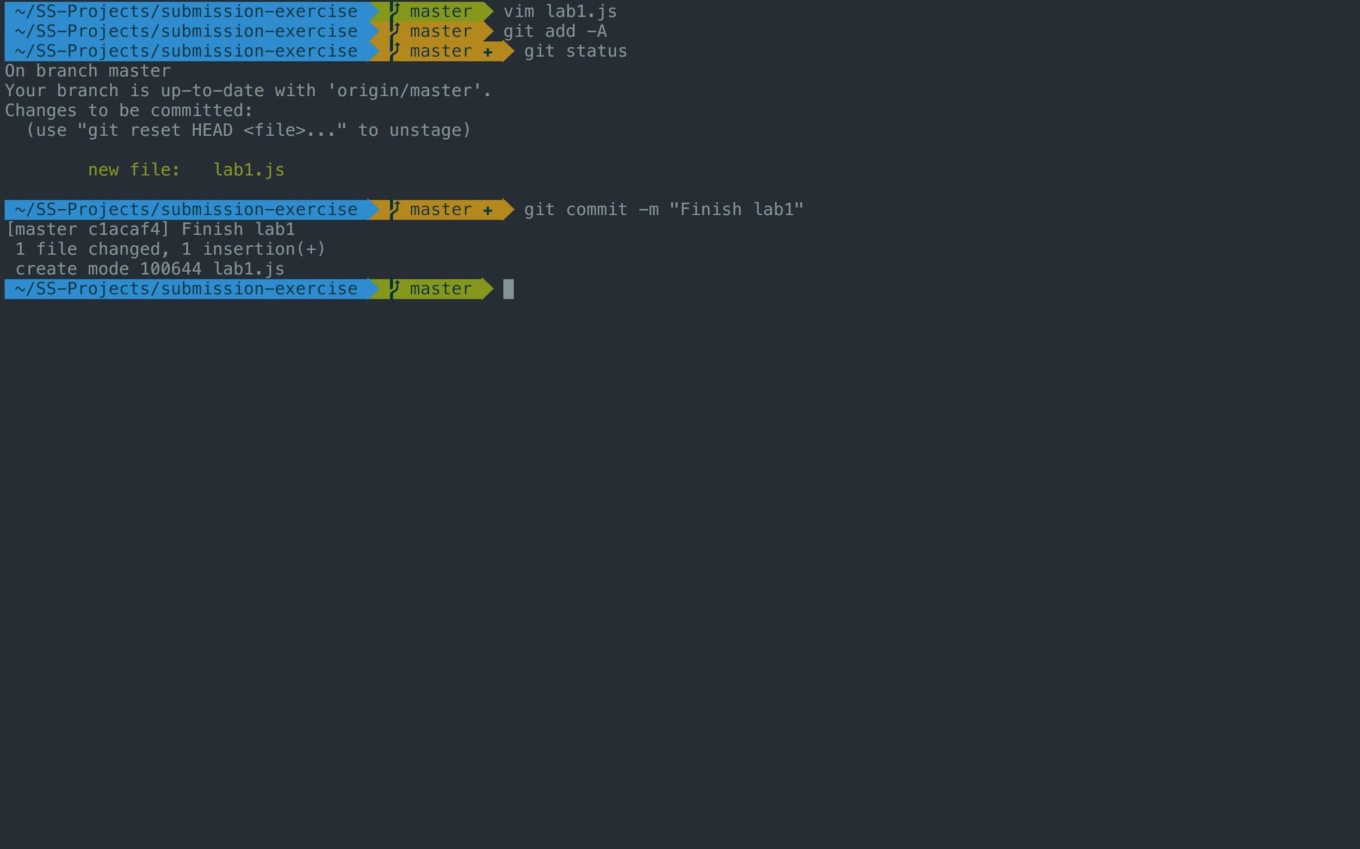



-A means all files
Check if your file is added to git
3. Commit your changes

Slide 89
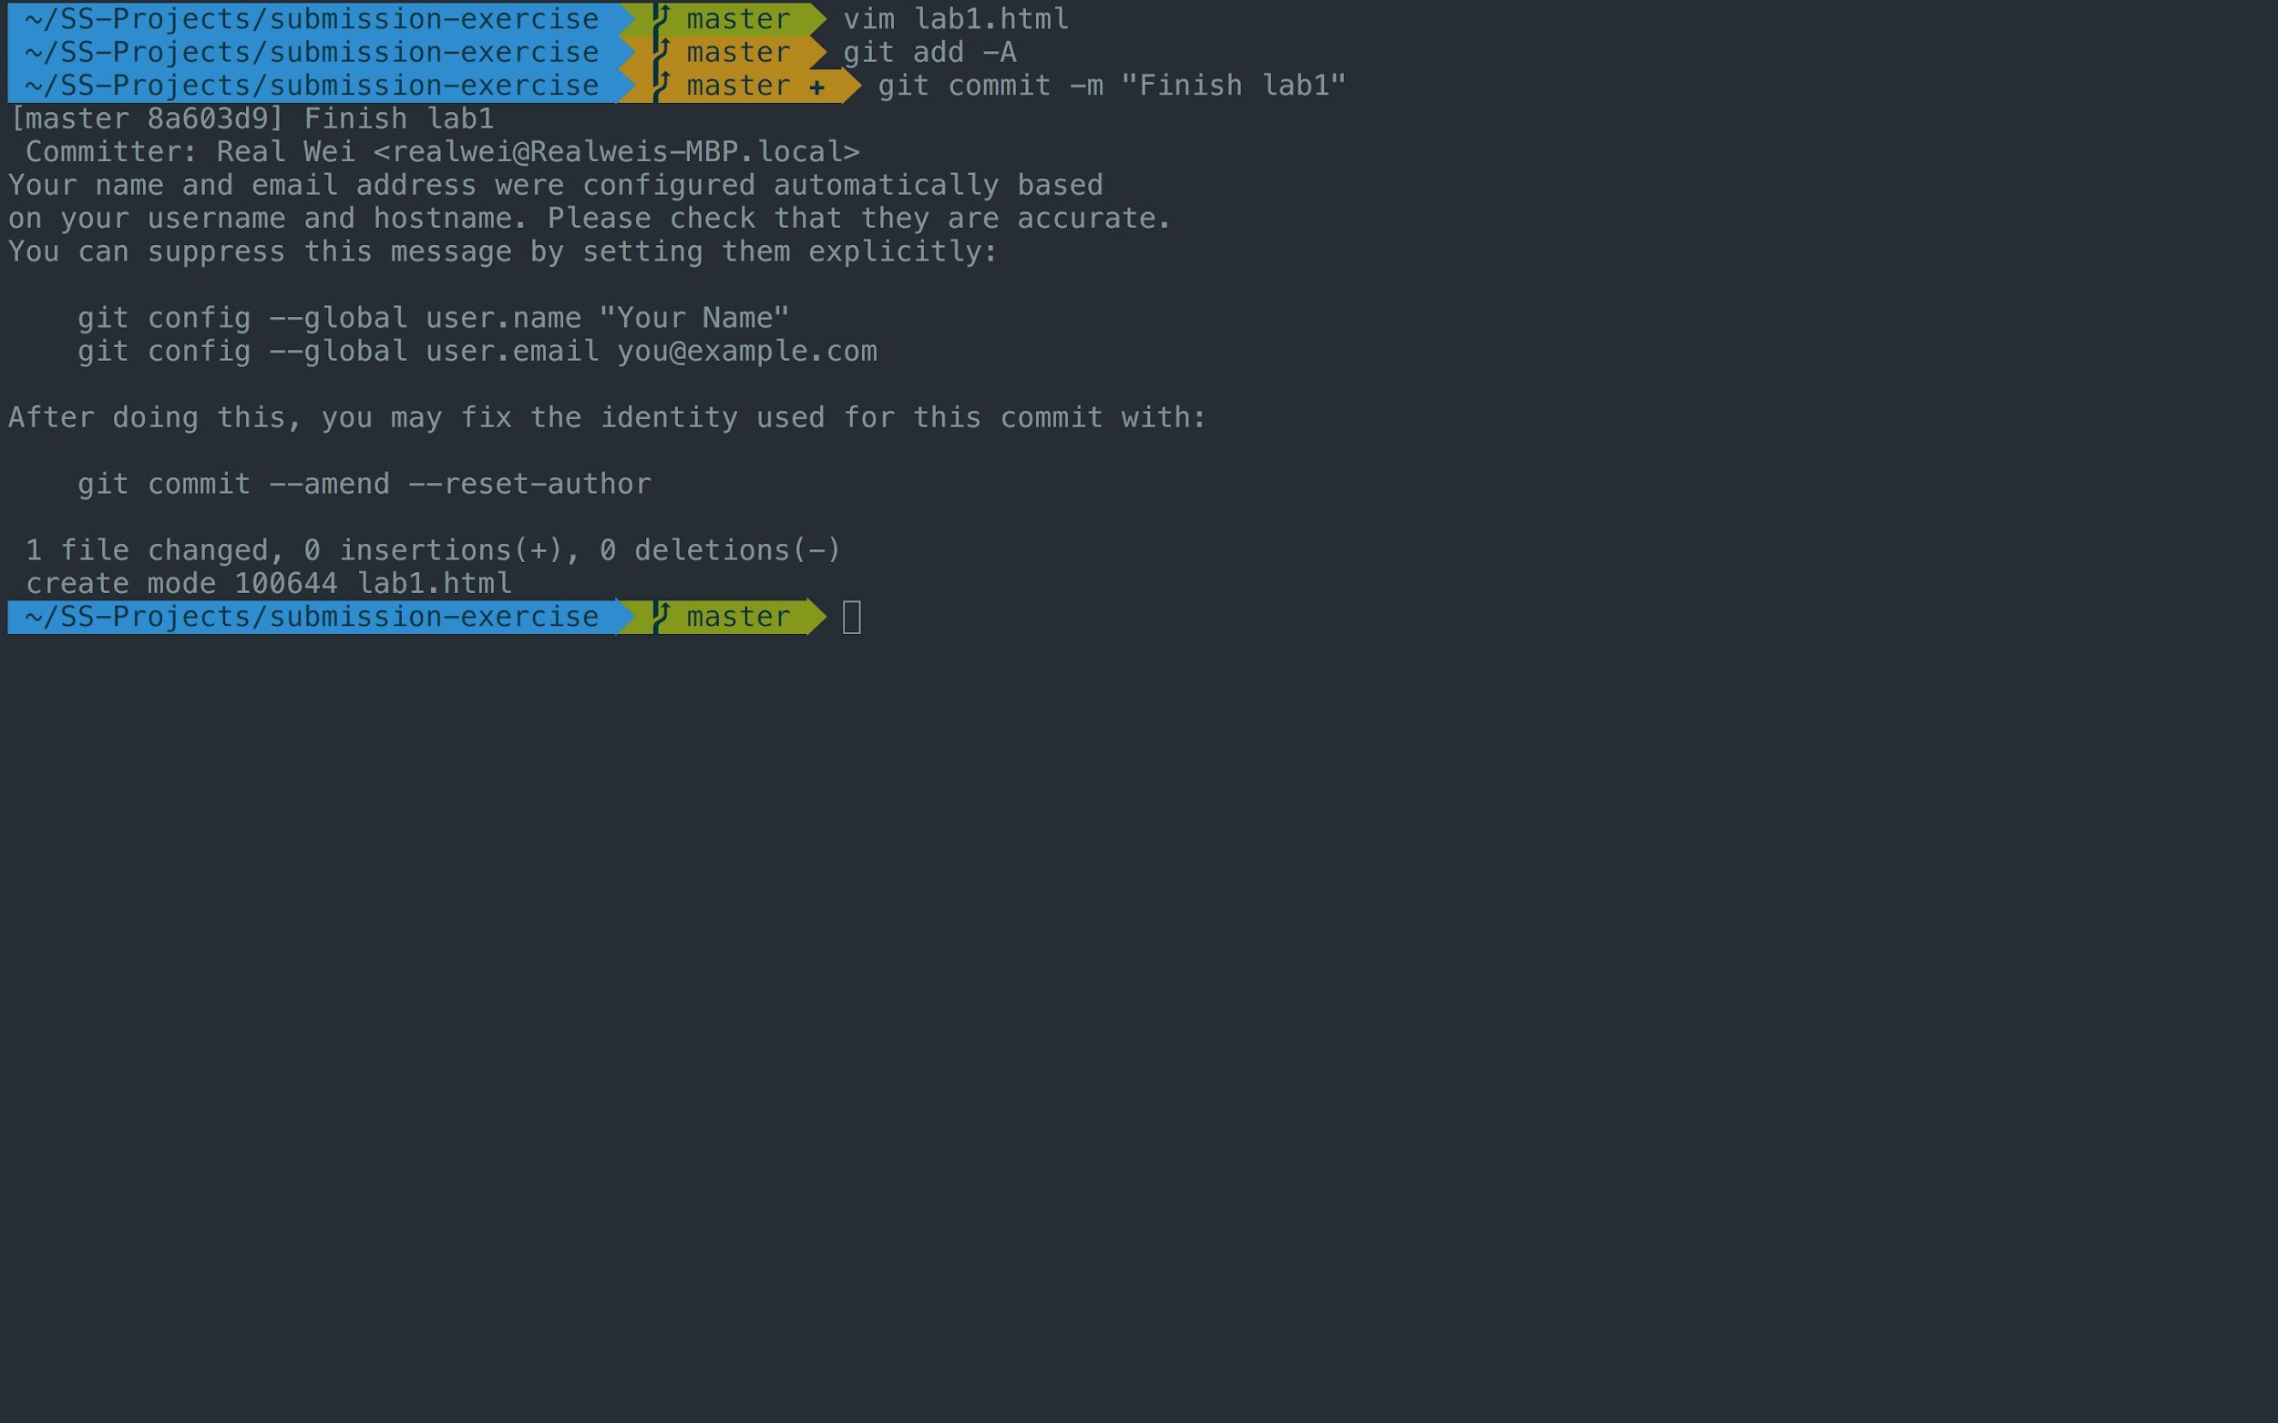

If you see these message, type
git config --global user.name "{name}" git config --global user.email "{email}"
{email} is the email you use on gitlab

Slide 90
Workflow
For each lab, you should follow the workflow below
Fork our template repository on Gitlab
Clone the forked repository to your computer
Finish your lab
Commit in your computer
Push to Gitlab
Send merge request of your branch to our template repository

Slide 91
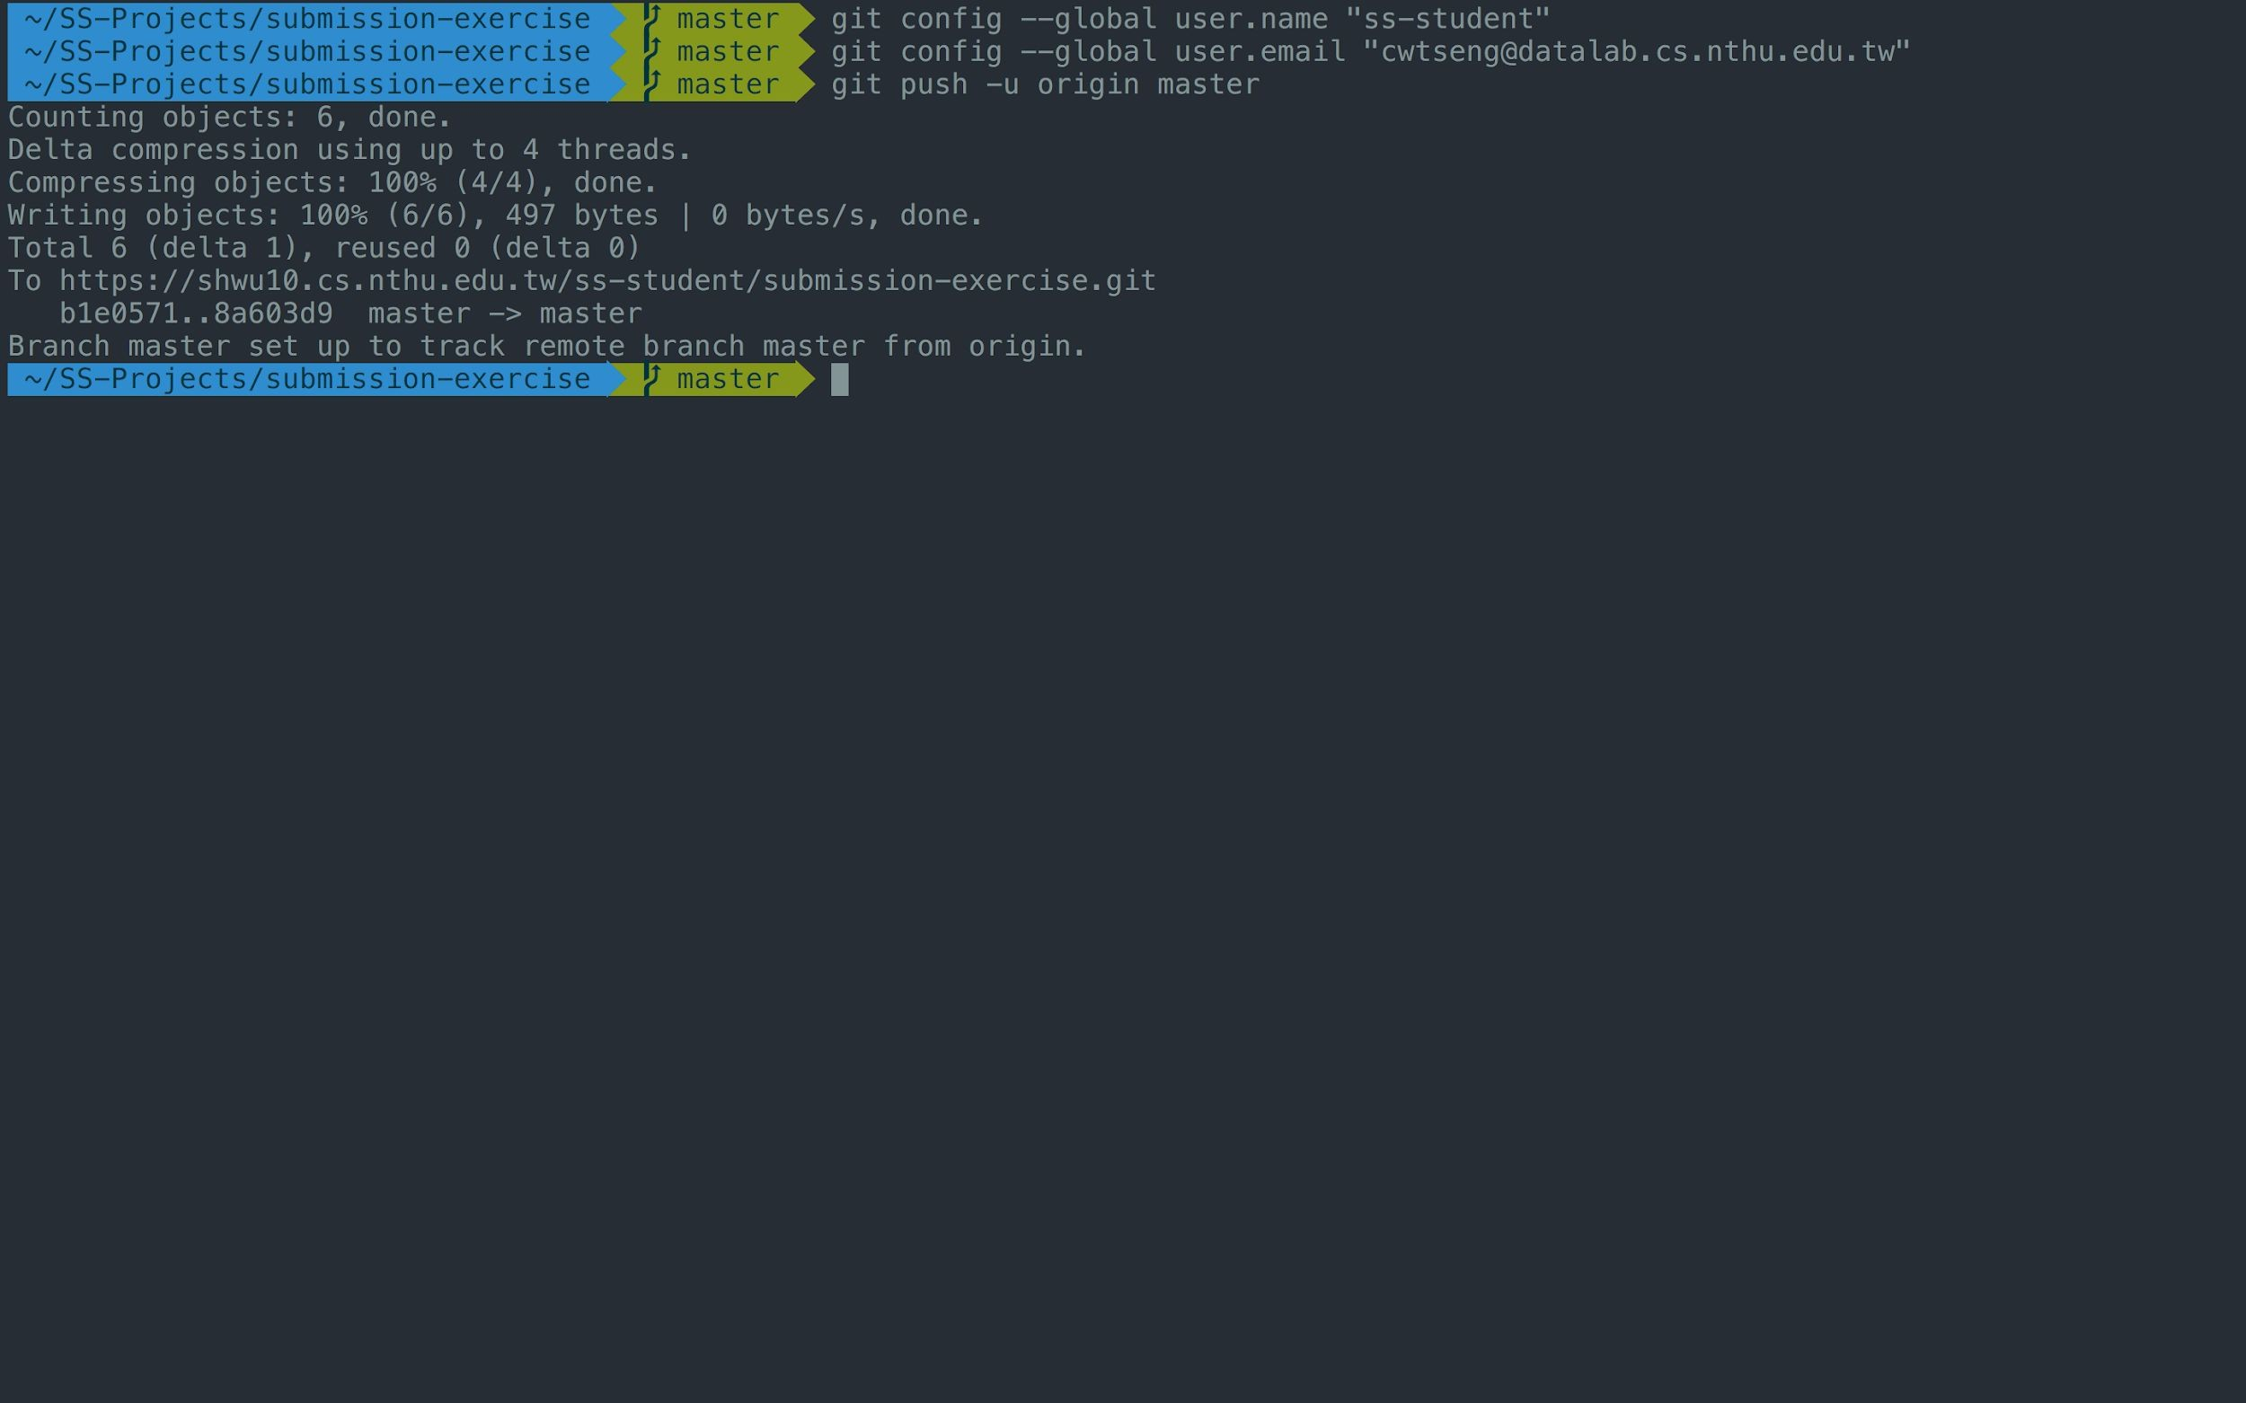
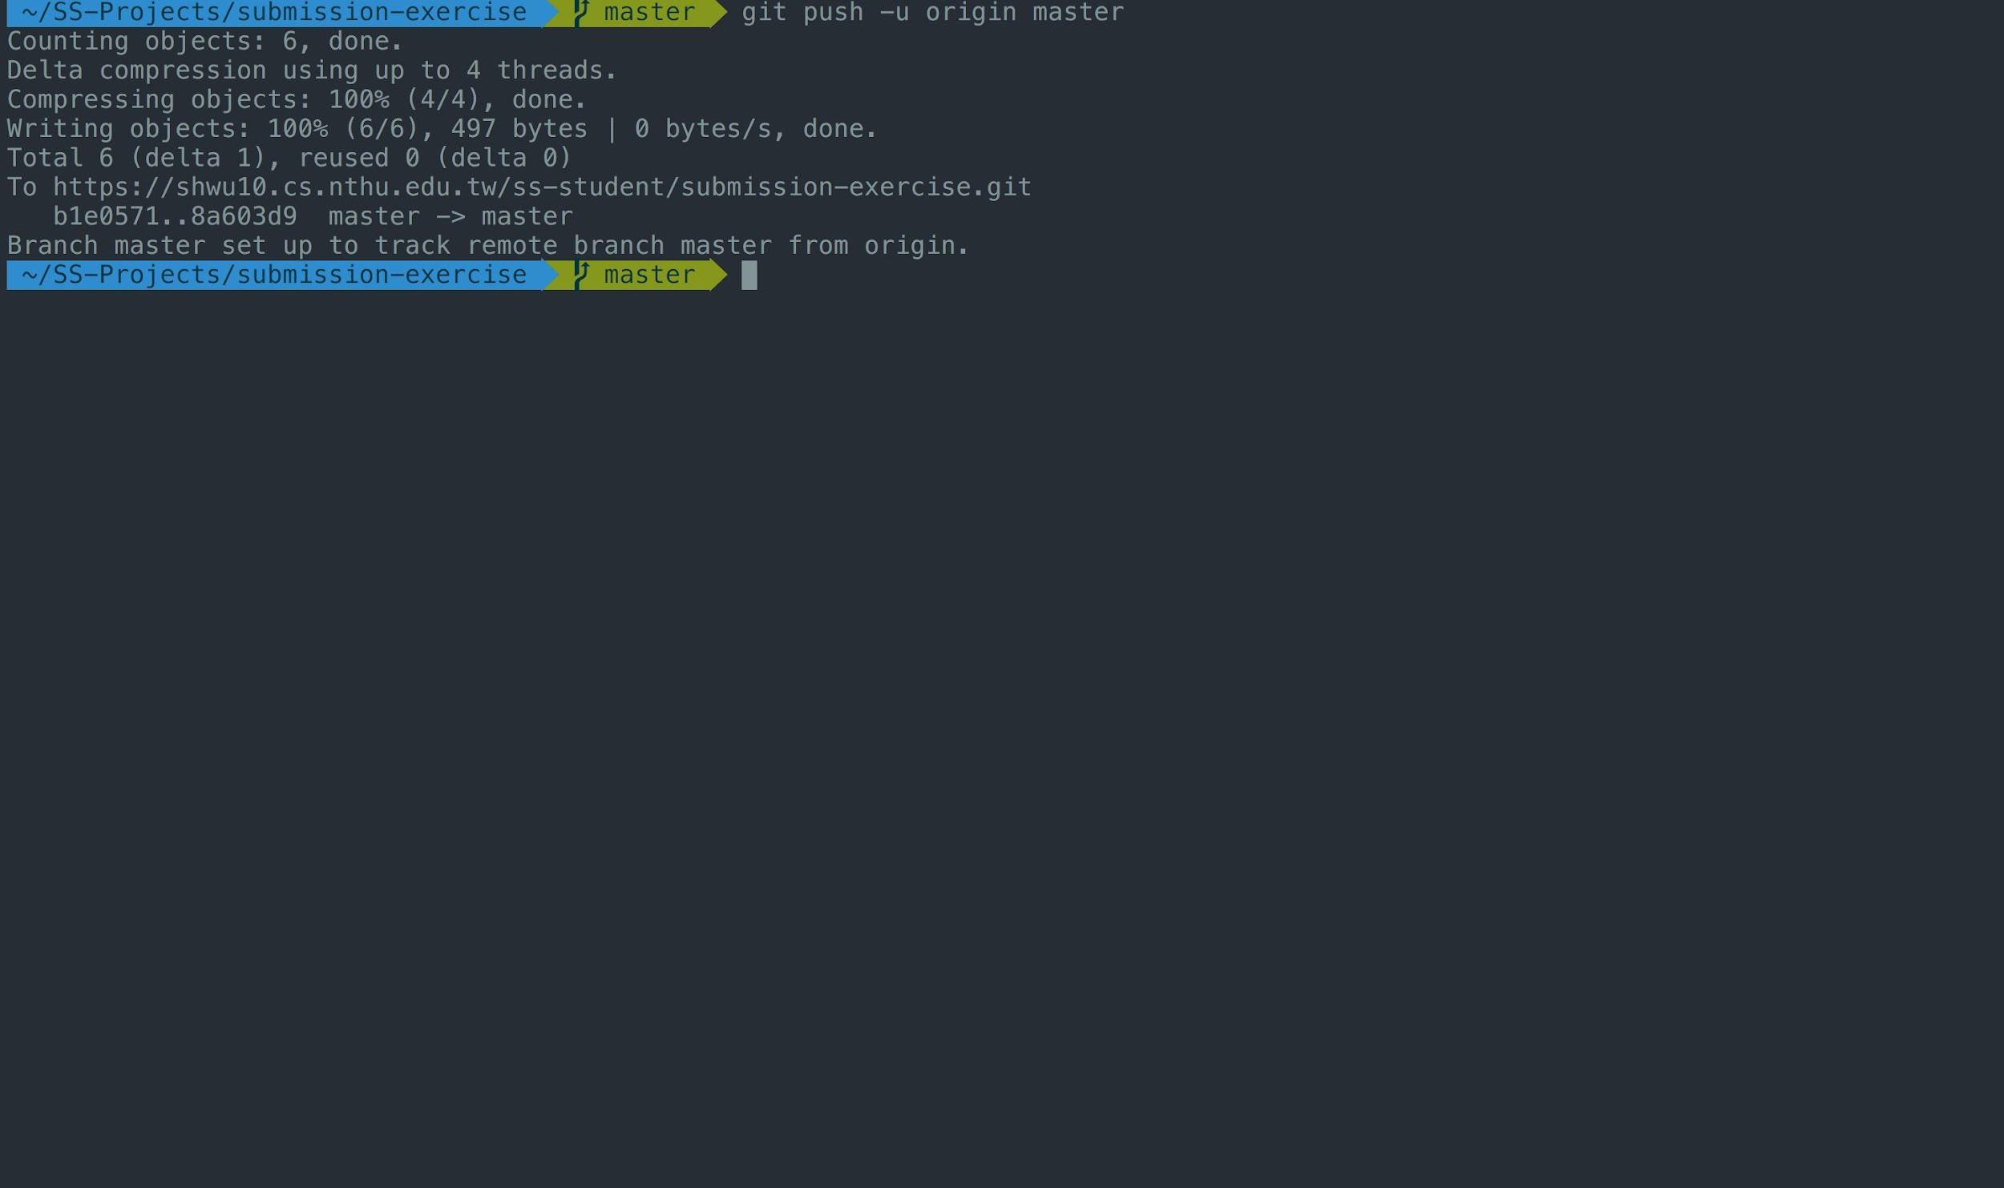

Type "git push -u origin master"

Slide 92
Workflow
For each lab, you should follow the workflow below
Fork our template repository on Gitlab
Clone the forked repository to your computer
Finish your lab
Commit in your computer
Push to Gitlab
Send merge request of your branch to our template repository

Slide 93


1. Click Merge Requests

Slide 94


2. New merge request

Slide 95



3. Choose the branch you pushed in your repo
Ensure that the commit in the version record of the selected branch matches the commit name of the final version you have in mind.

Slide 96

4. Choose the branch named after your ID
Ensure that the source of the selected branch is the class folder (courses/software-studio/2026-spring/submission-exercise) and your student ID (not master or someone else’s student ID).

Slide 97

5. Compare branches

Slide 98


You can also confirm or change whether the selected branch is correct in this section. For instance, in the picture, the course branch selected is master, which is incorrect. The correct one should be
courses/software-studio/2026-spring/submission-exercise: {your student ID}.
Courses/software-studio/2026-spring/submission-exerice: {ID}
6. Set title to "{ID} Submission"

Slide 99


7. If everything is OK, submit your merge request

Slide 100

Notice - Don’t do this

Slide 101

Notice - Don’t do this

Slide 102

Notice - Don’t do this

Slide 103

The GitLab setup in our laboratory is accessible through the link.
Here!!!!!

Slide 104
Outline
General Rule
Introduction to Git
Version control
Branch and merge
How to Submit Your Code to Gitlab
Tools & References

Slide 105
Tools
Git GUI
GitKraken
Editor / IDE
Visual Studio Code
Atom
Sublime Text
Brackets
Notepad++
Webstorm

Slide 106

10
5

Slide 107


Slide 108


Slide 109


Slide 110


Slide 111
Reference
Learn Git branching (interactive)
http://pcottle.github.io/learnGitBranching/
Pro Git
http://git-scm.com/book/
寫給大家的 Git 教學
http://www.slideshare.net/littlebtc/git-5528339

Slide 112
Today’s exercise
Install Git command line tool in your computer.
Follow appendix “Git Command-line Tool Installation”.
Try to submit in GitLab.

