Slide 1
Software Design & Studio
Shan-Hung Wu
CS, NTHU

Slide 2
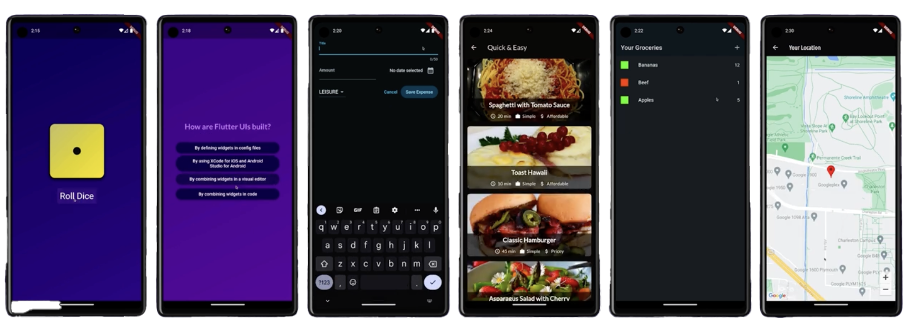
Course Objective
To offer hand-on guidance in
Software design process
Project- and team-based software development
Through writing intelligent apps:

Slide 3
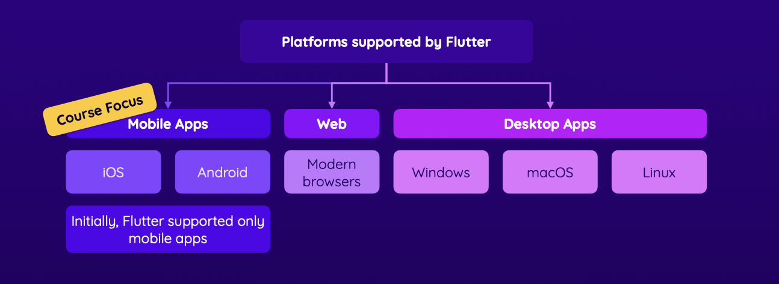
Flutter for App Development
Supports multiple platforms & screens
Shared codebase written in Dart
Hot reload & high performance (60+ fps)

Slide 4
Why Dart?
Easy to learn for people familiar with C, C# or Java
New language features
Functional programming
Asynchronous programming
Null-safety
Similar to JavaScript, but no legacy “bad” part

Slide 5
Flutter vs. Dart
Dart: a programming language
Flutter: libraries, framework and tools
You write code in Dart within Flutter’s framework
Then, Flutter tools compile it to native code for each of your target platforms

Slide 6
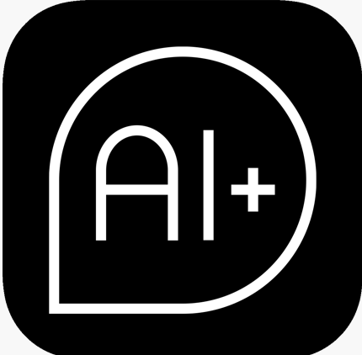
Software Design
Term project: a useful app empowered by AI technologies
Usefulness through design sprint
Problem identification, solution ideation, competitive analysis, prototyping and usability testing
AI technologies
Machine Learning & Deep Learning concepts, generative AI and APIs

Slide 7
Interleaved Sections
Flutter and Dart
AI fundamentals and services
Software design process and user-centric development
Syllabus (subject to change)

Slide 8
Classes
Tue: lectures
at Delta 105
Thu: labs
at EECS 326 & 328
Course website: www.cs.nthu.edu.tw/~shwu

Slide 9
Grading (1/2)
Labs: 40%
Design demo (with usability testing): 30%
Implementation demo: 30%
Q/A bonus: up to 5%

Slide 10
Grading (2/2)
Late lab submissions only get 60% of original scores
Demos get 60% of original scores if all your team members rate you as “non-contributing”
Top-three popular demos get 15%, 10% and 5% extra credits, respectively

Slide 11
Questions?

Slide 12
FAQ (1/3)
Is this a light-loading class or heavy-loading class?
Should be heavy to most students
Is this a programming language course?
No, we teach Dart in only 2 weeks
Is this a software engineering (SE) course?
No. We don’t focus on SE theories, but you will learn some “best practices”
Is this a entrepreneur course?
No. We don’t talk about things after deployment

Slide 13
FAQ (2/3)
How many people a team?
3 to 6 people
For 4+ people teams, your apps must have back-end
What back-end will we use
Firebase, a Backend-as-a-Service (BaaS)
Do we need to come to the class?
No, as long as you can pass
Can I use generative AI to write code?
Sure, but make sure it helps you learn rather than score

Slide 14
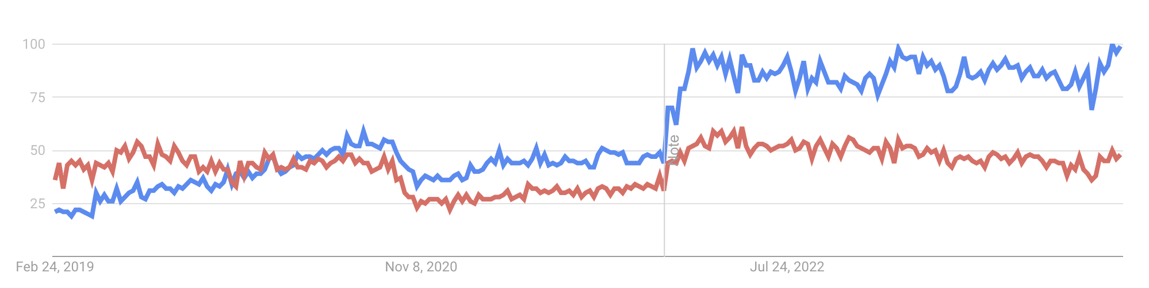
FAQ (3/3)
Are we going to interact with open source software?
Yes, Flutter & Dart are open source projects themselves
3rd Dart/Flutter libraries through pub.dev
Why not JavaScript + React + React Native?

Slide 15
TODO
Complete these tutorials by Thu:
Environment setup
Write your first Flutter app

