Slide 1
Lab 00
How to Survive &
Introduction to Git
Software Studio
DataLab, CS, NTHU

Slide 2
Notice
These slides will focus on how to submit you code by using Git command line
You can also use other Git GUI tool or built-in Git tool in other IDE/editor

Slide 3

Teaching Assistants

Slide 4
How to Find Us?
Office Hour (TAs)
Tue. 10:10am-12:00pm at Delta 729
Email
Yu-Hsuan Chen : yhch@datalab.cs.nthu.edu.tw
Jou-Hsuan Yang : jhya@datalab.cs.nthu.edu.tw
Sheng-Wei Cheng: swcheng@datalab.cs.nthu.edu.tw
Online Forum
eeclass

Slide 5

If I have Question?

Slide 6
If I have Question?
Always Google first !
Learn how to google is important.
If you try your best but still can’t catch it.
Feel free to ask us on eeclass or office hour.

Slide 7
Today’s exercise (1/2)
Install Git command line tool in your computer.
Follow appendix “Git Command-line Tool Installation”.
Follow following steps.

Slide 8
Outline
General Rule
Introduction to Git
Version control
Git Basics
Try Git!
Remote Repositories
How to Submit Your Code to Gitlab
Tools & References

Slide 9
Outline
General Rule
Introduction to Git
Version control
Git Basics
Try Git!
Remote Repositories
How to Submit Your Code to Gitlab
Tools & References

Slide 10
The Policy of Labs
All labs need to be submitted to GitLab.
Late submission will not be accepted.
Plagiarism will not be tolerated.
If we find you copy someone’s code, you will get 0 point for that lab.
Grading
Submission before lab ends gets 100% score
Submission before 11:59pm gets 60% score

Slide 11
Grading Example
4 problems, 25% each
Solved 4 during the lab
100
Solved 3 during the lab, 1 before 11:59pm
75 + 25*0.6 = 90
Solved 4 after the lab, before 11:59pm
100 * 0.6 = 60

Slide 12
Outline
General Rule
Introduction to Git
Version control
Git Basics
Try Git!
Remote Repositories
How to Submit Your Code to Gitlab
Tools & References

Slide 13
Why use version control?

Slide 14
We want to track what we did and when we did it.

Slide 15
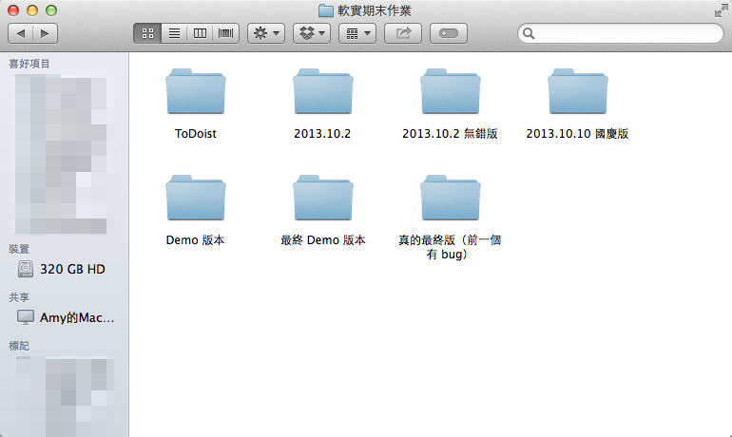
Students’ VCS
Notes:
It is easy to forget which directory you’re in and accidentally write to the wrong file or copy over files you don’t mean to

Slide 16
Why use VCS?
Managing your projects - tracking your files and modifications.
Synchronization between modifications made by different developers.
Revision history is still very helpful even if you work alone.

Slide 17
Outline
General Rule
Introduction to Git
Version control
Git Basics
Try Git!
Remote Repositories
How to Submit Your Code to Gitlab
Tools & References

Slide 18

Git

Slide 19
Git
Git is a popular version control system which is
Fast
Easy to use
Distributed
A git repository is a mini database that tracks your files.

Slide 20
Git Workflow (1/2)
With a local repository in your computer, you’ll need following operations to make git track your work:
Create/modify files
Let git monitor the files by adding them to staging files.
Commit your changes to and git will create snapshots (versions) of the files for you.

Slide 21
Git Workflow (2/2)
Modifying Files
2. add
modify file
Staging Modified Files
Committing A Version
3. commit

Slide 22
Git Branch
Master
Branching
Merging
Develop

Slide 23
Outline
General Rule
Introduction to Git
Version control
Git Basics
Try Git!
Remote Repositories
How to Submit Your Code to Gitlab
Tools & References

Slide 24

Be Professional

Slide 25
Basic Git Commands
git init
Initialize a repository at current directory.
git add [file_name] ( * git add . * → means add all files )
Add files to git repository and let git track them.
git commit -m "commit messages"
Save the changes to the git repository and create snapshots of the files.
git checkout [version]
Go to a specific version.

Slide 26
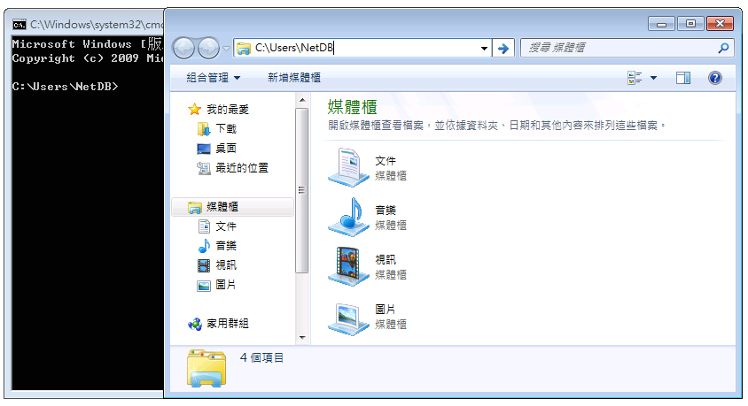
2. Go to that directory
1. Find current directory

Slide 27
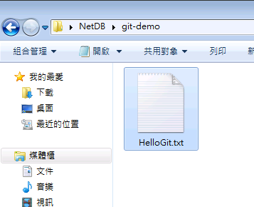
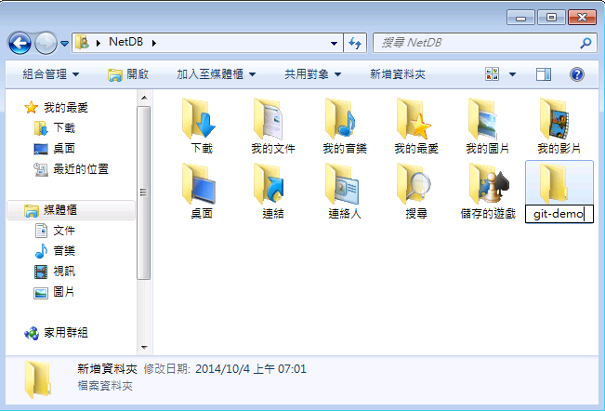
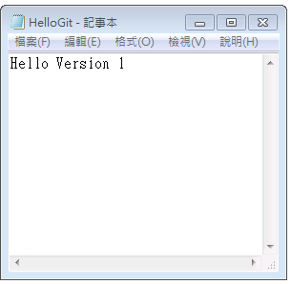
4. Go to that folder
3. Add a new folder
5. Create a new file
6. Put some contents and save

Slide 28
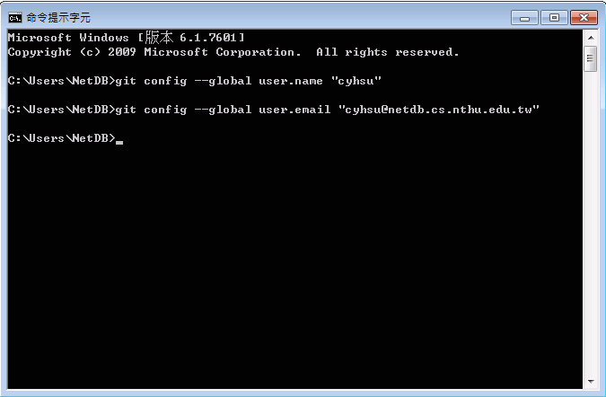
7. Setup user information
With --global: for all repositories in computer
Without --global: for current repository
$ git config --global user.name "name"
$ git config --global user.email "email"

Slide 29
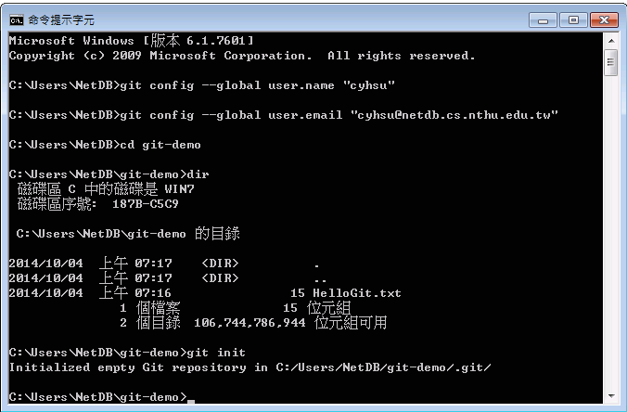
8. Go to “git-demo”
9. Show the files in “git-demo”
10. Initialize a Git repository
$ cd git-demo # go to git-demo directory
$ dir # list the files
$ git init # initialize a repository

Slide 30
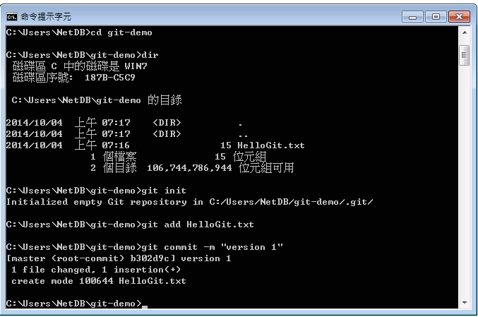
11. Add HelloGit.txt to staging files
12. Commit your changes
# Add HelloGit.txt to staging files
$ git add HelloGit.txt
# Commit the changes to the repository
# where "version 1" is the commit message
$ git commit -m "version 1"

Slide 31
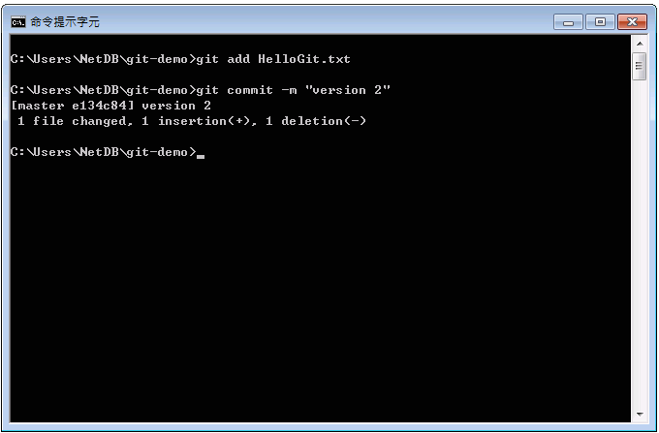
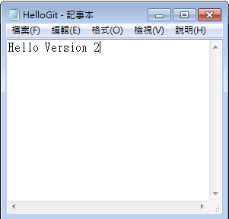
14. Add it and commit again
13. Make some changes and save

Slide 32
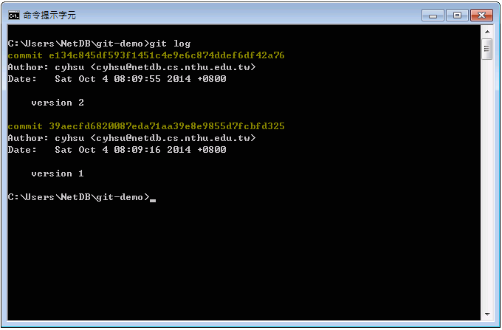

15. View your versions
Version ID
Commit messages
# Show the versions you’ve created so far
$ git log

Slide 33
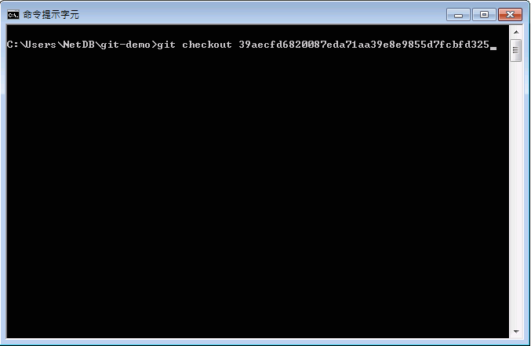
16. Go to a specific version
# Go to a specific version
$ git checkout {version_id}

Slide 34
LIFE IS
TOO SHORT
TO TYPE THAT
VERSION ID!
which is 40 characters long…

Slide 35
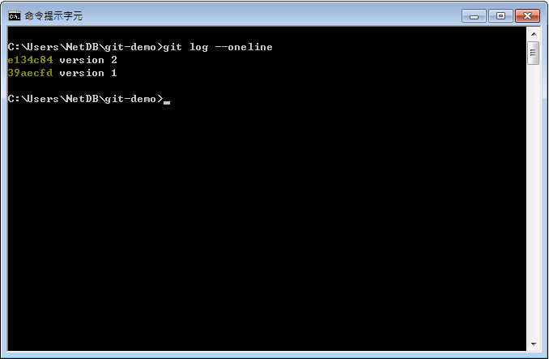
Version ID
15. Show versions with short version ID
56% shorter!
# Show versions with short version id
$ git log --oneline

Slide 36
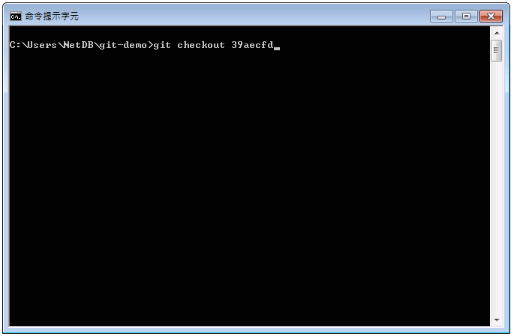
16. Go to a specific version
# Go to a specific version.
# In fact, you only need to type
# the first 5 characters.
$ git checkout {short_version_id}

Slide 37
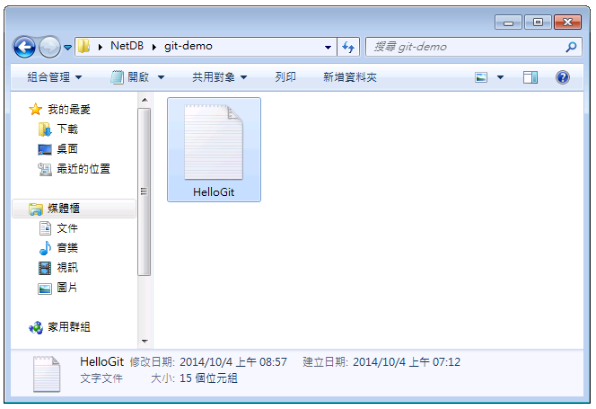
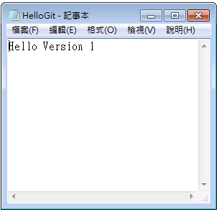
17. Close and reopen HelloGit.txt
18. Back to the version 1!

Slide 38
Try yourself (1/2)
Branching steps
Creating a new branch
Checking out the branch
git branch [branch name]
git checkout [branch name]

Slide 39
Try yourself (2/2)
Merging steps
Checking out a branch to merge
Merging another branch
git checkout [branch 1 name]
git merge [branch 2 name]

Slide 40
Outline
General Rule
Introduction to Git
Version control
Git Basics
Try Git!
Remote Repositories
How to Submit Your Code to Gitlab
Tools & References

Slide 41
Collaboration
To work with others using git, you’ll need a server that store the repository.
Git is distributed, which means
Everyone can store a copy of the repository downloaded from the server to their computer and do their jobs independently.

Slide 42
Collaboration Workflows (1/2)
If you don’t have the project, clone (download) the repository from the server.
Do your work and commit the changes at local. Once done, push (upload) the repository to the server.
If someone else modified the project, you can pull (sync) the repository to get the updated project.
Repeat 2 and 3.

Slide 43

Collaboration Workflows (2/2)
Server
Clone
Clone
Local A
Local B

Slide 44

Collaboration Workflows (2/2)
Server
Commit
Version A
A
Local A
Local B

Slide 45
Collaboration Workflows (2/2)
Server
Push
A
Version A
A
Local A
Local B

Slide 46
Collaboration Workflows (2/2)
Version A
A
A
Server
Pull
Version A
A
Local A
Local B

Slide 47
Collaboration Workflows (2/2)
A
A
Server
Pull
A
A
Version A
Local A
Local B

Slide 48
Something went wrong.

Slide 49
Authentication Failed
Authentication Failed
Server
Push
A
Version A
A
Local A
Local B

Slide 50
Why Authentication Failed?

Slide 51
Collaboration Workflow
If you tried to clone the code template from a server and want to push the modified file.
You will get authentication failed.
It’s because it was a project of others, which means you are not able to save the changes back to the server.
So, how can I copy a project from others on a open source platform like Github?

Slide 52

Introducing
Fork

Slide 53

Author
Original Project
A
A2
Open a Merge Request
Forked Project
A
A1
A2
Forked from Red
Commit
Commit
Editor

Slide 54
Author
✔︎
Accept
A
A2
A
A1
A2
Editor

Slide 55
Author
A
A2
A
A1
A2
Editor

Slide 56
Forked from Red A2
A2
A
A
A2
A
A1
A2

Slide 57
Git Collaboration Workflow
Fork a repository to make a copy of it.
Clone the repository you forked to your workspace.
Do your work and commit the changes in your workspace.
Push the repository to the server to synchronize them.
Open a merge request to origin repository .

Slide 58
Basic Git Commands (2/2)
git clone [url]
Clone a repository from remote server
git push [url] [branch-name]
Push committed file to remote server

Slide 59
Outline
General Rule
Introduction to Git
Version control
Git Basics
Try Git!
Remote Repositories
How to Submit Your Code to Gitlab
Tools & References

Slide 60


Slide 61
Gitlab
We have created account for you
Account: student ID (e.g. 106012345)
Password: student ID (e.g. 106012345)

Slide 62
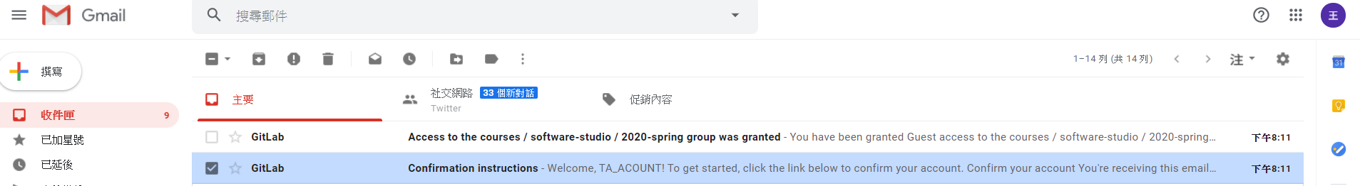
Gitlab

Slide 63
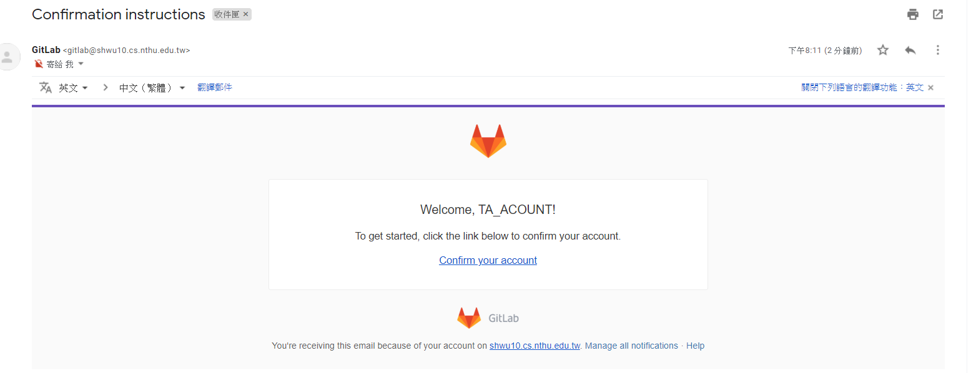
Gitlab

Slide 64
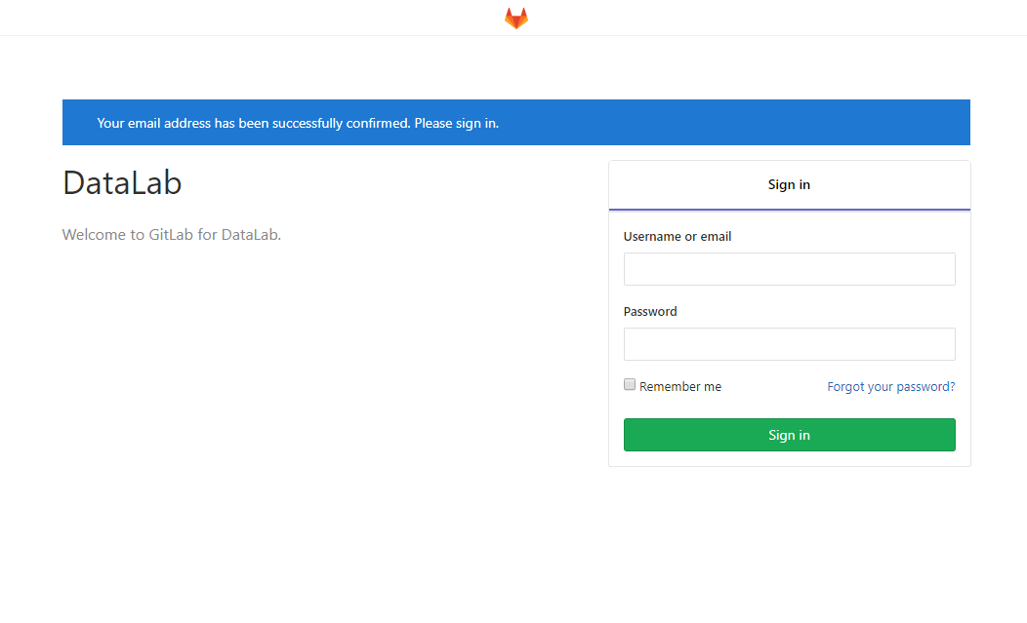
Gitlab

Slide 65
Workflow
For each lab, you should follow the workflow below
Fork our template repository on Gitlab
Clone the forked repository to your computer
Finish your lab
Commit in your computer
Push to Gitlab
Send merge request of your branch to our template repository

Slide 66
Workflow
For each lab, you should follow the workflow below
Fork our template repository on Gitlab
Clone the forked repository to your computer
Finish your lab
Commit in your computer
Push to Gitlab
Send merge request of your branch to our template repository

Slide 67
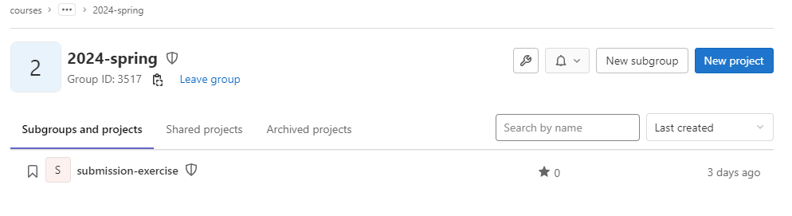
You can access course projects in this group

Slide 68
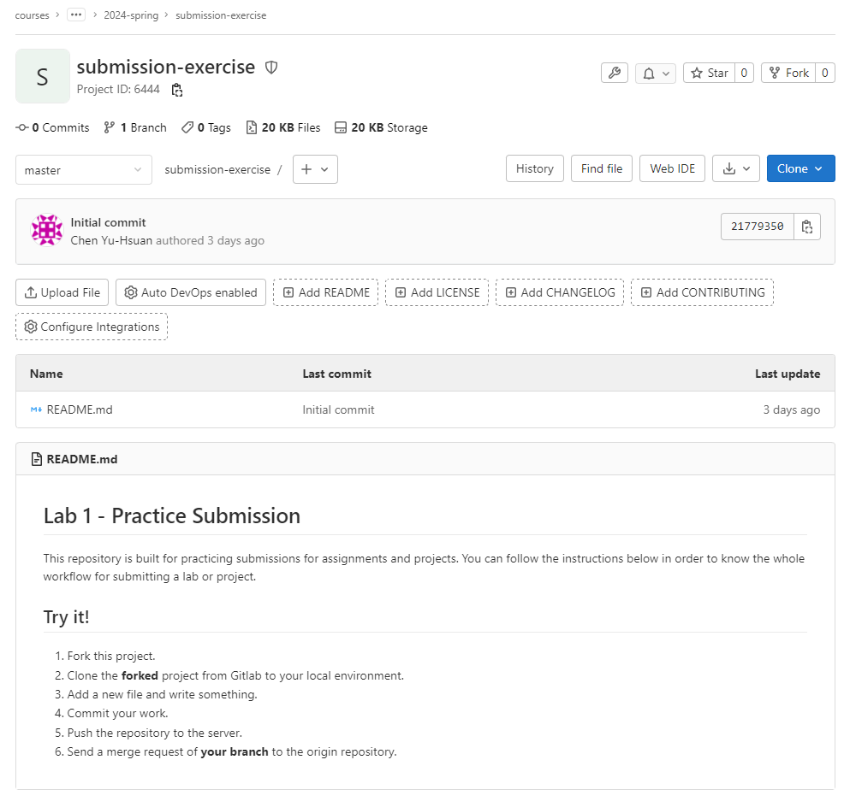
1. Click to fork

Slide 69
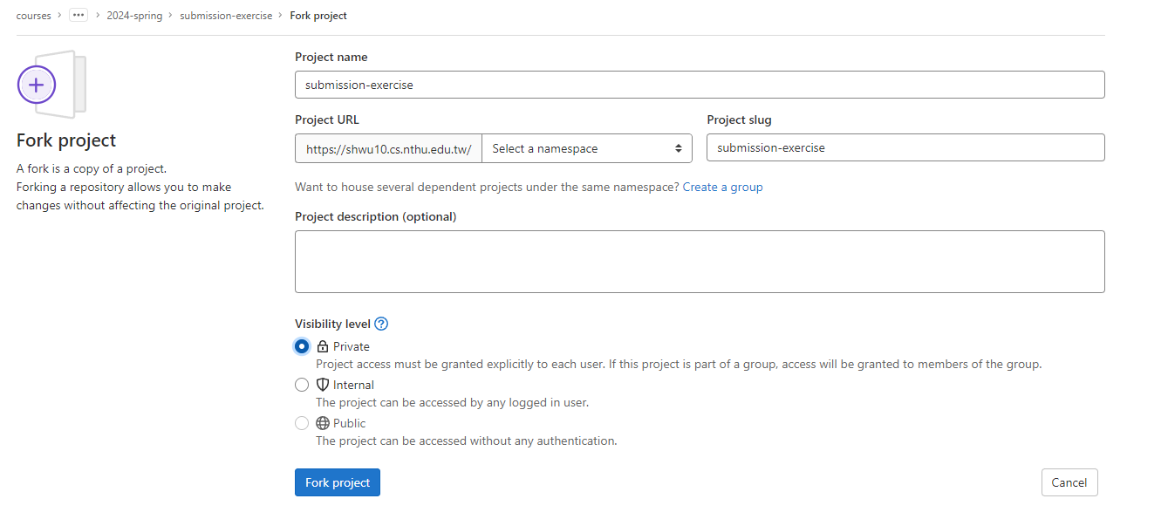
2. Select your name
3. Click Private
4. Click to fork

Slide 70
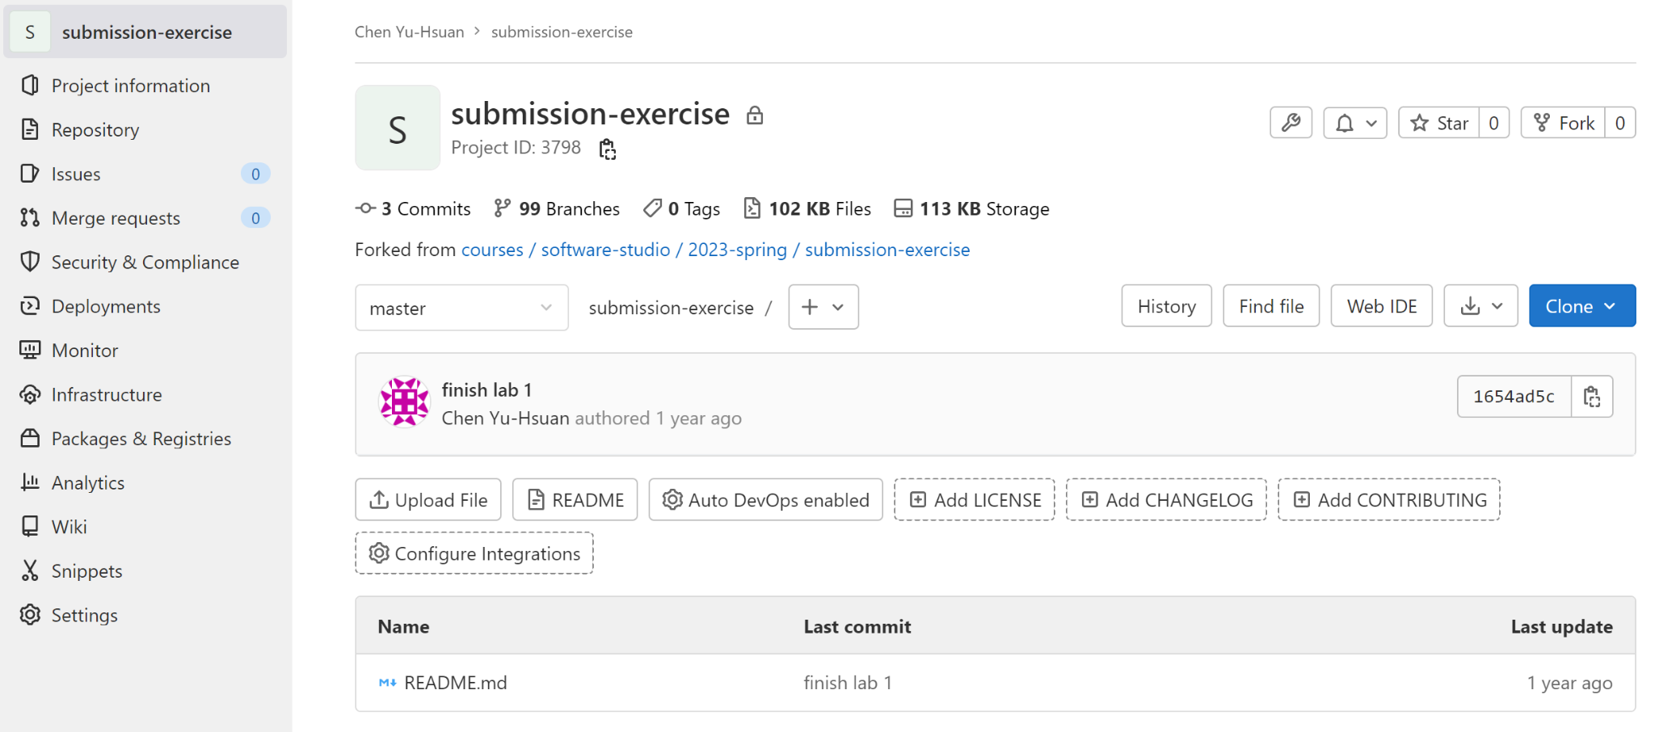
5. Check if this repository is under your account
6. Go to settings

Slide 71
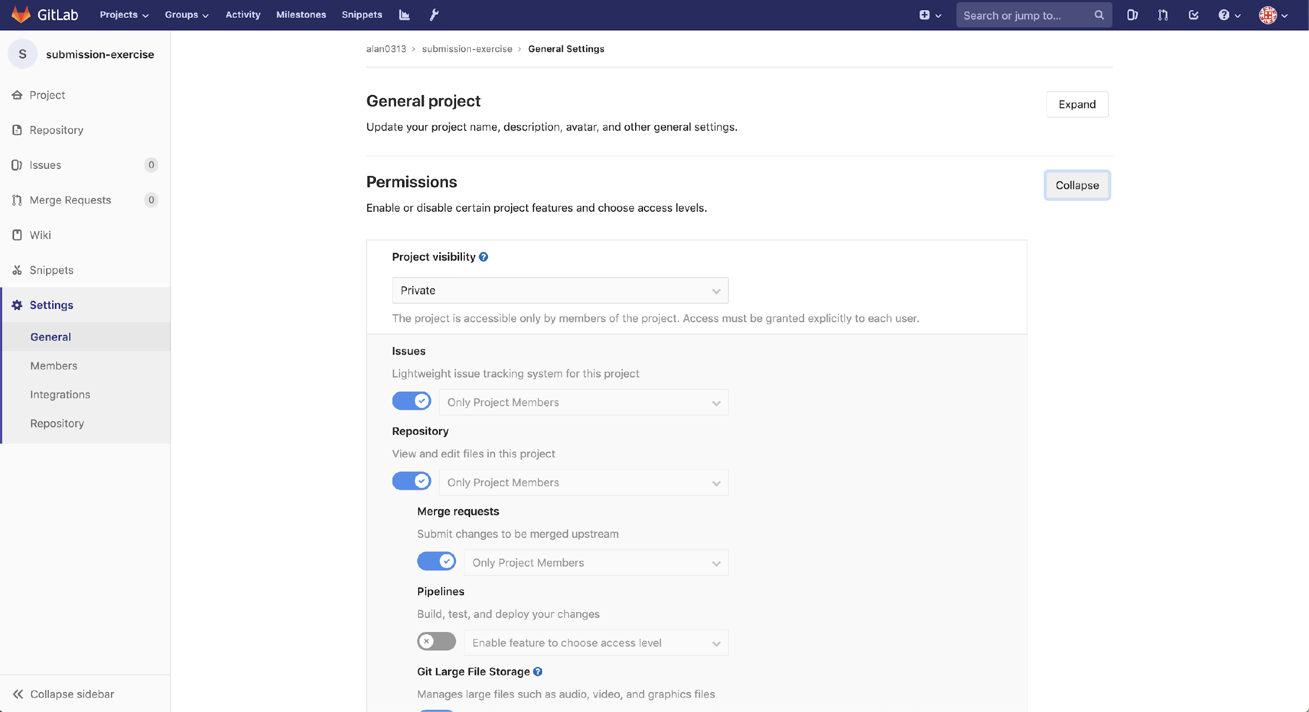
7. Set project to private

Slide 72
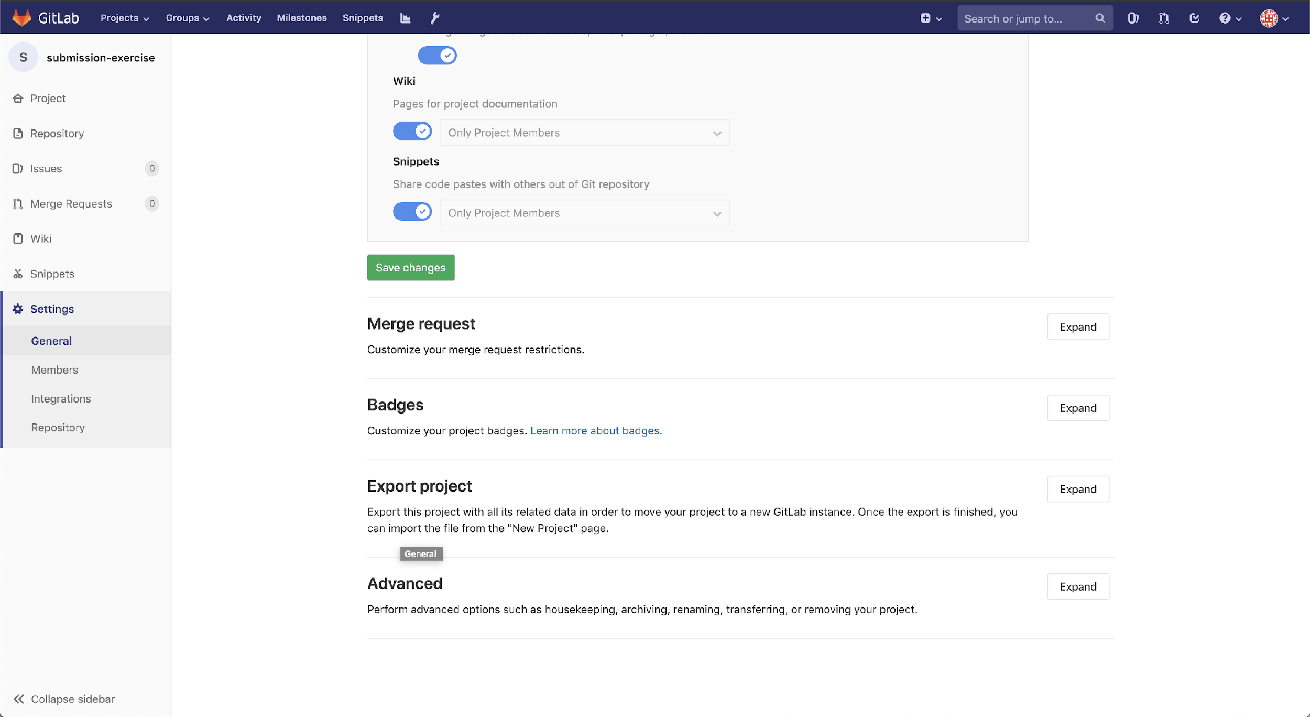
8. Scroll down and save changes

Slide 73
Workflow
For each lab, you should follow the workflow below
Fork our template repository on Gitlab
Clone the forked repository to your computer
Finish your lab
Commit in your computer
Push to Gitlab
Send merge request of your branch to our template repository

Slide 74
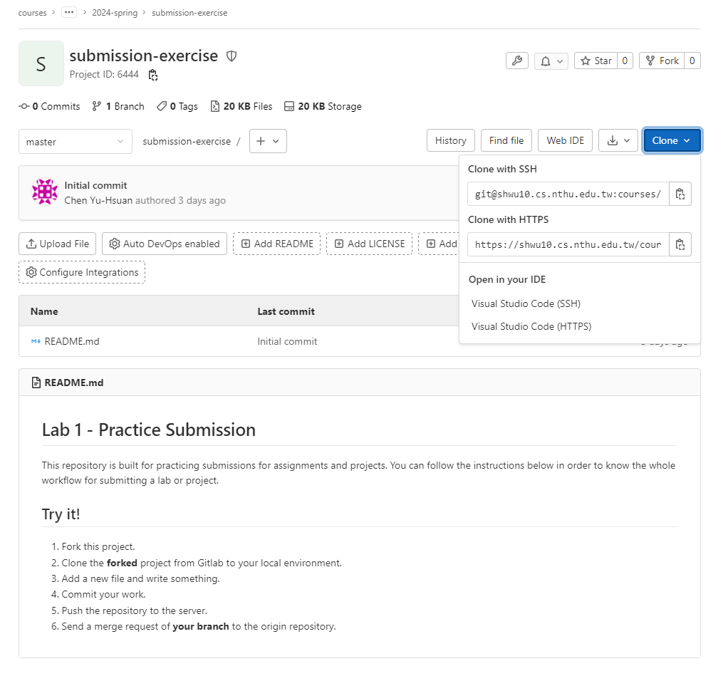
2. Copy the link
1. Choose HTTPS

Slide 75
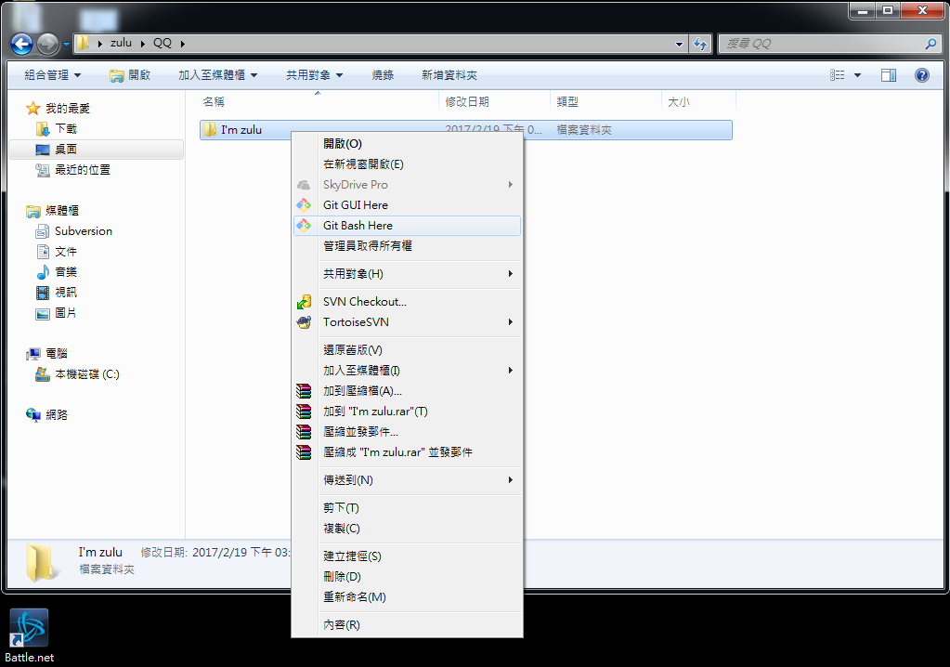

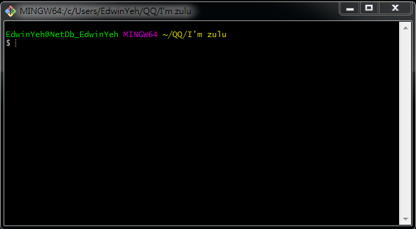
If You use Windows

Slide 76
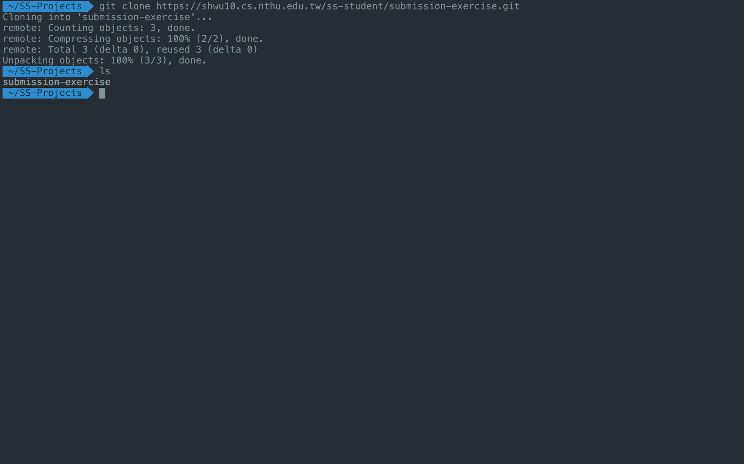
3. Create a folder to put your repos
4. Type "git clone {URL}"
5. The repo has been successfully cloned

Slide 77
Workflow
For each lab, you should follow the workflow below
Fork our template repository on Gitlab
Clone the forked repository to your computer
Finish your lab
Commit in your computer
Push to Gitlab
Send merge request of your branch to our template repository

Slide 78
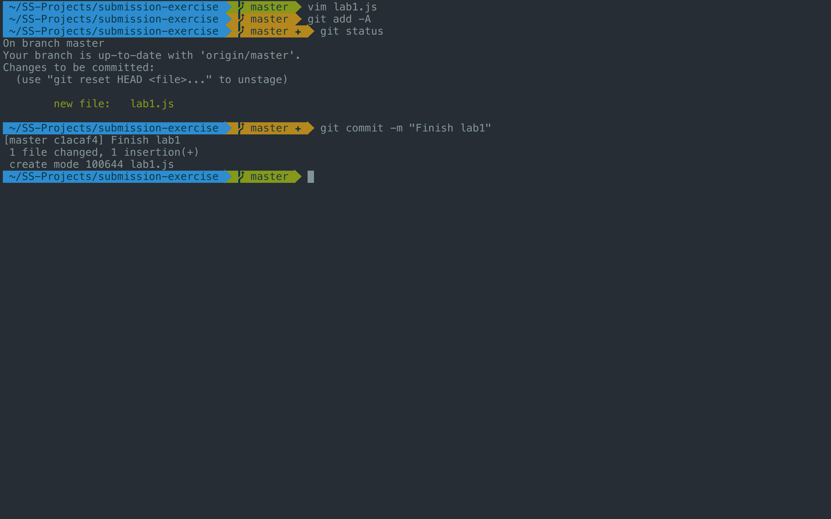
1. -A means all files
2. Check if your file is added to git
3. Commit your changes

Slide 79
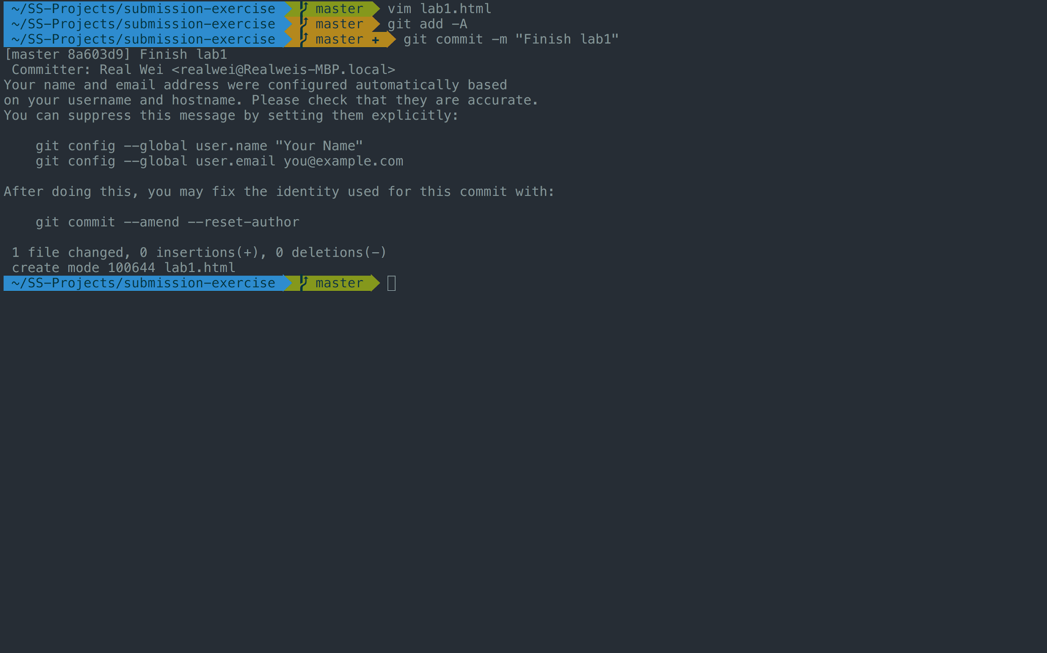
If you see these message, type
git config --global user.name "{name}"
git config --global user.email "{email}"
{email} is the email you use on gitlab

Slide 80
Workflow
For each lab, you should follow the workflow below
Fork our template repository on Gitlab
Clone the forked repository to your computer
Finish your lab
Commit in your computer
Push to Gitlab
Send merge request of your branch to our template repository

Slide 81
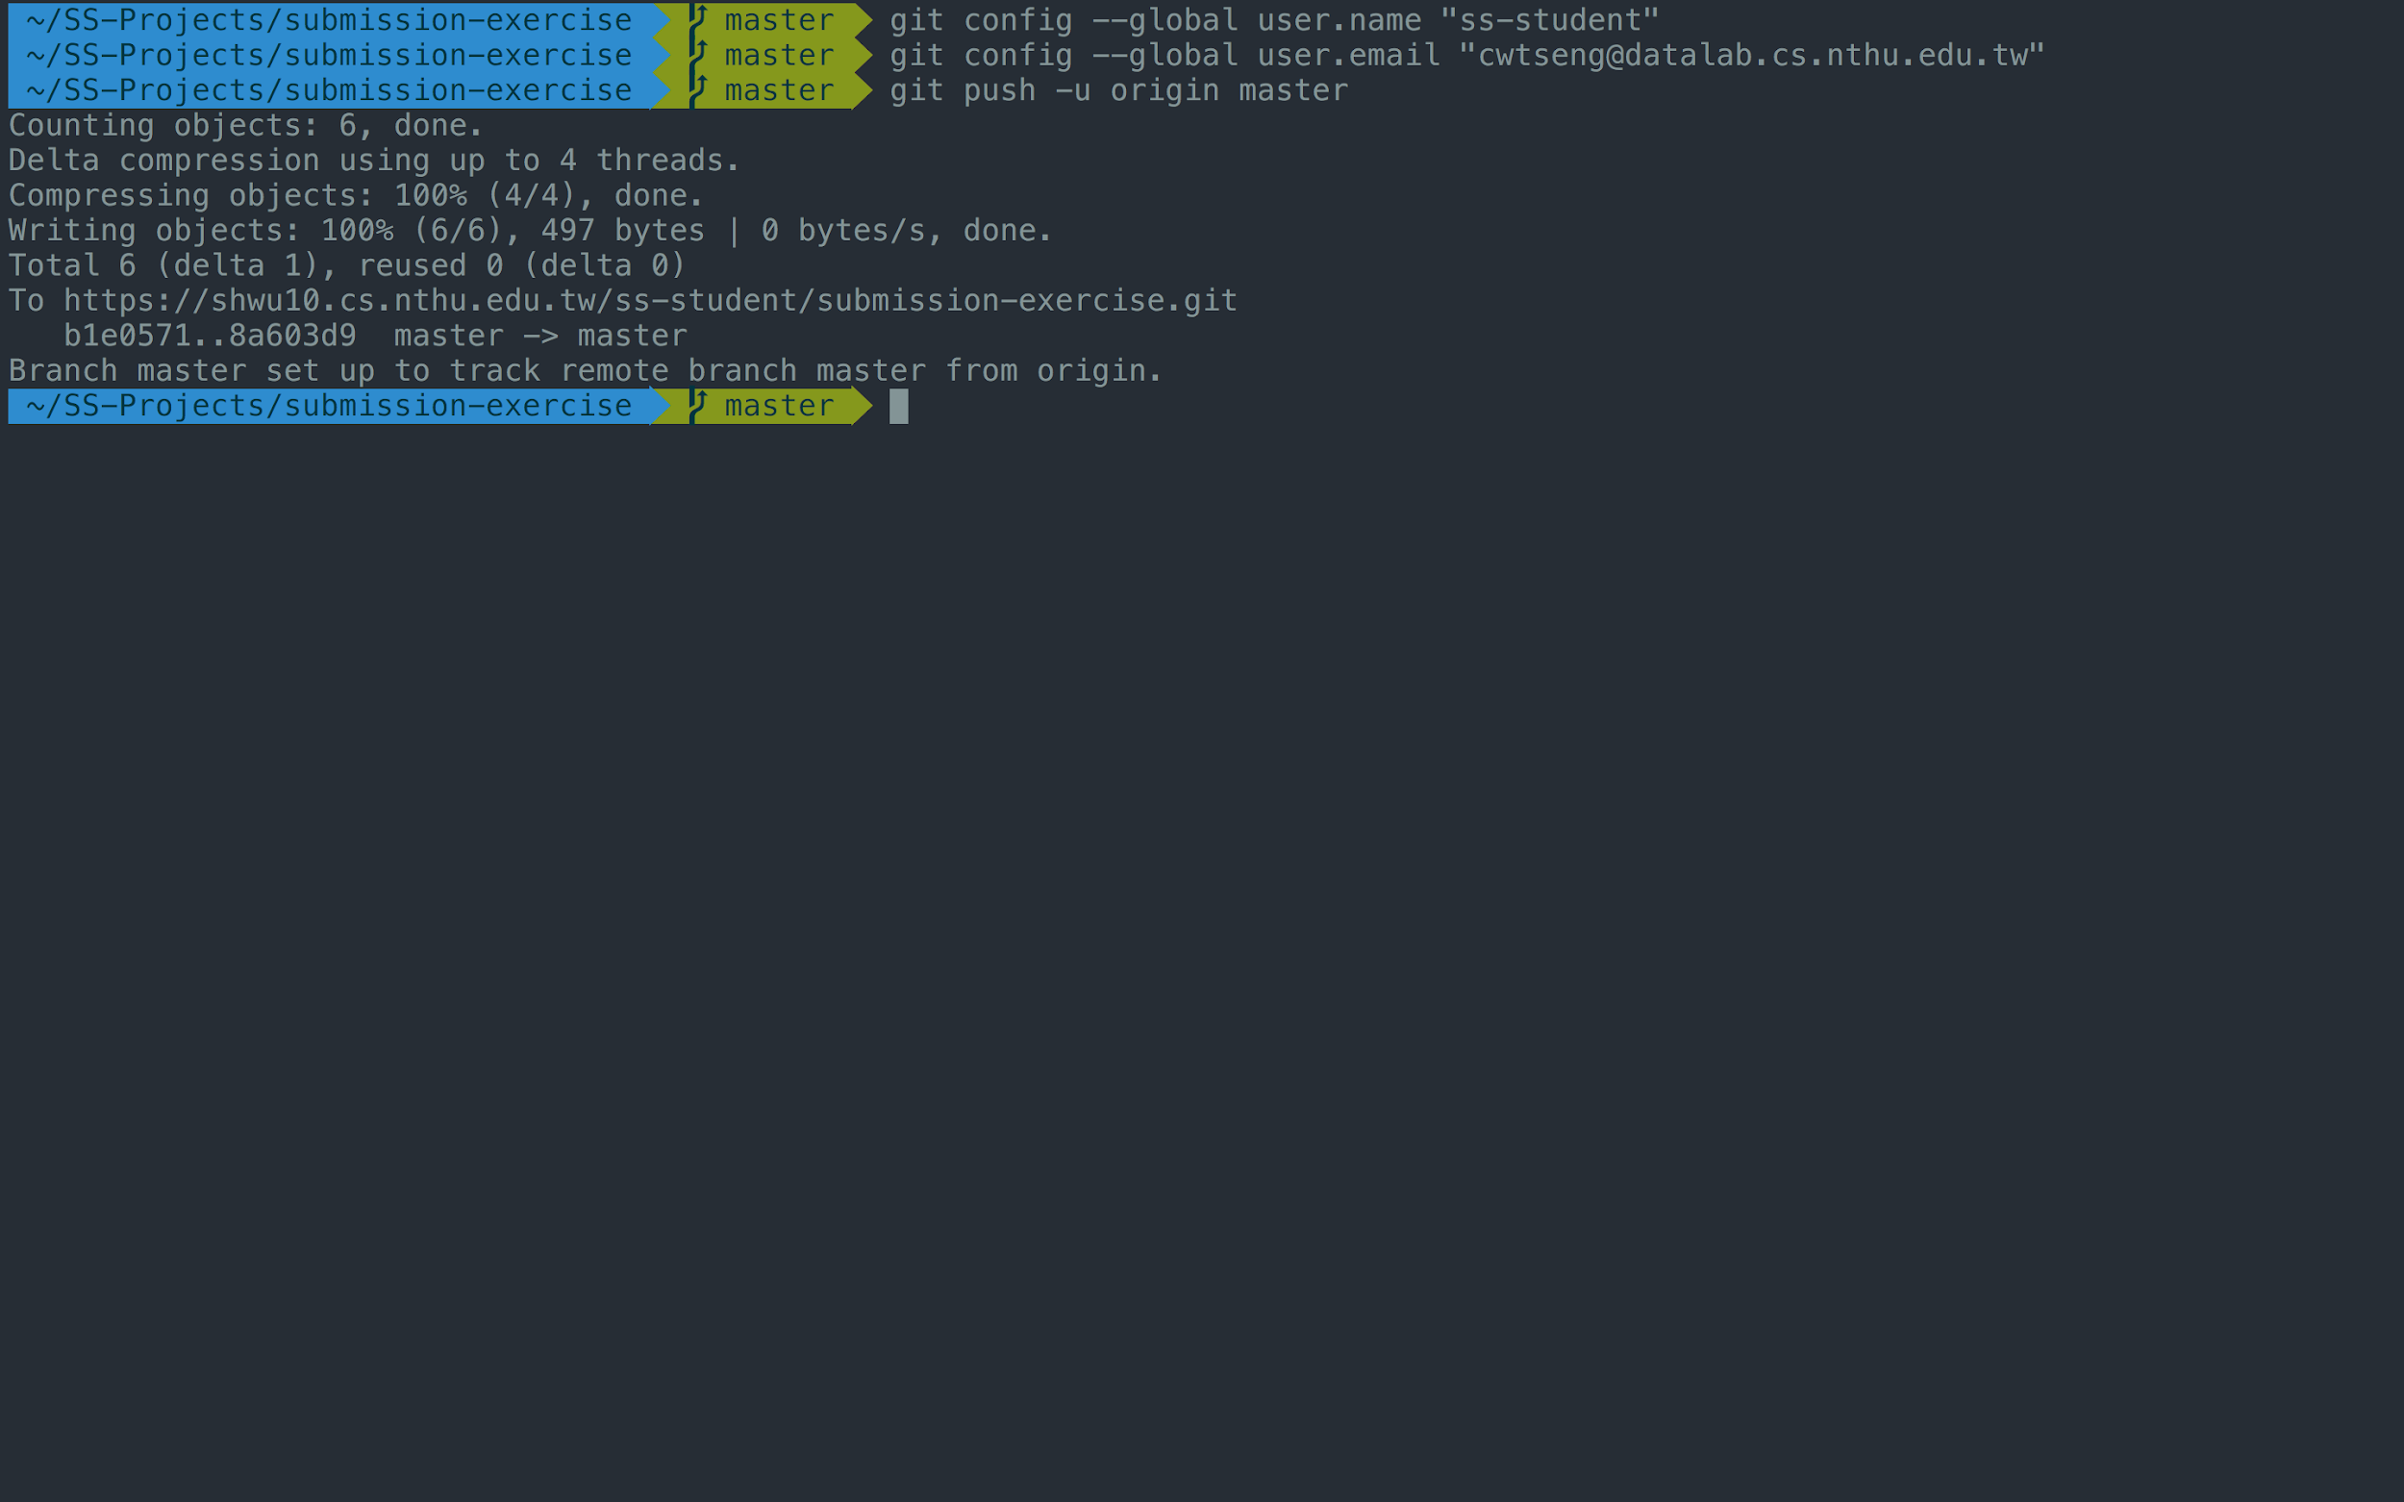
Type "git push -u origin master"

Slide 82
Workflow
For each lab, you should follow the workflow below
Fork our template repository on Gitlab
Clone the forked repository to your computer
Finish your lab
Commit in your computer
Push to Gitlab
Send merge request of your branch to our template repository

Slide 83
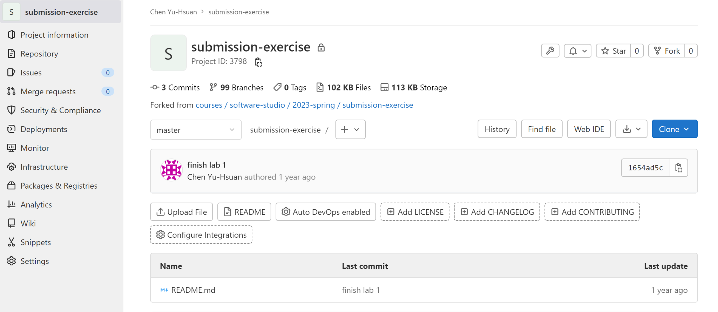
1. Click Merge Requests

Slide 84
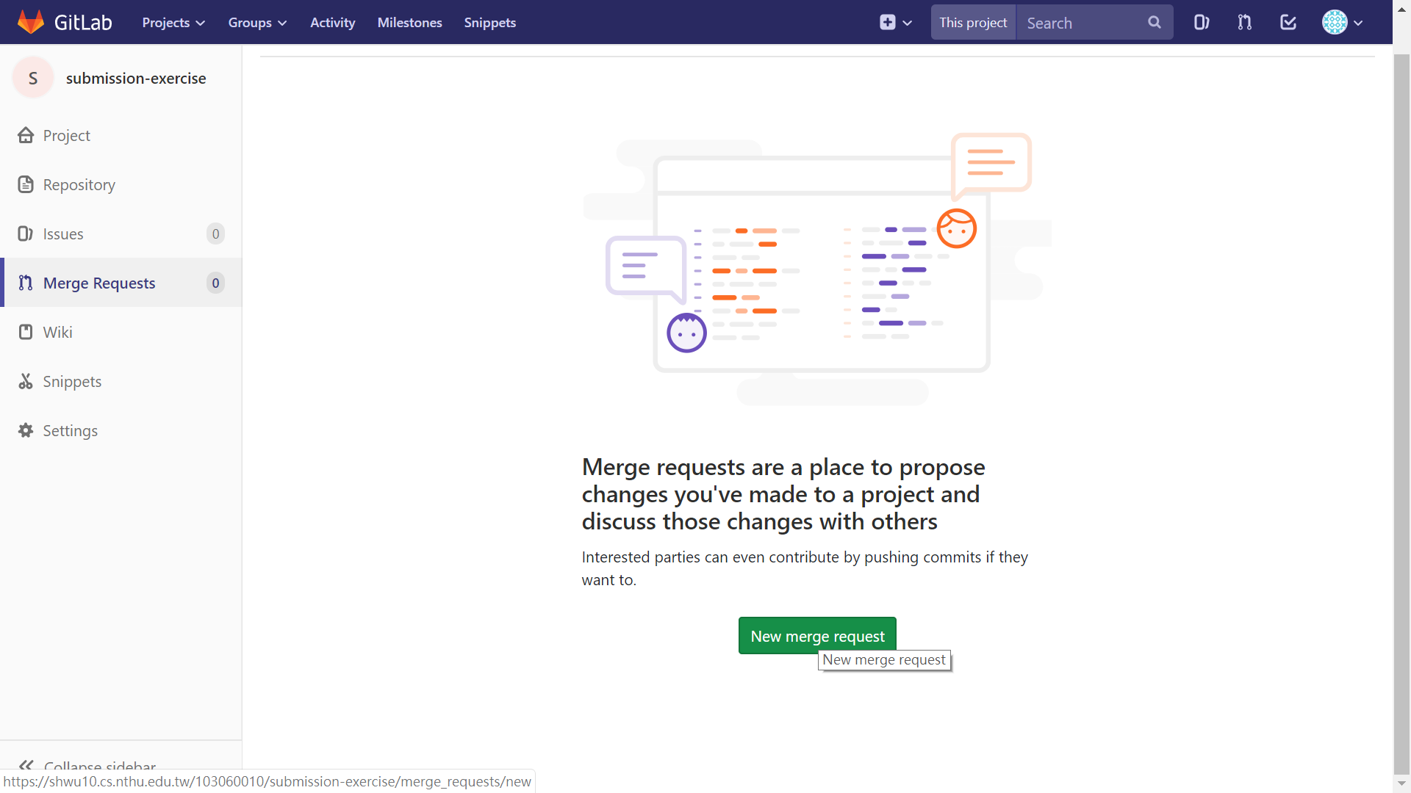
2. New merge request

Slide 85
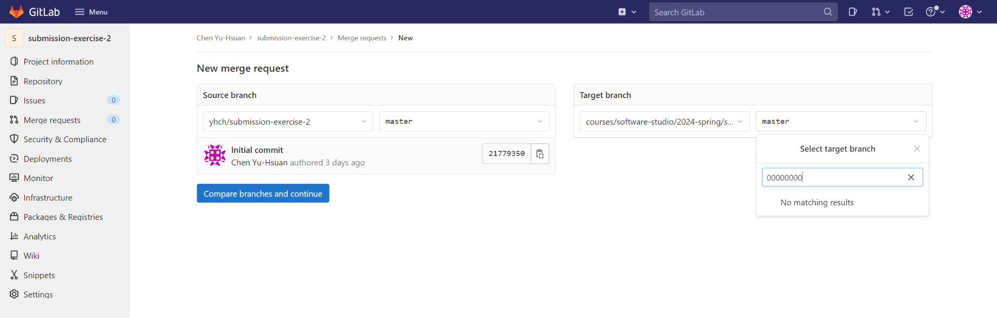
3. Choose the branch you pushed in your repo
Ensure that the commit in the version record of the selected branch matches the commit name of the final version you have in mind.

Slide 86
4. Choose the branch named after your ID
Ensure that the source of the selected branch is the class folder (courses/software-studio/2024-spring/submission-exercise) and your student ID (not master or someone else’s student ID).

Slide 87
5. Compare branches

Slide 88
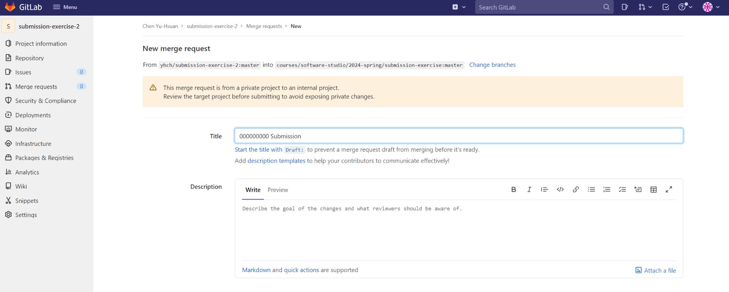
You can also confirm or change whether the selected branch is correct in this section. For instance, in the picture, the course branch selected is master, which is incorrect. The correct one should be courses/software-studio/2024-spring/submission-exercise: {your student ID}.
6. Set title to "{ID} Submission"

Slide 89
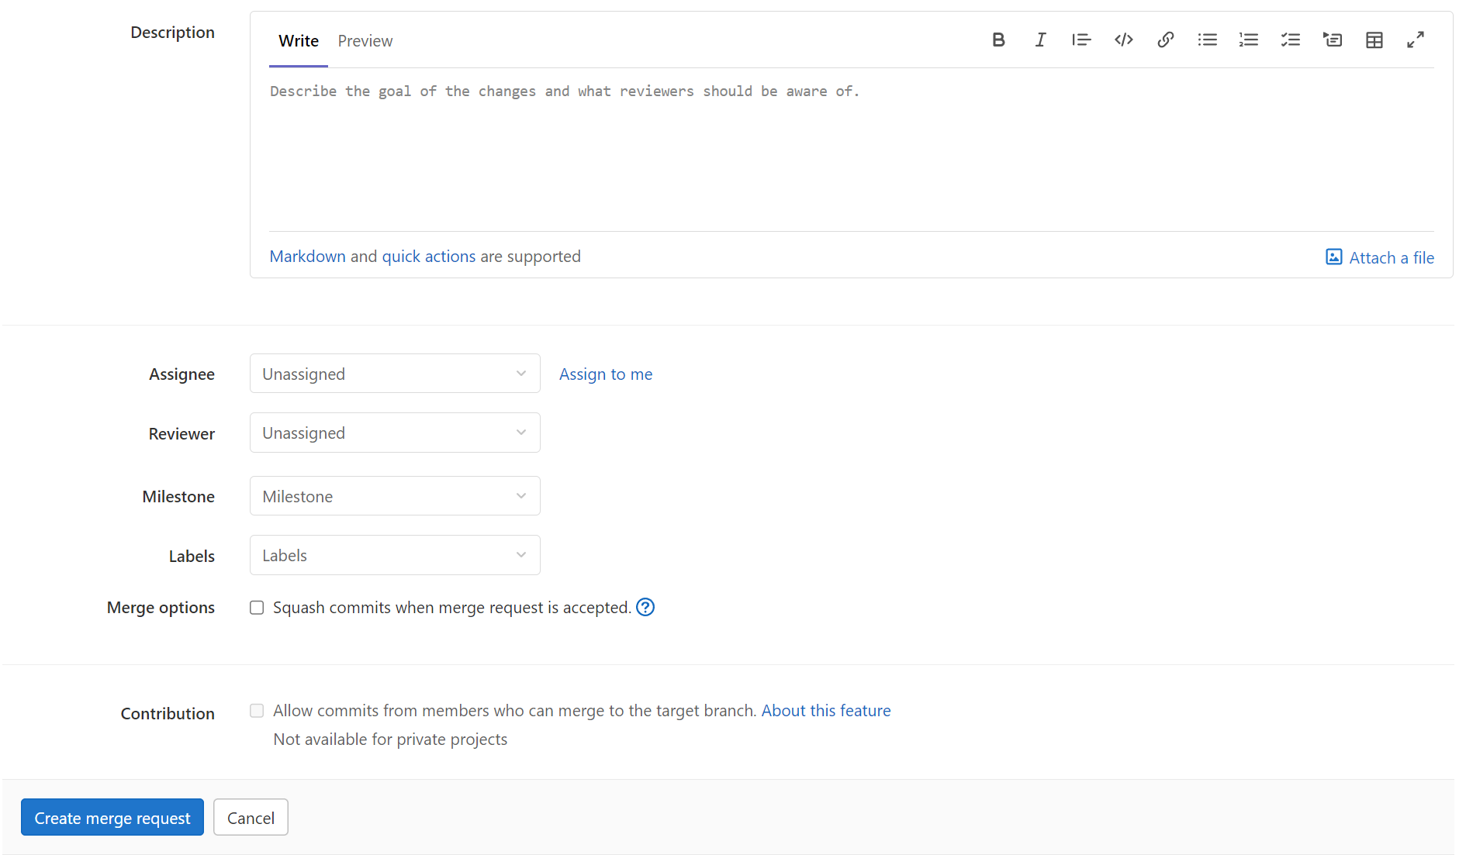
7. If everything is OK,
submit your merge request

Slide 90

Notice - Don’t do this

Slide 91
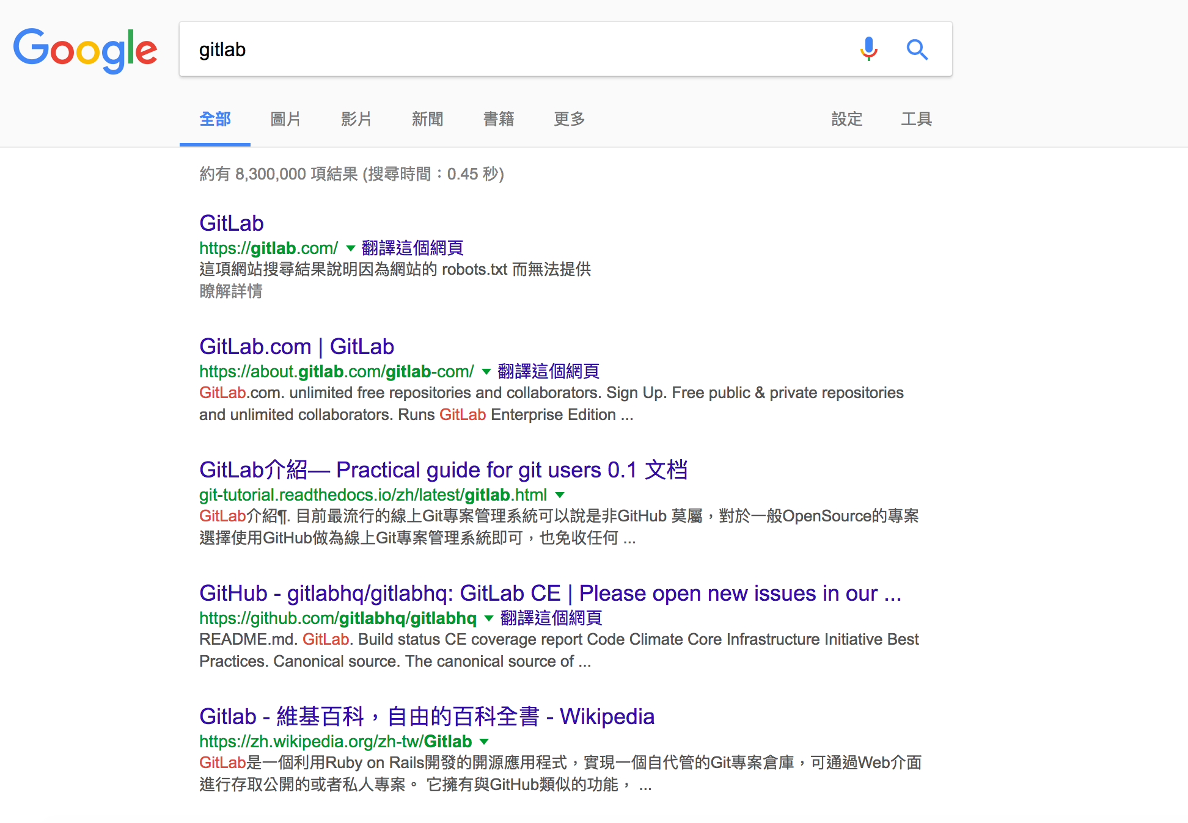
Notice - Don’t do this

Slide 92
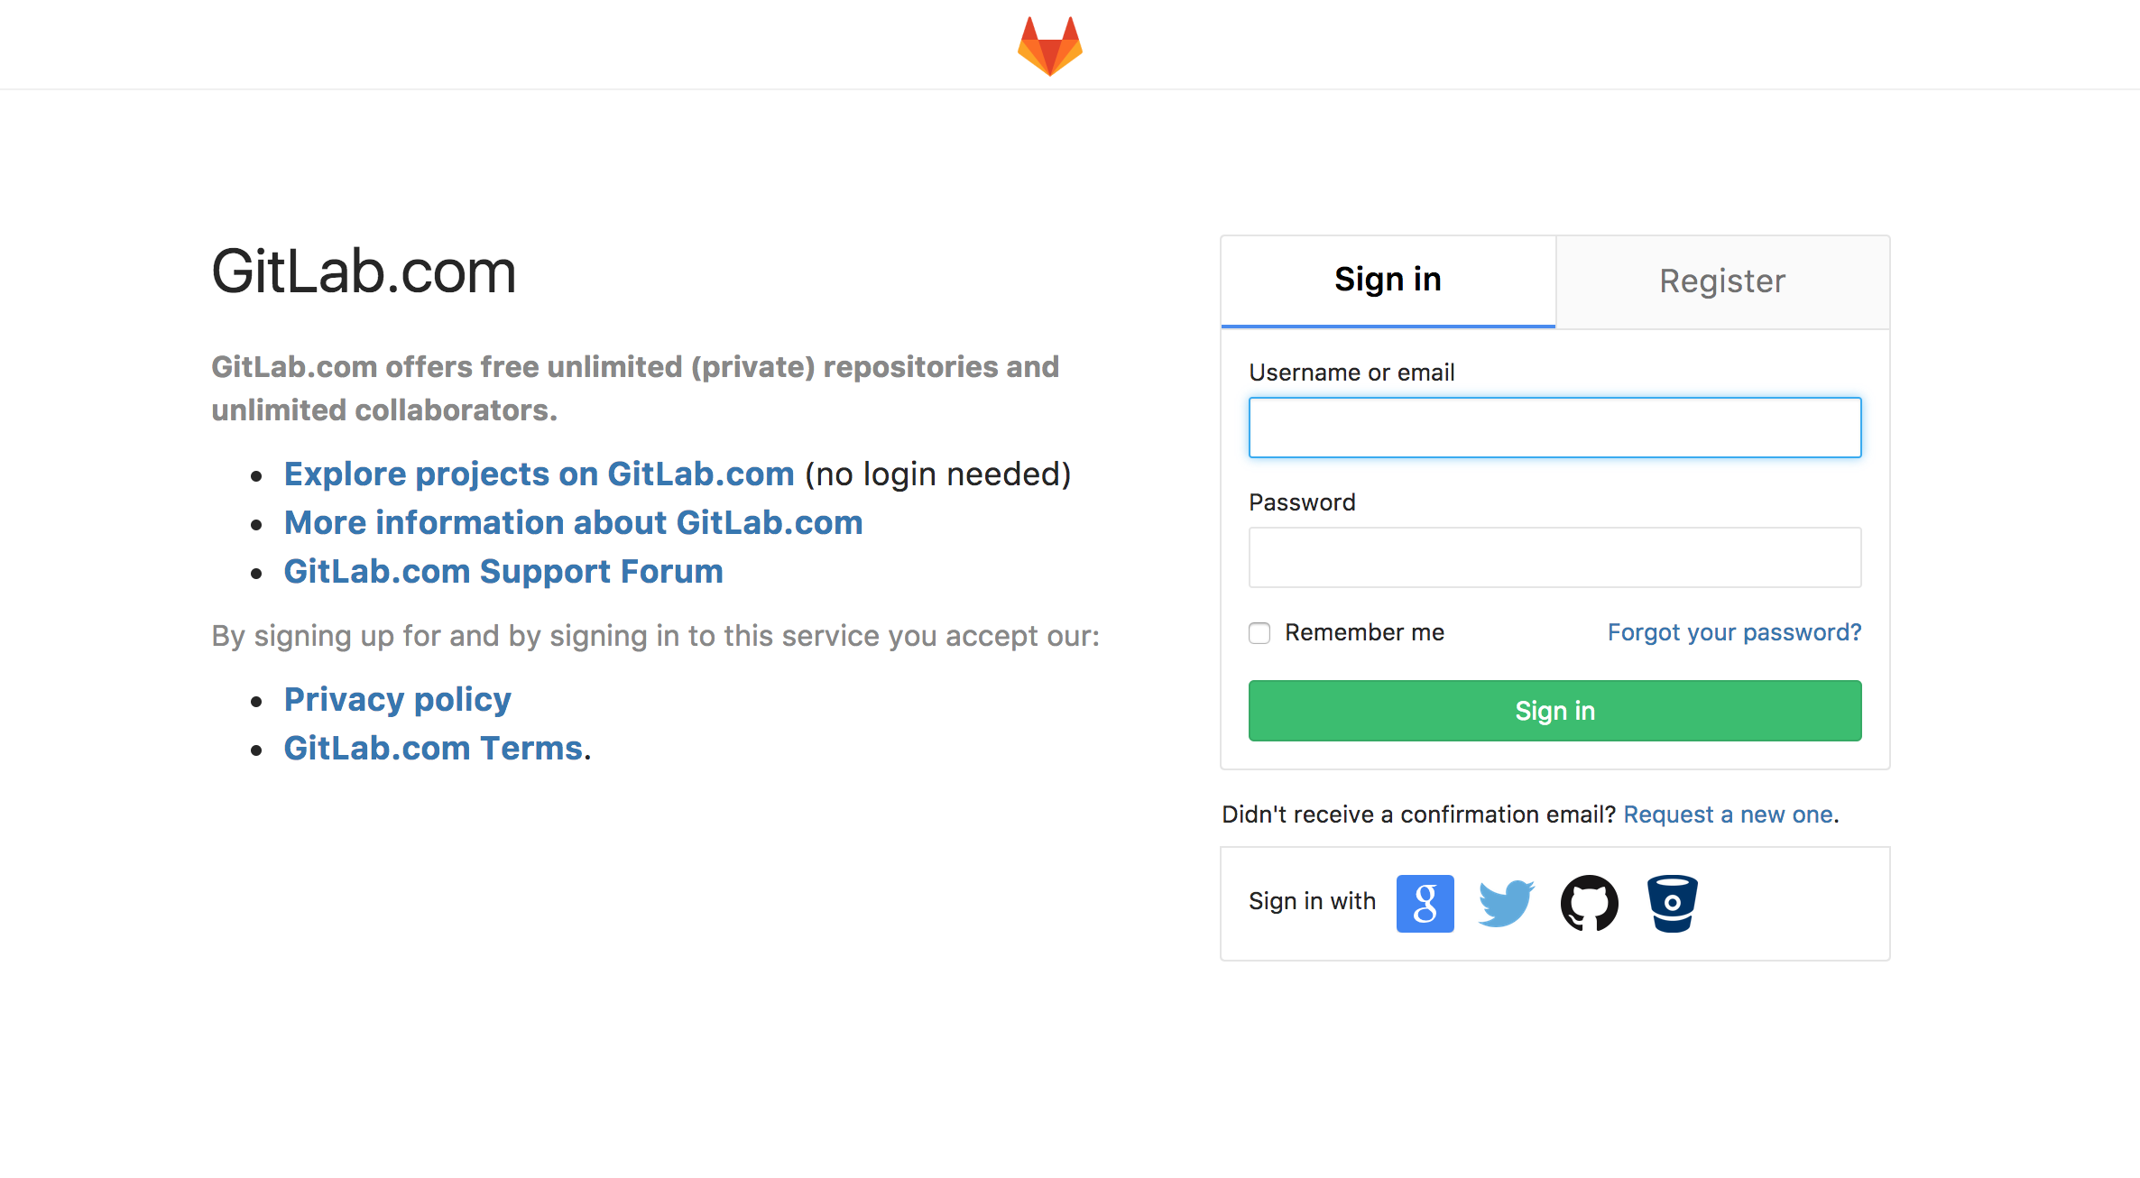
Notice - Don’t do this

Slide 93
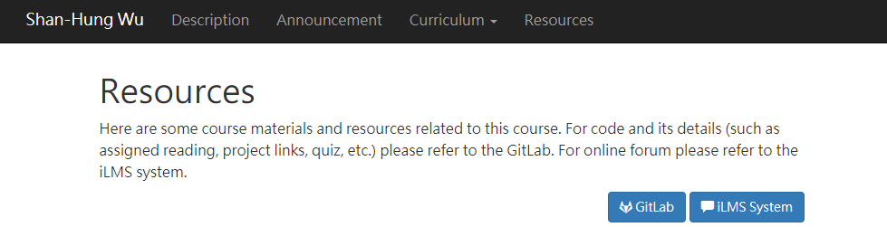
The GitLab setup in our laboratory is accessible through the link.
Here!!!!!

Slide 94
Outline
General Rule
Introduction to Git
Version control
Git Basics
Try Git!
Remote Repositories
How to Submit Your Code to Gitlab
Tools & References

Slide 95
Tools
Git GUI
GitKraken
Editor / IDE
Visual Studio Code
Atom
Sublime Text
Brackets
Notepad++
Webstorm

Slide 96


Slide 97
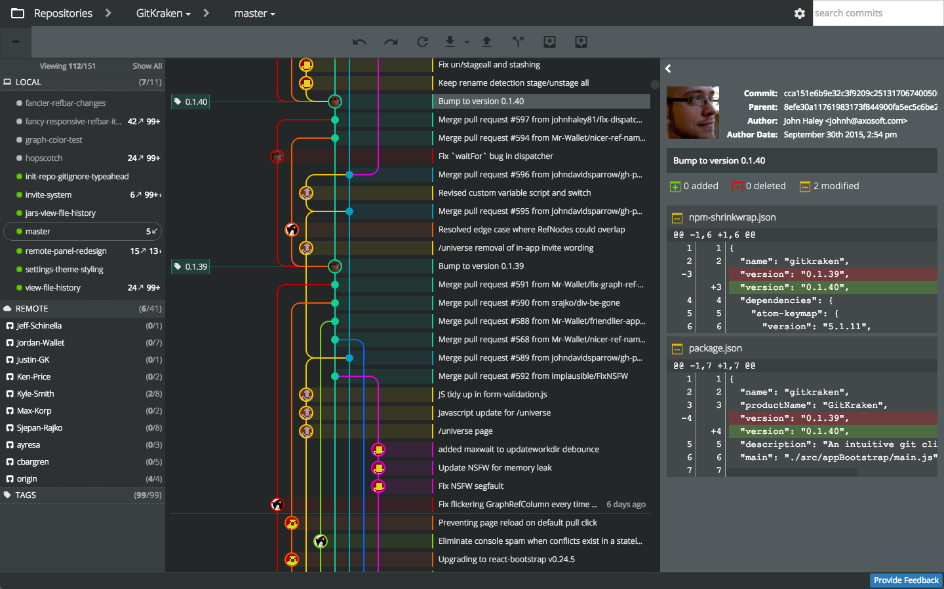

Slide 98


Slide 99
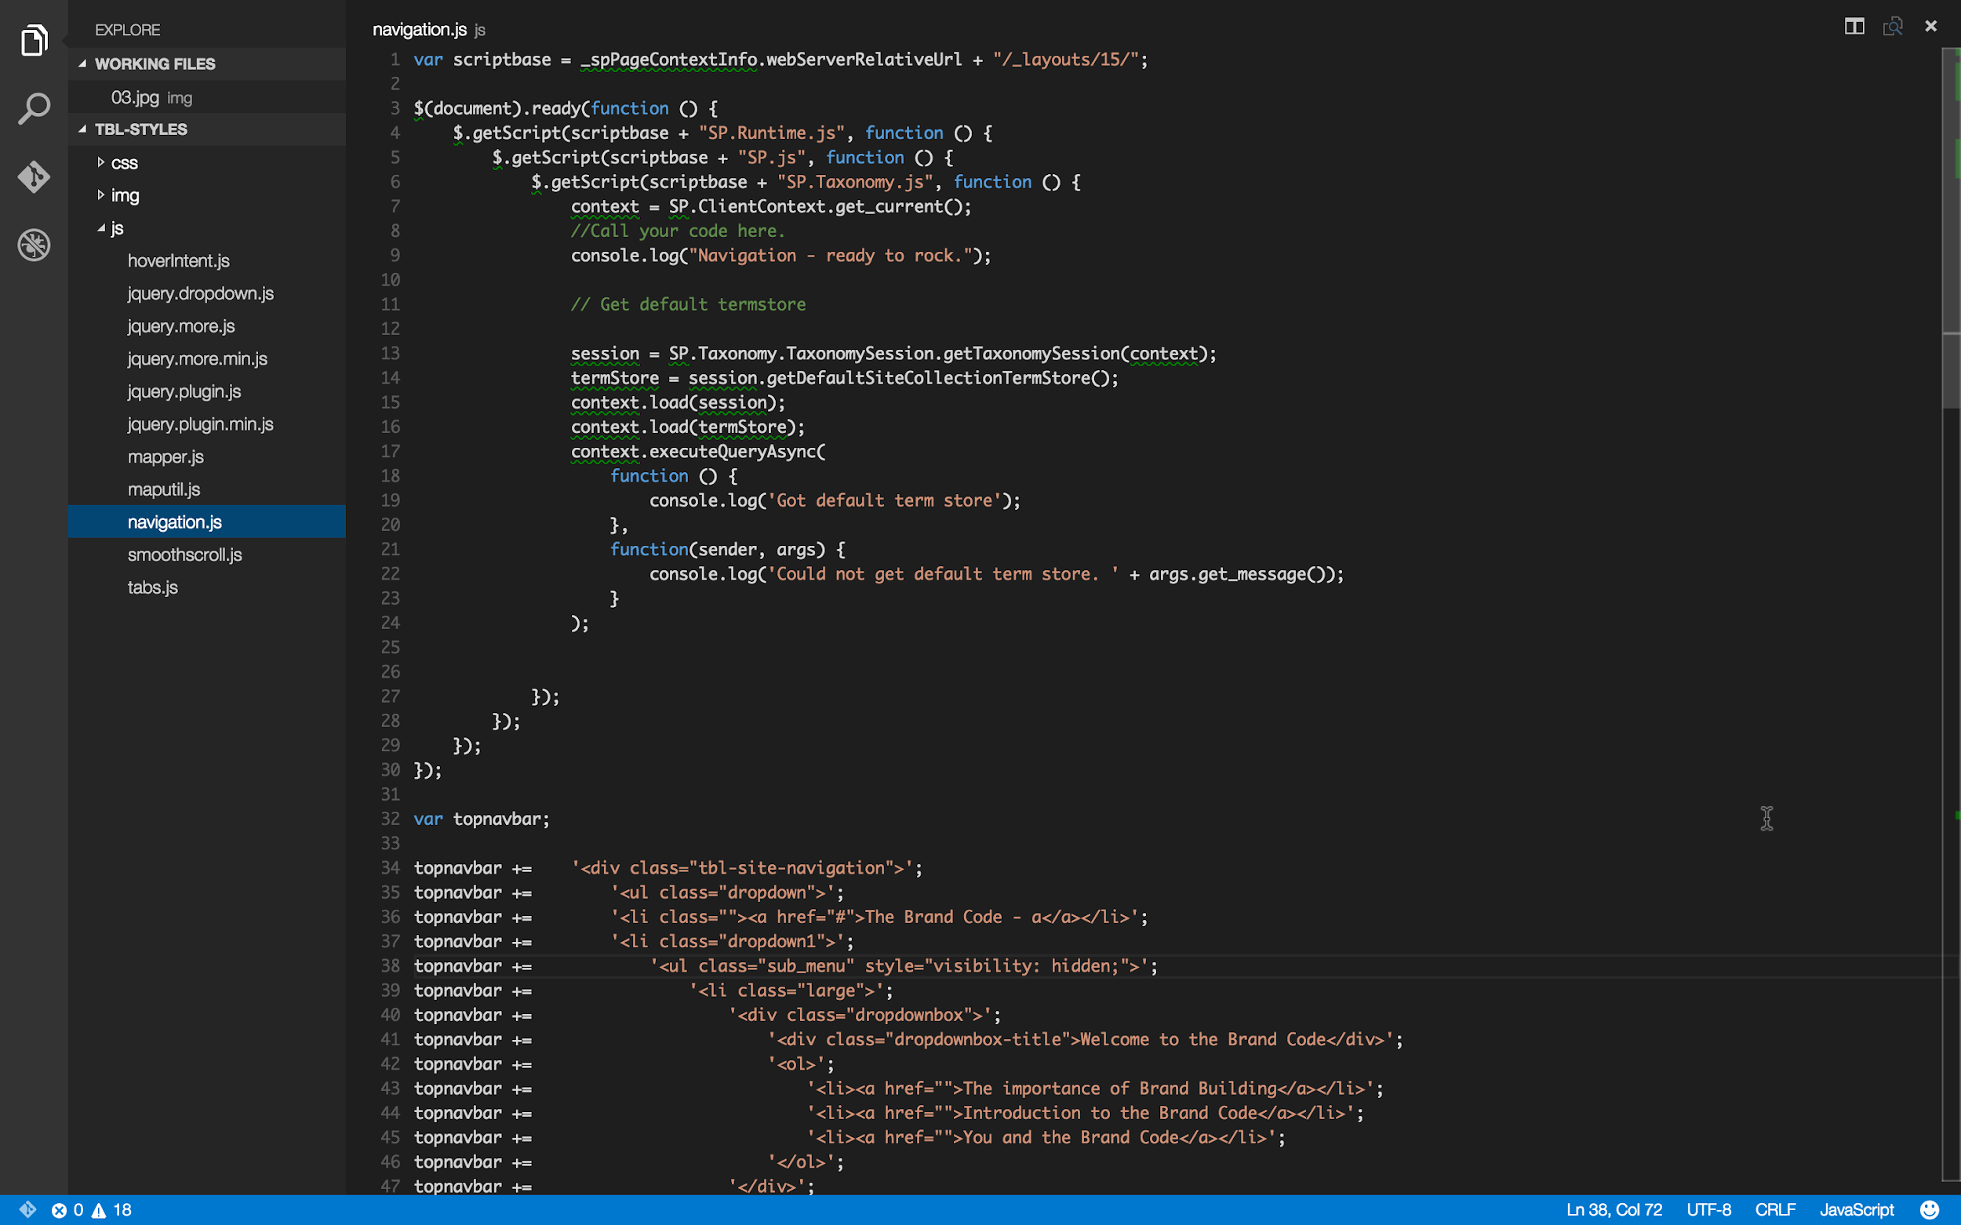

Slide 100
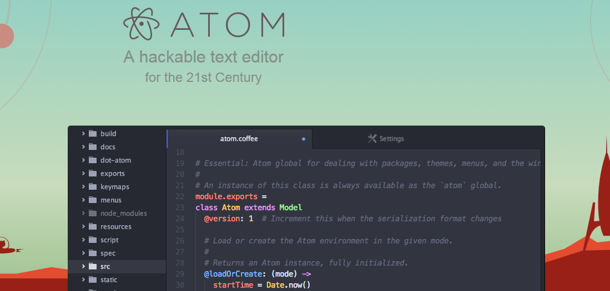

Slide 101
Reference
Learn Git branching (interactive)
http://pcottle.github.io/learnGitBranching/
Pro Git
http://git-scm.com/book/
寫給大家的 Git 教學
http://www.slideshare.net/littlebtc/git-5528339

Slide 102
Today’s exercise
Install Git command line tool in your computer.
Follow appendix “Git Command-line Tool Installation”.
Try to submit in GitLab.

