Slide 1
Lab 00
How to Survive &
Introduction to Git
Software Studio
DataLab, CS, NTHU

Slide 2
Notice
These slides will focus on how to submit you code by using Git command line
You can also use other Git GUI tool or built-in Git tool in other IDE/editor

Slide 3

Teaching Assistants

Slide 4
How to Find Us?
Office Hour (TAs)
Tue. 1:30pm-3:30pm at Delta 729
Thur. 10:00am-12:00pm at Delta 729
Email
ssta2025@datalab.cs.nthu.edu.tw
Online Forum
eeclass

Slide 5


If I have Question?

Slide 6
If I have Question?
Always Google or ask Chatgpt first!
Learn how to google and generative AI is important.
If you try your best but still can’t catch it.
Feel free to ask us on eeclass or office hour.

Slide 7
Today’s exercise
Install Git command line tool in your computer
Follow appendix “Git Command-line Tool Installation”.
Try to submit in GitLab.
Set up flutter environment (If we have time)

Slide 8
Outline
General Rule
Introduction to Git
Version control
Branch and merge
How to Submit Your Code to Gitlab
Tools & References

Slide 9
Outline
General Rule
Introduction to Git
Version control
Branch and merge
How to Submit Your Code to Gitlab
Tools & References

Slide 10
The Policy of Labs
All labs need to be submitted to GitLab.
Late submission will not be accepted.
Plagiarism will not be tolerated.
If we find you copy someone’s code, you will get 0 point for that lab.
Grading
Submission before lab ends gets 100% score
Submission before 11:59pm gets 60% score

Slide 11
Grading Example
4 problems, 25% each
Solved 4 during the lab
100
Solved 3 during the lab, 1 before 11:59pm
75 + 25*0.6 = 90
Solved 4 after the lab, before 11:59pm
100 * 0.6 = 60

Slide 12
Outline
General Rule
Introduction to Git
Version control
Branch and merge
How to Submit Your Code to Gitlab
Tools & References

Slide 13
Why should we use version control?

Slide 14
We want to track what we did and when we did it.

Slide 15
Why use version control system?
Managing your projects - tracking your files and modifications.
Synchronization between modifications made by different developers.
Revision history is still very helpful even if you work alone.

Slide 16
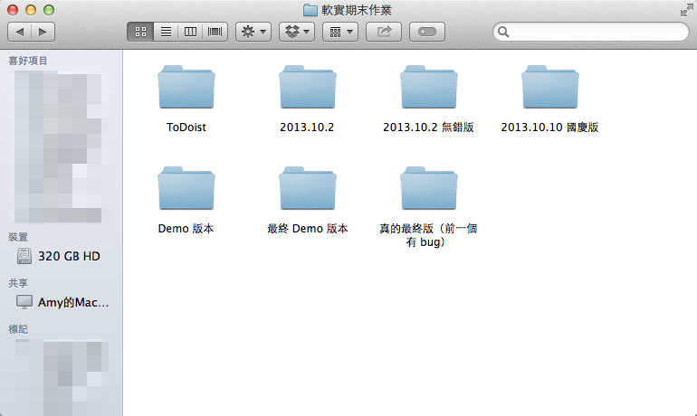
Students’ VCS
Notes:
It is easy to forget which directory you’re in and accidentally write to the wrong file or copy over files you don’t mean to

Slide 17

Git

Slide 18
Git
Git is a popular version control system which is
Fast
Easy to use
Distributed
A git repository is a mini database that tracks your files.
Notes:
Distributed:
It does not rely on aa central server to store all versions of a project file. Instead, developer has a complete copy of the repository, including its entire history.

Slide 19

Be Professional

Slide 20
Outline
General Rule
Introduction to Git
Version control
Branch and merge
How to Submit Your Code to Gitlab
Tools & References

Slide 21
Git VCS (1/2)
With a local repository in your computer, you’ll need following operations to make git track your work:
Create/modify files
Let git monitor the files by adding them to staging files.
Commit your changes to and git will create snapshots (versions) of the files for you.

Slide 22
Git VCS (2/2)
Modifying Files
2. add
modify file
Staging Modified Files
Committing A Version
3. commit
Committing B Version

Slide 23
Basic Git Commands
git init
Initialize a repository at current directory.
git add [file_name] ( * git add . * → means add all files )
Add files to git repository and let git track them.
git commit -m "commit messages"
Save the changes to the git repository and create snapshots of the files.
git checkout [version]
Go to a specific version.

Slide 24
scenario
Create a project repository and initialize Git, and track the HelloGit.txt file for version control.

Slide 25
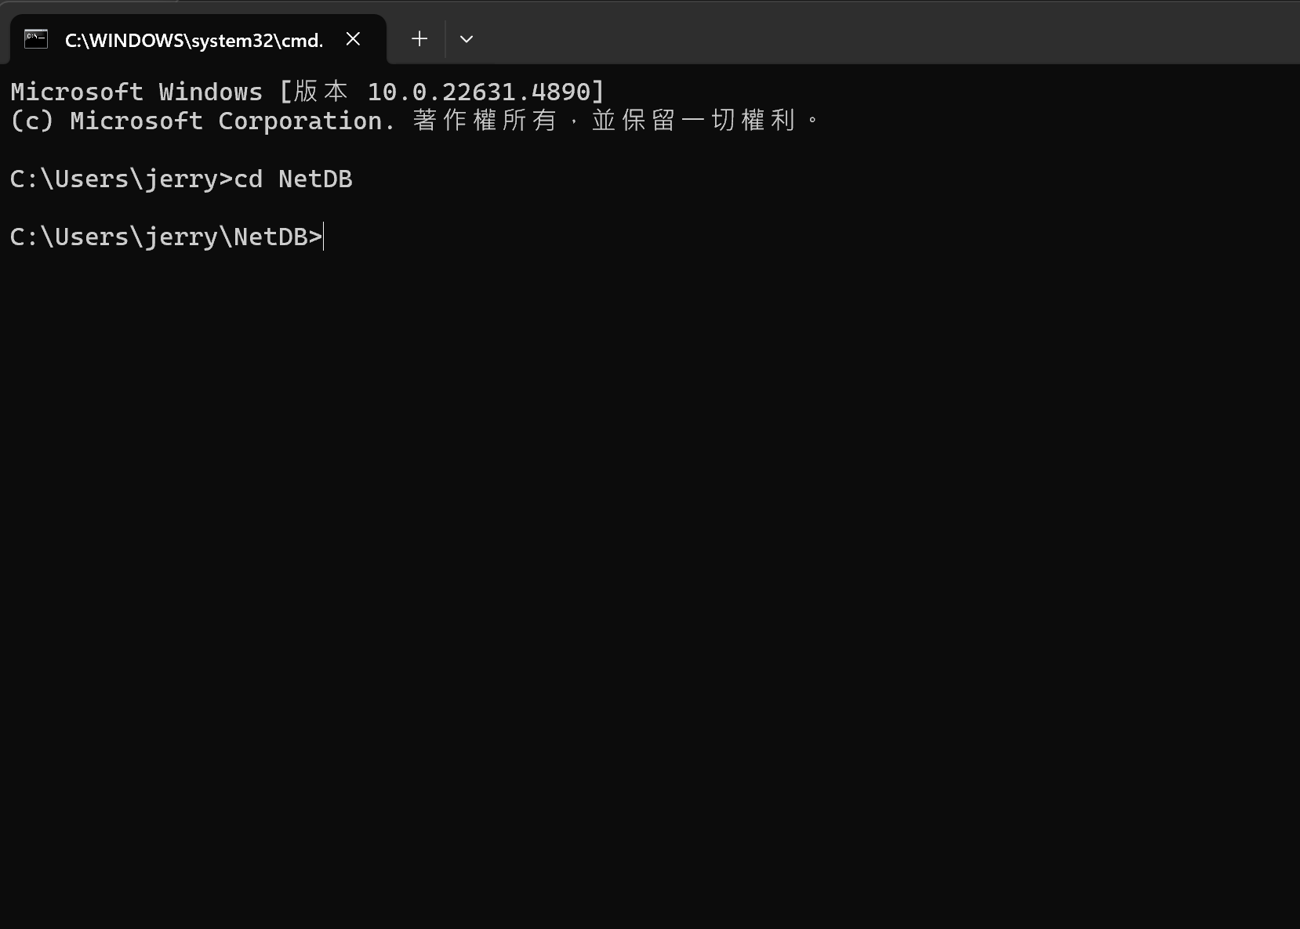
1. Navigate to the repository where you want to place the project.

Slide 26
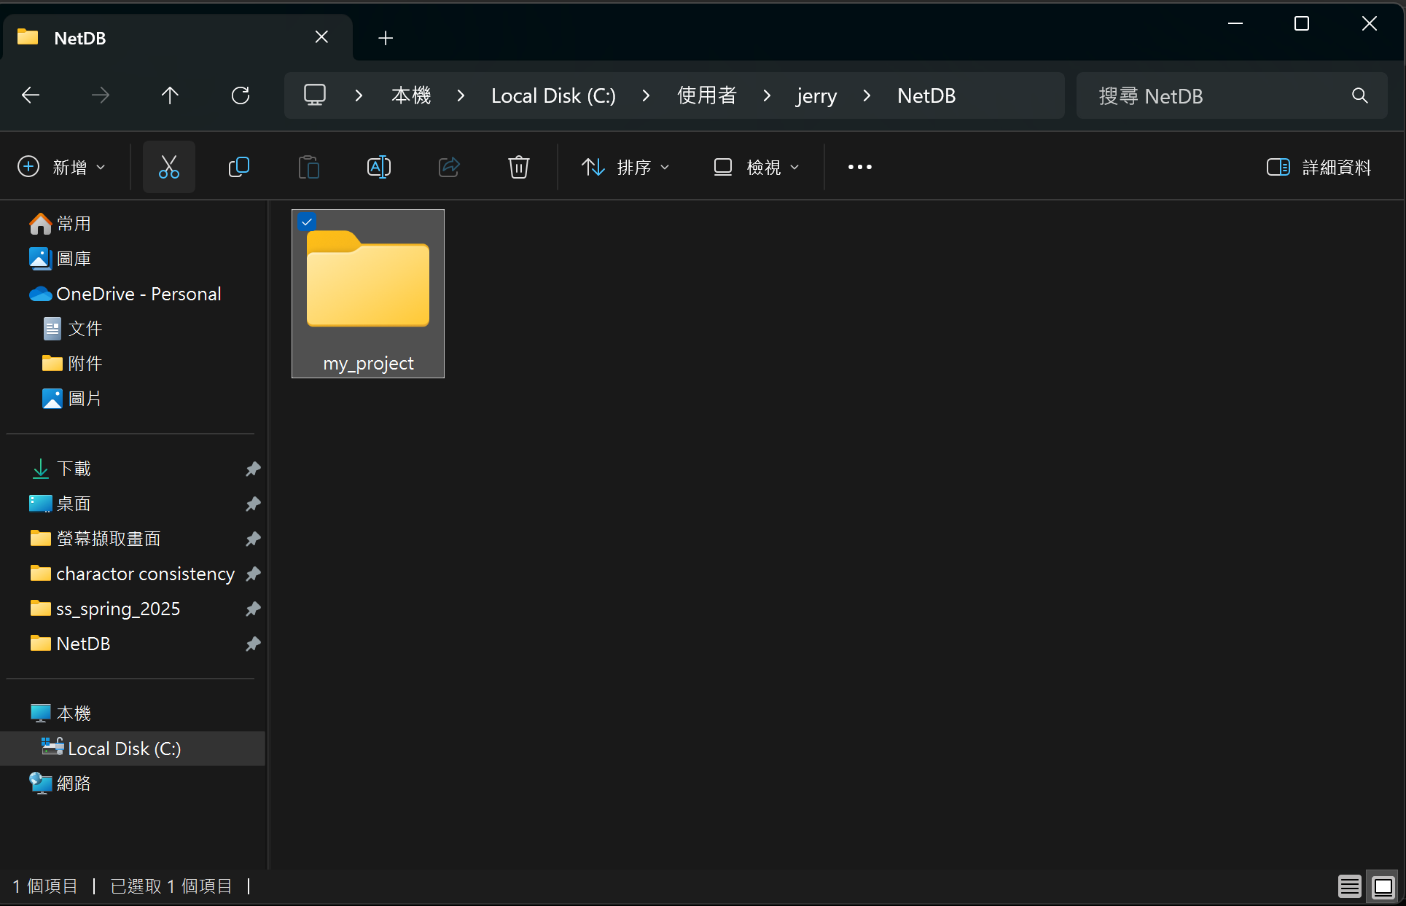
2. Create a folder for your project.

Slide 27
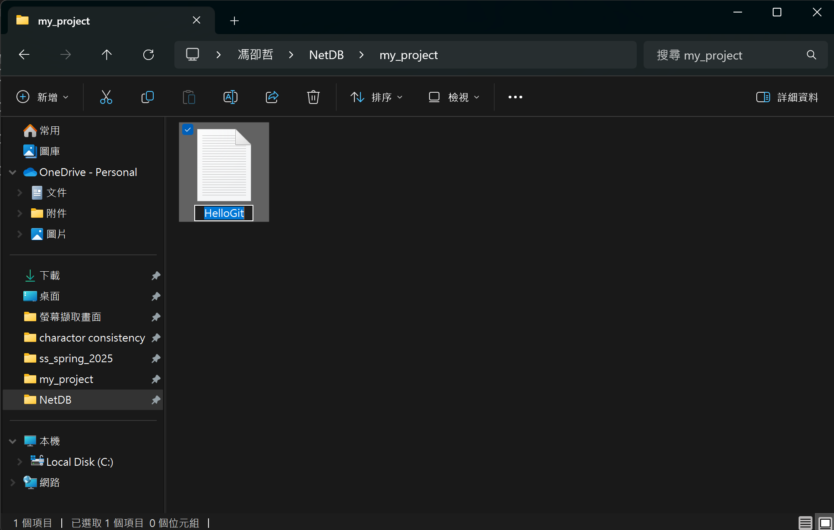
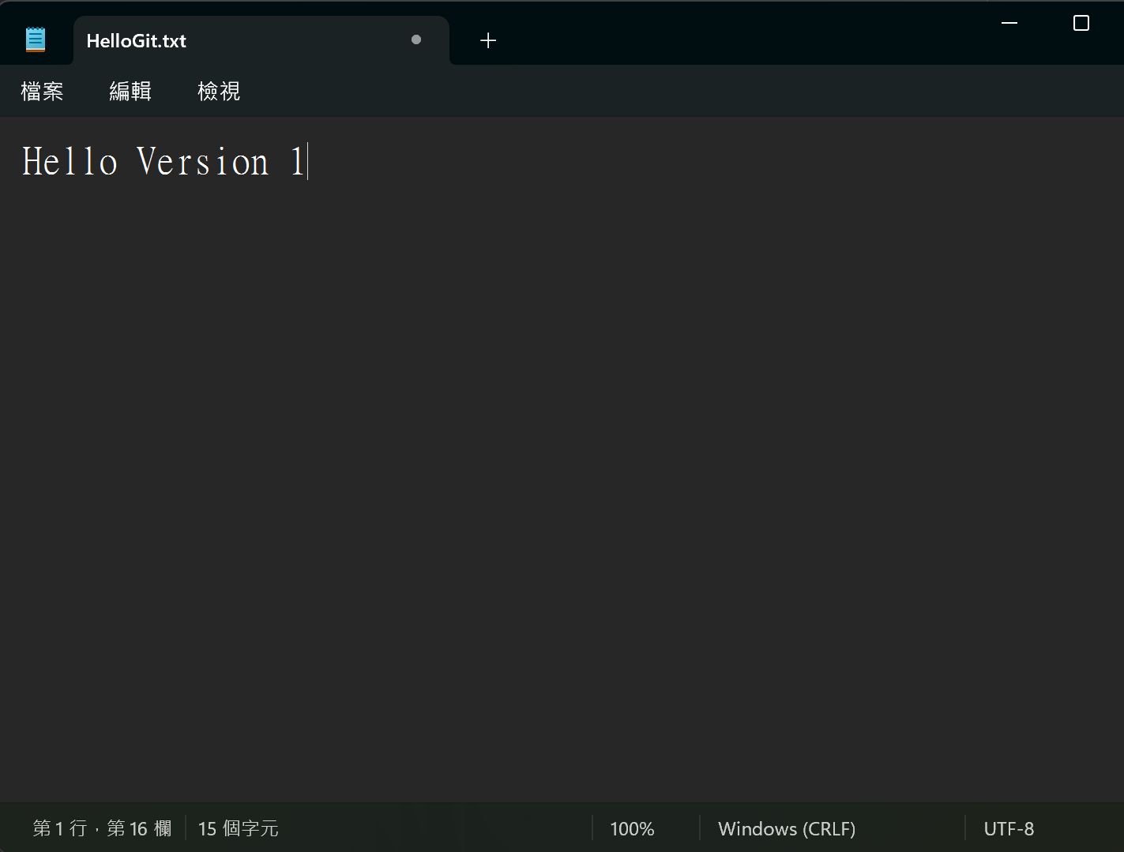
3. In your project folder create a HelloGit.txt file.
4. Write something in the HelloGit.txt file.

Slide 28
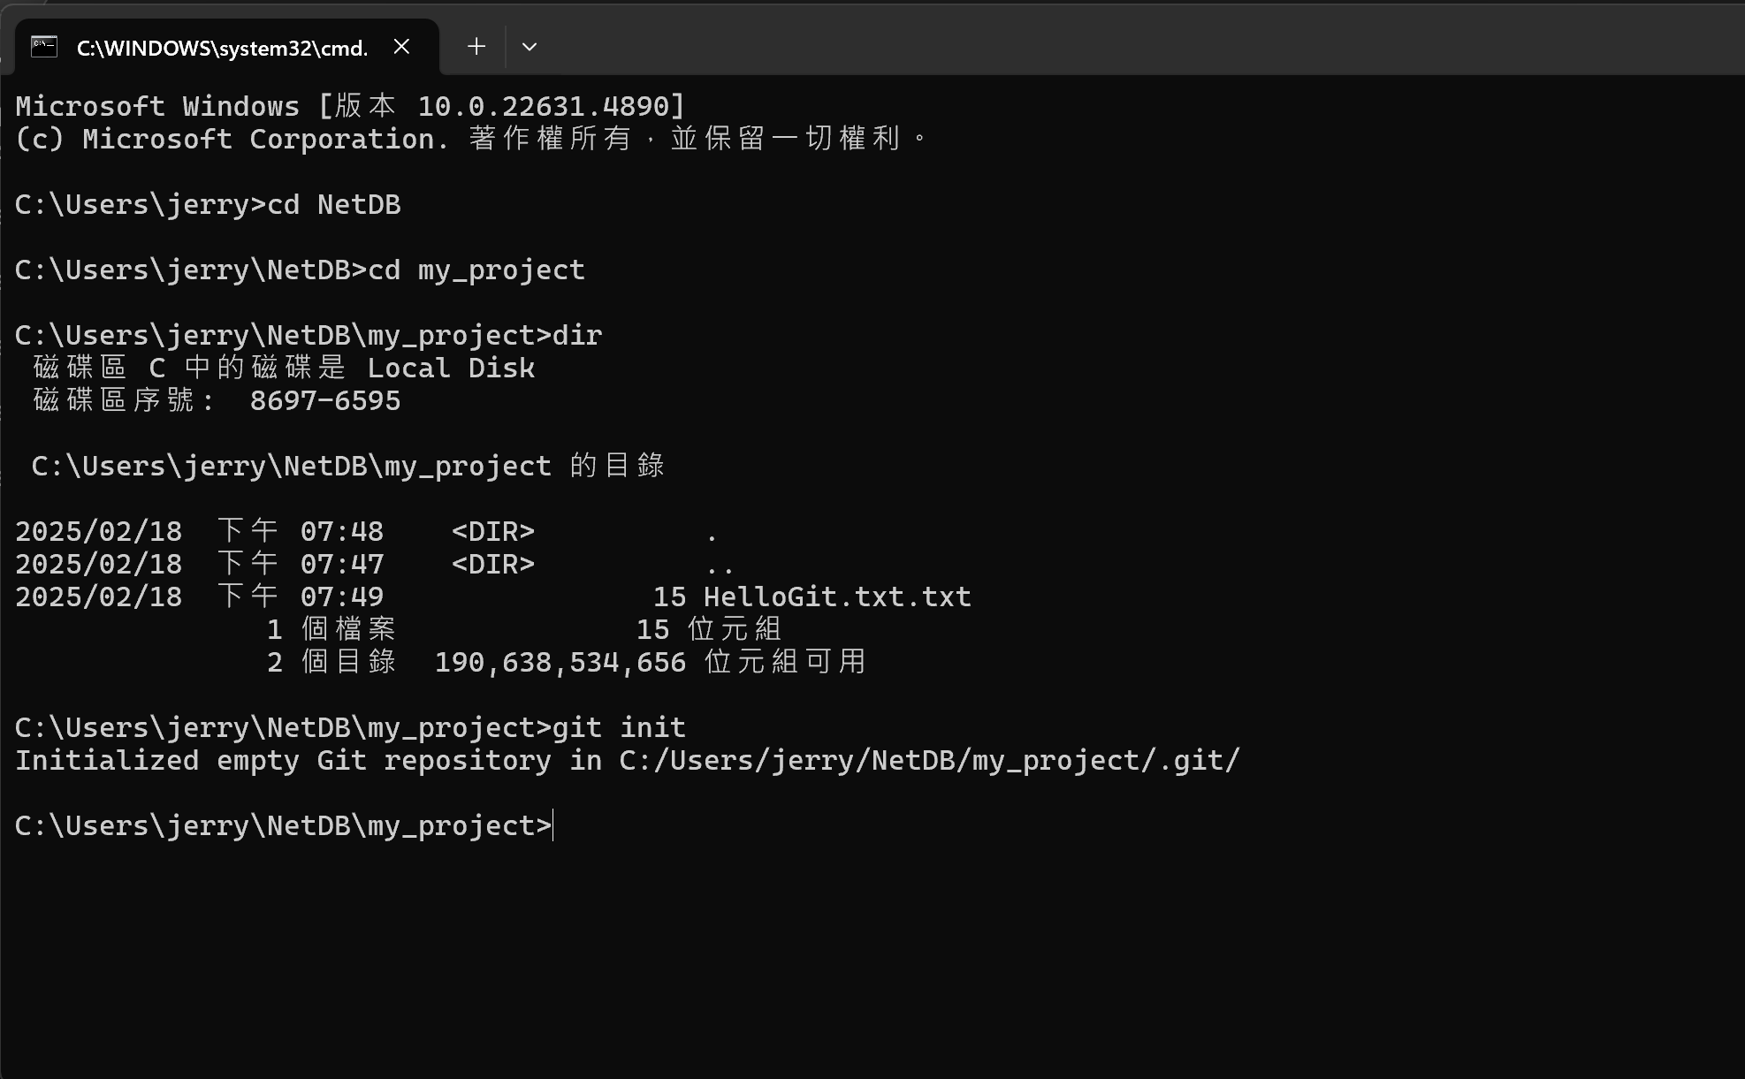
5. Navigate to the project fold.
6. Use the ‘’dir’’ command to list the contents of a folder. (if windows)
7. Use the ‘’git init’’ command to initialize a Git repository.

Slide 29
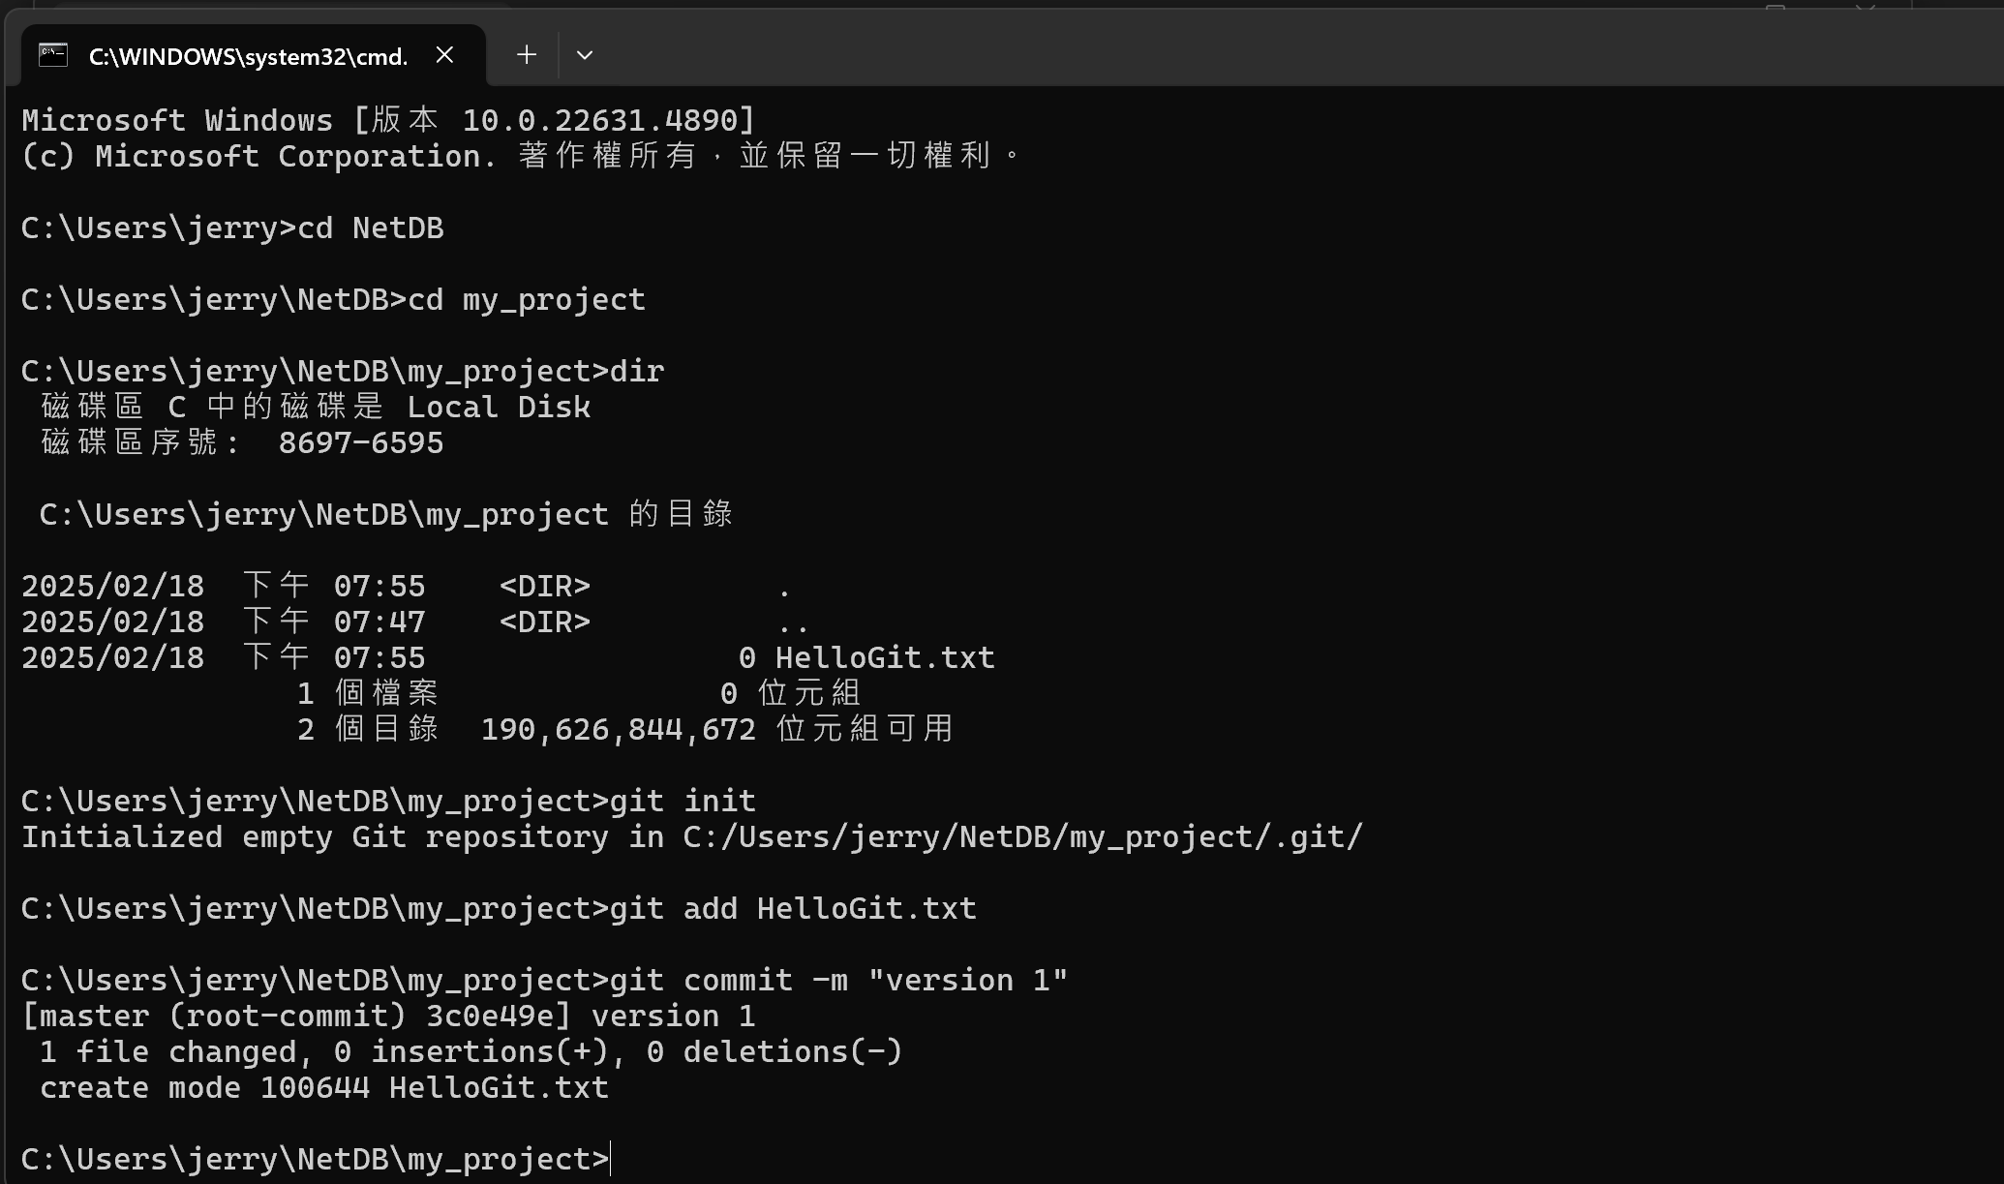
8. Use the ‘’git add’’ command to add HelloGit.txt to staging file.
9. Use the “git commit –m” command to commit the change.

Slide 30
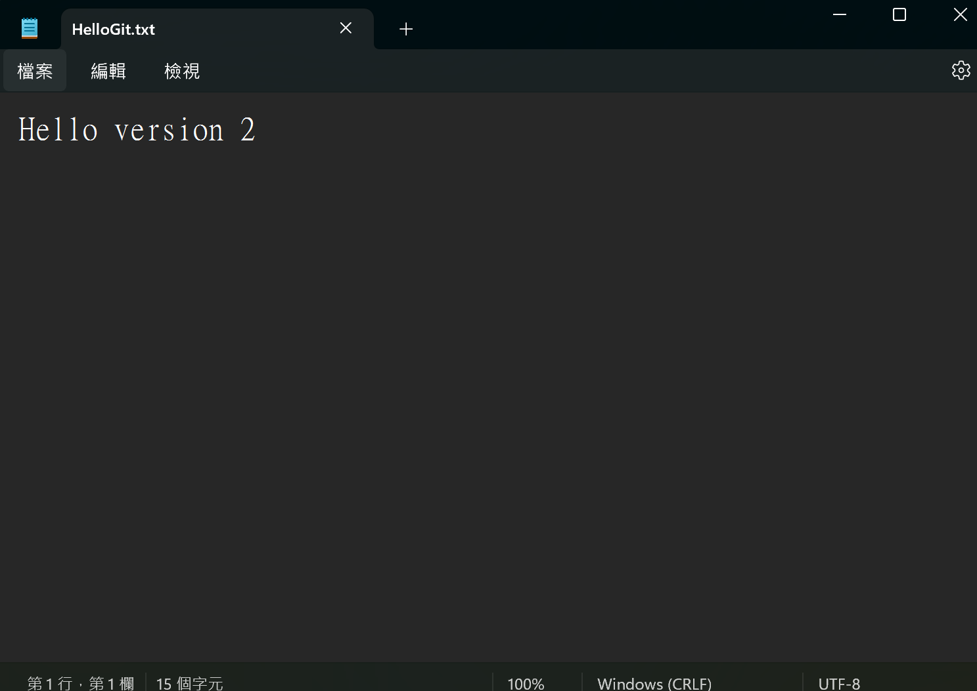
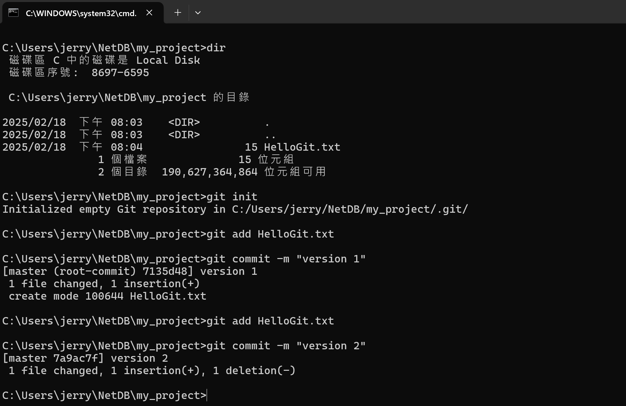
10. Modify the hello.txt and save the change.
11. Add It and commit again.

Slide 31
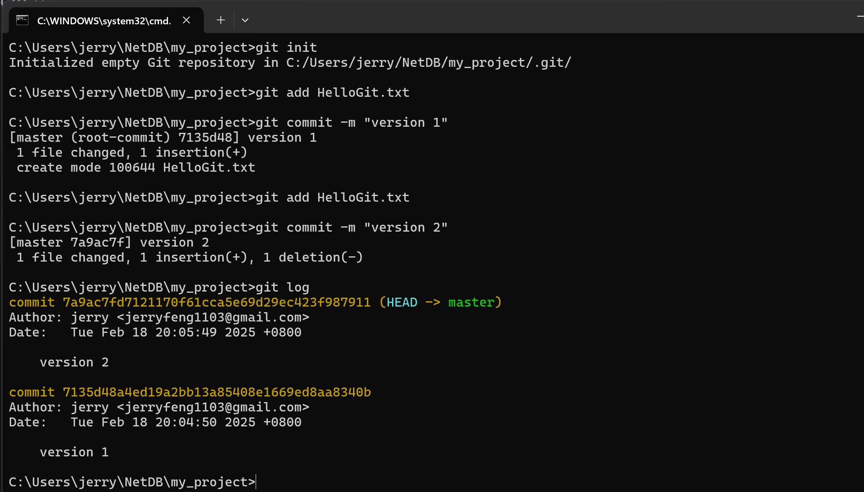
10.Use the ‘’git log’’ command to view your versions.
Head:
A reference to where you are currently working on.
Master:
The default branch in a Git repository, typically where the final, stable version of the project is maintained.

Slide 32
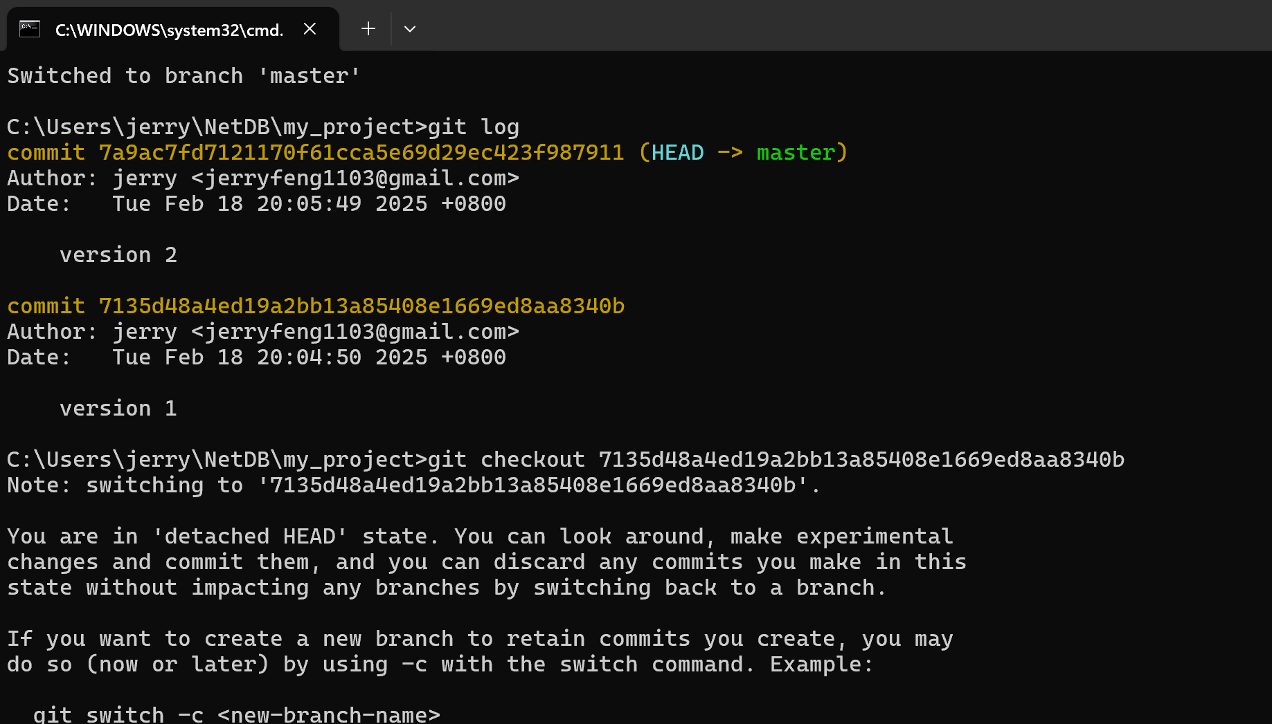
Version ID
11. Go to specific version with the ‘’git checkout’’ command and version ID
12. Reopen the HelloGit.txt find yourself back to version 1 !

Slide 33
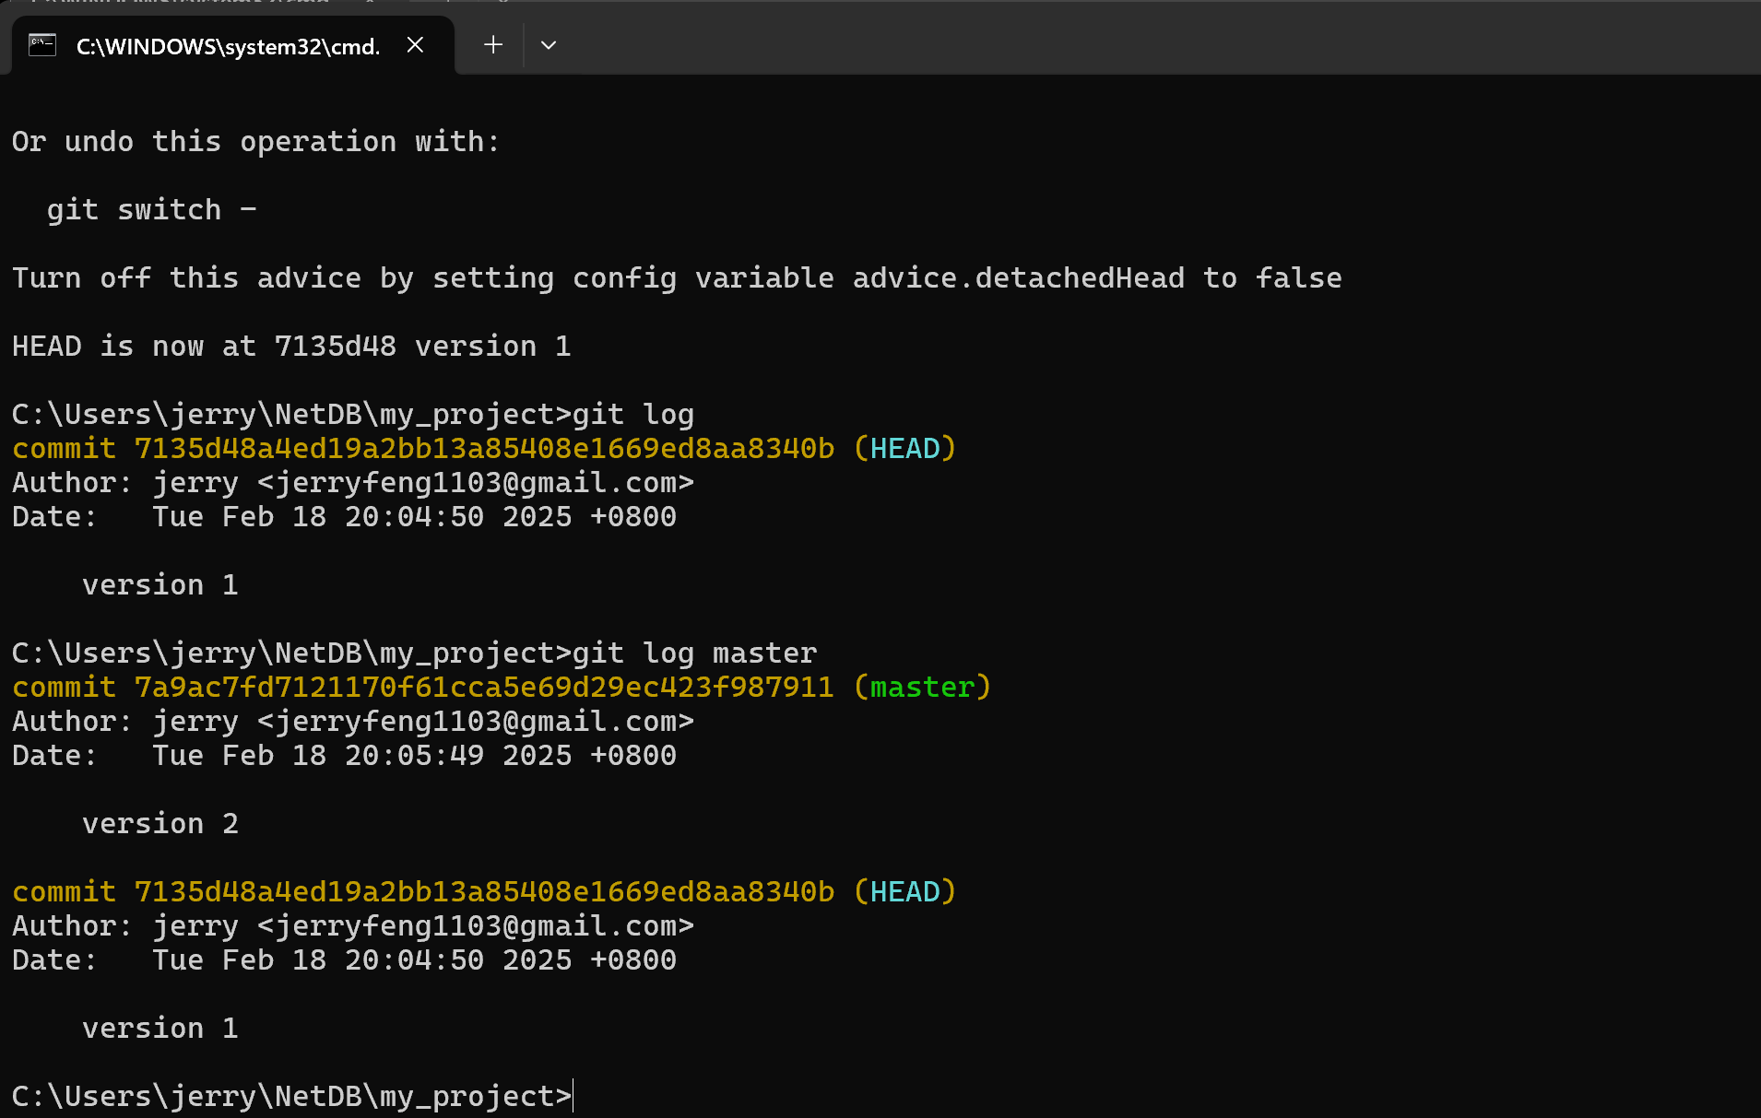

Slide 34
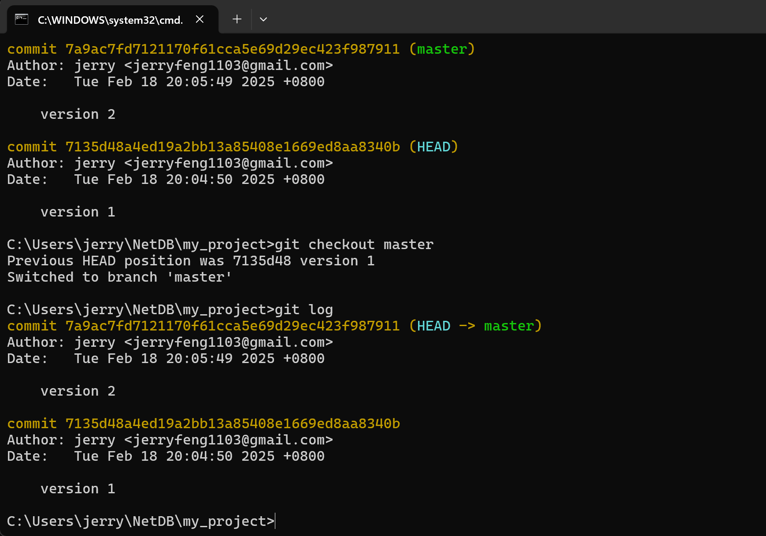
13. Use the “git checkout master” command to go back to the final vesion of your project
14. Reopen the HelloGit.txt again. Back to the lastest version.

Slide 35
LIFE IS
TOO SHORT
TO TYPE THAT
VERSION ID!
which is 40 characters long…

Slide 36
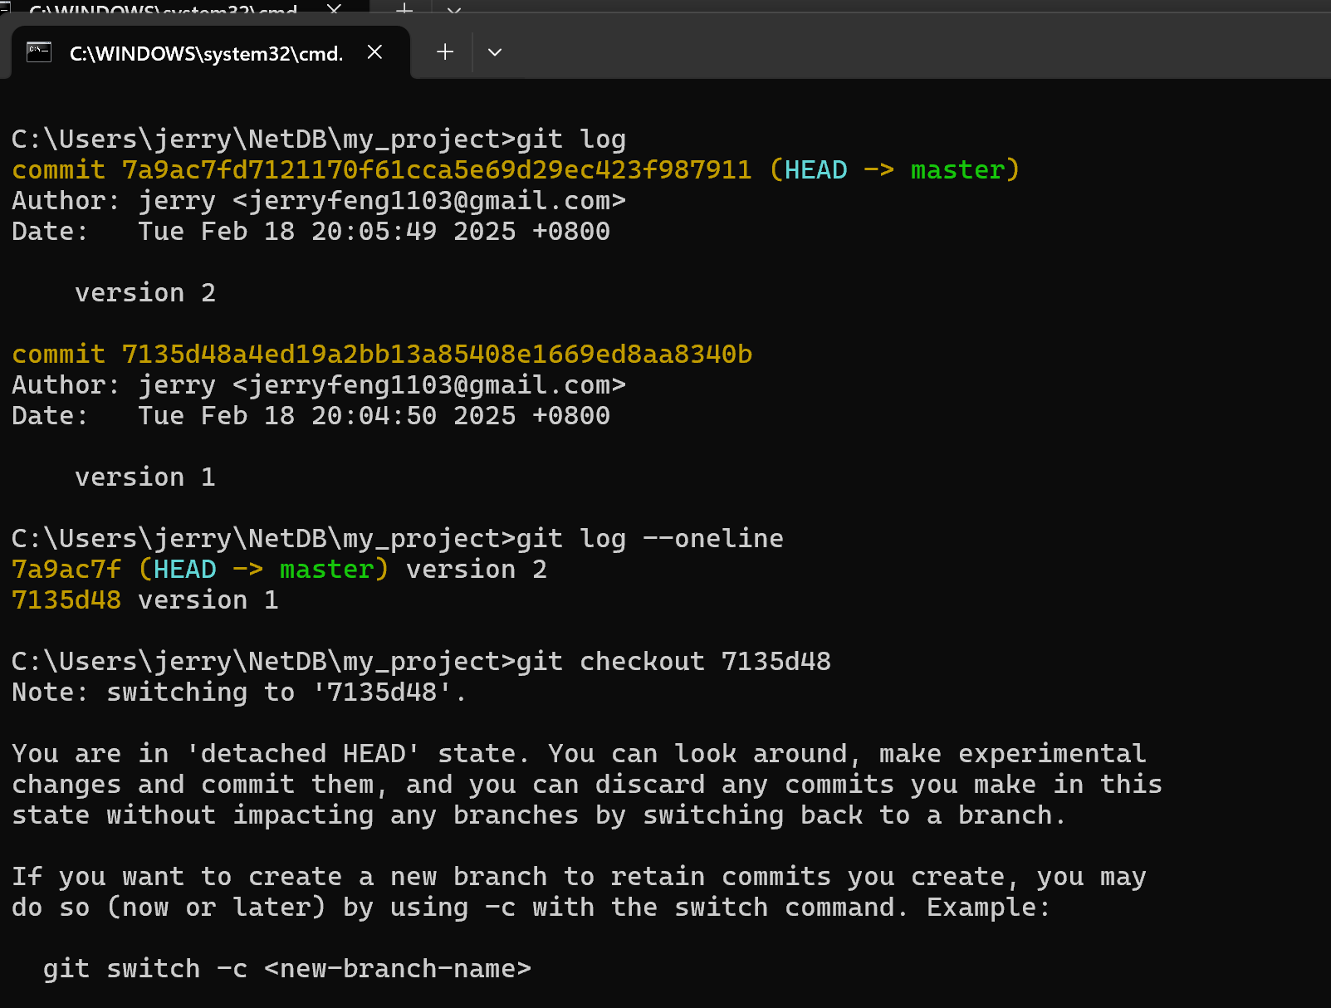
15. Use the ‘’git log --oneline’’ command to get the shorter version ID.
16. Use shorter version ID to check specific version.

Slide 37
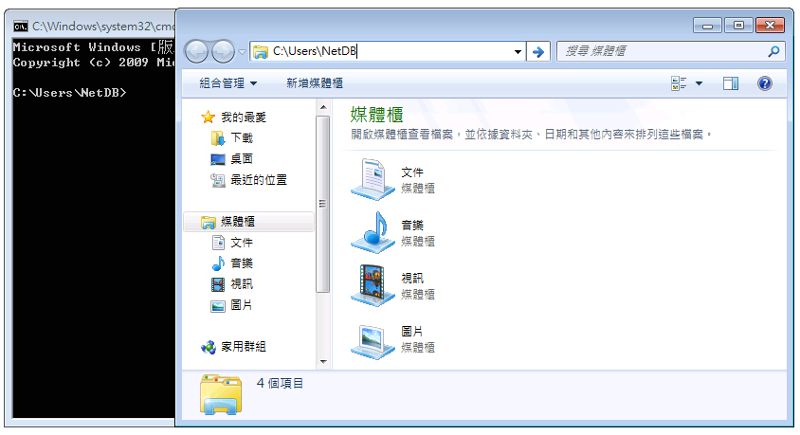
2. Go to that directory
1. Find current directory

Slide 38
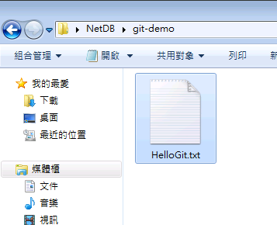
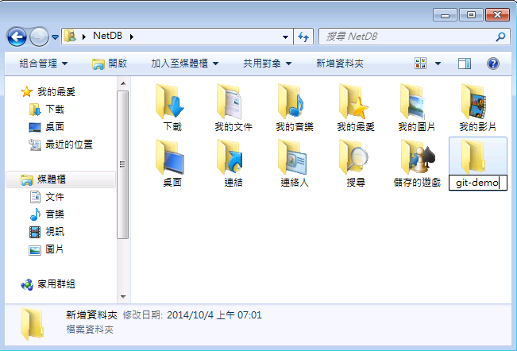
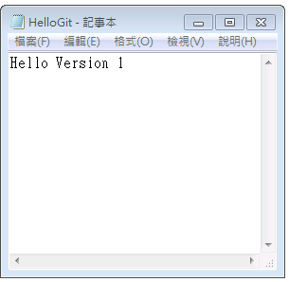
4. Go to that folder
3. Add a new folder
5. Create a new file
6. Put some contents and save

Slide 39
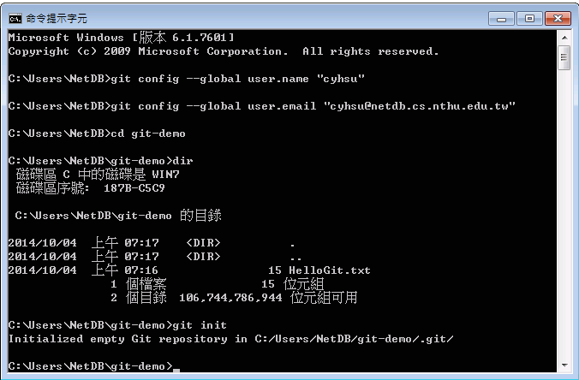
7. Go to “git-demo”
8. Show the files in “git-demo”
9. Initialize a Git repository
$ cd git-demo # go to git-demo directory
$ dir # list the files
$ git init # initialize a repository

Slide 40
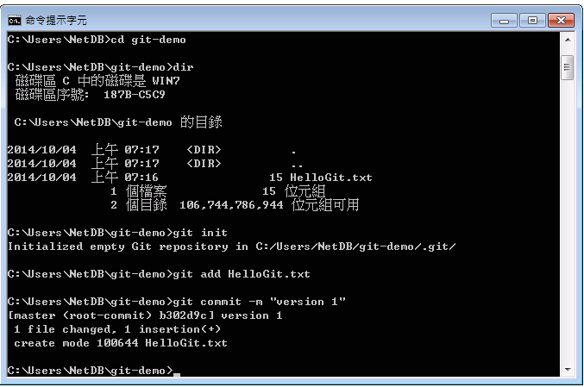
10. Add HelloGit.txt to staging files
11. Commit your changes
# Add HelloGit.txt to staging files
$ git add HelloGit.txt
# Commit the changes to the repository
# where "version 1" is the commit message
$ git commit -m "version 1"

Slide 41
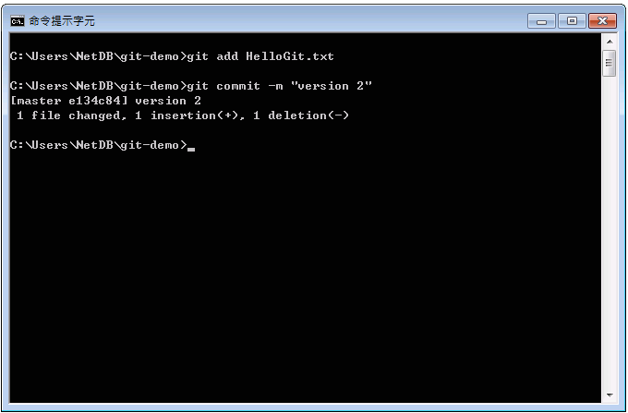
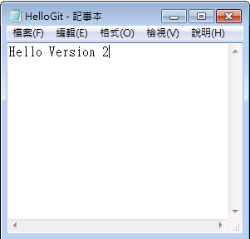
13. Add it and commit again
12. Make some changes and save

Slide 42
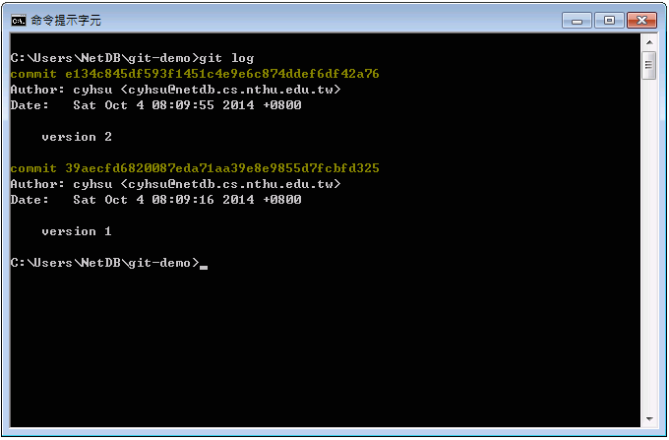

14. View your versions
Version ID
Commit messages
# Show the versions you’ve created so far
$ git log

Slide 43
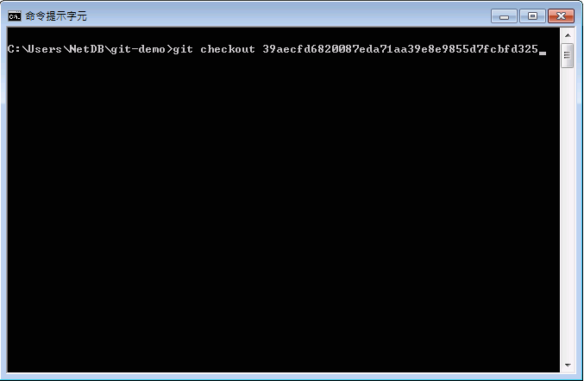
16. Go to a specific version
# Go to a specific version
$ git checkout {version_id}

Slide 44
LIFE IS
TOO SHORT
TO TYPE THAT
VERSION ID!
which is 40 characters long…

Slide 45
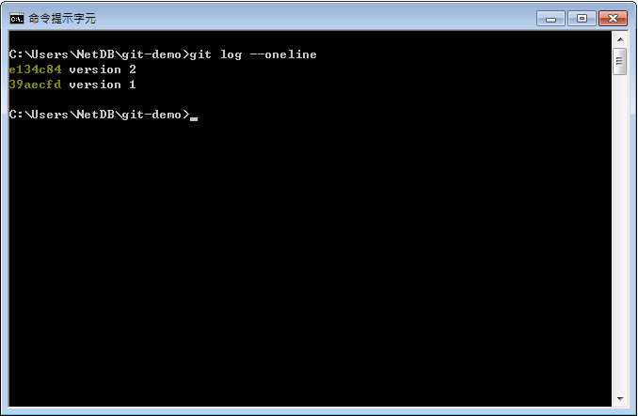
Version ID
15. Show versions with short version ID
56% shorter!
# Show versions with short version id
$ git log --oneline

Slide 46
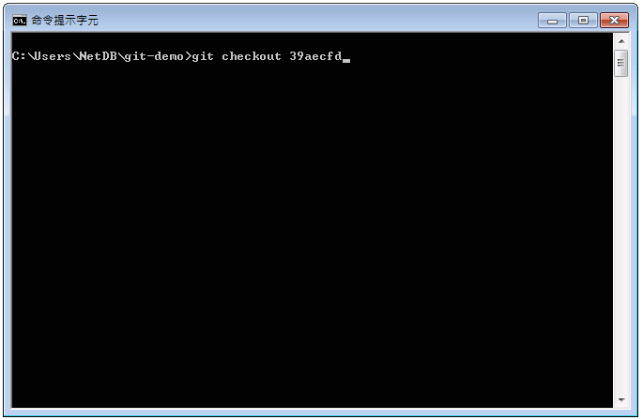
16. Go to a specific version
# Go to a specific version.
# In fact, you only need to type
# the first 5 characters.
$ git checkout {short_version_id}

Slide 47
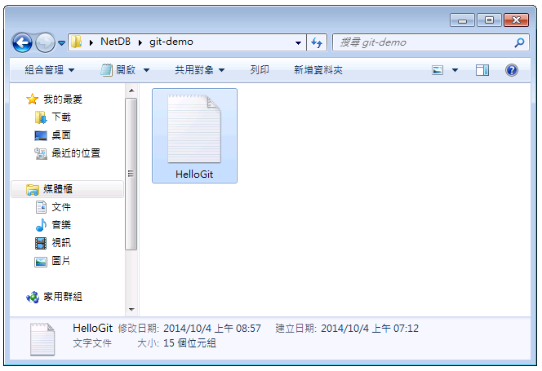
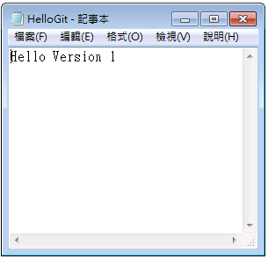
17. Close and reopen HelloGit.txt
18. Back to the version 1!

Slide 48
Outline
General Rule
Introduction to Git
Version control
Branch and merge
How to Submit Your Code to Gitlab
Tools & References

Slide 49
Git Branch
Master
Branching
Merging
Develop

Slide 50
Git commands (1/2)
Branching steps
Creating a new branch
Checking out the branch
git branch [branch name]
git checkout [branch name]

Slide 51
Git commands (2/2)
Merging steps
Checking out a branch to merge
Merging another branch
git checkout [branch 1 name]
git merge [branch 2 name]

Slide 52
scenario
Assume you are working on a new feature in a Git repository and want to create a separate branch work on it and then merge it back into master branch

Slide 53
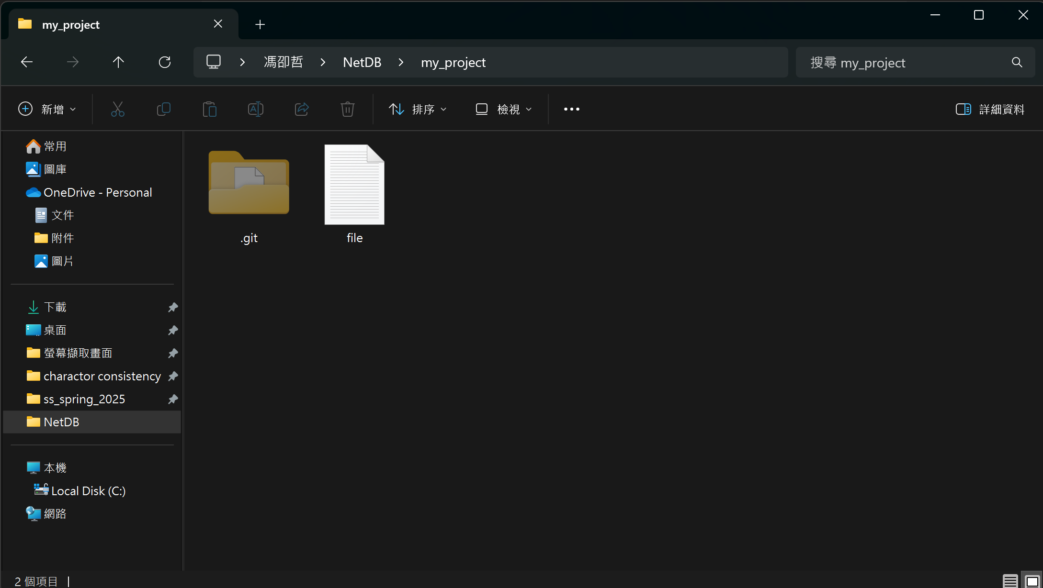
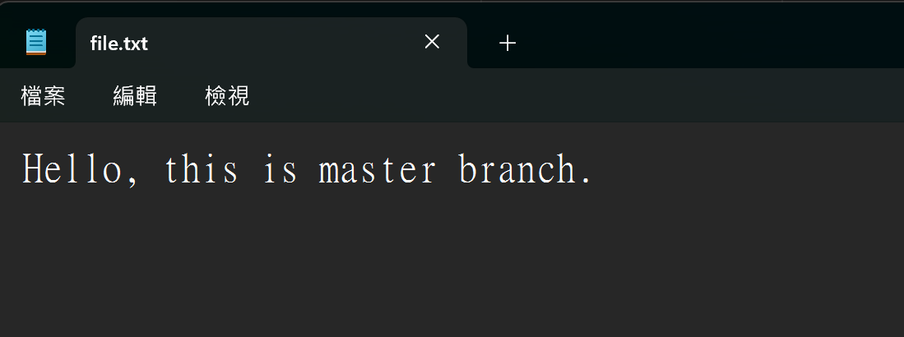
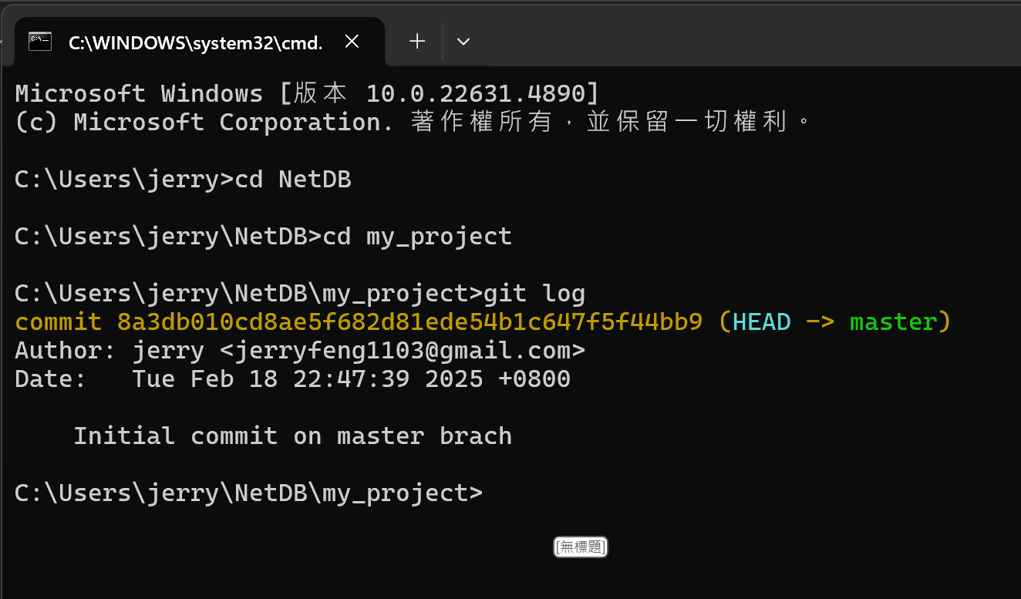
Initial content in file.txt
Initial log of master branch
1. Initially there is a file.txt in ~.\NetDB\my_project with git already initalized

Slide 54
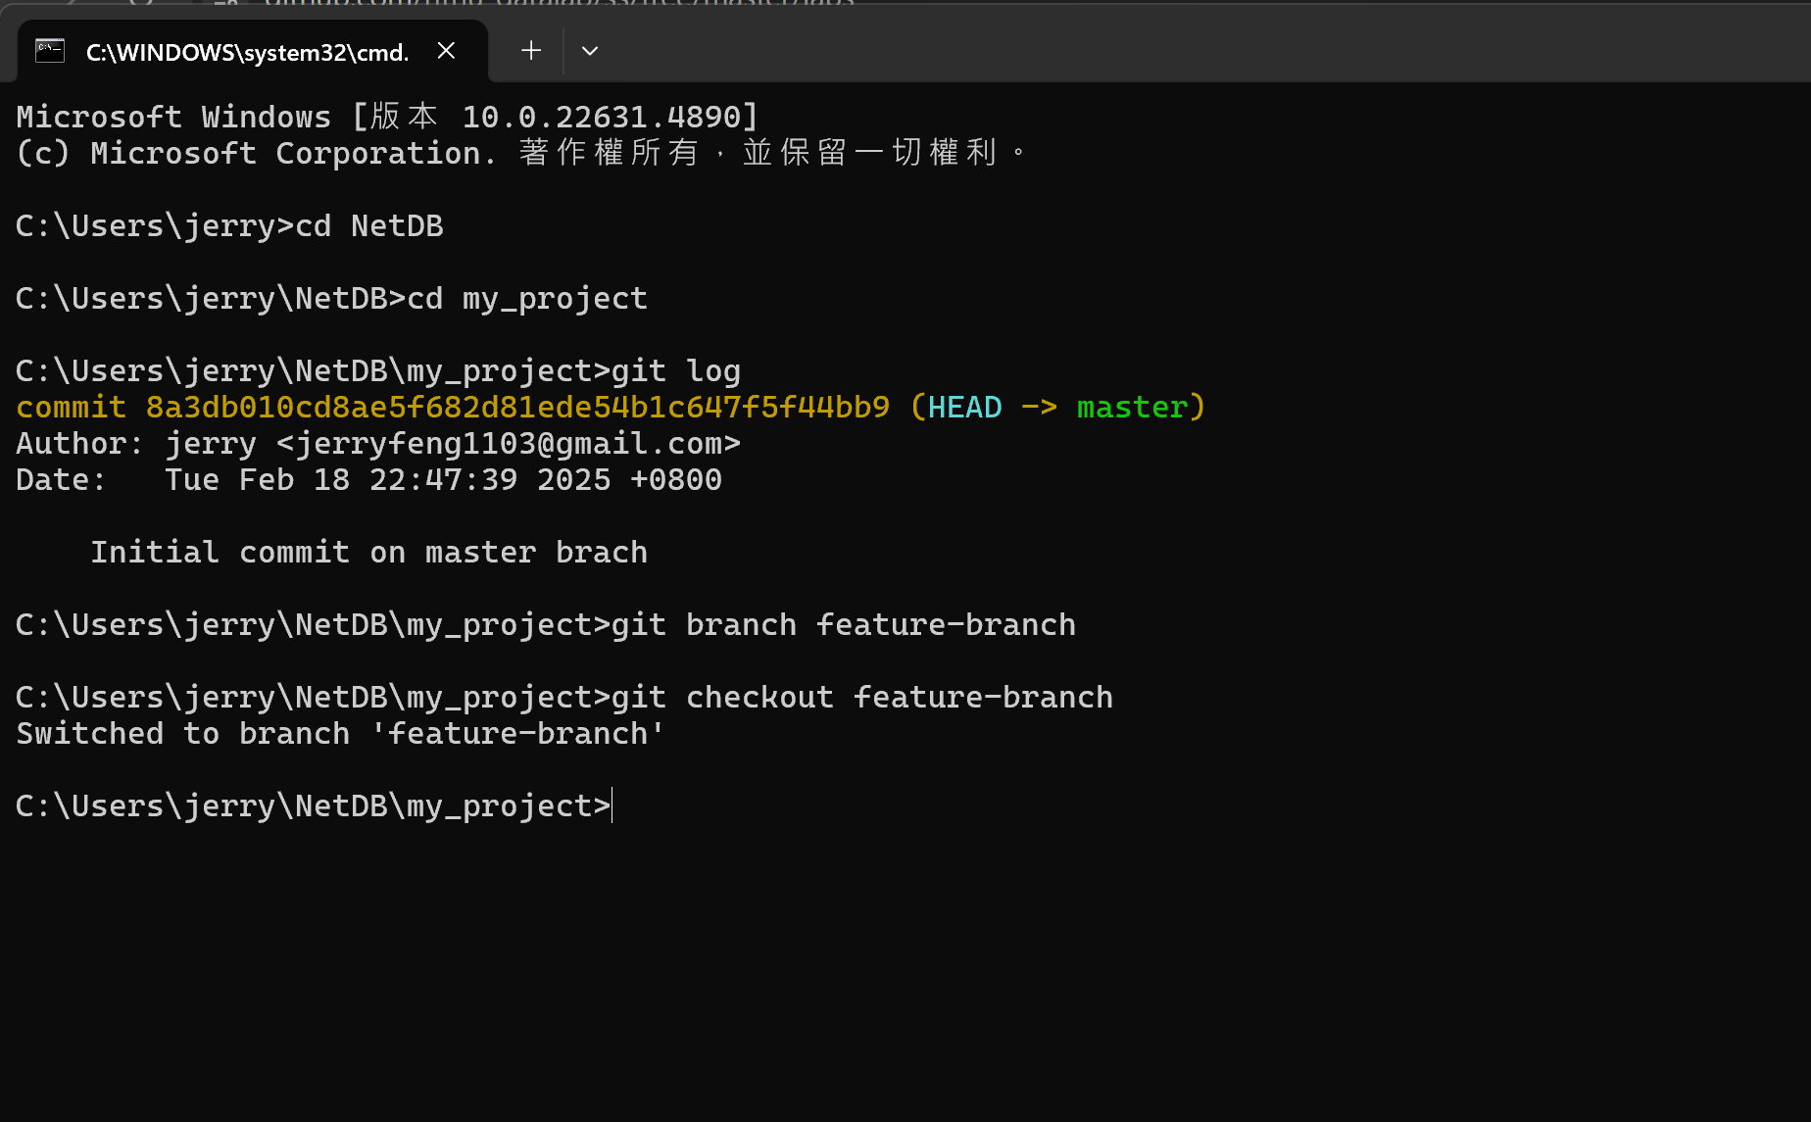
2. Create a new Branch using the “git branch [branch name] ” command
3. Switch to the new branch using the “git checkout [branch name] ” command

Slide 55
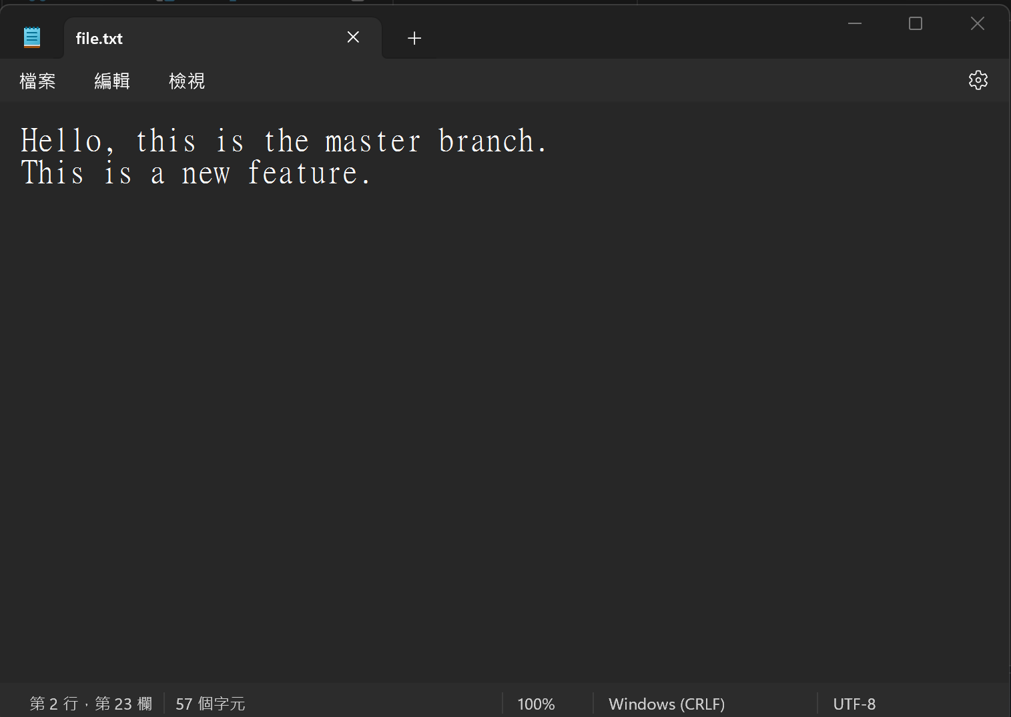
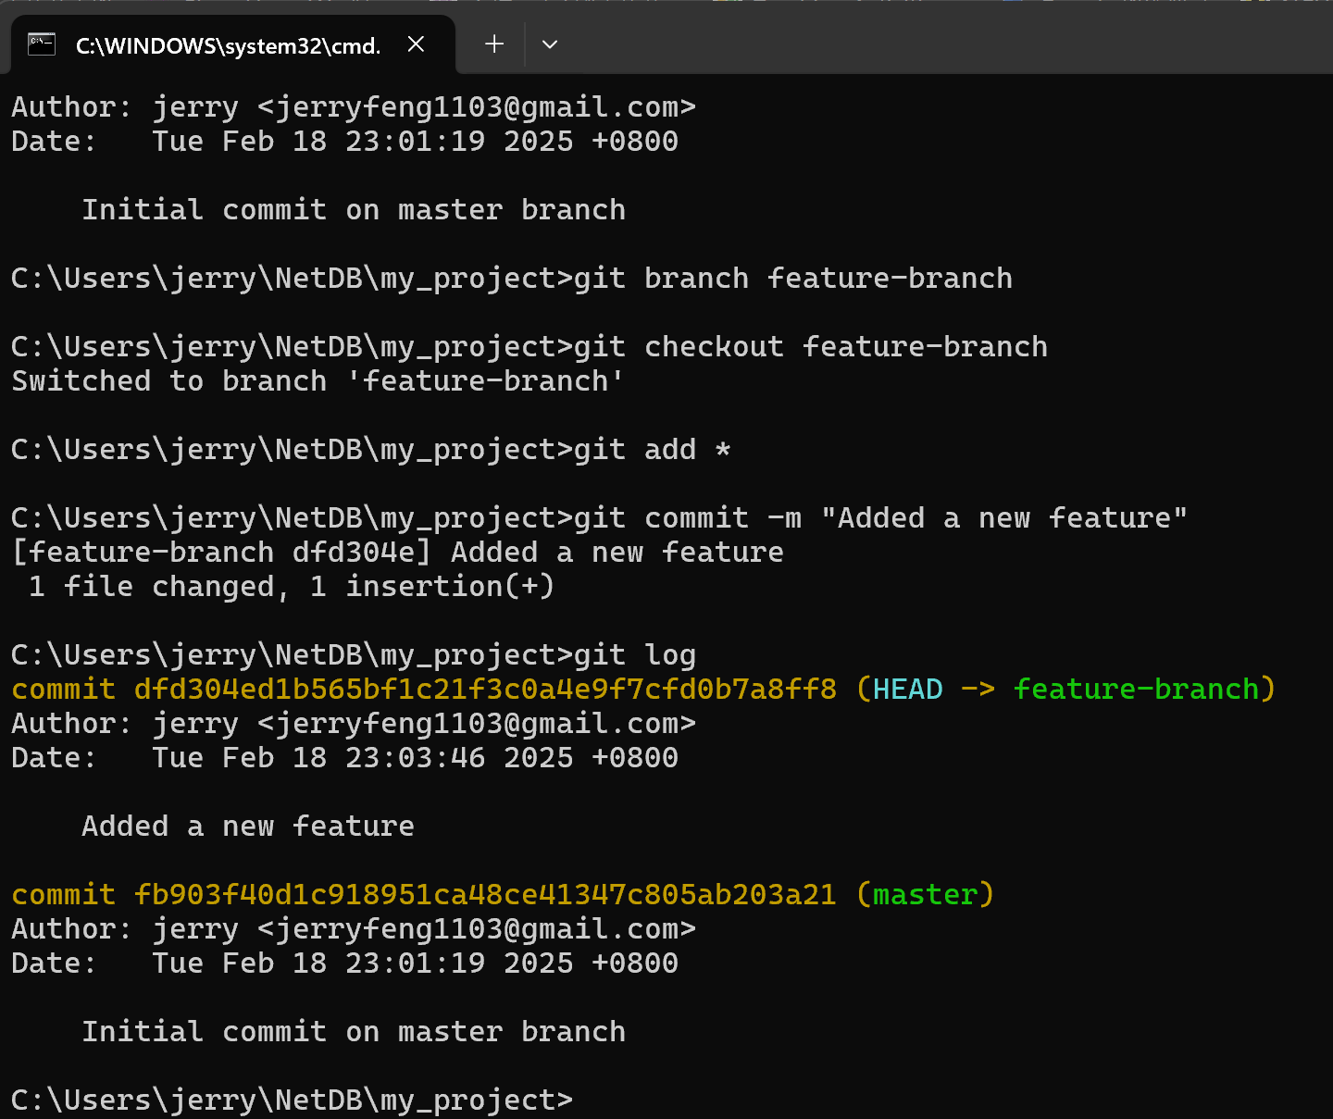

4. Make Changes in the feature branch
5. Add and commit the check in feature branch. (use ‘’git add *’’ to stage all files in the current directory)
Since we already switch to feature branch. ‘’git log” will show the log in feature branch

Slide 56
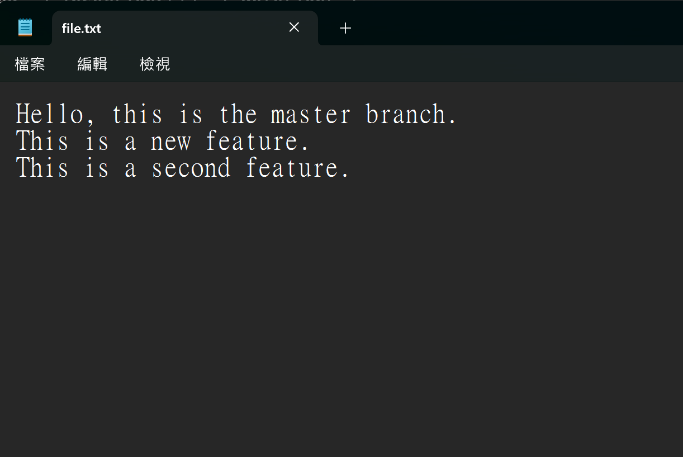
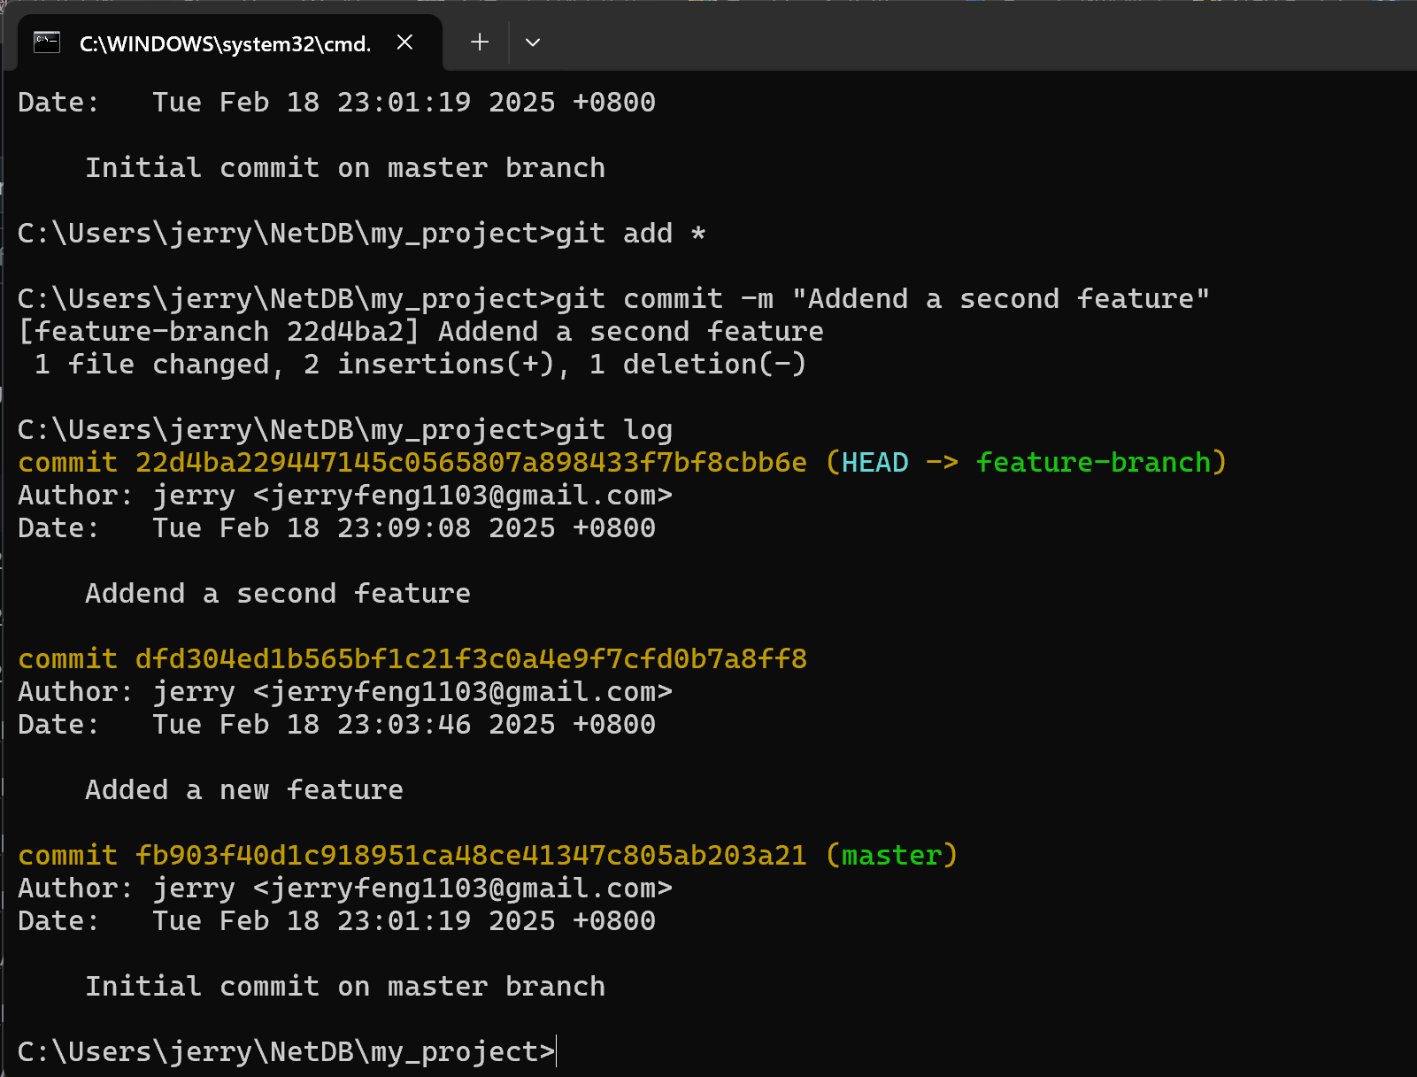
6. Perform another change, repeat the previous steps, and observe the Git log.

Slide 57
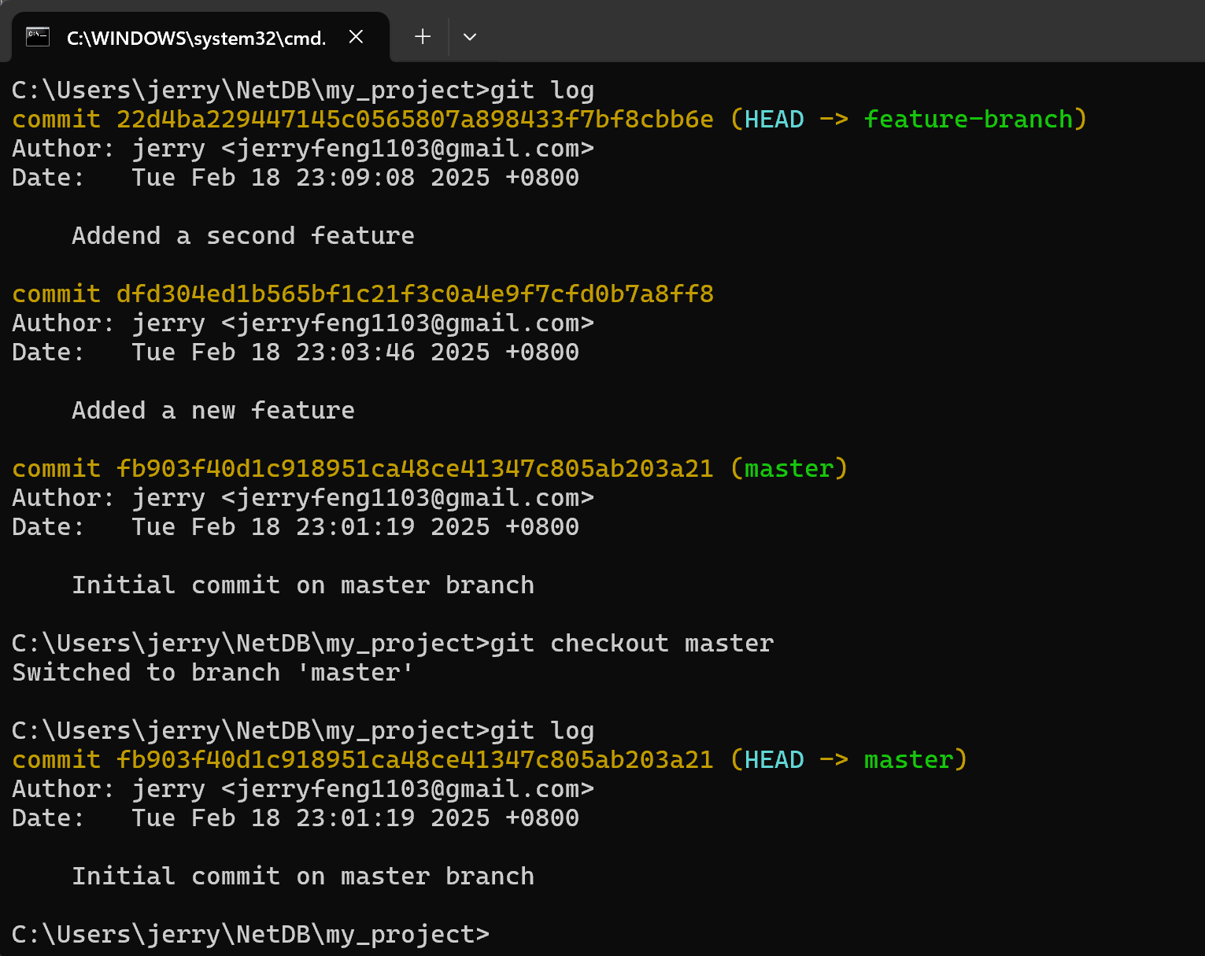
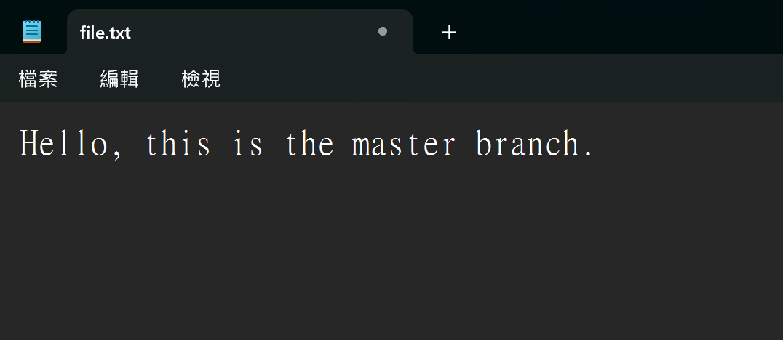
Reopen file.txt, and the content reverts to its initial state.
7. Switch Back to master branch
8. The log remains unchanged in the master branch."
9. Reopen the file.txt and the content go back to initial

Slide 58
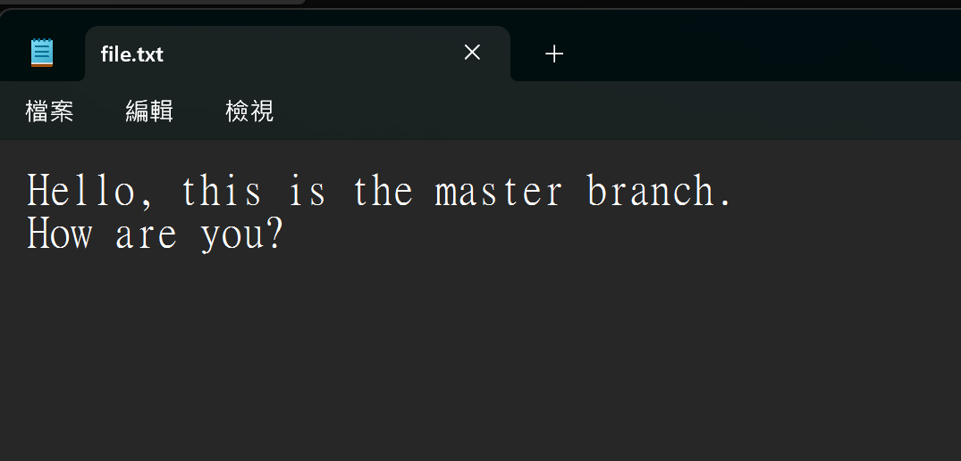
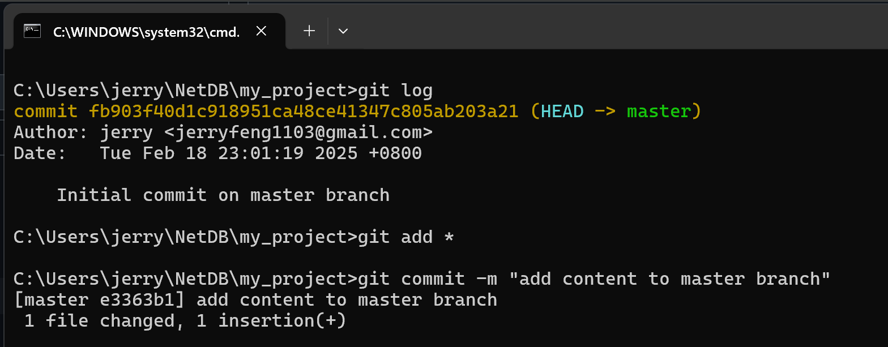
10. Try to also make change in master branch and commit the change

Slide 59
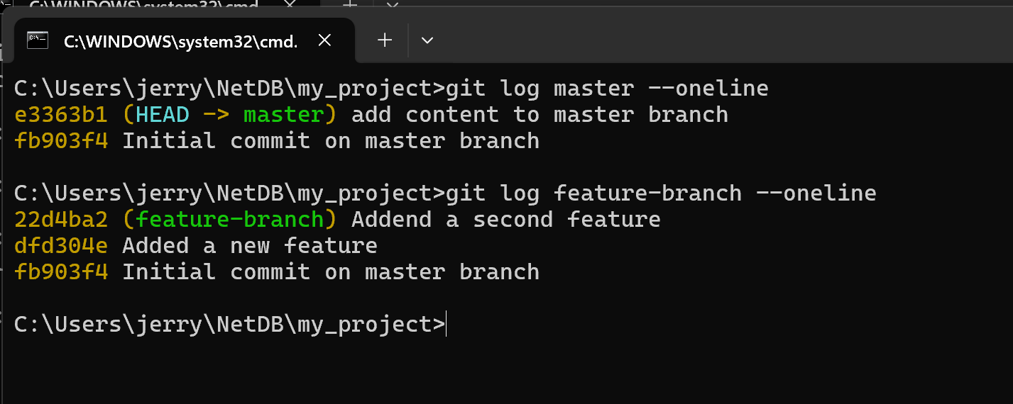
As observed in the log, a commit in one branch will not affect another branch.

Slide 60
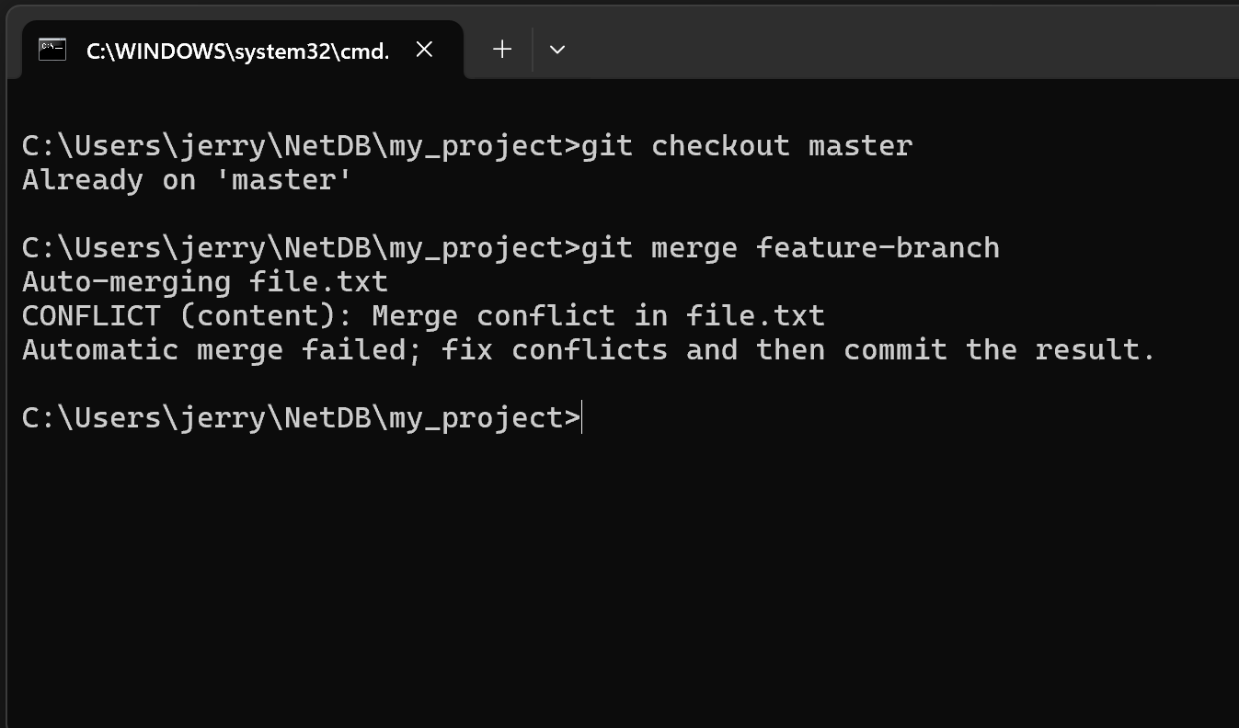
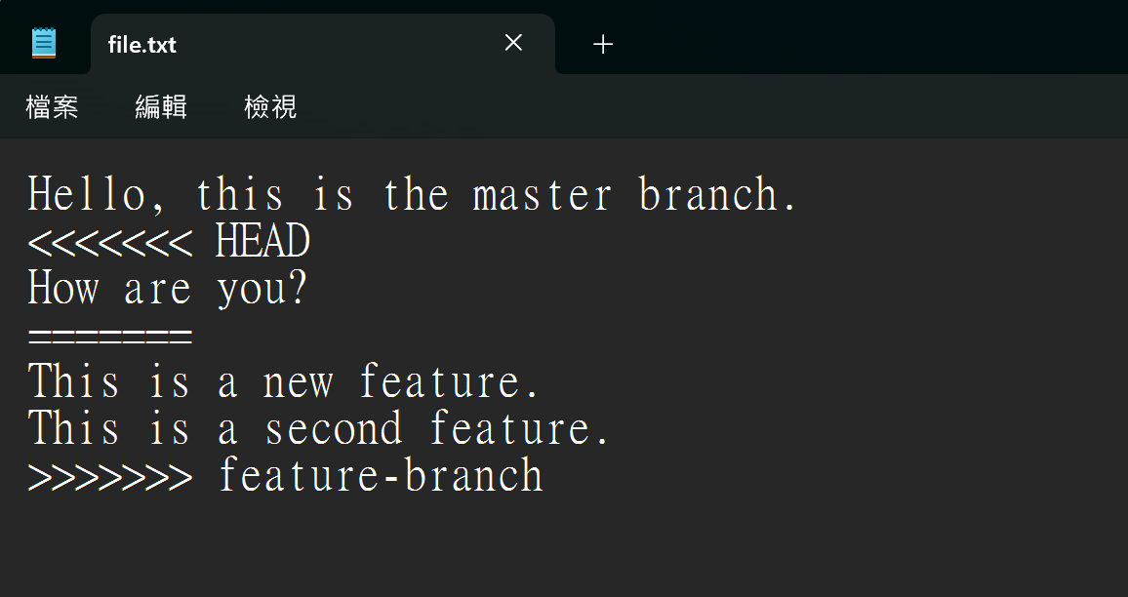
11. Ensure to move back to master branch (or any target branch you want to merge with)
12. Use the “git merge [branch name]” to merge the branch
Note that there is a merge conflict
13. Reopen the file.txt file then you found that there is merge conflict mark
<<<<<<<< HEAD:
Show the change from your target branch.
======:
Separator between the conflicting change
>>>>>>>> feature-branch
The changes from the branch you are trying to marge with the target branch

Slide 61
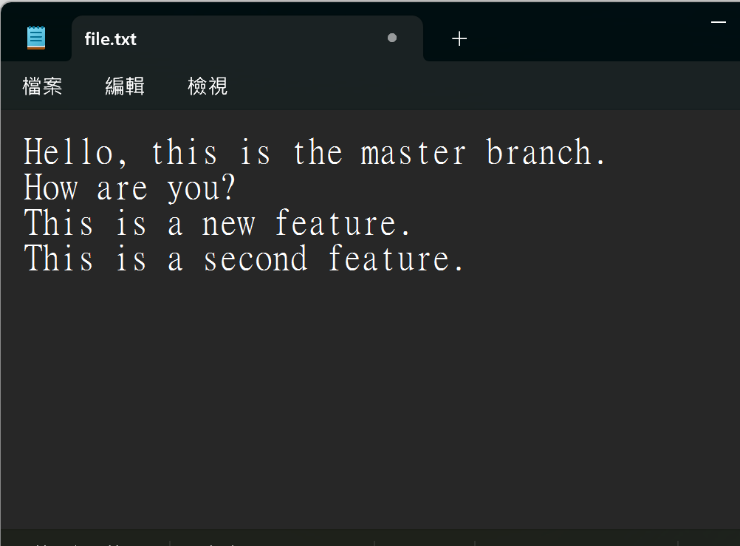
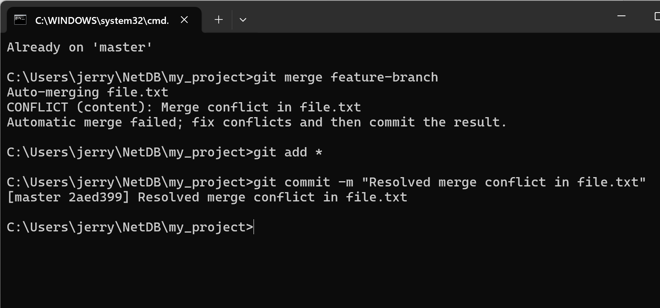
14. Decide which version to keep and edit the file to resolve a marge conflict and save the change. In this case I reserve all the version.
15. Add and commit again

Slide 62
Outline
General Rule
Introduction to Git
Version control
Branch and merge
How to Submit Your Code to Gitlab
Tools & References

Slide 63
Collaboration
To work with others using git, you’ll need a server that store the repository.
Git is distributed, which means
Everyone can store a copy of the repository downloaded from the server to their computer and do their jobs independently.

Slide 64
Collaboration Workflows (1/2)
If you don’t have the project, clone (download) the repository from the server.
Do your work and commit the changes at local. Once done, push (upload) the repository to the server.
If someone else modified the project, you can pull (sync) the repository to get the updated project.
Repeat 2 and 3.

Slide 65

Collaboration Workflows (2/2)
Server
Clone
Clone
Local A
Local B

Slide 66

Collaboration Workflows (2/2)
Server
Commit
Version A
A
Local A
Local B

Slide 67
Collaboration Workflows (2/2)
Server
Push
A
Version A
A
Local A
Local B

Slide 68
Collaboration Workflows (2/2)
Version A
A
A
Server
Pull
Version A
A
Local A
Local B

Slide 69
Collaboration Workflows (2/2)
A
A
Server
Pull
A
A
Version A
Local A
Local B

Slide 70
Something went wrong.

Slide 71
Authentication Failed
Authentication Failed
Server
Push
A
Version A
A
Local A
Local B

Slide 72
Why Authentication Failed?

Slide 73
Collaboration Workflow
If you tried to clone the code template from a server and want to push the modified file.
You will get authentication failed.
It’s because it was a project of others, which means you are not able to save the changes back to the server.
So, how can I copy a project from others on a open source platform like Github?

Slide 74

Introducing
Fork

Slide 75

Author
Original Project
A
A2
Open a Merge Request
Forked Project
A
A1
A2
Forked from Red
Commit
Commit
Editor

Slide 76
Author
✔︎
Accept
A
A2
A
A1
A2
Editor

Slide 77
Author
A
A2
A
A1
A2
Editor

Slide 78
Forked from Red A2
A2
A
A
A2
A
A1
A2

Slide 79
Git Collaboration Workflow
Fork a repository to make a copy of it.
Clone the repository you forked to your workspace.
Do your work and commit the changes in your workspace.
Push the repository to the server to synchronize them.
Open a merge request to origin repository .

Slide 80
Basic Git Commands (2/2)
git clone [url]
Clone a repository from remote server
git push [url] [branch-name]
Push committed file to remote server

Slide 81
Outline
General Rule
Introduction to Git
Version control
Git Basics
Try Git!
Remote Repositories
How to Submit Your Code to Gitlab
Tools & References

Slide 82


Slide 83
Gitlab
We have created account for you
Account: student ID (e.g. 106012345)
Password: student ID (e.g. 106012345)

Slide 84
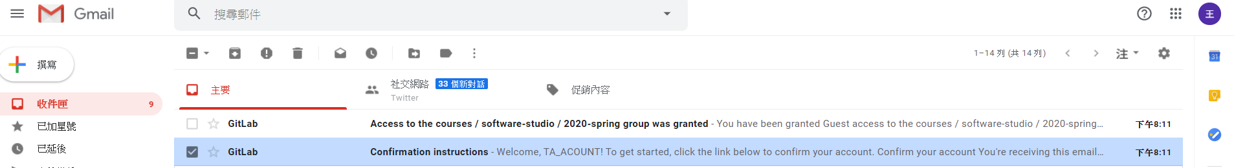
Gitlab

Slide 85
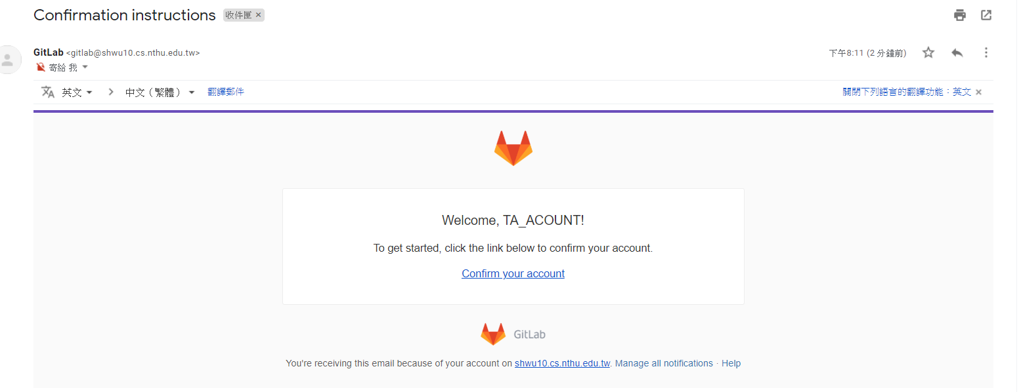
Gitlab

Slide 86
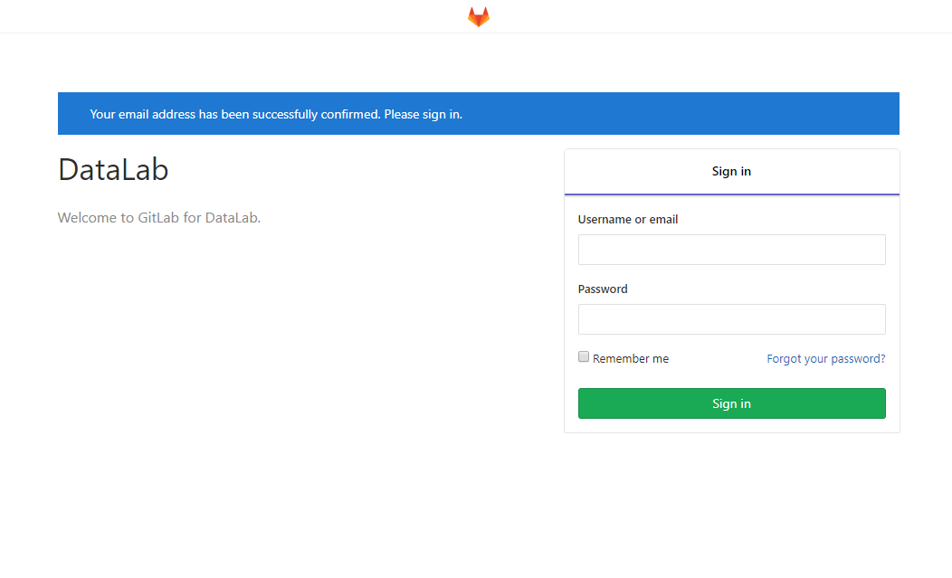
Gitlab
Username : studendID
Email: your email
Passward: studentID

Slide 87
Workflow
For each lab, you should follow the workflow below
Fork our template repository on Gitlab
Clone the forked repository to your computer
Finish your lab
Commit in your computer
Push to Gitlab
Send merge request of your branch to our template repository

Slide 88
Workflow
For each lab, you should follow the workflow below
Fork our template repository on Gitlab
Clone the forked repository to your computer
Finish your lab
Commit in your computer
Push to Gitlab
Send merge request of your branch to our template repository

Slide 89
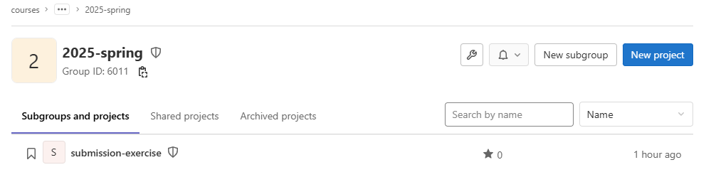
You can access course projects in this group

Slide 90
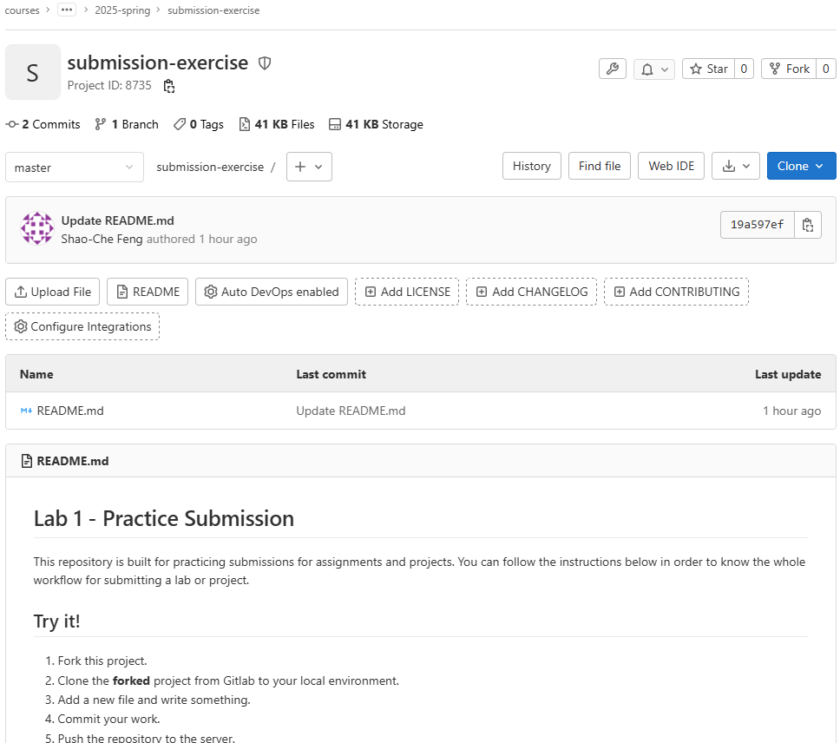
1. Click to fork

Slide 91

2. Select your name
3. Click Private
4. Click to fork

Slide 92

5. Check if this repository is under your account
6. Go to settings

Slide 93

7. Set project to private

Slide 94

8. Scroll down and save changes

Slide 95
Workflow
For each lab, you should follow the workflow below
Fork our template repository on Gitlab
Clone the forked repository to your computer
Finish your lab
Commit in your computer
Push to Gitlab
Send merge request of your branch to our template repository

Slide 96

2. Copy the link
1. Choose HTTPS

Slide 97



If You use Windows

Slide 98

3. Create a folder to put your repos
4. Type "git clone {URL}"
5. The repo has been successfully cloned

Slide 99
Workflow
For each lab, you should follow the workflow below
Fork our template repository on Gitlab
Clone the forked repository to your computer
Finish your lab
Commit in your computer
Push to Gitlab
Send merge request of your branch to our template repository

Slide 100

1. -A means all files
2. Check if your file is added to git
3. Commit your changes

Slide 101

If you see these message, type
git config --global user.name "{name}"
git config --global user.email "{email}"
{email} is the email you use on gitlab

Slide 102
Workflow
For each lab, you should follow the workflow below
Fork our template repository on Gitlab
Clone the forked repository to your computer
Finish your lab
Commit in your computer
Push to Gitlab
Send merge request of your branch to our template repository

Slide 103

Type "git push -u origin master"

Slide 104
Workflow
For each lab, you should follow the workflow below
Fork our template repository on Gitlab
Clone the forked repository to your computer
Finish your lab
Commit in your computer
Push to Gitlab
Send merge request of your branch to our template repository

Slide 105

1. Click Merge Requests

Slide 106

2. New merge request

Slide 107


3. Choose the branch you pushed in your repo
Ensure that the commit in the version record of the selected branch matches the commit name of the final version you have in mind.

Slide 108
4. Choose the branch named after your ID
Ensure that the source of the selected branch is the class folder (courses/software-studio/2025-spring/submission-exercise) and your student ID (not master or someone else’s student ID).

Slide 109
5. Compare branches

Slide 110

You can also confirm or change whether the selected branch is correct in this section. For instance, in the picture, the course branch selected is master, which is incorrect. The correct one should be courses/software-studio/2025-spring/submission-exercise: {your student ID}.
Courses/software-studio/2025-spring/submission-exerice: {ID}
6. Set title to "{ID} Submission"

Slide 111

7. If everything is OK,
submit your merge request

Slide 112

Notice - Don’t do this

Slide 113

Notice - Don’t do this

Slide 114

Notice - Don’t do this

Slide 115

The GitLab setup in our laboratory is accessible through the link.
Here!!!!!

Slide 116
Outline
General Rule
Introduction to Git
Version control
Branch and merge
How to Submit Your Code to Gitlab
Tools & References

Slide 117
Tools
Git GUI
GitKraken
Editor / IDE
Visual Studio Code
Atom
Sublime Text
Brackets
Notepad++
Webstorm

Slide 118


Slide 119


Slide 120


Slide 121


Slide 122


Slide 123
Reference
Learn Git branching (interactive)
http://pcottle.github.io/learnGitBranching/
Pro Git
http://git-scm.com/book/
寫給大家的 Git 教學
http://www.slideshare.net/littlebtc/git-5528339

Slide 124
Today’s exercise
Install Git command line tool in your computer.
Follow appendix “Git Command-line Tool Installation”.
Try to submit in GitLab.

