Slide 1
System overview

Slide 2
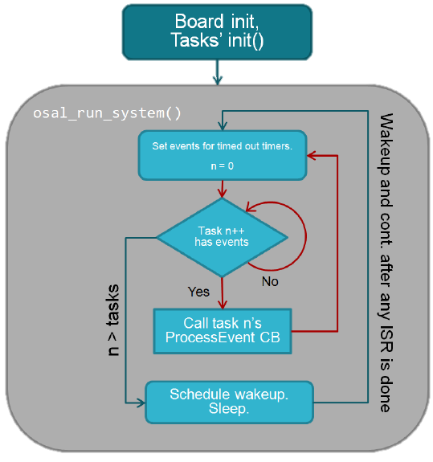
OSAL – Operating System Abstraction Layer
BLE Protocol stack
Profiles
Applications

Slide 3
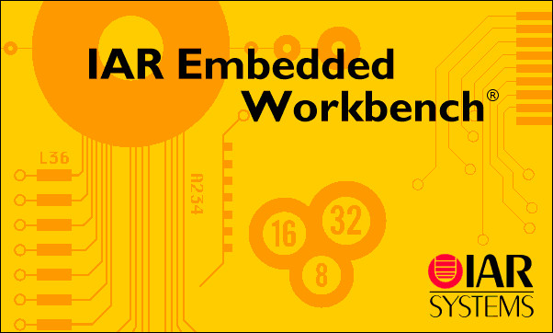
Compiler & Library
TI BLE stack ( binary only )
IAR Embedded Workbench for 8051

Slide 4
CBL
Compiler Binding Layer

Slide 5
CBL Overview
CBL
IAR
SDCC

Slide 6
Implementation
SDCC
IAR & SDCC Compiler manual
Parameter-Passing Modes
IAR Library

Slide 7
GATT services
Profile
WriteCB()
ReadCB()
SetParameter()
GetParameter()
ChangeCB()
…
Attribute 0
Attribute
Attribute
Attribute 18

Slide 8
OSAL
Schedule
User Event Call Back

Slide 9
SDCC
Call Backs
cg_simpleProfileChangeCB
cg_accelEnablerChangeCB
cg_battProfileChangeCB
cg_timeserviceChangeCB
Event Call Backs
cg_EVT_1_CB
cg_EVT_2_CB
cg_EVT_3_CB
cg_EVT_4_CB

Slide 10
Development Mode
SDCC
Compiler Binding Layer
Communication Layer
Main
Call Backs

Slide 11
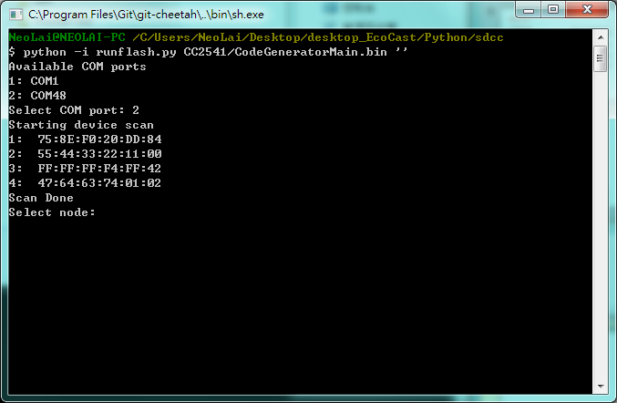
Scan

Slide 12
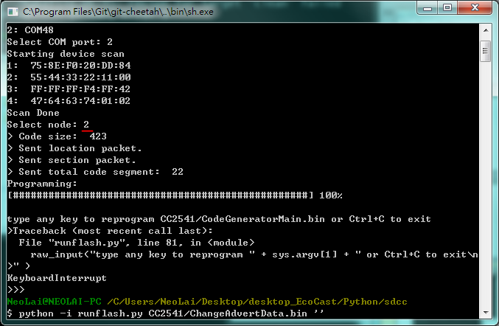

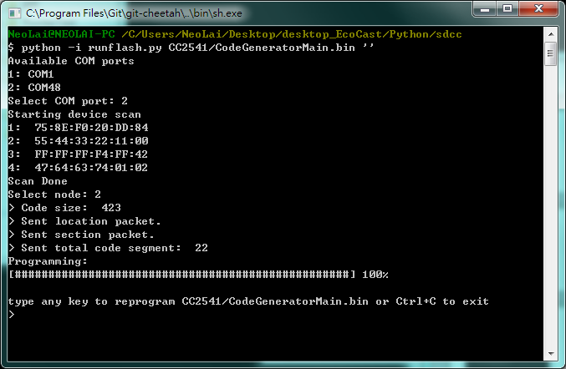
Connect

Slide 13
Code Overview
Sample

Slide 14
Memory: 270 Bytes ( static / global variable )

Slide 15
End

