Slide 1
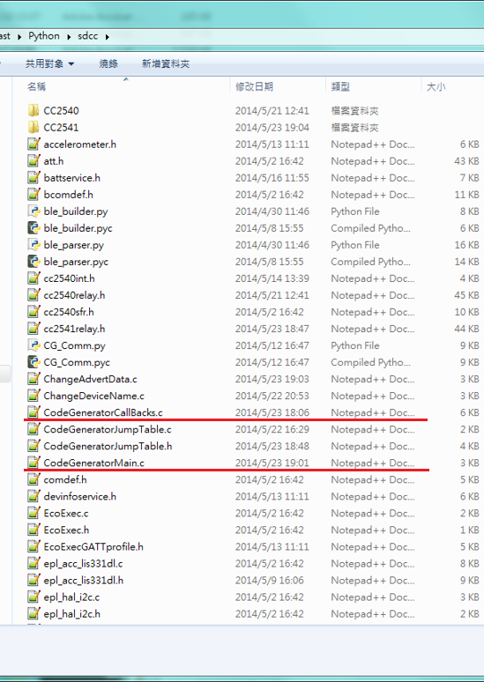
Modify source code
CodeGeneratorMain.c
execute after wireless update
or boots up
CodeGeneratrCallBacks.c
User can fill up all call back
functions in this file to custom call backs
behavior

Slide 2
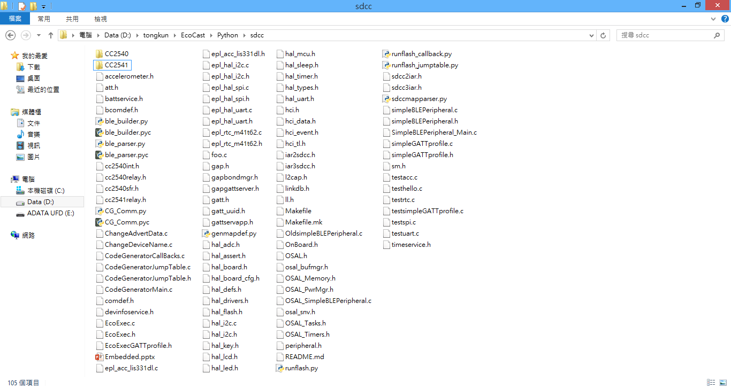
Sample Code
ChangeDeviceName.c
Change device name
ChangeAdvertData.c
Change device advertising
data
testacc.c
initial accelerometer and
read register
testhello.c
Use the notify buffer to return
‘hello’ string from slave node
testrtc.c
initial and read RTC infor-
mation

Slide 3
Sample Code
testspi.c
initial and write one byte to
spi bus
testuart.c
initial and write one byte to
uart buffer

Slide 4
How to program
1. Compile source code(Cygwin)
Enter the CC2541 directory and run the make command
e.g. : make CodeGeneratorMain.bin
2. Wireless update(git bash)
At the same directory with source code
e.g. : python runflash.py CC2541/CodeGeneratorMain.bin ‘’

Slide 5
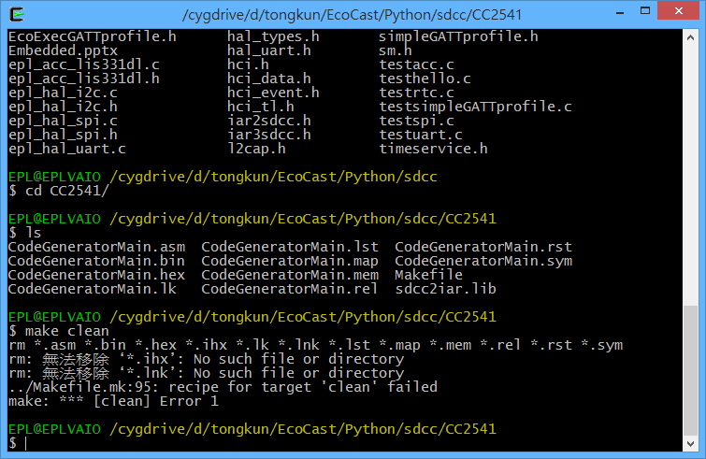
Cygwin – compile source code
First, enter CC2541 directory, then ‘make clean’

Slide 6
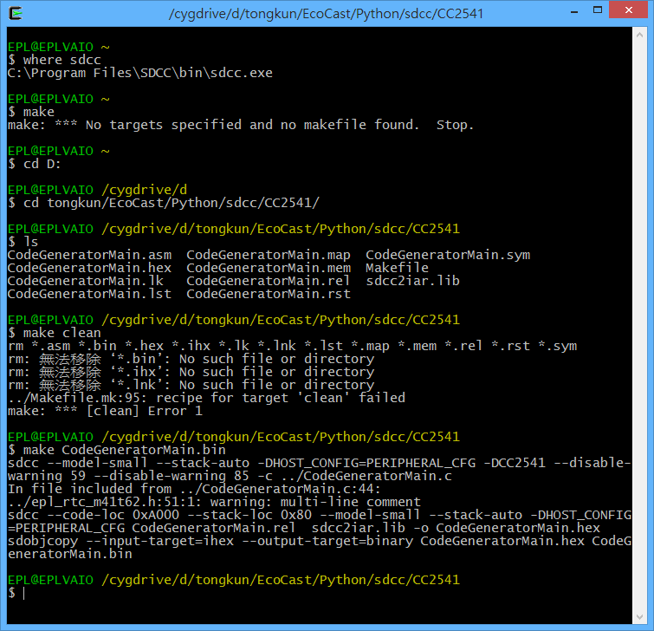
Cygwin – compile source code
Then run ‘make’ command

Slide 7
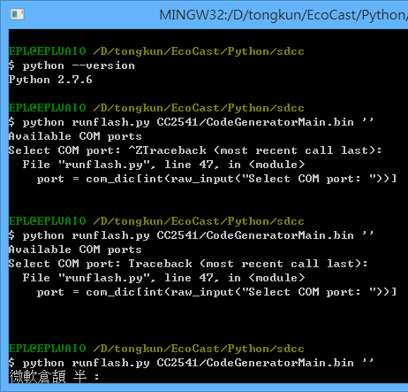
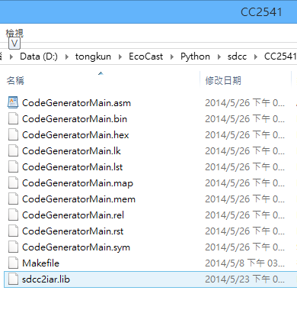
Wireless update (git bash)
python runflash.py CC2541/xxx.bin ‘’
e.g.: CodeGeneratorMain.bin

Slide 8
Rewrite call back function steps
Modify CodeGeneratorCallBacks.c
Compile source code
make CodeGeneratorCallBacks.bin
Wireless update
python runflash.py CC2541/CodeGeneratorCallBacks.bin ‘’
Modify CodeGeneratorMain.c
Compile source code
make CodeGeneratorMain.bin
Wireless update
python runflash.py CC2541/CodeGeneratorMain.bin ‘’
Finish

Slide 9
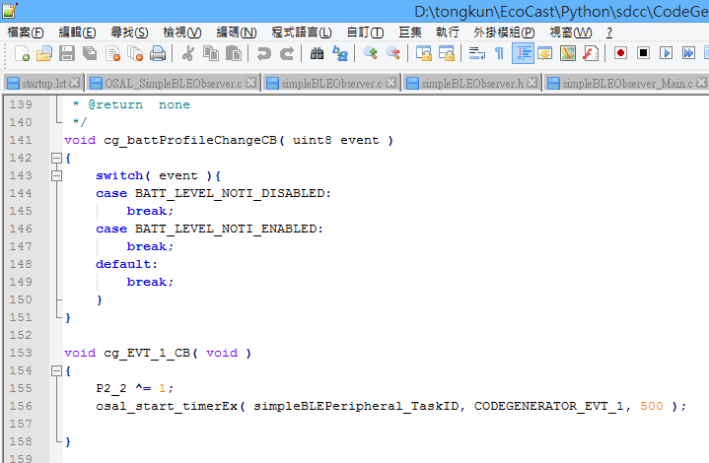
Rewrite call back – CodeGeneratorCallBacks.c
Define in simpleBLEperipheral.h
Toggle LED 2
Recall CODEGENERATOR_EVT_1 after 500ms

Slide 10
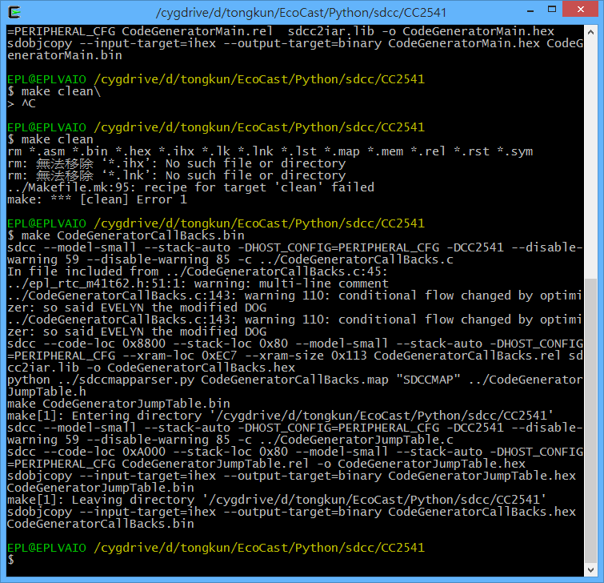
make CodeGeneratorCallBakcs.bin

Slide 11
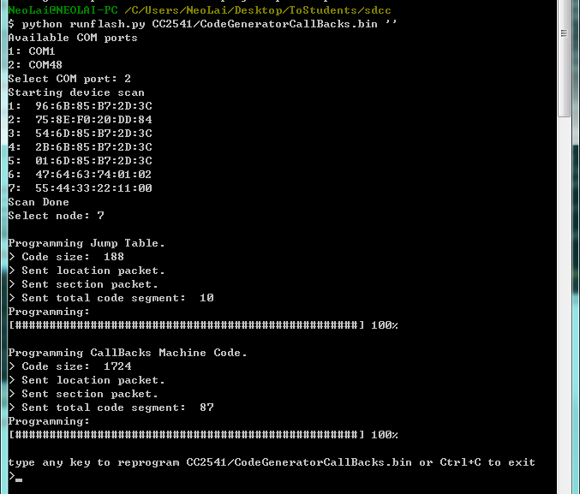
Wireless update
dongle com port index

Slide 12
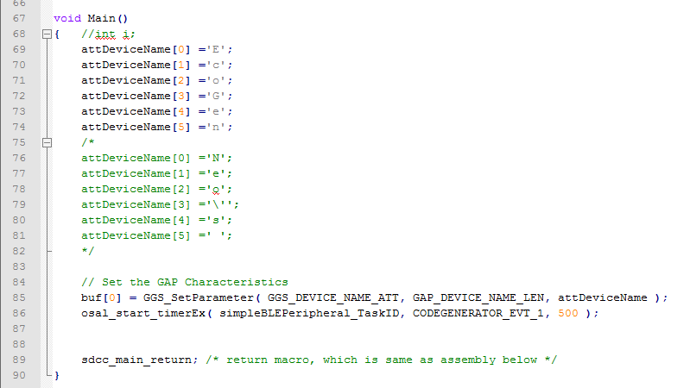
CodeGeneratorMain.c
Set device name, and use buffer ’buf’ to notify setting result.
Trigger first time CODEGENERATOR_EVT_1 callback.

Slide 13
make CodeGeneratorMain.bin

Slide 14
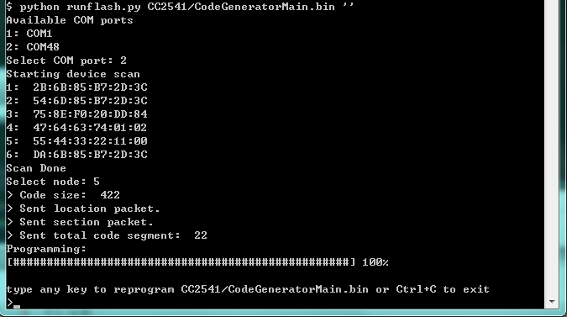
Wireless update

Slide 15
end

