Slide 1

LESSON 3
READING
ASEAN news

Slide 2
Warm-up: Guess the News Topic
Read the headline. Choose: Politics • Education • Sports • Culture
Students Join an ASEAN School Exchange Programme
Topic: __________
Vietnamese Athletes Win Medals at Regional Games
Topic: __________
Traditional Dance Festival Brings ASEAN Cultures Together
Topic: __________
ASEAN Leaders Meet to Discuss Regional Cooperation
Topic: __________
Women Across Southeast Asia Call for Equality in Sport
Topic: __________
Schools Introduce New Digital Learning Programmes
Topic: __________
Unit 4 • ASEAN and Viet Nam
02 / 73

Slide 3

WARM-UP
Labelling game
03 / 73

Slide 4

WARM-UP
Students work in 4 groups
There are some news headlines and some categories: Sport, Laws, Education, etc…
Raise your hands to get turns and choose the correct category for the headlines.
04 / 73

Slide 5

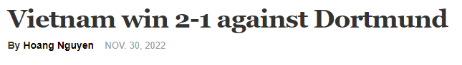
Choose the correct category for the headline.
1
Economy
Food
Politics
Sport

Slide 6
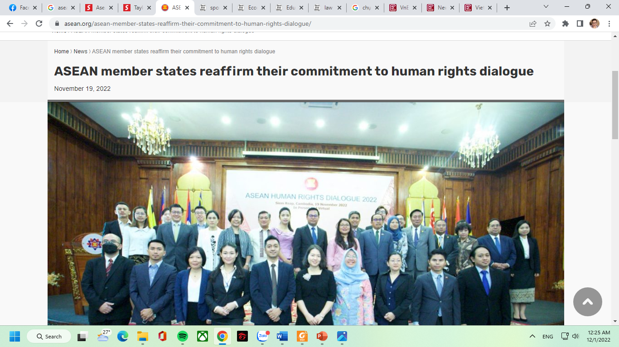
Choose the correct category for the headline.
2
Economy
Food
Law
Sport

Slide 7
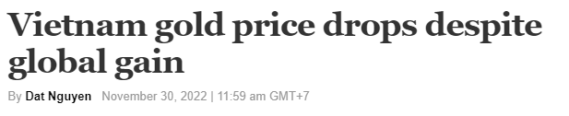
Choose the correct category for the headline.
3
Economy
Food
Politics
Sport

Slide 8
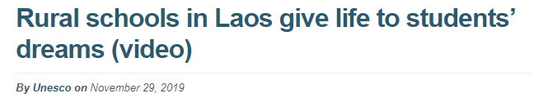
Put the news headlines in the correct category
4
Economy
Education
Politics
Sport

Slide 9
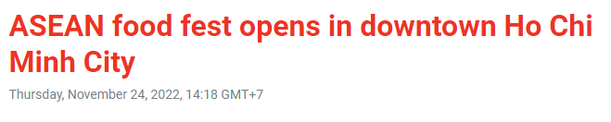
Choose the correct category for the headline.
5
Economy
Food
Politics
Sport

Slide 10
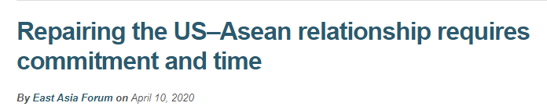
Choose the correct category for the headline.
6
Economy
Education
Politics
Laws

Slide 11
Task 1: Your News Habits
Work in pairs.
1. Where do you most often read the news?
2. What is your favourite news section?
Useful answers
I usually read news on social media/news websites.
My favourite section is Culture because...
Unit 4 • ASEAN and Viet Nam
11 / 73

Slide 12
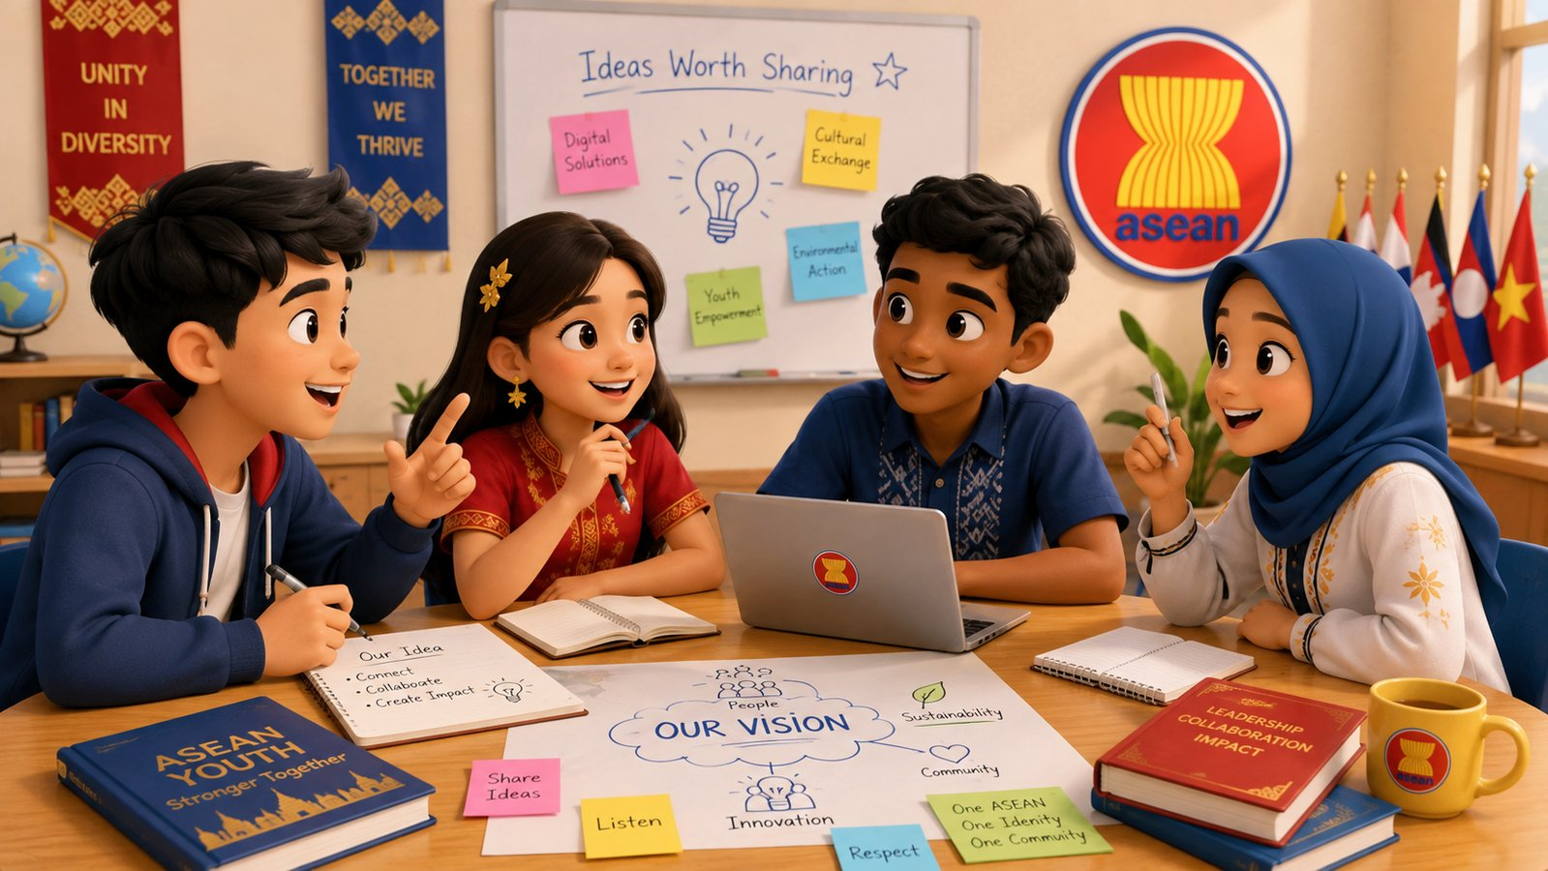
Pre-reading Vocabulary
Read the news more easily.
We will learn key words first, then use context to match highlighted words in Task 3.
Focus skills
• Guess meaning from context
• Skim for headlines
• Scan for specific information
Unit 4 • ASEAN and Viet Nam
12 / 73

Slide 13
raise awareness
phrase
🔔
to help people know more about a problem or issue
Example: The programme raises awareness of ASEAN.
raise awareness of/about something
Unit 4 • ASEAN and Viet Nam
13 / 73

Slide 14
discuss
verb
💬
/dɪˈskʌs/
to talk about something with other people
Example: Students discussed why ASEAN was important.
discussion (n)
Unit 4 • ASEAN and Viet Nam
14 / 73

Slide 15
discussion
noun
🗣️
/dɪˈskʌʃən/
a conversation about a topic
Example: They joined discussions on social and youth issues.
have a discussion about something
Unit 4 • ASEAN and Viet Nam
15 / 73

Slide 16
strengthen
verb
💪
/ˈstreŋθən/
to make something stronger
Example: The tour strengthened ASEAN-Korea relations.
strong (adj) → strength (n) -> strengthen (v)
Unit 4 • ASEAN and Viet Nam
16 / 73

Slide 17
relation
noun
🔗
/rɪˈleɪʃən/
the way people or groups behave towards each other
Example: ASEAN-Korea relations are important.
relations between A and B
Unit 4 • ASEAN and Viet Nam
17 / 73

Slide 18
look for
phrasal verb
🔍
to try to find someone or something
Example: SSEAYP is looking for participants.
look for = search for
Unit 4 • ASEAN and Viet Nam
18 / 73

Slide 19
participant
noun
🧑‍🤝‍🧑
/pɑːˈtɪsɪpənt/
a person who takes part in an activity
Example: Over 300 youths will be participants.
participate (v) • participation (n)
Unit 4 • ASEAN and Viet Nam
19 / 73

Slide 20
participate
verb
🙌
/pɑːˈtɪsɪpeɪt/
to take part in an activity or event
Example: Young people participate in cultural exchanges.
participate in = take part in
Unit 4 • ASEAN and Viet Nam
20 / 73

Slide 21
participation
noun
📝
/pɑːˌtɪsɪˈpeɪʃən/
the act of taking part in something
Example: Participation in school activities builds confidence.
participation in something
Unit 4 • ASEAN and Viet Nam
21 / 73

Slide 22
support
verb / noun
🤲
/səˈpɔːt/
to help or encourage someone or something
Example: The programme is supported by governments.
support sb/sth • give support
Unit 4 • ASEAN and Viet Nam
22 / 73

Slide 23
opportunity
noun
🚪
/ˌɒpəˈtjuːnəti/
a chance to do something good or useful
Example: Students have the opportunity to join discussions.
an opportunity to do something
Unit 4 • ASEAN and Viet Nam
23 / 73

Slide 24
issue
noun
❗
/ˈɪʃuː/
an important topic or problem for discussion
Example: Participants discuss current social and youth issues.
social issue • youth issue
Unit 4 • ASEAN and Viet Nam
24 / 73

Slide 25
eye-opening
adjective
👀
/ˈaɪ ˌəʊpənɪŋ/
surprising because you learn something new
Example: Cultural exchanges can be eye-opening.
an eye-opening experience
Unit 4 • ASEAN and Viet Nam
25 / 73

Slide 26
gender equality
noun phrase
⚖️
equal rights and opportunities for all genders
Example: The talk show promoted gender equality in sport.
Not “gender quality”
Unit 4 • ASEAN and Viet Nam
26 / 73

Slide 27
disability
noun
♿
/ˌdɪsəˈbɪləti/
a physical or mental condition that makes some activities harder
Example: The show discussed the rights of sportspeople with disabilities.
people with disabilities
Unit 4 • ASEAN and Viet Nam
27 / 73

Slide 28
live-streamed
adjective / verb
📡
shown live over the Internet
Example: The talk show was live-streamed on the ASEAN webpage.
live-stream (v/n)
Unit 4 • ASEAN and Viet Nam
28 / 73

Slide 29
represent
verb
🏳️
/ˌreprɪˈzent/
to act officially for another person, group, or country
Example: Athletes represent their countries at international events.
representative (n)
Unit 4 • ASEAN and Viet Nam
29 / 73

Slide 30
Vocabulary Check
Choose the best word or phrase.
1. Cultural exchanges can be very ______ because you learn new things.
2. The programme is ______ by several governments.
3. Athletes ______ their countries at international events.
4. Students joined a ______ about youth issues.
Answers: eye-opening • supported • represent • discussion
Unit 4 • ASEAN and Viet Nam
30 / 73

Slide 31
Task 3: Word Detective
Match the highlighted words with their meanings.
1. relations
a. shown over the Internet
2. eye-opening
b. to act officially for another person or organisation
3. represent
c. the way groups behave towards each other
4. live-streamed
d. surprising because you learn something new
Tip: Look at the words before and after the highlighted word.
Unit 4 • ASEAN and Viet Nam
31 / 73

Slide 32
Task 3: Answers
Use context, not translation only.
relations
C
the way groups behave towards each other
eye-opening
D
surprising because you learn something new
represent
B
to act officially for another person or organisation
live-streamed
A
shown over the Internet
Unit 4 • ASEAN and Viet Nam
32 / 73

Slide 33


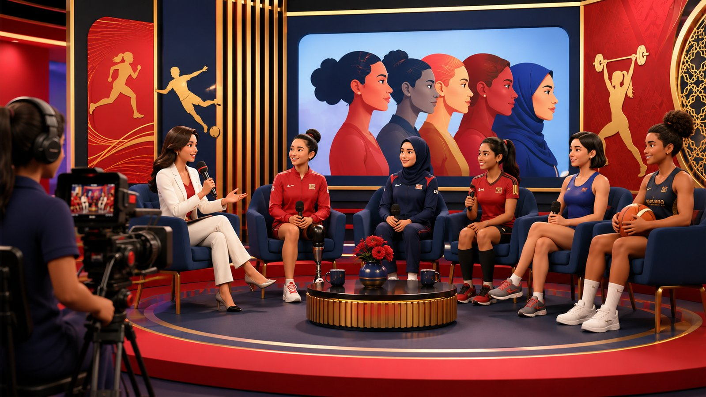
Task 2: Headline Hunt
Skim the news items and choose the best headline.
News Item 1
News Item 2
News Item 3
Rule: Read quickly. Do not translate every word. Find the main idea.
There are TWO extra headlines.
Unit 4 • ASEAN and Viet Nam
33 / 73

Slide 34
Task 2: Answers + Clues
Which words helped you choose the headline?
1
D. Korean and ASEAN students
Clues: ASEAN-Korea Centre • 121 Korean and Asian students
2
B. Travelling to ASEAN countries
Clues: Ship • journey • travel to five ASEAN countries
3
C. Equality in sport for ASEAN women
Clues: women in sport • gender equality • female representatives
Unit 4 • ASEAN and Viet Nam
34 / 73

Slide 35

Task 4: Explore ASEAN Reading Game
Scan for specific information.
Use the HTML game:
explore_asean_reading_game.html
Game structure
• 12 flags
• 8 reading missions
• Lucky / Unlucky / Double / Lose a turn
• +5 evidence bonus
Reading rule: NO MORE THAN FOUR WORDS AND/OR A NUMBER
Unit 4 • ASEAN and Viet Nam
35 / 73

Slide 36
Task 4: Answers + Evidence
Check after the game.
1. How many students?
121
welcomed 121 Korean and Asian students
2. How long on board?
50 days
the journey will last for 50 days
3. Discuss besides youth issues?
current social issues
current social and youth issues
4. When?
in December
took place in December
5. Where shown live?
on the ASEAN webpage
live-streamed on the ASEAN webpage
Unit 4 • ASEAN and Viet Nam
36 / 73

Slide 37
Task 5: Which News Item Interests You?
Work in groups. Give reasons.
Question
Do you want to find more information about any of the news items in Task 2? Which one? Why?
Useful language
• I’d like to know more about News Item __ because...
• I’m interested in...
• I think it is important because...
• I want to find out more about...
Unit 4 • ASEAN and Viet Nam
37 / 73

Slide 38

30-second ASEAN Reporter
Optional speaking extension
Choose one news item and report it in 3–4 sentences.
Good morning. Here is today’s ASEAN news.
This news is about...
It happened in/on...
I think it is interesting because...
Vote: Best Reporter • Best English • Best News Team
Unit 4 • ASEAN and Viet Nam
38 / 73

Slide 39











UNIT 4 • ASEAN & VIET NAM
THE MYSTERY
BOX
Read • Think • Win!
15 NEWS CHALLENGES
READING GAME
Notes:
NOTE: This template is for educational, non-commercial purposes only. For more free game templates like this one, visit https://pinnyteaching.web.app/

Slide 40

.
ASEAN NEWS • READING
Game rules
Divide the class into 2 - 4 teams. Teams take turns choosing a number from 1 to 15 and answering a question
If your team answers correctly, you earn a chance to open a Mystery Box.
If wrong, the turn goes to the next player/team
When you get the correct answer, you’ll get a random Mystery Box with secret points. You can choose to keep it or give it to another player/team.
After all 15 questions, the player/team with the most points wins!

Slide 41

GAMEBOARD
1
2
3
4
5
6
7
8
9
10
11
12
13
14
15
Notes:
NOTE:
This is the gameboard where students choose a number to answer the question.
Click into each box to jump to the question section.

Slide 42


ASEAN NEWS • READING
News 1: The 121 students came from ______ schools.
A. two
C. six
B. ten
D. twelve
Notes:
Câu 1. Đáp án: C. six

Slide 43




ASEAN NEWS • READING
KEEP OR GIVE THE BOX
Notes:
NOTE:
This is the mystery box.
Students will have a chance to keep or give the box to the other.
After that, the teacher will click on the “CUBE” to reveal the secret point.
Then, the teacher clicks on the “CIRCUS PERFORMER” on the left of the screen to come back to the gameboard to continue.

Slide 44


ASEAN NEWS • READING
Make a sentence about the news with the two cues.
Korean students
traditional songs
Notes:
Câu 2. Câu mẫu: Korean students sang traditional songs and made ASEAN posters.

Slide 45

ASEAN NEWS • READING
KEEP OR GIVE THE BOX
Notes:
NOTE:
This is the mystery box.
Students will have a chance to keep or give the box to the other.
After that, the teacher will click on the “CUBE” to reveal the secret point.
Then, the teacher clicks on the “CIRCUS PERFORMER” on the left of the screen to come back to the gameboard to continue.

Slide 46
ASEAN NEWS • READING
News 1: Who organises the ASEAN School Tour Programme?
the ASEAN-Korea Centre (AKC)
Notes:
Câu 3. Đáp án: the ASEAN-Korea Centre (AKC)

Slide 47
ASEAN NEWS • READING
KEEP OR GIVE THE BOX
Notes:
NOTE:
This is the mystery box.
Students will have a chance to keep or give the box to the other.
After that, the teacher will click on the “CUBE” to reveal the secret point.
Then, the teacher clicks on the “CIRCUS PERFORMER” on the left of the screen to come back to the gameboard to continue.

Slide 48


ASEAN NEWS • READING
Make a sentence about the news with the two cues.
the AKC
cultural exchanges
Notes:
Câu 4. Câu mẫu: The AKC wants to raise awareness of ASEAN and promote cultural exchanges.

Slide 49


ASEAN NEWS • READING
KEEP OR GIVE THE BOX
Notes:
NOTE:
This is the mystery box.
Students will have a chance to keep or give the box to the other.
After that, the teacher will click on the “CUBE” to reveal the secret point.
Then, the teacher clicks on the “CIRCUS PERFORMER” on the left of the screen to come back to the gameboard to continue.

Slide 50
ASEAN NEWS • READING
“relations” means…
A. the way people or groups behave towards each other
C. news reports
B. family members
D. travel plans
Notes:
Câu 5. Đáp án: A. the way people or groups behave towards each other

Slide 51

ASEAN NEWS • READING
KEEP OR GIVE THE BOX
Notes:
NOTE:
This is the mystery box.
Students will have a chance to keep or give the box to the other.
After that, the teacher will click on the “CUBE” to reveal the secret point.
Then, the teacher clicks on the “CIRCUS PERFORMER” on the left of the screen to come back to the gameboard to continue.

Slide 52
ASEAN NEWS • READING
Complete with ONE word from the text.
News 2: SSEAYP is organised by the government of ______.
Japan
Notes:
Câu 6. Đáp án: Japan

Slide 53
ASEAN NEWS • READING
KEEP OR GIVE THE BOX
Notes:
NOTE:
This is the mystery box.
Students will have a chance to keep or give the box to the other.
After that, the teacher will click on the “CUBE” to reveal the secret point.
Then, the teacher clicks on the “CIRCUS PERFORMER” on the left of the screen to come back to the gameboard to continue.

Slide 54


ASEAN NEWS • READING
Make a sentence about the news with the two cues.
SSEAYP youths
50 days
Notes:
Câu 7. Câu mẫu: SSEAYP participants stay together on a ship for 50 days.

Slide 55
ASEAN NEWS • READING
KEEP OR GIVE THE BOX
Notes:
NOTE:
This is the mystery box.
Students will have a chance to keep or give the box to the other.
After that, the teacher will click on the “CUBE” to reveal the secret point.
Then, the teacher clicks on the “CIRCUS PERFORMER” on the left of the screen to come back to the gameboard to continue.

Slide 56
ASEAN NEWS • READING
News 2: How many youths will join the ship?
over 300
Notes:
Câu 8. Đáp án: over 300

Slide 57
ASEAN NEWS • READING
KEEP OR GIVE THE BOX
Notes:
NOTE:
This is the mystery box.
Students will have a chance to keep or give the box to the other.
After that, the teacher will click on the “CUBE” to reveal the secret point.
Then, the teacher clicks on the “CIRCUS PERFORMER” on the left of the screen to come back to the gameboard to continue.

Slide 58


ASEAN NEWS • READING
Make a sentence about the news with the two cues.
problem-solving
leadership
Notes:
Câu 9. Câu mẫu: SSEAYP participants will develop problem-solving and leadership skills.

Slide 59
ASEAN NEWS • READING
KEEP OR GIVE THE BOX
Notes:
NOTE:
This is the mystery box.
Students will have a chance to keep or give the box to the other.
After that, the teacher will click on the “CUBE” to reveal the secret point.
Then, the teacher clicks on the “CIRCUS PERFORMER” on the left of the screen to come back to the gameboard to continue.

Slide 60
ASEAN NEWS • READING
Complete with ONE word from the text.
News 2: Participants will discuss youth issues and current ______ issues.
social
Notes:
Câu 10. Đáp án: social

Slide 61
ASEAN NEWS • READING
KEEP OR GIVE THE BOX
Notes:
NOTE:
This is the mystery box.
Students will have a chance to keep or give the box to the other.
After that, the teacher will click on the “CUBE” to reveal the secret point.
Then, the teacher clicks on the “CIRCUS PERFORMER” on the left of the screen to come back to the gameboard to continue.

Slide 62


ASEAN NEWS • READING
Make a sentence about the news with the two cues.
women in sport
gender equality
Notes:
Câu 11. Câu mẫu: The talk show promoted gender equality in and through sport.

Slide 63
ASEAN NEWS • READING
KEEP OR GIVE THE BOX
Notes:
NOTE:
This is the mystery box.
Students will have a chance to keep or give the box to the other.
After that, the teacher will click on the “CUBE” to reveal the secret point.
Then, the teacher clicks on the “CIRCUS PERFORMER” on the left of the screen to come back to the gameboard to continue.

Slide 64
ASEAN NEWS • READING
Complete with ONE word from the text.
News 3: The talk show was ______ on the ASEAN webpage.
live-streamed
Notes:
Câu 12. Đáp án: live-streamed

Slide 65
ASEAN NEWS • READING
KEEP OR GIVE THE BOX
Notes:
NOTE:
This is the mystery box.
Students will have a chance to keep or give the box to the other.
After that, the teacher will click on the “CUBE” to reveal the secret point.
Then, the teacher clicks on the “CIRCUS PERFORMER” on the left of the screen to come back to the gameboard to continue.

Slide 66
ASEAN NEWS • READING
News 3: How many female sports representatives were there?
A. 5
C. 121
B. 50
D. 10
Notes:
Câu 13. Đáp án: D. 10

Slide 67
ASEAN NEWS • READING
KEEP OR GIVE THE BOX
Notes:
NOTE:
This is the mystery box.
Students will have a chance to keep or give the box to the other.
After that, the teacher will click on the “CUBE” to reveal the secret point.
Then, the teacher clicks on the “CIRCUS PERFORMER” on the left of the screen to come back to the gameboard to continue.

Slide 68
ASEAN NEWS • READING
News 3: Whose rights did the talk show also discuss?
sports people with disabilities
Notes:
Câu 14. Đáp án: sports people with disabilities

Slide 69
ASEAN NEWS • READING
KEEP OR GIVE THE BOX
Notes:
NOTE:
This is the mystery box.
Students will have a chance to keep or give the box to the other.
After that, the teacher will click on the “CUBE” to reveal the secret point.
Then, the teacher clicks on the “CIRCUS PERFORMER” on the left of the screen to come back to the gameboard to continue.

Slide 70



ASEAN NEWS • READING
Which programme would you like to join? Why?
ASEAN youths
eye-opening
Notes:
Câu 15. Câu mẫu: I’d like to join SSEAYP because it would be an eye-opening experience.

Slide 71
ASEAN NEWS • READING
KEEP OR GIVE THE BOX
Notes:
NOTE:
This is the mystery box.
Students will have a chance to keep or give the box to the other.
After that, the teacher will click on the “CUBE” to reveal the secret point.
Then, the teacher clicks on the “CIRCUS PERFORMER” on the left of the screen to come back to the gameboard to continue.

Slide 72

MISSION COMPLETE!
Great teamwork!
Keep reading. Keep exploring ASEAN.
UNIT 4 • READING

Slide 73
Lesson Wrap-up
What did we practise today?
Skimming
choose suitable headlines
Scanning
find specific information quickly
Vocabulary
understand ASEAN news words
Speaking
give opinions about news items
Homework: Write 4–5 sentences about the news item you are most interested in.
Unit 4 • ASEAN and Viet Nam
73 / 73

