Slide 1





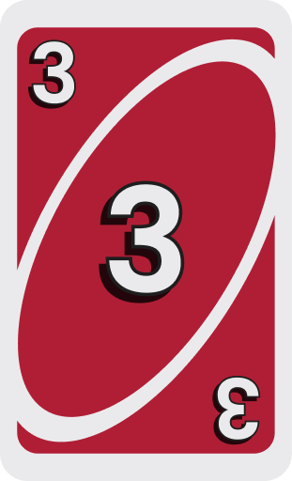










zz
7
+4
2
Notes:
NOTE: This template is for educational, non-commercial purposes only. For more free game templates like this one, visit https://pinny-teaching.web.app/
This game is adapted from the board game “UNO”

Slide 2
The number on the cards is the point you can get
1
9
1
9
3
5
3
1
9
5
3
Notes:
NOTE:
The text and the animation will appear automatically.

Slide 3
If this card appears, you must swap your score to the opponent.
Notes:
NOTE:
The text and the animation will appear automatically.

Slide 4
If this card appears, the opponent will lose a chance to play the next round
Notes:
NOTE:
The text and the animation will appear automatically.

Slide 5


If this card appears, you will lose all the points.
Notes:
NOTE:
The text and the animation will appear automatically.

Slide 6
- 4
If this card appears, you will lose 4 points.
- 4
Notes:
NOTE:
The text and the animation will appear automatically.

Slide 7
I WILL SHOW YOU A CARD
6
- 4
9
6
9
6
9
- 4
Notes:
NOTE:
The text and the animation will appear automatically.

Slide 8
KEEP THE POINTS OR DRAW AGAIN FOR MORE POINTS
6
- 4
9
6
DRAW AGAIN
9
TAKE 9 POINTS
6
9
- 4
Notes:
NOTE:
The text and the animation will appear automatically.

Slide 9
KEEP THE POINTS OR DRAW AGAIN FOR MORE POINTS
6
- 4
9
6
DRAW AGAIN
9
TAKE 15 POINTS
6
9
- 4
Notes:
NOTE:
The text and the animation will appear automatically.

Slide 10
BE AWARE! IF THIS CARD APPEARS, YOU MUST SWAP YOUR SCORE TO THE OPPONENT.
6
- 4
6
DRAW AGAIN
TAKE 11 POINTS
6
- 4

Slide 11
BE AWARE! IF THIS CARD APPEARS, YOU WILL LOSE 4 POINTS.
- 4
DRAW AGAIN
TAKE 11 POINTS
- 4
Notes:
NOTE:
The text and the animation will appear automatically.

Slide 12
BE AWARE! IF THIS CARD APPEARS, YOU WILL LOSE ALL THE POINTS.
- 4
0 POINTS
- 4
Notes:
NOTE:
The text and the animation will appear automatically.

Slide 13
QUESTIONS
1
2
3
4
5
6
7
8
9
10
11
12
13
14
15
Notes:
NOTE:
1. The teacher clicks on the number that students choose to jump to the question section

Slide 14
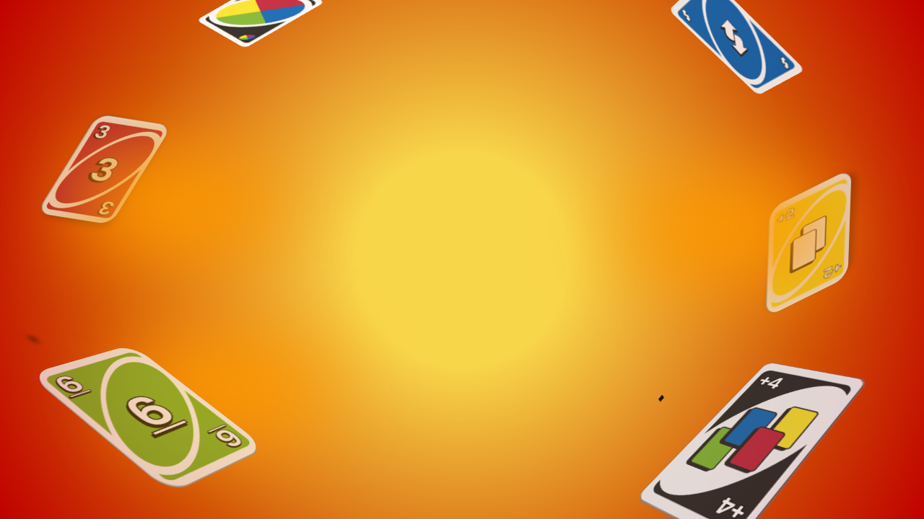




Task 2 · What was Tam doing when Kim went to her house?
SHE WAS WORKING AS A VOLUNTEER AT THE LOCAL CENTRE.
Notes:
Câu 1. Task 2 · What was Tam doing when Kim went to her house?
Đáp án: She was working as a volunteer at the local centre.
Bấm 1: hiện câu hỏi · Bấm 2: hiện đáp án · rồi sang slide rút thẻ tính điểm.

Slide 15
3
1
6
- 4
0
4
3
6
0
6
3
1
Total Scores
1
6
3
- 4
Notes:
NOTE:
This slide contains a set of five cards. When students answer correctly, they earn the opportunity to draw a card.
Students can continue drawing cards until the end or stop at any time to secure their points.’
The teacher presses "ENTER" to draw a card.
Click on the HOUSE ICON to return to the question selection slide.

Slide 16



Task 2 · According to Tam, what can community service do for young people?
A. help them earn a lot of money
B. boost their confidence
C. give them more free time
B. BOOST THEIR CONFIDENCE
Notes:
Câu 6. Task 2 · According to Tam, what can community service do for young people?
A. help them earn a lot of money
B. boost their confidence
C. give them more free time
Đáp án: B. boost their confidence
Bấm 1: hiện câu hỏi · Bấm 2: hiện đáp án · rồi sang slide rút thẻ tính điểm.

Slide 17
8
4
- 4
8
4
8
0
8
4
Total Scores
4
8
- 4
Notes:
NOTE:
This slide contains a set of five cards. When students answer correctly, they earn the opportunity to draw a card.
Students can continue drawing cards until the end or stop at any time to secure their points.’
The teacher presses "ENTER" to draw a card.
Click on the HOUSE ICON to return to the question selection slide.

Slide 18



Task 3 · Find the adjective ending in -less in the conversation.
ENDLESS
Notes:
Câu 11. Task 3 · Find the adjective ending in -less in the conversation.
Đáp án: endless
Bấm 1: hiện câu hỏi · Bấm 2: hiện đáp án · rồi sang slide rút thẻ tính điểm.

Slide 19
2
5
9
- 4
11
12
7
2
0
9
0
2
5
Total Scores
5
9
2
- 4
Notes:
NOTE:
This slide contains a set of five cards. When students answer correctly, they earn the opportunity to draw a card.
Students can continue drawing cards until the end or stop at any time to secure their points.’
The teacher presses "ENTER" to draw a card.
Click on the HOUSE ICON to return to the question selection slide.

Slide 20



Task 2 · What are some regular activities at the centre for community development?
CLEANING UP THE PARK AND VOLUNTEERING AT AN ORPHANAGE.
Notes:
Câu 2. Task 2 · What are some regular activities at the centre for community development?
Đáp án: Cleaning up the park and volunteering at an orphanage.
Bấm 1: hiện câu hỏi · Bấm 2: hiện đáp án · rồi sang slide rút thẻ tính điểm.

Slide 21
5
2
3
7
3
5
5
0
7
0
7
5
2
3
Total Scores
2
3
7
5
Notes:
NOTE:
This slide contains a set of five cards. When students answer correctly, they earn the opportunity to draw a card.
Students can continue drawing cards until the end or stop at any time to secure their points.’
The teacher presses "ENTER" to draw a card.
Click on the HOUSE ICON to return to the question selection slide.

Slide 22


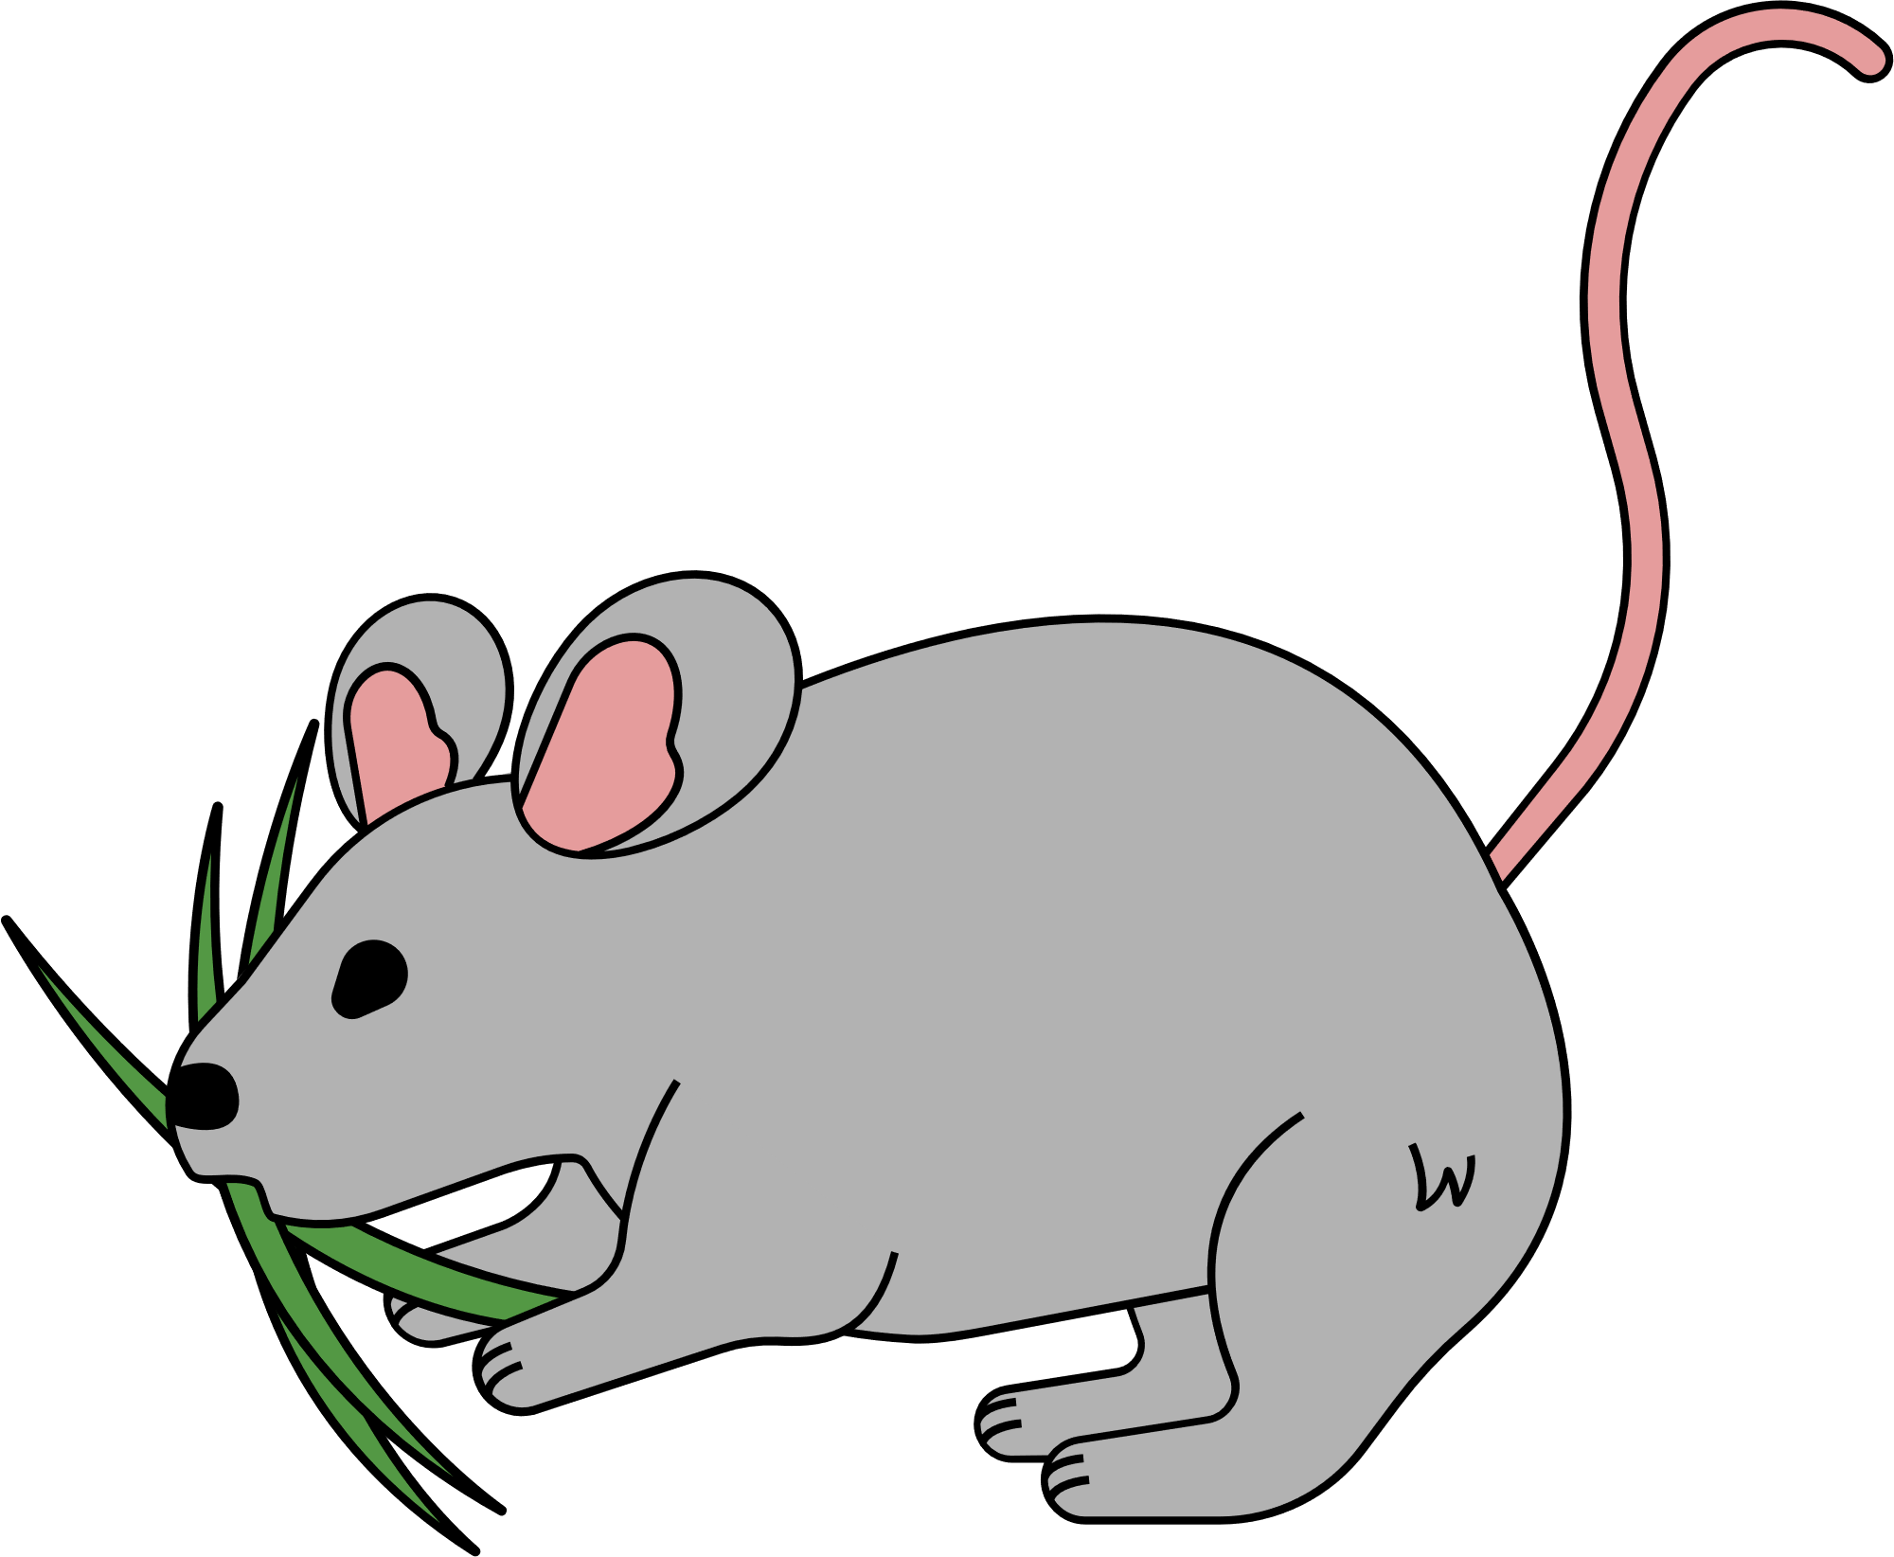
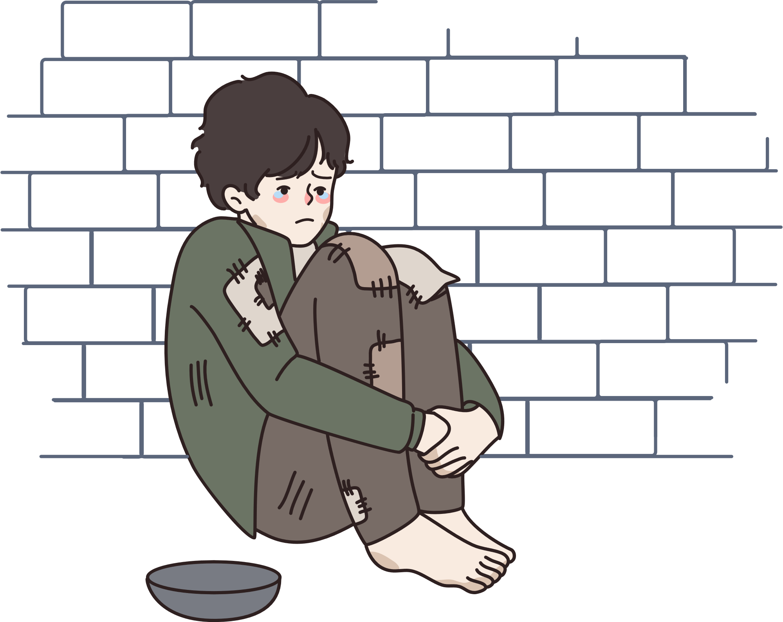
Task 2 · How often does the local environmental group clean up the park?
A. once a week
B. once a month
C. once a year
A. ONCE A WEEK
Notes:
Câu 7. Task 2 · How often does the local environmental group clean up the park?
A. once a week
B. once a month
C. once a year
Đáp án: A. once a week
Bấm 1: hiện câu hỏi · Bấm 2: hiện đáp án · rồi sang slide rút thẻ tính điểm.

Slide 23
4
2
1
- 4
-1
-3
3
1
0
1
4
2
Total Scores
4
2
1
- 4
Notes:
NOTE:
This slide contains a set of five cards. When students answer correctly, they earn the opportunity to draw a card.
Students can continue drawing cards until the end or stop at any time to secure their points.’
The teacher presses "ENTER" to draw a card.
Click on the HOUSE ICON to return to the question selection slide.

Slide 24



Task 3 · The suffix -less means…
A. full of
B. causing the feeling
C. without or lacking
C. WITHOUT OR LACKING
Notes:
Câu 12. Task 3 · The suffix -less means…
A. full of
B. causing the feeling
C. without or lacking
Đáp án: C. without or lacking
Bấm 1: hiện câu hỏi · Bấm 2: hiện đáp án · rồi sang slide rút thẻ tính điểm.

Slide 25
2
9
- 4
5
7
9
0
2
9
Total Scores
2
9
- 4
Notes:
NOTE:
This slide contains a set of five cards. When students answer correctly, they earn the opportunity to draw a card.
Students can continue drawing cards until the end or stop at any time to secure their points.’
The teacher presses "ENTER" to draw a card.
Click on the HOUSE ICON to return to the question selection slide.

Slide 26


Task 2 · How can Kim apply for volunteer work at the centre?
SHE NEEDS TO FILL IN THE FORM AND SEND IT IN.
Notes:
Câu 3. Task 2 · How can Kim apply for volunteer work at the centre?
Đáp án: She needs to fill in the form and send it in.
Bấm 1: hiện câu hỏi · Bấm 2: hiện đáp án · rồi sang slide rút thẻ tính điểm.

Slide 27
5
8
1
- 4
- 4
6
9
5
1
0
1
5
8
1
Total Scores
8
1
5
- 4
- 4
Notes:
NOTE:
This slide contains a set of five cards. When students answer correctly, they earn the opportunity to draw a card.
Students can continue drawing cards until the end or stop at any time to secure their points.’
The teacher presses "ENTER" to draw a card.
Click on the HOUSE ICON to return to the question selection slide.

Slide 28




Task 3 · Find the adjective ending in -ed in the conversation.
EXCITED
Notes:
Câu 8. Task 3 · Find the adjective ending in -ed in the conversation.
Đáp án: excited
Bấm 1: hiện câu hỏi · Bấm 2: hiện đáp án · rồi sang slide rút thẻ tính điểm.

Slide 29
2
3
4
2
7
0
4
0
2
3
4
Total Scores
3
4
2
Notes:
NOTE:
This slide contains a set of five cards. When students answer correctly, they earn the opportunity to draw a card.
Students can continue drawing cards until the end or stop at any time to secure their points.’
The teacher presses "ENTER" to draw a card.
Click on the HOUSE ICON to return to the question selection slide.

Slide 30




Task 3 · Which adjective describes how people FEEL?
A. excited
B. interesting
C. useful
A. EXCITED
Notes:
Câu 13. Task 3 · Which adjective describes how people FEEL?
A. excited
B. interesting
C. useful
Đáp án: A. excited
Bấm 1: hiện câu hỏi · Bấm 2: hiện đáp án · rồi sang slide rút thẻ tính điểm.

Slide 31
8
1
7
- 4
- 4
8
3
4
7
0
0
8
1
7
Total Scores
1
7
8
- 4
- 4
Notes:
NOTE:
This slide contains a set of five cards. When students answer correctly, they earn the opportunity to draw a card.
Students can continue drawing cards until the end or stop at any time to secure their points.’
The teacher presses "ENTER" to draw a card.
Click on the HOUSE ICON to return to the question selection slide.

Slide 32




Task 2 · How did Tam find out about the volunteer work?
A. A friend told her about it.
B. She read about it at school.
C. She saw an advertisement at the centre.
C. SHE SAW AN ADVERTISEMENT AT THE CENTRE.
Notes:
Câu 4. Task 2 · How did Tam find out about the volunteer work?
A. A friend told her about it.
B. She read about it at school.
C. She saw an advertisement at the centre.
Đáp án: C. She saw an advertisement at the centre.
Bấm 1: hiện câu hỏi · Bấm 2: hiện đáp án · rồi sang slide rút thẻ tính điểm.

Slide 33
3
6
1
- 4
7
6
1
0
3
3
6
1
Total Scores
6
1
3
- 4
Notes:
NOTE:
This slide contains a set of five cards. When students answer correctly, they earn the opportunity to draw a card.
Students can continue drawing cards until the end or stop at any time to secure their points.’
The teacher presses "ENTER" to draw a card.
Click on the HOUSE ICON to return to the question selection slide.

Slide 34



Task 3 · Find the adjective ending in -ing in the conversation.
INTERESTING
Notes:
Câu 9. Task 3 · Find the adjective ending in -ing in the conversation.
Đáp án: interesting
Bấm 1: hiện câu hỏi · Bấm 2: hiện đáp án · rồi sang slide rút thẻ tính điểm.

Slide 35
7
6
9
- 4
0
6
9
6
0
1
7
6
9
Total Scores
6
9
7
- 4
Notes:
NOTE:
This slide contains a set of five cards. When students answer correctly, they earn the opportunity to draw a card.
Students can continue drawing cards until the end or stop at any time to secure their points.’
The teacher presses "ENTER" to draw a card.
Click on the HOUSE ICON to return to the question selection slide.

Slide 36



Task 4 · Oh, when you came, I ______ as a volunteer at our local centre for community development.
WAS WORKING
Notes:
Câu 14. Task 4 · Oh, when you came, I ______ as a volunteer at our local centre for community development.
Đáp án: was working
Bấm 1: hiện câu hỏi · Bấm 2: hiện đáp án · rồi sang slide rút thẻ tính điểm.

Slide 37
5
4
- 4
9
5
0
4
5
4
Total Scores
5
4
- 4
Notes:
NOTE:
This slide contains a set of five cards. When students answer correctly, they earn the opportunity to draw a card.
Students can continue drawing cards until the end or stop at any time to secure their points.’
The teacher presses "ENTER" to draw a card.
Click on the HOUSE ICON to return to the question selection slide.

Slide 38


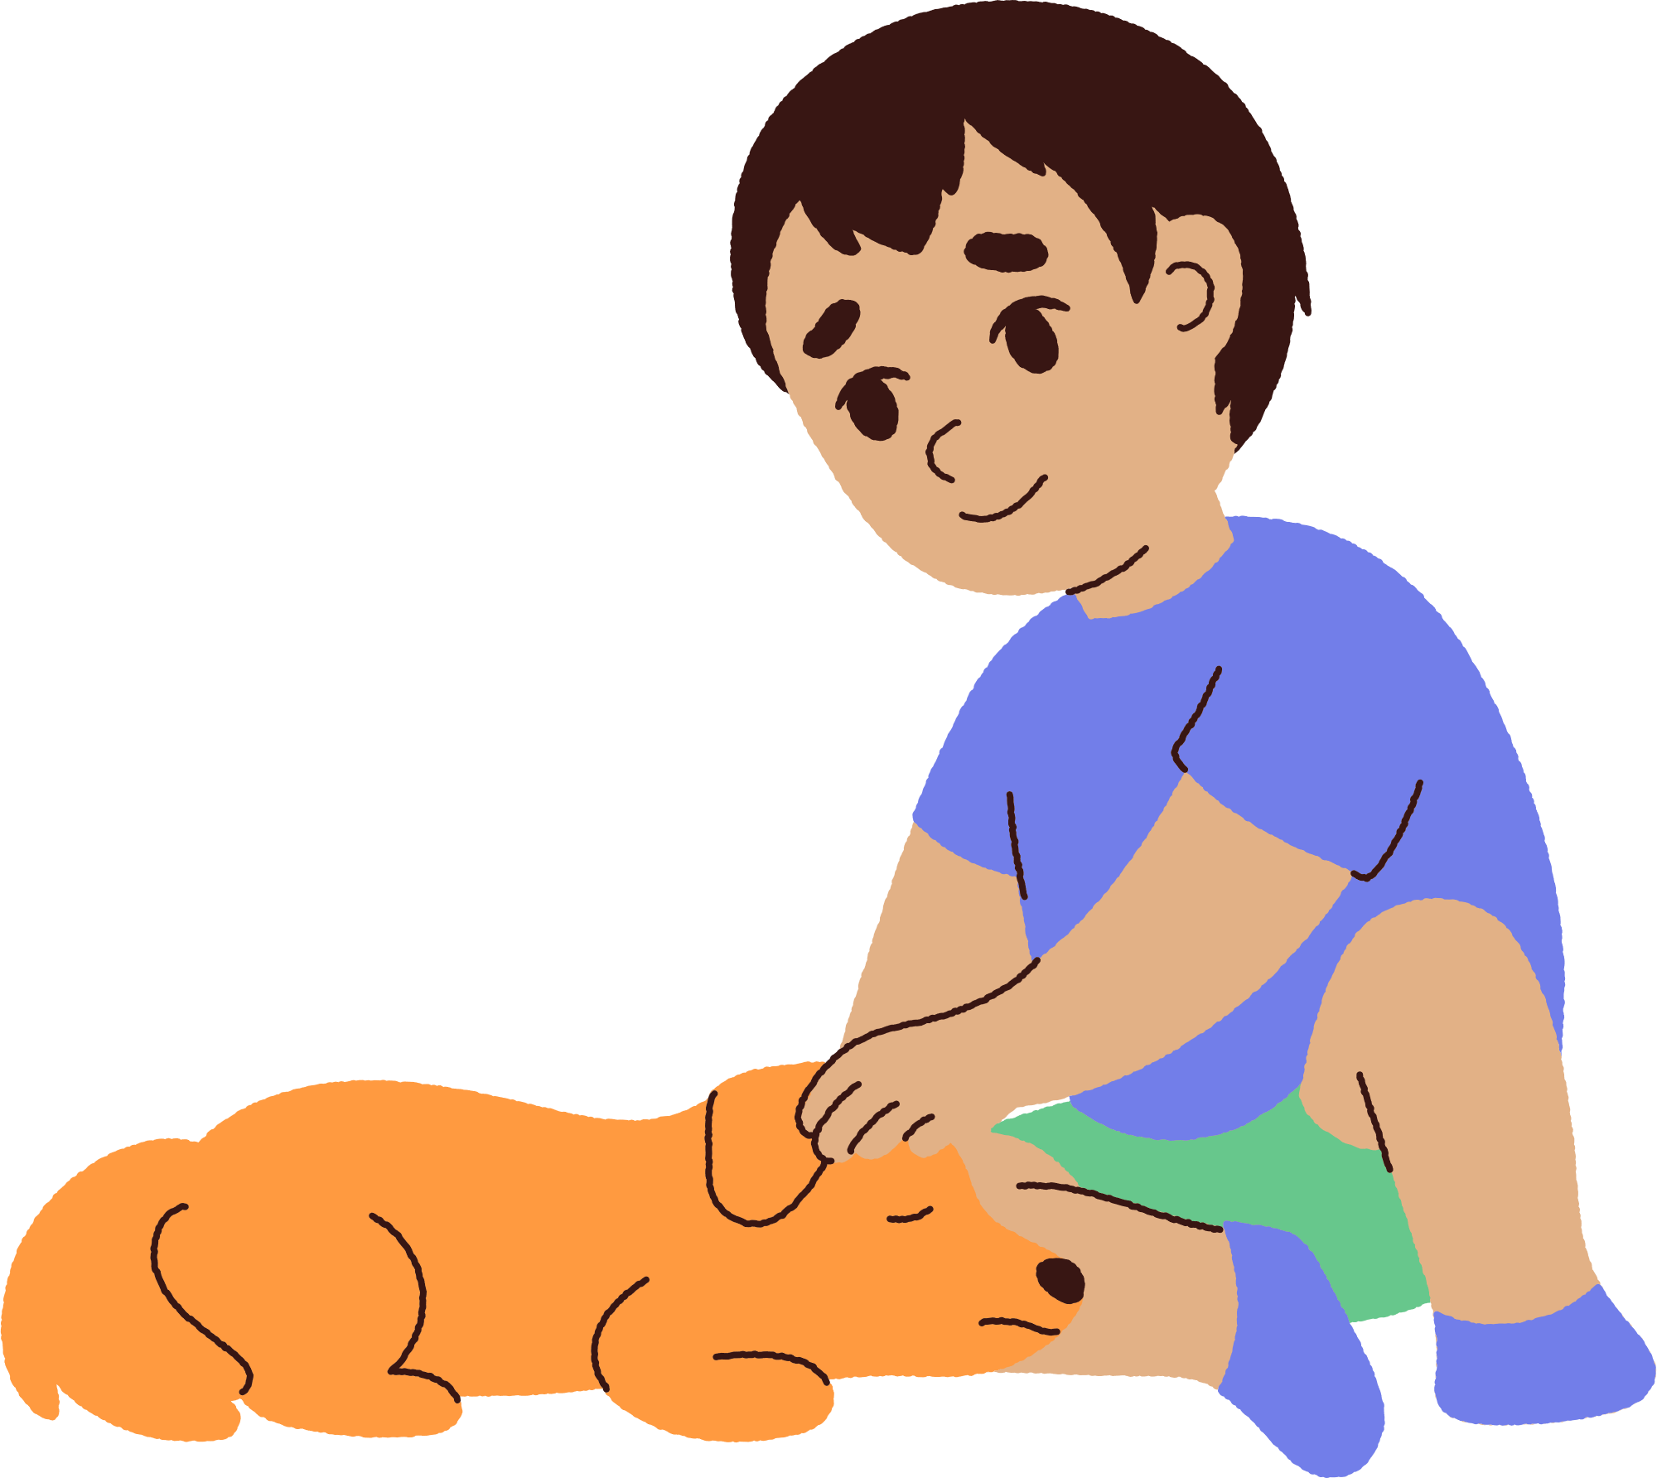
Task 2 · When did Tam see the advertisement for volunteers?
A. last summer
B. last month
C. last week
A. LAST SUMMER
Notes:
Câu 5. Task 2 · When did Tam see the advertisement for volunteers?
A. last summer
B. last month
C. last week
Đáp án: A. last summer
Bấm 1: hiện câu hỏi · Bấm 2: hiện đáp án · rồi sang slide rút thẻ tính điểm.

Slide 39
9
4
3
- 4
12
-1
3
0
8
9
4
3
Total Scores
4
3
9
- 4
Notes:
NOTE:
This slide contains a set of five cards. When students answer correctly, they earn the opportunity to draw a card.
Students can continue drawing cards until the end or stop at any time to secure their points.’
The teacher presses "ENTER" to draw a card.
Click on the HOUSE ICON to return to the question selection slide.

Slide 40



Task 3 · Find TWO adjectives ending in -ful in the conversation.
USEFUL, SUCCESSFUL
Notes:
Câu 10. Task 3 · Find TWO adjectives ending in -ful in the conversation.
Đáp án: useful, successful
Bấm 1: hiện câu hỏi · Bấm 2: hiện đáp án · rồi sang slide rút thẻ tính điểm.

Slide 41
5
7
- 4
0
3
7
0
8
5
7
Total Scores
7
5
- 4
Notes:
NOTE:
This slide contains a set of five cards. When students answer correctly, they earn the opportunity to draw a card.
Students can continue drawing cards until the end or stop at any time to secure their points.’
The teacher presses "ENTER" to draw a card.
Click on the HOUSE ICON to return to the question selection slide.

Slide 42



Task 4 · Last summer, while I was visiting the centre, I ______ an advertisement for volunteers.
SAW
Notes:
Câu 15. Task 4 · Last summer, while I was visiting the centre, I ______ an advertisement for volunteers.
Đáp án: saw
Bấm 1: hiện câu hỏi · Bấm 2: hiện đáp án · rồi sang slide rút thẻ tính điểm.

Slide 43
7
6
- 4
4
0
6
0
7
7
6
Total Scores
6
7
- 4
Notes:
NOTE:
This slide contains a set of five cards. When students answer correctly, they earn the opportunity to draw a card.
Students can continue drawing cards until the end or stop at any time to secure their points.’
The teacher presses "ENTER" to draw a card.
Click on the HOUSE ICON to return to the question selection slide.

Slide 44
zz
7
+4
2
THE END

