Slide 1
Airlines are Still the Safest Way to Travel
Video Presentation
Nicole Aguilera
DSC 640 T301

Slide 2
The Facts: 2000 - 2014
Total Number of Airline Accidents:
231
Total Number of Airline Fatalities:
3,109
Total Number of Automobile Accidents:
89,137,000
Total Number of Automobile Fatalities:
576,546

Slide 3
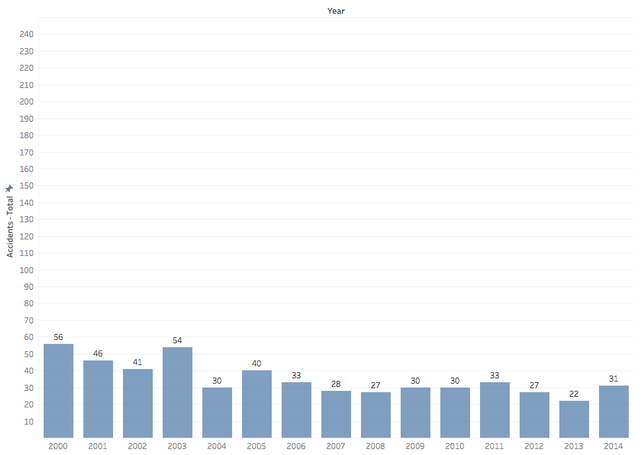
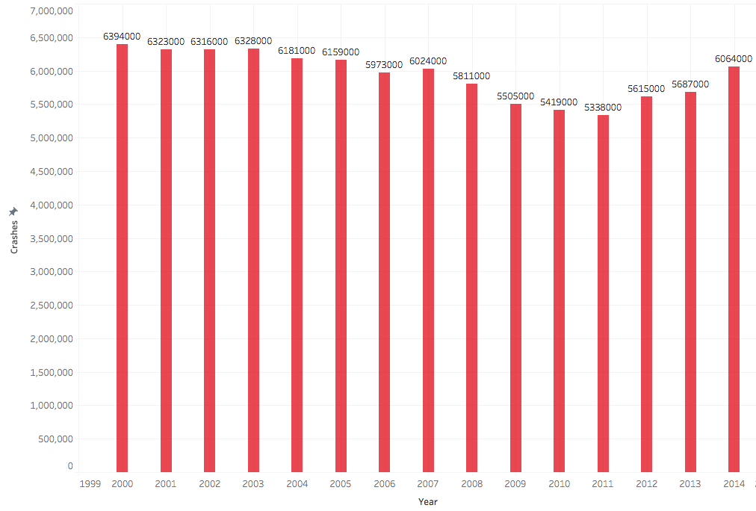
Total Number of Accidents per Year: 2000-2014
Airlines
Automobiles

Slide 4
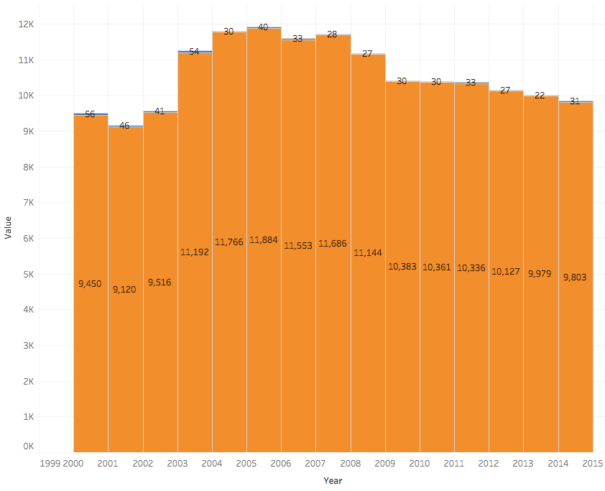

Airline Accidents as portions of Departures(000)

Slide 5
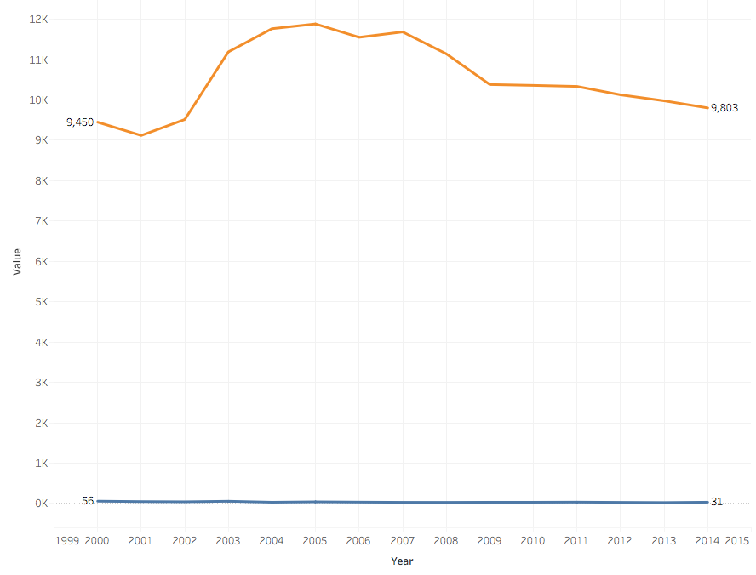
US Airline Departures(000) compared to Accidents in 2000-2014

Slide 6
Sources
Motor Vehicle Safety Data. Bureau of Transportation Statistics. https://www.bts.gov/content/motor-vehicle-safety-data
Airline Safety. GitHub. https://github.com/fivethirtyeight/data/blob/master/airline-safety/airline-safety.csv
U.S. Airline Traffic and Capacity. Airlines for America. https://www.airlines.org/dataset/annual-results-u-s-airlines-2/#

