Slide 1
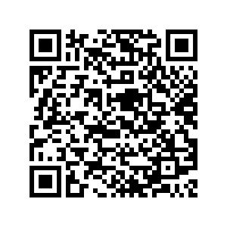
Browser Extensions 101: Building Custom Tools for Accessibility Testing
Noel Tibbles
https://github.com/ntibbles/accessu
Download the presentation

Slide 2
Agenda
Introduction
Considerations when creating an extension
Fundamentals of a browser extension
Creating a ‘Display Target Size’ Extension
Distributing the extension (internally and externally)
Key Takeaways
Q & A
Resources
Notes:
Introduction
About me
Extensions created
How I got started creating extensions
Considerations when creating an extension
Testing gaps
An extension doesn’t do what you want or expect
Bookmarkletss are clunky, insecure, and can have unexpected results.
Repeatable way to test for accessibility for Teams (limited technical experience)
Extension limitations (no external APIs, security, complexity)
Fundamentals of a browser extension
Understanding extension scope (Isolation vs global)
Manifest.json
Content scripts
Maintaining state
Creating a ‘Display Text Target Extension’
Developing the requirements of the extension
Creating the manifest.json
Creating the content script
Maintaining state
Testing the extension
Distributing the extension
Internally (Developer mode)
Chrome webstore
Key Takeaways
Q&A

Slide 3

Learning Objectives
Covering only the basics of extension creation
Understanding the architecture of an extension
Focus on making an extension work
Manual testing of the extension
Things to look out for when working with extensions
Primarily focusing on Chrome, speak to others
Notes:
You should be able to walk away with the basic knowledge to create a simple extension
Understand the required file to make the extension functional
How to manually test the extension
Talk about FireFox and Edge
What I will NOT be covering
How to code
Development best practices (unit testing, minimizing, etc.)
Extension API documentation

Slide 4
Introduction
Notes:
Welcome everyone to my first conference subject, Here’s a little about me and how I got started in creating extensions.

Slide 5

About Me
Certified Professional in Web Accessibility (CPWA)
Accessibility Lead based out of Publicis Sapient's Toronto office.
Over 25 years’ experience in Front End Technologies, including 14 years at Publicis Sapient.
Focused exclusively on accessibility for the past 7+ years.
Member in Publicis Sapient’s Accessibility Center of Excellence

Slide 6
Why I got started creating extensions
Using multiple extensions for testing was a pain
Extension didn’t exist
Flexibility to update a test based on needs
Repeatable accessibility tests with a simple UI
Internal testing needs

Slide 7



My Extensions
Equa11y: Accessibility Testing Utilities
A utility extension of 15 tests for testing webpages for accessibility.
Resize Text By Equa11y
Quickly and easily resize the browser text up to 200%
Accessibility Indicators Tests*
A set of 22 tests to establish a baseline of website accessibility
* Internal extension

Slide 8
Considerations when creating an extension
Notes:
Why you might want to create an extension

Slide 9
Testing gaps
People test differently
Inconsistent results
Repeatability
Specialized testing for the project
Notes:
Pattern matching in a page title
Testing aria-labels contain visual labels (locale specific)

Slide 10
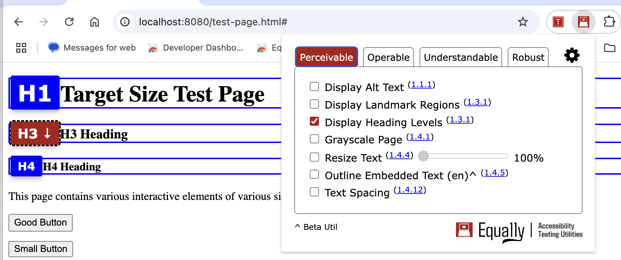
Current Extensions Miss the Mark
Missing features
Example, testing headings with just the heading level
What about hidden headings?
Missing skipped headings
Notes:
Some extensions use pure CSS for identifying heading levels and can’t identify skipped headings

Slide 11
Bookmarklets are clunky
Technically challenging to install
The JavaScript can be insecure
Difficult to update
Missing features
Perform only simple tests
Notes:
Not everyone knows how to use snippets
If you’re not technical, or the javascript is minified, you might not know what you’re copying and pasting into the browser. And then you’re executing it.
If there’s an update you have go through the whole process again and then you have all the other issues to worry about.
Usually bookmarklets are very simple in implementation and can be missing features.

Slide 12
Considerations
No remotely hosted code (Chrome v3)
High development and testing effort
Maintainability
Long review time for WebStore release (Chrome)
Can be technically difficult to implement (many APIs to learn, service workers, debugger, etc.)
Only tests code. Not a replacement for manual testing.

Slide 13
Recap
Current extensions don’t exist or are limited in testing
When technical capabilities of testers are low
Resources and time permits creating an extension
Multiple people are testing and need repeatable results
OR
You just want to create one!

Slide 14
Fundamentals of a browser extension

Slide 15
Getting Started
Chrome Extension Developer Docs
Chrome Extension Samples
Chrome Extension Tutorials
Online learning
Inspecting other extensions

Slide 16
Minimum Requirements
Manifest file
Icons
Functionality (Content Script)
Notes:
You could use AI like Chat GPT to help create the manifest and content script.

Slide 17
Other Files/Topics
Popup HTML
Popup CSS
Popup JS
Extension CSS
Maintaining State

Slide 18
Manifest File
A required file for the extension
Defines the manifest version (current v3)
Defines the name, version of the extension
Webstore also requires
Extension description
Extension Icons
Many optional keys for security, actions, APIs, etc.

Slide 19
Icons
Used as the extension icon
Chrome will create a default icon (if not provided)
Required if submitting to the WebStore
Sizes required:
16px by 16px
48px by 48px
18px by 128 px

Slide 20
Functionality
The functionality the extension will perform
Usually in the form of a content script
Scripts are injected into the specified tabs (can be global)
Content scripts can manipulate the DOM

Slide 21
Understanding Extension Scope
Popup:
Extension popup has its own isolated DOM
HTML, JS, CSS are isolated
DevTools are separate
Content Scripts:
IIFE (Immediately Invoked Function Expression)
Extensions (by default) work in an isolated world
It can be changed in the manifest, but not recommended

Slide 22
Creating a ‘Display Target Size’ Extension
Notes:
Now that we understand why we would want to create an extension, and what files are required to create an extension. Just jump right in and create a simple extension that checks the target size of buttons and links.

Slide 23
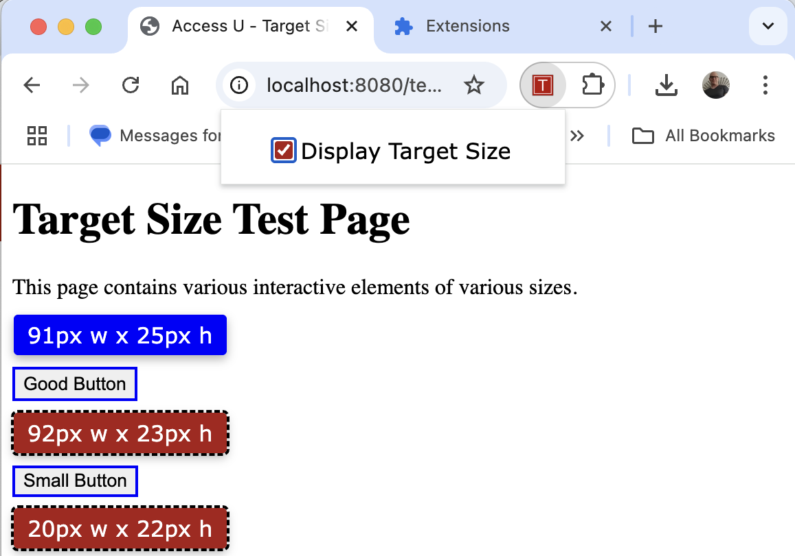
Target Size Extension
Repo: https://github.com/ntibbles/accessu

Slide 24
2.5.8 Target Size (Minimum)(AA)
The size of the target for pointer inputs is at least 24 by 24 CSS pixels, except when:
Spacing
Undersized targets (those less than 24 by 24 CSS pixels) are positioned so that if a 24 CSS pixel diameter circle is centered on the bounding box of each, the circles do not intersect another target or the circle for another undersized target;
Equivalent
The function can be achieved through a different control on the same page that meets this criterion;
Inline
The target is in a sentence, or its size is otherwise constrained by the line-height of non-target text;
User Agent Control
The size of the target is determined by the user agent and is not modified by the author;
Essential
A particular presentation of the target is essential or is legally required for the information being conveyed.

Slide 25
Target Size Extension Requirements
When the checkbox is checked:
Find all interactive elements that require a target size
Determine their width and height
Label all elements found with their width and height
If the width or height is less than 24px, label them differently
Ignore any hidden interactive elements
When the checkbox is unchecked:
Remove all labels

Slide 26
Manifest File: Target Size - Versions
{
"manifest_version": 3,
"name": "AccessU - Target Size",
"version": "0.1",
"description": "An extension for the AccessU presentation",
"permissions": [
"activeTab",
"scripting",
"storage"
],
"action": {
"default_popup": "popup.html"
},
"content_scripts": [
{
"matches": ["<all_urls>"],
"css": ["extension.css"]
}
],
"icons": {
"16": "icons/icon-16.png",
"48": "icons/icon-48.png",
"128": "icons/icon-128.png"
}
}
Notes:
The three values that are required for the manifest file are “manifest version”, this defines the API version of extension. The “name” of the extension. This is the name that the user will see in their chrome extensions page and when hovering over the extension icon, and the “version” of the extension. Following usual semantic versioning convention, it will be “0.1”.

Slide 27
Manifest File: Target Size - Permissions
{
"manifest_version": 3,
"name": "AccessU - Target Size",
"version": "0.1",
"description": "An extension for the AccessU presentation",
"permissions": [
"activeTab",
"scripting",
"storage"
],
"action": {
"default_popup": "popup.html"
},
"content_scripts": [
{
"matches": ["<all_urls>"],
"css": ["extension.css"]
}
],
"icons": {
"16": "icons/icon-16.png",
"48": "icons/icon-48.png",
"128": "icons/icon-128.png"
}
}
Notes:
Other values that are useful and will be needed if you’re submitting the extension to the Chrome WebStore are the “description” and the “permissions”. The description is crucial in explaining what your extension does and again, is needed if you’re submitting it to the WebStore. The permissions are used for the API’s being used in the extension. Each of these API’s require a “justification” for use and can be controlled by the user. Be careful to only include the permissions that the extension is actually using. When you’re learning, it’s easy to add an API then forget you’re not using it anymore.

Slide 28
Manifest File: Target Size - Actions
{
"manifest_version": 3,
"name": "AccessU - Target Size",
"version": "0.1",
"description": "An extension for the AccessU presentation",
"permissions": [
"activeTab",
"scripting",
"storage"
],
"action": {
"default_popup": "popup.html"
},
"content_scripts": [
{
"matches": ["<all_urls>"],
"css": ["extension.css"]
}
],
"icons": {
"16": "icons/icon-16.png",
"48": "icons/icon-48.png",
"128": "icons/icon-128.png"
}
}
Notes:
The “action” defines what happens when a user clicks on the extension icon. There are many actions that can happen, and you’ll need to refer to the docs if you plan on performing something other than displaying a popup for the extension. The “default popup” value is a reference to the HTML file that will be used as the extension’s UI after the user clicks on the extension icon.

Slide 29
Manifest File: Target Size – Content Scripts
{
"manifest_version": 3,
"name": "AccessU - Target Size",
"version": "0.1",
"description": "An extension for the AccessU presentation",
"permissions": [
"activeTab",
"scripting",
"storage"
],
"action": {
"default_popup": "popup.html"
},
"content_scripts": [
{
"matches": ["<all_urls>"],
"css": ["extension.css"]
}
],
"icons": {
"16": "icons/icon-16.png",
"48": "icons/icon-48.png",
"128": "icons/icon-128.png"
}
}
Notes:
The “Content scripts” key is used when you want a script to execute on every page that defined on the “Matches” key. You can use the keyword “all_urls” for the "matches” value to inject the script on every page you visit. The “css” key defines all the CSS you want to inject into the pages with the value referencing an internal file for the extension. In this case it’s simply “extension.css”.

Slide 30
Manifest File: Target Size - Icons
{
"manifest_version": 3,
"name": "AccessU - Target Size",
"version": "0.1",
"description": "An extension for the AccessU presentation",
"permissions": [
"activeTab",
"scripting",
"storage"
],
"action": {
"default_popup": "popup.html"
},
"content_scripts": [
{
"matches": ["<all_urls>"],
"css": ["extension.css"]
}
],
"icons": {
"16": "icons/icon-16.png",
"48": "icons/icon-48.png",
"128": "icons/icon-128.png"
}
}
Notes:
The last key to talk about in the manifest files is the icons. These are references to files within the extension to show the user in the browser and the extensions page. The keys are values to represent the size with the values as paths to the icon image file.

Slide 31
Popup.html: Target Size - Files
<!DOCTYPE html>
<html lang="en">
<head>
<meta charset="UTF-8">
<meta name="viewport" content="width=device-width, initial-scale=1.0">
<title>AccessU - Target Size</title>
<link rel="stylesheet" href="popup.css">
<script src="popup.js" type="module"></script>
</head>
<body>
<label>
<input id="targetSize" type="checkbox"/>
Display Target Size
</label>
</body>
</html>
Notes:
The next file I want to discuss with you is the popup.html file. This is the HTML that’s displayed when the user clicks on the extension icon. All the file references in this HTML are isolated to the extension. This is to make sure there are no collisions with the browser window or content.

Slide 32
Popup.html: Target Size - Checkbox
<!DOCTYPE html>
<html lang="en">
<head>
<meta charset="UTF-8">
<meta name="viewport" content="width=device-width, initial-scale=1.0">
<title>AccessU - Target Size</title>
<link rel="stylesheet" href="popup.css">
<script src="popup.js" type="module"></script>
</head>
<body>
<label>
<input id="targetSize" type="checkbox"/>
Display Target Size
</label>
</body>
</html>
Notes:
Here I’m simply creating a checkbox with the label of “Display Target Size” that the user will click to toggle the extension’s functionality on and off.

Slide 33
Popup.js: Target Size - Init
import { toggleTargetSize } from "./target-size.js";
document.addEventListener('DOMContentLoaded', init);
function getTabId() { … }
async function init() {
const tabId = await getTabId();
document.getElementById("targetSize").addEventListener('change', evt => {
// setState(tabId, evt, evt.target.id);
loadScript(tabId, evt);
});
// restoreCb(tabId);
}
function loadScript(tabId, evt) {
chrome.scripting.executeScript({
target: { tabId },
function: toggleTargetSize,
args: [evt.target.checked]
});
}
Notes:
Now let’s look at the contents of the javascript file. This is the main functionality of the extension. There are many ways to code this, but I’ve created it to make this extension work with as little complexity as possible and to make it easy to understand.
This init function is the gets called as soon as the DOM (Document Object Model) is ready. It gets the current tab id and sets the event listeners on the checkbox. Once a user changes the checkbox, it loads the script (we’ll discuss this on the next screen). Please note the lines that are commented out relate to saving the extension state that we’ll talk about a little later.

Slide 34
Popup.js: Target Size - Load
import { toggleTargetSize } from "./target-size.js";
document.addEventListener('DOMContentLoaded', init);
function getTabId() { … }
async function init() {
const tabId = await getTabId();
document.getElementById("targetSize").addEventListener('change', evt => {
// setState(tabId, evt, evt.target.id);
loadScript(tabId, evt);
});
// restoreCb(tabId);
}
function loadScript(tabId, evt) {
chrome.scripting.executeScript({
target: { tabId },
function: toggleTargetSize,
args: [evt.target.checked]
});
}
Notes:
The load script function is responsible for loading the script into the DOM of the current tab. Here we’re using the scripting API to execute a script and call the “toggleTargetSize” method. The API will also pass the argument of the checked state of the checkbox.

Slide 35
Target-Size.js: Target Size Props
export function toggleTargetSize(isChecked) {
// a list of the elements we want to test
const interactiveRoles = ['button', 'a', '[role="button"]', '[role="link"]'];
// join the list to iterate
const roleList = document.querySelectorAll(interactiveRoles.join(','));
// class for the label
const clsList = ['equa11y-label'];
// classes to identify the elements
const elList = ['equa11y-border', 'equa11y-size'];
// toggle if the extension checkbox is checked or not
isChecked ? targetSize_checked() : targetSize_unchecked();
// cont’d …
Notes:
Now let’s move on the main content script of the extension. Target-size.js is the script that performs the main functionality of the extension. It takes the “isChecked” argument to determine if we need to display the labels on the relevant elements or remove the labels. The function takes a list of elements we want to test, in this case it’s “button”, “a” (links), role=“button” and role=“link”. This list is used to test against all the elements in the current tab.

Slide 36
Target-Size.js: Target Size Checked State
// handle the checked state
function targetSize_checked() {
roleList.forEach(element => {
if(!element.classList.contains('equa11y-size')) {
const dimensions = getComputedDimensions(element);
if(dimensions.height > 0 || dimensions.width > 0) {
const label = document.createElement('div');
label.innerHTML = `${dimensions.width}px w x ${dimensions.height}px h`;
label.classList.add(...clsList);
if(dimensions.width < 24 || dimensions.height < 24) {
label.style.cssText = 'background-color: #AB1B18 !important; outline: 2px dashed black;’;
}
element.classList.add(...elList);
element.parentNode.insertBefore(label, element);
}
});
}
}
Notes:
“targetsize_checked” is the function that’s called when the extension’s checkbox is checked. It’s loop through the list of elements we specifiied in the previous slide. We then test to make sure that the label isn’t already displayed and then checks the dimensions of the element. If the element is larger than 1 pixel, we add a label with the width and height of the element. If the element has a width or height of less than 24 pixels, we change the label color to red with a dashed outline.

Slide 37
Target-Size.js: Target Size Unchecked State
// handle the unchecked state
function targetSize_unchecked() {
document.querySelectorAll('.equa11y-size').forEach(el => {
el.classList.remove(...elList);
});
document.querySelectorAll('.equa11y-label').forEach(el => {
el.remove();
});
}
// get the dimensions of the element
function getComputedDimensions(element) {
const dimensions = {
width: element.offsetWidth,
height: element.offsetHeight
}
return dimensions;
}
}
Notes:
Here we’re checking if the checkbox of the extension is unchecked and then removing the labels. Essentially undoing what we did when it was checked. Finally, we have our getComputedDimensions function which returns the width and height of the element.

Slide 38
Demo – Alpha Version
Notes:
Let’s take a look at what we have so far in the browser.

Slide 39
Popup.js: Target Size Saving State
// set the checkbox state for the tab
function setState(tabId, event, id) {
const store = {};
chrome.storage.sync.get(store[tabId]).then(() => {
const isChecked = event.target.checked;
store[id] = {isChecked};
chrome.storage.sync.set( store );
})
}
// restore the checkbox state
function restoreCb(tabId) {
const store = {};
chrome.storage.sync.get(store[tabId]).then(result => {
const cb = document.getElementById('targetSize');
cb.checked = result[tabId]?.isChecked;
});
}
Notes:
Maintaining state can be important when you’re using a checkbox. The extension doesn’t automatically maintain state. It’s reinitialized when the extension’s icon is clicked, so we must do it manually. In this example, we’re setting the checkbox state using the storage API with sync. Sync will actually maintain state when you’re logged into multiple Chrome browsers. Each time the checkbox is checked, we set the state based on the current tab. The function “restoreCb” is very similar to the “setState” function where it retrieves the current state and then sets the checkbox based on it’s value.

Slide 40
Demo – Beta Version

Slide 41
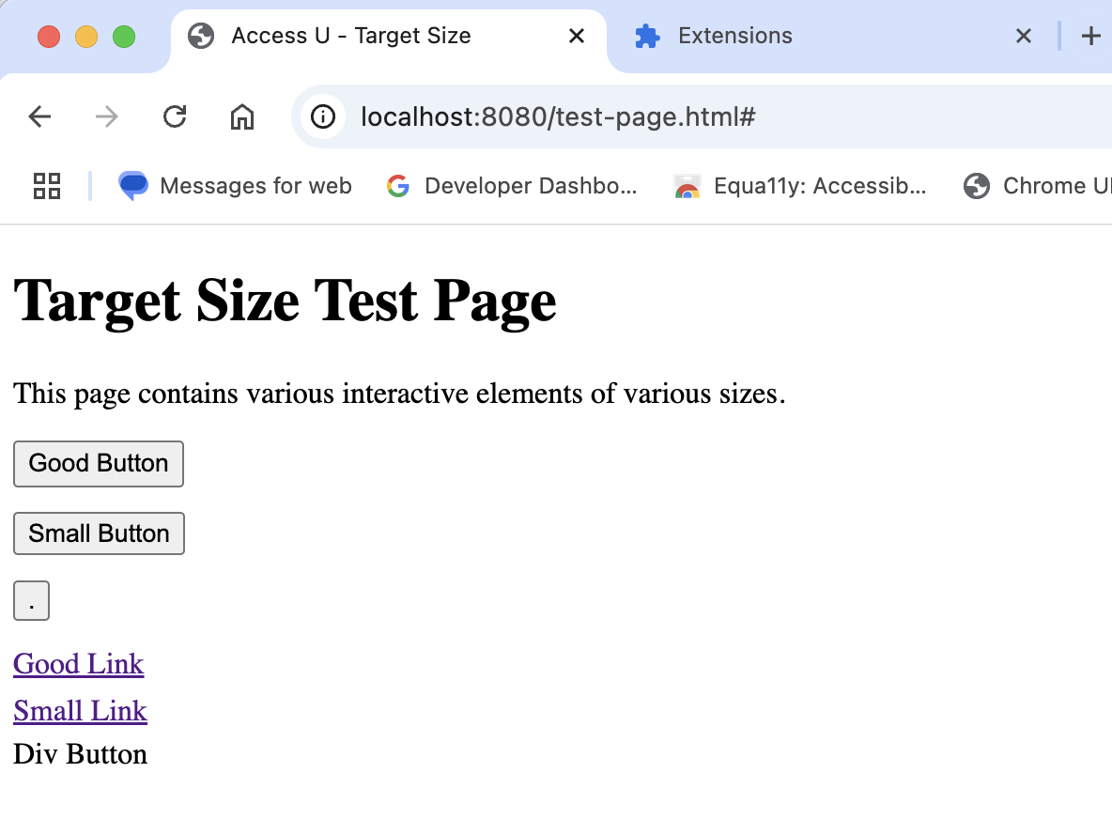
Testing the Extension
Write Unit Tests
Create a local “testing” page
Review the “Extensions” page for errors
Use the DevTools to monitor storage
Test in the “wild”

Slide 42
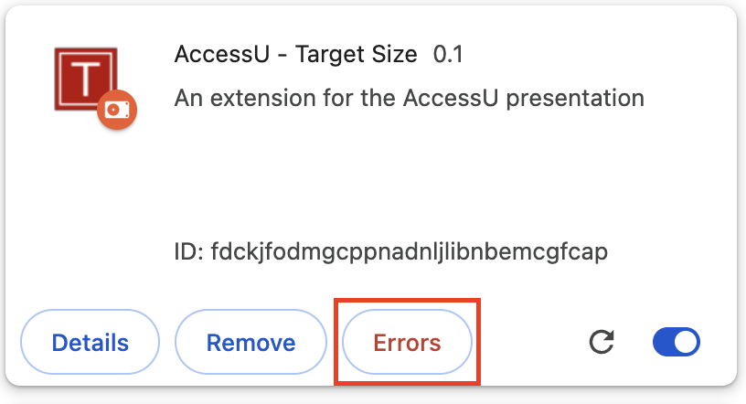
Testing the Extension – Errors
Chrome will throw errors in the chrome://extensions page
Click on the “Errors” button to inspect the error

Slide 43
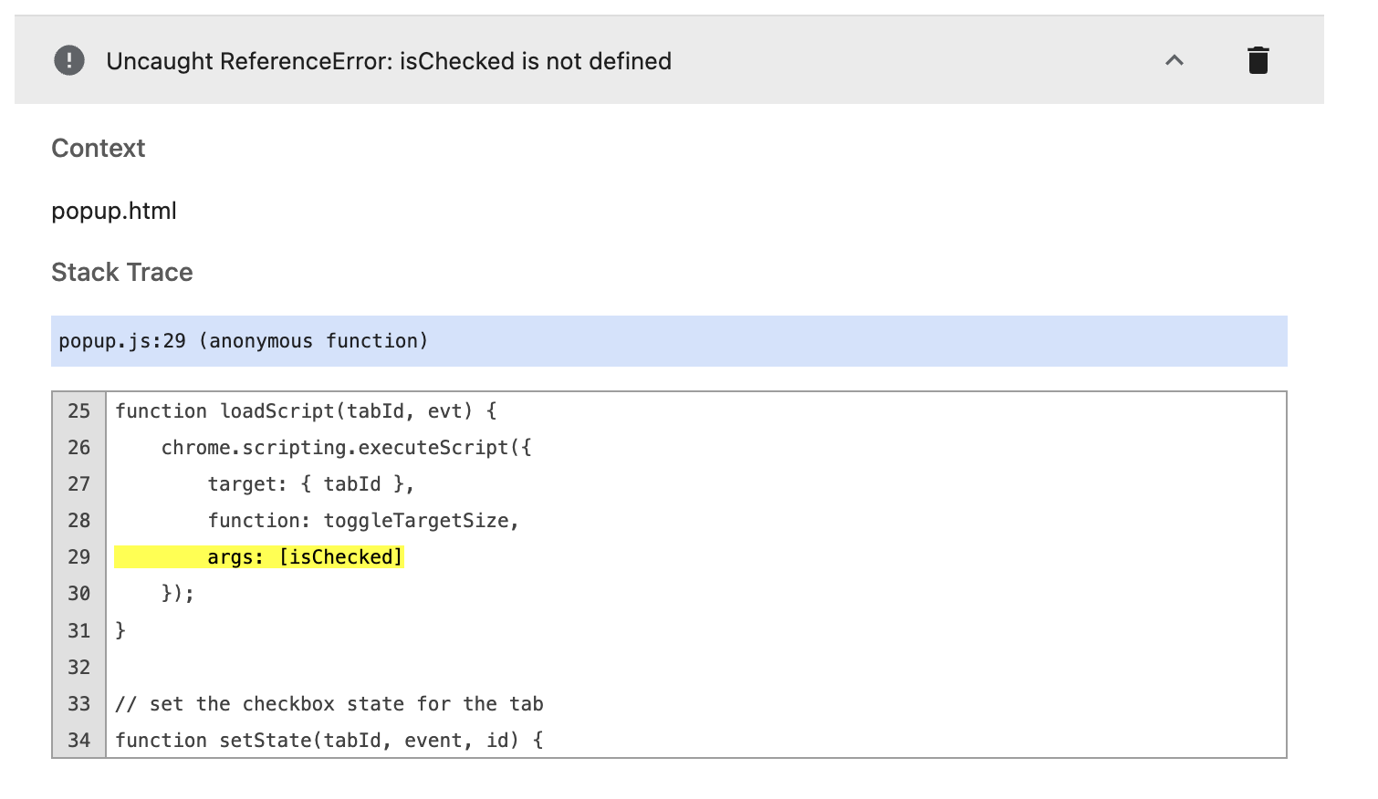
Testing the Extension – Error Inspector
Chrome displays the line in error with the error message

Slide 44
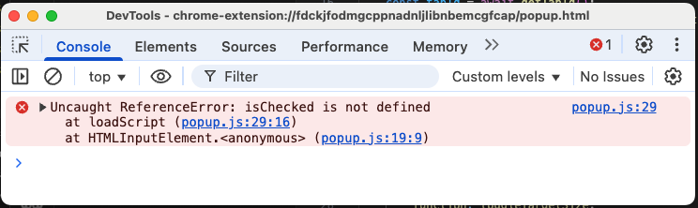
Testing the Extension – Error DevTools
Inspect the error in the DevTool Console by right clicking on the extension popup panel.

Slide 45
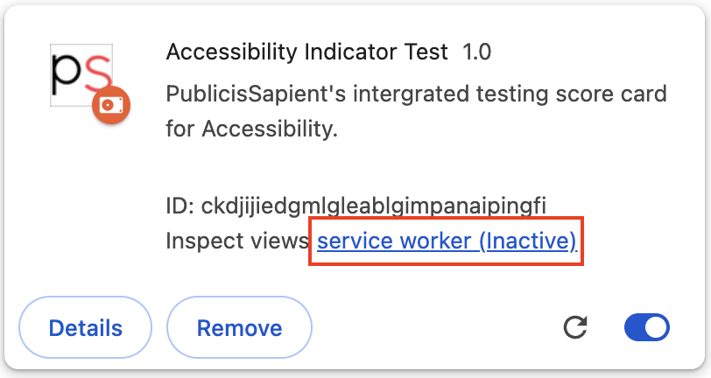
Testing the Extension – Service Workers
If you’re using Service Workers, they can be accessed from chrome://extensions in the extension tile.

Slide 46
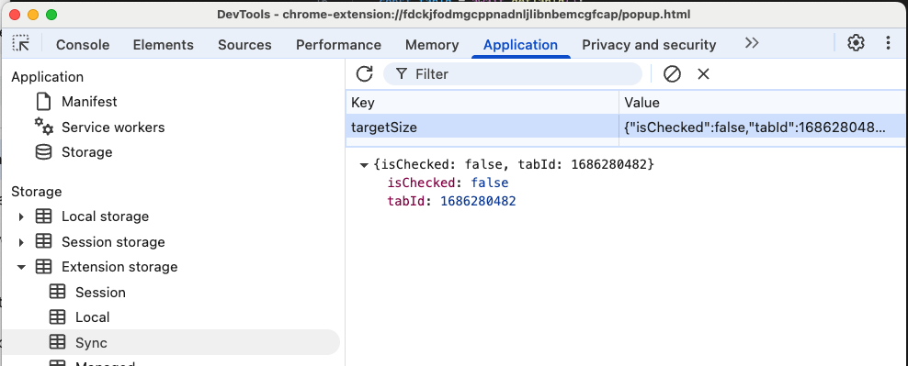
Testing the Extension – Storage
Inspect the storage in the DevTool Console by right clicking on the extension popup panel and navigating to “Application”.

Slide 47
Demo – Testing

Slide 48
Testing the Extension – Things to Remember
Reload the extension when the manifest, service worker or icons change
Re-initialize the extension if only the code, html or CSS changes
Clear out the error history once the the error is resolved
Make sure you’re inspecting the correct console!
If in doubt, consult the docs.

Slide 49
Distributing the extension

Slide 50
Internal Distribution
Zip all the contents of the extension into a folder
Distribute the folder to the Team (email, file system, etc.)
Install the extension within Chrome:
Go to the Extensions page by entering chrome://extensions in a new tab. (By design chrome:// URLs are not linkable.)
Alternatively, click the Extensions menu puzzle button and select Manage Extensions at the bottom of the menu.
Or click the Chrome menu, hover over More Tools, then select Extensions.
Enable Developer Mode by clicking the toggle switch next to Developer mode.
Click the Load unpacked button and select the extension directory.

Slide 51
WebStore Distribution
Requires a paid developer account ($5)
Upload the extension into your account
Complete the information for your extension, including:
Screenshots of the extension
Promo images of the extension
Icons of the extension
Purpose of your extension
Justification of each “permission” requested in the extension
Wait for the review process (and pray there’s no issues)
It may take a couple of weeks (depending on your APIs)
Google Enterprise account*

Slide 52
Key Takeaways

Slide 53
Key Takeaways – 1 of 2
Extensions are handy when you:
Can’t find an extension for your use case
Need easily repeatable results
Have specialized needs for your project
Time to create and maintain the extension
Extension minimum requirements:
Manifest file
Icons
Functionality (Content script)
Keep your extension code isolated from the webpage

Slide 54
Key Takeaways – 2 of 2
Maintain state of the extension where it makes sense
Test the extension thoroughly
Distribute the extension:
Internally in developer mode
Chrome webstore.
Consult the documentation often

Slide 55
Q&A

Slide 56
Resources
Chrome Extension Developer Docs
Chrome Extension Samples
Equa11y (Extension) (Github)
Access U Target Size (Github)
Contact me on LinkedIn https://www.linkedin.com/in/noeltibbles/

Slide 57
Thank You

