Slide 1
Opinion Formation: Impacts of convincing extreme individuals onto a society that typically converges to one opinion
The Opinionators

Slide 2
Contents
Introduction
The Model
The Code
The Questions
The Problems

Slide 3
Introduction
Introduction
The Model
The Code
The Questions
The Problems
Based on paper of Laguna and others “Minorities in a Model for Opinion Formation”
agent-based model
individuals with opinion on interval [0,1], uniformly distributed
Parameters 𝝻 (weight on foreign opinion), u (threshold of interaction) and T (number of time steps)
u as “bounded confidence” of interaction with people of similar opinion
Own contribution: The insertion of extreme opinion individuals
fixed opinions at 0 and 1
additional 2 parameters: n_conv (number of convinced agents) and infop (interval of influence of extremists)

Slide 4
The Code
Introduction
The Model
The Code
The Questions
The Problems
N
T
T times
N

Slide 5
The Code
Introduction
The Model
The Code
The Questions
The Problems
gen_av_plot
gen_plot, gen_plot_interval
T
N
Tg

Slide 6
The Code
Introduction
The Model
The Code
The Questions
The Problems
without E
with E
0
1

Slide 7
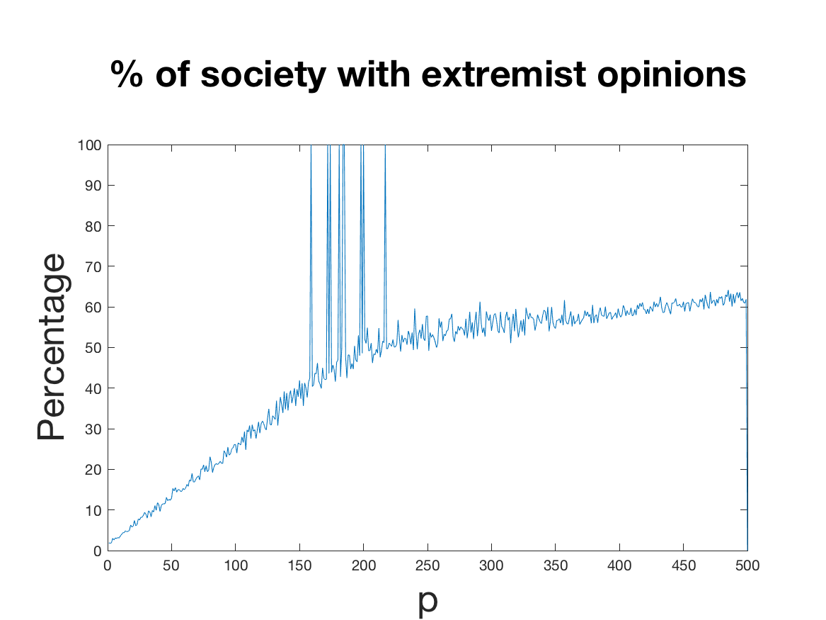
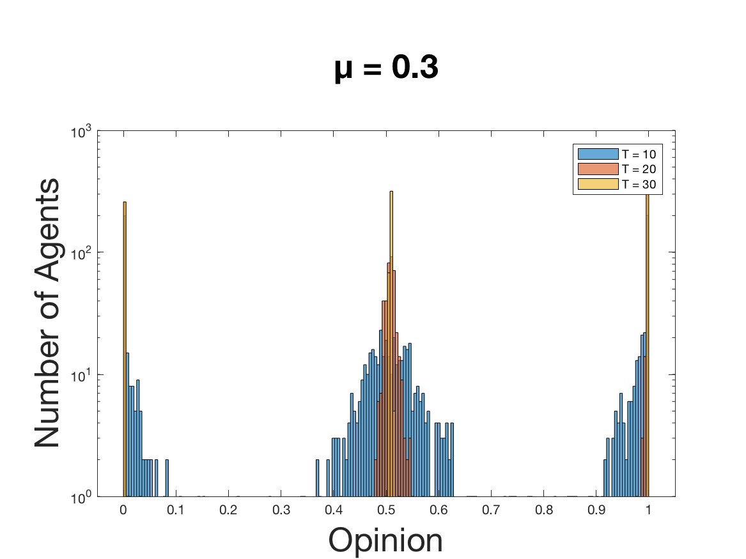
The Code
Introduction
The Model
The Code
The Questions
The Problems
Line plot
Histogram

