Slide 1
Opinion Formation: Impacts of convincing extreme individuals onto a society that typically converges to one opinion
The Opinionators

Slide 2
Contents
Introduction
The Model
The Code
The Results
The Problems

Slide 3
Introduction
Introduction
The Model
The Code
The Results
The Problems
Based on paper of Laguna and others “Minorities in a Model for Opinion Formation”
agent-based model
individuals with opinion on interval [0,1], uniformly distributed
Parameters 𝝻 (weight on foreign opinion), u (threshold of interaction) and T (number of time steps)
u as “bounded confidence” of interaction with people of similar opinion
Own contribution: The insertion of extreme opinion individuals
fixed opinions at 0 and 1
additional 2 parameters: n_conv (number of convinced agents) and infop (interval of influence of extremists)

Slide 4
The Model
Introduction
The Model
The Code
The Results
The Problems
Society agent in a single time step
if within distance u of each other
x(t+1) = x(t) + µ(x'(t) - x(t))
x’(t+1) = x'(t) + µ(x(t) - x'(t))
only 0 < 𝝻 < 0.5 allowed
close opinions come closer and opinions further than u don’t influence each other.
Insertion of extremists
parameters for each side: n extremists can persuade p agents with a probability of kappa
can be united to one parameter of convinced agents n_conv
second parameter infop as the interval of influence

Slide 5
The Question?
Introduction
The Model
The Code
The Results
The Problems
In a model of a society converging to one average opinion, what influence do charismatic extremists possess?

Slide 6
The Code
Introduction
The Model
The Code
The Results
The Problems
N
T
T times
N

Slide 7
The Code
Introduction
The Model
The Code
The Results
The Problems
gen_av_plot
gen_plot, gen_plot_interval
T
N
Tg

Slide 8
The Code
Introduction
The Model
The Code
The Results
The Problems
without E
with E
0
1

Slide 9
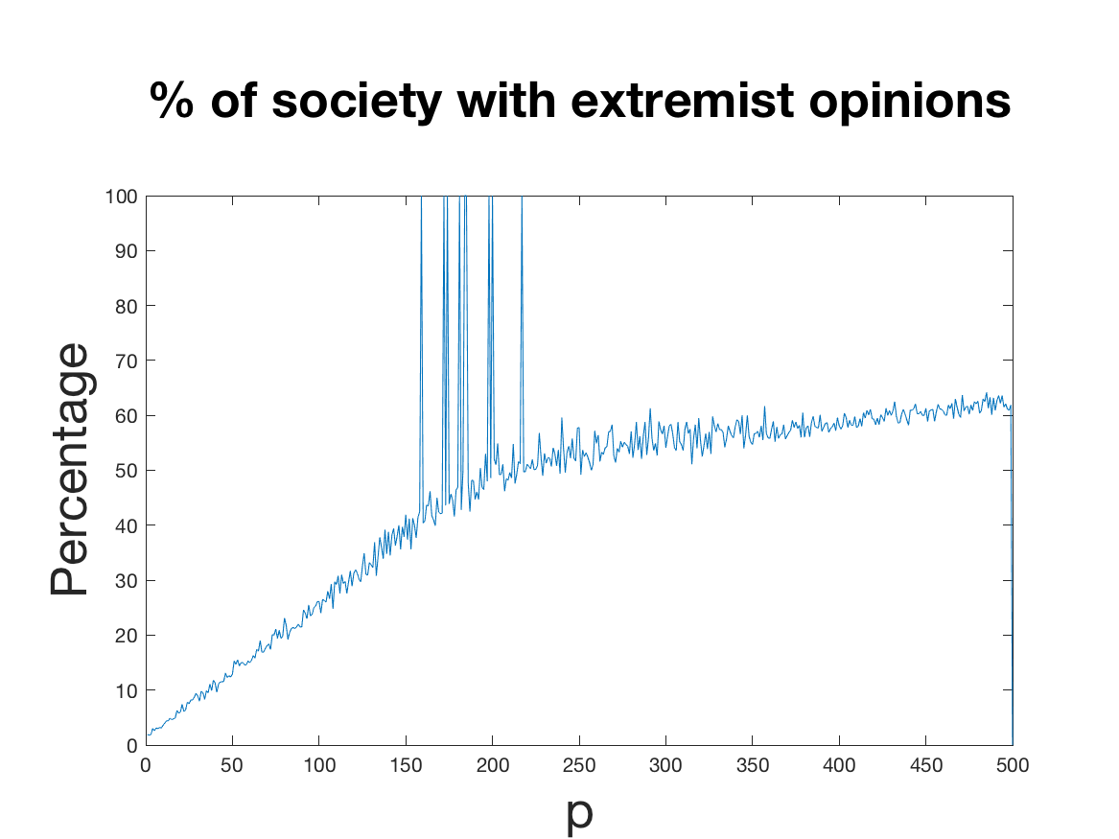
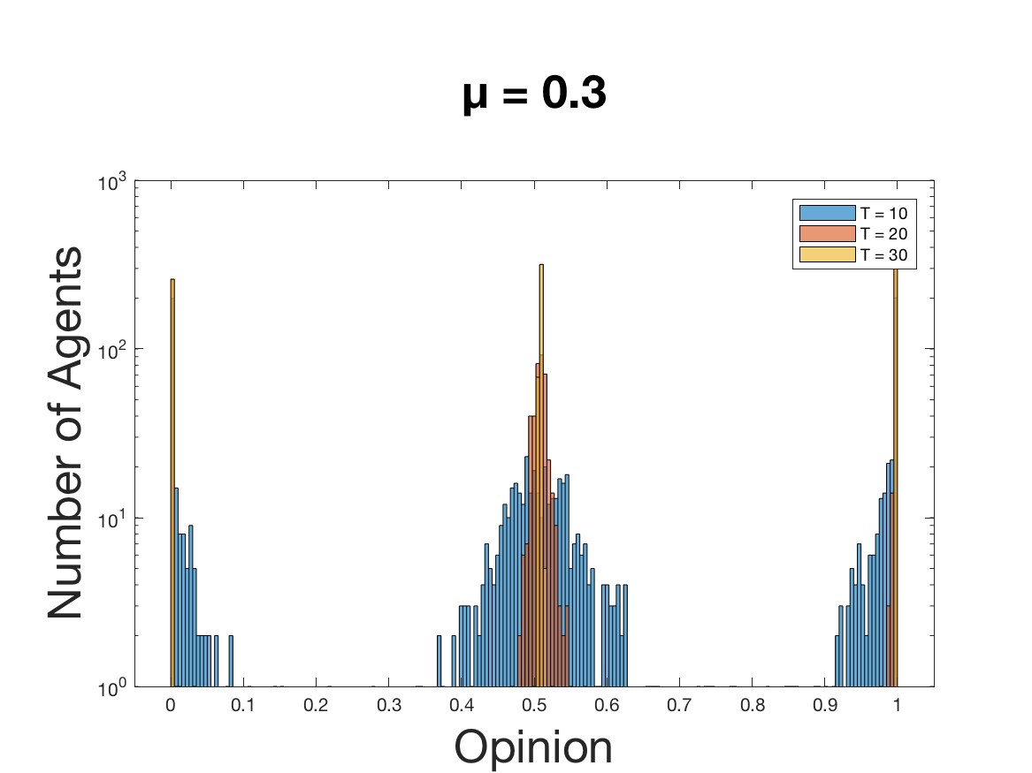
The Code
Introduction
The Model
The Code
The Results
The Problems
Line plot
Histogram

Slide 10
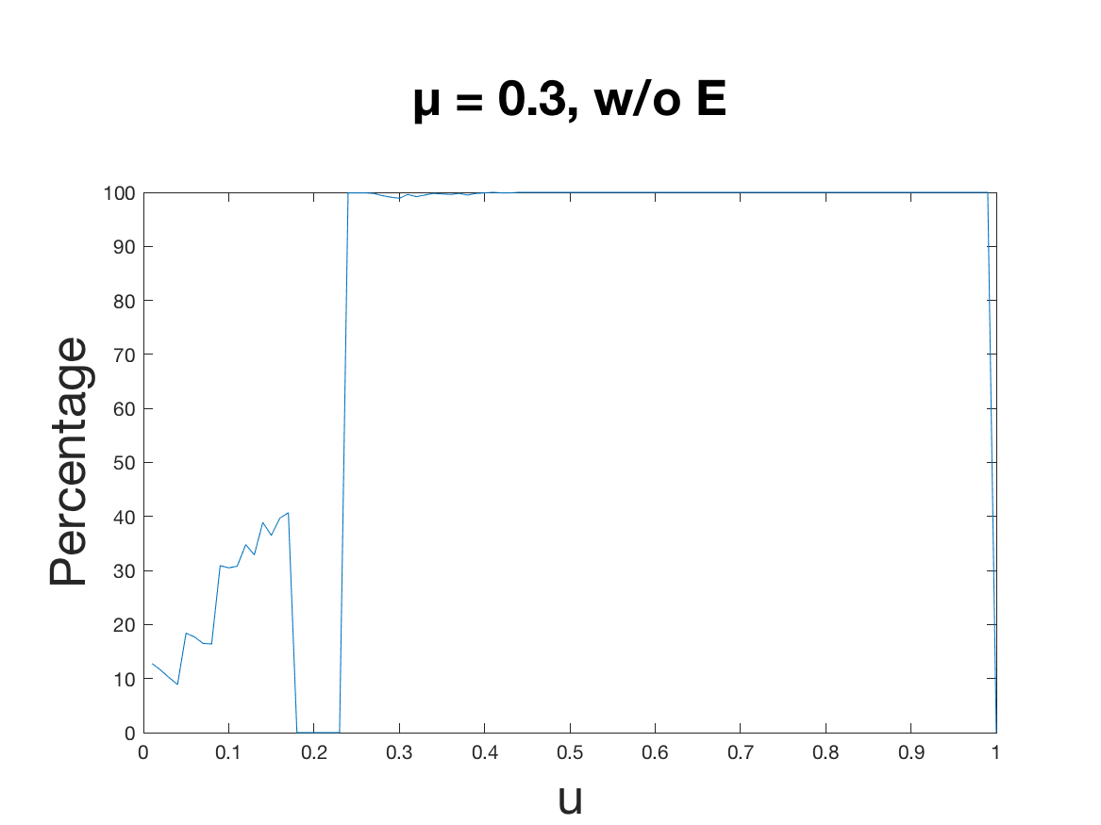
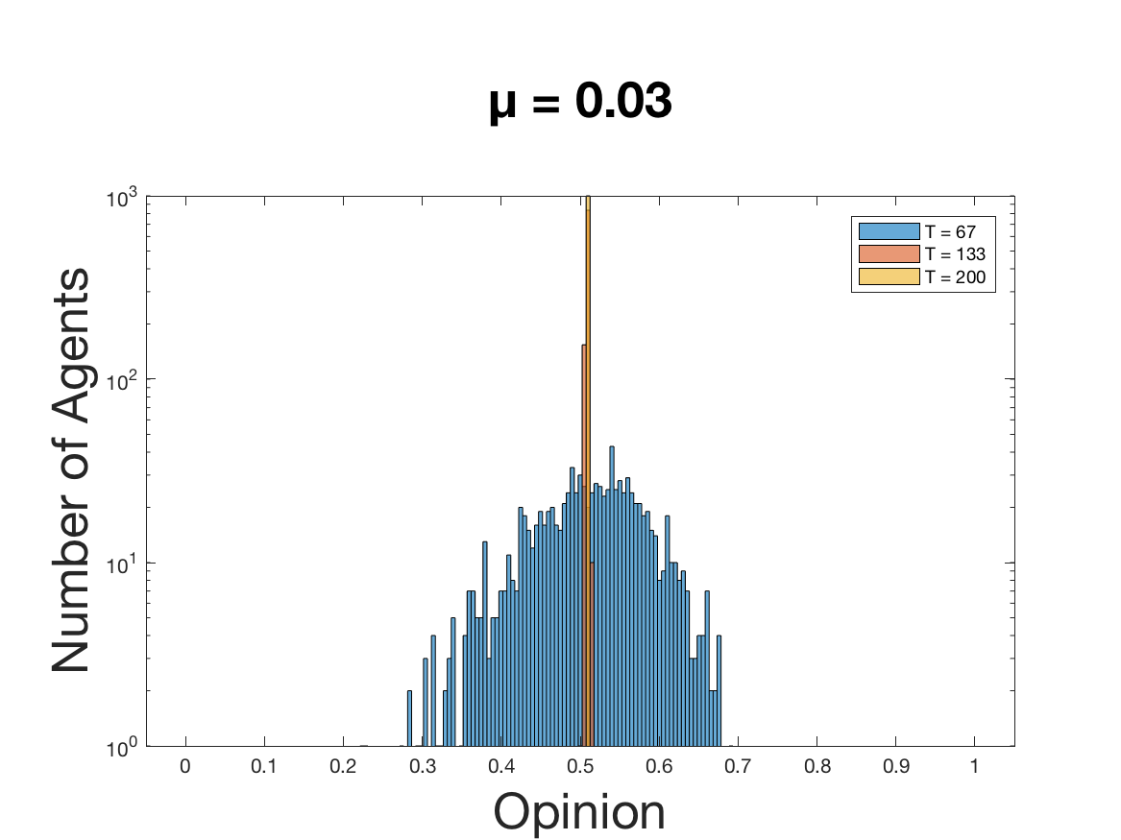
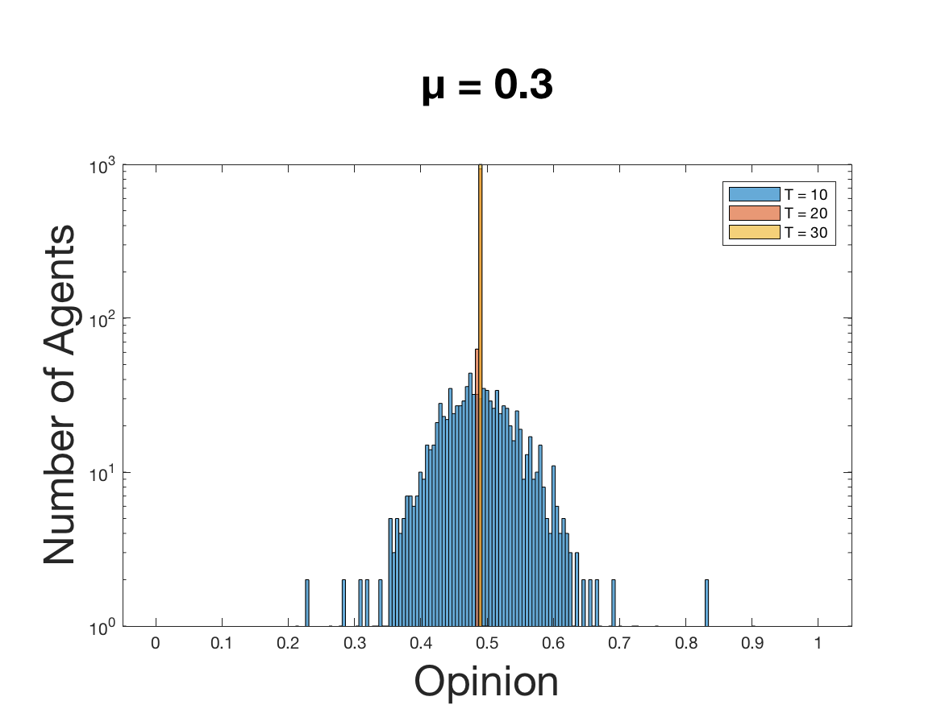
The Results
Introduction
The Model
The Code
The Results
The Problems
A world without extremists (based on paper)
𝝻 as speed of convergence and therefore correlated with the number of timesteps
if u > 0.3, opinion converges to a single opinion

Slide 11
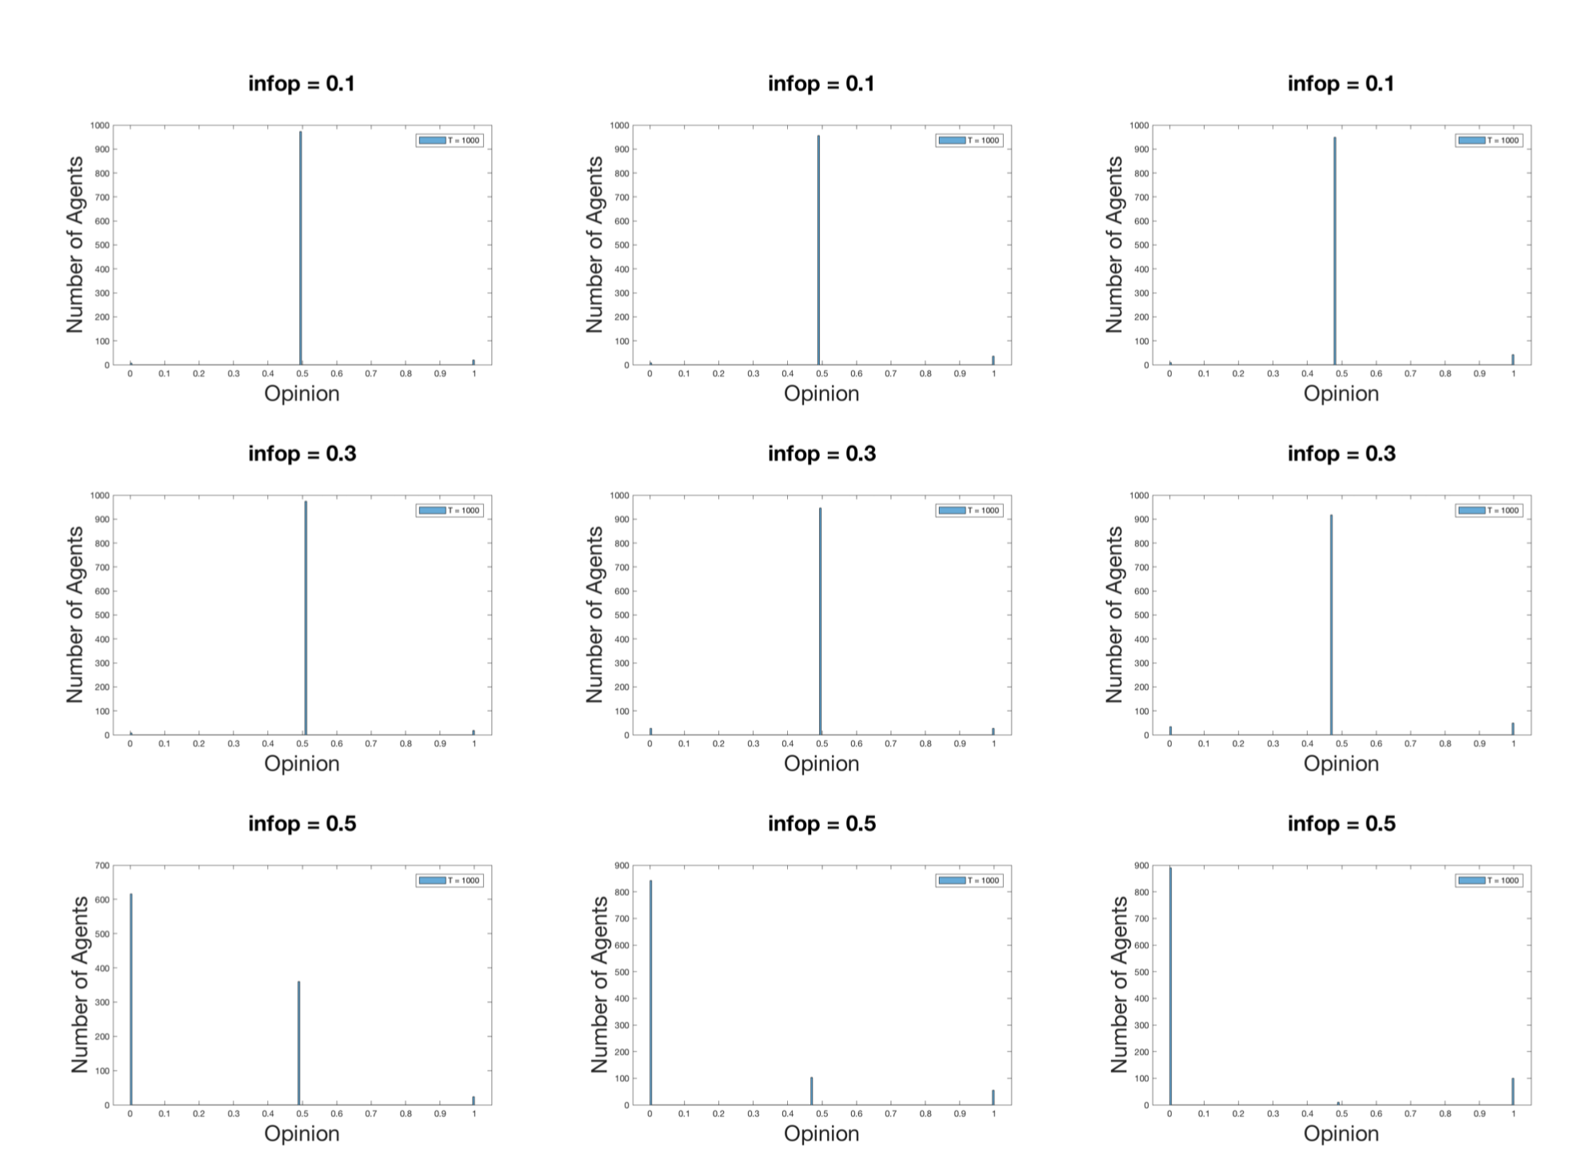
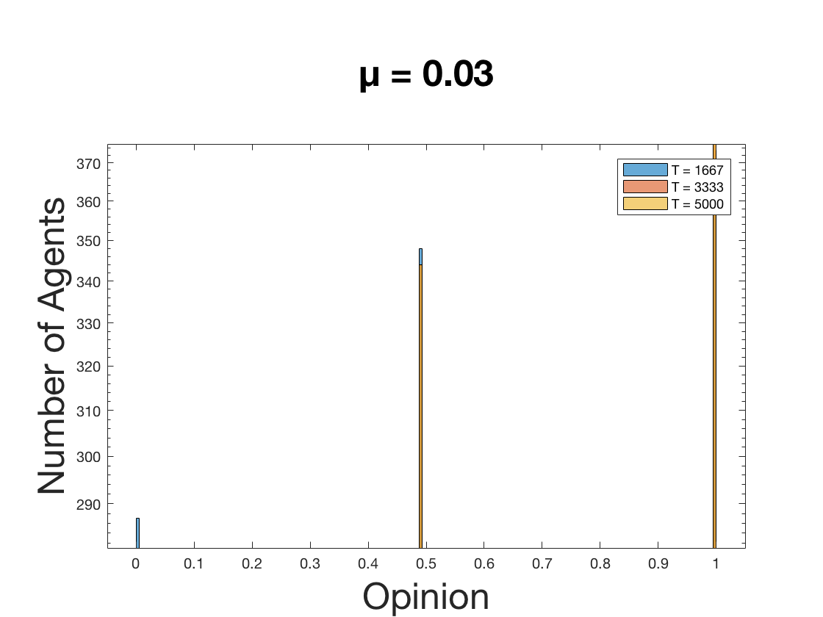
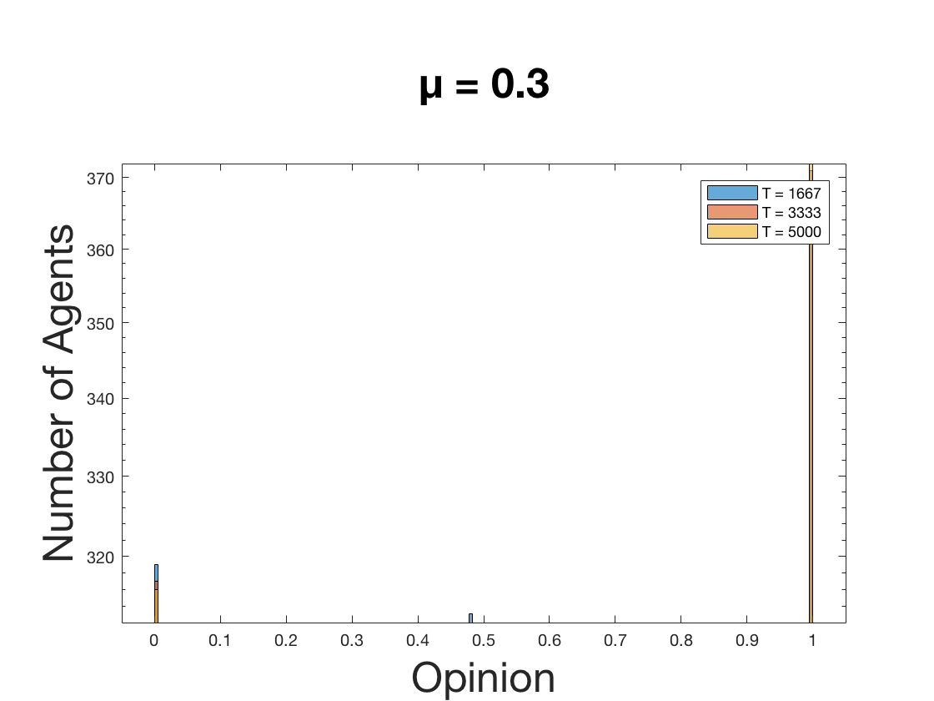
The Results
Introduction
The Model
The Code
The Results
The Problems
A world with extremists
the new 𝝻:
Before: 𝝻 defined the speed of convergence, no influence on the final result
After: 𝝻 has a new role
interval of influence
the power of convincing
infop
infop

Slide 12
The Problems
Introduction
The Model
The Code
The Results
The Problems
Challenge: keeping track of varying parameters in societies with and without extremists
Difference to Laguna: u threshold of 0.28 instead of 0.3
Interesting: change of variable 𝝻

Slide 13
Any questions?
Introduction
The Model
The Code
The Results
The Problems
We will try to answer them

Slide 14
Thanks

