Slide 1

Recent Advances in Bayesian Optimization
Dr Vu Nguyen
vu@robots.ox.ac.uk
University of Oxford

Slide 2
About This Tutorial
Goal: introduce the Bayesian Optimization - techniques, applications and future research directions.
Provide a broad summary of recent advances in
Batch Bayesian Optimization
High dimensional Bayes Opt
Mixed Categorical-Continuous Bayes Opt
It is a 2.5-hour tutorial for ACML 2020 on Bayes Opt.
25 papers are surveyed and organized in this talk, but they are by no means to complete.
We highlight the research trend, summarize the state-of-the-art results and describe some real-world applications.

Slide 3
Agenda
Part0: Parameter Tuning as Black-Box Function
Part I: Bayesian Optimization
Part II.1: Batch Bayesian Optimization
Part II.2: High Dimensional Bayesian Optimization
Part II.3: Mixed Categorical-Continuous Bayes Opt
Future Research Directions in Bayesian Optimization

Slide 4
Machine Learning Hyper-parameters Tuning
ML algorithm’s performances depend on hyper-parameters.
x is the parameter for the machine learning algorithm
scale parameter (in kernel methods)
learning rate (in gradient methods)
number of hidden units (in deep learning methods)
y is the utility output
Accuracy (classification)
RMSE (regression)
NMI (clustering)
Tuning x to achieve the best y is critical for ML algorithm.

Slide 5
Machine Learning Hyper-parameters Tuning
The straightforward way to tune hyper-parameters is based on human expertise.
Experienced Machine Learning practitioners know approximately how to chose good hyper-parameters.
For a new dataset, they will follow a trial and error process with various configurations of hyper-parameters.
This process of experimenting with hyper-parameters is heuristic and different people with different experience might come up with different settings and the process is not easily reproducible.

Slide 6
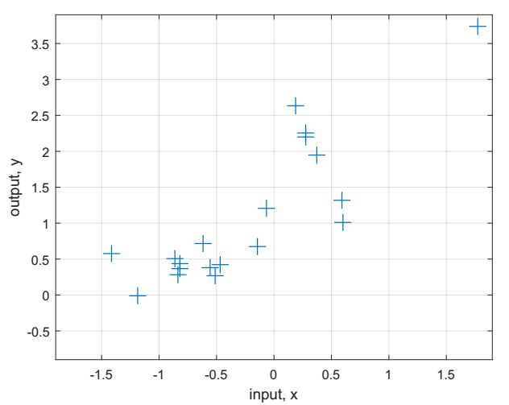
Traditional Hyper-parameter Tuning
Grid Search:
Create a list of values for each parameter.
Consider all possible combinations of these values.
Exhaustively evaluate the model and choose the best parameter.
Random Search:
Randomly select a parameter to evaluate.
Select the best parameter.
Example of Random Search

Slide 7
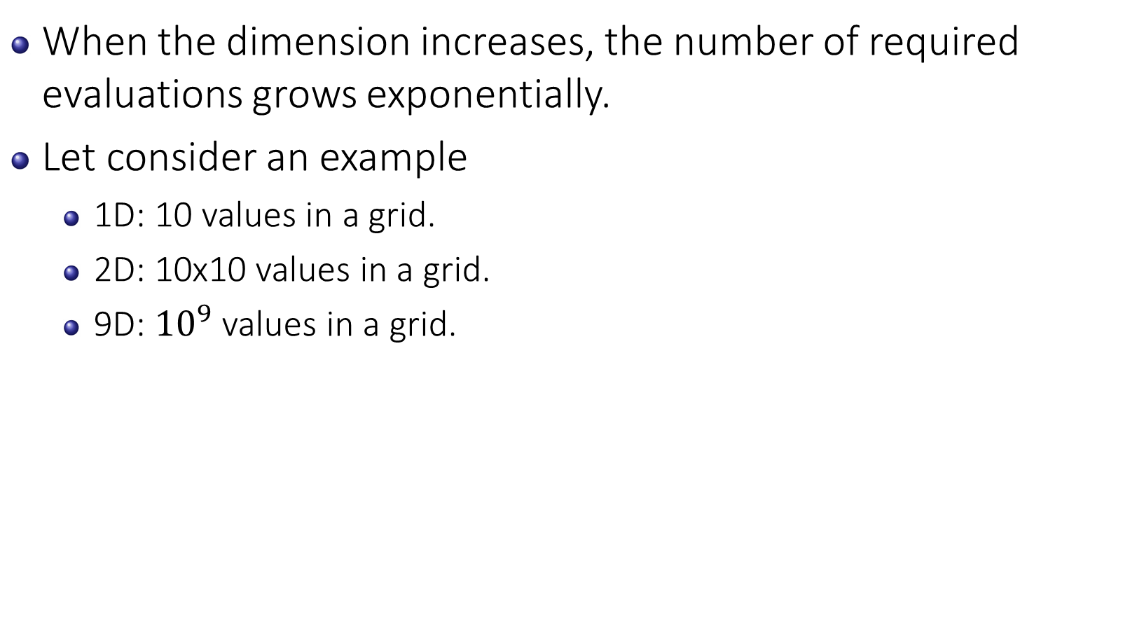
Problem of Traditional Hyper-parameter Tuning
When the dimension increases, the number of required evaluations grows exponentially.
Let consider an example
1D: 10 values in a grid.
2D: 10x10 values in a grid.
9D: ${10}^{9}$ values in a grid.
Example of Random Search

Slide 8
Problem of Traditional Hyper-parameter Tuning
Humans are not good at handling high dimensional data and can easily misinterpret or miss trends and relationships when trying to tune multiple hyper-parameters.
For instance, while tuning just two parameters, practitioners often fall back to tuning one parameter then tuning the second parameter.
This may lead to concluding improvement in performance has plateaued while adjusting the second hyper-parameter, while more improvement might be available by going back to changing the first hyper-parameter.

Slide 9
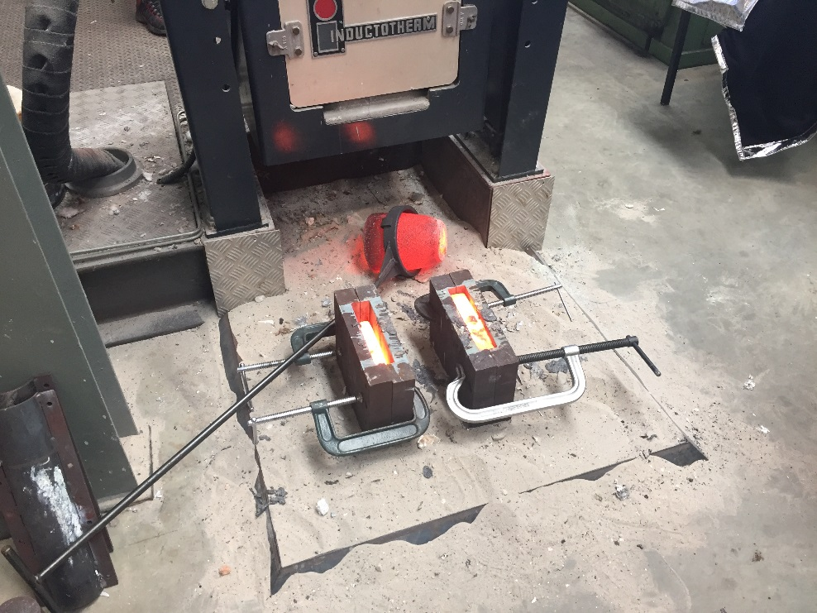
Problem of Traditional Hyper-parameter Tuning
Each evaluation is costly and time consuming.
For example, the cost (money and time) for casting a real alloy.

Slide 10
Connection of Parameter x and Utility y
There is a connection between x and y, but no analytical form.

Slide 11
Black-Box Function and Global Optimization
Black-box function is a function for which the analytic form is not known.
Evaluating the black-box function is expensive.

Slide 12

Motivation
Given the observations from black-box function.
Our goal is to find the global maximizer.
Where should we evaluate next to improve the most ?

Slide 13
Motivation
Each line is a belief about the underlying function.

Slide 14
Motivation
Where should be the maximum after having 4 observations.

Slide 15
Motivation
Each line is a belief about the underlying function.

