Slide 1

Part II: Recent Advances in Bayesian Optimization Sec 3: High Dimensional Bayesian Optimization
Dr Vu Nguyen
vu@robots.ox.ac.uk
University of Oxford

Slide 2
Agenda
Parameter Tuning as Black-Box Function
Part I: Bayesian Optimization
Part II: Recent Advances in Bayesian Optimization
Batch Bayesian Optimization
High dimensional Bayes Opt
Mixed Categorical-Continuous Bayes Opt
Research Directions in Bayesian Optimization

Slide 3
Challenges for High-dimensional Bayesian Optimization
Standard BO often works on less than 10 dimensions.
High dimension causes problem for optimization – the search space grows exponentially with the dimension.

Slide 4
High-dimensional Bayesian Optimization
Optimize high-dimensional acquisition functions?
Difficult
High-dimensional (d>10) acquisition functions feature only a few peaks and a large terrain of almost flat surface [Rana et al ICML 2017]
Global optimizers (DIRECT) fail to return an optimum within limited time and resource;
Gradient-dependent Local optimizers get stuck due to non-significant gradients in the flat surface of acquisition functions;

Slide 5
High-dimensional Bayesian Optimization
Random embeddings : [Wang et al IJCAI 2013]
project high-dimensional space to low-dimensional space
This 2D function only has d=1 effective dimension.
It is more efficient to search for the optimum along the 1-dimensional random embedding than in the original 2-dimensional space.
Notes:
Realistically, many problems have low effective dimensionality, i.e., the objective is primarily determined by a manifold in the input space

Slide 6
High-dimensional Bayesian Optimization
Additive kernel: [Kandasamy et al ICML 2015]
decompose high dimensions into disjointed groups
infer the GP posterior of the individual GP (for each disjointed group).
Define the additive acquisition function.
Two observations
Two dimensions

Slide 7
High-dimensional Bayesian Optimization
Elastic Gaussian process [Rana et al. ICML 2017]
Locally optimize the acquisition function by changing the length-scale.
Drop-out [Li et al. IJCAI 2017]
Randomly select a smaller number of dimension for optimization.

Slide 8
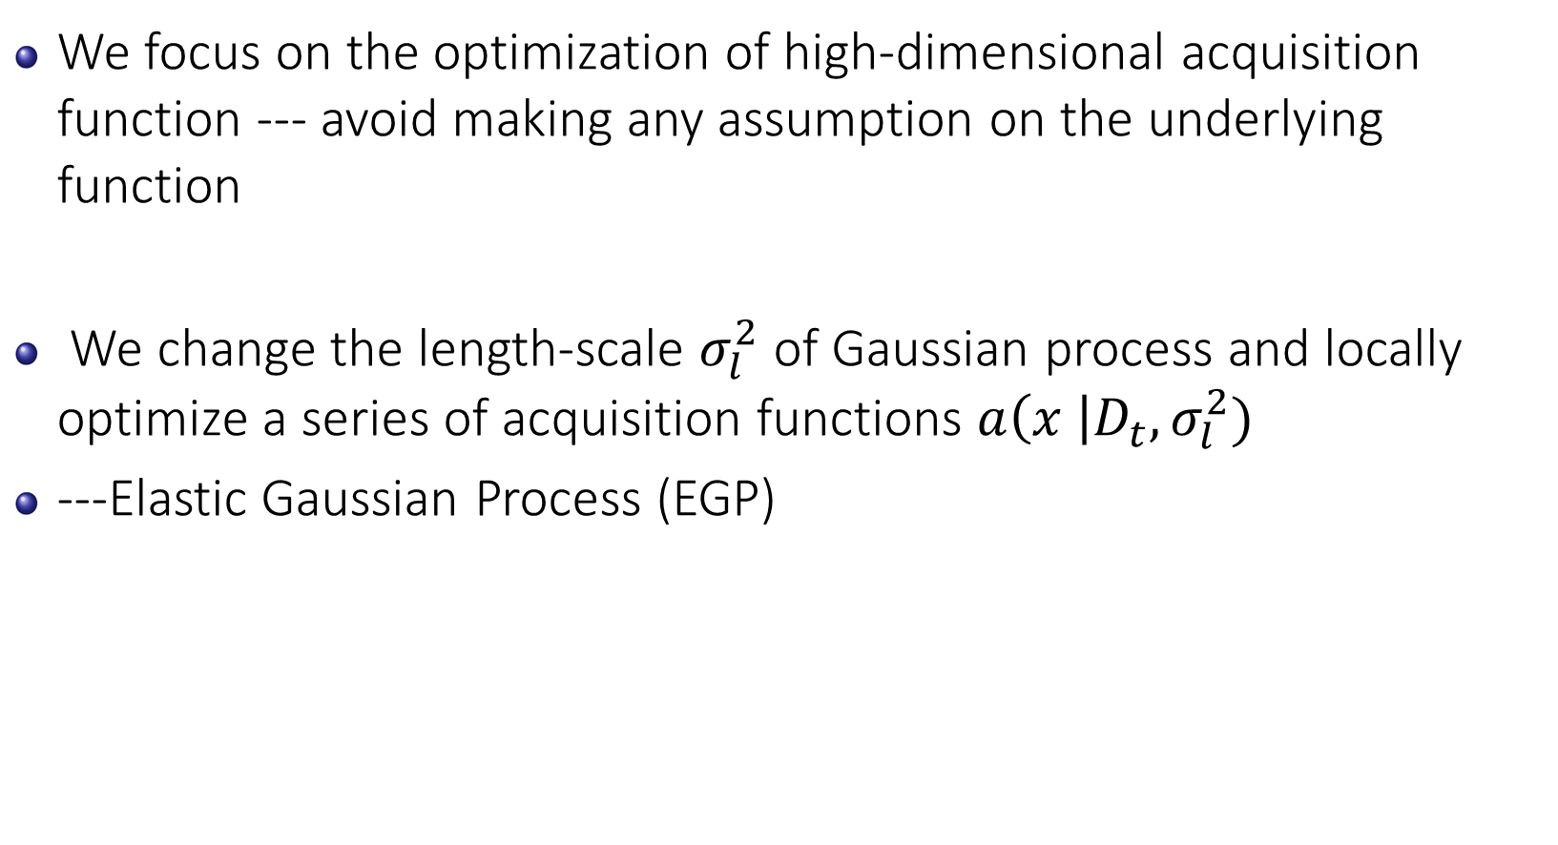
Elastic Gaussian Process
We focus on the optimization of high-dimensional acquisition function --- avoid making any assumption on the underlying function
We change the length-scale $σ_{l}^{2}$ of Gaussian process and locally optimize a series of acquisition functions $a\left(x \right|D_{t},σ_{l}^{2})$
---Elastic Gaussian Process (EGP)

Slide 9
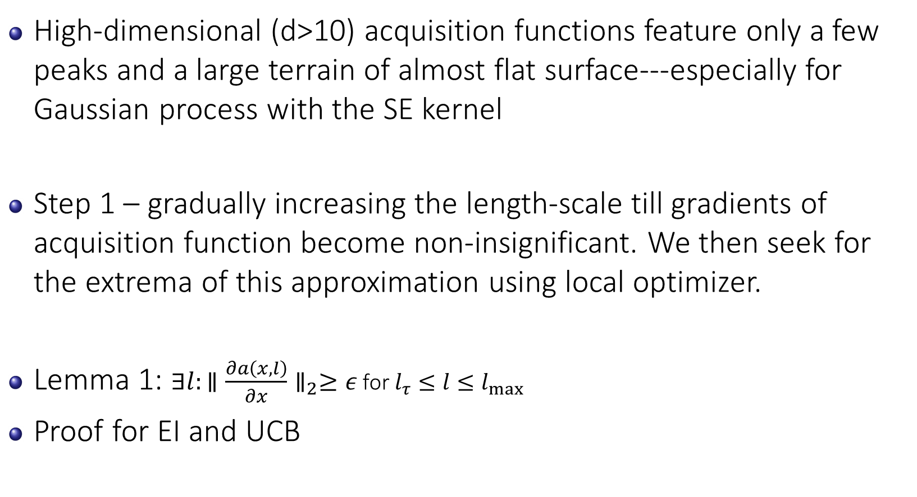
Elastic Gaussian Process
High-dimensional (d>10) acquisition functions feature only a few peaks and a large terrain of almost flat surface---especially for Gaussian process with the SE kernel
Step 1 – gradually increasing the length-scale till gradients of acquisition function become non-insignificant. We then seek for the extrema of this approximation using local optimizer.
Lemma 1: $∃l:∥\frac{∂a\left(x,l\right)}{∂x}∥_{2}≥ε$ for $l_{τ}≤l≤l_{\max{}}$
Proof for EI and UCB

Slide 10
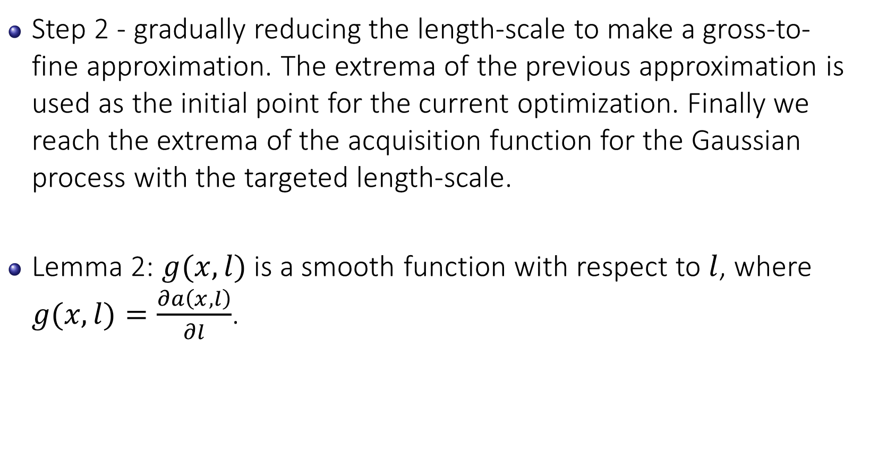
Elastic Gaussian Process
Step 2 - gradually reducing the length-scale to make a gross-to-fine approximation. The extrema of the previous approximation is used as the initial point for the current optimization. Finally we reach the extrema of the acquisition function for the Gaussian process with the targeted length-scale.
Lemma 2: $g(x,l)$ is a smooth function with respect to $l$, where $g(x,l)=\frac{∂a\left(x,l\right)}{∂l}$.

Slide 11
Illustration of Elastic Gaussian Process

Slide 12

Elastic Gaussian Process
Step 2 - gradually reducing the length-scale to make a gross-to-fine approximation. The extrema of the previous approximation is used as the initial point for the current optimization. Finally we reach the extrema of the acquisition function for the Gaussian process with the targeted length-scale.
Lemma 2: $g(x,l)$ is a smooth function with respect to $l$, where $g(x,l)=\frac{∂a\left(x,l\right)}{∂l}$.

Slide 13
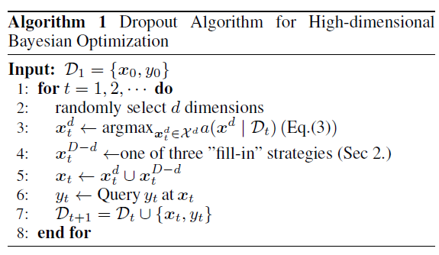


High Dimensional BO Using Dropout
Assume we have $d_{0}$ dimension to optimize.
We randomly select $d≤d_{0}$ dimensions.
We propose three fill-in strategies for the remaining $d_{0}−d$ dimensions.

Slide 14
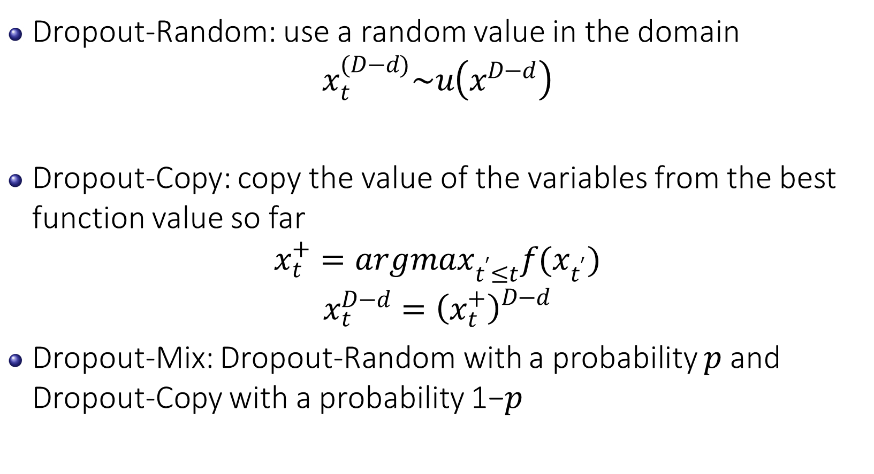
Fill-In Strategies for Drop Out
Dropout-Random: use a random value in the domain
$$x_{t}^{(D−d)}\sim u\left(x^{D−d}\right)$$
Dropout-Copy: copy the value of the variables from the best function value so far
$$x_{t}^{+}=argmax_{t^{′}≤t}f(x_{t^{′}})$$
$$x_{t}^{D−d}={\left(x_{t}^{+}\right)}_{}^{D−d}$$
Dropout-Mix: Dropout-Random with a probability 𝑝 and Dropout-Copy with a probability 1−𝑝

Slide 15
Experiment in High Dimension
In low dimensions (D = 5 and D = 10), standard BO is the best.
In high dimensions (D = 20 and D = 30) , our Dropout-Mix and Dropout-Copy significantly outperform other baselines.

Slide 16
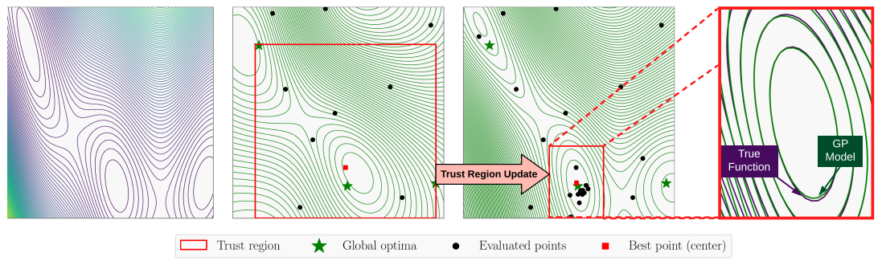
Trust Region Bayesian Optimization
High-level idea:
Build the trust regions
Perform local optimization in each trust region
Repeat

Slide 17
TuRBO
Can optimize 200 dimensions.
Eriksson, David, et al. "Scalable global optimization via local bayesian optimization." Advances in Neural Information Processing Systems. 2019.

Slide 18
Short Summary
Bayesian optimization can work effectively up to 10 dimensions.
In real-world scenarios, we may tackle the problems with large number of dimensions.
Bayesian optimization research in high dimension is essential.

Slide 19

Question and Answer

Slide 20
Reference
Eric Brochu, Vlad M. Cora, and Nando de Freitas. A tutorial on Bayesian optimization of expensive cost functions, with application to active user modelling and hierarchical reinforcement learning. 2010.
Ziyu Wang, Masrour Zoghi, Frank Hutter, David Matheson, and Nando De Freitas. Bayesian optimization in high dimensions via random embeddings. In IJCAI, pages 1778–1784, 2013.
C. Li, K. Kandasamy, B. Poczos, and J. Schneider. High dimensional Bayesian optimization via restricted projection pursuit models. In AISTATS, pages 1–9, 2016a.
S. Rana, C. Li, S. Gupta, V. Nguyen ,S. Venkatesh. High dimensional Bayesian optimisation with elastic Gaussian process. In ICML,2017.
Niranjan Srinivas, Andreas Krause, Sham Kakade, and Matthias Seeger. Gaussian process optimization in the bandit setting: No regret and experimental design. In ICML, 2010.
L. Li, K. Jamieson, G. DeSalvo, A. Rostamizadeh, and A. Talwalkar. Hyperband:a novel bandit-based approach to hyperparameter optimization. In ArXiv e-prints, 2016b.
C. Li, S. Gupta, S. Rana, V. Nguyen, S. Venkatesh, & A. Shilton. High Dimensional Bayesian Optimization Using Dropout. IJCAI 2017
Eriksson, D., Pearce, M., Gardner, J., Turner, R. D., & Poloczek, M. (2019). Scalable global optimization via local bayesian optimization. NeurIPS 2019.
Kandasamy, K., Schneider, J., & Póczos, B. High dimensional Bayesian optimisation and bandits via additive models. ICML 2015.
Wang, Z., Zoghi, M., Hutter, F., Matheson, D. and De Freitas, N. Bayesian optimization in high dimensions via random embeddings. IJCAI 2013.

