Slide 1
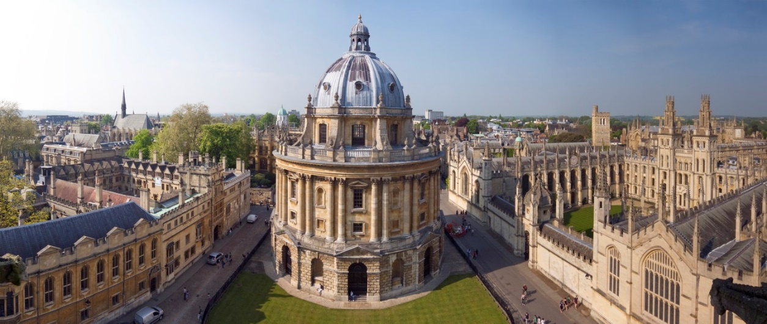
Part II: Recent Advances in Bayesian Optimization Sec 3: Mixed Categorical-Continuous Bayes Opt
Dr Vu Nguyen
vu@robots.ox.ac.uk
University of Oxford

Slide 2
Agenda
Parameter Tuning as Black-Box Function
Part I: Bayesian Optimization
Part II: Recent Advances in Bayesian Optimization
Batch Bayesian Optimization
High dimensional Bayes Opt
Mixed Categorical-Continuous Bayes Opt
Research Directions in Bayesian Optimization

Slide 3
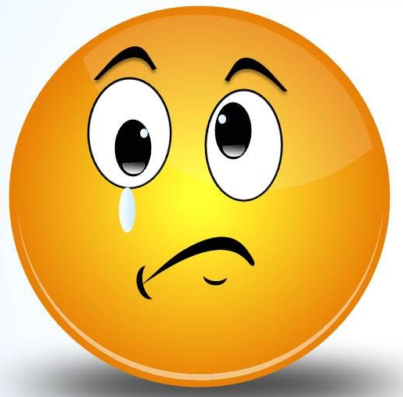
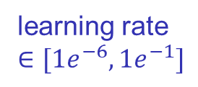

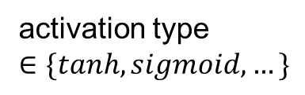
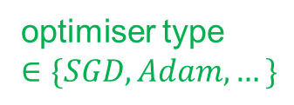

Bayes Opt Mixed Categorical – Continuous Input
Tuning hyperparameters for deep neural network
$y=f({ x}_{1} , x_{2} { x}_{3} ,{ x}_{4 })$
Multiple categorical - each categorical has multiple options
continuous variables
categorical variables
learning rate
$$∈[1e^{−6},1e^{−1}]$$
weight decay
$$∈[1e^{−6},1e^{−1}]$$
optimiser type
$$∈\{SGD,Adam,…\}$$
activation type
$$∈\{tanh,sigmoid,…\}$$

Slide 4
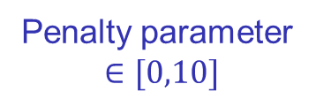

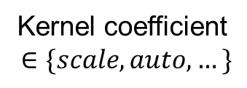

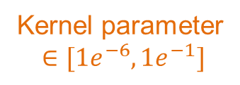
Bayes Opt Mixed Categorical – Continuous Input
Tuning hyperparameters for support vector machine
$y=f({ x}_{1} , x_{2} { x}_{3} ,{ x}_{4 })$
Multiple categorical - each categorical has multiple options
continuous variables
categorical variables
Penalty parameter
$$∈[0,10]$$
Kernel parameter
$$∈[1e^{−6},1e^{−1}]$$
kernel type
$$∈\{RBF,Poly,…\}$$
Kernel coefficient
$$∈\{scale,auto,…\}$$

Slide 5
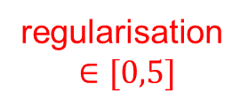
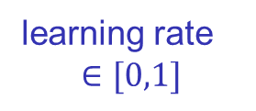

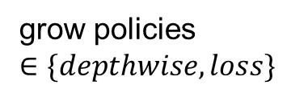

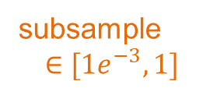
Bayes Opt Mixed Categorical – Continuous Input
Tuning hyperparameters for XGBoost
$y=f({ x}_{1} , x_{2} , x_{3} { x}_{4} ,{ x}_{5 })$
Multiple categorical - each categorical has multiple options
continuous variables
categorical variables
learning rate
$$∈[0,1]$$
subsample
$$∈[1e^{−3},1]$$
regularisation
$$∈[0,5]$$
booster type
$$∈\{gbtree,dart\}$$
grow policies
$$∈\{depthwise,loss\}$$

Slide 6
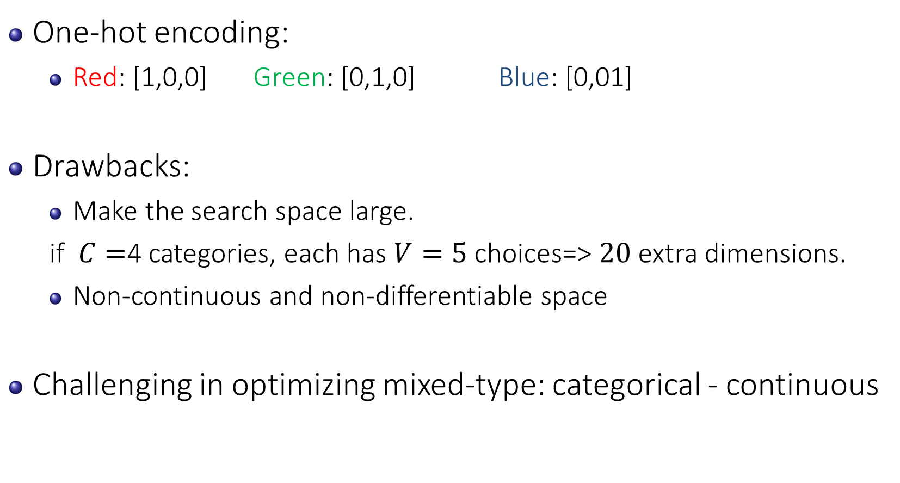
Bayes Opt Mixed Categorical – Continuous Input
One-hot encoding:
Red: [1,0,0] Green: [0,1,0] Blue: [0,01]
Drawbacks:
Make the search space large.
if $C=$4 categories, each has $V=5$ choices=> $20$ extra dimensions.
Non-continuous and non-differentiable space
Challenging in optimizing mixed-type: categorical - continuous

Slide 7
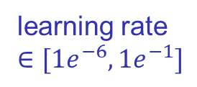

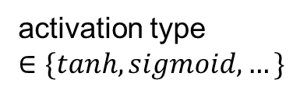
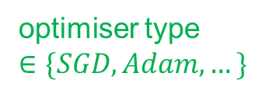

Bayes Opt Mixed Categorical – Continuous Input
continuous
categorical
$y=f({ x}_{1} , x_{2} { x}_{3} ,{ x}_{4 })$
learning rate
$$∈[1e^{−6},1e^{−1}]$$
weight decay
$$∈[1e^{−6},1e^{−1}]$$
optimiser type
$$∈\{SGD,Adam,…\}$$
activation type
$$∈\{tanh,sigmoid,…\}$$
Bayes Opt
Multi-armed Bandit

Slide 8
Agenda
Parameter Tuning as Black-Box Function
Part I: Bayesian Optimization
Part II: Recent Advances in Bayesian Optimization
Batch Bayesian Optimization
Bayesian Optimization in Unknown Search Space
Mixed Categorical-Continuous Bayes Opt
Problem setting
Multi-armed bandits
Categorical-specific continuous optimization
Categorical-(non-)specific continuous optimization
Research Directions in Bayesian Optimization

Slide 9
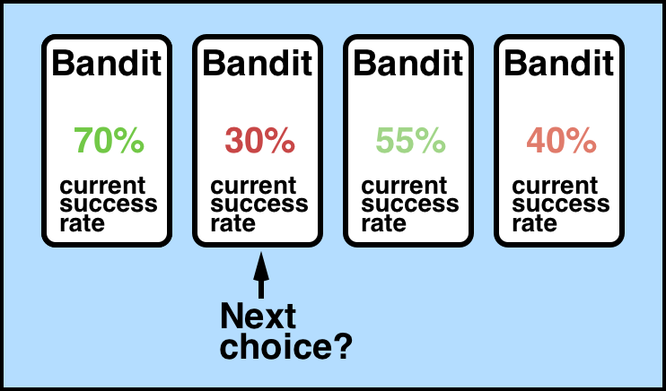
Multi-Armed Bandit Setting
A fixed set of arms, each of which returns a reward.
Observe the reward before the next pull.
The goal is to pull and receive as high reward as possible.
A
B
C
D

Slide 10

Multi-Armed Bandit Setting
Goal: Pull arms sequentially to maximize the total reward
Bandit scheme/policy: Sequential algorithm to play arms (items)
Regret of a scheme = Expected loss relative to the “oracle” optimal scheme that always plays the best arm
“best” means highest success probability
But, the best arm is not known … unless you have an oracle
Regret is the price of exploration
Low regret implies quick convergence to the best
Bandit “arms”

Slide 11
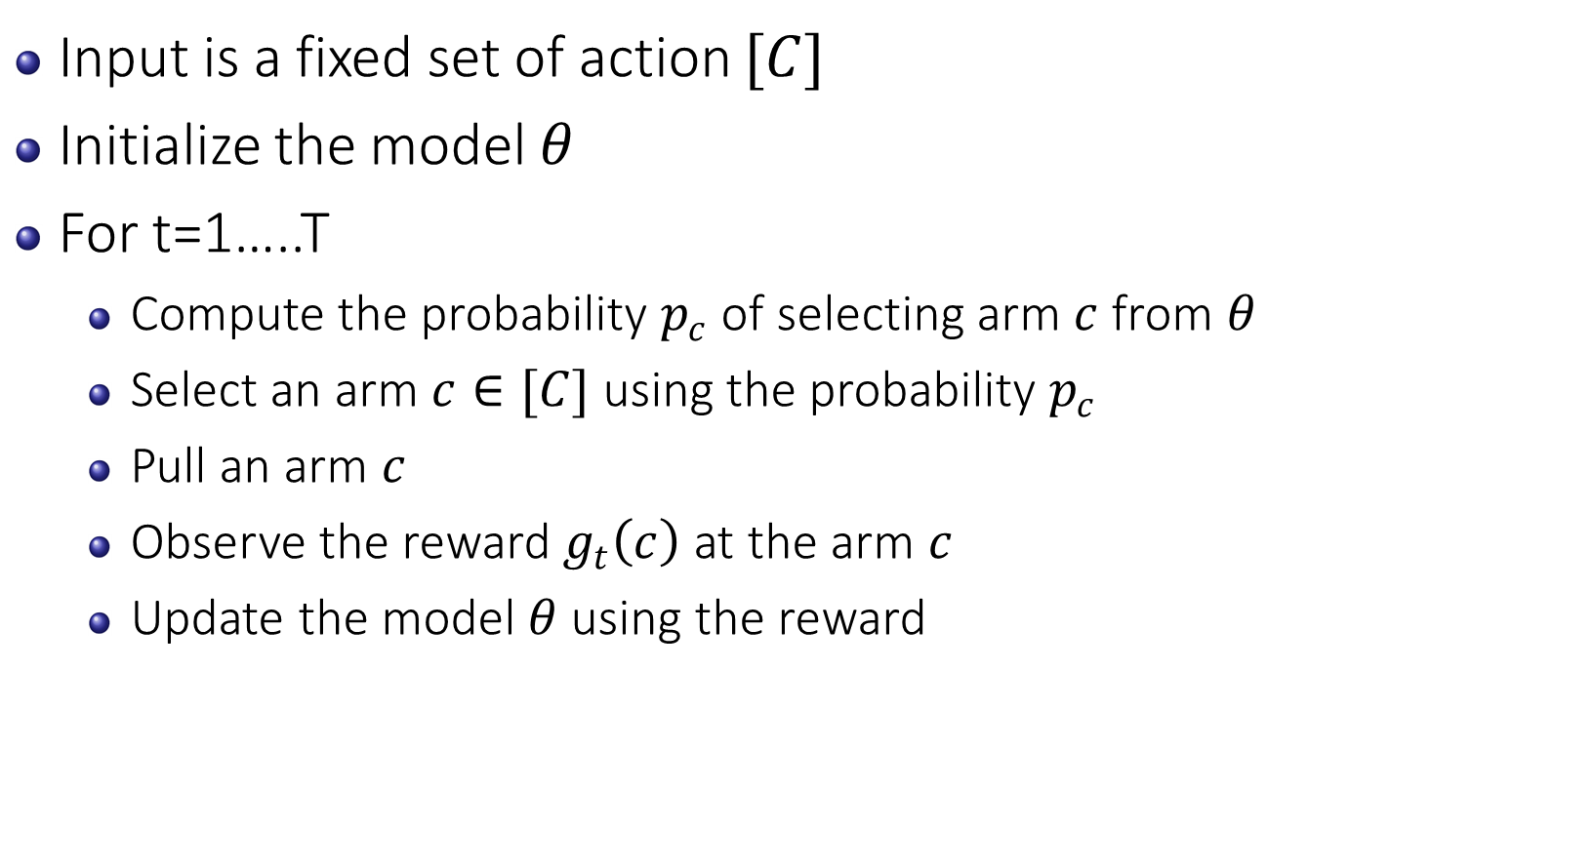
General Algorithm for Multi-Armed Bandit
Input is a fixed set of action $[C]$
Initialize the model $θ$
For t=1…..T
Compute the probability $p_{c}$ of selecting arm $c$ from $θ$
Select an arm $c∈[C]$ using the probability $p_{c}$
Pull an arm $c$
Observe the reward $g_{t}\left(c\right)$ at the arm $c$
Update the model $θ$ using the reward
There involves randomness here

Slide 12
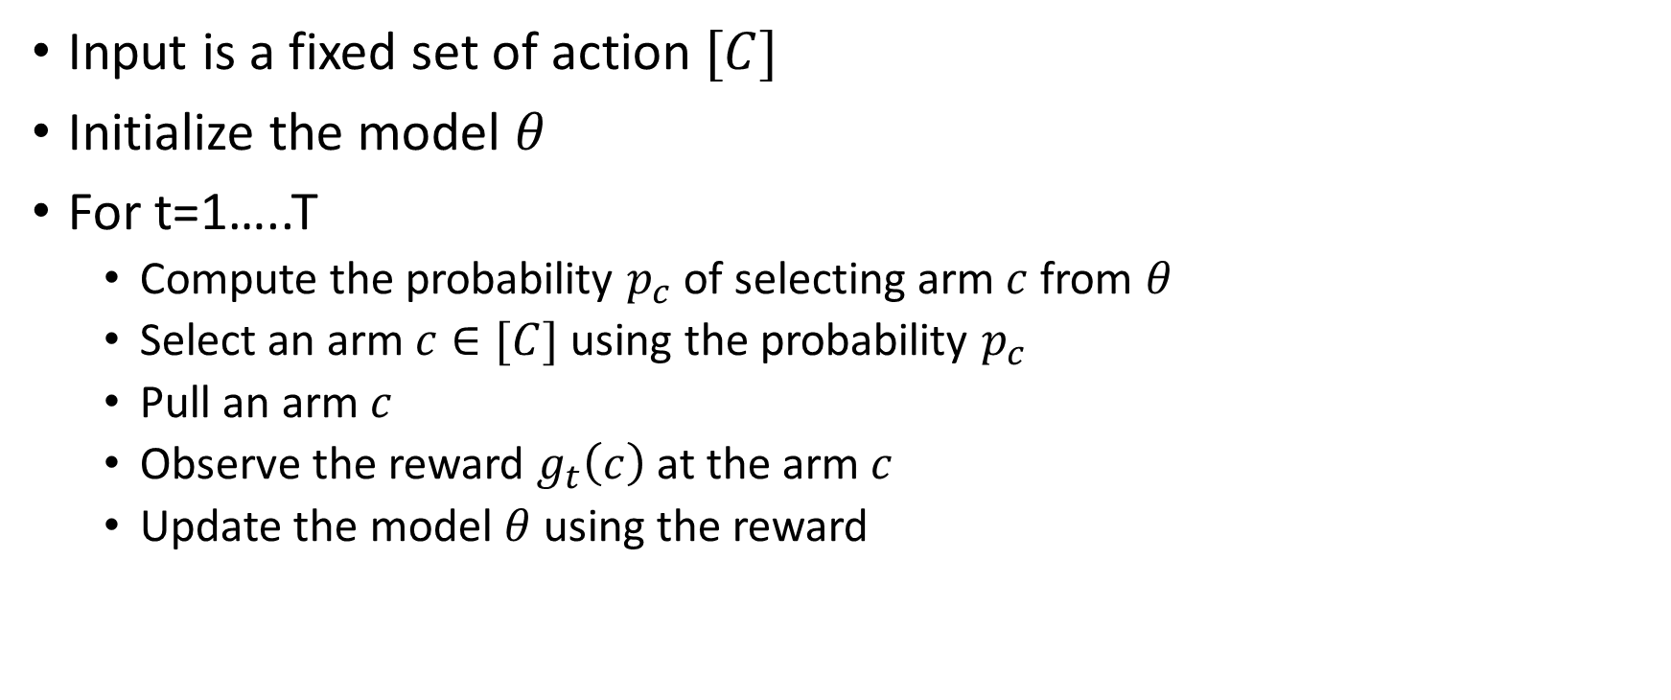
General Algorithm for Multi-Armed Bandit
Input is a fixed set of action $[C]$
Initialize the model $θ$
For t=1…..T
Compute the probability $p_{c}$ of selecting arm $c$ from $θ$
Select an arm $c∈[C]$ using the probability $p_{c}$
Pull an arm $c$
Observe the reward $g_{t}\left(c\right)$ at the arm $c$
Update the model $θ$ using the reward
These steps are the key of MAB

Slide 13
Exploration and Exploitation
This illustrates a classic problem, which is the defining characteristic of decision making: the trade-off between exploring and exploiting.
Exploring is to try new actions to learn their effects.
Exploiting is to try what we know has worked well in the past.

Slide 14
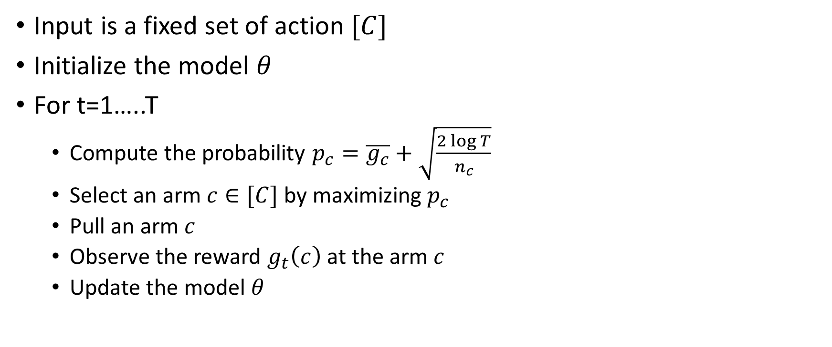
UCB1 algorithm
Input is a fixed set of action $[C]$
Initialize the model $θ$
For t=1…..T
Compute the probability $p_{c}=\overline{g_{c}}+\sqrt{\frac{2\log{T}}{n_{c}}}$
Select an arm $c∈[C]$ by maximizing $p_{c}$
Pull an arm $c$
Observe the reward $g_{t}\left(c\right)$ at the arm $c$
Update the model $θ$
utility score
uncertainty

Slide 15
EXP3 Algorithm
Theoretical guarantee (sublinear regret).
No assumption on the distribution of the reward.
Auer, P., Cesa-Bianchi, N., Freund, Y., & Schapire, R. E. (2002). The nonstochastic multiarmed bandit problem. SIAM journal on computing, 32(1), 48-77.

Slide 16
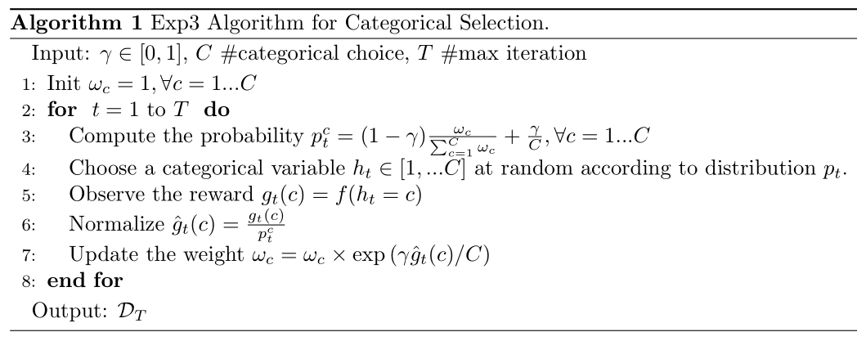
EXP3 Algorithm
This step is different
This step is different

Slide 17




Two settings in mixed variables optimization
Categorical-specific
Each categorical variable forms an independent function
$$f_{c}^{∗}=\max_{xεX}{f_{c} (x)}$$
Category 1
Category 2
Category 3
$$f_{1}(x)$$
$$f_{2}(x)$$
$$f_{3}(x)$$
Continuous variable is specific to categorical variable

Slide 18

Two settings in mixed variables optimization
Categorical-specific
Continuous is not specific to categorical
Category 1
Category 2
Category 3
$$f_{1}(x)$$
$$f_{2}(x)$$
$$f_{3}(x)$$
Continuous variable is specific to categorical variable
categorical
$$f\left(x,h\right)$$
Cat 1
Cat 2
Cat 3
continuous
continuous

Slide 19




Two settings in mixed variables optimization
Categorical-specific
Continuous is not specific to categorical
$$f_{1}(x)$$
$$f_{2}(x)$$
$$f_{3}(x)$$
Category 1
Category 2
Category 3
Three independent functions
$$f\left(x,h\right)$$
Cat 1
Cat 2
Cat 3
Single function
continuous

Slide 20
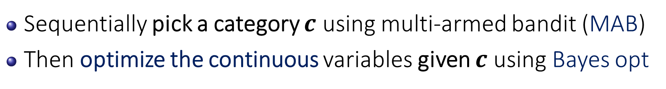

1. Categorical-specific
Explore-exploit by MAB
$$f_{1}(x)$$
Cat 1
Explore-exploit
by Bayes opt
Ignore
Ignore
Sequentially pick a category $c$ using multi-armed bandit (MAB)
Then optimize the continuous variables given $c$ using Bayes opt

Slide 21



Visualization of the Algorithm
$$f_{1}(x)$$
Cat 1
$$f_{2}(x)$$
Cat 2
$$f_{3}(x)$$
Cat 3
Concentrate on cat 2
with higher (expected) value.

Slide 22
Agenda
Parameter Tuning as Black-Box Function
Part I: Bayesian Optimization
Part II: Recent Advances in Bayesian Optimization
Batch Bayesian Optimization
Bayesian Optimization in Unknown Search Space
Mixed Categorical-Continuous Bayes Opt
Problem setting
Multi-armed bandits
Categorical-specific continuous optimization
Categorical-(non-)specific continuous optimization
Research Directions in Bayesian Optimization

Slide 23
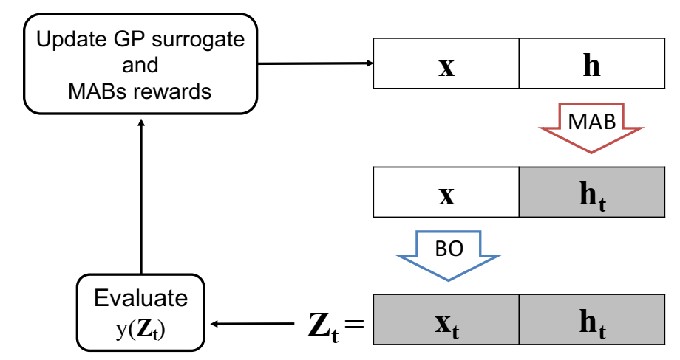




2. Continuous is not specific to categorical variable
MAB picks multiple categories: $h$={SGD optimizer, tanh activation}
Then optimize the continuous $x$ given $h$ in a single function
$x$
$$h$$
$$f\left( , \right)$$
continuous
categorical

Slide 24

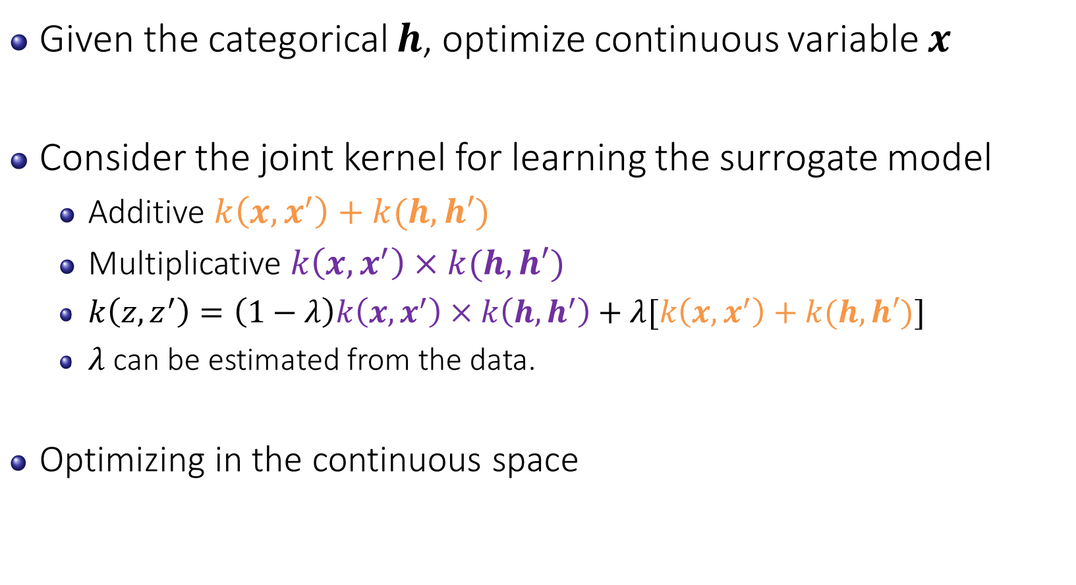
Given $h$, we optimize the continuous $x$
Given the categorical $h$, optimize continuous variable $x$
Consider the joint kernel for learning the surrogate model
Additive $k\left(x,x^{′}\right)+k(h,h′)$
Multiplicative $k\left(x,x^{′}\right)×k(h,h′)$
$k\left(z,z^{′}\right)=\left(1−λ\right)k\left(x,x^{′}\right)×k\left(h,h^{′}\right)+λ[k\left(x,x^{′}\right)+k(h,h′)]$
$λ$ can be estimated from the data.
Optimizing in the continuous space

Slide 25










Given the feedback $f(\left[x,h\right])$, we optimize $h$
Select $h$ by EXP3 algorithm
There is no assumption on the distribution of the reward
Bandit arm
Reward
probability
$$A_{1}$$
$$A_{2}$$
$$A_{3}$$
$$B_{1}$$
$$B_{2}$$
$$C_{1}$$
$$C_{2}$$
$$C_{5}$$
Cat A
Cat B
Cat C
Multiple categories

Slide 26

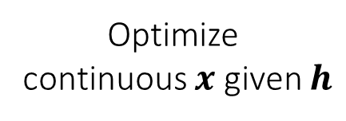



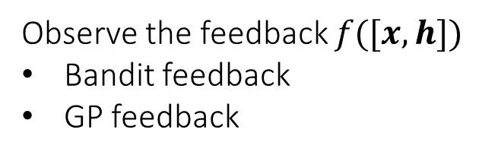



Given the feedback $f(\left[x,h\right])$, we optimize $h$
Optimize categorical $h$
$$A_{1}$$
$$A_{2}$$
$$A_{3}$$
$$B_{1}$$
$$B_{2}$$
Optimize
continuous $x$ given $h$
Cat A
Cat B
Observe the feedback $f([x,h])$
Bandit feedback
GP feedback

Slide 27
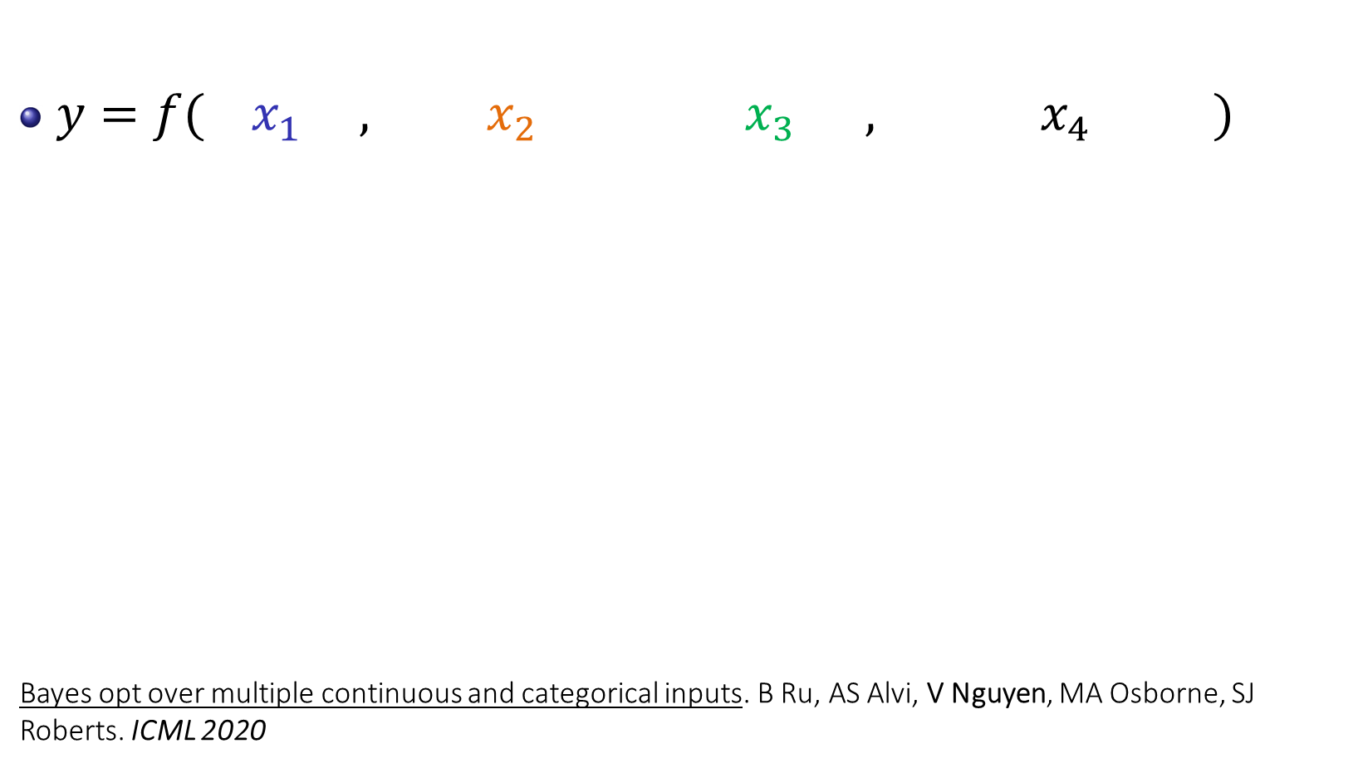
Bayes Opt Mixed Categorical – Continuous Input
continuous
categorical
$y=f({ x}_{1} , x_{2} { x}_{3} ,{ x}_{4 })$
Bayes opt over multiple continuous and categorical inputs. B Ru, AS Alvi, V Nguyen, MA Osborne, SJ Roberts. ICML 2020
learning rate
$$∈[1e^{−6},1e^{−1}]$$
weight decay
$$∈[1e^{−6},1e^{−1}]$$
optimiser type
$$∈\{SGD,Adam,…\}$$
activation type
$$∈\{tanh,sigmoid,…\}$$
Bayes Opt
Multi-armed Bandit
Continuous Categorical Bayesian Optimisation
(CoCaBO)

Slide 28
Short Summary
Bayesian optimization can work effectively up to 10 dimensions.
In real-world scenarios, we may tackle the problems with large number of dimensions.
Bayesian optimization research in high dimension is essential.

Slide 29

Question and Answer

Slide 30
Reference
Eric Brochu, Vlad M. Cora, and Nando de Freitas. A tutorial on Bayesian optimization of expensive cost functions, with application to active user modelling and hierarchical reinforcement learning. 2010.
B. Ru, AS. Alvi, V. Nguyen, M. A. Osborne, SJ. Roberts. Bayesian Optimisation over Multiple Continuous and Categorical Inputs. ICML, 2020.
S. Gopakumar, S. Gupta, S. Rana, V. Nguyen, S. Venkatesh. Algorithmic Assurance: An Active Approach to Algorithmic Testing using Bayesian Optimisation. NeurIPS, 2018
Daxberger, E., Makarova, A., Turchetta, M., & Krause, A. Mixed-Variable Bayesian Optimization. IJCAI 2020

Slide 31
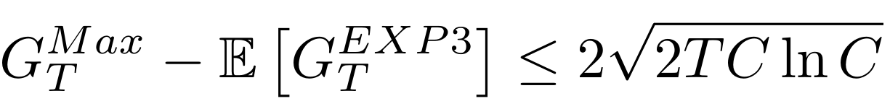
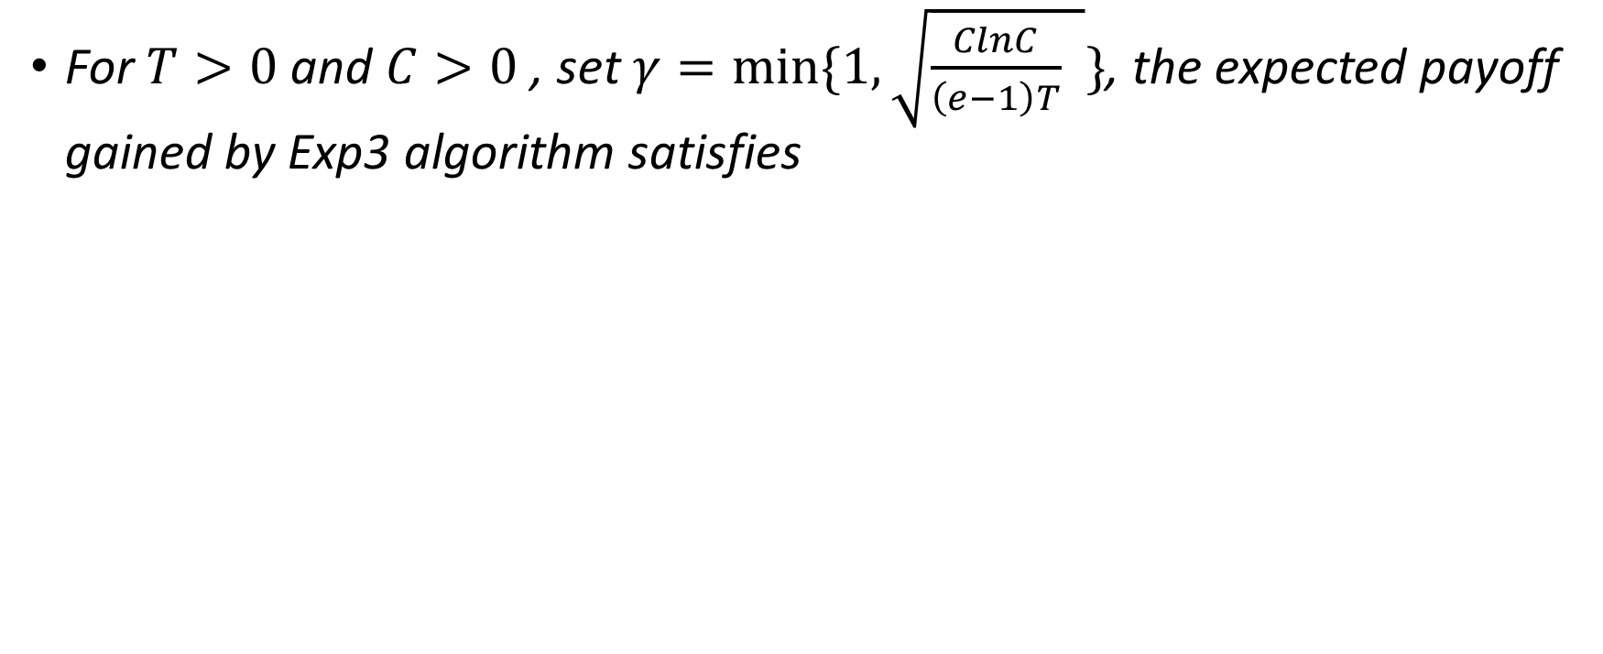
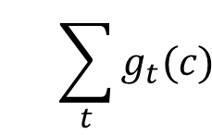
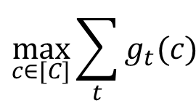
EXP3 Regret
For $T>0$ and $C>0$ , set $γ=min⁡\{1,\sqrt{\frac{ClnC}{\left(e−1\right)T} }\}$, the expected payoff gained by Exp3 algorithm satisfies
$$\max_{c∈[C]}{\sum_{t}{g_{t}(c)} }$$
$${\sum_{t}{g_{t}(c)} }$$
$c$ is selected by EXP3 algorithm at each iteration

