Slide 1
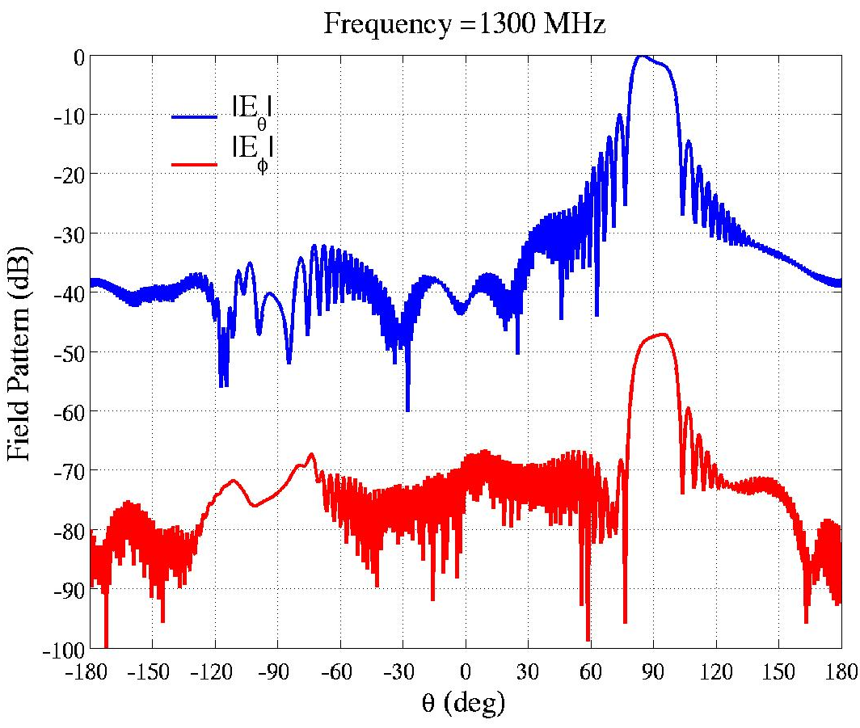
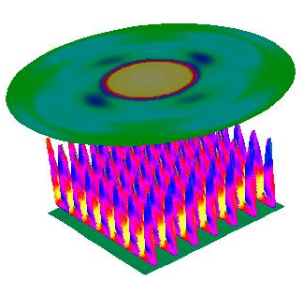
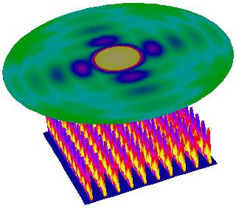
An Efficient Non-Conforming Finite Element Domain Decomposition Method for the Analysis of Large Finite Arrays
Seung-Cheol Lee, Marinos Vouvakis, and Jin-Fa Lee
Computational Science Group, ESL, ECE Dept.
The Ohio State University
http://esl.eng.ohio-state.edu/~csg
Sponsored jointly by Ansoft Corp. Pittsburgh And Temasek Lab., NUS, Singapore and

Slide 2
Vector Finite Element Methods
Capability of “brute-force” FEM in a single PC using
p-type MUltiplicative Schwarz (pMUS) preconditioner
h-adaptive refinement
N | NZ | NC(PC) | NI | CPU(PC) | CPU(CG)
1659412 | 40996023 | 37413985 | 20 | 666 | 198
2125948 | 52502667 | 47556258 | 22 | 910 | 279
2767454 | 68346617 | 61767681 | 18 | 1323 | 362
[1] Jin-Fa Lee, Din Kow Sun, “pMUS (p-type Multiplicative Schwarz) Method with Vector Finite Elements for Modeling Three-Dimensional Waveguide Discontinuities,” IEEE Trans. Microwave Theory Tech., March, 2004.
[2] D. K. Sun, J. F. Lee, and Z. J. Cendes, “Construction of Nearly Orthogonal Nedelec Bases for Rapid Convergence with Multilevel Preconditioned Solvers,” SIAM J. Sci. Comput., vol. 23, no. 4, pp. 1053-1076.

Slide 3
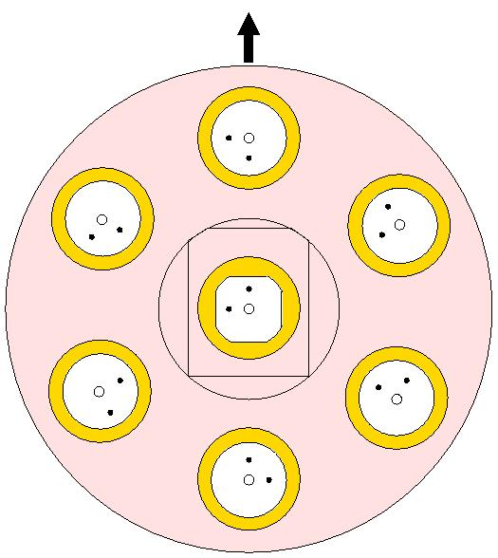
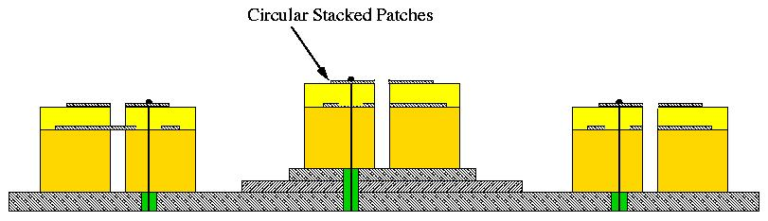
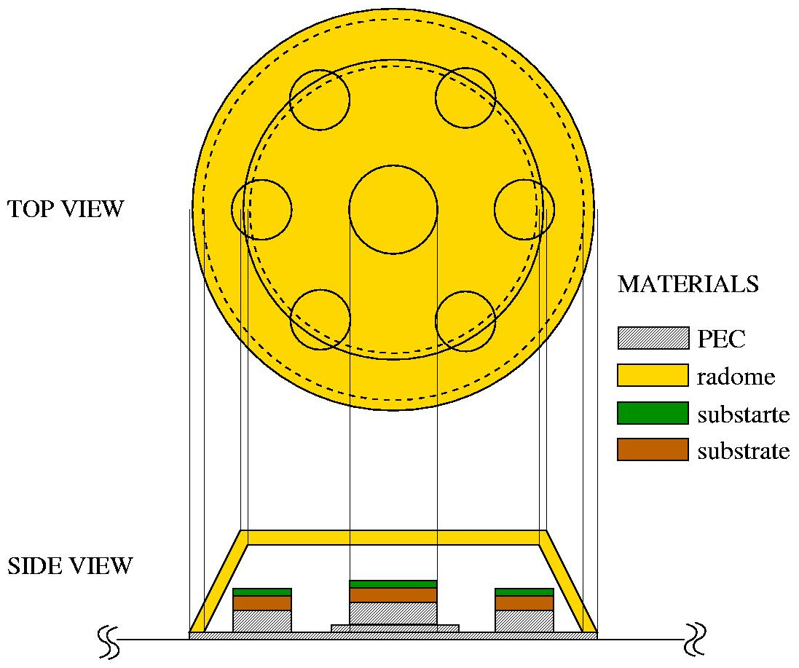
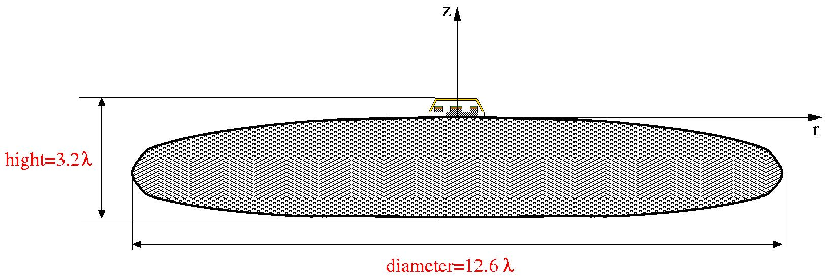
Dual band operation
7 elements antenna array, circular polarized
The 7 elements array, coated with Radome, sitting on top of a large finite ground plane

Slide 4
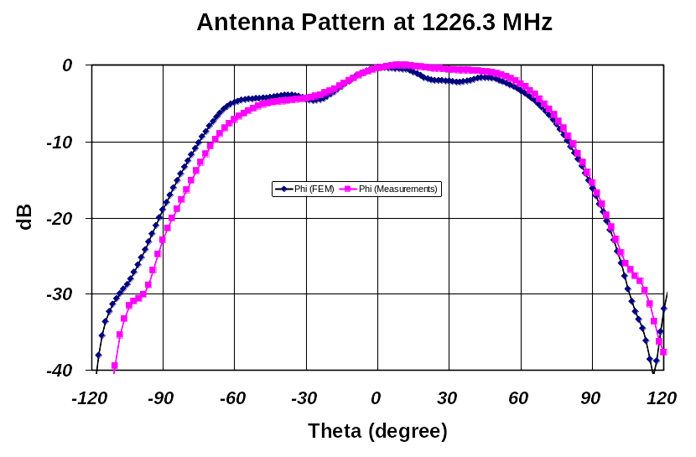
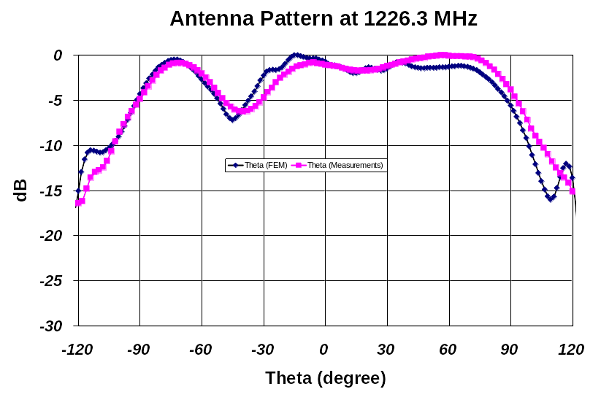
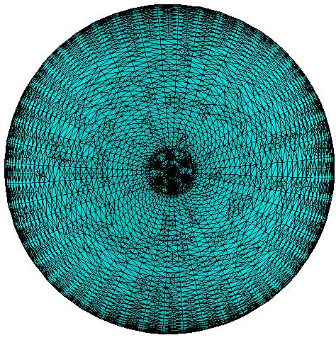
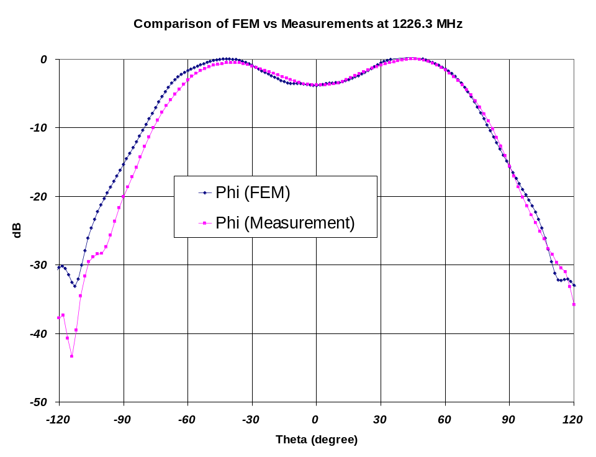
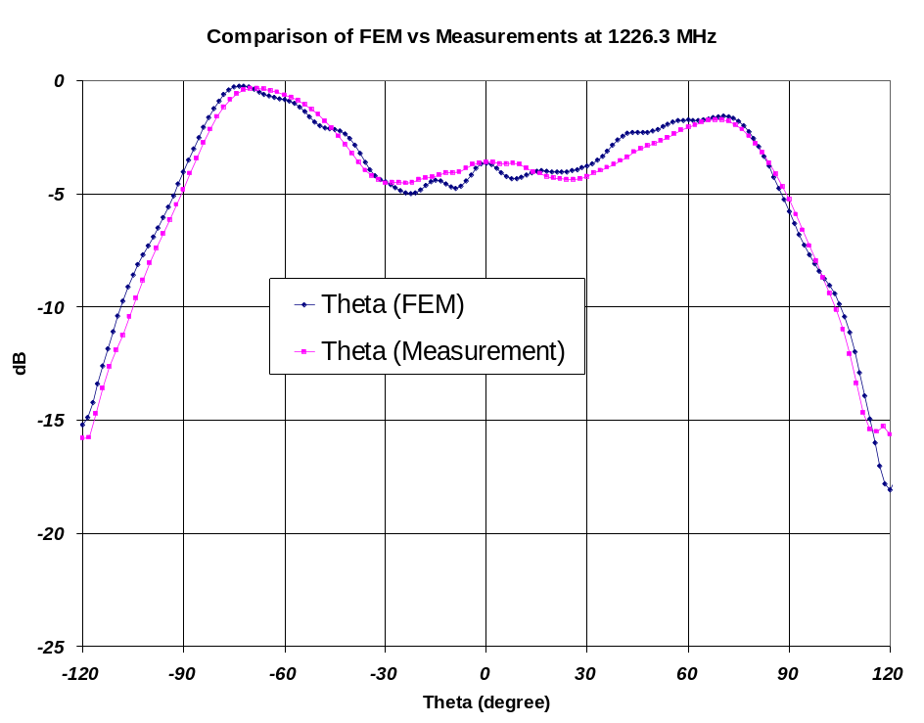
Smoothed finite ground plane
Smoothed finite ground plane

Slide 5
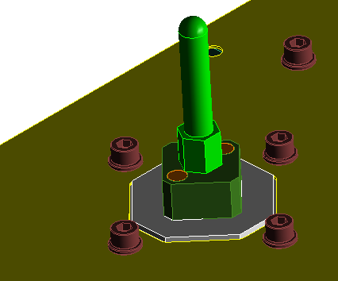
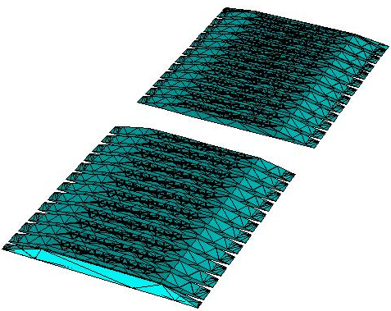
What Problems We Are Targeting?
Typical RADAR Array
40 million unknowns!!!
108 elements (60λ)
With current “conventional” full-wave approaches arrays up to 18×12 without RADOME can be accurately simulated, on 2GB PC.
12 elements (10λ)

Slide 6
Outline
Non-overlapping Conformal Domain Decomposition
  Conventional Formulation
  Alternative Formulation with “Largrange” Multiplier
  Duality Pairing
Non-Overlapping Non-Conformal Domain Decomposition
  Mortar Technique
1st Order Transmission Condition Between Domains
  Fourier Analysis
  Convergence Plots for Dirichlet-Neumann mapping and Robin Transmission Condition
Numerical Results
  Vivaldi Arrays
  Monopole Antenna Arrays

Slide 7

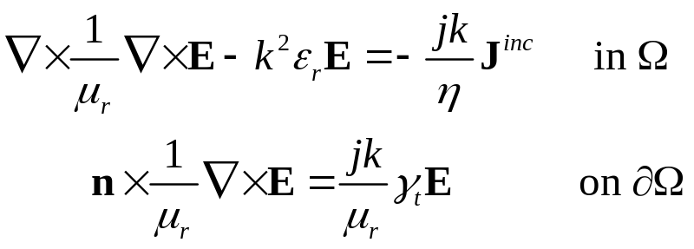


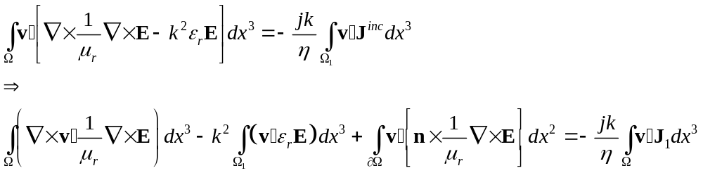
Implementing ABC in FEM
B.V.P.
#1: Traditional Formulation
Imposing the natural boundary condition results in

Slide 8


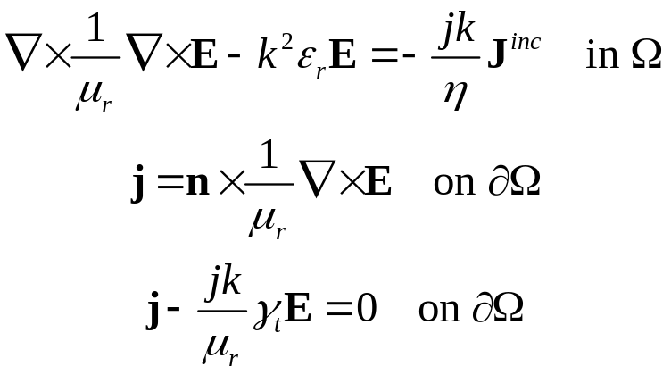
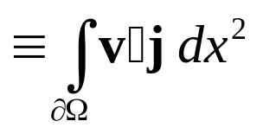
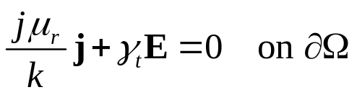
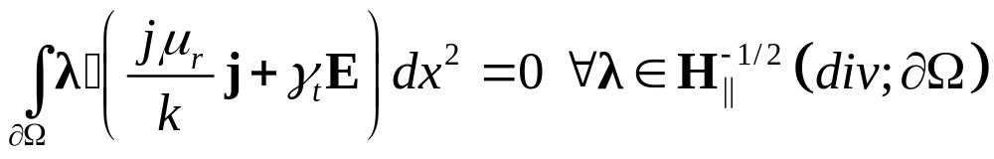
#2: Alternative Formulation
Introduce an additional set of unknowns on the boundary , and the BVP reads

Slide 9
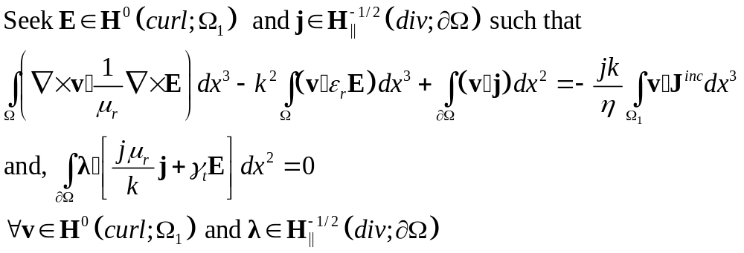
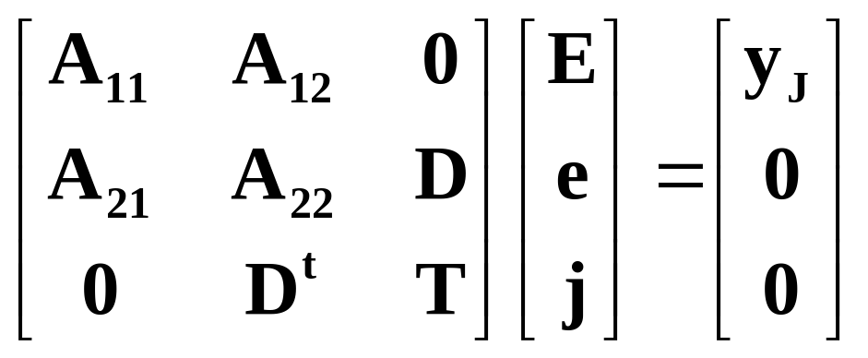
Galerkin Formulation of the Alternative BVP
Note the matrix is Symmetric and There is no zero diagonal block!!!

Slide 10





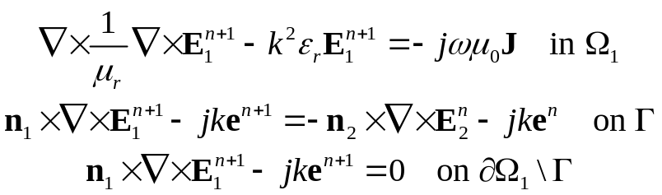



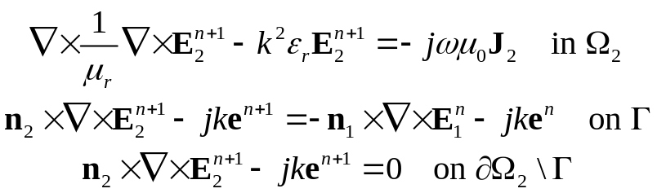

Conforming DDMs
At nth iteration, let us assume that are available
everywhere. Then,
and
Gauss-Siedel iteration scheme is adopted, and therefore denote the most update values of the variables
The two BVPs are well-posed. Existence and uniqueness are trivially established
For simplicity, ABC is used for mesh truncation in the formulation. Other mesh truncation methods can be subsituted into the formulation with straightforward modifications.
Can be employed to update variables
Common variable e is used to strongly enforced tangential component of electric field being continuous
Tangential component of magnetic field continuous is imposed “weakly” through natural boundary condition in FEM formulation

Slide 11
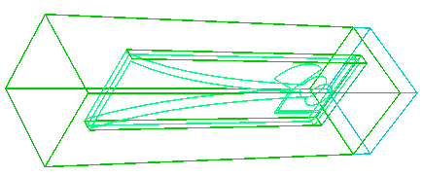
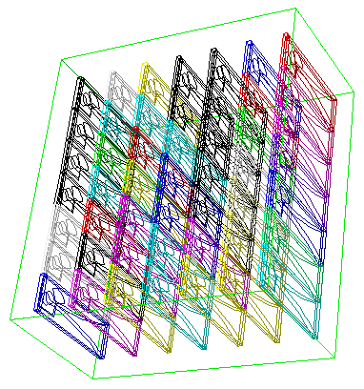
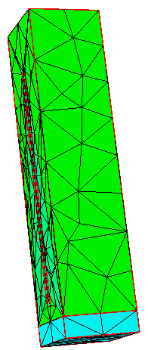
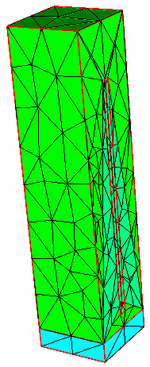
Boundary Value Problem
for Single Building Block
_{back}
_{left}
ABC/IE
ABC/IE
_{top}
_{bottom}
_{front}
ABC/IE
_{right}
ABC/IE
non-conforming triangular meshes
ABC/IE

Slide 12
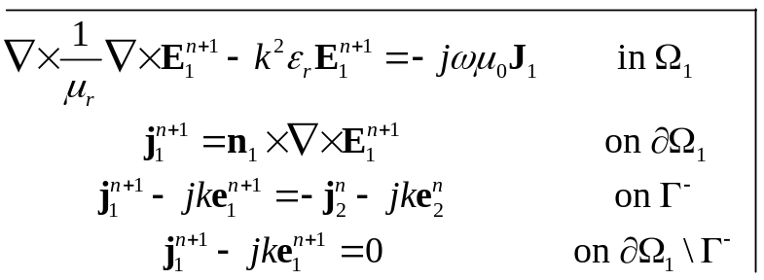










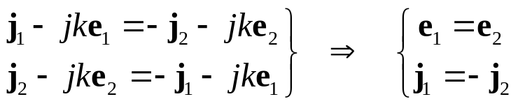
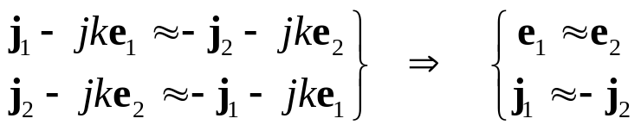
Non-conforming DDM and Mortar Technique
And,
Do these two BVPs imply the needed Physics, namely ?
YES, though weakly
Galerkin treatments result in

Slide 13
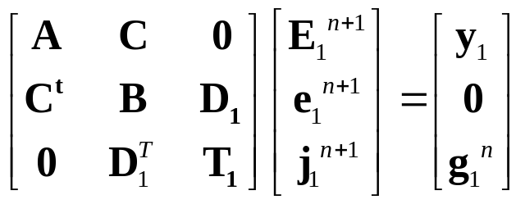
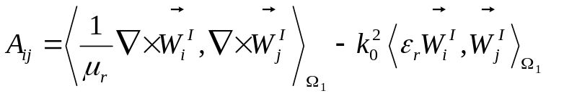
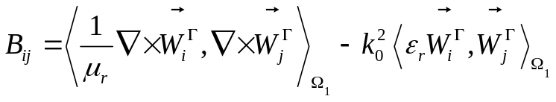
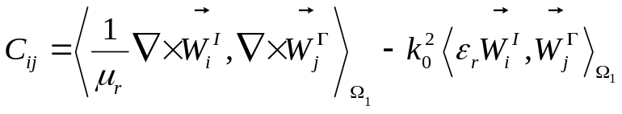

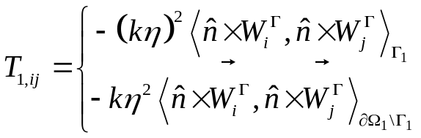
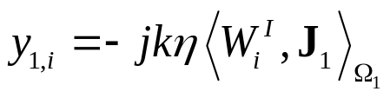
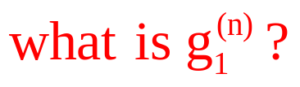
Boundary Value Problem
for Two Domains (cont.)

Slide 14

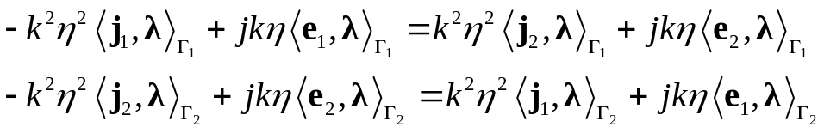
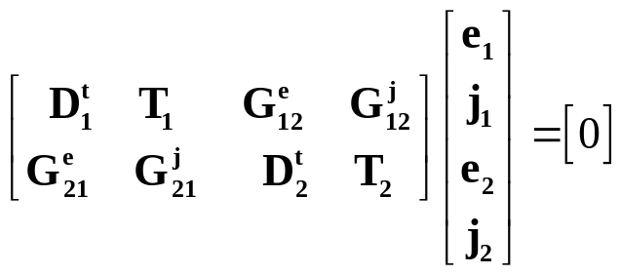

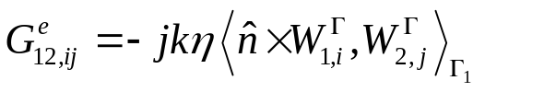
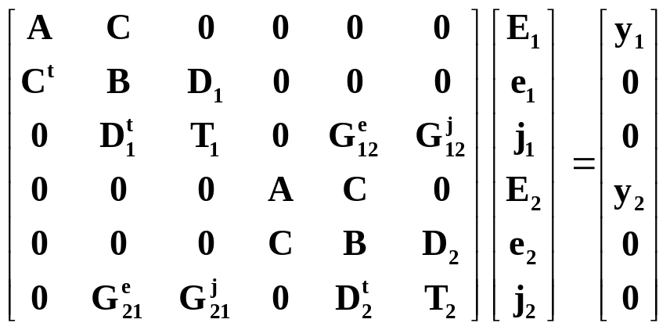



Boundary Value Problem
for Two Domains (cont.)
Mortar Elements (non-Galerkin testing)

Slide 15
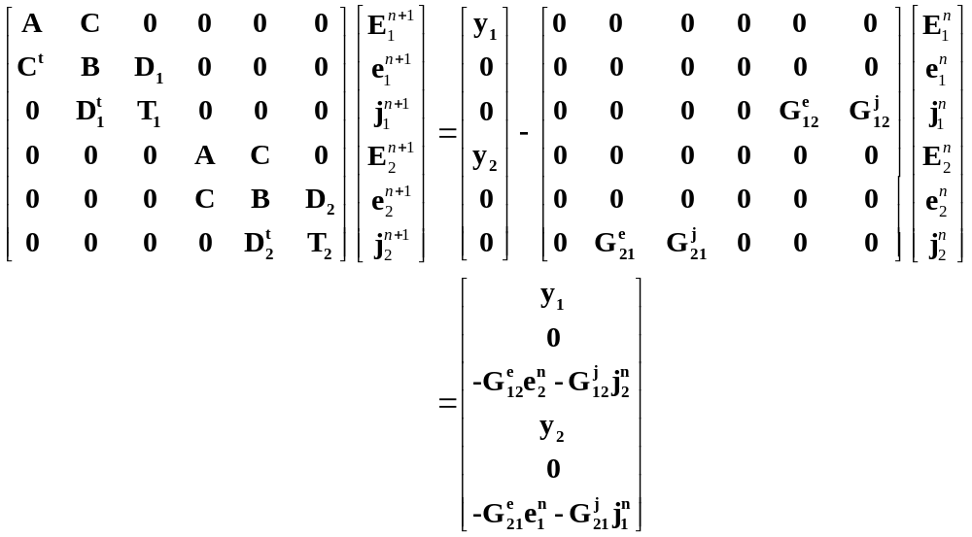
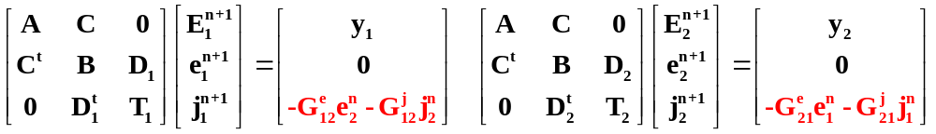
DD Viewed as Operator Splitting
Comments: Gauss-Seidel vs. Jacobi
Faster convergence
Half memory saving

Slide 16
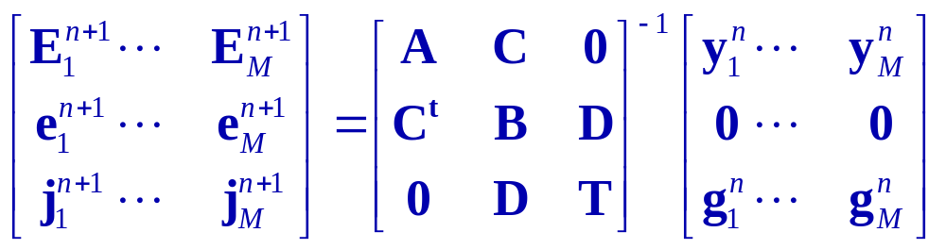
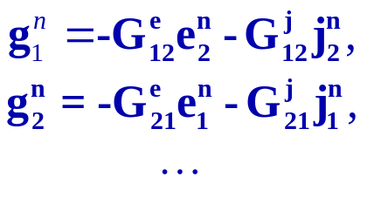
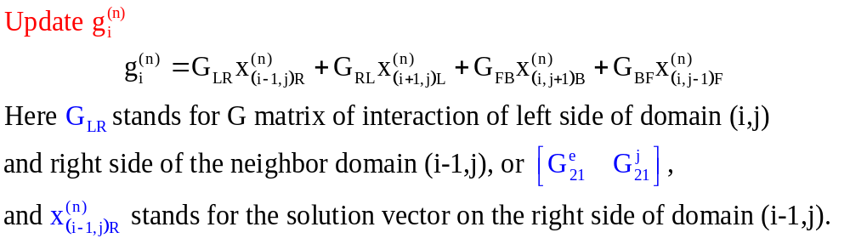
Mortar + DDM
where
Back (3)
Back (3)
Back (3)
Left (0)
Domain (i-1, j)
Right (1)
Left (0)
Domain (i, j)
Right (1)
Left (0)
Right (1)
Domain (i+1, j)
Front (2)
Front (2)
Front (2)

Slide 17
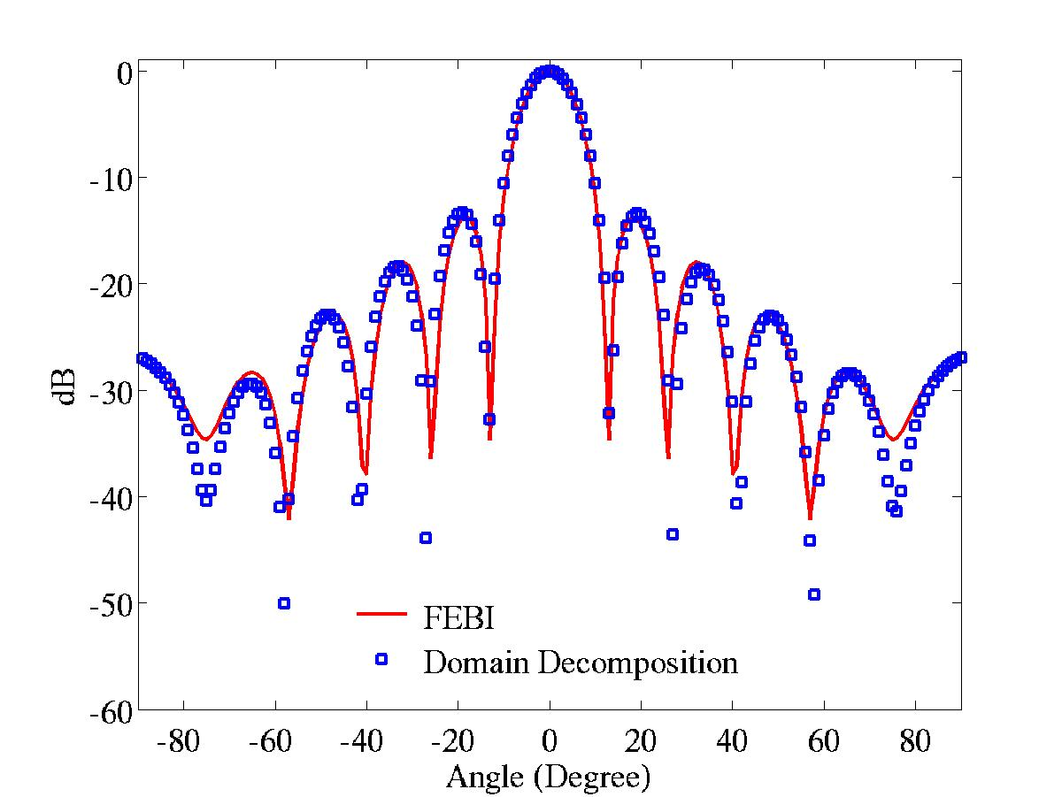
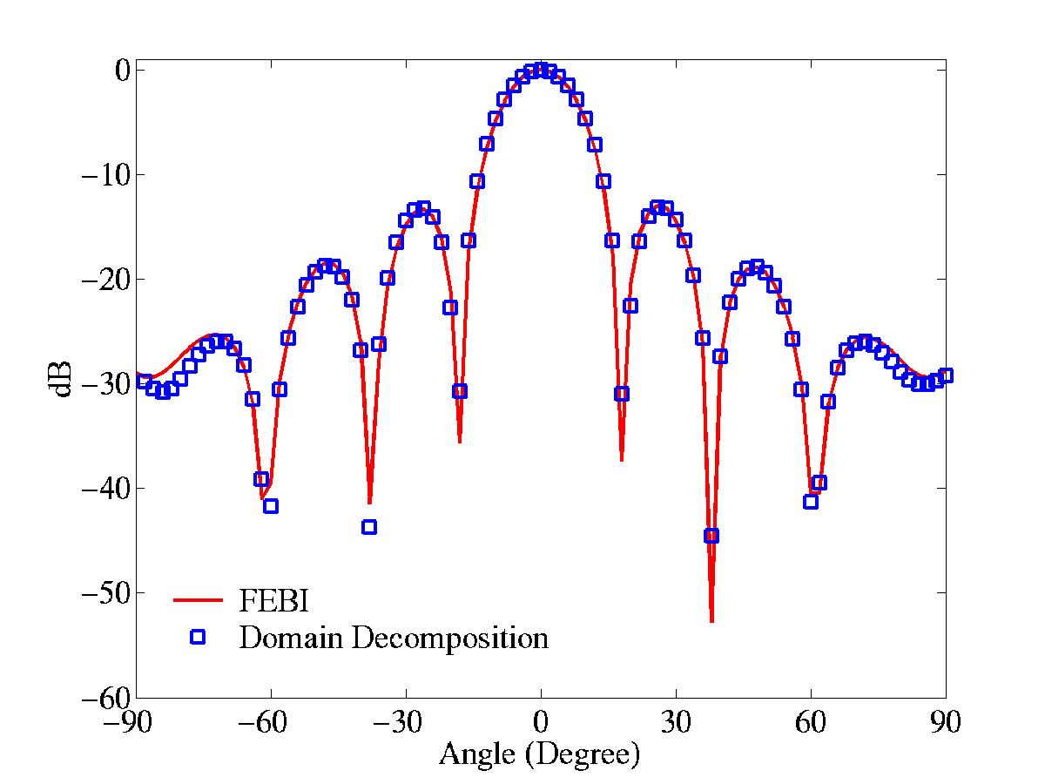
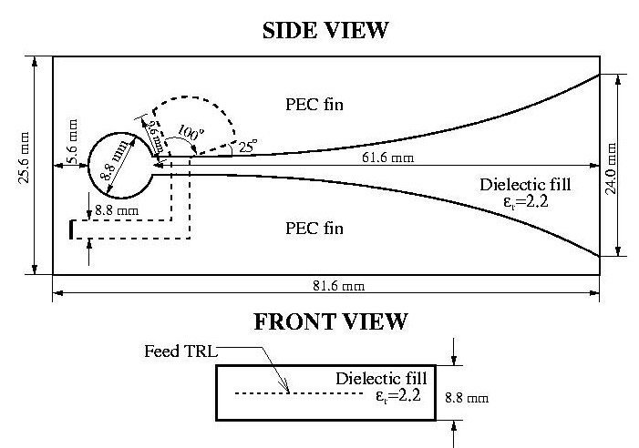


Comparisons With “brute-force” FEBI
7×7 Vivaldi Array
10×10 Vivaldi Array

Slide 18
Comparison of Mortar+DDM and Mortar+DDM+FETI
Array Size | Number of Unknowns | Mortar DDM |  | Mortar DDM + FETI
 |  | Memory | CPU (hh:mm) | Memory | CPU (hh:mm)
3x3 | 10,890x9 (98K) | 11 MB | 00:04 | 16 MB | 00:08
7x7 | 10,890x49 (534K) | 17.9 MB | 00:25 | 17.7 MB | 00:08
50x50 | 10,890x2,500 (27.23M) | 471MB | 30:12 | 55.6 MB | 00:28
100x100 | 10,890x10,000 (108.9M) | 1,650 MB | 112:40 | 167 MB | 01:27
300x300 | 10,890x90,000 (980.1M) | \ | \ | 1,370 MB | 12:00
Solution time only

Slide 19



Beam Scanning
15x10 vivaldi array with scanning angle θ = 45°,φ = 0°
φ
θ
Scaning
θ = 45°,φ = 0°
φ = 0° plane
broadside

Slide 20



Beam Scanning
50x50 vivaldi array with scanning angle θ = 45°,φ = 0°
φ
θ
Scaning
θ = 45°,φ = 0°
φ = 0° plane
broadside

Slide 21
Conclusions
Mortar technique is a powerful machinary to to implement non-conforming domain decomposition method
Using Robin transmission condition results in slower convergence for high frequency Fourier modes and fast rate of damping for “low” frequency Fourier modes.
The Mortar+DDM can be further improved to model large electromagnetic problems by employing FETI algorithm

