Slide 1
A Domain Decomposition Technique for Efficient Iterative Solution of Nonlinear Electromagnetic Problems
Giacomo Guarnieri¹, Giuseppe Pelosi², Lorenzo Rossi², Stefano Selleri²
¹BU Sistemi Radar Antenne, Selex Galileo S.p.A.
Via A. Einstein, 35 50013 Campi Bisenzio (FI).
²Department of Electronics and Telecommunications, University of Florence
via C. Lombroso 6/17 - 50134 - Firenze.

Slide 2
Outline
Introduction
Finite Elements
Non Linear Media
Domain Decomposition
Implementation
Numerical Results
Conclusions

Slide 3
Among the usual hypotheses used in the solution of Maxwell’s equations there is the one concerning the linear response of materials.
On the other hand only free space is perfectly linear, while all material media do exhibit some non linearity for extreme values of the electromagnetic fields.
There are also media whose behavior can be non-linear also for the electromagnetic field intensities usually found within a microwave device.

Slide 4
Numerical solution of the non-linear electromagnetic problem is relatively easy in time domain.
In frequency-domain methods, the solution of the non-linear electromagnetic problem requires a series of solutions in which the fields computed at each step are used to determine the media behavior at the subsequent steps.
This iteration is obviously very time consuming and any possible speed-up would increase soultion efficiency.

Slide 5
The Finite Elements method (FE) in frequency domain is well known for its accuracy, reliability, and flexibility.
The application of the FE method to a generic microwave device requires:
Domain discretization in elements
Building of the solving linear system of equations
Solving the obtained linear system
The presence of nonlinear media impairs carrying out second point unless a value for the electromagnetic field is assumed and an iteration requiring the repetition of the last two step implemented.
The last two steps are usually the most time-consuming.

Slide 6
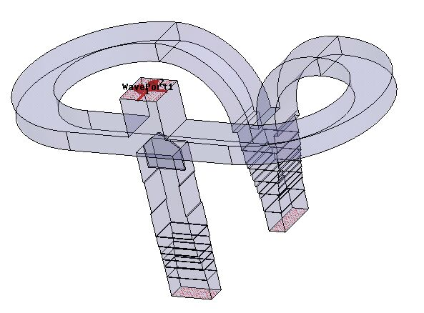
Metals are usually linear in behavior, while dielectrics and ferrites are more apt to exhibit nonlinerities.
Dielectrics and ferrites are usually small parts within a large metallic device, hence the nonlinear behavior can be assumed limited to a small portion of the domain.

Slide 7
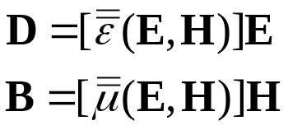
A nonlinear media can usually be modeled as a media whose permittivity and permerability are functions of the intensity of the electromagnetic field within the media.
This leads to a nonlinear dependence of the inductions from the fields.

Slide 8

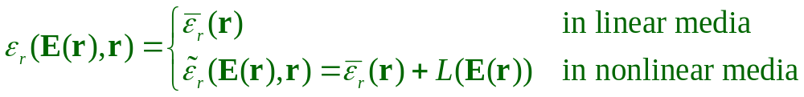
In this context, and without any loss of generality, we will consider materials exhibiting a nonlinearity only on the electrical permittivity and in the form:
Being L a generic operator on the intensity of the vector electric field E
In an inhomogeneously filled device

Slide 9
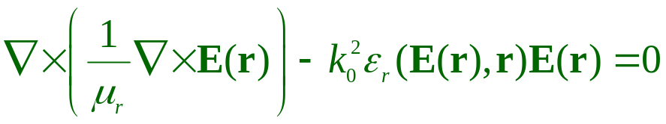
The wave equation to be solved is:
And the FE procedure cannot be applied due to the dependance of the permittivity with respect to the intensity of the electric field.
The solution is to assume a given initial value for such an intensity – usually 0 – to linearize the medium and solve the wave equation via conventional finite elements .

Slide 10

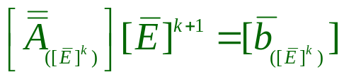

FEM
Sol
ve
Picard Iteration
Arthur Wouk On the Cauchy-Picard Method
The American Mathematical Monthly,
Vol. 70, No. 2 (Feb., 1963), pp. 158-162

Slide 11
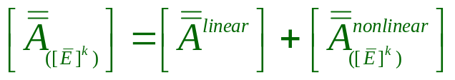
Even if matrix assembly can be made efficient by pre-calculating the linear part and by adding the nonlinear part within the iteration
BIG
Small
Solution must anyway be performed on the whole system at each iteration

Slide 12
A possible approach for problems which can benefit from the extraction and separate solution of a small portion of their domain is the Domain Decomposition.
G. Guarnieri, G. Pelosi, L. Rossi, S. Selleri, “A Domain Decomposition Technique for Finite Element Based Parametric Sweep and Tolerance Analyses of Microwave Passive Devices,” International Journal of RF and Microwave Computer Aided Engineering, Vol. 19, No. 3, May 2009, pp. 328-337.
G. Guarnieri, G. Pelosi, L. Rossi, S. Selleri, “A Domain Decomposition Techique for Efficient Approximate Solution of Nonlinear Electromagnetic Problems,” to appear on IEEE Transactions on Antennas and Propagation.
G. Guarnieri, G. Pelosi, L. Rossi, S. Selleri, “A new FEM/BEM domain decomposition approach for solving high diversity electromagnetic problems,” 8th International Workshop on Finite Elements for Microwave Engineering, 25-26 May 2006, Stellenbosh (Sud Africa), p. 60
G. Guarnieri, G. Pelosi, L. Rossi, S. Selleri, “Una tecnica di decomposizione del dominio per l’analisi agli elementi finiti delle tolleranze di fabbricazione in dispositivi passivi a microonde,” III giornata di studio Il Metodo degli Elementi Finiti nelle Applicazioni dell’Ingegneria Elettrica e dell’Informazione, 14 dicembre 2007, Roma.
S. Selleri, O. Farle, G. Guarnieri, M. Lösch, G. Pelosi, R. Dyczij-Edlinger, “Fast material parametric sweeps by exploiting a combined Domain-Decomposition-Model-Order-Reduction technique” XVII Riunione Nazionale di Elettromagnetismo, Lecce, September 15-18, 2008.

Slide 13
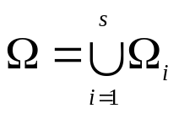
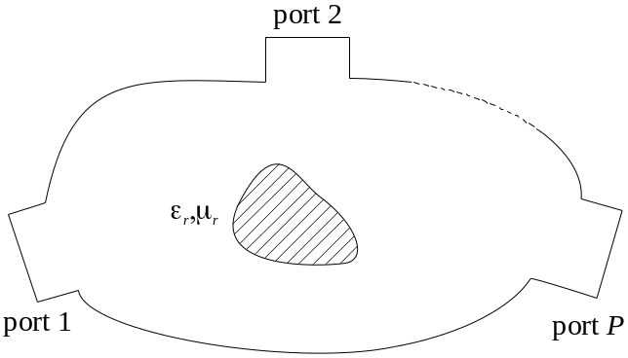
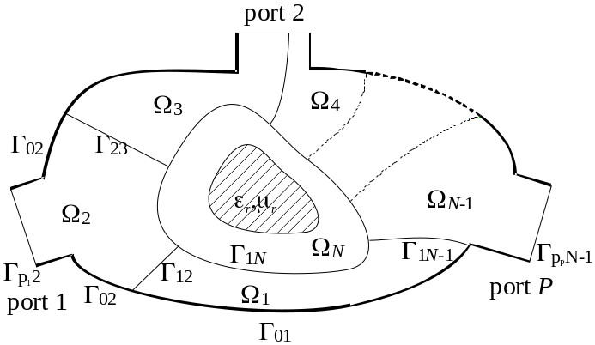
Let’s assume that the device domain Ω can be decomposed into a given number of non-overlapping sub-domains Ω_{i}
In each of these subdomains the FE method can be applied separately.

Slide 14
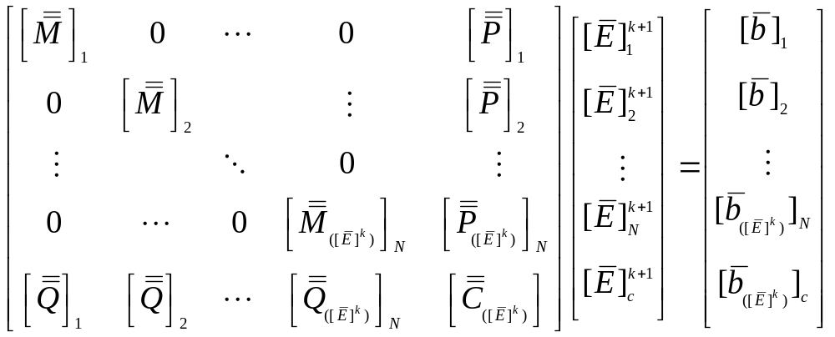
With an appropriate numbering scheme grouping all degrees of freedom pertaining to a given subdomain interior and altogether the degrees of freedom belonging to the domain boundaries the following linear system of equations can be attained:

Slide 15

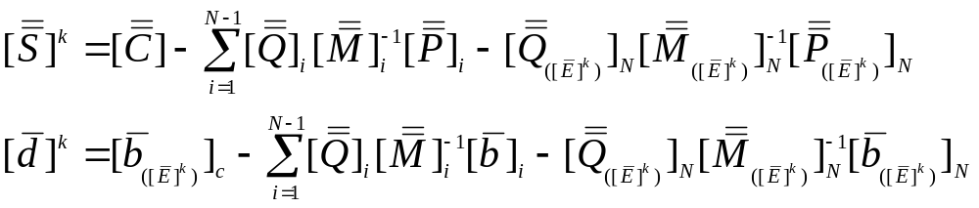
The system can be solved as a whole or by resorting to the Schur complement concept:
It is important to note that the Schur complement can be computed on a domain-by-domain basis as:
The Schur complement can hence be computed only once for all sub-domains except for the one containing the non-linearity.

Slide 16
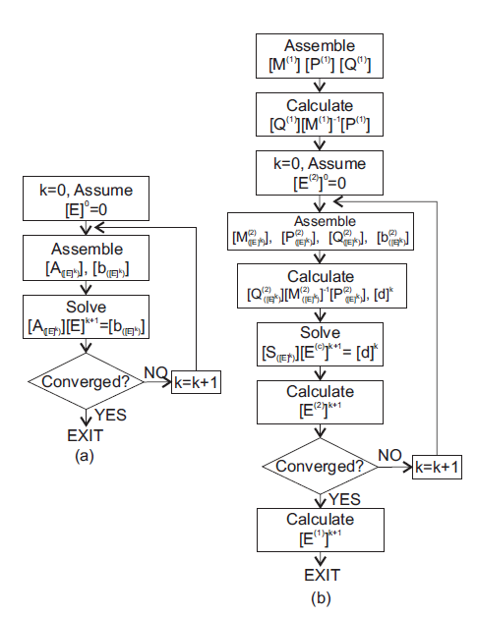
The implemented article is shown on the right, with a standard FE implementation on the left for comparison

Slide 17
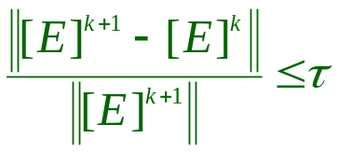
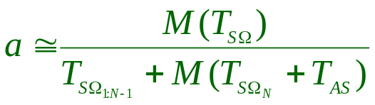
The iterative process is stopped when an appropriate convergence criterion is met:
A speed up for the process can then be defined by comparing the CPU time of the two algorithms.
Full system solution
“Nonlinear” Shur comp.
“Linear” Shur comp.
Linear System sol.
Matrix fill time not considered
Notes:
Important: explicit parameter dependence
Example: … if frequency dependence is included => polynomially parameterized system => numerical examples

Slide 18

Finally, the law governing the non linear behavior of the material is chosen, without any loss of generality for the code, to be of the Kerr type:
Jian-Guo Ma Investigating nonlinear propagation in dielectric slab waveguides,
IEEE Trans. Microwave Theory Techn.,
Vol. 45 (1997) pp. 304-306.
Notes:
Important: explicit parameter dependence
Example: … if frequency dependence is included => polynomially parameterized system => numerical examples

Slide 19
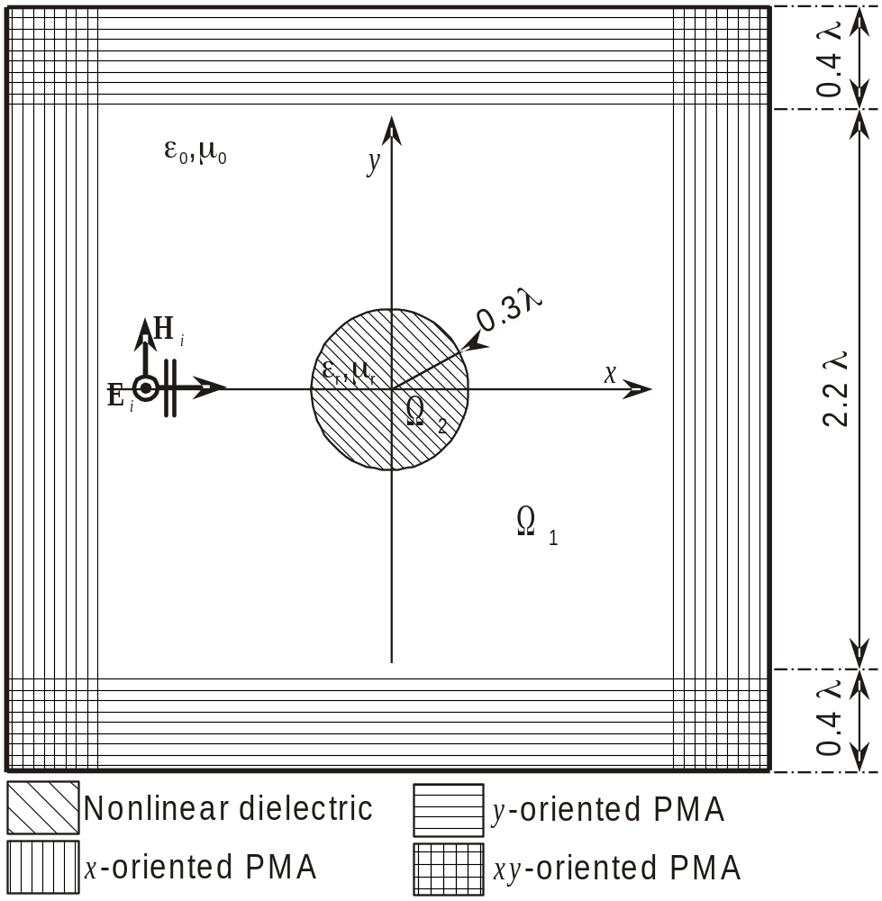
Scattering by a non-linear cylinder:

Slide 20
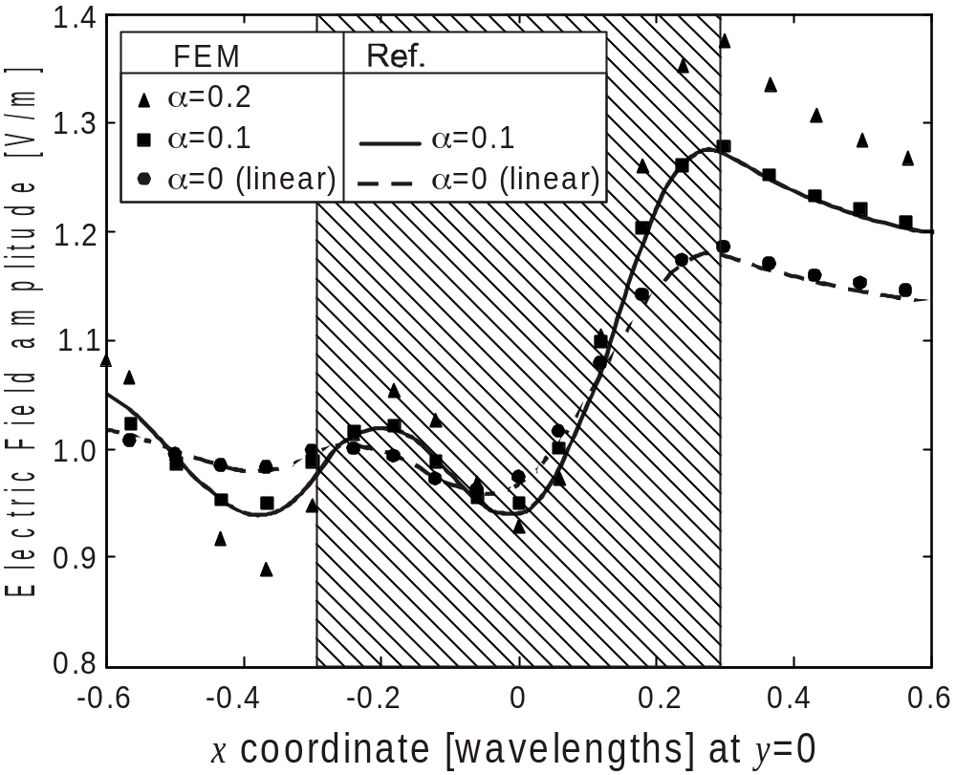
Validation
S. Caorsi, A. Massa, M. Pastorino, Approximate solutions to the scattering by nonlinear isotropic dielectric cylinders of circular cross sections under TM illumination,
IEEE Trans. Antennas Propagat.,
Vol. 43, no. 11, pp. 1262-1269, 1995..

Slide 21
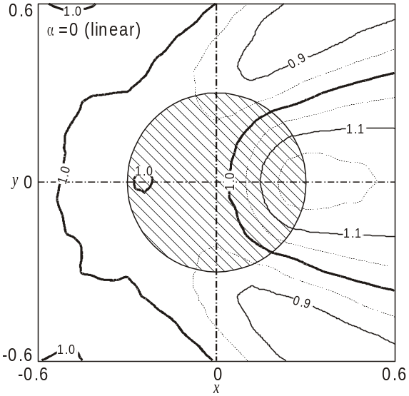
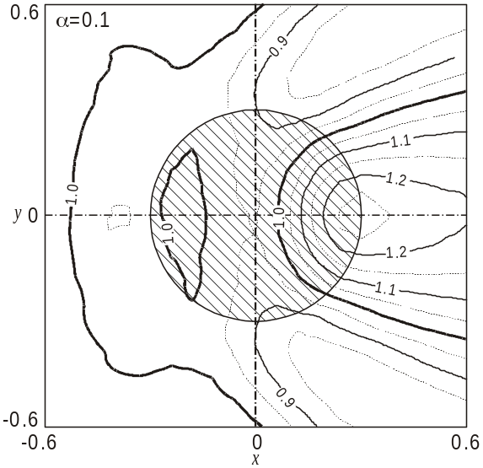
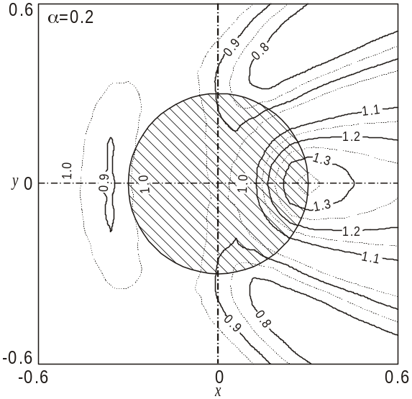
Fieldmaps

Slide 22
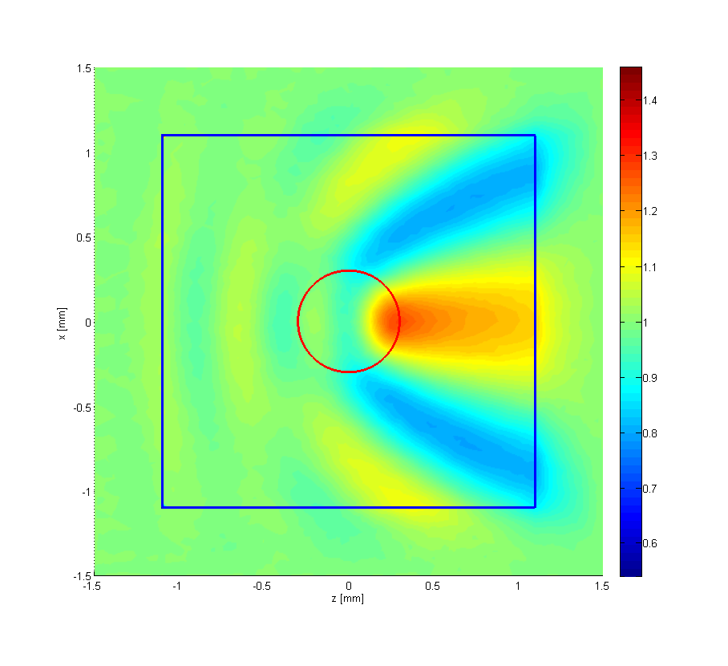
Fieldmaps (Colorful!) for α=0.1

Slide 23
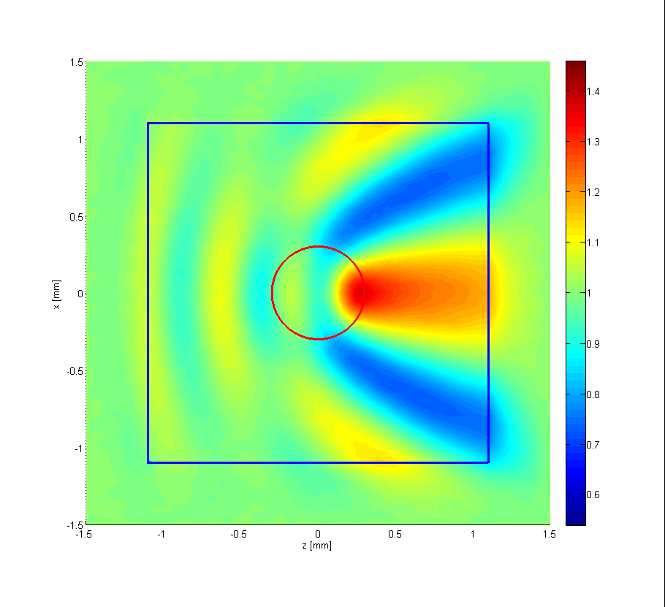
Fieldmaps (Colorful!) for α=0.2

Slide 24
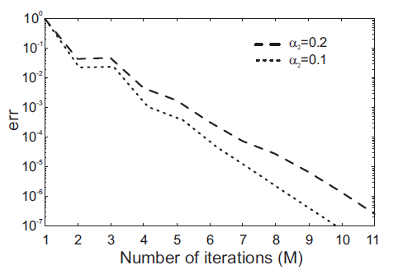
Convergence

Slide 25
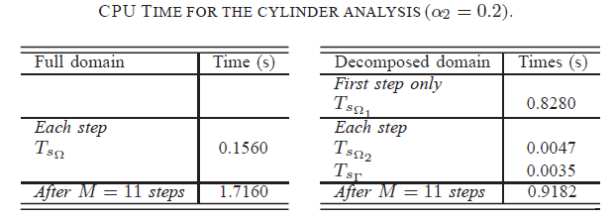
Speedups

Slide 26

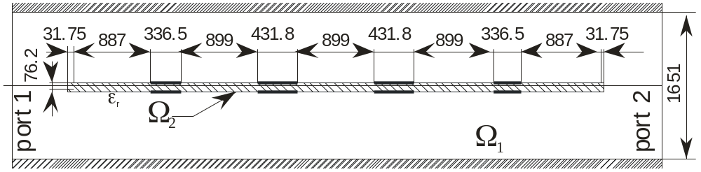
Microwave filter, WR6 rectangular waveguide.

Slide 27
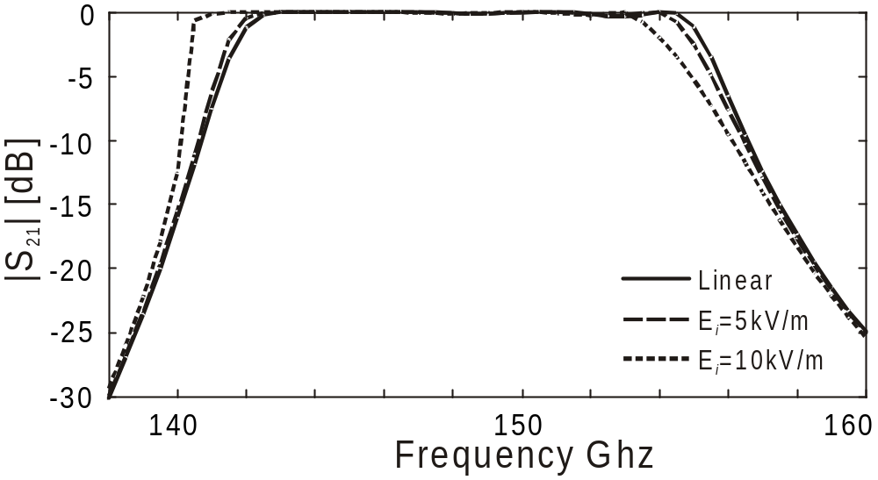
Microwave filter, WR6 rectangular waveguide.
Might looks a lot, but corresponding power in waveguide is 18mW and 72mW, respectiverly, Maximuim power in WR6 is in excess of few kW

Slide 28
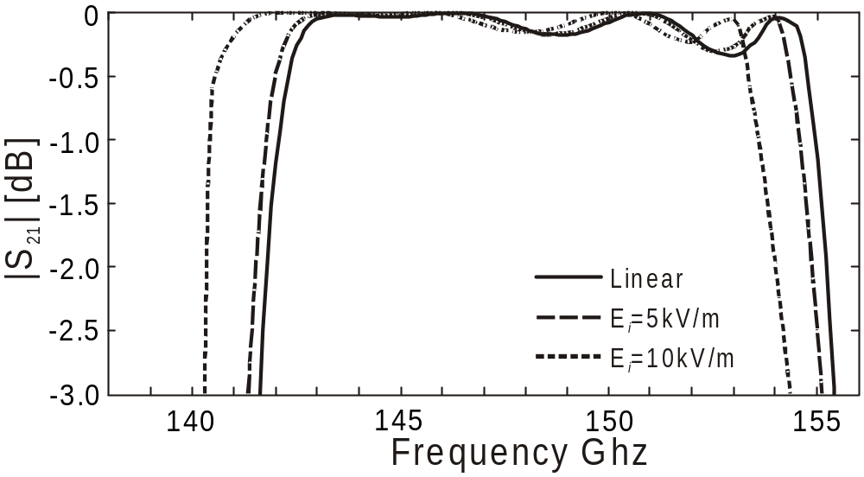
Microwave filter, WR6 rectangular waveguide (zoom).

Slide 29
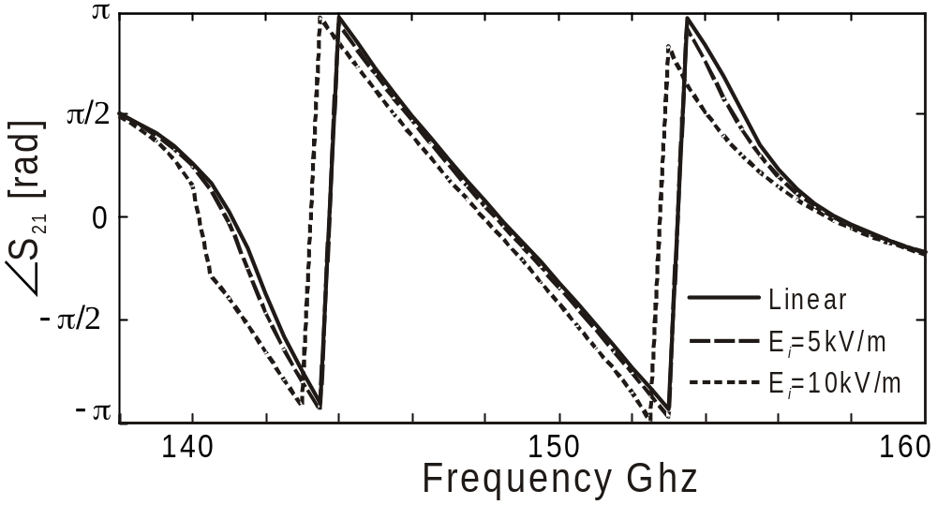
Microwave filter, WR6 rectangular waveguide (phase).

Slide 30
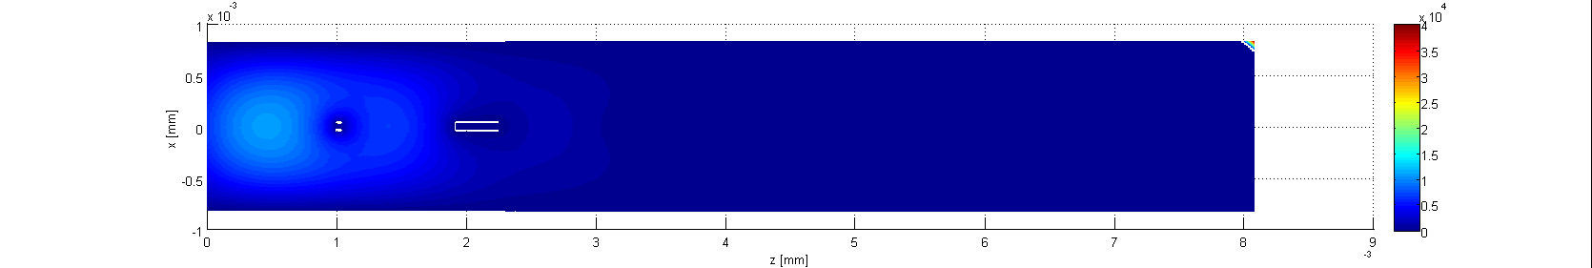
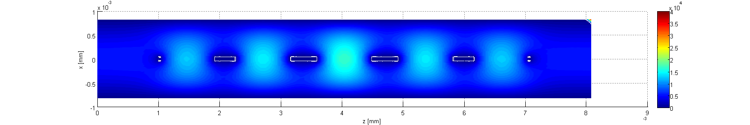
Stop (130GHz) and pass (146GHz) band at 5kV/m

Slide 31
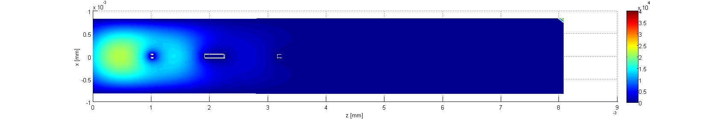
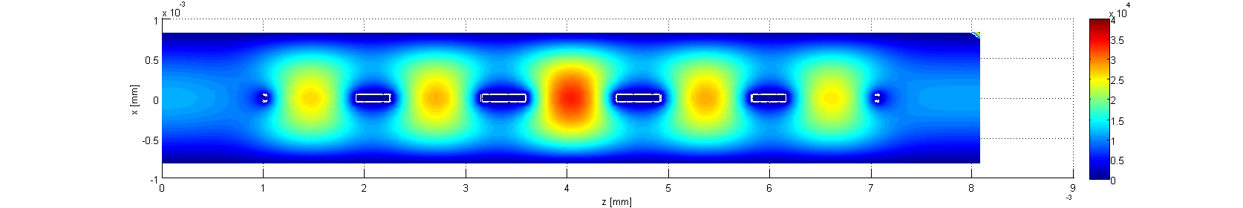
Stop (130GHz) and pass (146GHz) band at 10kV/m

Slide 32
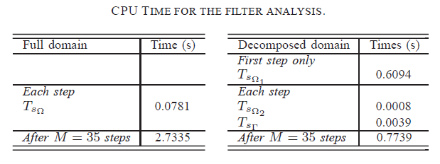
Speedups

Slide 33
Conclusions
A new DD-based approach to the numerical analysis of non-linear material has been presented.
The technique is based on the very efficient FE approach
With respect to a conventional full FE approach a substantial reduction of computing time is observed

