Slide 1
Harmonic Balance Domain Decomposition Finite Elements for Nonlinear Passive Microwave Devices Analysis
Laurent Ntibarikure, Giuseppe Pelosi, Stefano Selleri
Department of Electronics and Telecommunications
University of Florence
Via di S. Marta 3, Florence, I-50133, Italy
11th International Workshop on Finite Elements for Microwave Engineering – FEM2012
June 4-6, 2012, Estes Park, Colorado, USA

Slide 2
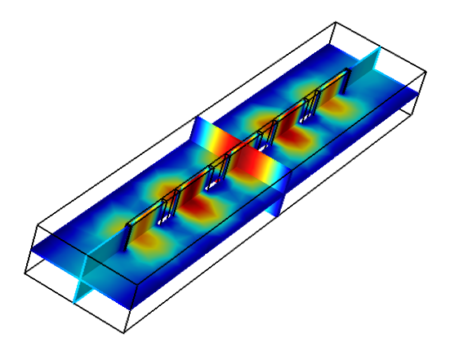
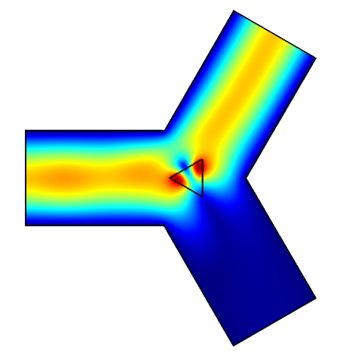
Outline
Motivation
Formulation
Harmonic Balance
Domain decomposition
Numerical experiments
Nonlinear permittivity
Nonlinear permeability
Conclusion

Slide 3
Motivation: The problem
When high power densities are involved within microwave devices, materials exhibit a significant nonlinear behavior:
If steady state fields are aimed at for a finite set of frequencies, a frequency domain analysis might be preferable to a time domain analysis
Frequency domain methods for solving nonlinear PDEs require an iterative solution and the inclusion of higher order harmonic to improve accuracy
Depending on the field intensities and the nonlinear operator that describes the material behavior, the nonlinear solving loop might be computationally expensive and, for extreme conditions, convergence might not be guaranteed

Slide 4
Motivation: Proposed methodology
Harmonic Balance
A multiharmonic finite elements formulation, the Harmonic Balance Finite Elements (HBFE), allows for the inclusion of higher order harmonics which are coupled by means of material characteristics
The HBFE approach also allows for passive intermodulation analysis (3rd order intermodulation products)
Domain Decomposition
For designs that include small parts of materials that present significant nonlinear behavior at high intensity fields, domain decompositions techniques might be used to restrict the nonlinear solving loop to fewer DoFs

Slide 5
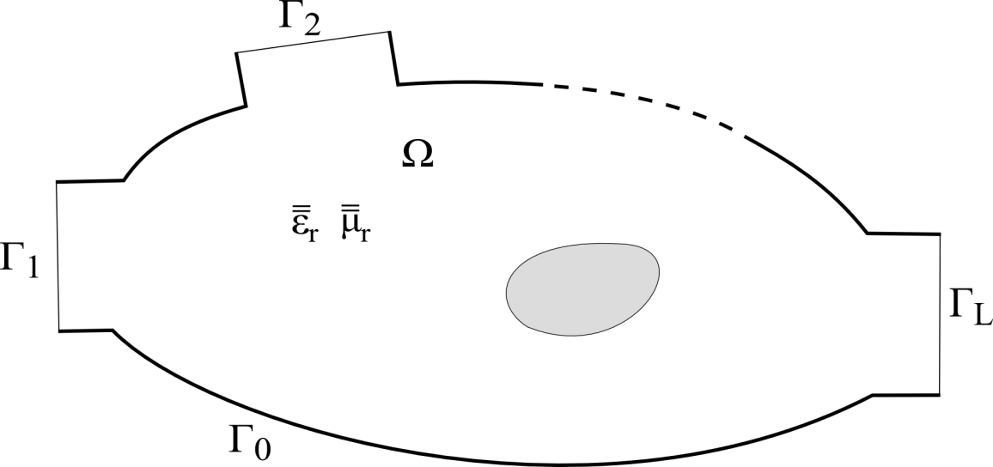
Formulation: Harmonic Balance Finite Elements
Conventional FE (single harmonic)
We wish to solve the vector Helmholtz equation
with perfect electric conditions on Γ₀ and modal port expansions on Γ_{l}, l=1…L.
The electric field is expanded in terms of basis functions and a Galerkin projection leads to a linear system of equations

Slide 6
Formulation: Harmonic Balance Finite Elements
Harmonic Balance FE (multiple harmonics)
The electric field is expressed as a sum of harmonic functions:
Materials permittivity or permeability is also expressed in terms of harmonic functions:
with
S. Yamada, K. Bessho, and J. Lu, “Harmonic balance finite element method applied to nonlinear AC magnetic analysis,” IEEE Trans. Magn., vol. MAG-25, no. 4, pp. 2971–2973, Jul. 1989
D. M. Copeland and U. Langer, “Domain decomposition solvers for nonlinear multiharmonic finite element equations,” J. Numer. Math., vol. 18, no. 3, pp. 157–175, Oct. 2010

Slide 7
Formulation: Harmonic Balance Finite Elements
Harmonic Balance FE (multiple harmonics)
With further Galerkin projection of the vector Helmholtz equation with the chosen harmonic functions (k₀=ω_{p}/c₀), a large scale HBFE system is obtained
The nonlinear solution is handled via a relaxed iteration, starting from a null solution vector to evaluate material properties
The convergence criterion is chosen on the basis of consecutive solutions:

Slide 8

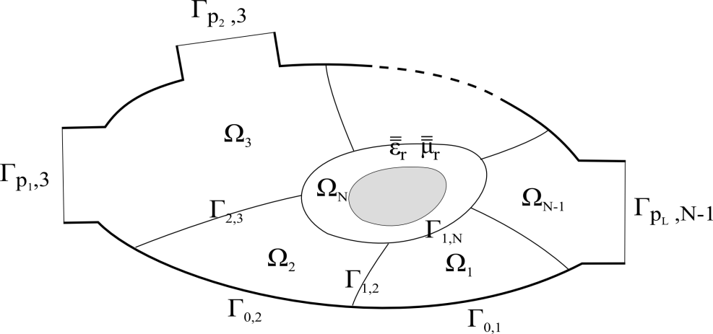
Formulation: Domain Decomposition
Let’s assume that the device domain Ω can be decomposed into a given number of non-overlapping sub-domains Ω_{i}
In each of these subdomains the FE method can be applied separately.
G. Guarnieri, G. Pelosi, L. Rossi, S. Selleri, “A Domain Decomposition Technique for Finite Element Based Parametric Sweep and Tolerance Analyses of Microwave Passive Devices,” Int. J. RF Microw. Comp. Aid. Eng., Vol. 19, No. 3, pp. 328-337, May 2009.

Slide 9
Formulation: Domain Decomposition
With an appropriate numbering scheme grouping all DoFs pertaining to a given subdomain interior and altogether the DoFs belonging to the domain boundaries the following linear system of equations can be attained:

Slide 10
Formulation: Domain Decomposition
The system can be solved as a whole or by resorting to the Schur complement concept:
It is important to notice that the Schur complement can be computed on a domain-by-domain basis as:
Thus, the Schur complement can be computed only once for all sub-domains except for the one containing the non-linearity.

Slide 11
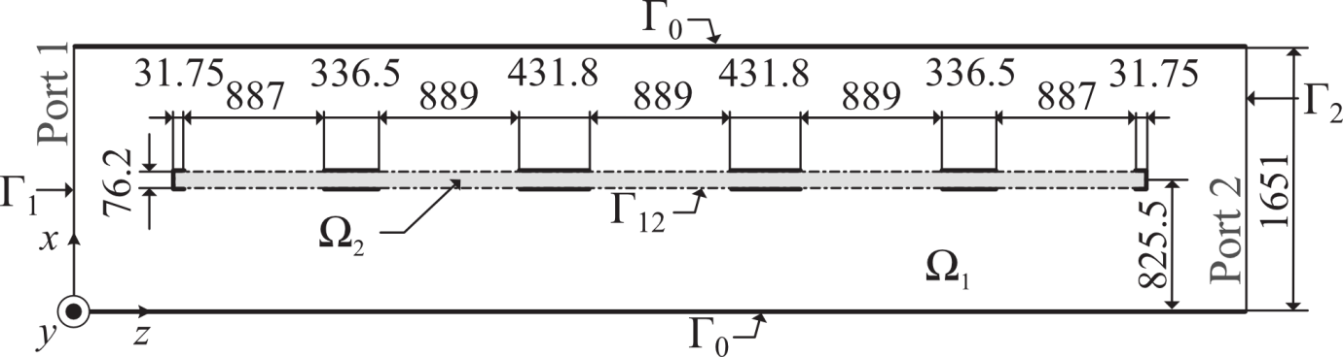
Numerical experiments: Nonlinear permittivity
Millimeter wave filter (revisited)
G. Guarnieri, G. Pelosi, L. Rossi, and S. Selleri, “A domain decomposition technique for efficient iterative solution of nonlinear electromagnetic problems,” IEEE Trans. Antennas Propag., vol. 58, no. 12, pp. 4090–4095, Dec. 2010.
Kerr-like permittivity of the dielectric slab:
Being the Helmholtz equation an elliptic PDE, no coupling between sine and cosine harmonic functions occurs. Either sine or cosine can be retained for field expansion of HBFE to halve matrices dimensions

Slide 12
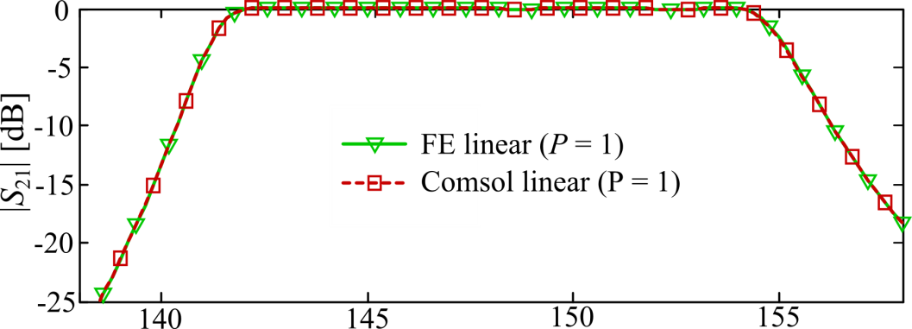
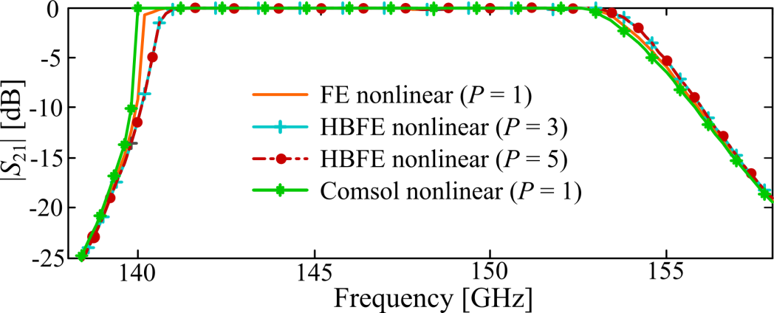

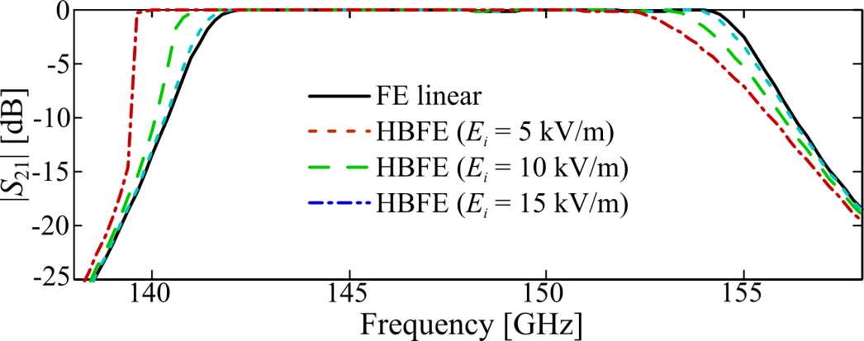
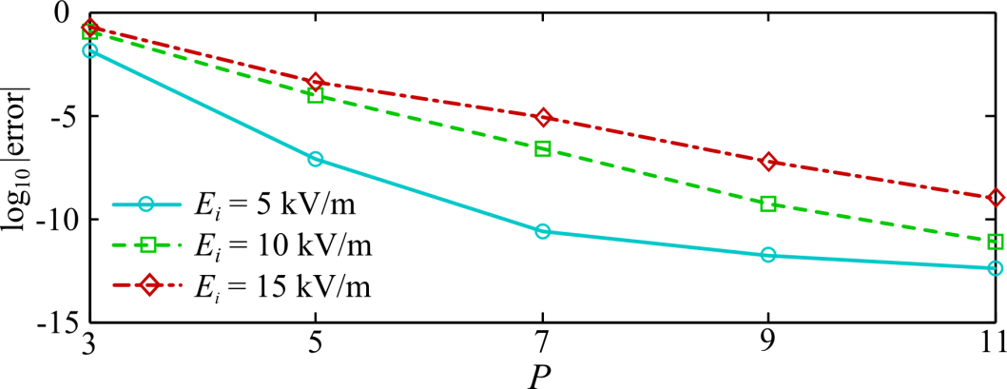
Numerical experiments: Nonlinear permittivity
Millimeter wave filter: linear and nonlinear frequency responses

Slide 13
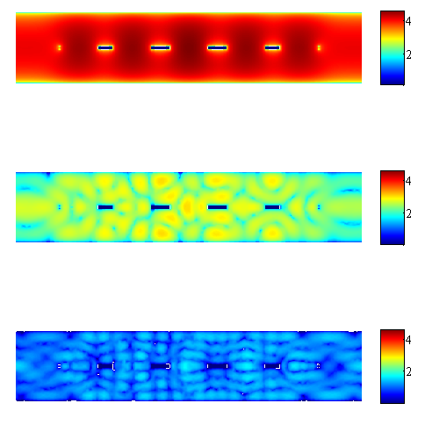
Numerical experiments: Nonlinear permittivity
Millimeter wave filter: higher order harmonic fields
|E| @ 150 GHz
|E| @ 450 GHz
|E| @ 750 GHz

Slide 14
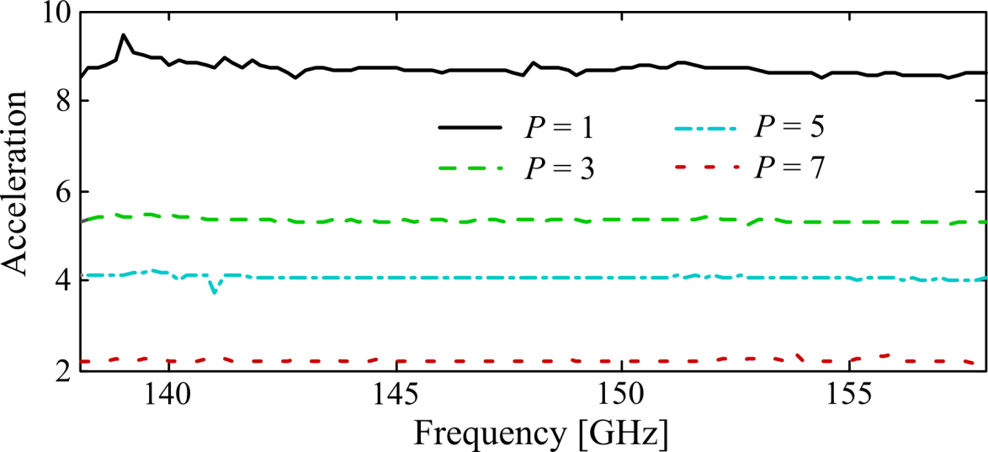
Numerical experiments: Nonlinear permittivity
Millimeter wave filter: DD acceleration
Test conditions: 94 out of 2473 DoFs (conventional FE) pertain to nonlinear media ~ 3.8%
L. Ntibarikure, G. Pelosi; S. Selleri, “Efficient Harmonic Balance Analysis of Waveguide Devices With Nonlinear Dielectrics,” IEEE Microw. Wireless Compon. Lett., vol.22, no.5, pp.221-223, May 2012

Slide 15
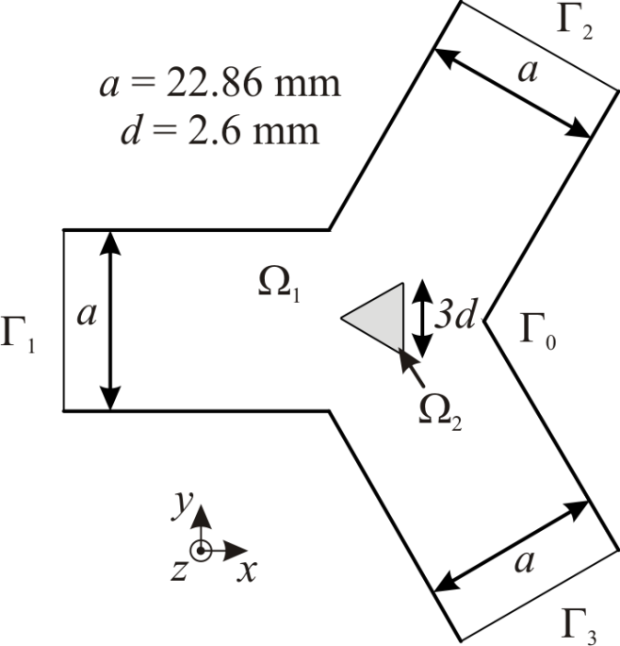
Numerical experiments: Nonlinear permeability
Microwave ferrite circulator: linear FE analysis
M. Koshiba and M. Suzuki, “Finite-Element Analysis of H-Plane Waveguide Junction with Arbitrarily Shaped Ferrite Post,” IEEE Trans. Microw. Theory Tech., MTT-34, no. 1, pp. 103–109, Jan. 1986.

Slide 16
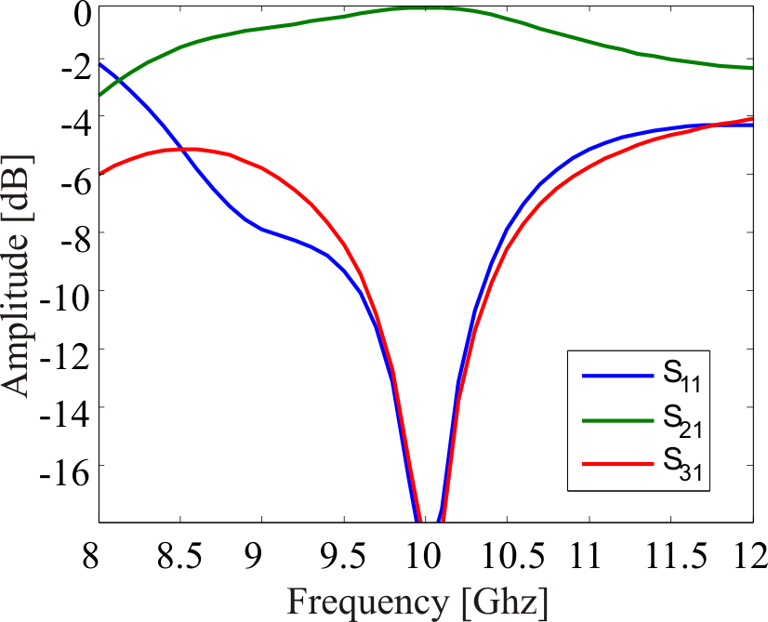
Numerical experiments: Nonlinear permeability
Microwave ferrite circulator: linear FE response
The internal DC out-of-plane magnetic field H₀ is
considered uniform

Slide 17
Numerical experiments: Nonlinear permeability
Microwave ferrite circulator: nonlinear permeability
To derive a nonlinear permeability of the ferrite at microwave frequencies, the total magnetic induction and field are given by:
The macroscopic equation of motion is
and expressing equation for each component of the magnetization in frequency domain

Slide 18
Numerical experiments: Nonlinear permeability
Microwave ferrite circulator: nonlinear permeability
By solving the previous system of equations, the following nonlinear relative permeability tensor is obtained:
Magnetic losses are added letting

Slide 19
Numerical experiments: Nonlinear permeability
Microwave ferrite circulator: HBFE for intermodulation products
Two signals at ω₁ and ω₂ impinging on the device are considered. The out-of-plane electric field is hence expressed in terms of harmonic functions as
and so will be the magnetic in-plane components.
Ferrite permeability is also expressed in terms of harmonic functions, with coefficients given by, for example for the diagonal ones of the permeability tensor:

Slide 20
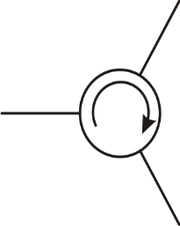
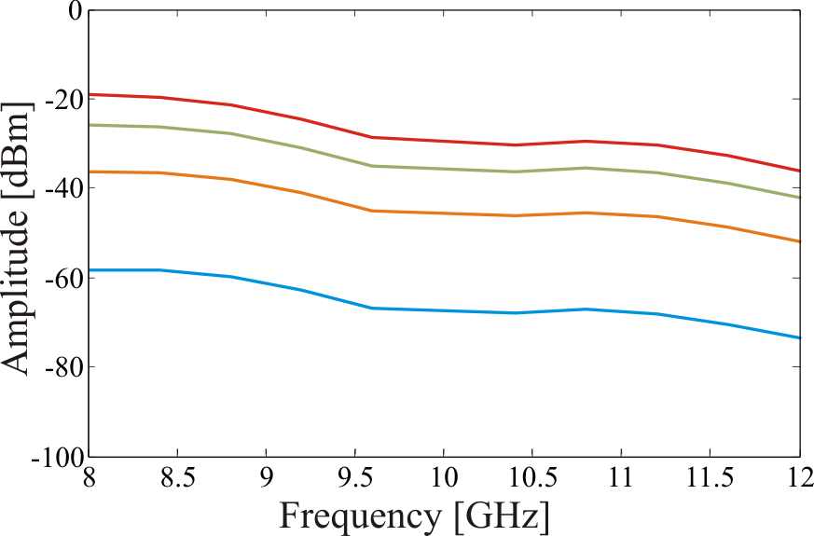
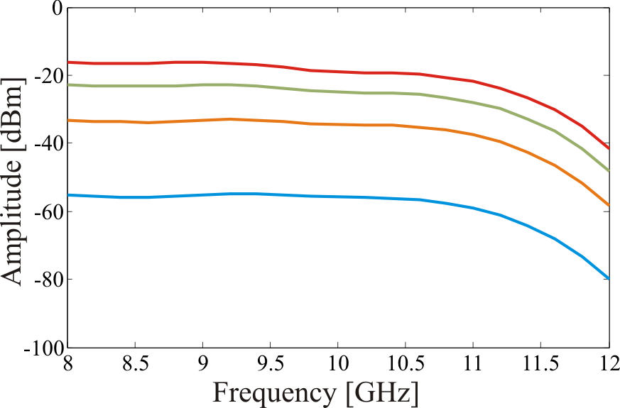
Numerical experiments: Nonlinear permeability
Microwave ferrite circulator: HBFE for intermodulation products
H. How, C. Vittoria and R. Schmidt, “Nonlinear intermodulation coupling in ferrite circulator junctions,” IEEE Trans. Microw. Theory Tech., MTT-45, no. 3, pp. 245–252, Feb. 1997.

Slide 21
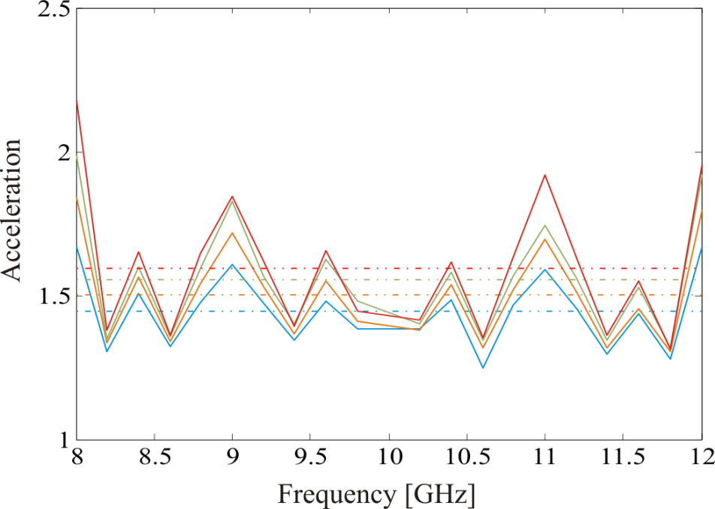
Numerical experiments: Nonlinear permeability
Microwave ferrite circulator: Domain decomposition
Depending on gcd(ω₁, ω₂), the FFT algorithm employed to perform the permeability harmonic expansion required different amount of times, leading to significantly variable spectral acceleration:
The mean acceleration has been found between 1.5 and 1.65 for the studied impinging power cases

Slide 22
Conclusions
A Harmonic Balance Finite Element technique has been presented for solving the wave equation in presence of nonlinear media
A substructuring domain decomposition technique have been employed to restrict the nonlinear solving loop to fewer DoFs, leading to noticeable acceleration

