Slide 1
Finite element analysis of wideband nanostructures
for photovoltaic applications
Niccolò Breda, Giuseppe Pelosi, Stefano Selleri, and Ruggero Taddei
Department of Electronics and Telecommunications, University of Florence,
Via di S. Marta 3, 50139, Florence, Italy
11th International Workshop on Finite Elements for Microwave Engineering – FEM2012
June 4-6, 2012, Estes Park, Colorado, USA

Slide 2
Introduction
Objectives:
  Increase the efficiency of a solar cell through nanostructures, capable of triggering plasmonic resonances
  Extend the resonant bandwidth of such nanostructures

Slide 3

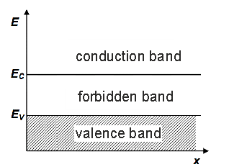
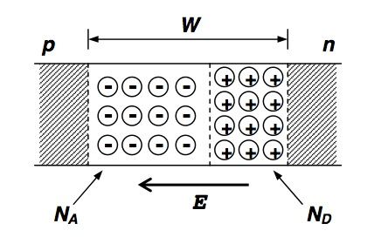
Photovoltaic Effect
When light is striking over a semiconductor layer, a certain number of electrons passes from the valence band to the conduction band; at the same time an equal number of holes cover the opposite path, reaching the valence band (photoelectric effect).
Only the impinging photons with an energy greater than the bandgap
are capable of triggering interband transitions, hence actively foraging the energy conversion process
In the presence of an electric field within the layer, free carriers generated with this process can be exploited to produce a current density.
Electric field in a p-n junction is generated via spontaneous electron-hole recombinations
As a result, a depletion region is formed. A built-in electric field is associated with this region

Slide 4
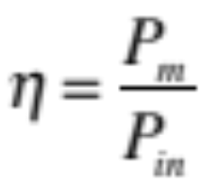


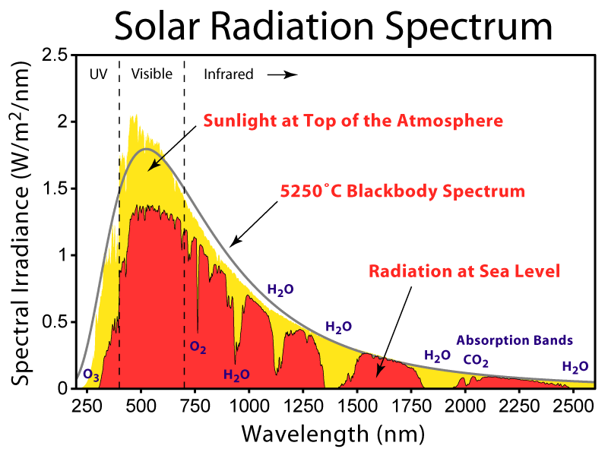

Conversion Efficiency
Quantifies the amount of power converted by a solar cell when it is connected to an electric circuit, and in maximum power transfer conditions.
is the power transferred to the load
is the impinging spectral power density

Slide 5
Three generations of Solar Cells
First and Second Generation Solar Cells
Conventional p-n junctions (1st gen)
Thin film solar cells (2nd gen)
Theoretical limit on efficiency at 33.7 %,
due to the difference in energy between the bandgap of the substrate (usually silicon) and solar photons
High manufacturing cost for1st gen
Lower cost and flexibility for 2nd gen, but associated with lower efficiency
Third Generation Solar Cells
No need for a sylicon-based substrate, hence no theoretical limit on efficiency
Many possibilities currently under investigation, in cluding polymer solar cells, nanocrystalline cells, and dye-sensitized solar cells
Objectives: low-cost, high efficiency

Slide 6
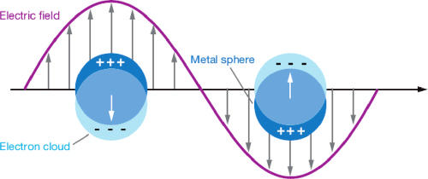
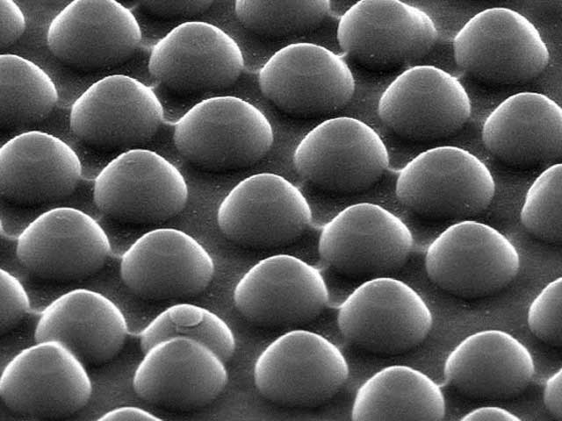
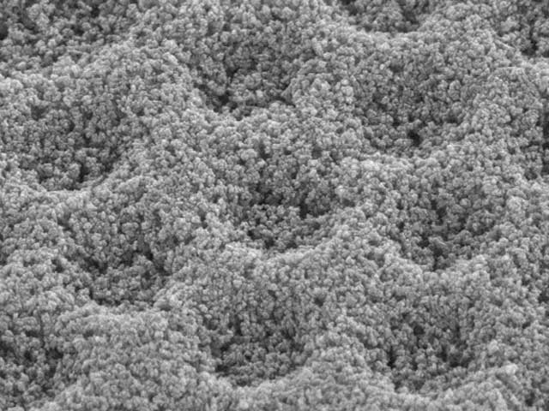
“Plasmonics”
An innovative approach in the pursuit of an increment in the total conversion efficieny of conventional semiconductor solar cells is emerging. It consists in the exploitation of a deposition of metal nanoparticles over the semiconductor layer, capable of triggering a localized surface plasmon resonance.
Localized surface plasmons (LSP):
Collective oscillations of the electrons in a metal, associated with a great increment of the electromagnetic field in the vicinity of the particle

Slide 7
Frequency behavior of metals
Microwaves:
metals are reflective: propagation through them is not possible. The perfect electric conductor (PEC) approximation is valid.
Near Infrared and Visible:
penetration of the field into the metal increases, despite the high levels of dispersion
Ultraviolet:
metals acquire dielectric behavior and propagation through them is possible.
Noble metals like gold and silver have their plasma frequency in this range, hence they exhibit a resonant behavior

Slide 8
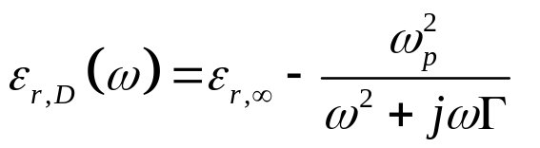
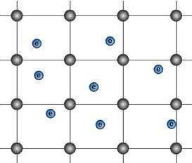

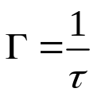
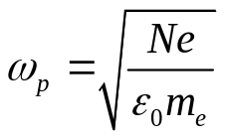
Drude Model- 1
Electromagnetic properties of metals have been expressed by the German physicist P.K.L. Drude with a complex dielectric function, derived from a modified plasma model of the metal; at optical frequencies the metal is modeled as a fixed lattice of positive charges, surrounded by a gas of free electrons:
where is the complex permittivity at infinite frequencies,
is the damping rate of the material, defined as the reciprocal of the relaxation time of the electron gas τ, defined as the mean free time between two electron-lattice collisions and
Is the plasma frequency of the electron gas, N is the electron density, e is the electron charge, m_{e} is the electron mass

Slide 9
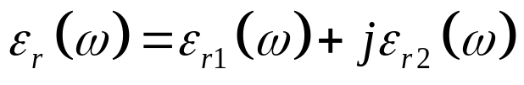
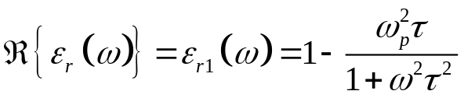
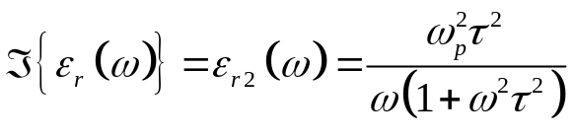


Drude Model- 2
Making explicit the real and imaginary of the complex permittivity:
The dielectric function is mostly real, hence propagation is possible through the metal
The dielectric function is mostly imaginary, hence a damping mechanism occurs: no propagation through the metal at frequencies below the plasma frequency

Slide 10
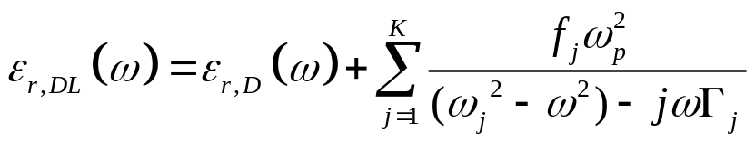

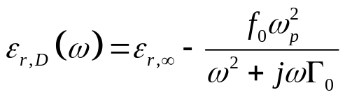
Drude-Lorentz Model
The simple Drude model does not take into account the interband transitions which occur
in metals at frequencies above the plasma one.
The Drude-Lorentz model, which consists in the addition of K Lorentzian terms, corresponding to K damped
harmonic oscillators used to describe the small resonances observed in the metal’s frequency response,
Is instead capable of achieving a more accurate modeling of the permittivity at optical frequencies
where are the resonance frequency, strength and damping frequency, respectively , of the k-th oscillator,
and the simple Drude model can be viewed as

Slide 11
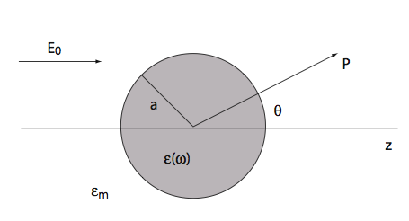


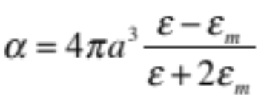

Localized Surface Plasmons (LSP)
Localized Surface Plasmons are nonpropagating excitations of the conduction electrons of metallic nanostructures coupled to the electromagnetic field, which arise naturally from the scattering problem of small, subwavelength conductive nanoparticles in an oscillating electromagnetic field
If , there is no phase variation of the field within the sphere.
Hence an electrostatic approximation is possible. Under these circumstances, the nanoparticle acts as an electric dipole, resonantly absorbing and scattering electromagnetic fields
The plasmonic resonance occurs when the Frölich condition is met
Which corresponds to a great value of the polarizability
And hence to a great value of the magnitude of the polarization intensity

Slide 12
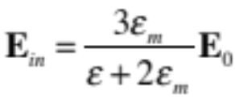
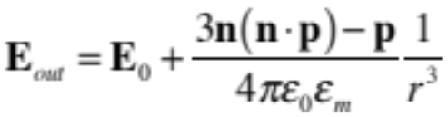
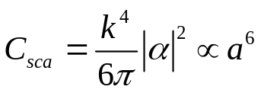


Localized Surface Plasmons (LSP)
At the plasmonic resonance the electric field inside and outside the nanoparticle is greatly enhanced, and so does the efficiency with which a metal nanoparticle scatters and absorbs light
Scattering and Absorption cross-section:
dominant for small particles
Ten to one-hundred-fold increments of the electric field are reported in literature
Internal electric field
External electric field

Slide 13
Mie Theory
For particles with radius below 200 nm, illuminated with visible or near-infrared radiation, the quasi-static approximation holds
For particles of larger dimensions the electrostatic approximation is not justified due to significant phase-changes of the driving field over the particle volume.
Mie developed a theory about scattering and absorption of electromagnetic radiation by a metallic sphere of arbitrary radius
It consists in an expansion of the internal and scattered fields into a set of normal modes described by vector spherical harmonics. The quasi-static results valid for sub-wavelength spheres are then recovered retaining only the first term.

Slide 14
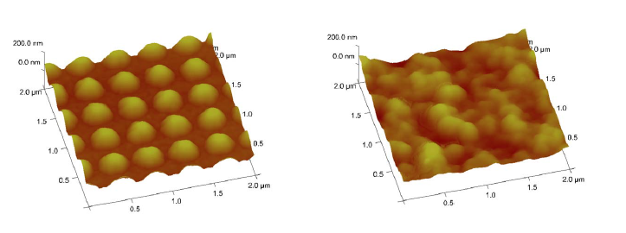
Spherical Nanoparticle Deposition
The properties of a structure composed by a deposition of metallic nanoparticles over a silicon substrate
Regular (periodic array) deposition opposed to random deposition
Investigation inspired by Polman’s work, where a solar cell composed by a periodic deposition of nanoparticles is compared to a randomly patterned one

Slide 15
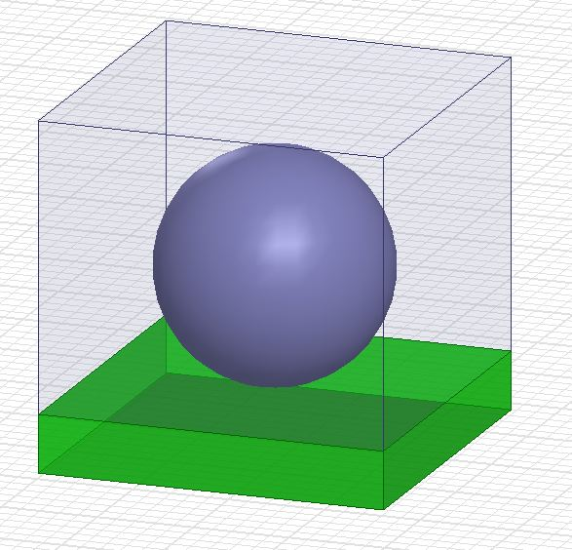
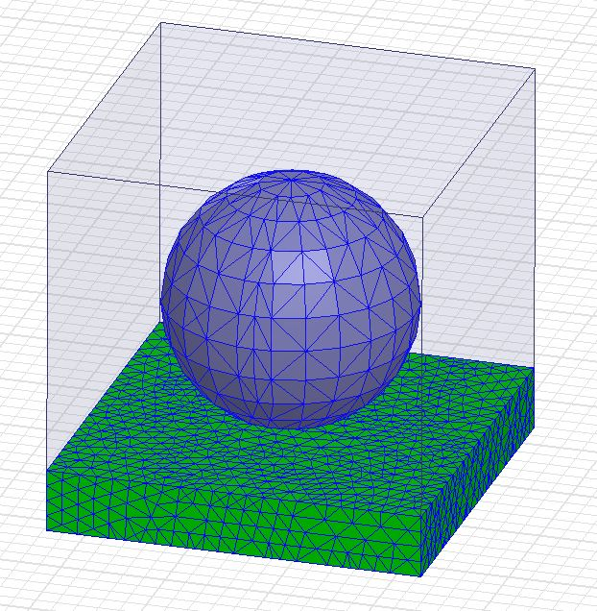
FEM
Finite Element Setup – Unit Cell
50000+ tetrahedra
First Order Basis Functions
Floquet Port
Master/Slave boundaries

Slide 16
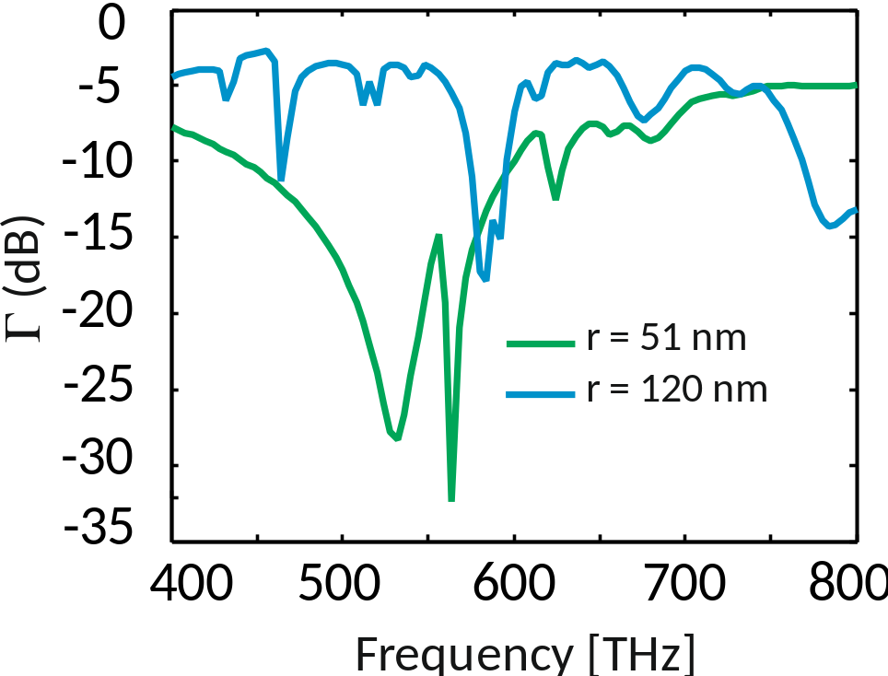
Spherical Nanoparticles – deterministic deposition
Regular periodic deposition – particle radiuses chosen after parametric analysis in the [30 – 150] nm range
Dimensions of the periodic cell are related to the particle ones
Silver– Drude-Lorentz model
Absorption
Silicon – Drude-Lorentz model

Slide 17
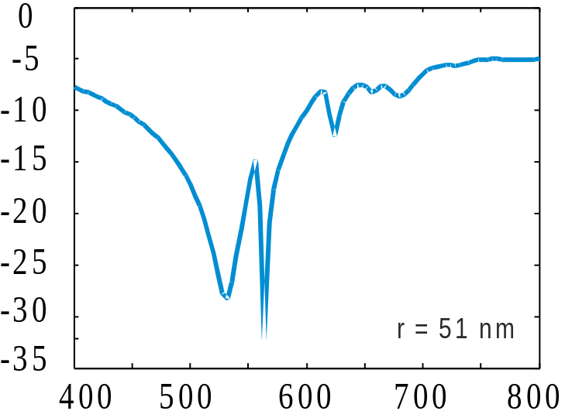
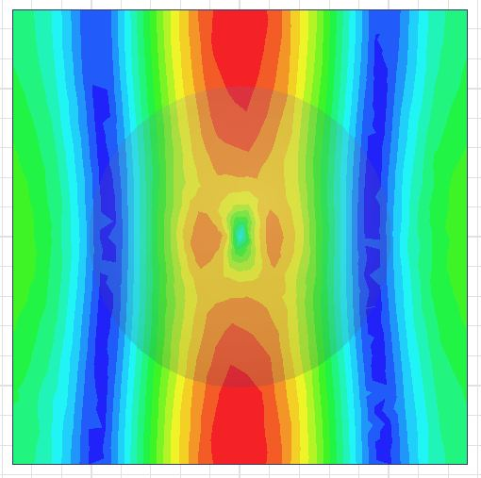
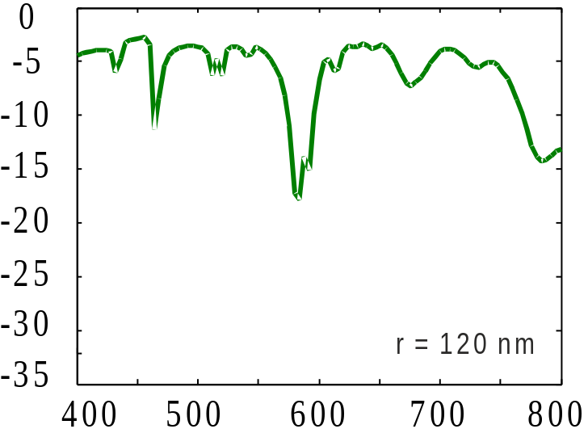
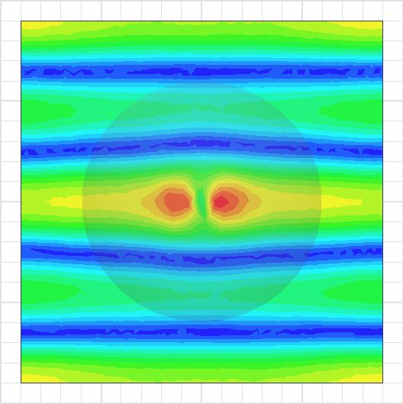
Spherical Nanoparticles – deterministic deposition
Radius: 51nm
Mean absorption : - 9.47 dB
Field enhancement @ 564 THz
Radius: 120nm
Mean absorption : -5.53 dB
Field enhancement @ 584 THz

Slide 18
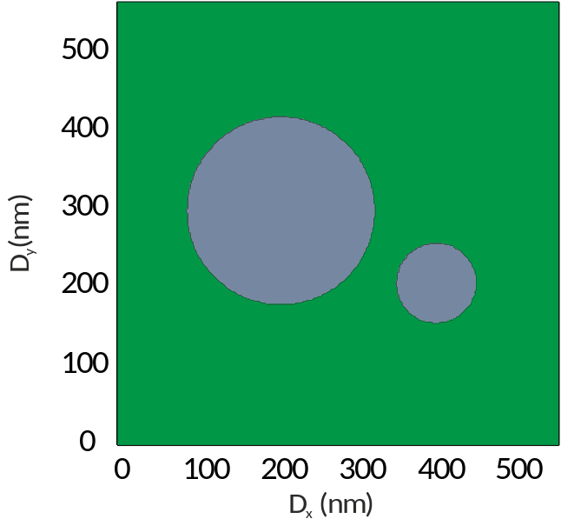
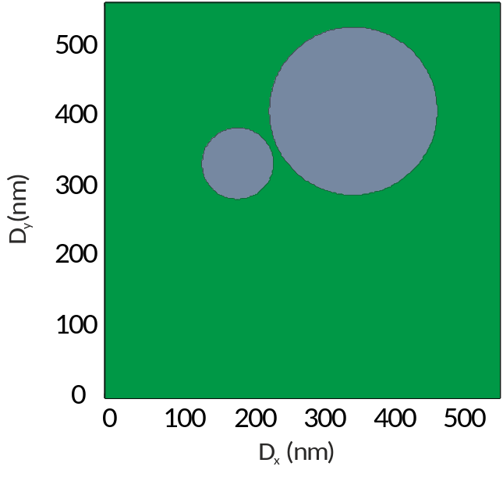
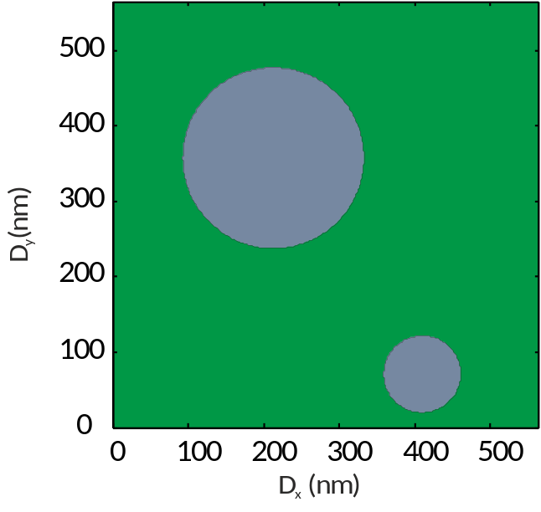
Spherical Nanoparticles – random deposition
Using particle diameters previously selected, a great number of two-particles deposition configurations has been simulated.
Particle depositions have been chosen in a random fashion, with the same FE setup as before, only with a fixed-dimensions unit cell.

Slide 19
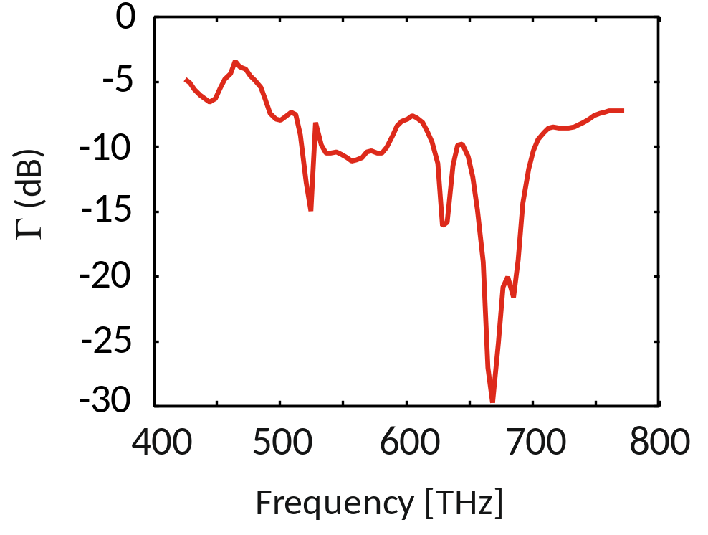
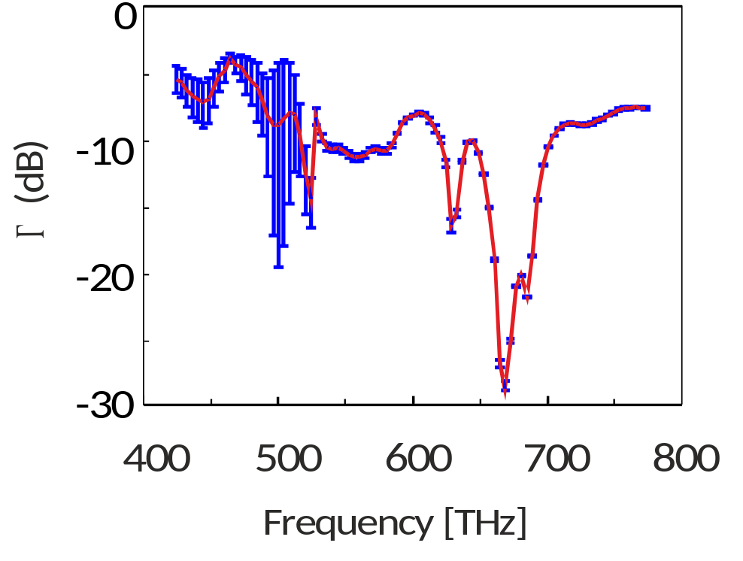
Spherical Nanoparticles – random deposition
Results
Mean absorption
Error bar
Mean absorption over the frequency range: -9.28 dB
Comparable absorption with the periodic array case

Slide 20

Conclusions
FEM simulations have shown that combining particles with different dimensions, and hence different resonance frequencies, it is possible to achieve a good absorption
…

