Slide 1
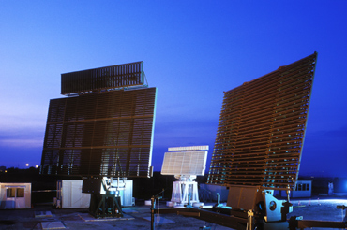

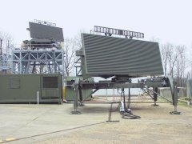
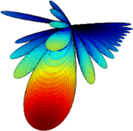
Fast phased array pattern computations
Need for fast and accurate prediction of large phased array antennas pattern in front of a beamsteering process:
Finite elements (FE) with geometric multigrid preconditioned iterative solvers are employed for near field computations (including antennas coupling, dielectric losses, etc.)
Near field to far field transformation (N2F): Stratton-Chu formulas for pattern computation using a Fourier approximation (FFT)
A projection-based model order reduction (MOR) allows for significant pattern computations speedup

Slide 2
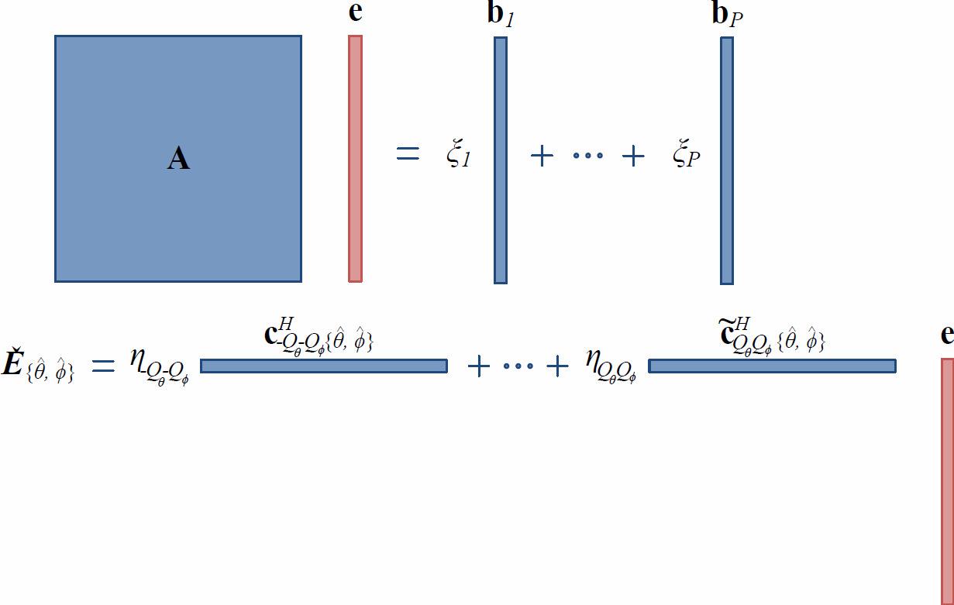
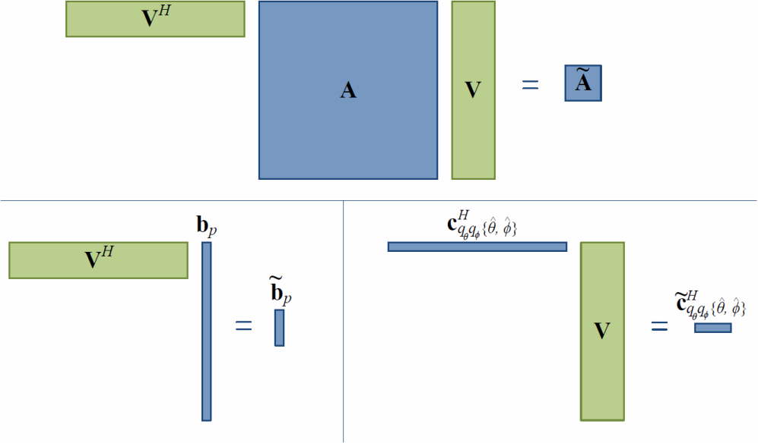
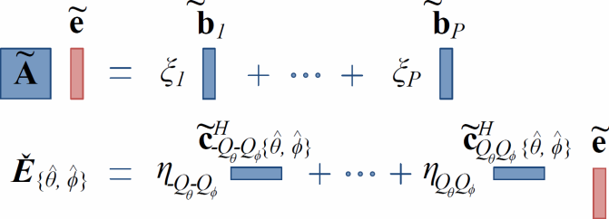
Radiation Model
Full radiation system
Projection-based MOR: V is a collection of P linearly independent solutions for different scan angles (θ_{s},ϕ_{s})
Complex weighting at ports excitations
FE
N2F
Reduced order radiation system

Slide 3
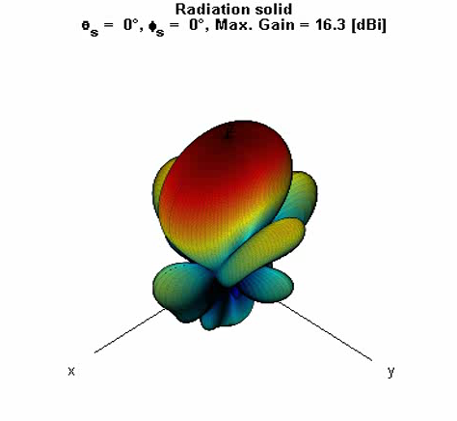
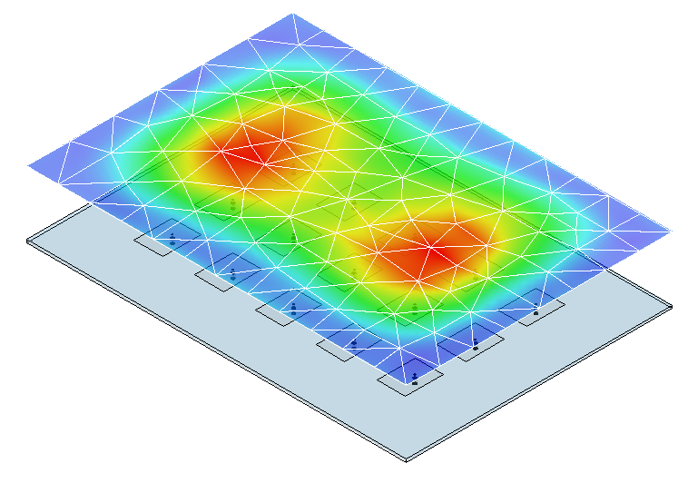
Numerical results for 3x5 patch antennas array
Rank(V) = 15 (n° of antennas)
n° of DoFs: 358' 648 → 15
Memory usage: 625 MB → 1.5 MB
MOR error: ε ≤ 10⁻¹¹
2D-DFT truncation error: ε_{n2f} ≤ 10⁻⁴
≈ 0.01 dB max. gain error
Whole movie:
for HFSS (commercial package) 10 h 20 min
for the full parameterized model: 1 min 3 s
for the reduced parameterized model: 8 s

