Slide 1
Harmonic Balance Finite Element Analysis of Third Order Intermodulation Products in Ferrite Devices
Laurent Ntibarikure, Giuseppe Pelosi, Stefano Selleri
Department of Electronics and Telecommunications (DET), University of Florence
Via di Santa Marta 3 - 50139 - Florence, Italy

Slide 2
Outline
Motivation
Formulation
Harmonic Balance Finite Elements for nonlinear microwave devices
Numerical experiment
H-plane nonlinear analysis of rectangular waveguide ferrite circulator
Conclusions

Slide 3
Motivation: The problem
When high power densities are involved within microwave devices, materials exhibit a significant nonlinear behavior:
If steady state fields are aimed at for a finite set of frequencies, a frequency domain analysis might be preferable to a time domain analysis
Frequency domain methods for solving nonlinear PDEs require an iterative solution and the inclusion of higher order harmonics to improve accuracy

Slide 4
Motivation: Proposed methodology
Harmonic Balance Finite Elements:
A multiharmonic finite elements formulation, the Harmonic Balance Finite Elements (HBFE), allows for the inclusion of higher order harmonics which are coupled by means of material characteristics
The HBFE approach allows for passive intermodulation analysis (3rd order intermodulation products)

Slide 5
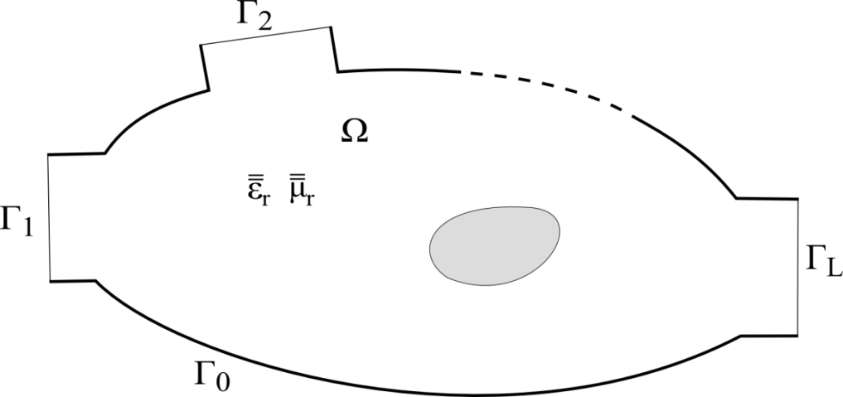
Formulation: Conventional Finite Elements (Single Harmonic)
We wish to solve the vector Helmholtz equation
with
perfect electric conditions on Γ₀
modal port expansions on Γ_{l}, l=1…L.

Slide 6
Formulation: Conventional Finite Elements (Single Harmonic)
The electric field is expanded in terms of basis functions:
Galerkin projection leads to a linear system of equations:

Slide 7
Formulation: Harmonic Balance FE (Multiple Harmonics)
The electric field is expressed as a sum of harmonic functions:
where
S. Yamada, K. Bessho, and J. Lu, “Harmonic balance finite element method applied to nonlinear AC magnetic analysis,” IEEE Trans. Magn., MAG-25, no. 4, pp. 2971–2973, Jul. 1989
D. M. Copeland and U. Langer, “Domain decomposition solvers for nonlinear multiharmonic finite element equations,” J. Numer. Math., vol. 18, no. 3, pp. 157–175, Oct. 2010

Slide 8
Formulation: Harmonic Balance FE (Multiple Harmonics)
Materials permittivity or permeability is also expressed in terms of harmonic functions:
with

Slide 9
Formulation: Harmonic Balance FE (Multiple Harmonics)
With further Galerkin projection of the vector Helmholtz equation with the chosen harmonic functions (k₀=ω_{p}/c₀), a large scale HBFE system is obtained

Slide 10
Formulation: Harmonic Balance FE (Multiple Harmonics)
The nonlinear solution is handled via a relaxed iteration, starting from a null solution vector to evaluate material properties
The convergence criterion is chosen on the basis of consecutive solutions:

Slide 11
Numerical experiment: Linear microwave ferrite circulator
For H-plane uniformity
Thus, vector formulation can be treated as scalar:

Slide 12
Numerical experiment: Linear microwave ferrite circulator
M. Koshiba and M. Suzuki, “Finite-Element Analysis of H-Plane Waveguide Junction with Arbitrarily Shaped Ferrite Post,” IEEE Trans. Microw. Theory Tech., MTT-34, no. 1, pp. 103–109, Jan. 1986.

Slide 13
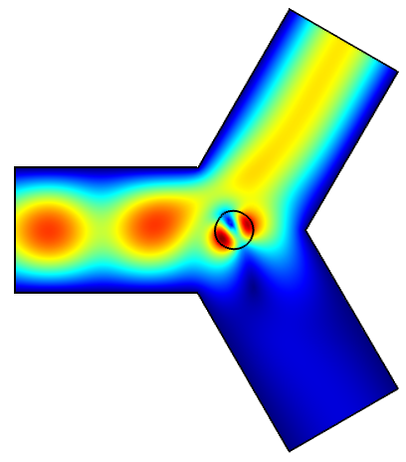
Numerical experiment: Linear microwave ferrite circulator
The internal DC magnetic field H₀ , out-of-plane directed, is considered uniform within the TT1-109 ferrite post

Slide 14
Numerical experiment: Nonlinear microwave ferrite circulator
To derive a nonlinear permeability of the ferrite at microwave frequencies, the total magnetic induction and field are given by:
The macroscopic equation of motion is
and expressing equation for each component of the magnetization in frequency domain:

Slide 15
Numerical experiment: Nonlinear microwave ferrite circulator
By solving the previous system of equations, the following nonlinear relative permeability tensor is obtained:

Slide 16
Numerical experiment: Nonlinear microwave ferrite circulator
Two signals at ω₁ and ω₂ impinging on the device are considered. The out-of-plane electric field is hence expressed in terms of harmonic functions as
and so will be the magnetic in-plane components.

Slide 17
Numerical experiment: Nonlinear microwave ferrite circulator
Ferrite permeability is also expressed in terms of harmonic functions, with coefficients given by, for example for the diagonal ones of the permeability tensor:
with
and

Slide 18
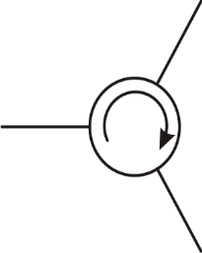
Numerical experiment: Nonlinear microwave ferrite circulator

Slide 19
Numerical experiment: Nonlinear microwave ferrite circulator
H. How, C. Vittoria and R. Schmidt, “Nonlinear intermodulation coupling in ferrite circulator junctions,” IEEE Trans. Microw. Theory Tech., MTT-45, no. 3, pp. 245–252, Feb. 1997.

Slide 20
Conclusions
A Harmonic Balance Finite Element technique has been presented for solving the wave equation in presence of nonlinear media
Third order intermodulation products within a nonlinear ferrite circulator have been evaluated, in good agreement with the reported litterature

