Slide 1
Design of Circular Corrugated Horn
with Constant Width Corrugations
Leonardo Lucci¹, Renzo Nesti², Giuseppe Pelosi¹, Stefano Selleri¹
¹Department of Electronics and Telecommunications (DET), University of Florence
via C. Lombroso 6/17 - 50134 - Florence, IT
²Arcetri Astrophysical Observatory - National Institute for Astrophysics
Largo Enrico Fermi, 5 - 50125 - Florence, IT

Slide 2
Outline
Introduction
Aperture antennas for space applications
Lens Antennas and high aperture efficiency
Horn antennas as lens elements
Conflicting goal optimization
Multi-Objective Formulation
Numerical results
Conclusions

Slide 3
State of the art satellite communications requires:
  High efficiency antennas
  Multibeam capabilities
  Reduced dimensions and weight
  Fault-tolerant antennas
  Reconfigurable antennas

Slide 4
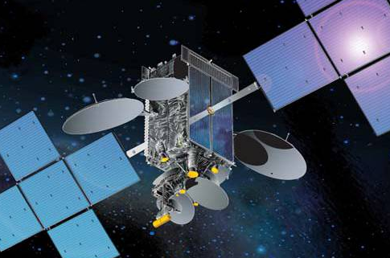
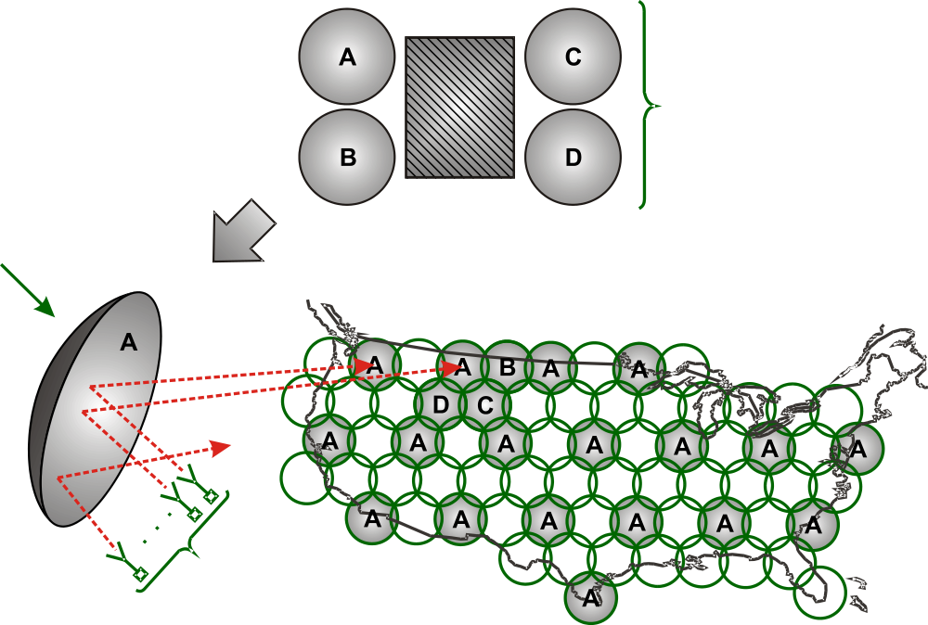
4 aperture
antennas
Offset Reflector
Tx/Rx Beam
Forming Network

Slide 5
single aperture
antenna
Lens
Antenna
Tx/Rx Beam
Forming Network

Slide 6
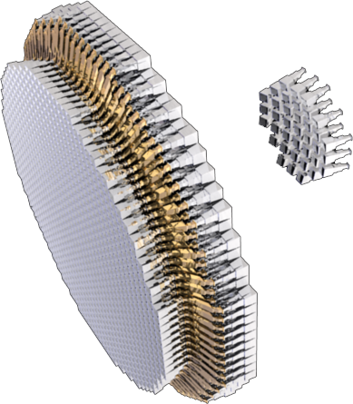
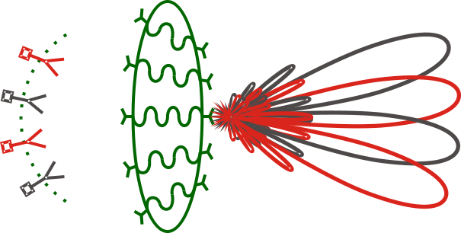
A₁
B₂
B₁
A₂
A₂
B₁
B₂
A₁

Slide 7
Within the lens: High efficiency radiating elements allows for
  Less elements for the same electrical aperture
  Mechanical and weight readiness in system assembling
  Grow up system efficiency
  Economical benefits

Slide 8
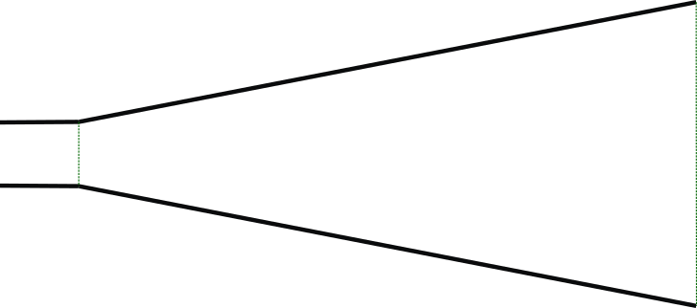
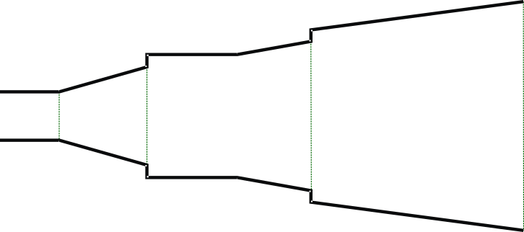
Standard Horn
50 – 60 % of aperture
efficiency
Multi step Horn
92 % of aperture
Efficiency ¹
¹E. Agastra, G. Bellaveglia, L. Lucci, R. Nesti, G. Pelosi, G. Ruggerini and S. Selleri: Genetic algorithm optimization of high-efficiency wide-band multimodal square horns for discrete lenses, PIER 83 335-352 (2008)

Slide 9
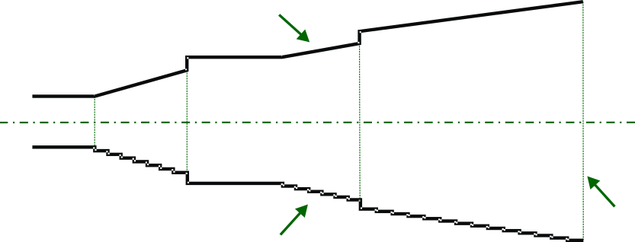
ModeMatching + MoM
Real Structure
Method of Moments
(MoM)
Analyzed Structure
(Mode Matching)

Slide 10
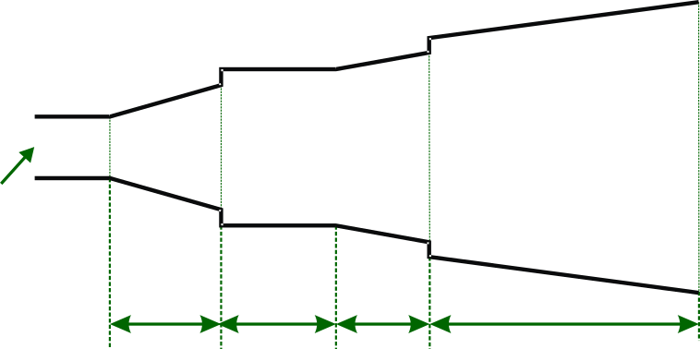
Step-2
Step-1
a0
a1
a2
a3
a4
app
Wave giude
L1
L2
L3
L4
High aperture efficiency leads to high horn length, specially for the last section (L4)¹
¹E. Agastra, G. Bellaveglia, L. Lucci, R. Nesti, G. Pelosi, G. Ruggerini and S. Selleri: Genetic algorithm optimization of high-efficiency wide-band multimodal square horns for discrete lenses, PIER 83 335-352 (2008)

Slide 11
Conflicting goal:
  Aperture efficiency
  Horn longitudinal length
  Return loss
Multi – Objective optimization
  MOEA: (Multi-Objective Evolutionary Algorithm)
Modified NSGA-II: (Modified Nondominated Sorting Genetic Algorithm – II)

Slide 12
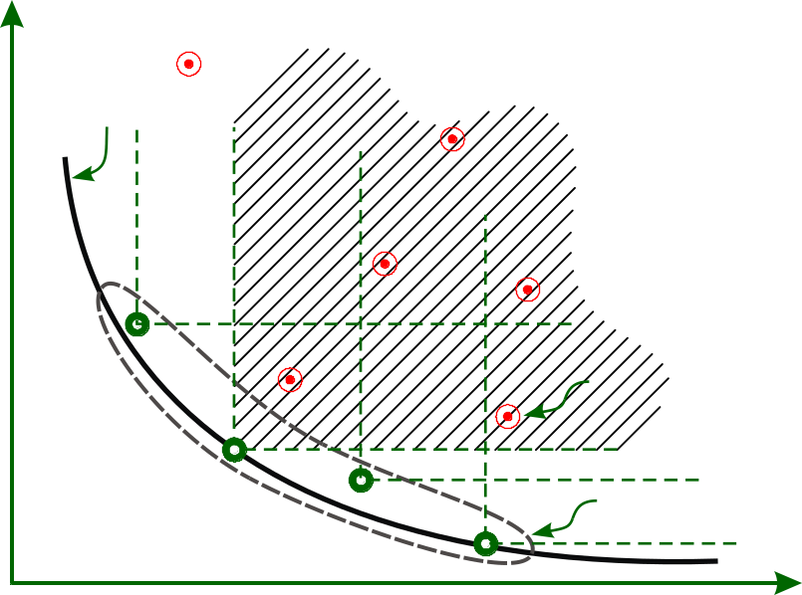
Definition of Pareto front, Pareto set and dominated and non-dominated solutions
True Pareto Front
Obj. 2
Dominated Solution
Pareto set
Obj. 1

Slide 13
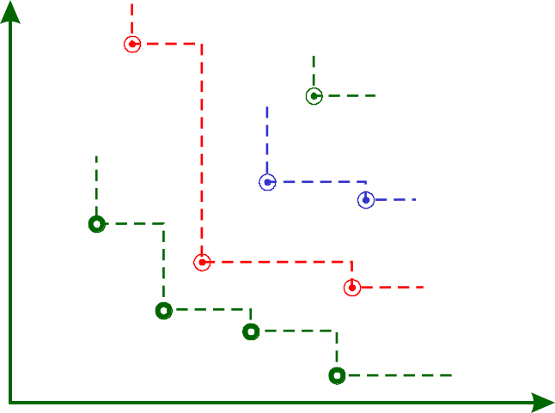
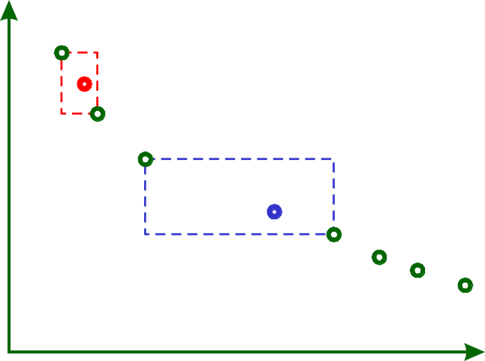
Non-dominated sorting and Crowding Distance (CD)
F⁽²⁾
F⁽⁴⁾
CD₁
CD₁ < CD₂
F⁽³⁾
F⁽¹⁾
CD₂
Obj. 2
Obj. 2
Obj. 1
Obj. 1

Slide 14
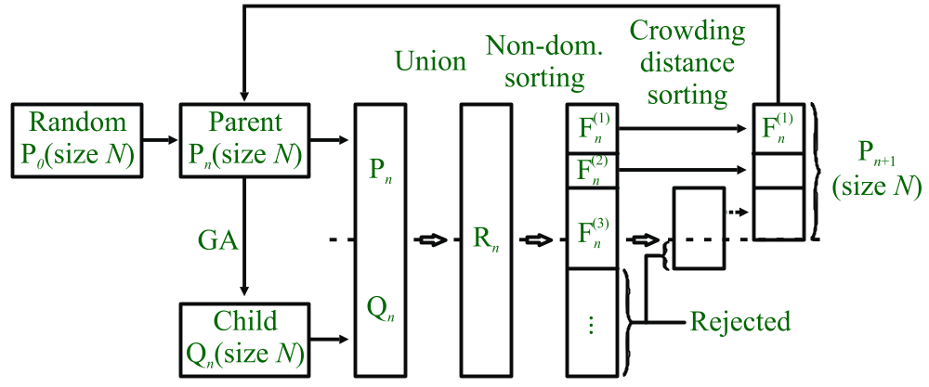
    Standard NSGA-II algorithm:

Slide 15
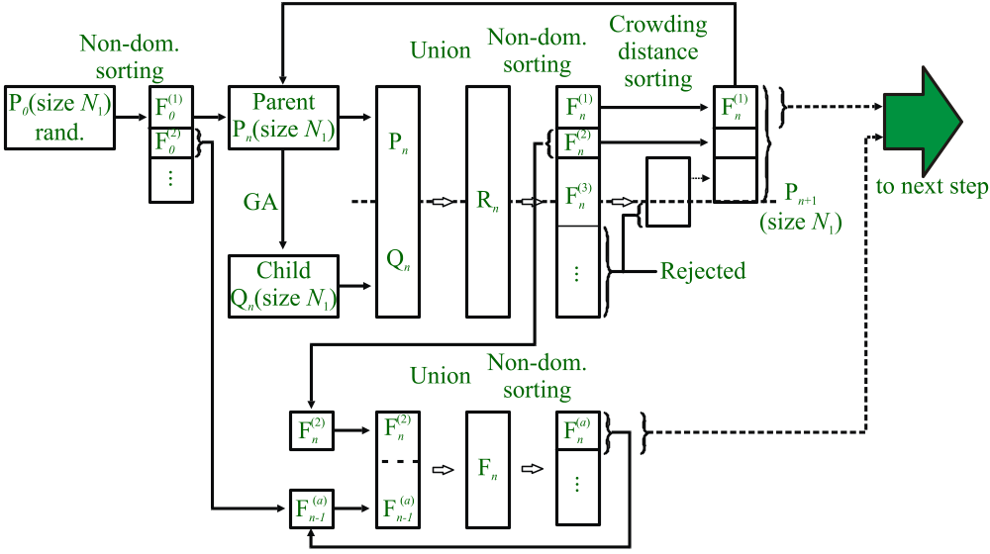
    Modified NSGA-II algorithm: STEP - I

Slide 16
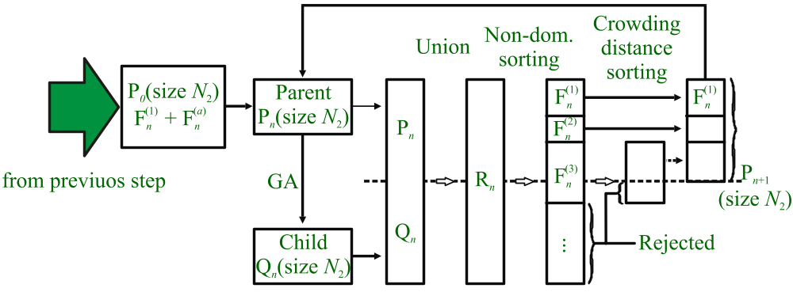
    Modified NSGA-II algorithm: STEP - II

Slide 17
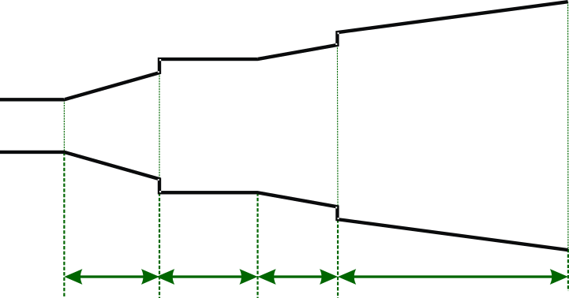
    Geometrical constrains for algorithm Step-I
a0
a1
a2
a3
a4
app
L1
L2
L3
L4
 | Parameters [mm]
 | a1 | a2 | a3 | a4 | L1 | L2 | L3 | L4
min | 10.7 | 10.7 | 15 | 15 | 2 | 2 | 2 | 40
max | 35 | 35 | 55 | 55 | 30 | 20 | 40 | 90
    a0 e app are fixed due to feeding waveguide dimensions and the number of total elements to expand the lens surface

Slide 18
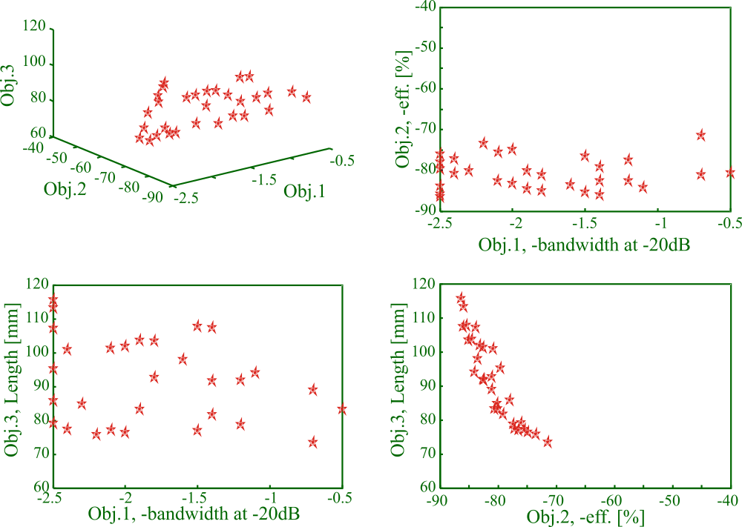
    Pareto set, 30 individuals after 91 generation (result of Step-I).

Slide 19
    Geometrical constrains for algorithm Step-II
a0
a1
a2
a3
a4
app
L1
L2
L3
L4
 | Parameter [mm]
 | a1 | a2 | a3 | a4 | L1 | L2 | L3 | L4
min | 22  | 22  | 33  | 33  | 18  | 11  | 22  | 56 
max | 41 ↓ | 41 ↓ | 59 ↓ | 59 ↓ | 34 ↓ | 22 ↓ | 41 ↓ | 104 
Δ | ➔ | ➔ | ➔ | ➔ | ➔ | ➔ | ➔ | ➔

Slide 20
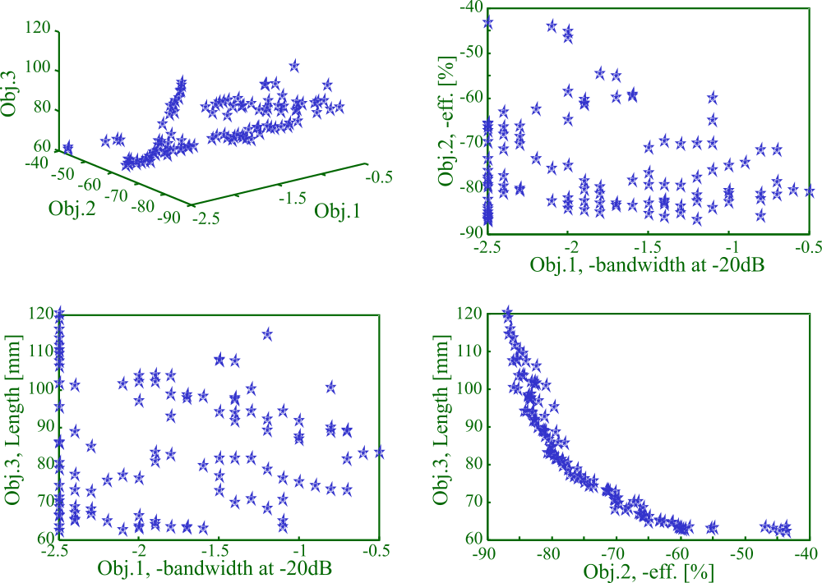
    Pareto set, 100 individuals at the end of the optimization procedure (91 generation of Step-I + 28 generations of Step-II)

Slide 21
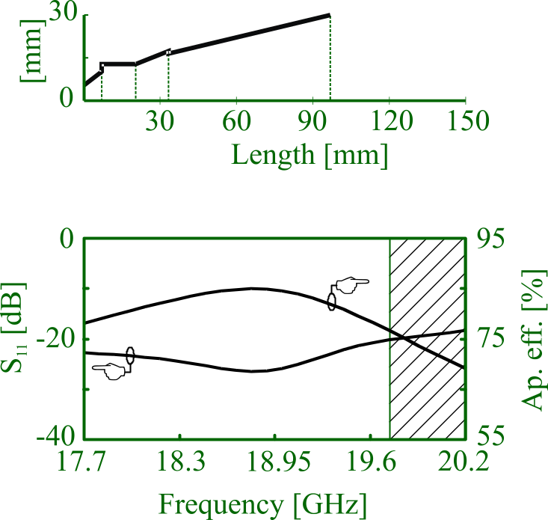
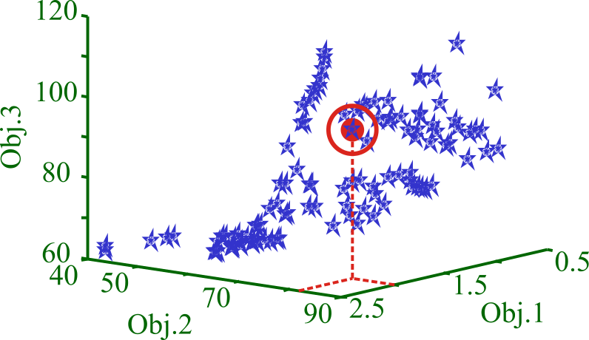
    Selected individual with B=2GHz, η=82.04%, L=96.89mm;

Slide 22
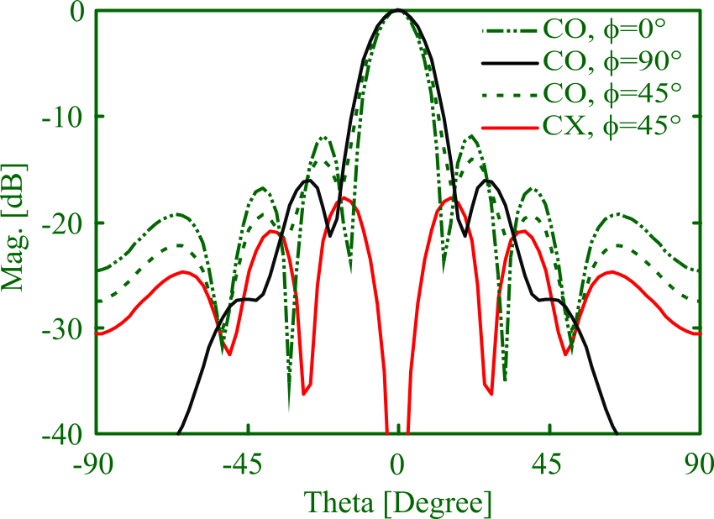
    Selected individual with B=2GHz, η=82.04%, L=96.89mm;

Slide 23
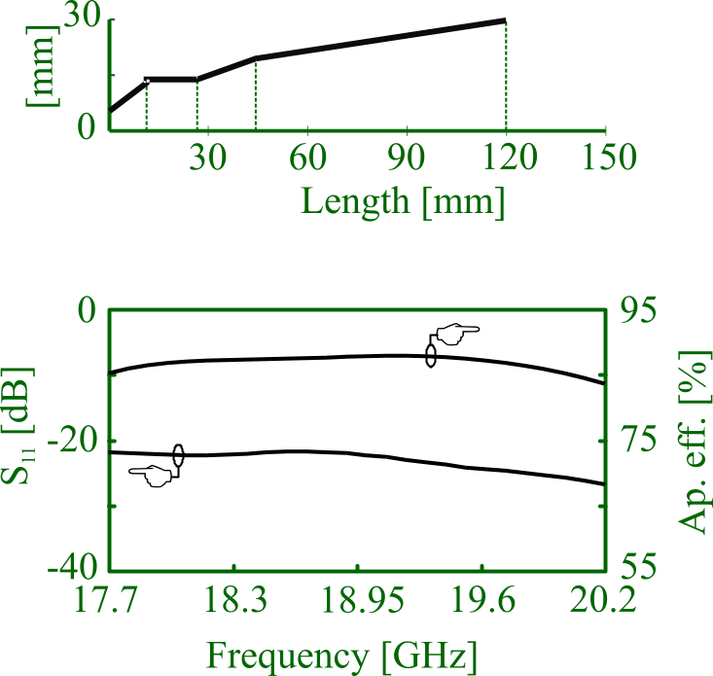
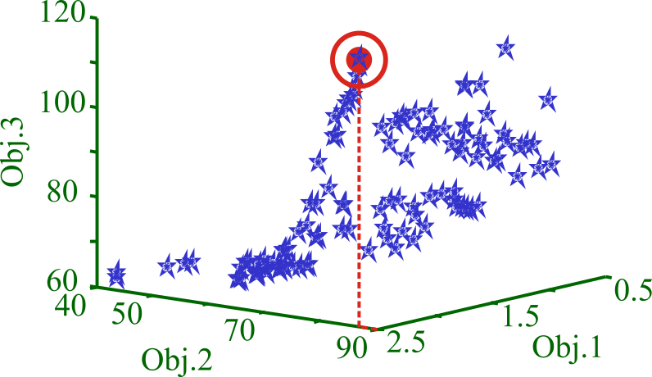
    Selected individual with B=2.5GHz, η=86.85%, L=119,83mm;

Slide 24
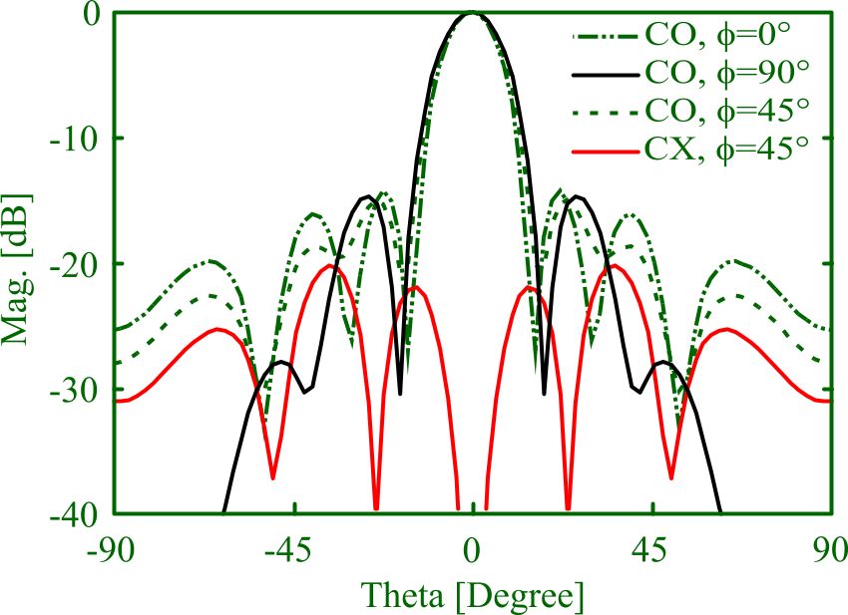
    Selected individual with B=2.5GHz, η=86.85%, L=119,83mm;

Slide 25
    The proposed structure vs. the standard pyramidal horn
 | Total Length [mm] | Band [GHz] | η [%] | η (Pyram.) [%] | Δη [%]
1st choice | 82.97 | 2.0 | 80.25 | 54.4 | 25.85
2nd choice | 119.83 | 2.5 | 86.85 | 67.08 | 19.77

Slide 26
    The proposed algorithm vs. the standard NSGA-II
 | Algorithm Parameter |  |  |  | Number of Solutions in the Pareto Set dominated by the Pareto set produced by:
 | Population | generations | Cost function evaluations | Individuals on the final pareto set | Proposed algorithm | NSGA-II run A | NSGA-II run B
Proposed algorithm | 30 + 100 | 91+28 | 2730+2800 = 5530 | 100 | - | 0 | 0
NSGA-II run A | 100 | 55 | 5500 | 100 | 49 | - | 48
NSGA-II run B | 286 | 20 | 5720 | 100 | 66 | 16 | -
    The Pareto set produced by the proposed algorithm dominates 49% of the solutions produced by the standard NSGA-II in run A and 66% of the solutions generated by standard NSGA-II in run B.

Slide 27
The proposed structure has a better efficiency with respect to a standard pyramidal horn of the same length.
The proposed algorithm better approximates the Pareto front on the same number of cost functions evaluations.

