Slide 1
Design of Circular Corrugated Horn
with Constant Width Corrugations
Leonardo Lucci¹, Renzo Nesti², Giuseppe Pelosi¹, Stefano Selleri¹
¹Department of Electronics and Telecommunications (DET), University of Florence
via C. Lombroso 6/17 - 50134 - Florence, IT
²Arcetri Astrophysical Observatory - National Institute for Astrophysics
Largo Enrico Fermi, 5 - 50125 - Florence, IT

Slide 2
Outline
Introduction
Platelet horns
Design
Fabrication
Test
Conclusions

Slide 3
Modern focal plane arrays for reflector antennas require:
  Large number of elements
  High performances
  Reduced dimension and weight
  Reliable fabrication technique
  Low cost

Slide 4
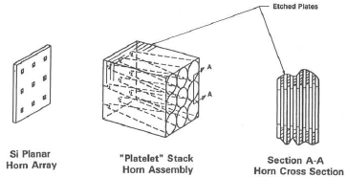
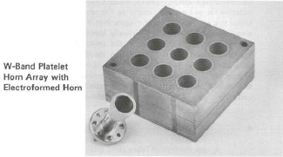
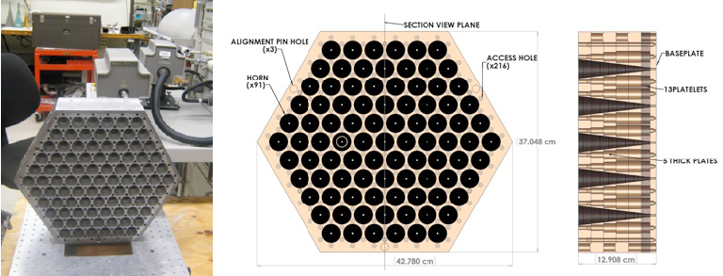
  Stacks of photoetched platelets
R. W. Haas, D. Brest, H. Mueggenburg, L. Lang, D. Heimlich, "Fabrication and Performance of MMW and SMMW Platelet Horn Arrays," International Journal of Infrared and Millimeter Waves, vol. 14, pp. 2289-2293, 1993
  Stacks of machined thick and thin platelets
J.Gundersen, E.Wollack, “Millimeter Wave Corrugated Platelet Feeds,” 2009 J. Phys.: Conf. Ser. 155, 012005.
Notes:
Sopra: Left: principle of platelet horns; Right figure shows the Platelet Horn Array of zirconium copper platelets diffusion bonded and a comparison standard corrugated horn.
Sotto: The left hand figure shows the 91-element W-band array that has been developed for QUIET as it was undergoing return loss measurements. The dimensions of the 20 kg array are given in the middle and right hand figures. The right hand figure shows that the platelet array consists of 5 thick plates each with 18 corrugations per horn hole, 13 platelets each consisting of a tooth and a groove, and a baseplate. The right hand figure also shows how the access holes open to light weighted pockets through the bulk of the structure.

Slide 5
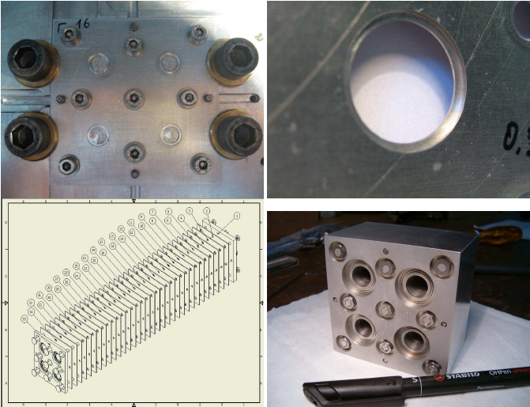
  Stacks of machined non bonded platelets
F. Del Torto et al. “W-band prototype of platelet feed-horn array for CMB polarisation measurements”, JINST, Vol. 6, June 2011
  …. and few other works
Notes:
Top Left: top view of a single plate screwed inside the CNC. There are nine screws:four (black) on the sides and five(gray) located in previously drille drod-holes. After fixing the plate the four antenna holes were milled.
Top Right: corrugation details.
Bottom Left: prototype assembling scheme.
Bottom Right: The completed prototype

Slide 6
Requirements (performances):
  Bandwidth: 33-50GHz (Q-band)
  Return loss: >30dB
  Cross-polarization: <-30dB
  Tapering: 11dB@12°
Requirements (mechanics):
  High compactness (array oriented)
  Constant step width: (w = 2.6mm)

Slide 7
CAD procedure:
  Analysis
    Proprietary software
      Mode Matching
      Method of Moments
  Optimization
    Quasi Newton Method

Slide 8
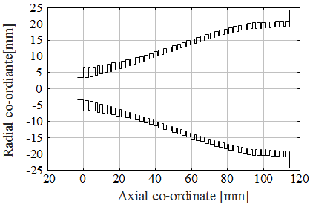
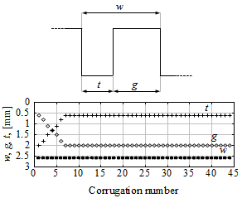
  Corrugation profile
  Optimized sine squared shape
  Corrugation geometry
  Constant step width (w = g + t): To be noticed
  A total of NT = 44 corrugations
  Ideally NT = 44 equally thick plates

Slide 9
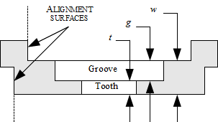
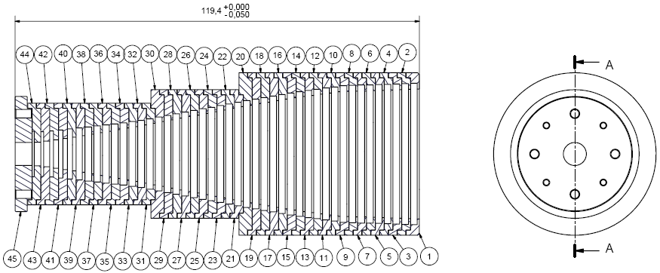
  Self aligned disks for each horn corrugation
  Instead of platelets with whole array pattern of holes
  No pins; No glue; No bonding;
  Only tightening screws;
  Allowing consistent mass reduction
  Allowing array modularity
  Single horn

Slide 10
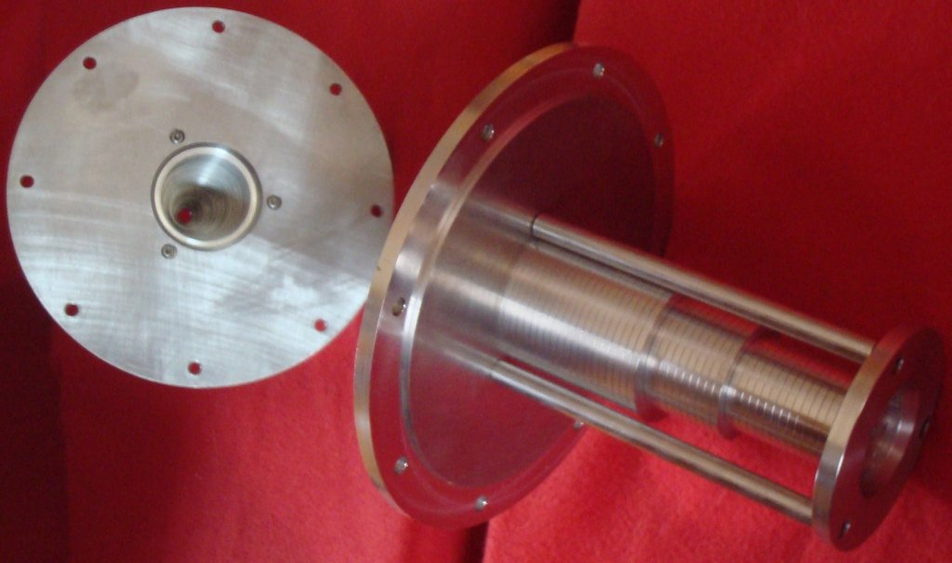
  Single horn (mirrored)

Slide 11
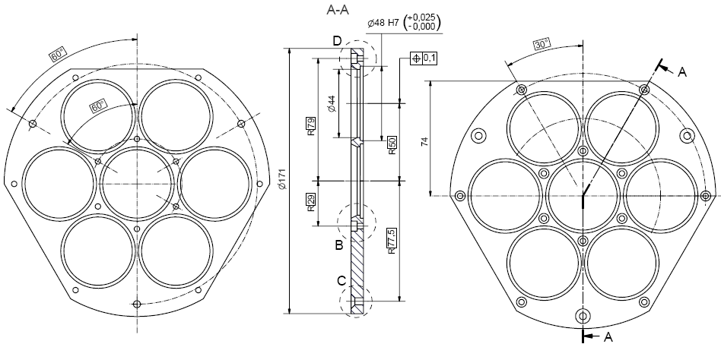
  Array of seven horns

Slide 12
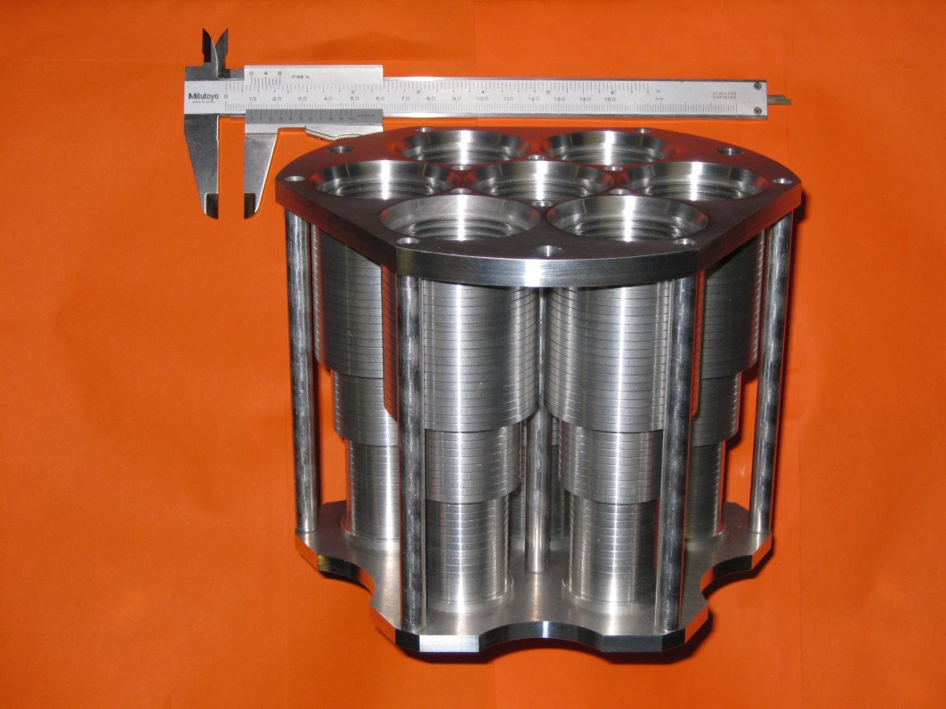
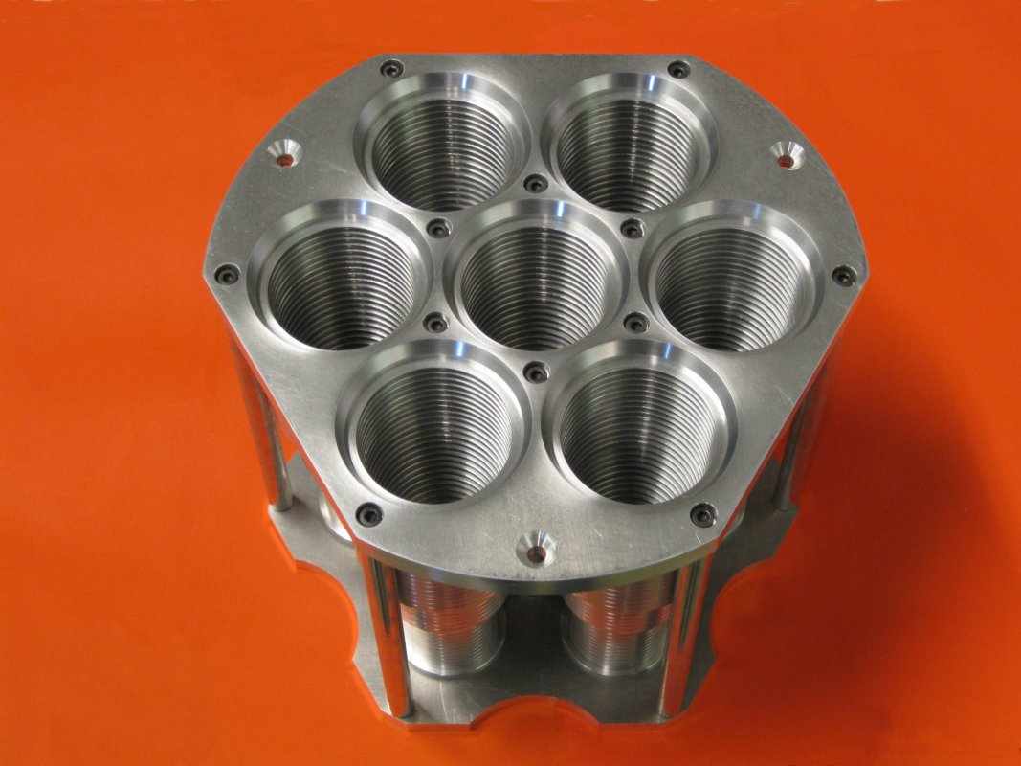
  Array of seven horns

Slide 13
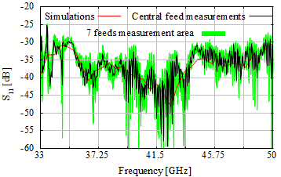
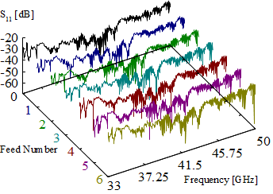
  Reflection coefficient
  Cross-Coupling < -60dB (instrument limit)

Slide 14
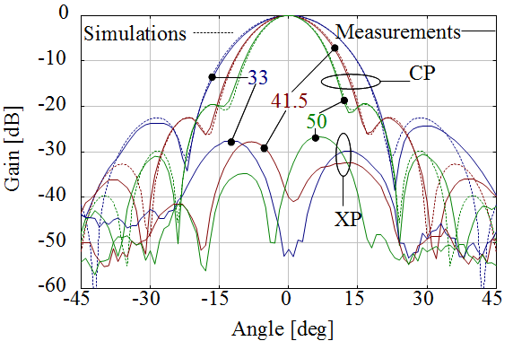
  Co-polar (comparison) and cross-polar pattern in the 45° cut at three frequencies
Notes:
Confronto co-polare simulato – misurato: ottimo accordo.
Cross-polare: circa 5dB peggio delle simulazioni (mediamente)

Slide 15
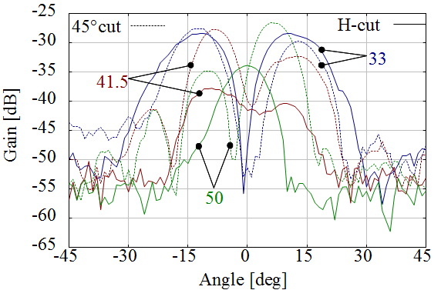
  Measured cross-polar pattern in the 45° and H cuts at three frequencies
Notes:
Cross-polare misurato.
Piano 45° si ha il massimo della cross. Vedi nota slide precedente per i valori attesi rispetto alle simulazioni.
Piano H (interessante): in teoria nullo, in pratica si leggono le tolleranze di fabbricazione…
a 33GHz molto simile al taglio 45°; far notare che in bassa frequenza si ‘legge’ un’eccitazione di modi TM0n come effetto dominante sulla cross….
A 41.5 e 50GHz la cross presenta un massimo nella direzione assiale: si legge un’eccitazione del modo TE11 ortogonale come effetto dominante sulla cross…

Slide 16
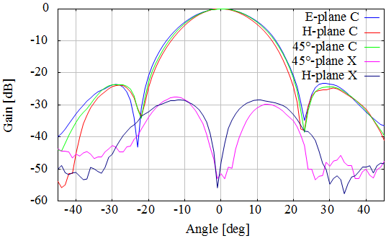
  Measured co-polar and cross-polar pattern at 33GHz

Slide 17
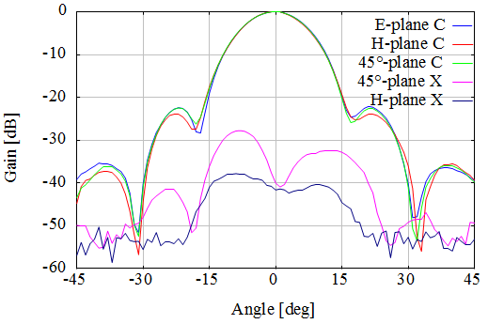
  Measured co-polar and cross-polar pattern at 41.5GHz

Slide 18
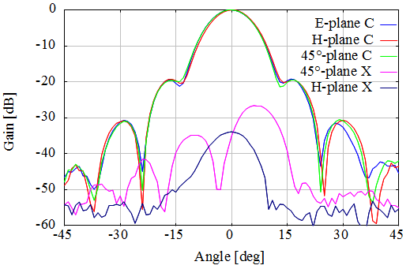
  Measured co-polar and cross-polar pattern at 50GHz

Slide 19
A corrugated horn design with constant corrugation width for platelet technology and low-cost production has been presented
The electromagnetic tests highlight very good performances at Q band
Proposed design and technology show attractive features for high-performance and low-cost focal plane arrays in the lower part of the millimetre-wave band

