Slide 1
Finite Element Methods for High Frequency Applications -
Recent Research Results
O. Farle, V. Hill, R. Dyczij-Edlinger,
Saarland University, Germany
S.-C. Lee, M. Vouvakis, J.-F. Lee,
The Ohio State University, U.S.A.

Slide 2
Contents
Efficient frequency domain solvers
  Adaptive multi-level method
  Domain decomposition
Multi-variate model reduction
  Single expansion point method

Slide 3
Fast Frequency Domain Solvers
Adaptive Multi-Level Method
  Multi-grid approach
  Nested mesh hierarchies
  Efficient treatment of locally refined zones
  One coarse mesh over entire domain
Domain Decomposition Method
  Spatial partitioning
  Weakly coupled sub-problems of smaller size
  Inconsistent meshes
  Many fine meshes over sub-domains

Slide 4
Adaptive Multi-Level Solver
Goal: Optimal computational complexity
  CPU time proportional to number of variables
  Multi-grid approach to solve Ax=b

Slide 5
Multi-Grid Solver
Foundations
  Large eigenvalues: rapidly oscillating fields
  Small eigenvalues: slowly oscillating fields
  Iterative solvers: very efficient for components corresponding to large eigenvalues.
  Coarse grid: capable of representing slowly oscillating fields.

Slide 6
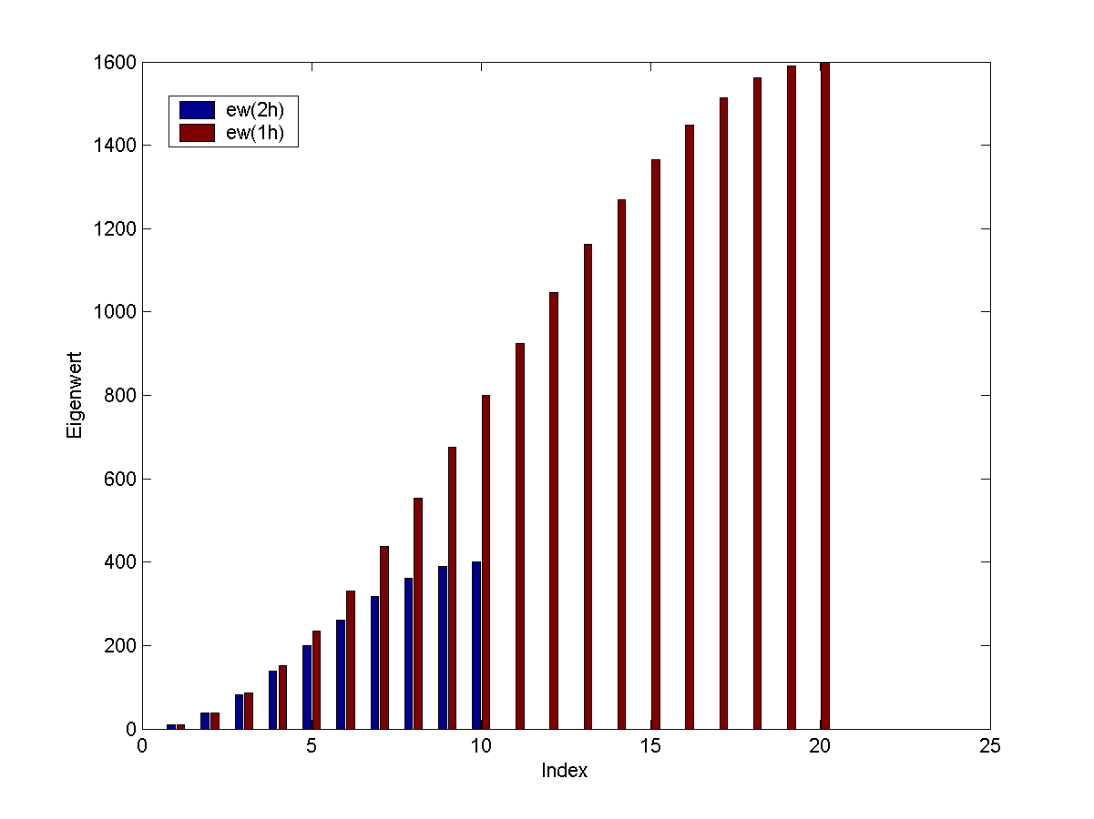
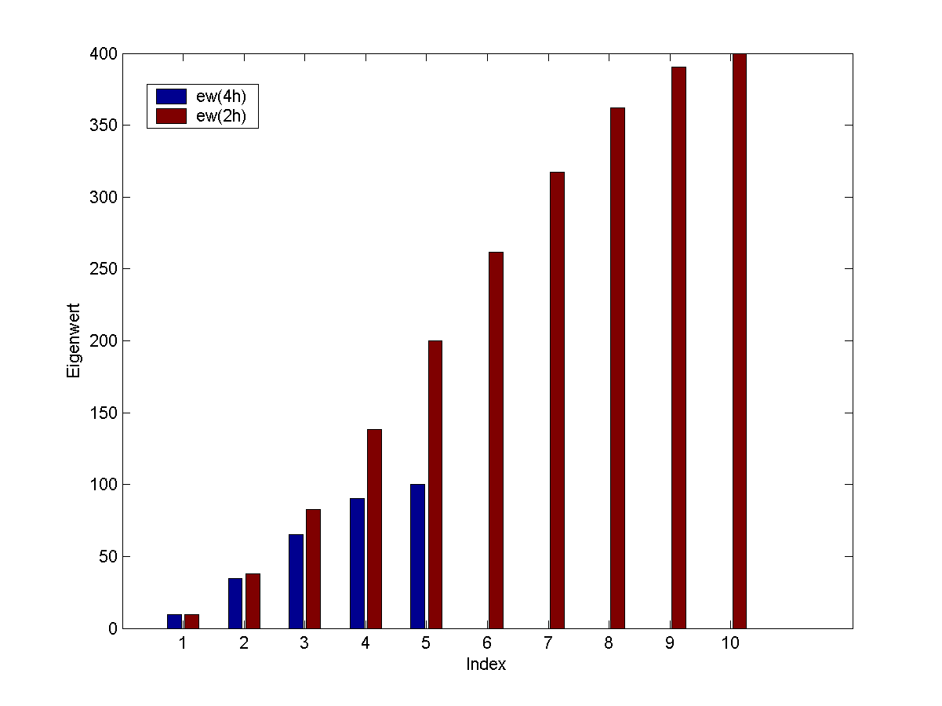
Eigenvalue Distribution

Slide 7
Multi-Grid V Cycle
Grid
size
h
Smoother
(iterative)
2h
Restriction
4h
Prolongation
Direct
solver

Slide 8
Multigrid-Preconditioned Krylov Solver
Nested Finite Element Spaces
Krylov Subspace Methods
Multigrid-Preconditioner
  V-cycle:
    Partially gauged formulation for refined meshes
    Forward/back Gauss-Seidel smoothers
  Coarsest mesh:
    Tree gauge for lowest order scheme
    Direct solver
P-Enrichment:
  Any level of mesh refinement

Slide 9
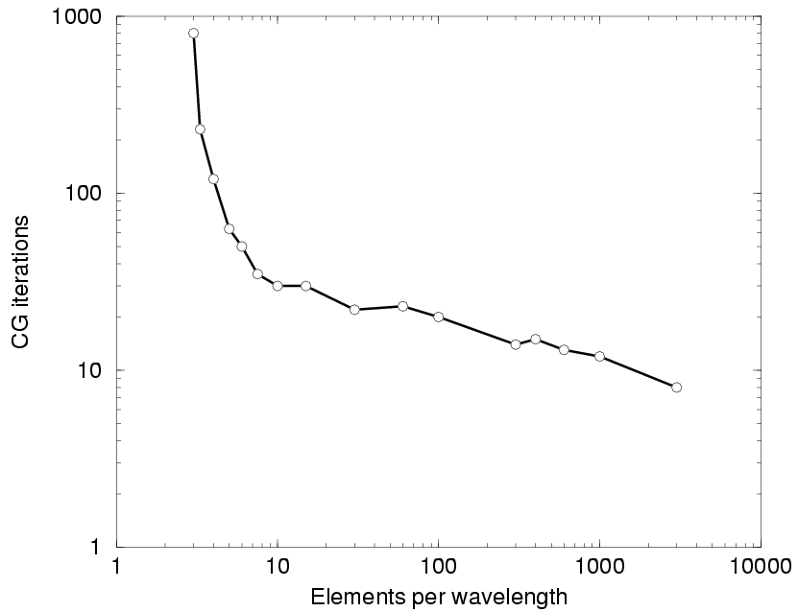
Numerical Convergence as Function of Element Size on Coarse Mesh
Rectangular waveguide:
Width w = 1m,
Height h = 1m,
Length l = 100 m

Slide 10
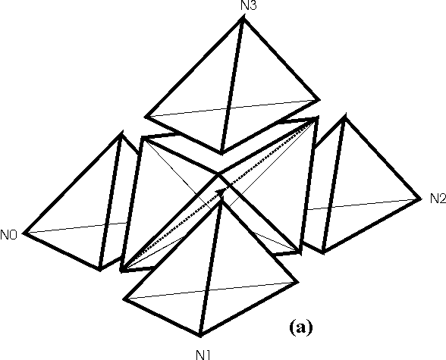
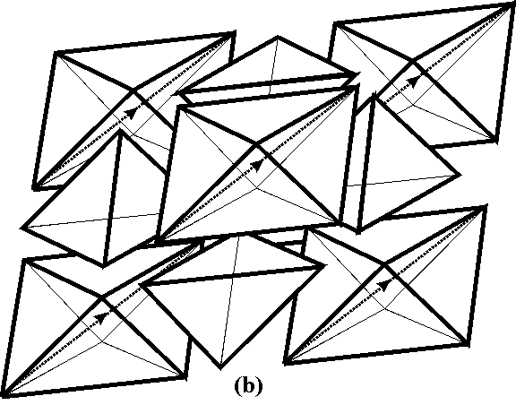
Construction of Nested Tetrahedral Meshes
Three types of shape only
  Lower bound on mesh quality
One geometrical test to specify initial axis

Slide 11
Non-Uniform Refinement I
Conventional schemes:
  Layers of irregular elements:
    inferior shape
  Further refinement
    Irregular layers need to change
    FE spaces no longer perfectly nested
  Three dimensional case
    Numerous special cases: painful implementation

Slide 12
Non-Uniform Refinement II
Hanging variables
  Perfectly nested meshes
  Continuity: Constraints on
  hanging variables
Practical implementation
  Initiated by error control
  Extend fine mesh into neighboring elements
  Propagation of refinement is restricted to one layer on coarsest mesh

Slide 13
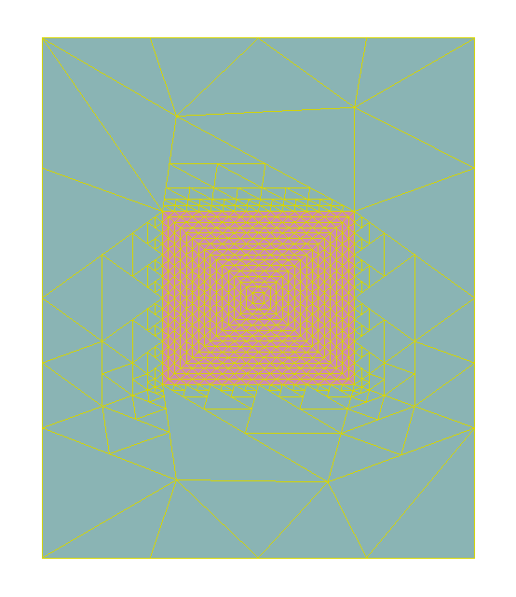
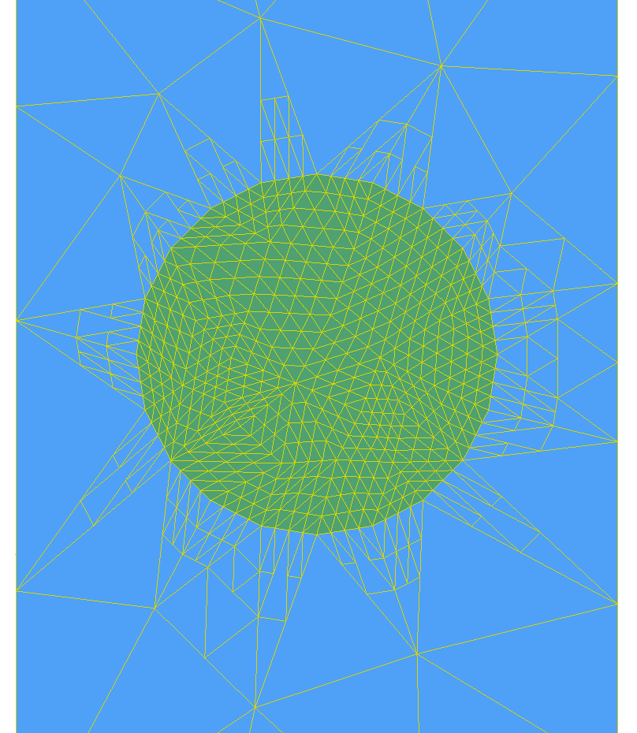
Propagation of Refinement: Examples

Slide 14
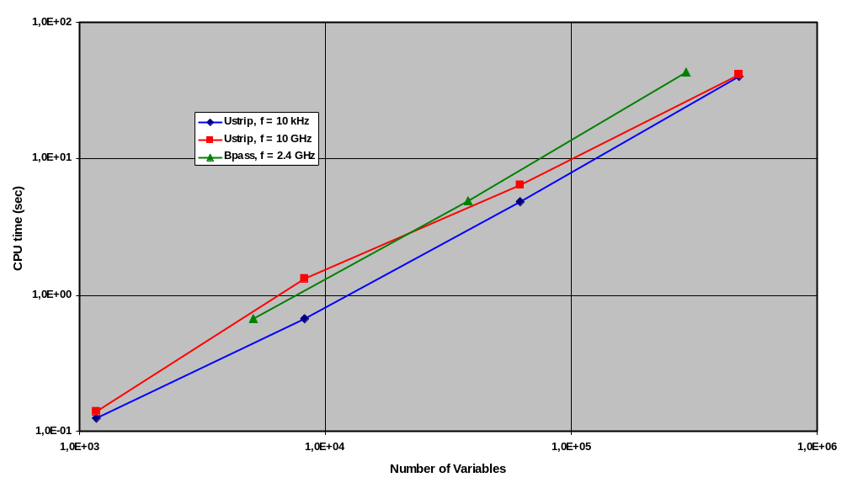
Numerical Convergence
(Uniform refinement of non-uniform meshes)

Slide 15
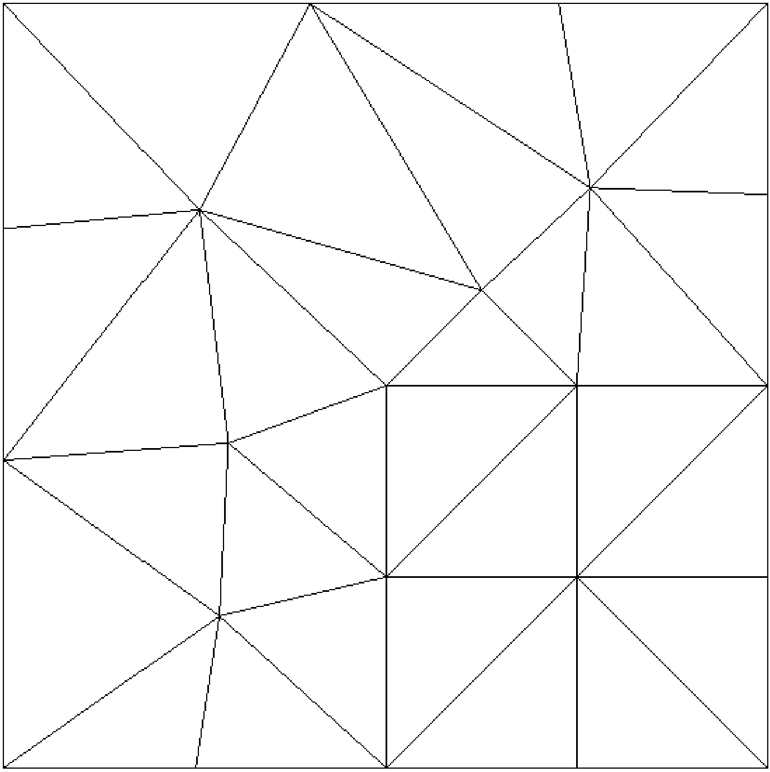
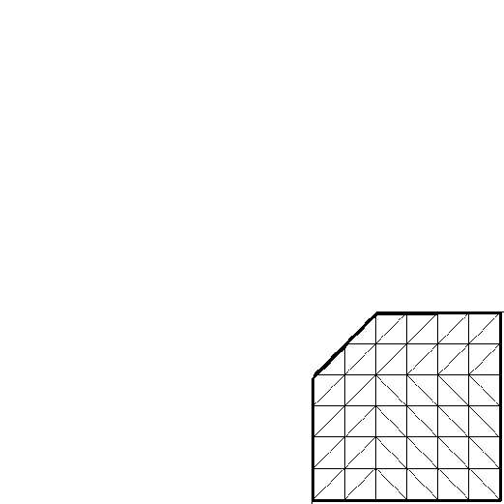
Adaptive Multi-Level Method 1
Practical structures:
  Highly inhomogeneous.
  Singularities.
  Highly non-uniform meshes.
Adaptive meshes:
  Highly localized regions.
  Strong increase in level depth.
  Small increase in variables.

Slide 16
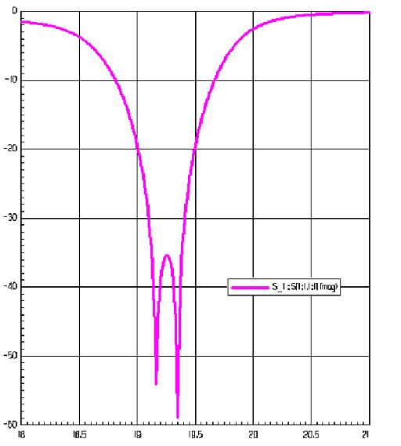
Rectangular Waveguide Filter
Project | Level | Variables | Nonzeros
WG Filter 1st order | 2/2/2/2 2/2/2/3 | 366 069 404 001 | 4 691 153 5 226 339
WG Filter 2nd order | 1/1/1 1/1/2 | 224 650 254 725 | 5 071 442 5 864 254
Return loss
Frequency (GHz)
len1
len2
len2
len1
len1 | 9.747 mm
len2 | 9.941 mm
w1 | 1.994 mm
w2 | 2.288 mm
w3 | 3.127 mm
a
w1
w2
w3
w2
w1
H-Plane View

Slide 17
Adaptive Multi-Level Method 2
Sub-domains:
Small increase in variables only
Entire domain:
Strong increase in variables per level
Oscillatory corrections:
Localized multi-level method

Slide 18
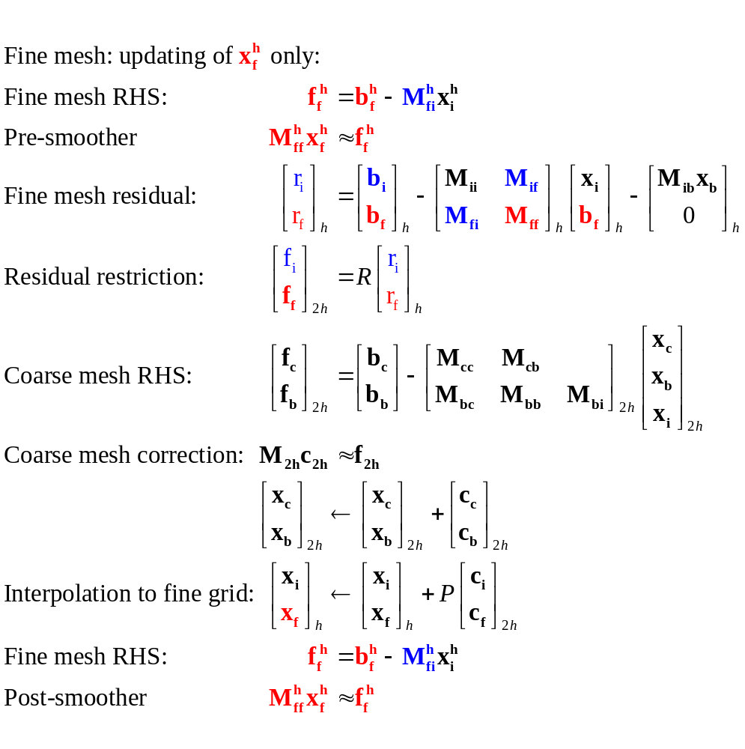
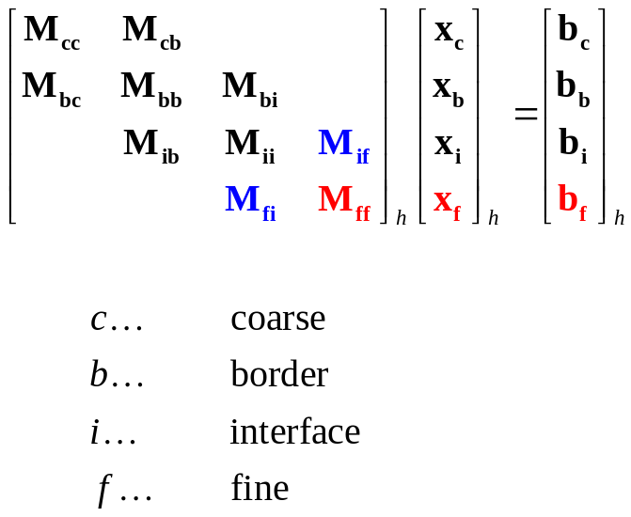
Multi-Level Algorithm – Outline
Not the actual algorithm!!

Slide 19
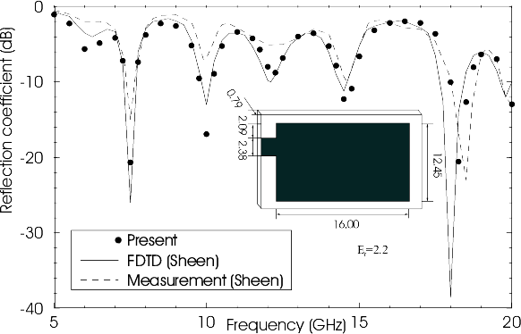
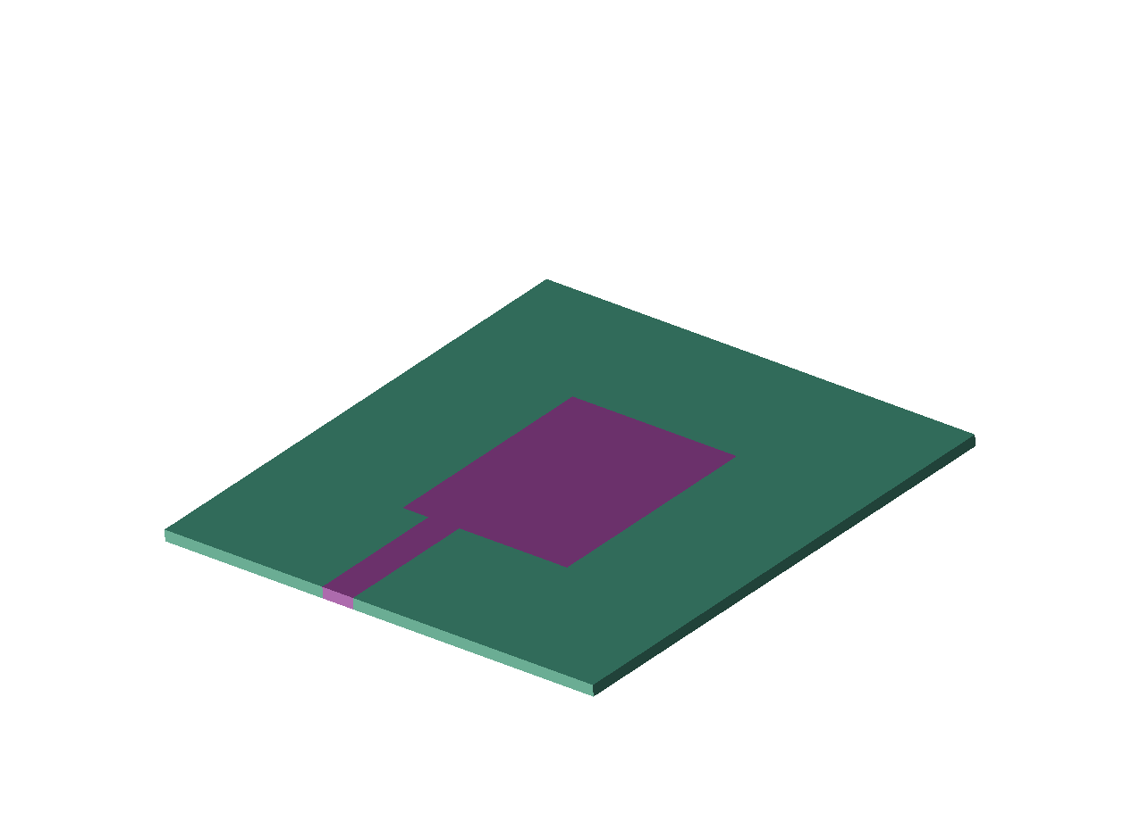
Microwave Patch Antenna
D.M.Sheen, S.M.Ali, M.D.Abouzahra, J.A.Kong, „Application of the Three-Dimensional Finite-Difference Time-Domain
Method to the Analysis of Planar Microstrip Circuits,“ IEEE Trans. Microwave Theory & Tech., vol. 38, pp. 849-857, 1990.

Slide 20
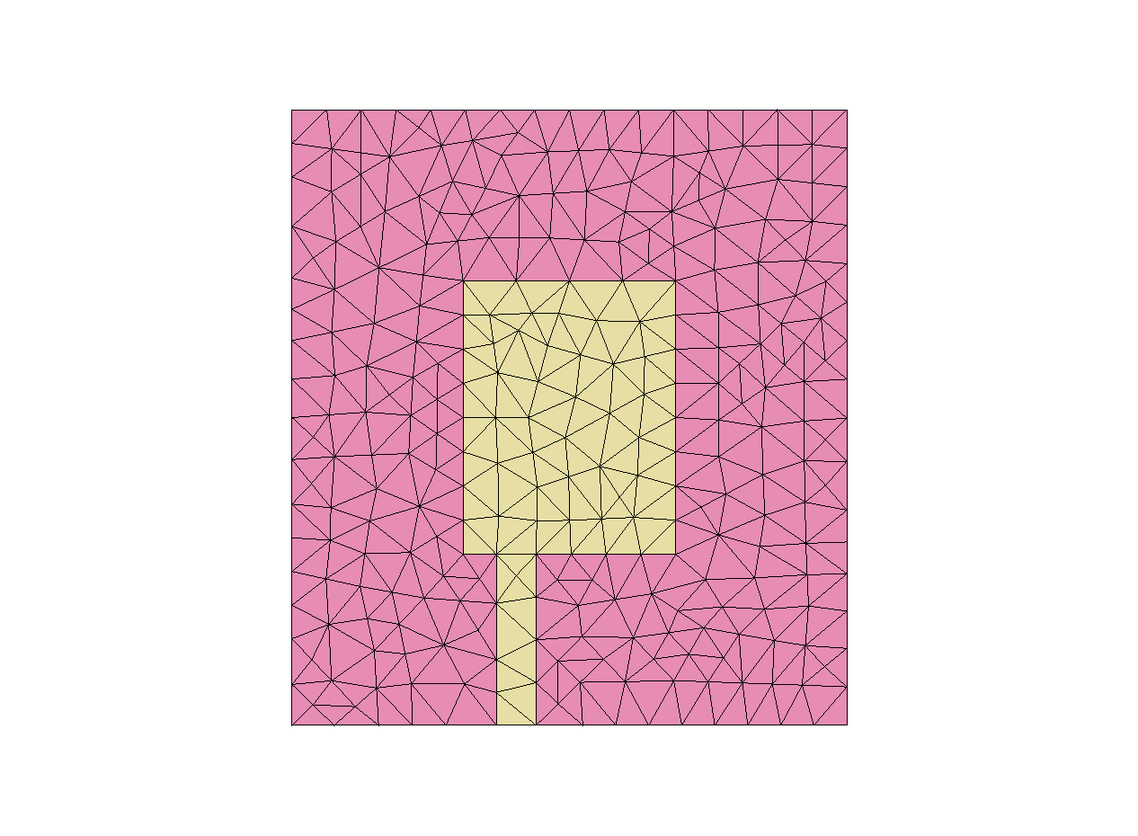
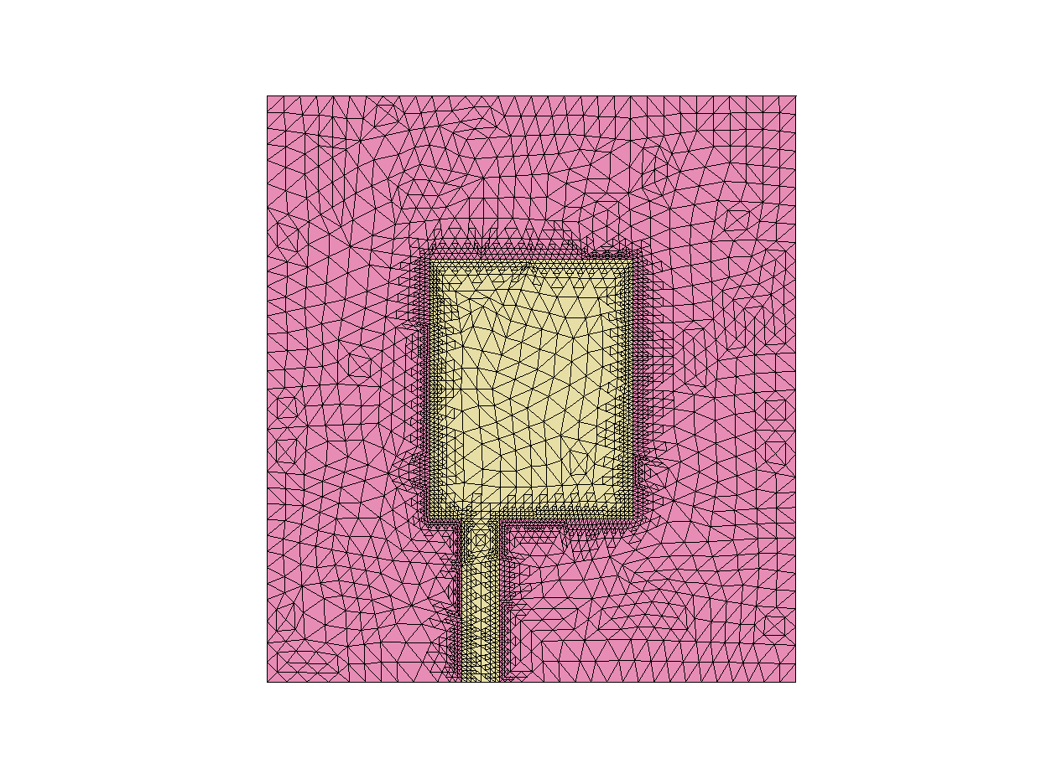
Non-Uniform Mesh Refinement

Slide 21
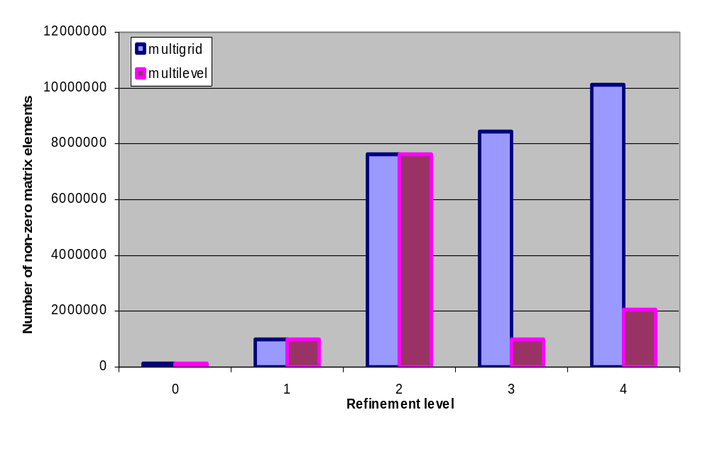
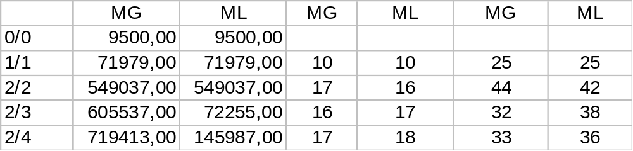
Results (Incomplete 1st Order)

Slide 22
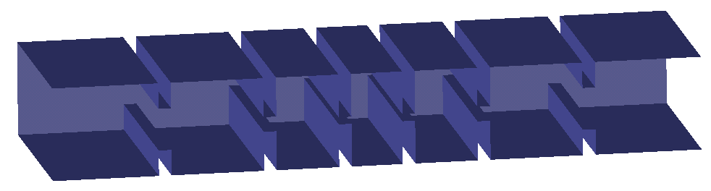
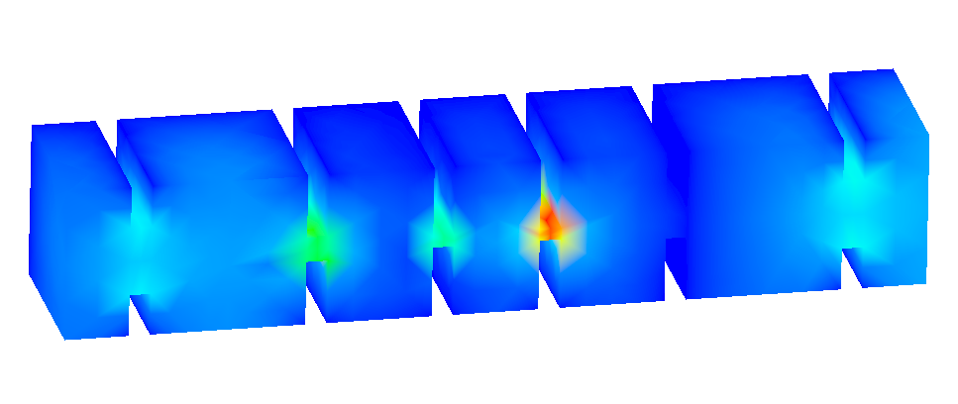
Microwave Bandpass Filter 1
J.M. Reiter, F. Arndt, „Rigorous Analysis of Arbitrarily Shaped H- and E-Plane Discontinuities in Rectangular Waveguides by a Full- Wave Boundary Contour Mode-Matching Method,“IEEE Trans. Microwave Theory & Tech., vol. 43, no.4, pp. 796-801, April 1995

Slide 23
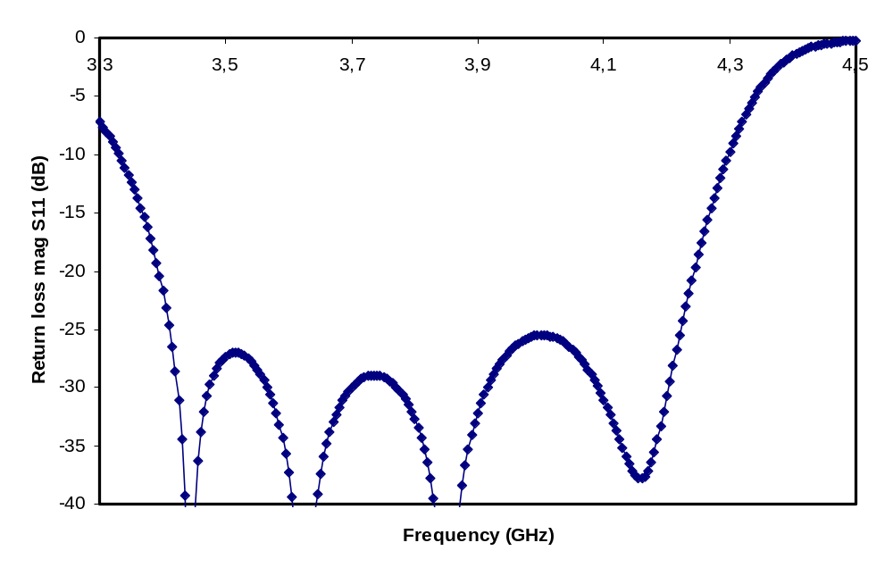
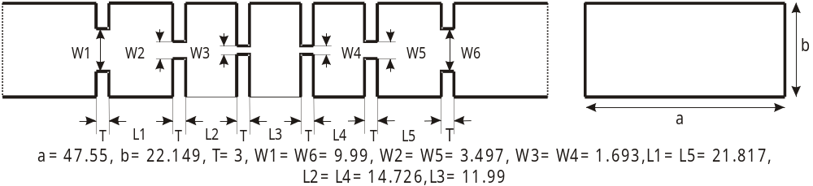
Microwave Bandpass Filter 2

Slide 24
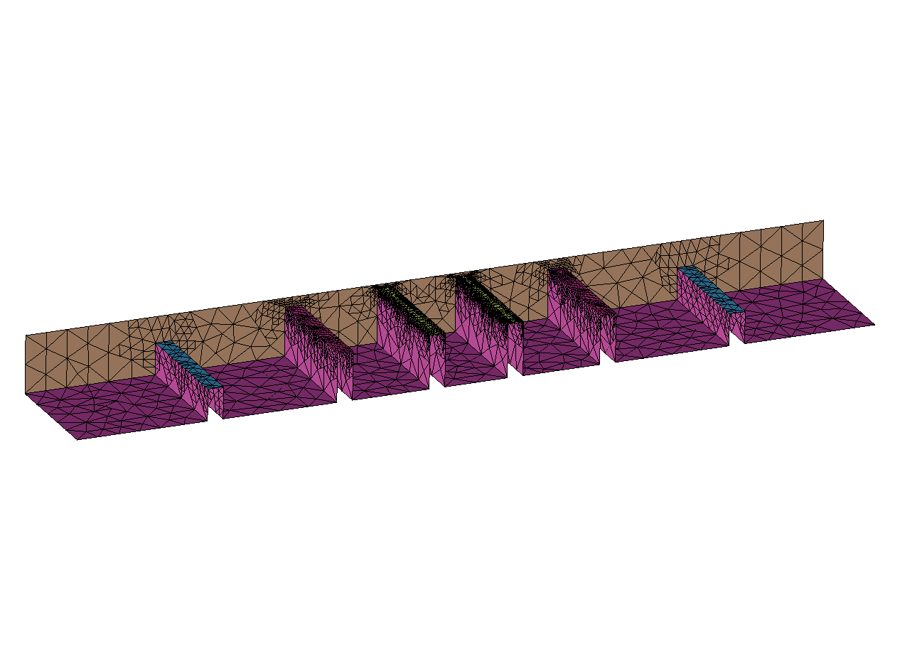
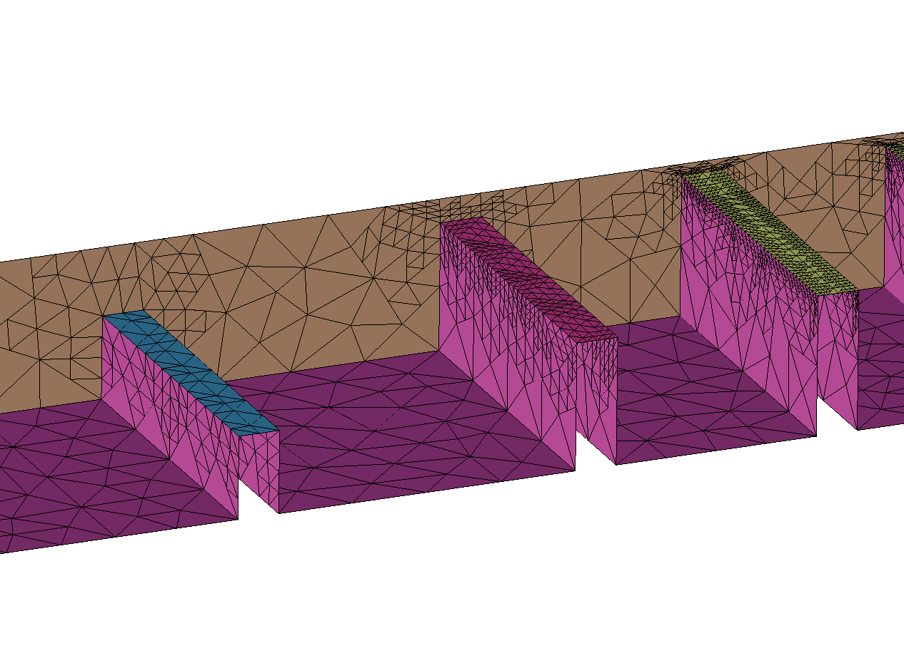
Non-Uniform Refinement

Slide 25
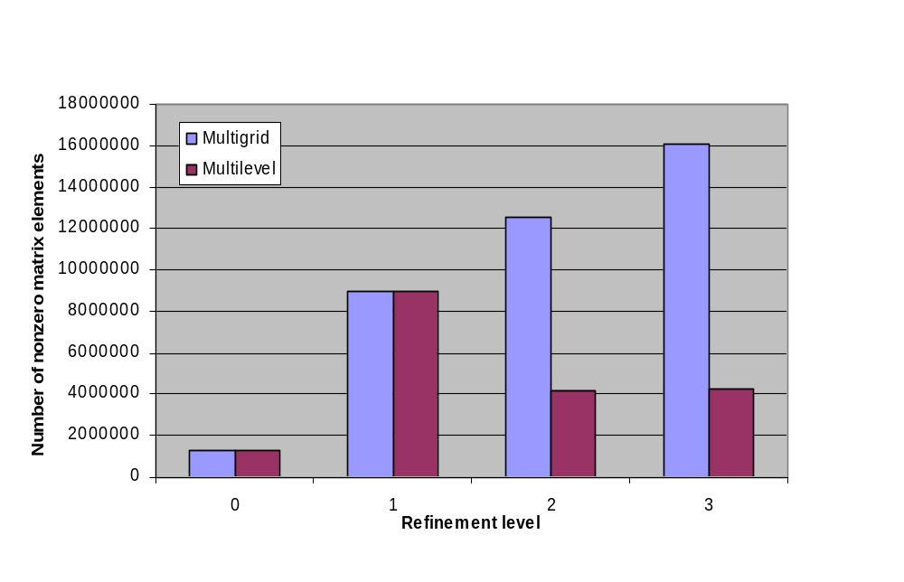
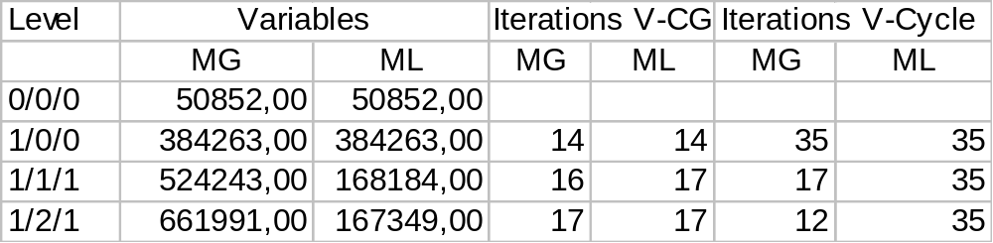
Results (Incomplete 2nd Order)

Slide 26
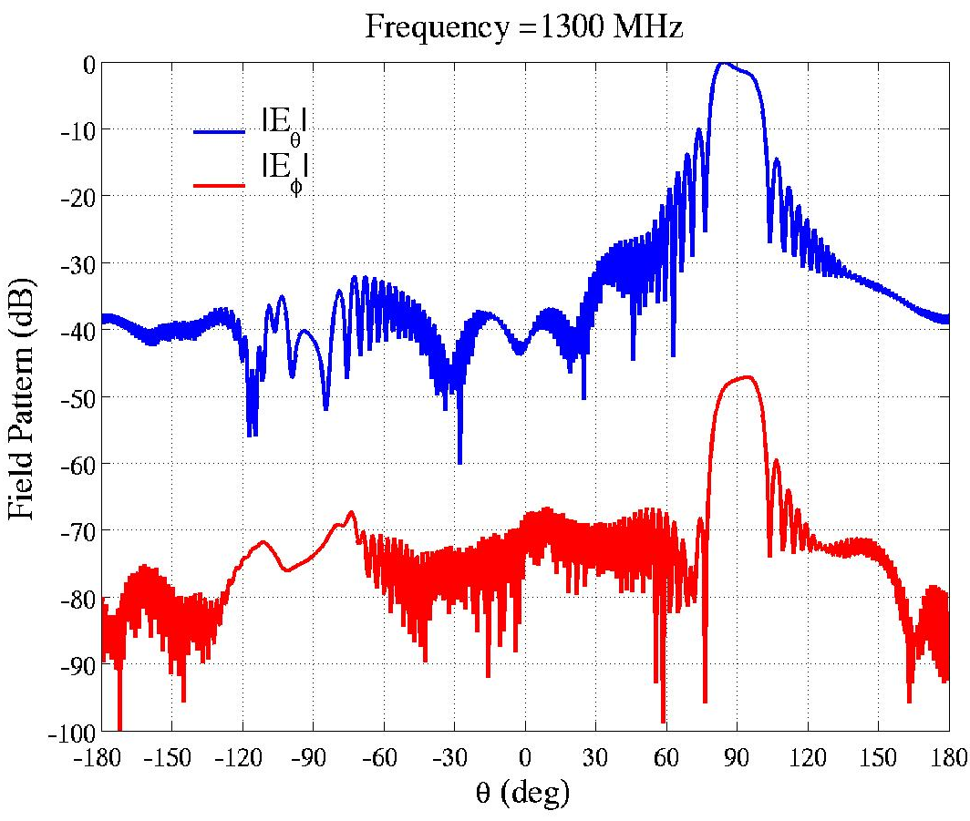
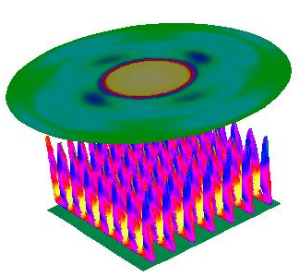
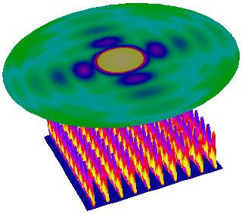
Domain Decomposition Methods
Seung-Cheol Lee, Marinos Vouvakis, and Jin-Fa Lee
Computational Science Group, ESL, ECE Dept.
The Ohio State University
http://esl.eng.ohio-state.edu/~csg

Slide 27
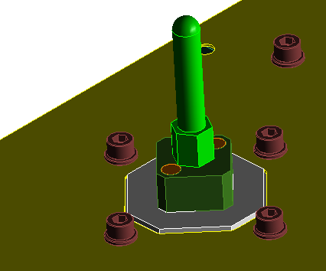
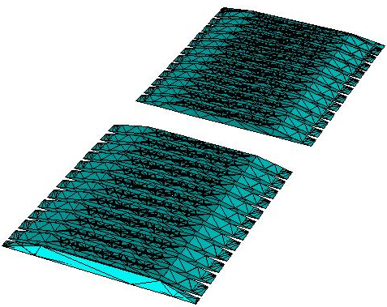
What Problems We Are Targeting?
Typical RADAR Array
40 million unknowns!!!
108 elements (60λ)
With current “conventional” full-wave approaches arrays up to 18×12 without RADOME can be accurately simulated, on 2GB PC.
12 elements (10λ)

Slide 28
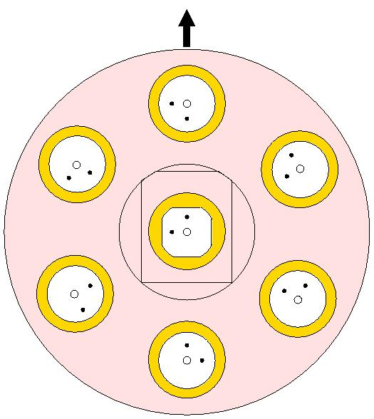
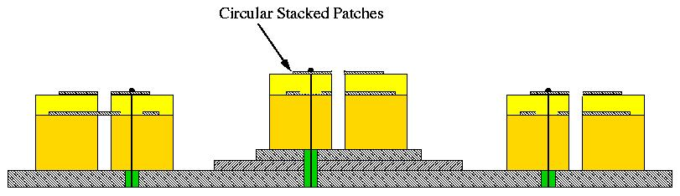
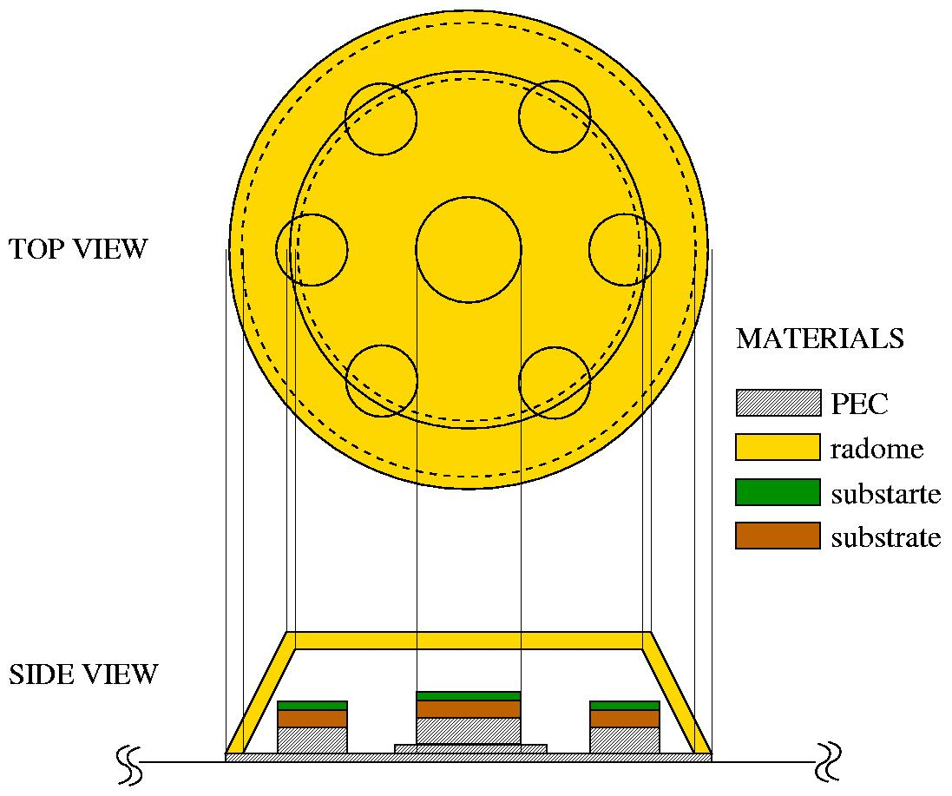
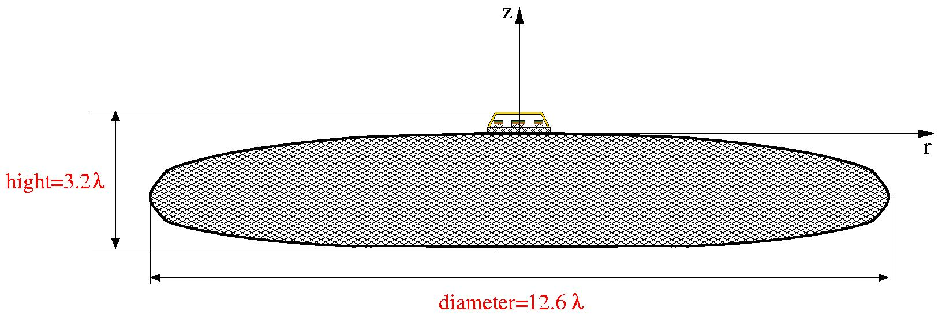
Dual band operation
7 elements antenna array, circular polarized
The 7 elements array, coated with Radome, sitting on top of a large finite ground plane

Slide 29
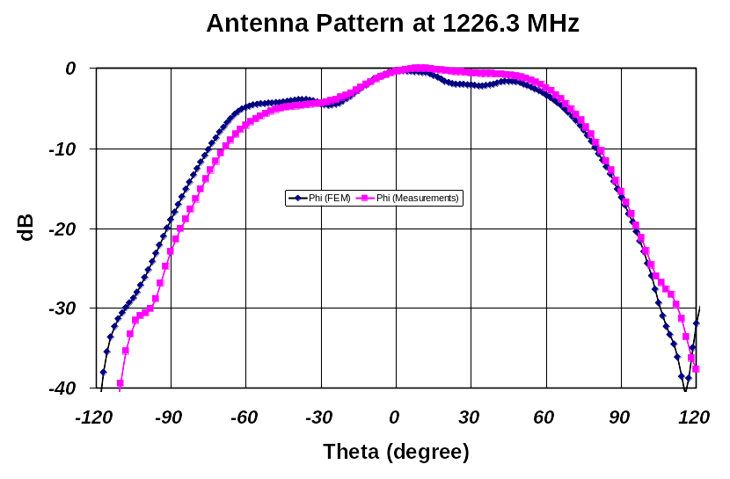
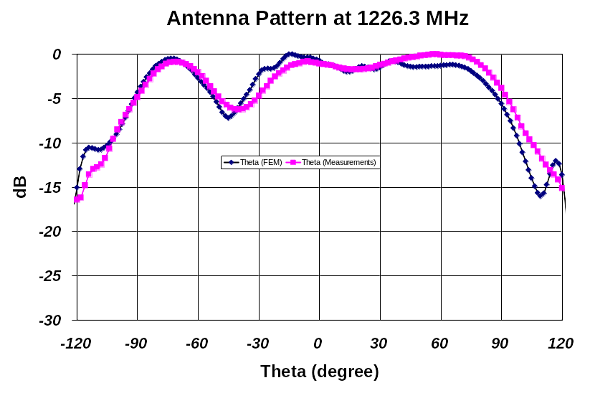
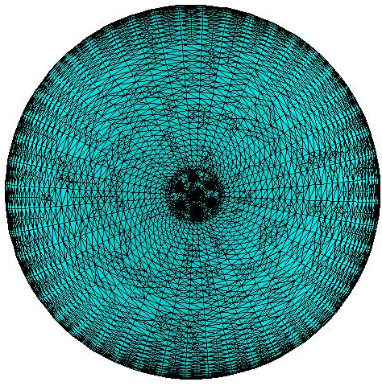
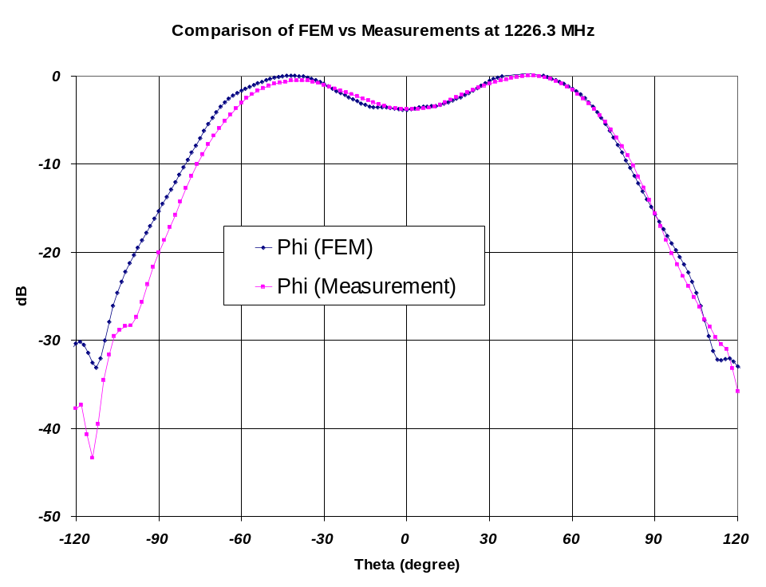
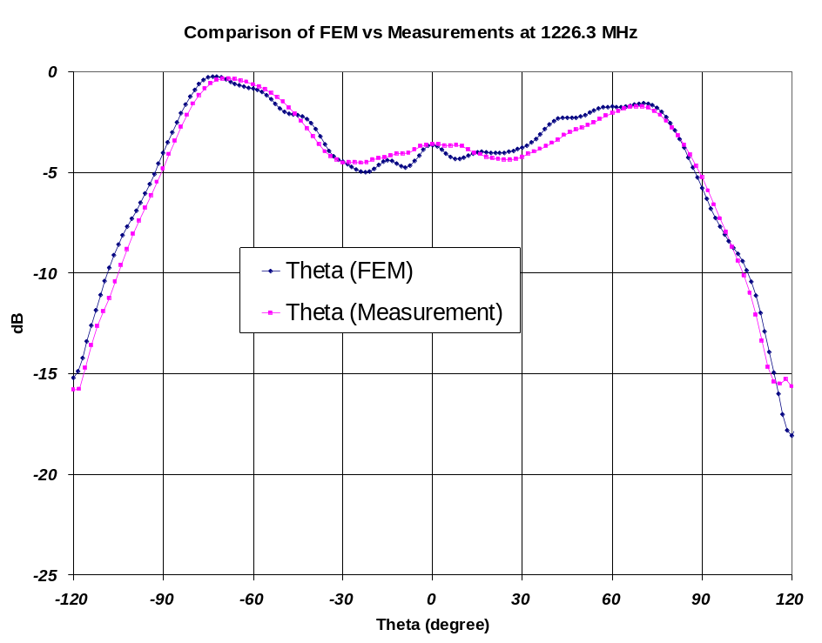
Smoothed finite ground plane
Smoothed finite ground plane

Slide 30





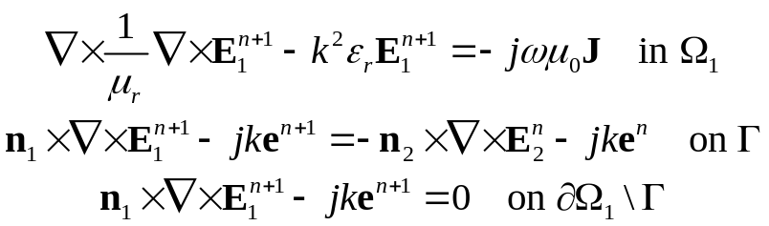



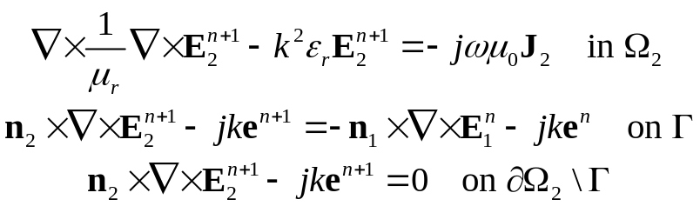

Conforming DDMs
At nth iteration, let us assume that are available
everywhere. Then,
and
Gauss-Siedel iteration scheme is adopted, and therefore denote the most update values of the variables
The two BVPs are well-posed. Existence and uniqueness are trivially established
For simplicity, ABC is used for mesh truncation in the formulation. Other mesh truncation methods can be subsituted into the formulation with straightforward modifications.
Can be employed to update variables
Common variable e is used to strongly enforced tangential component of electric field being continuous
Tangential component of magnetic field continuous is imposed “weakly” through natural boundary condition in FEM formulation

Slide 31
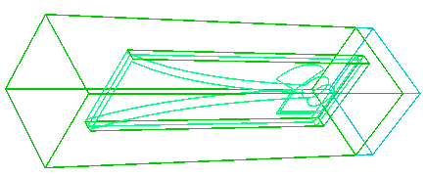
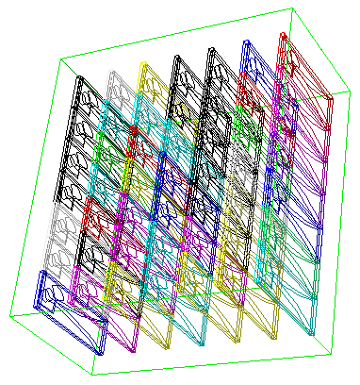
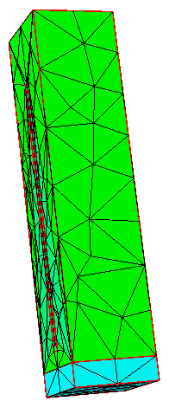
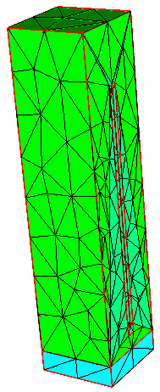
Boundary Value Problem
for Single Building Block
_{back}
_{left}
ABC/IE
ABC/IE
_{top}
_{bottom}
_{front}
ABC/IE
_{right}
ABC/IE
non-conforming triangular meshes
ABC/IE

Slide 32
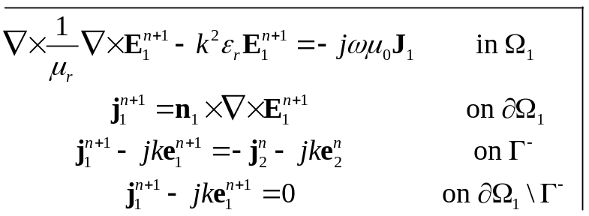










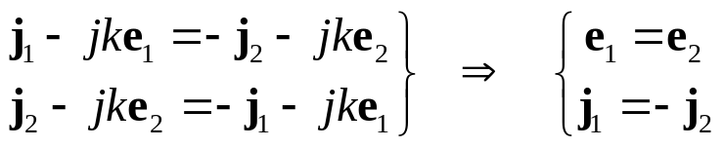
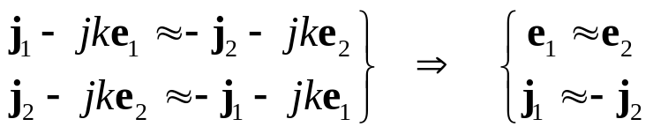
Non-Conforming DDM and Mortar Technique
And,
Do these two BVPs imply the needed Physics, namely ?
YES, though weakly
Galerkin treatments result in

Slide 33





Comparisons With “brute-force” FEBI
7×7 Vivaldi Array
10×10 Vivaldi Array

Slide 34



Beam Scanning
15x10 vivaldi array with scanning angle θ = 45°,φ = 0°
φ
θ
Scanning
θ = 45°,φ = 0°
φ = 0° plane
broadside

Slide 35



Beam Scanning
50x50 vivaldi array with scanning angle θ = 45°,φ = 0°
φ
θ
Scanning
θ = 45°,φ = 0°
φ = 0° plane
broadside

Slide 36
Comparison of Mortar+DDM and Mortar+DDM+FETI
Array Size | Number of Unknowns | Mortar DDM |  | Mortar DDM + FETI
 |  | Memory | CPU (hh:mm) | Memory | CPU (hh:mm)
3x3 | 10,890x9 (98K) | 11 MB | 00:04 | 16 MB | 00:08
7x7 | 10,890x49 (534K) | 17.9 MB | 00:25 | 17.7 MB | 00:08
50x50 | 10,890x2,500 (27.23M) | 471MB | 30:12 | 55.6 MB | 00:28
100x100 | 10,890x10,000 (108.9M) | 1,650 MB | 112:40 | 167 MB | 01:27
300x300 | 10,890x90,000 (980.1M) | \ | \ | 1,370 MB | 12:00
Solution time only

Slide 37
Multi-Variate Model Reduction
Compute solution over a wide range in multi-dimensional parameter space.
Discrete sweeps:
Too slow, especially in multidimensional case.
Multi-point methods:
Low order models at any given point.
Independent sub-problems.
Matrix factorization at every point.
Single-point methods:
High order model.
One matrix factorization only.
Can be combined with multi-point methods.
Challenge: stability.
Notes:
.

Slide 38















Projection Framework
Parameter-dependent linear equation system:
Model reduction: Approximate x by a small number of global shape functions
Perform Galerkin procedure:
Reduced model:

Slide 39









How to Choose Trial Space V?
where
Cayley-Hamilton:
Krylov space:

Slide 40


Structure of Krylov Space V
Order 0
Order 1
Order 2
Order 3

Slide 41




Choice of Basis
Straight-forward idea:
Construct explicitly.
Vectors will line up with dominant eigenspace!
Stability
Good idea:
Orthogonalization by Arnoldi-like approach
Notes:
Because of line up: higher order models will become unstable

Slide 42










2-Dimensional Arnoldi-Type Algorithm
Step m:
Expansion by previous Krylov vectors
New orthogonal direction
Notes:
mit Glg. … folgt

Slide 43





Coaxial Cable
∅ 20
25
50
25
∅ 46
All dimensions are in millimeter
Frequency range | 1...8 GHz
Relative magnetic permeability range | 1...7
Degrees of freedom | 64536
Model dimension | 240

Slide 44

Coaxial Cable: Analytical Solution

Slide 45

Coaxial Cable: Explicit Moments
Model order = 15.
Moments have been orthogonalized.

Slide 46

Coaxial Cable: Present Method
Model order = 15.
200 x 200 samples.

Slide 47



Coaxial Cable: Numerical Results for

Slide 48

Langer Filter: Geometry
Frequency range | 4...10 GHz
Relative electric permittivity range | 1...40
Degrees of freedom | 103848
Model dimension | 182
All dimensions are in millimeters
∅4
∅1,25
8
∅11,7
11,5
20
∅4
23
16
10,8
8
5,2
20,45
66

Slide 49

Langer Filter: Magnitude of S₁₁
250 x 250 samples.
Model order = 13.
Notes:
Spitzen sind Granularität der Auswertung

Slide 50




Langer Filter: Numerical Results
Notes:
good agreement

Slide 51
Computational Data
(Pentium 4, 2.2 GHz)
Example | Variable Count | Type | Model Order | Model Generation
Coaxial Cable | 64536 | double | 15 x 15 | 1312
 |  | dcmplx |  | 4861
Langer Filter | 103848 | double | 13 x 13 | 1389
 |  | dcmplx |  | 5132
Run times are in seconds

Slide 52
Conclusions
Efficient frequency domain solvers
  Adaptive multi-level solver
    Optimal computational complexity
    Nested meshes, hanging variables
    Very efficient for adaptively refined meshes
  Domain decomposition method
    Weakly coupled sub-problems of smaller size
    Mortar elements: even for inconsistent meshes
    Highly efficient treatment of repetitive building blocks
Multi-parameter model reduction method
    Reliable solutions over wide parameter range.
    Single-point method, one matrix factorization only.
    High order building block for multi-point methods.

