Slide 1
The Finite Element Method
in
Time Domain
Stefano Selleri
Department of Electronics and Telecomunications
University of Florence

Slide 2
Introduction
The Time Domain
Applications
Bibliography

Slide 3
Introduction
  A projective approach to wave equation
  Finite Elements
  Elemental matrices
  a Global system of equations

Slide 4
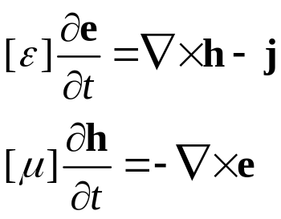
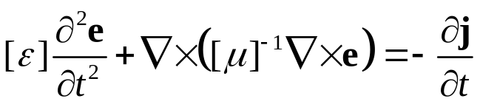
A projective approach to wave equation
The solution of the wave electromagnetic problem requires either the solution of:
  The two-fields first-order Maxwell differential equations:
  The one-field second-order Helmholtz differential equations:

Slide 5
A projective approach to wave equation
In both cases the key point is that of solving a differential equation which must hold exactly in every point of the domain.
If an analytic solution is unfeasible. Then a numeric solution is, strictly speaking impossible unless we make the problem simpler.
The key issues are in the bold, italics lighter green words. We cannot do that, but we can find a (or two) fields which approximately satisfy the equation in a subset of the domain.

Slide 6
A projective approach to wave equation
We can write a numerically solvable simpler problem by:
  Reducing the domain from a continuous set to:
    a discontinuous set of finite extension
    a continuous set subdivided into a finite set of region within each of which the field(s) have a finite rappresentation
  Enforcing the equation over these finite sets

Slide 7
A projective approach to wave equation
The Finite Element Method (FEM) requires:
  Subdivide the domain into a finite set of non-overlapping subdomains within each of which the field is expanded over a finite set of bases.
  The unknowns shifts from a field, which is a member of a function vector space of infinite dimension to a finite set of real/complex coefficients of the expansion of the unknown over a finite set of bases.
  This expansion can of course only approximate the field since the finite base can span only a finite subspace of the infinite function space.

Slide 8
A projective approach to wave equation
The Finite Element Method (FEM) requires:
  The equation still needs to be enforced. This is not done directly but rather by applying a weighted integral to it.
  This allows to write as many equations as there are weight functions, and reduce the integrals to known quantities
  The result is that the equation is satisfied in weak sense, meaning that it is not punctually true but rather true on average.

Slide 9
A projective approach to wave equation
The weak form corresponds in projecting the equation over the subspace spanned by the weighting function and letting the equation be strictly true (within the limitations of finite machine precision) only on this sub-space)
In other words we projected the equation onto the subspace and enforced its validity only in projective sense.
Once these concept are grasped we’re ready to get into FEM

Slide 10
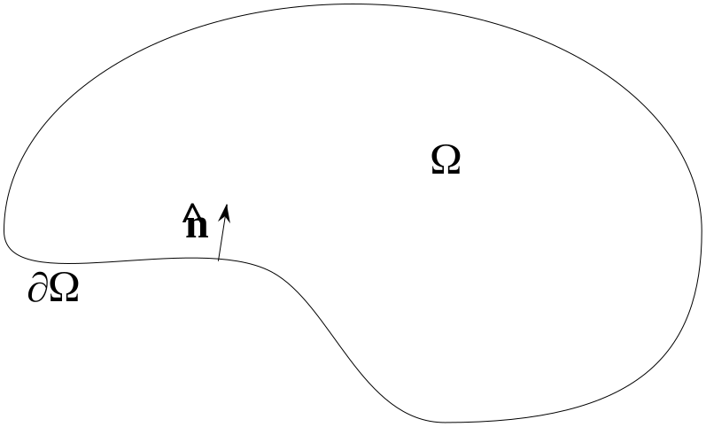
Finite Elements
The first tep to solve an electromagnetic problem encompassing a domain Ω bounded by ∂Ω is to write our weak form of the equation.

Slide 11

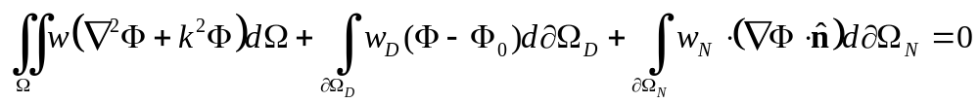
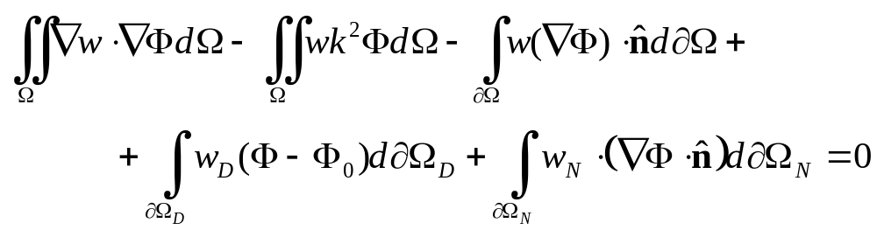
Finite Elements
If we, for example consider Helmholtz vector equation
Its weak form in Ω is
And, by applying Green’s theorem

Slide 12

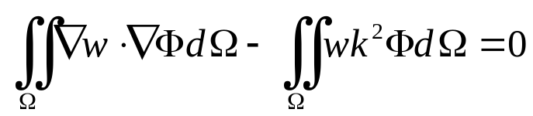
Finite Elements
By choosing Φ so that Dirichelet boundary conditions are automatically satisfied, and by choosing w = -w_{N} and w=0 at
And we reduce to

Slide 13
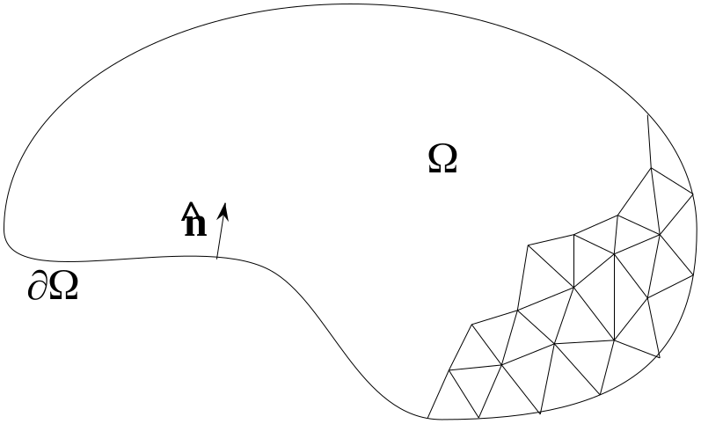
Finite Elements
Now, as a second step, the domain is to be discretized. Elements are usually triangles (2D) or tetrahedron (3D) but many other shapes are possible.

Slide 14
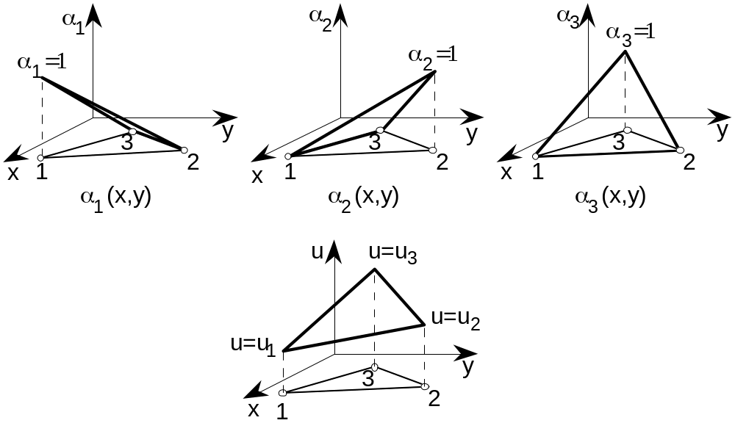
Finite Elements
On the top of each element a set of bases (three in the lowest 1st order elements) can be defined, leading to a picewise linear approximation of the unknown scalar field u within the element interpolating at the element vertices.

Slide 15
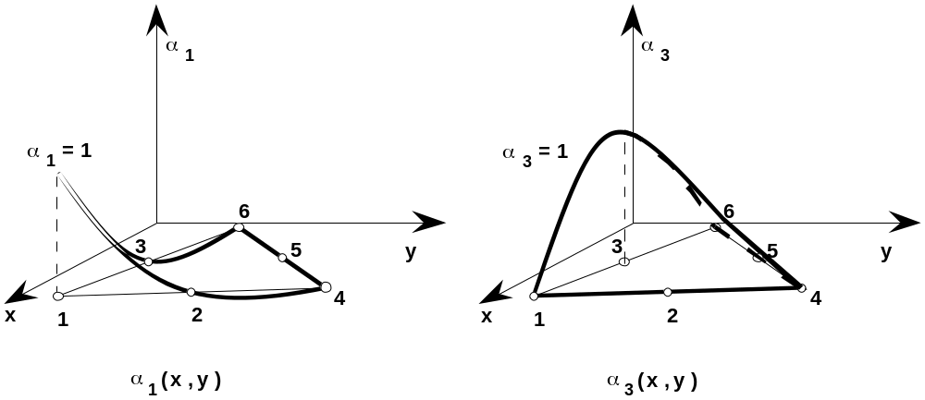
Finite Elements
Higher order scalar elements are easily attainable by adding interpolating points.

Slide 16
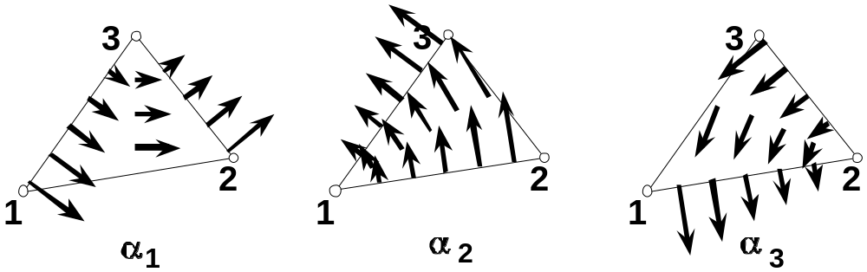
Finite Elements
But to efficiently model vector fields vector elements are usually prefearable

Slide 17
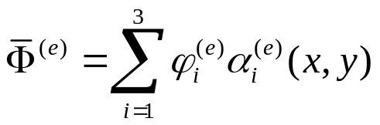
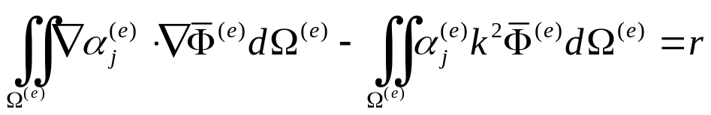
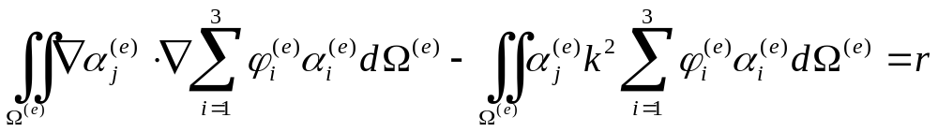
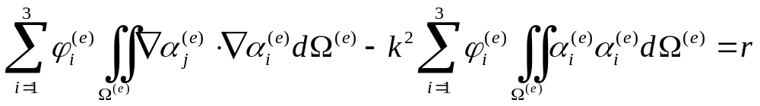
Finite Elements
Unknown field Φ can now be expanded on each element in terms of basis α:
And, if we use the same α as weights:

Slide 18
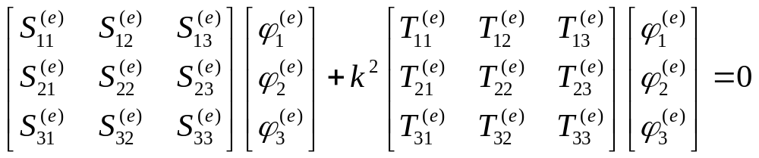
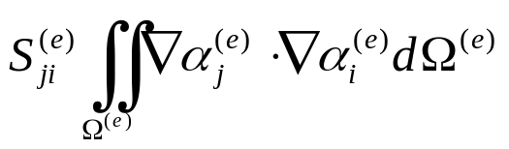
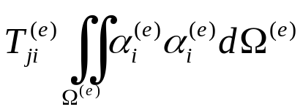
Finite Elements
Leading to the linear system:
with

Slide 19
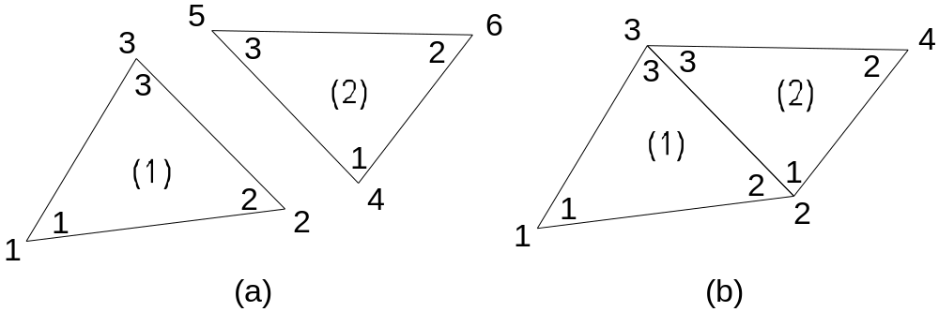
Finite Elements
Bookkeeping is a bit more complex in FEM with respect to FD-TD and TLM due to the unstructured nature of the discretization (which, on the other hand, is a very strong point)
A table matching a local and a global numbering scheme for interpolation points must be handled

Slide 20
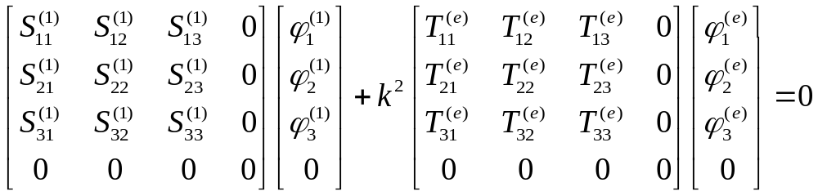
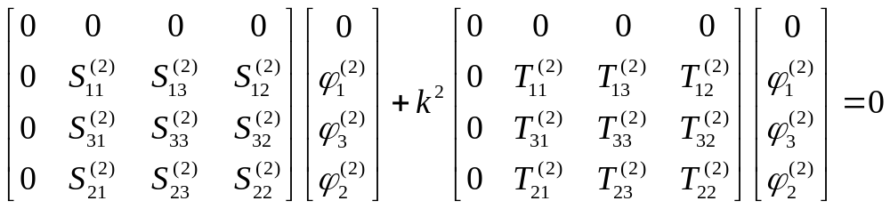
Finite Elements

Slide 21
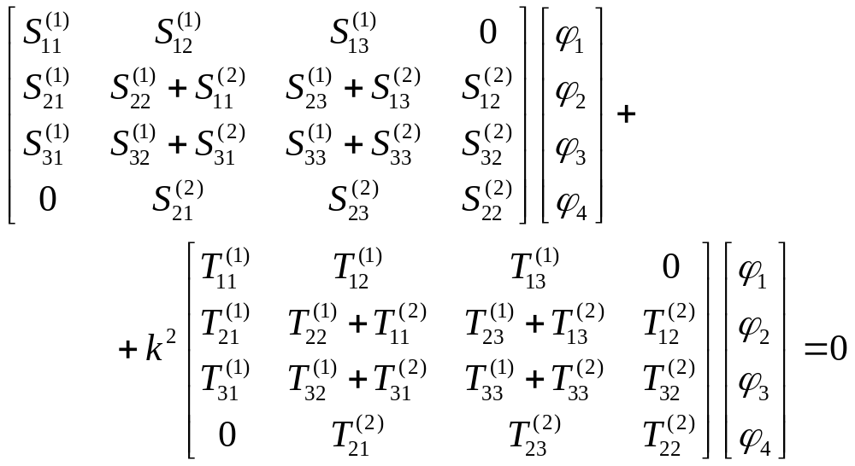
Finite Elements

Slide 22
The Time Domain
  A two-fields approach
  A one-field approach
  Consistency, Stability etc.
  1,2 and 3D Schemes
  FEM-TD vs. FD-TD

Slide 23
The Time Domain
The FEM-TD approach relies usually on a Faedo-Galerkin formulation to produce a semi-discrete approximation for Maxwell equations.
The Equations can either be:
  the first order differential Maxwell equation in both e and h fields
  the second order differential Helmholtz equation in either the e or h fields alone.

Slide 24
Two Fields
Two fields formulation

Slide 25
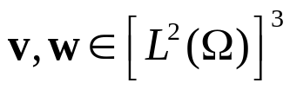
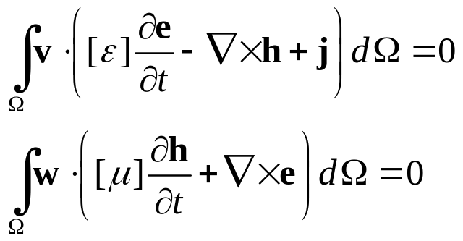
Two Fields
Two fields formulation
  Let’s test in a weighted residual framework the unknown fields with suitable vector functions which are square integrable on Ω
  Leading to the weak form

Slide 26
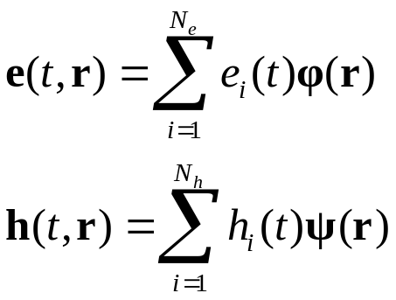
Two Fields
Two fields formulation
  Next we expand the unknown fields on a suitable set of bases

Slide 27
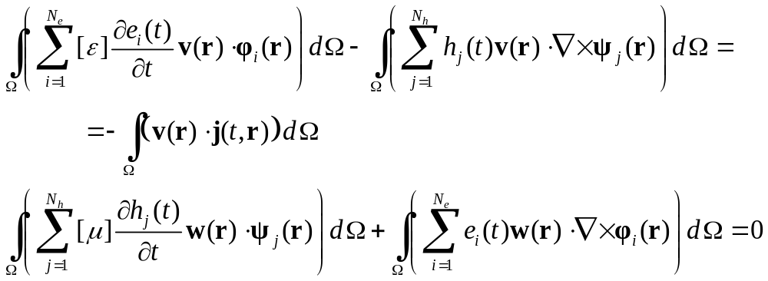
Two Fields
Two fields formulation

Slide 28
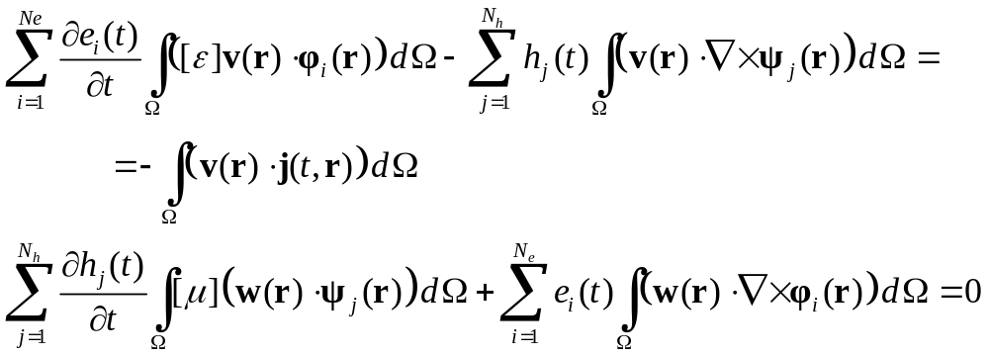
Two Fields
Two fields formulation
  Where integrals and summations can be swapped

Slide 29
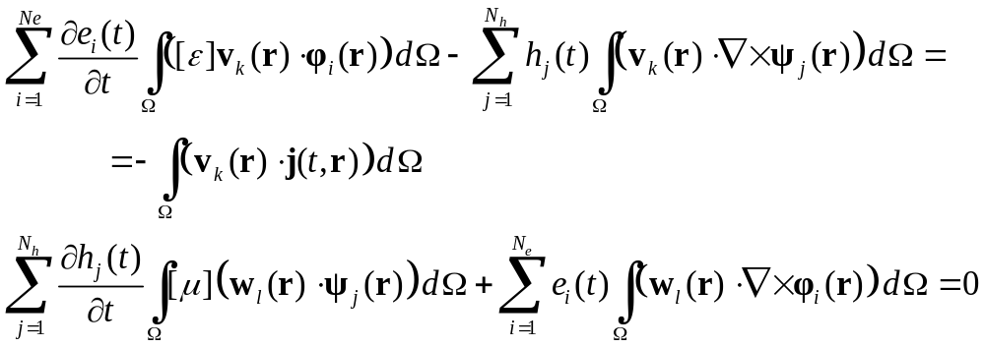
Two Fields
Two fields formulation
  Now, if weights belong to a suitable finite set

Slide 30
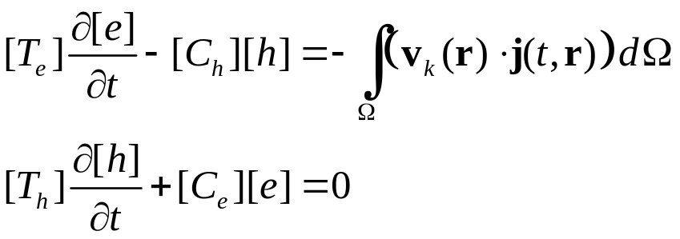
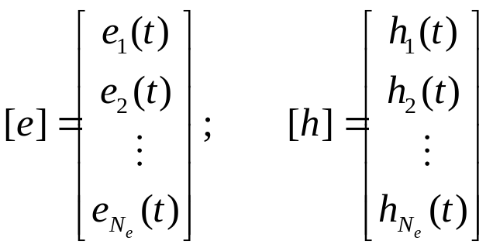
Two Fields
Two fields formulation
  And the following set of matrix equations obtained
  where

Slide 31
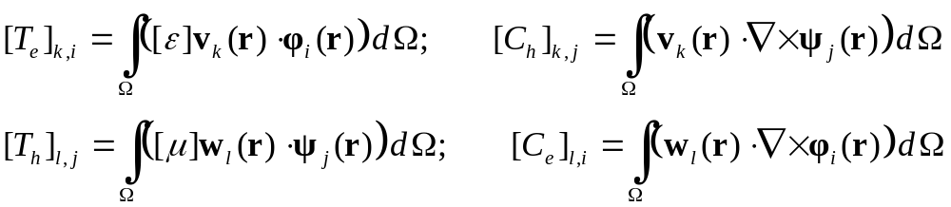
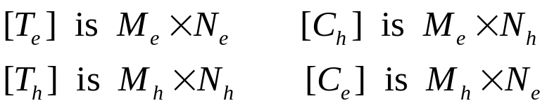
Two Fields
Two fields formulation
  Matrices are:
  Hence

Slide 32
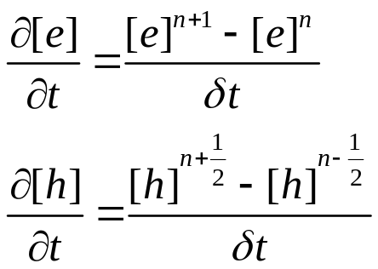
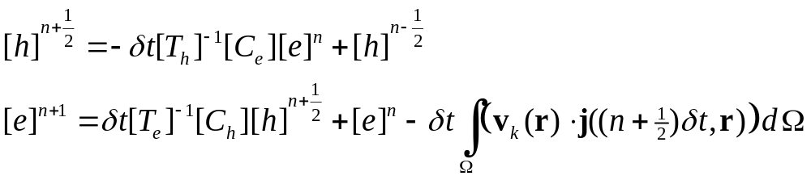
Two Fields
Two fields formulation
  The last step is to discretize in time, exploiting a classical leap-frog algorithm:
  Leading to

Slide 33
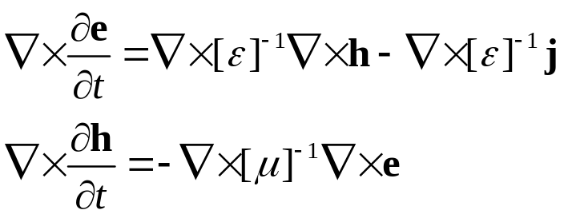
One Field
One field formulation
  By applying the rotor…

Slide 34
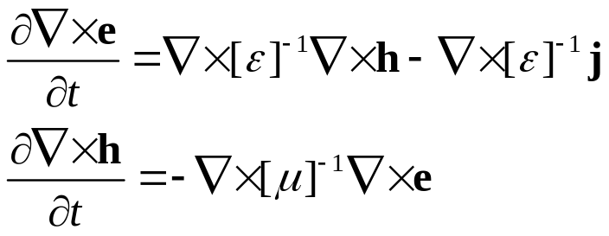
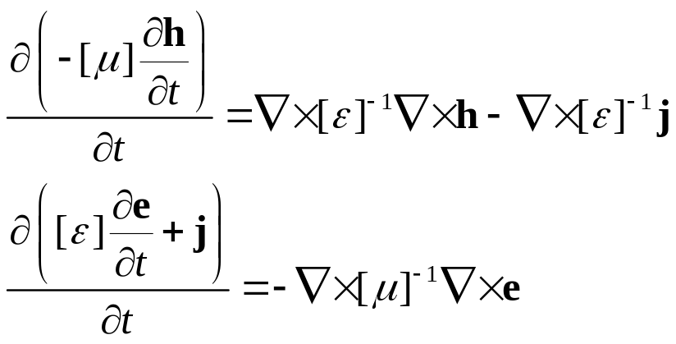
One Field
One field formulation
  …commuting differential operators…
  … and using Maxwell equations anew…

Slide 35
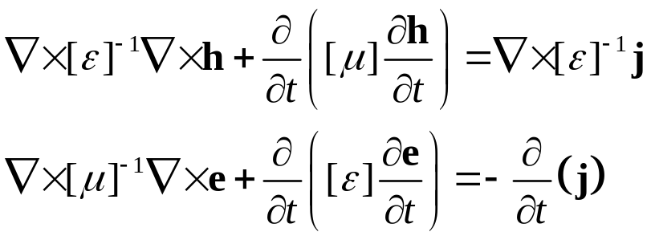
One Field
One field formulation
  …we obtain
  which are essentially the same equation, hence only the second will be considered.

Slide 36
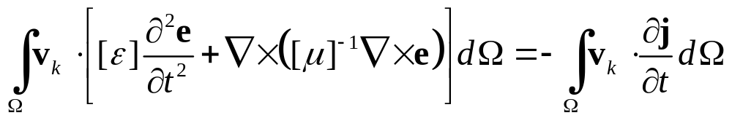
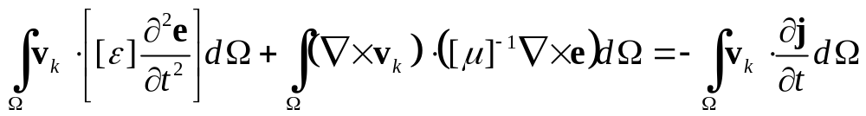
One Field
One field formulation
  in a time-independent medium
  as for the two field case, we will weight this with a suitable set of weights

Slide 37
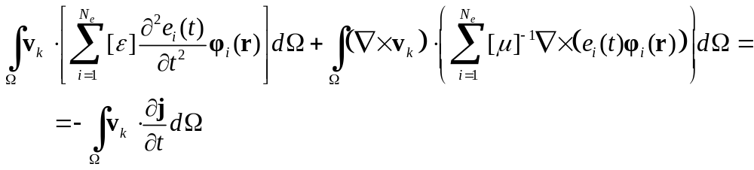
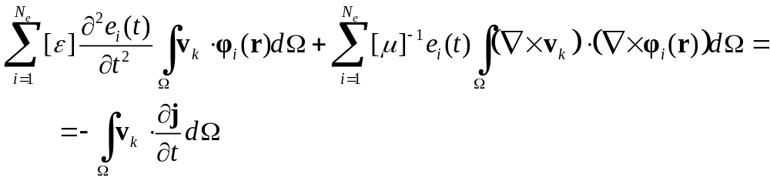
One Field
One field formulation
  and by expanding the unknown field over a suitable set of bases

Slide 38
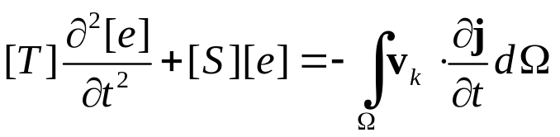
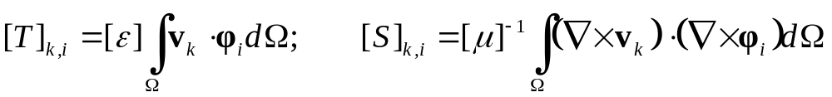
One Field
One field formulation
  This can be again rewritten in matrix form
  with

Slide 39
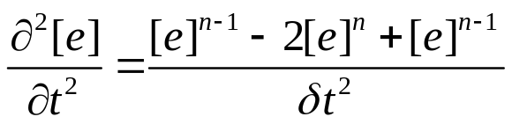
One Field
One field formulation
  This time the second derivative in time must be approximated with three points:
  Which is valid in time step n.
  The time step to sample [e] right multiplying [S] is crucial.

Slide 40
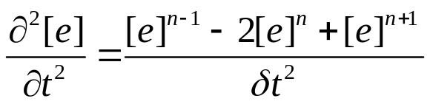



One Field
One field formulation
UNSTABLE (and forward differences)
Stable (but backward differences)
Conditionally Stable (but central differences)

Slide 41
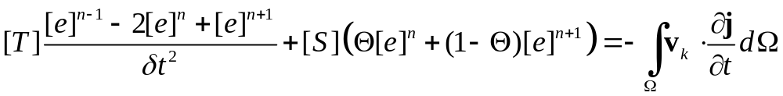
One Field
One field formulation
  Since stability ids a major issue the following mixed approach can be implemented:
  which is central differences for Θ=1 and backward if Θ=0.

Slide 42
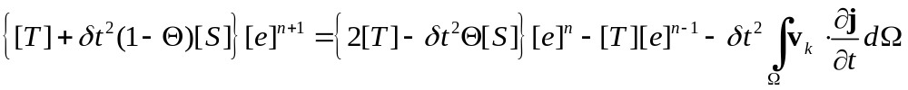
One Field
One field formulation
  The time stepping algorithm is
  Considering that δt is in the order of ps and that [T] and [S] contains permittivity and permeability it is numerically better to write
  Having extracted ε and μ from [T] and [S]

Slide 43
Consistency, Stability and Convergence
Consistency, stability and convergence.
  Lax equivalence:
  Consistency & stability imply convergence
  So question reduces to
  Is approach consistent?
  Is approach stable?

Slide 44
Consistency, Stability and Convergence
  Consistency is self-evident, since we are dealing with a weak formulation of Maxwell/Helmholtz equations
  Hence we should concentrate on stability

Slide 45
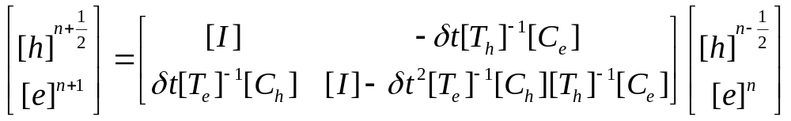

Consistency, Stability and Convergence
Two fields
  by assuming j=0
  or, shortly

Slide 46

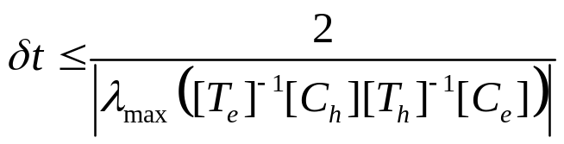
Consistency, Stability and Convergence
Two fields
  Now, an iterative setup
  is stable if
  Which means

Slide 47
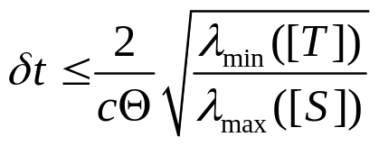
Consistency, Stability and Convergence
One field
  Thanks to the additional term Θ:

Slide 48

1D Scheme
Let’s assume a 1D linear domain along x.

Slide 49





1D Scheme
Maxwell equations reduces to:
To be expanded on the element first order bases

Slide 50

1D Scheme
If the simplest base functions we can think of are linear interpolant, while the simples weight functions are Dirac’s ones.
This calls for an interleaved scheme to avoid singularities

Slide 51




1D Scheme
The electric field is sampled at
The magnetic field at
With

Slide 52



1D Scheme
Matrices [T] are computed with both bases and weights on the same mesh:
The integral is nonzero only for k=i and l=j

Slide 53


1D Scheme
Matrices [C] are computed with bases on a mesh and weights on the other, thus leading to rectangular matrices:
Along y
Along z but rotated onto y from the rotor (here formally written as vector product)

Slide 54




1D Scheme
For what concerns the source
Vector with all zeros except in entry k

Slide 55




1D Scheme
A nice idea for excitation can be a Gaussian pulse, possibly modulated
With

Slide 56

1D Scheme
Now, being [T] matrices diagonal the inverse is trivial and, by considering all elements equal in length (δx) we have

Slide 57

1D Scheme
But if we write each equation separately…
The interleaved point matching FEM-TD results in exactly the same algorithm as FD-TD!

Slide 58

1D Scheme - Alternate
Of course Point Matching is unFEMish, so what about Galerkin?
By using same bases and weights, keeping the interleaved scheme:

Slide 59


1D Scheme - Alternate
Matrices [T] are then

Slide 60


1D Scheme - Alternate
It is more FEMish to consider elemental matrices and assemble them:
If we maintain the interleaved scheme and there are N elements, then there are
And to compute C matrices it must be taken into account the overlapping

Slide 61


1D Scheme - Alternate
Any derivative of the bases (constants!) in an element interacts with two elements of the other discretization for weights

Slide 62

1D Scheme - Alternate
Any derivative of the bases (constants!) in an element interacts with two elements of the other discretization for weights

Slide 63

1D Scheme - Alternate
Now, [T] matrices are tri-diagonal, hence inversion must be performed numerically

Slide 64

1D Scheme – Alternate (bis)
But you DON’T NEED to keep the interleaved scheme in space!

Slide 65
1D Scheme - Alternate
Matrices [T] stays the same, since they were already computed on matching discretizations
Of course, this time, both [T] matrices are the same size!

Slide 66

1D Scheme - Alternate
Any derivative of the bases (constants!) in an element interacts with just one element of the same discretization for the other field for weights:

Slide 67

1D Scheme - Alternate
Any derivative of the bases (constants!) in an element interacts with two elements of the other discretization for weights

Slide 68

1D Scheme - Alternate
Now, [T] matrices are tri-diagonal, hence inversion must be performed numerically

Slide 69
1D Scheme – One Field
One field formulation is appealing:
  You always use One Mesh
  You don’t need leapfrogging
  Matrices are simpler, and obtained by assembling conventional FEM [S] and [T] matrices.

Slide 70
1D Scheme – One Field
So… Uninterleaved spatial discretization!

Slide 71

1D Scheme – One Field
The electric field is sampled at
The magnetic field does not need to be sampled!
Matrices [T] relative to
Are essentially the same as in the Two Fields formulation(s)

Slide 72



1D Scheme – One Field
Matrix [S] is computed according to:
Both rotors stays parallel and becomes constant! So the elemental matrix is:

Slide 73


1D Scheme – One Field
For what concerns the source
Now the weight is distributed, but the source might be punctual! So the integral do revert the same to a point value

Slide 74
1D Scheme – One Field
Of course our Gaussian pulse, possibly modulated
Can be differtentiated numerically, but it would be smarter to differentiate it analytically, since this can be afforded.

Slide 75

1D Scheme – One Field
Now, global [T] and [S] matrices looks like

Slide 76
1D Scheme – One Field
Which we can now cast into

Slide 77
1D Scheme
Hands
on the
CODE!

Slide 78

2D Scheme
Now, if we want to do something significant we must go beyond 1D
The two fiels and one field formulations does not scale in a similar way with dimensions.
The necessity of an interleaved mesh in the two field formulation leads to implementable algorithms only for quadrilateral meshes

Slide 79
2D Scheme
For 2D triangular meshes the ideal bases are those of Whitney vector elements already recalled:
These needs now some more detailed definitions.

Slide 80



2D Scheme
First, we define area coordinates:

Slide 81


2D Scheme
Then we define bases

Slide 82


2D Scheme
Matrix [S] is, for the element

Slide 83


2D Scheme
While matrix [T] is, for the element

Slide 84



2D Scheme
Being
and

Slide 85

2D Scheme
Some results
1m x 0.4m 2D resonant cavity, 224 elements, 313 dof, b₀=300MHz, f0=350MHz

Slide 86

2D Scheme
Some results

Slide 87
2D Scheme
Hands
on the
CODE!

Slide 88
3D Scheme
Needless to say, 3D is what everyone needs
Here we have again to resort to a One Field formulation,
And to vector elements
Tetrahedra are a nice choice

Slide 89

3D Scheme
Edge i | From node n_{i} | To node m_{i}
1 | 1 | 2
2 | 1 | 3
3 | 1 | 4
4 | 2 | 3
5 | 4 | 2
6 | 3 | 4

Slide 90

3D Scheme
For 3D tetrahedrons Whitney vector elements are:

Slide 91



3D Scheme
And matrices
Where coefficients b,c and d are obtained writing the volume of the tetrahedron

Slide 92






3D Scheme
And matrices

Slide 93





3D Scheme
And matrices

Slide 94










3D Scheme
And matrices

Slide 95

3D Scheme
Some results
4m x 3m x 2m 3D cavity, 360 tetrahedrons, 858 dof, b₀=30MHz, f0=90MHz

Slide 96

3D Scheme
Some results

Slide 97


FEM-TD vs. FD-TD
Well, what are comparisons?
2D
3D

Slide 98
Applications
  But does FD-TD always win?
  Hybrid FEM-TD – FD-TD
  Some Results

Slide 99

But does FD-TD always win?
Well, a nicer comparison says

Slide 100

Hybrid FEM-TD – FD-TD
So a nice idea can be that of hybridizing the two techniques, keeping FEM-TD limited next to geometrical variations.

Slide 101

Hybrid FEM-TD – FD-TD
It’s just a matter of devising a suitable interface between the two techniques.

Slide 102

Hybrid FEM-TD – FD-TD
And a time marching algorithm (beware! You have 2 fields in FD-TD and one in FEM-TD!!):
  Compute H field at interrleaved step n+0.5 in FD
  Compute E field in FD grid at n+1 except on
  green arrows
  Use the known E field in the FD grid as forcing
  boundary condition at the red arrows to compute
  the E field in the FEM grid at n+1
  Cast back E field from FEM to FD at green arrows

Slide 103

Some Results
A metallic cylinder in free space

Slide 104
Some Results
Geometrical data:
  Cylinder diameter: 15cm
  Source (Magnetic current line) at 60cm from cylinder axis
  Field (H) computed at 40cm from cylinder axis
  δx = 15mm δt = 10ps
  Frequency band
  f₀=0.5, 1, 1.5 and 2 GHz
  b₀=50MHz

Slide 105

Some Results

Slide 106

Some Results

Slide 107

Some Results
A Vivaldi dipole

Slide 108
Some Results
Geometrical data:
  Antenna with exponential profile from 1cm to 20cm
  Source (Voltage source) at antenna port
  δx = 20mm δt = 10ps
  Frequency band
  f₀=1GHz
  b₀=500MHz

Slide 109

Some Results

Slide 110

Some Results
A Via hole
  Screen thickness: 1.98mm, l=d=7.94mm
  δx = 20mm δt = 10ps

Slide 111



Some Results
(a)
(b)
b)

Slide 112

Some Results
A microstrip filter
  RT/Duroid substrate εr=2.2, h=0.794 mm; w1=2.413 mm, w2=2.54 mm, l1=12.257 mm and l2=20.32 mm.

Slide 113

Some Results
b)

Slide 114

Some Results
An active antenna

Slide 115

Some Results
Geometry
  Illumination: Line source with Gaussian shaped current (Carrier 1GHz, Band 50MHz);
  Network: Ge or Si diode, eventually with a neighboring local oscillator at 800MHz;
b)

Slide 116

Some Results
b)

Slide 117

Some Results
b)

Slide 118
Bibliography
  Core References
  More recent papers
  My works…
  Other nice things to read
  Code fragments coming from…

Slide 119
Bibliography
Core references
D.H. Choi, W.J.R. Hoefer, “The finite-difference time-domain method and its application to eigenvalue problems,” IEEE Trans. Microwave Theory Tech., Vol. MTT-34, pp. 1464-1470, 1986.
A.C. Cangellaris, C.C. Lin, K.K. Mei, “Point-matched time-domain finite element methods for electromagnetic radiation and scattering,” IEEE Trans. Antennas Propagat., Vol. AP. 35, pp. 1160-1173, October 1987.
R.D. Lynch, K.D. Paulsen, “Time-domain integration of the Maxwell equations on finite elements,” IEEE Trans. Antennas Propagat., Vol. 38, pp. 1933-1942, December 1990.
K. Mahadevan, R. Mittra, “Radar cross section computation of inhomogeneous scatterers using edge-based finite element method in frequency and time domains,” Radio Science, Vol. 28, pp. 1181-1193, 1993.
M.F. Wong, O. Picon, V.F. Hanna, “A finite element method based on Whitney forms to solve Maxwell equations in time domain,” IEEE Trans. Magn., Vol. 31, pp. 1618-1621, May 1995.
J.F. Lee and Z.S. Sacks, “Whitney element time domain methods,” IEEE Trans. Magn., Vol. 31, pp. 1325-1329, May 1995.
J.F. Lee, R. Lee, A. Cangellaris, “Time-Domain Finite-Element Methods,” IEEE Transaction Antennas Propagat., Vol. 45, No. 3, March 1997.
JF. Lee, “WETD-A Finite Element Time-Domain Approach for Solving Maxwell's Equations,” IEEE Microwave and Guided Wave Let., Vol. 4, No. 1, January 1994, pp.11-14.

Slide 120
Bibliography
More recent references
B. Butrylo, C. Vollaire, L. Nicolas, “Stability and fidelity of the finite element time domain method with distorted mesh,” IEEE Trans. Magnetics, Vol. 40, March 2004 pp. 1424 – 1427.
T.-H. Loh, C. Mias, “Implementation of an exact modal absorbing boundary termination condition for the application of the finite-element time-domain technique to discontinuity problems in closed homogeneous waveguides,” IEEE Trans. Microwave Theory Tech., Vol. 52, March 2004, pp. 882 – 888.
A. Monorchio, A.R. Bretones, R. Mittra, G. Manara, R.G. Martin, “A hybrid time-domain technique that combines the finite element, finite difference and method of moment techniques to solve complex electromagnetic problems,” IEEE Trans. Antennas Propagat. Vol. 52, Oct. 2004, pp. 2666 – 2674.
H. Bo, F.L. Texeira, “Sparse and explicit FETD via approximate inverse Hodge (mass) matrix,” IEEE Microwave and Wireless Components Letters, Vol. 16, June 2006 pp. 348 – 350.
R.A. Chilton, R. Lee, “Late-time instability of the finite element time domain (FETD) method when using newmark time integration,” IEEE AP-S Symposyum, 9-15 June 2007 pp. 5071 – 5074.
N. Marais, D.B. Davidson, “A Comparison of Some Finite Element Time Domain Formulations in Electromagnetics” Int. Conf. on Electromagnetics in Advanced Applications, ICEAA 2007,
17-21 Sept. 2007, pp. 814 – 817.
Y.Cai, C. Mias, “Fast Finite Element Time Domain – Floquet Modal Absorbing Boundary Condition Modelling of Periodic Structures Using Recursive Convolution,” IEEE Trans. Antennas Propagat., Vol. 55, Sept. 2007, pp. 2550 – 2558.

Slide 121
Bibliography
My works on the topic (IMNSHO)
S. Selleri, J.Y. Dauvignac, G. Pelosi, Ch. Pichot, “Comparison between FDTD and hybrid FDTD-FETD applied to scattering and antenna problems,” Microwave and Optical Technology Letters, Vol. 18, N. 4, July 1998. pp. 247-250;
S. Selleri, J.Y. Dauvignac, Ch. pichot, G. Pelosi, “Numerical modeling of antennas with nonlinear lumped elements via a hybrid FETD-FDTD method,” AP-S/URSI Symposium, Atlanta, Georgia (USA), June 21-26, 1998, p. 100;
S. Selleri, J.Y. Dauvignac, Ch. Pichot, G. Pelosi, “Hybrid FETD-FDTD method applied to the analysis of antennas with nonlinear lumped elements,” 4th International Workshop on ‘Finite Elements for Microwave Engineering’, Poitiers, France, July 10-11, 1998;
A. Gaggelli, G. Pelosi, S. Selleri, “A FE/FD-TD procedure for the analysis of electromagnetic packaging problems,” URSI’98, Pamplona (Spain) September 16-18, 1998, pp. 381-382;
Plus a Technical Report dated 1997 at the University of Nice…

Slide 122
Bibliography
Other nice things to read
J.P. Bérenger, “A perfectly matched layer for the absorption of electromagnetic waves,” J. Comput. Phys., Vol. 114, pp. 185-200, October 1994.
J.P. Bérenger, “Perfectly matched layer for the FDTD solution of wave-structure interaction problems,” IEEE Trans. Antennas Propagat., Vol. 44, pp. 110-117, January 1996.
R.B. Wu, T. Itoh, “Hybridizing FD-TD analysis with unconditionally stable FEM for objects of curved boundary,” IEEE MTT-S Digest, pp. 833-836, 1995.
K.S. Yee, “Numerical Solution of initial boundary value probleminvolving Maxwell's equations in isotropic media,” IEEE Trans. Antennas Propagat., Vol. AP-14, pp. 302-307, May 1966.
A.Taflowe, M.E. Brodwin, “Numerical solution of steady-state electromagnetics scattering problems using the time dependent Maxwell' equations,” IEEE Trans. Microwave Theory Tech., Vol. MTT-23, pp. 623-630, 1975.
K.D. Paulsen, R.D. Lynch, “Elimination of vector parasites in finite element Maxwell solutions,” IEEE Trans. Microwave Theory Tech., Vol. 39, pp. 395-404, March 1991.
G.F. Carey, J.T. Oden, Finite Elements III: Computational Aspects, Prentice-Hall, Englewood Cliffs (NJ), 1994.
R.D. Richtmyer, K.W. Morton, Difference Methods for Initial-Value Problems, John Wiley & Sons, New York, 1967.
P.P. Silvester, R.L. Ferrari, Finite Elements for Electrical Engineering, Cambridge University Press, Cambridge, UK, 3rd Ed. 1996.
J. Jin, The Finite Element Method in Electromagnetics, John Wiley & Sons, New York, 1993.
P.P Silvester, G. Pelosi, Finite Elements for Wave Electromagnetics, IEEE Press, New York, 1994.
J.C. Nedelec, “Mixed Finite Elements in 3,” Numer. Math., Vol. 35, 1980, pp. 315-341.

Slide 123

Bibliography
Code fragments coming from …
G. Pelosi, R. Coccioli, S. Selleri, Quick Finite Elements for Electromagnetic Waves, Artech House, London (UK), June 1998. ISBN 0-89006-848-8.
Second edition being worked on

