Slide 1
HEMT(high electron mobillity transistor)
Hyun Sub Kim

Slide 2
Contents of presentation
1.Introduction to HEMT
2. Basic Device physics
♣ Principle of FET
♣ The basic structure of HEMT
♣ modulation doping
♣ Measurement of mobillity
3.Variants of HEMT
4.Applications
5.Conclusion

Slide 3
1.Introduction to HEMT
High Electron Mobility transistors (HEMT),
discovered in 1980 by T. Mimura.
HEMT is a kind of field effect transistor.
• HEMT: High Electron Mobility Transistor
– Also called:
– MODFET Modulation Doped Field Effect Transistor
– TEGFET Two-Dimensional Electron Gas Field Effect Transistor
– pHEMT Pseudomorphic HEMT
– HFET Heterojunction Field Effect Transistor
A common feature of this device is that a quantum confined 2DEG with high electron mobillity is used as the conducting carrier

Slide 4
Content of presentation
1.Introduction to HEMT
2.Basic device physics
♣ Principle of FET
♣ The basic structure of HEMT
♣ modulation doping
♣ measurement of mobillity
3.Variants of HEMT
4.applications
5.Conclusion

Slide 5
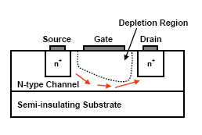
2.Basic device physics
♣ Principle of FET
Conducting semiconductor channel between two ohmic contacts – source and drain
The gate terminal controls the channel current
The gate structure acts as a two-terminal device:
  MOS-structure (MOSFET)
  p-n junction (JFET)
  Schottky barrier (MESFET)
  Heterojunction (HFET)
The gate is a very high-impedance terminal

Slide 6
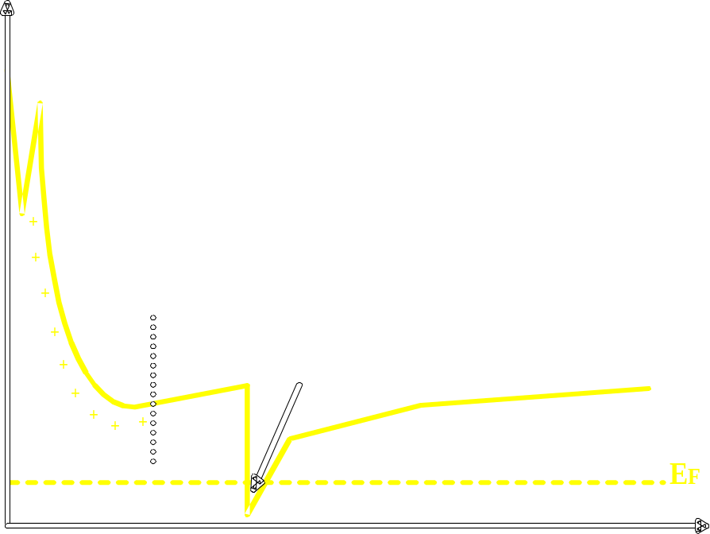
♣ The basic structure of HEMT
Source
Gate
Drain
n+ GaAs
n AlGaAs
AlGaAs
N-type
doping
n+ AlGaAs donor
Undoped AlGaAs spacer
AlGaAS spacer
2DEG
GaAs
Undoped GaAs channel
GaAs buffer layer
2DEG
GaAs semi-insulating substrate

Slide 7
♣ Buffer layer → defect isolation, smooth surface creation.
PHEMT(pseudomorphic HEMT): superlattice structure(to further inhibit substrate conduction)
This structure is a periodic arrangement of undoped epitaxial layers used to realize a thicker
epitaxial layer of a given property.
Ex) alternating layers of AlxGa1-xAs and GaAs form typical PHEMT superlattice.
♣ 2DEG→ This is a result from the band gap difference between AlxGa1-xAs and GaAs
A sheet of nearly-free electrons
Very high mobillity

Slide 8

2-DEG Sheet Carrier Density
DOS
Bulk (3D)
Quantum Well (2D)
DOS
Quantum Wire (1D)
DOS
DOS
Quantum Dot (0D)
Energy
Density of states for 2-DEG is D = which is independent of E while in 3-D,
(E) E1/2

Slide 9
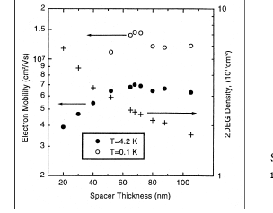
♣ The spacer layer→This layer serves to separate the 2DEG from any ionized donors
generated by n+ active layer.
Interaction decreases with increasing separation between impurities and 2-DEG
(mobillity )
drawback:
The sheet carrier concentration
in the channel is reduced as the spacer
layer
♣ Donor layer→ The source of electrons.
♣ n+ GaAs → low-resistance ohmic contacts.

Slide 10
♣
♣ modulation doping
0.2 eV
E
C
Si doped
2DEG
E
F
Undoped
E
1
GaAS cap
AlGaAs
AlGaAs
GaAs
(Spacer)
Charge transfer across heterojunction consisting of a large band gab and a small band gab material
Electrons are transferred until thermodynamic equilibrium is reached (constant Fermi level)
Electrons accumulate in undoped GaAs forming a 2-DEG and are thus spatially separated from the donor atoms in n-AlGaAs.

Slide 11
E y= v d B
♣ Measurement of mobillity
Hall effect
F=q E y
F=q v d B
B
Ex
VH= E y d
J x
Ex
ρ x y = E y/ j x = E y /n q v d
= -B / n e
+ + + + + + + + + +
Jx
E y
- - - - - - - - - -
ρ x x = E x / j x =1/n eμ
Measurement of ρ x y and ρ x x in known magnetic field B, can give the electron density and the mobility of the sample

Slide 12
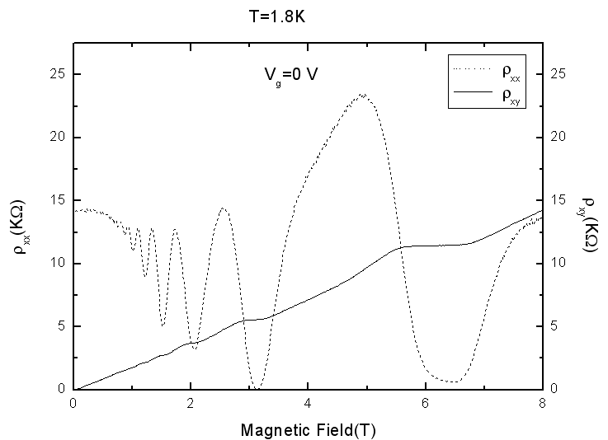
ρ x y
Hall bar
Source
Drain
ρ x x
N_{s} =3.2 * 10¹¹ cm⁻²
Mobillity=0.129 *10⁴ cm²[V•s]⁻¹

Slide 13
Content of presentation
1.Introduction to HEMT
2.Basic device physics
♣ Principle of FET
♣ The basic structure of HEMT
♣ modulation doping
♣ Measurement of mobillity
3.Variants of HEMT
4.Applications
5.Conclusion

Slide 14
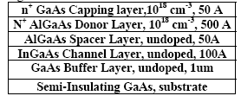
3.Variants of HEMT
♣ PHEMT(pseudomorphic HEMT)
This type of device is used in the microwave and high frequency applications
The performance advantages of InGaAs channel include:
1.higher bandgap discontinuity between InGaAs/AlGaAs compared to AlGaAs/ GaAs produces higher carrier sheet density and higher current.
2. InGaAs channel has higher electron mobility and higher saturation velocity than GaAs, which is good for high frequency performance. InGaAs channel also improves the PHEMT ís output

Slide 15
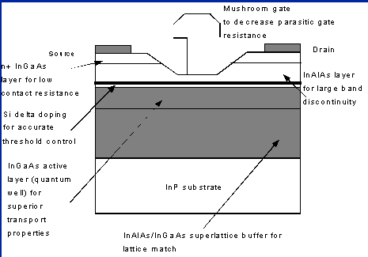
InP-based (InAlAs/InGaAs) HEMTs demonstrate the highest cutoff frequency among another three-terminal devices. HEMTs based on this material system are therefore of prime interest for millimeter wave applications.
♣InP based HEMT
Low noise
Higher cutoff frequency
Higher gain

Slide 16
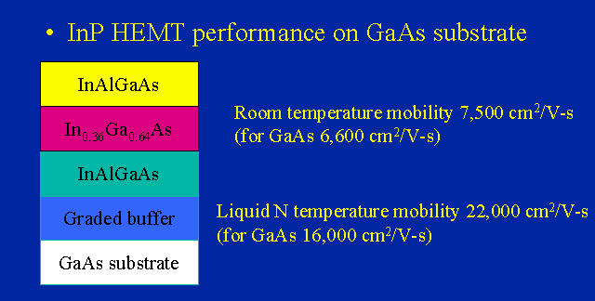
♣Metamorphic HEMT
GaAs P-HEMT’s show the
excellent power and gain performance at microwave
frequencies, but their millimeter-wave performances
are limited by the relatively small fT (unity gain cutoff
frequency) and fmax (maximum oscillation of frequency).
These limitations can be solved by using
metamorphic HEMT technologies
Where high In contant channel is necessary for high performance
Metamorphic epilayers allows the realization of high quality heterostructures having a lattice parameter different from that of the substrate. These materials have been developed to overcome the drawbacks of conventional lattice matched structures on GaAs and InP substrates, especially for HEMT application

Slide 17
Primary Advantages of HEMT over FET
Higher mobility, saturated velocity & overshoot ⇒ higher f
Lower scattering & buried channel ⇒ lower noise figure
Excellent RF performance with high gain and low noise

Slide 18
Content of presentation
1.Introduction to HEMT
2.Device physics
♣ Principle of FET
♣ The basic structure of HEMT
♣ modulation doping
♣ Measurement of mobillity
3.Other HEMT
4.Applications
5.Conclusion

Slide 19
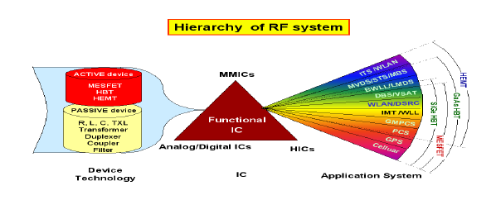
4.Applications

Slide 20
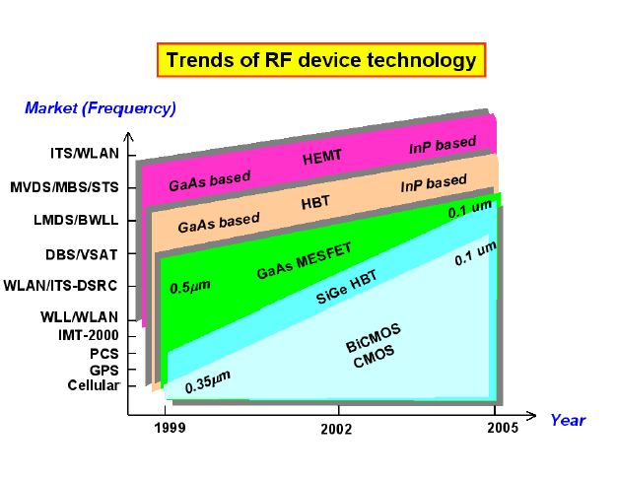

Slide 21
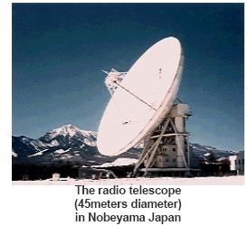
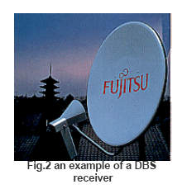
Initially, HEMT was used for a radio telescope (45 meters in diameter) in Nobeyama Japan
By using HEMT we can receive TV programs from satellites 36,000Km above the ground.

Slide 22
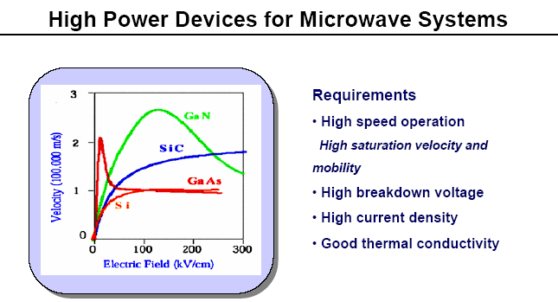
GaN HEMT is the appropriate
technology for the High power devices

Slide 23
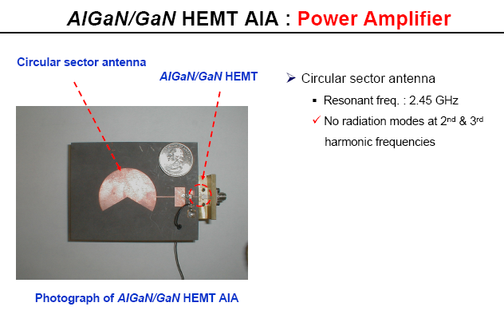

Slide 24
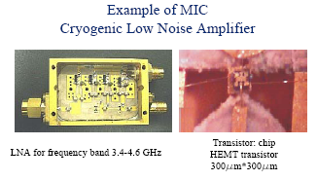
• 2D electron gas, increased mobility, increased transconductance, reduced shot noise.
• Low power consumption, especially for InP based HEMT.
InP HEMT is the appropriate
technology for the LNA devices
HEMT LNA
• It receives the broadcast television signal from the antenna, and with minimal signal -to-noise ratio degradation it amplifies the received signal sufficiently for further processing.

Slide 25
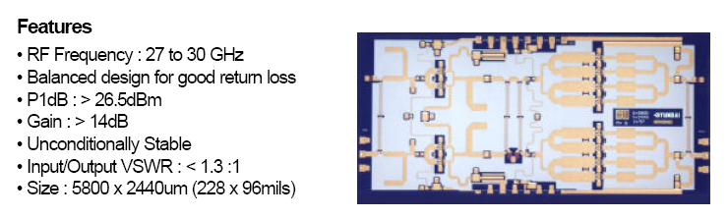
power HEMT amplifier
This is suitable for a variety of applications such as high power amplifiers, for satellite communications, LMDS/LMCS, and wireless communications.

Slide 26
5.Conclusion
The High Electron Mobility Transistor has demonstrated good characteristics for microwave and high frequency application as well as the power applications and is widely used.

Slide 27
Thank you ^^

Slide 28
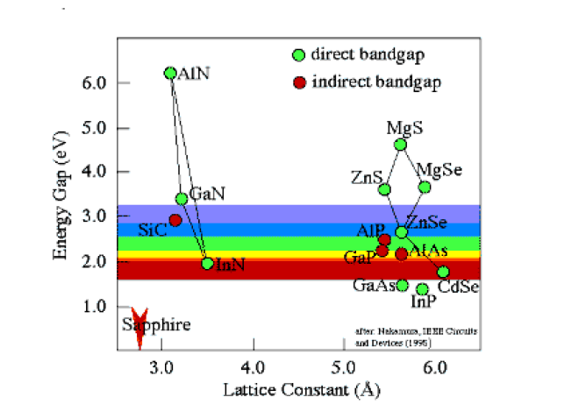

Slide 29
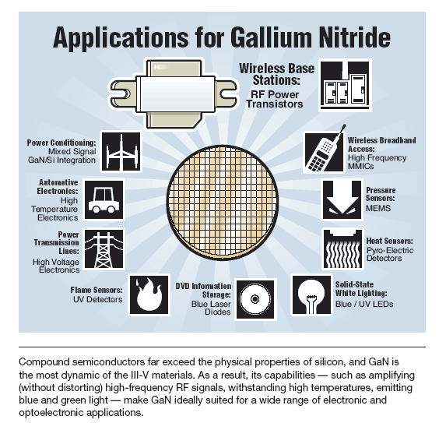

Slide 30
