Slide 1
Circuiti Integrati
per
Applicazioni Wireless
Ing. Giovanni Collodi
Università degli Studi di Firenze
Dipartimento di Elettronica e Telecomunicazioni

Slide 2
Transceiver Main Characteristics
True single-chip UHF trans-ceiver designed for very low power and very low voltage wireless applications.
Mainly intended for the ISM (Industrial, Scientific and Medical) and SRD (Short Range Device) frequency bands at 315, 433, 868 and 915 MHz.
Easily programmed for operation at other frequencies in the 300-1000 MHz range
The main operating parameters of CC1000 can be programmed via a serial bus, thus making CC1000 a very flexible and easy to use transceiver. In a typical system CC1000 will be used together with a microcontroller and a few external passive components.

Slide 3
RF Transceiver for Wireless Application
Transceiver Typical Fetures
True single chip UHF RF transceiver
Very low current consumption
Frequency range 300 – 1000 MHz
Integrated bit synchroniser
High sensitivity (typical -110 dBm at 2.4 kBaud)
Programmable output power –20 to 10 dBm
Small size (TSSOP-28 or UltraCSP™ package)
Low supply voltage (2.1 V to 3.6 V)
Very few external components required
No external RF switch / IF filter required
RSSI output
Single port antenna connection
FSK data rate up to 76.8 kBaud
Complies with EN 300 220 and FCC CFR47 part 15
Programmable frequency in 250 Hz steps makes crystal temperature drift compensation possible without TCXO
Suitable for frequency hopping protocols
Development kit available
Easy-to-use software for generating the CC1000 configuration data

Slide 4
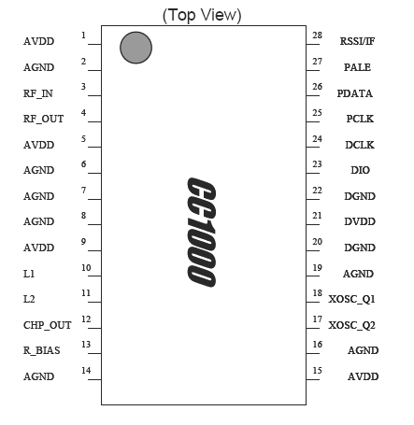
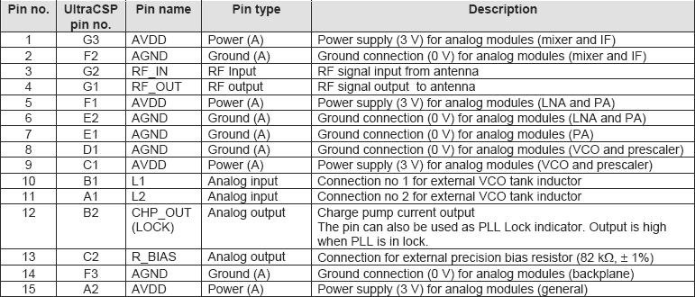
Pin Assignment 1

Slide 5
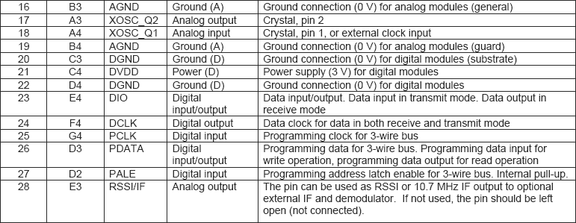
Pin Assignment 2

Slide 6
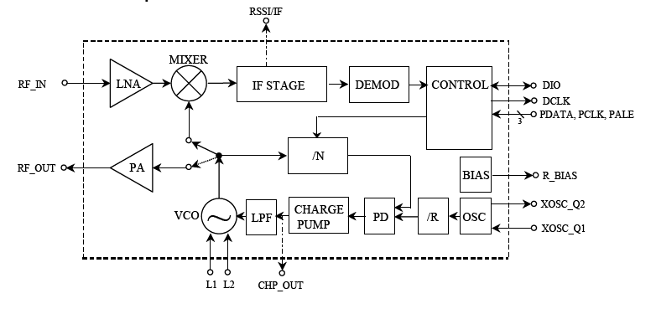
RF Transceiver Functional Blocks
In receive mode is configured as a traditional superheterodyne receiver.

Slide 7
RF Transceiver Receive Mode
In receive mode is configured as a traditional uperheterodyne receiver.
The RF input signal is amplified by the low-noise amplifier (LNA) and converted down to the intermediate frequency (IF) by the mixer (MIXER).
In the intermediate frequency stage (IF STAGE) this downconverted signal is amplified and filtered before being fed to the demodulator (DEMOD).
As an option a RSSI signal, or the IF signal after the mixer is available at the RSSI/IF pin.
After demodulation outputs the digital demodulated data on the pin DIO. Synchronisation is done on-chip providing data clock at DCLK.

Slide 8
RF Transceiver Transmit Mode
In transmit mode the voltage controlled oscillator (VCO) output signal is fed directly to the power amplifier (PA).
The RF output is frequency shift keyed (FSK) by the digital bit stream fed to the pin DIO.
The internal T/R switch circuitry makes the antenna interface and matching very easy.
.
The frequency synthesiser generates the local oscillator signal which is fed to the MIXER in receive mode and to the PA in transmit mode
The frequency synthesiser consists of a crystal oscillator (XOSC), phase detector (PD), charge pump (CHARGE PUMP), VCO, and frequency dividers (/R and /N).
An external crystal must be connected to XOSC, and only an external inductor is required for the VCO.
The 3-wire digital serial interface (CONTROL) is used for configuration.

Slide 9
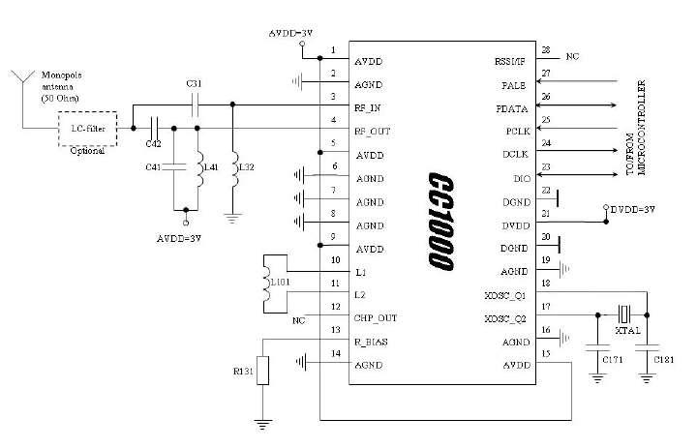
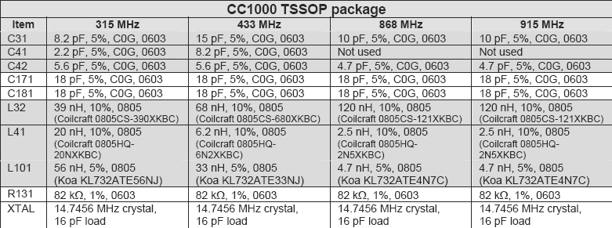
RF Transceiver External Components 1

Slide 10
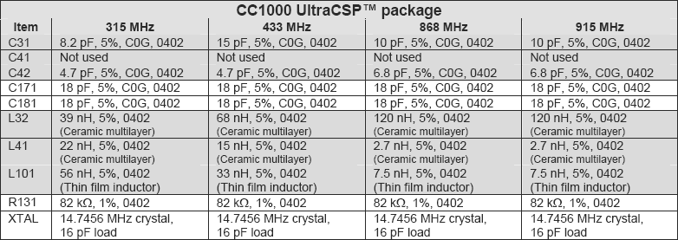
RF Transceiver External Components 2

Slide 11
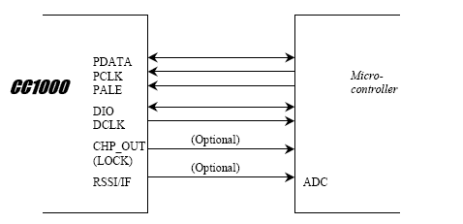
RF Transceiver to Microcontroller Interface
The microcontroller uses 3 output pins for the configuration interface (PDATA, PCLK and PALE).
PDATA should be a bi-directional pin for data read-back.
A bi-directional pin is used for data (DIO) to be transmitted and data received.
DCLK providing the data timing should be connected to a microcontroller input.
Optionally another pin can be used to monitor the LOCK signal (available at the CHP_OUT pin, this signal is logic level high when the PLL is in lock).

Slide 12
Transceiver Configuration
Transceiver can be configured to achieve the best performance for different applications.
Through the programmable configuration registers the following key parameters can be programmed:
  Receive / transmit mode
  RF output power
  Frequency synthesiser key parameters: RF output frequency, FSK frequency separation
  (deviation), crystal oscillator reference frequency
  Power-down / power-up mode
  Crystal oscillator power-up / power down
  Data rate and data format (NRZ, Manchester coded or UART interface)
  Synthesiser lock indicator mode
  Optional RSSI or external

Slide 13
RF Transceiver Signal Interface
The signal interface consists of DIO and DCLK and is used for the data to be transmitted and data received.
DIO is the bi-directional data line and DCLK provides a synchronous clock both during data transmission and data reception.
The Transceivercan be used with NRZ (Non-Return-to-Zero) data or Manchester (bi-phase-level) encoded data.

Slide 14
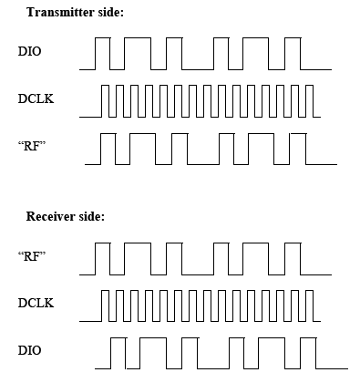
RF Transceiver NRZ Mode
Data provided by microcontroller
Clock provided by Transceiver
FSK modulating signal (NRZ)
Demodulated signal (NRZ)
Clock provided by Transceiver
Data provided by Transceiver

Slide 15
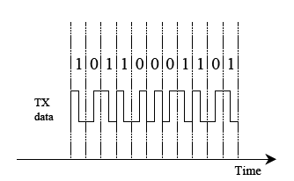
Manchester Encoding and Decoding
The Manchester code is based on transitions; a “0” is encoded as a low-to-high transition, a “1” is encoded as a high-to-low transition.
The Transceiver can detect a Manchester decoding violation and will set a Manchester Violation Flag when such a violation is detected in the incoming signal.
The Manchester code ensures that the signal has a constant DC component, which is necessary in some FSK demodulators.

Slide 16
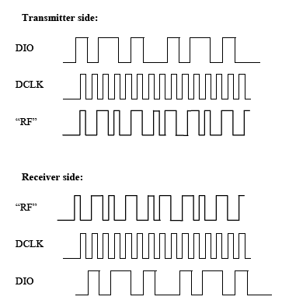
RF Transceiver Manchester Mode
Data provided by Microcontroller (NRZ)
Clock provided by Transceiver
FSK modulating signal (Manchester)
Demodulated signal (Manchester)
Clock provided by Transceiver
Data provided by Transceiver (NRZ)

Slide 17
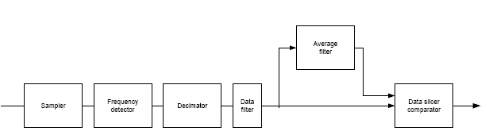
Demodulator Block Diagramm
The IF signal is sampled and its instantaneous frequency is detected.
The result is decimated and filtered.
In the data slicer the data filter output is compared to the average filter output to generate the data output.
The averaging filter is used to find the average value of the incoming data.
While the averaging filter is running and acquiring samples, it is important that the number of high and low bits received is equal (e.g. Manchester code or a balanced preamble).

Slide 18
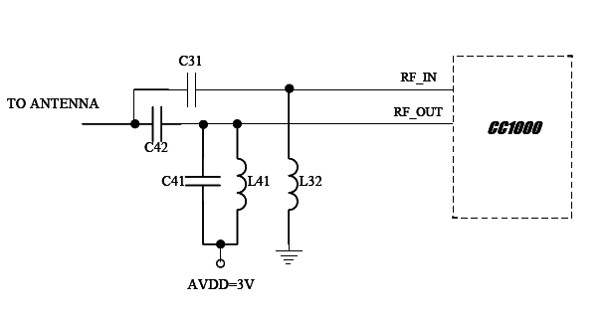
Input/Output Matching
A few passive external components combined with the internal T/R switch circuitry ensures match in both RX and TX mode.

