Slide 1
Circuiti Integrati
per
Applicazioni Wireless
Ing. Giovanni Collodi
Università degli Studi di Firenze
Dipartimento di Elettronica e Telecomunicazioni

Slide 2
CC2420 Main Characteristic
Is a true single-chip 2.4 GHz IEEE 802.15.4 compliant RF transceiver designed for low-power and low-voltage wireless applications
Includes a digital direct sequence spread spectrum baseband modem providing a spreading gain of 9 dB and an effective data rate of 250 kbps
Is a low-cost, highly integrated solution for robust wireless communication in the 2.4 GHz unlicensed ISM band.
It complies with worldwide regulations covered by ETSI EN 300 328 and EN 300 440 class 2 (Europe), FCC CFR47 Part 15 (US) and ARIB STD-T66 (Japan).
Provides extensive hardware support for packet handling, data buffering, burst transmissions, data encryption, data authentication, clear channel assessment, link quality indication and packet timing information.
These features reduce the load on the host controller and allow the transceiver to interface low-cost microcontrollers.
The configuration interface and transmit / receive FIFOs of CC2420 are accessed via an SPI interface.
In a typical application CC2420 will be used together with a microcontroller and a few external passive components.

Slide 3
2,45 GHz Zig BeeTransceiver
for Wireless Application
Typical Fetures
Programmable output power
No external RF switch / filter needed
I/Q low-IF receiver
I/Q direct upconversion transmitter
Very few external components
128(RX) + 128(TX) byte data buffering
Digital RSSI / LQI support
Hardware MAC encryption (AES-128)
Battery monitor
QLP-48 package, 7x7 mm
Complies with ETSI EN 300 328, EN 300 440 class 2, FCC CFR-47 part 15 and ARIB STD-T66
True single-chip 2.4 GHz IEEE 802.15.4 compliant Transceiver with baseband modem and MAC support
DSSS baseband modem with 2 MChips/s and 250 kbps effective data rate.
Suitable for both RFD and FFD operation
Low current consumption (RX: 18.8 mA, TX: 17.4 mA)
Low supply voltage (2.1 – 3.6 V) with integrated voltage regulator
Low supply voltage (1.6 – 2.0 V) with external voltage regulator

Slide 4
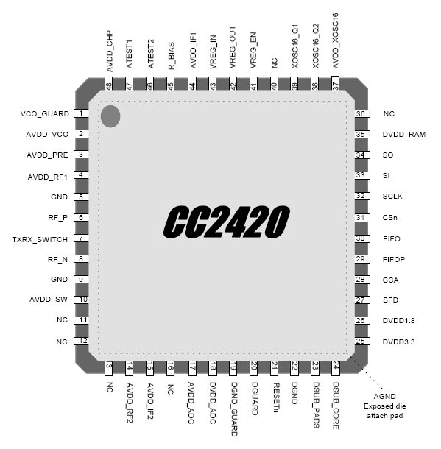
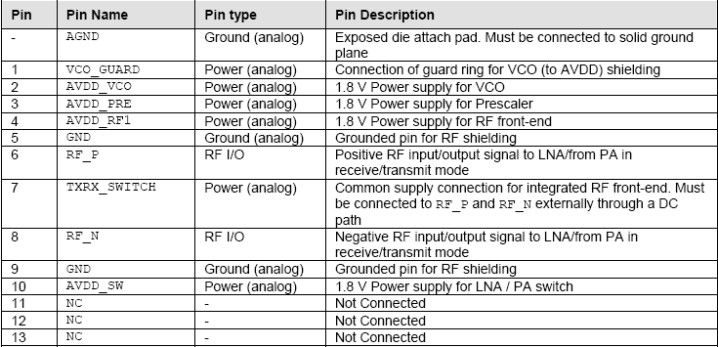
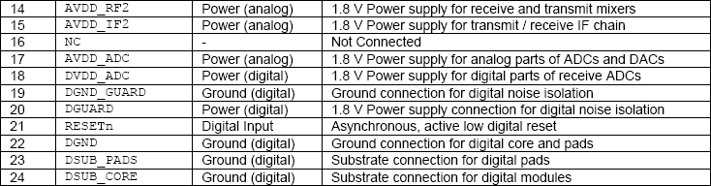
RF Transceiver for Wireless Application

Slide 5
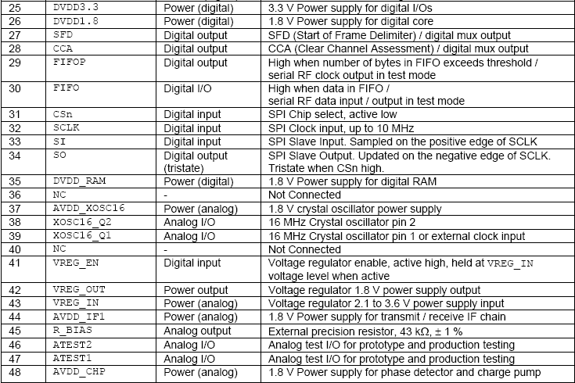
RF Transceiver for Wireless Application

Slide 6
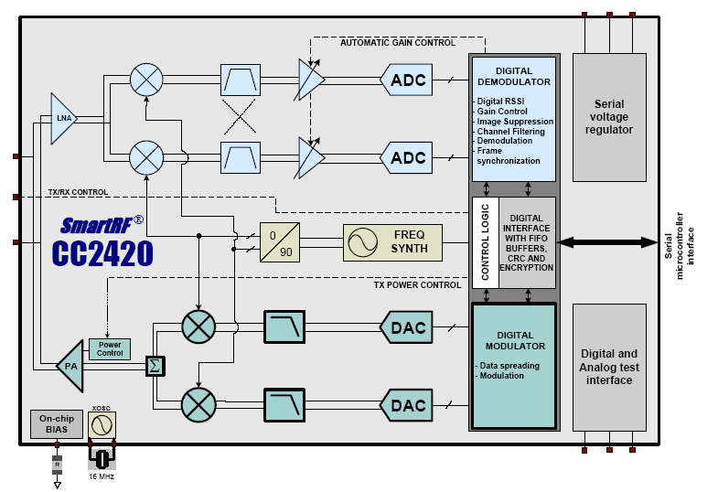
RF Transceiver Functional Blocks

Slide 7
RF Transceiver Recive Mode
The Transceiver is a low-IF receiver
The received RF signal is amplified by the low-noise amplifier (LNA) and down-converted in quadrature (I and Q) to the intermediate frequency (IF).
At IF (2 MHz), the complex I/Q signal is filtered and amplified, and then digitized by the ADCs.
Automatic gain control, final channel filtering, de-spreading, symbol correlation and byte synchronisation are performed digitally
When the SFD pin goes high, this indicates that a start of frame delimiter has been detected. The transceiver buffers the received data in a 128 byte receive FIFO.
The user may read the FIFO through an SPI interface.
CRC is verified in hardware

Slide 8
RF Transceiver Transmit Mode
The transmitter is based on direct up-conversion
The data is buffered in a 128 byte transmit FIFO (separate from the receive FIFO).
The preamble and start of frame delimiter are generated by hardware
Each symbol (4 bits) is spread using the IEEE 802.15.4 spreading sequence to 32 chips and output to the digital-to-analog converters (DACs).
An analog lowpass filter passes the signal to the quadrature (I and Q) upconversion mixers.
The RF signal is amplified in the power amplifier (PA) and fed to the antenna.
The internal T/R switch circuitry makes the antenna interface and matching easy.
The RF connection is differential.
A balun may be used for single-ended antennas.
The frequency synthesizer includes a completely on-chip LC VCO and a 90

Slide 9
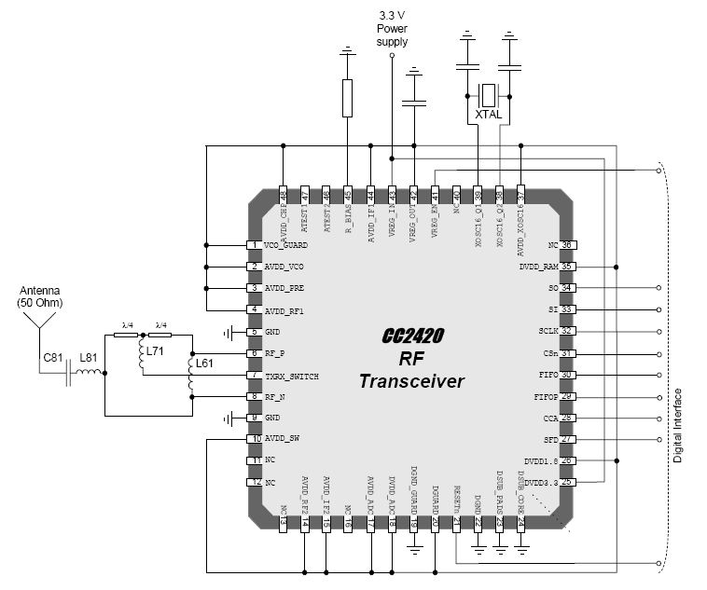
RF Transceiver External Components
Item | Single ended output, transmission line balun
C42 | 10 µF, 0.5Ω< ESR < 5Ω
C61 | Not used
C62 | Not used
C71 | Not used
C81 | 5.6 pF, +/- 0.25pF, NP0, 0402
C381 | 27 pF, 5%, NP0, 0402
C391 | 27 pF, 5%, NP0, 0402
L61 | 8.2 nH, 5%, Monolithic/multilayer, 0402
L62 | Not used
L71 | 22 nH, 5%, Monolithic/multilayer, 0402
L81 | 1.8 nH, +/- 0.3nH, Monolithic/multilayer, 0402
R451 | 43 kΩ, 1%, 0402
XTAL | 16 MHz crystal, 16 pF load (C_{L}), ESR < 60 Ω
Typical application circuit with transmission line balun for single-ended operation

Slide 10
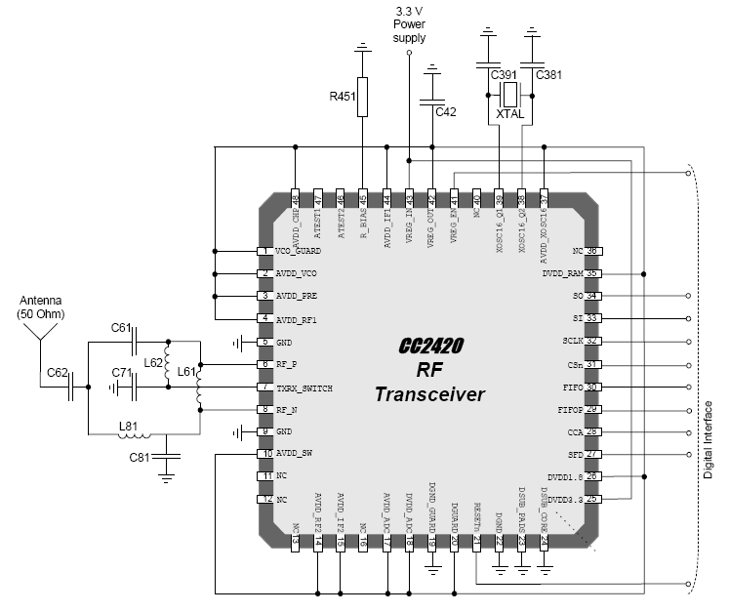
RF Transceiver External Components
Item | Single ended output, discrete balun
C42 | 10 µF, 0.5Ω< ESR < 5Ω
C61 | 0.5 pF, +/- 0.25pF, NP0, 0402
C62 | 5.6 pF, +/- 0.25pF, NP0, 0402
C71 | 5.6 pF, 10%, X5R, 0402
C81 | 0.5 pF, +/- 0.25pF, NP0, 0402
C381 | 27 pF, 5%, NP0, 0402
C391 | 27 pF, 5%, NP0, 0402
L61 | 7.5 nH, 5%, Monolithic/multilayer, 0402
L62 | 5.6 nH, 5%, Monolithic/multilayer, 0402
L71 | Not used
L81 | 7.5 nH, 5%, Monolithic/multilayer, 0402
R451 | 43 kΩ, 1%, 0402
XTAL | 16 MHz crystal, 16 pF load (C_{L}), ESR < 60 Ω
Typical application circuit with discrete balun for single-ended operation

Slide 11
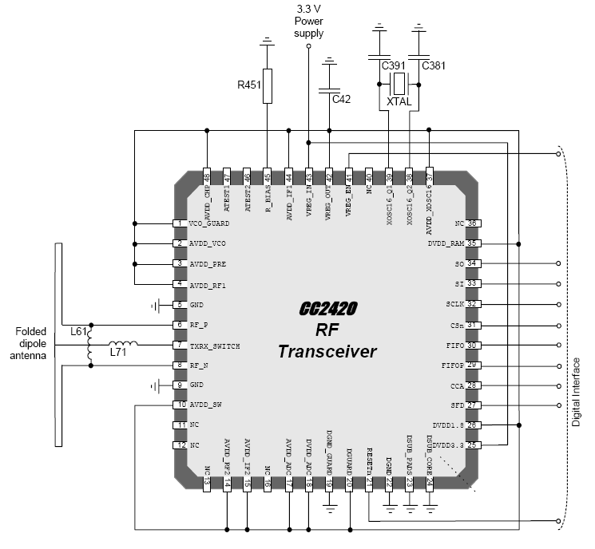
RF Transceiver External Components
Item | Differential antenna
C42 | 10 µF, 0.5Ω< ESR < 5Ω
C61 | Not used
C62 | Not used
C71 | 5.6 pF, 10%, X5R, 0402
C81 | Not used
C381 | 27 pF, 5%, NP0, 0402
C391 | 27 pF, 5%, NP0, 0402
L61 | 27 nH, 5%, Monolithic/multilayer, 0402
L62 | Not used
L71 | 12 nH, 5%, Monolithic/multilayer, 0402
L81 | Not used
R451 | 43 kΩ, 1%, 0402
XTAL | 16 MHz crystal, 16 pF load (C_{L}), ESR < 60 Ω
Suggested application circuit with differential antenna (folded dipole)

Slide 12
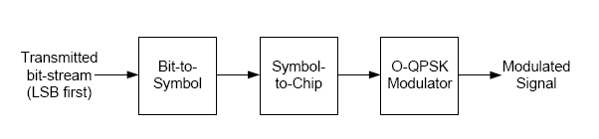
IEEE 802.15.4 Modulation Format
The transceiver is based on a 2.4 GHz direct sequence spread spectrum (DSSS) RF modulation format defined in IEEE 802.15.4.
Each byte is divided into two symbols, 4 bits each.
The least significant symbol is transmitted first.
For multi-byte fields, the least significant byte is transmitted first, except for security related fields where the most significant byte it transmitted first.
Each symbol is mapped to one out of 16 pseudo-random sequences, 32 chips each.
The chip sequence is then transmitted at 2 MChips/s, with the least significant chip (C0) transmitted first for each symbol.

Slide 13
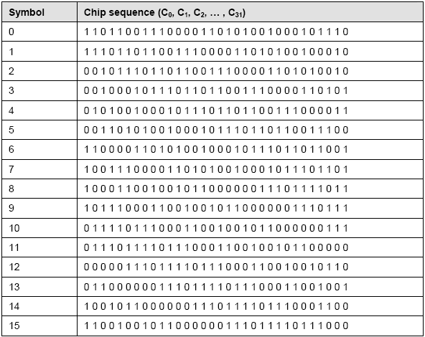
IEEE 802.15.4 Symbol-to-Chip Mapping

Slide 14
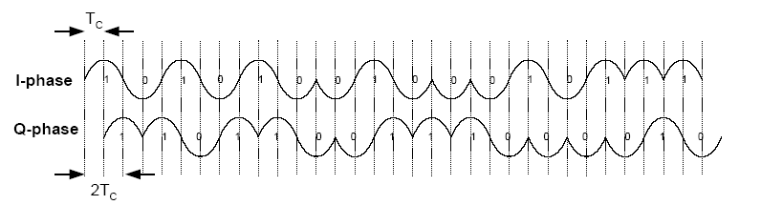
I / Q Phases for a Zero-Symbol Chip Sequence
The modulation format is Offset – Quadrature Phase Shift Keying (O-QPSK) with half-sine chip shaping.
This is equivalent to MSK modulation.
Each chip is shaped as a half-sine, transmitted alternately in the I and Q channels with one half chip period offset.

Slide 15
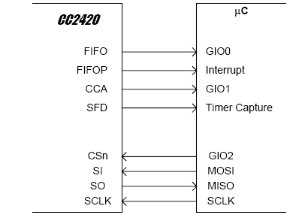
RF Transceiver to Microcontroller Interface
The microcontroller uses 4 I/O pins for the SPI configuration interface (SI, SO, SCLK and CSn).
SO should be connected to an input at the microcontroller.
SI, SCLK and CSn must be microcontroller outputs.
Preferably the microcontroller should have a hardware SPI interface.
The microcontroller pins connected to SI, SO and SCLK can be shared with other SPI-interface devices.
SO is a high impedance output as long as CSn is not activated (active low).
CSn should have an external pull-up resistor or be set to a high level when the voltage regulator is turned off in order to prevent the input from floating.
SI and SCLK should be set to a defined level to prevent the inputs from floating.

Slide 16
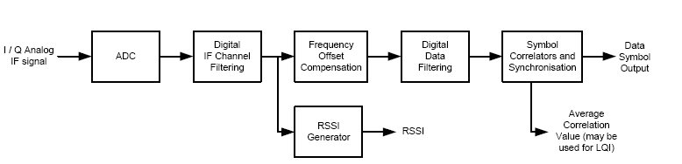
RF Transceiver to Microcontroller Interface
Channel filtering and frequency offset compensation is performed digitally.
The signal level in the channel is estimated to generate the RSSI level
The CC2420 demodulator tolerates up to 300 kHz offset without significant degradation of the receiver performance.
Symbol synchronisation is achieved by a continuous start of frame delimiter (SFD) search.
The demodulator also handles symbol rate errors in excess of 120 ppm without performance degradation. Resynchronisation is performed continuously to adjust for error in the incoming symbol rate.

