Slide 1
Circuiti Integrati
per
Applicazioni Wireless
Ing. Giovanni Collodi
Università degli Studi di Firenze
Dipartimento di Elettronica e Telecomunicazioni

Slide 2
CC 1100 Main Chracteristic
Is a low cost true single chip UHF transceiver designed for very low power wireless applications.
The circuit is mainly intended for the ISM (Industrial, Scientific and Medical) and SRD (Short Range Device) frequency bands
Can easily be programmed for operation at other frequencies in the 300-348 MHz, 400-464 MHz and 800-928 MHz bands.
The RF transceiver is integrated with a highly configurable baseband modem.
The modem supports various modulation formats and has a configurable data rate up to 500 kbps.
The communication range can be increased by enabling a Forward Error Correction option, which is integrated in the modem.
CC1100 provides extensive hardware support for packet handling, data buffering, burst transmissions, clear channel assessment, link quality indication and wake-on-radio.
The main operating parameters and the 64- byte transmit/receive FIFOs of CC1100 can be controlled via an SPI interface.

Slide 3
CC 1100 Transceiver for Wireless Application
Features
Small size (QLP 4x4 mm package, 20 pins)
True single chip UHF RF transceiver
Frequency bands: 300-348 MHz, 400-464 MHz and 800-928 MHz
High sensitivity (–110 dBm at 1.2 kbps, 1% packet error rate)
Programmable data rate up to 500 kbps
Low current consumption (15.4 mA in RX, 1.2 kbps, 433 MHz)
Programmable output power up to +10 dBm for all supported frequencies
Excellent receiver selectivity and blocking performance
Very few external components: Totally onchip frequency synthesizer, no external filters or RF switch needed
Programmable baseband modem
Ideal for multi-channel operation
Configurable packet handling hardware
Suitable for frequency hopping systems due to a fast settling frequency synthesizer
Optional Forward Error Correction with interleaving
Separate 64-byte RX and TX data FIFOs
Efficient SPI interface: All registers can be programmed with one “burst” transfer
Digital RSSI output
Wake-on-radio functionality for automatic low-power RX polling
Many powerful digital features allow a high-performance RF system to be made using an inexpensive microcontroller
Integrated analog temperature sensor Lead-free “green“ package
On chip support for sync word detection, address check, flexible packet length and automatic CRC handling

Slide 4
CC 1100 Transceiver for Wireless Application
Features
Programmable channel filter bandwidth
OOK and flexible ASK shaping supported
FSK, GFSK and MSK supported.
Automatic Frequency Compensation (AFC) can be used to align the frequency synthesizer to the received centre frequency
Optional automatic whitening and dewhitening of data
Support for asynchronous transparent receive/transmit mode for backwards compatibility with existing radio communication protocols
Programmable Carrier Sense (CS) indicator
Programmable Preamble Quality Indicator (PQI) for detecting preambles and improved protection against sync worddetection in random noise
Support for automatic Clear Channel Assessment (CCA) before transmitting (for listen-before-talk systems)
Support for per-package Link Quality
Indication

Slide 5
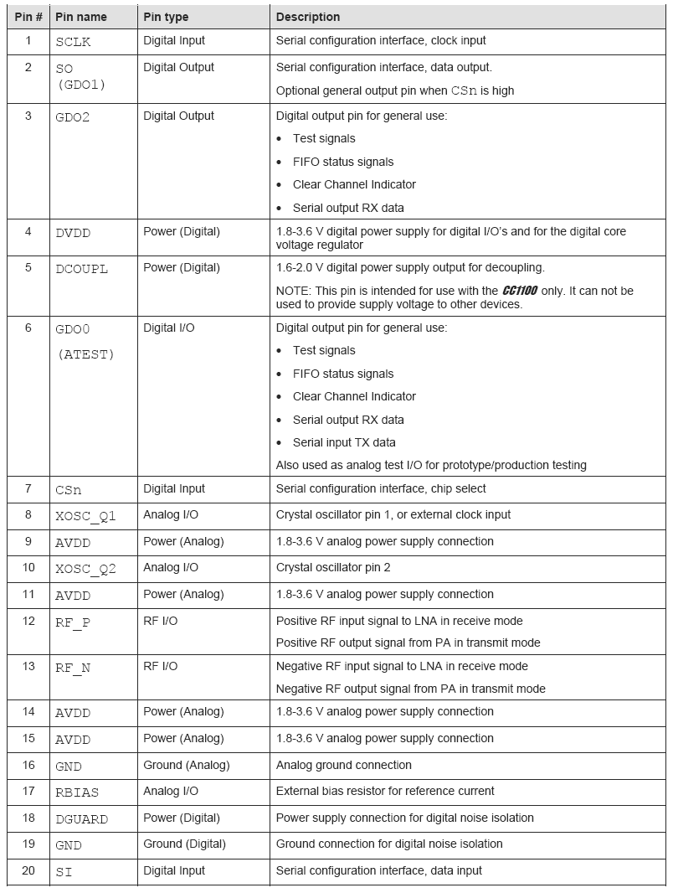
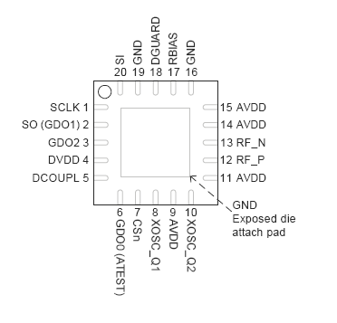
CC1100 PINOUT

Slide 6
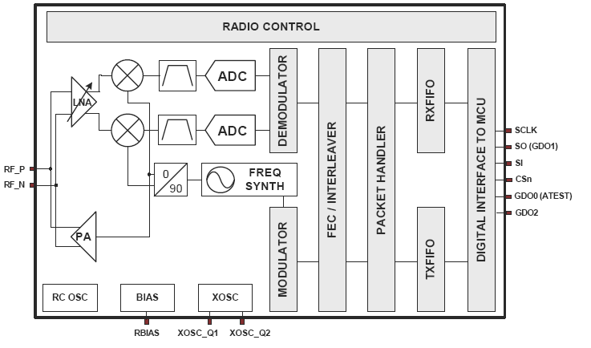
RF Transceiver Functional Blocks

Slide 7
CC1100 Receiver Portion
CC1100 features a low-IF receiver.
The received RF signal is amplified by the lownoise amplifier (LNA)
Down-converted in quadrature (I and Q) to the intermediate frequency (IF).
I/Q signals (at IF) are digitised by the ADCs .
Transeiver perform digitally:
1) Fine channel filtering
2) Demodulation
3) Bit/packet synchronization.
The frequency synthesizer includes a completely on-chip LC VCO and a 90 degree phase shifter for generating the I and Q LO signals to the down-conversion

Slide 8
CC1100 Transmitter Portion
Is based on direct synthesis of the RF frequency.
A crystal is to be connected to XOSC_Q1 and XOSC_Q2.
The crystal oscillator generates the reference frequency for the synthesizer, as well as clocks for the ADC and the digital part.
A 4-wire SPI serial interface is used for configuration and data buffer access.
The digital baseband includes support for channel configuration, packet handling and data buffering

Slide 9
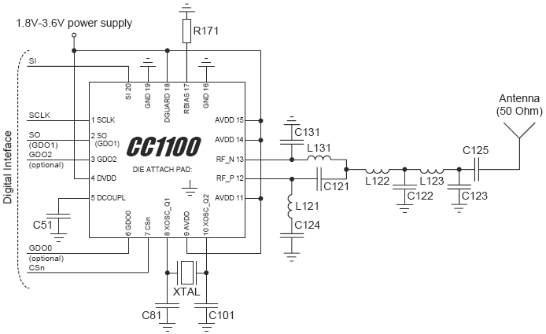
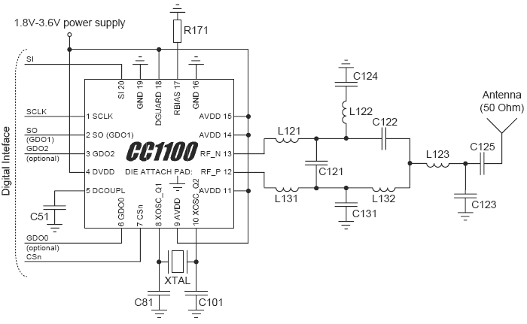
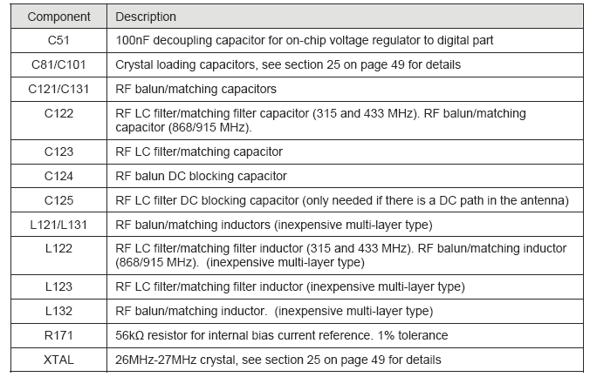
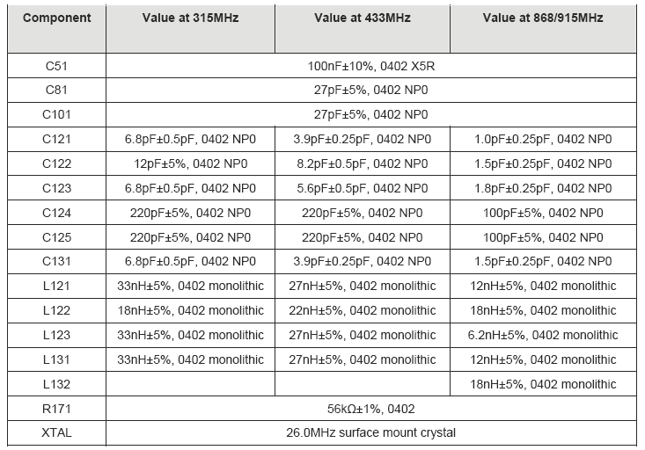
CC1100 External Componenets (1)

Slide 10
CC1100 External Componenets (2)
Only a few external components are required for using the CC1100.
Bias resistor:
The bias resistor R171 is used to set an accurate bias current reference.
Crystal:
The crystal oscillator uses an external crystal with two loading capacitors (C81 and C101).
Additional filtering:
Additional external components (e.g. an RF SAW filter) may be used in order to improve the performance in specific applications.

Slide 11
CC1100 External Componenets (3)
Balun and RF matching
The components between the RF_N/RF_P pins and the point where the two signals are joined together (C131, C121, L121 and L131 for the 315/433 MHz desgn. L121, L131, C121, L122, C131, C122 and L132 for the 868/915 MHz reference design) form a balun that converts the differential RF signal onCC1100 to a single-ended RF signal (C124 is also needed for DC blocking). Together with an appropriate LC network, the balun components also transform the mpedance to match a 50Ω antenna (or cable).
The balun and LC filter component values and their placement are important to achieve optimal performance.

Slide 12
RF Transceiver Signal Interface
In a typical system, CC1100 will interface to a microcontroller.
This microcontroller must be able to:
Program CC1100 into different modes,
Read and write buffered data
Read back status information via the 4-wire SPI-bus configuration interface (SI, SO, SCLK and CSn).
Configuration Interface
The microcontroller uses four I/O pins for the SPI configuration interface (SI, SO, SCLK and CSn).

Slide 13
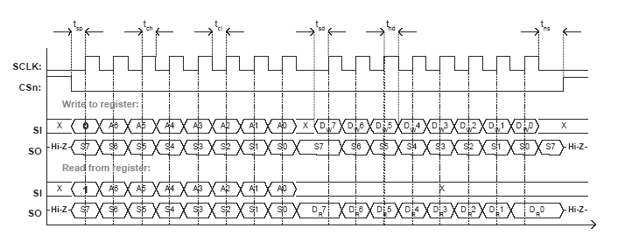
Transceiver I/O Timing
CC1100 is configured via a simple 4-wire SPIcompatible interface (SI, SO, SCLK and CSn)
where CC1100 is the slave.
This interface is also used to read and write buffered data. All address and data transfer on the SPI interface is done most significant bit first.
All transactions on the SPI interface start with a header byte containing a read/write bit, a burst access bit and a 6-bit address.
During address and data transfer, the CSn pin (Chip Select, active low) must be kept low.
If CSn goes high during the access, the transfer will be cancelled.

Slide 14
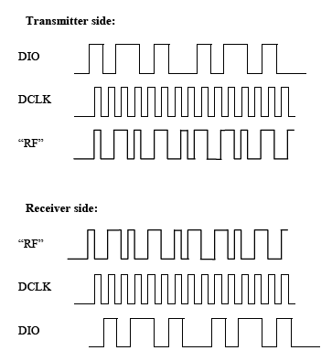
CC1100 supports amplitude, frequency and
phase shift modulation formats. The desired
modulation format is set in the
MDMCFG2.MOD_FORMAT register.
Optionally, the data stream can be Manchester
coded by the modulator and decoded by the
demodulator. This option is enabled by setting
MDMCFG2.MANCHESTER_EN=1. Manchester
encoding cuts the effective data rate in half,
and thus Manchester is not supported for 500
kbps. Manchester encoding is not supported at
the same time as using the FEC/Interleaver
option.
16.1 Frequency Shift Keying
FSK can optionally be shaped by a Gaussian
filter with BT=1, producing a GFSK modulated
signal.
The frequency deviation is programmed with
the DEVIATION_M and DEVIATION_E values
in the DEVIATN register. The value has an
exponent/mantissa form, and the resultant
deviation is given by:
E DEVIATION xosc
dev M DEVIATION f f _
17 2 ) _ 8 (
2
⋅ + ⋅ =
The symbol encoding is shown in Table 23.
Format Symbol Coding
FSK/GFSK ‘0’ – Deviation
‘1’ + Deviation
Table 23: Symbol encoding for FSK/GFSK
modulation
16.2 Minimum Shift Keying
When using MSK1, the complete transmission
(preamble, sync word and payload) will be
MSK modulated.
Phase shifts are performed with a constant
transition time.
The fraction of a symbol period used to
change the phase can be modified with the
DEVIATN.DEVIATION_M setting. This is
equivalent to changing the shaping of the
symbol.
The MSK modulation format implemented in
CC1100 inverts the sync word and data
compared to e.g. signal generators.
16.3 Amplitude Modulation
CC1100 supports two different forms of
amplitude modulation: On-Off Keying (OOK)
and Amplitude Shift Keying (ASK).
OOK modulation simply turns on or off the PA
to modulate 1 and 0 respectively.
The ASK variant supported by the CC1100
allows programming of the modulation depth
(the difference between 1 and 0), and shaping
of the pulse amplitude. Pulse shaping will
produce a more bandwidth constrained output
spectrum. Note that the pulse shaping feature
on the CC1100 does only support output power
up to about -1dBm. The PA_TABLE settings
that can be used for pulse shaping are 0x30 to
RF Transceiver Manchester Mode
Data provided by Microcontroller (NRZ)
Clock provided by Transceiver
FSK modulating signal (Manchester)
Demodulated signal (Manchester)
Clock provided by Transceiver
Data provided by Transceiver (NRZ)

Slide 15
RF Transceiver NRZ Mode
CC1100 is configured via a simple 4-wire SPIcompatible
interface (SI, SO, SCLK and CSn)
where CC1100 is the slave. This interface is
also used to read and write buffered data. All
address and data transfer on the SPI interface
is done most significant bit first.
All transactions on the SPI interface start with
a header byte containing a read/write bit, a
burst access bit and a 6-bit address.
During address and data transfer, the CSn pin
(Chip Select, active low) must be kept low. If
CSn goes high during the access, the transfer
will be cancelled. The timing for the address
and data transfer on the SPI interface is shown
in Figure 9 with reference to Table 16.

Slide 16
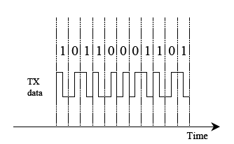
Manchester Encoding and Decoding
The Manchester code is based on transitions; a “0” is encoded as a low-to-high transition, a “1” is encoded as a high-to-low transition.
The Transceiver can detect a Manchester decoding violation and will set a Manchester Violation Flag when such a violation is detected in the incoming signal.
The Manchester code ensures that the signal has a constant DC component, which is necessary in some FSK demodulators.

Slide 17
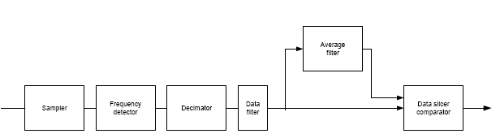
Demodulator Block Diagramm
The IF signal is sampled and its instantaneous frequency is detected.
The result is decimated and filtered.
In the data slicer the data filter output is compared to the average filter output to generate the data output.
The averaging filter is used to find the average value of the incoming data.
While the averaging filter is running and acquiring samples, it is important that the number of high and low bits received is equal (e.g. Manchester code or a balanced preamble).

Slide 18
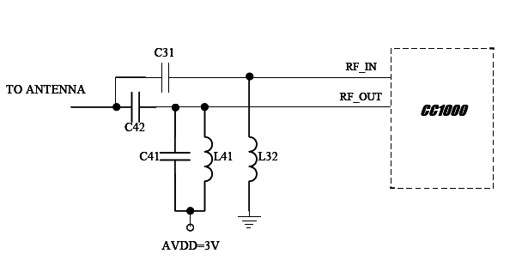
Input/Output Matching
A few passive external components combined with the internal T/R switch circuitry ensures match in both RX and TX mode.

