Slide 1
Circuiti Integrati
per
Applicazioni Wireless
Ing. Giovanni Collodi
Università degli Studi di Firenze
Dipartimento di Elettronica e Telecomunicazioni

Slide 2
TODAY’S WIRELESS THEMES
Ubiquitous communication with focus on interoperability, plug-and-play, IP, self-organizing networks and low power
High quality AV streaming
Bits/Hz/watt
Positioning & Location

Slide 3
THE 802 WIRELESS SPACE
WWAN
IEEE 802.22
IEEE 802.20
Range
WMAN
WiMax
IEEE 802.16
WLAN
WiFi
802.11
ZigBee
802.15.4
802.15.3
802.15.3a
802.15.3c
Bluetooth
802.15.1
WPAN
0.01
0.1
1
10
100
1000
Data Rate (Mbps)

Slide 4
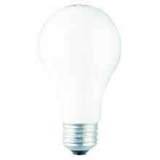
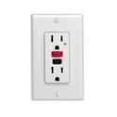

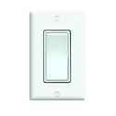
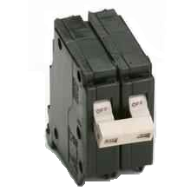
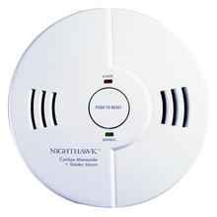
802.15.4 APPLICATION SPACE
Sensors & Controls:
  Home Automation
  Industrial Automation
  Remote Metering
  Automotive Networks
  Interactive Toys
  Active RFID/ asset tracking
  Medical

Slide 5
Sensor/Control Network Requirements
Large networks (large number of devices and large coverage area) that can form autonomously and that will operate very reliably for years without any operator intervention
Very long battery life (years off of a AA cell), very low infrastructure cost (low device & setup costs) and very low complexity and small size
Device data rate and QoS needs are low
Standardized protocols are necessary to allow multiple vendors to interoperate

Slide 6
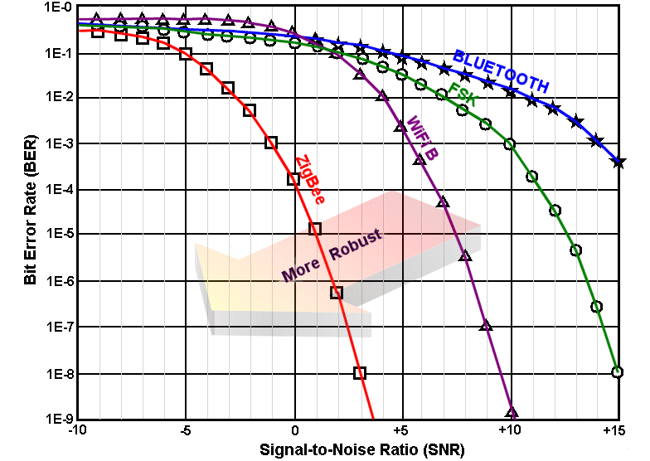
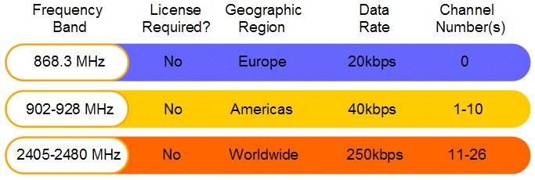
BASIC RADIO CHARACTERISTICS
ZigBee technology relies upon IEEE 802.15.4, which has excellent performance in low SNR environments

Slide 7
BASIC NETWORK CHARACTERISTICS
65,536 network (client) nodes
Optimized for timing-critical applications and power management
  Time to Join Network: <30ms
  Sleeping to active: <15ms
  Channel access time: <15ms
Full Mesh Networking Suppor
Network coordinator
Full Function node
Reduced Function node
Communications flow
Virtual links

Slide 8
ZigBee Network Topologies
Mesh
Star
PAN coordinator
Cluster Tree
Full Function Device
Reduced Function Device

Slide 9
CLUSTER TREE NETWORKS
Cluster tree networks enable a peer-peer network to be formed with a minimum of routing overhead.
20
14
CH2
12
11
CH1
CH4
4
5
8
6
13
DD/CH0
0
CH5
2
7
1
3
9
CH3
22
10
“Parent”
CH6
“Child”
Links indicate familial relationship, not communications capability

Slide 10
Cluster Tree Networks
Employ multi-hop routing
Can be very large: 255 clusters of 254 nodes each = 64,770 nodes
May span physically large areas
Suitable for latency-tolerant applications

Slide 11
ZigBee Device Types
ZigBee Coordinator (ZC)
  One and only one required for each ZB network.
  Initiates network formation.
  Acts as 802.15.4 2003 PAN coordinator (FFD).
  May act as router once network is formed.
ZigBee Router (ZR)
  Optional network component.
  May associate with ZC or with previously associated ZR.
  Acts as 802.15.4 2003 coordinator (FFD).
  Participates in multihop routing of messages.
ZigBee End Device (ZED)
  Optional network component.
  Shall not allow association.
  Shall not participate in routing.

Slide 12
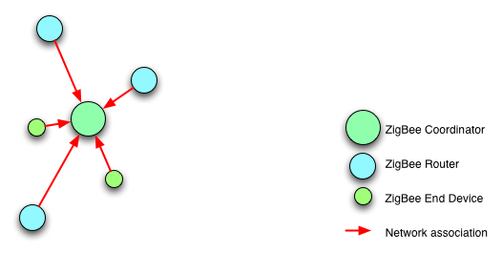
NETWORK STRUCTURE

Slide 13
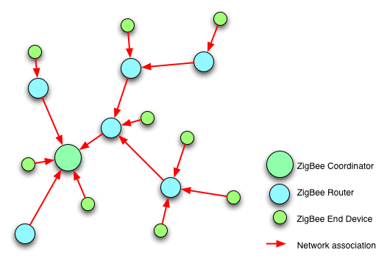
NETWORK STRUCTURE

Slide 14
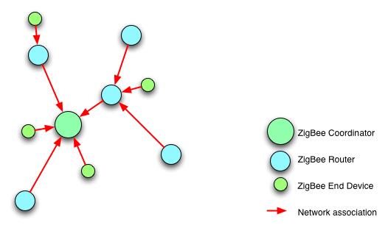
Network Structure

Slide 15
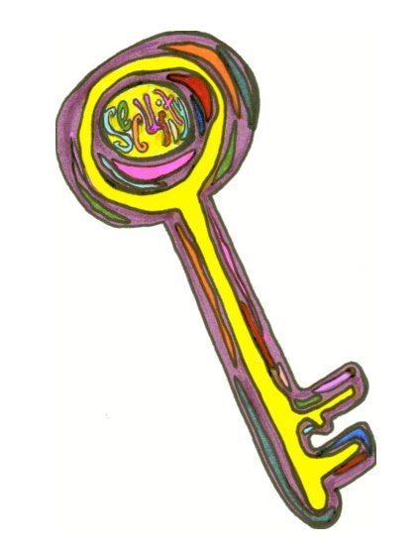
ZigBee – Highly Secure
Utilizes AES 128-bit encryption
Concept of a “trust center”
Link and network keys
Authentication and encryption
Security can be customized for the application
Keys can be “hard-wired” into application

Slide 16






ZigBee Applications
security
HVAC
AMR
lighting control
access control
BUILDING
AUTOMATION
CONSUMER ELECTRONICS
TV
VCR
DVD/CD
remote
PERSONAL HEALTH CARE
PC & PERIPHERALS
patient monitoring
fitness monitoring
ZigBee
Wireless Control that
Simply Works
mouse
keyboard
joystick
INDUSTRIAL
CONTROL
RESIDENTIAL/
LIGHT COMMERCIAL CONTROL
asset mgt
process control
environmental
energy mgt
security
HVAC
lighting control
access control
lawn & garden irrigation
Notes:
Future applications include Toys and Games, like consoles controllers, portable game pads (like gameboys), educational toys like leap frog stuff, and fun toys like RC (remote control) toys, etc.

Slide 17
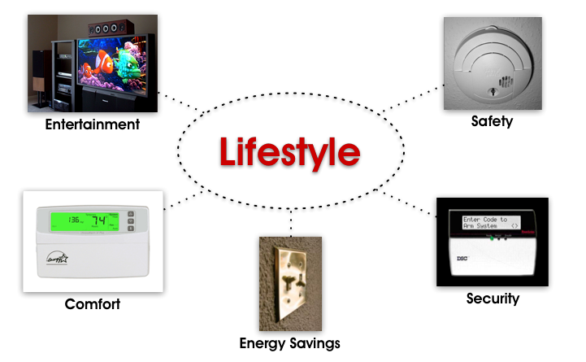
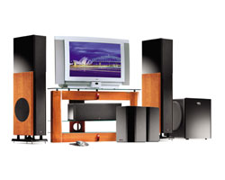
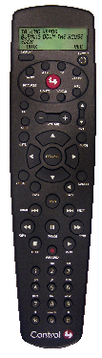
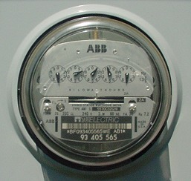
ZIGBEE HOME CONTROL

Slide 18
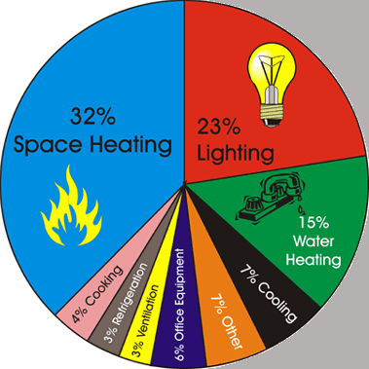
General Commercial Building Automation
Quick Payback Leads to Early Adoption
  Obvious Uses
    Lighting
    HVAC
    Alarm Systems
    Entry Systems
  Less Obvious Uses
    Landscaping
    Leak Detection
    Pest Monitoring
    Humidity in Walls

Slide 19
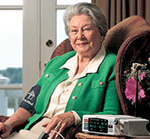

PATIENT MONITORING
graphic
May allow more patient freedom
  Monitors vital statistics and sends via internet
    Patient can remain in their own home
    Lowers cost and improves comfort
  Allows monitoring of elderly family member
    Sense movement or usage patterns in a home
    Notify via mobile phone when anomalies occur
    Can track behavior without visual “spying”
    Wireless panic buttons for falls or other problems
    Again lowers cost and improves patient lifestyle
  Can be used in hospice care
    Patients are allowed greater movement
    Reduced staff to patient ratio
    Light way to bathroom when they get out of bed
      Reduces patient confusion
graphic

Slide 20
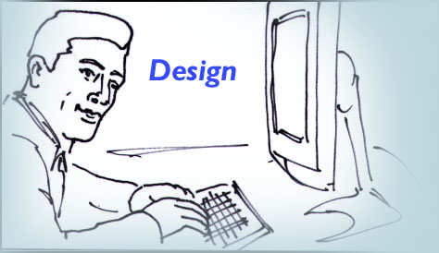
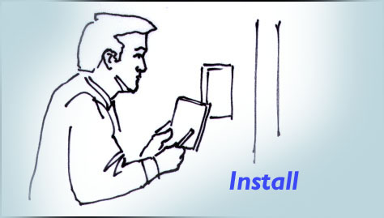
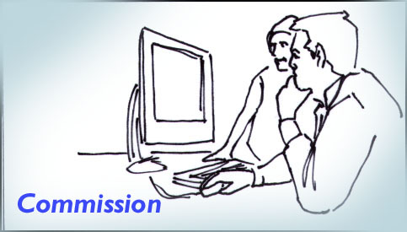
Key value drivers of a Wireless Lighting Control system
Simplify Lighting Control System design in both new construction and retrofit applications
Reduced cost and complexity of system installation
Simplicity of Commissioning
Notes:
Electrical Engineers can simply and cost effectively design lighting control systems into their projects.

Slide 21
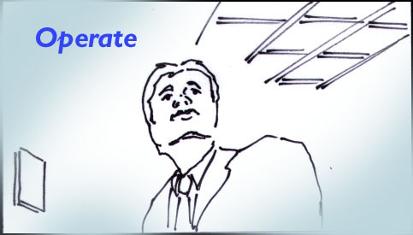
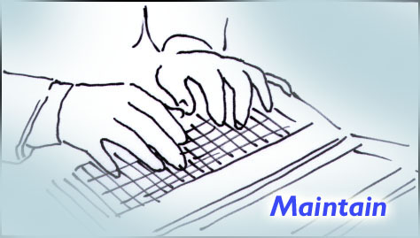
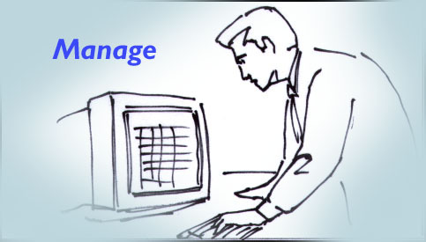
Easy and intuitive to use facilitating improved worker productivity
Key value drivers of a Wireless Lighting Control system
Operating cost and complexity reductions
Improved energy management and control
Notes:
Wireless personal dimming by office tenants is an immediate reality. In addition, security officers can program the lighting to be activated in the event of a security breach. And even the night cleaning staff can wirelessly activate the lighting while on the move.

Slide 22
WHY ZIGBEE?
Reliable and self healing
Supports large number of nodes
Easy to deploy
Very long battery life
Secure
Low cost
Can be used globally

Slide 23
ADVANTAGES OF ZIGBEE OVER PROPRIETARY SOLUTIONS?
Product interoperability
Vendor independence
Increased product innovation as a result of industry standardization
A common platform is more cost effective than creating a new proprietary solution from scratch every time
Companies can focus their energies on finding and serving customers

