Slide 1
Circuiti Integrati
per
Applicazioni Wireless
Ing. Giovanni Collodi
Università degli Studi di Firenze
Dipartimento di Elettronica e Telecomunicazioni

Slide 2
System on a Chip for Wireless Application
Features
Fully Integrated UHF RF Transceiver
Programmable frequency in the range 300 – 1000 MHz
High sensitivity (typically -107 dBm at 2.4 kBaud)
Programmable output power –20 to +10 dBm
Very low current consumption (RX: 9.1 mA)
Very few external components required and no external RF switch or IF filter required
Single port antenna connection
Fast PLL settling allows frequency hopping protocols
FSK modulation with a data rate of up to 76.8 kBaud
Manchester or NRZ coding and decoding of data performed in hardware.
High-Performance and Low-Power 8051-Compatible Microcontroller
Optimised 8051-core which typically gives 2.5x the performance of a standard 8051
Dual data pointers
Idle and sleep modes
Data and Non-volatile Program Memory
32 kB of non-volatile Flash memory in-system programmable through a simple SPI interface or by the 8051 core
Typical Flash memory endurance: 20 000 write/erase cycles
Programmable read and write lock of portions of Flash memory for software security
2048 + 128 Byte of internal SRAM

Slide 3
SoC for Wireless Application
Features
Hardware DES Encryption / Decryption
DES supported in hardware
Output Feedback Mode or Cipher Feedback
Mode DES to avoid the requirement that data length must be a multiple of eight bytes
Peripheral Features
Power On Reset
Three channel, max 23 kSample/s, 10 bit ADC
Real time clock with 32 kHz crystal oscillator
Two timers / pulse counters and two timers / pulse width modulators
Two programmable serial UARTs
Master SPI interface
26 configurable general-purpose I/O-pins
Random bit generator in hardware
Low Power
8051 core and peripherals can use the RTC's 32 kHz clock
Idle and sleep modes for reduced power consumption.
Low-power fully static CMOS design
Operating Conditions
2.7 - 3.6 V supply voltage
-40 - 85 °C operational temperature
3 - 24 MHz crystal (up to 50 ppm) for the main crystal oscillator

Slide 4
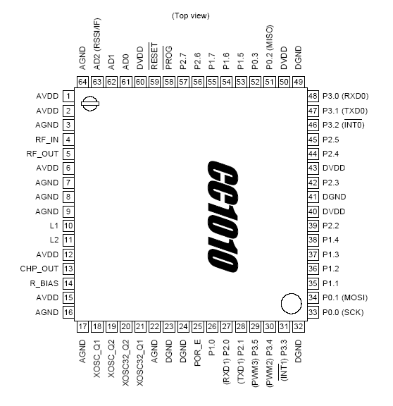
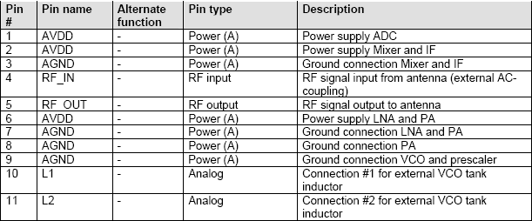
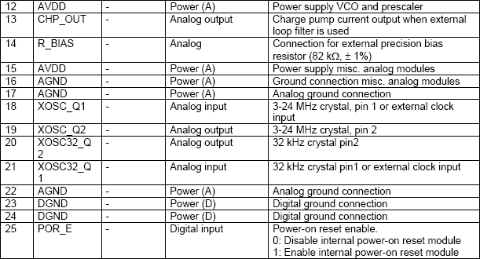
SoC for Wireless Application

Slide 5
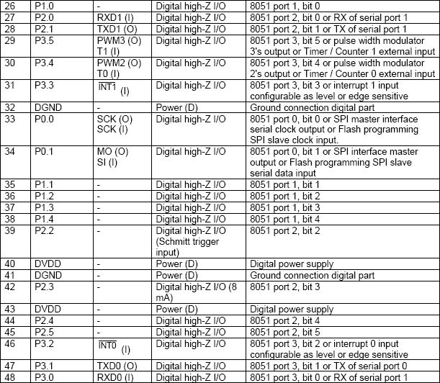
SoC for Wireless Application

Slide 6
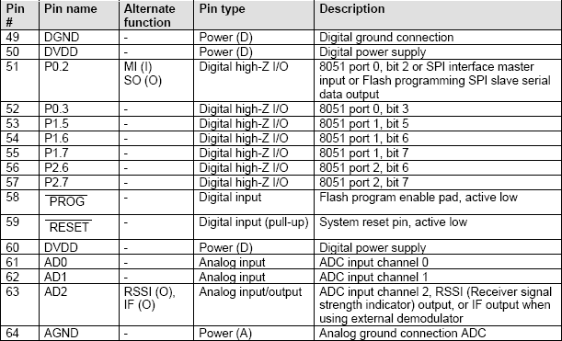
SoC for Wireless Application

Slide 7
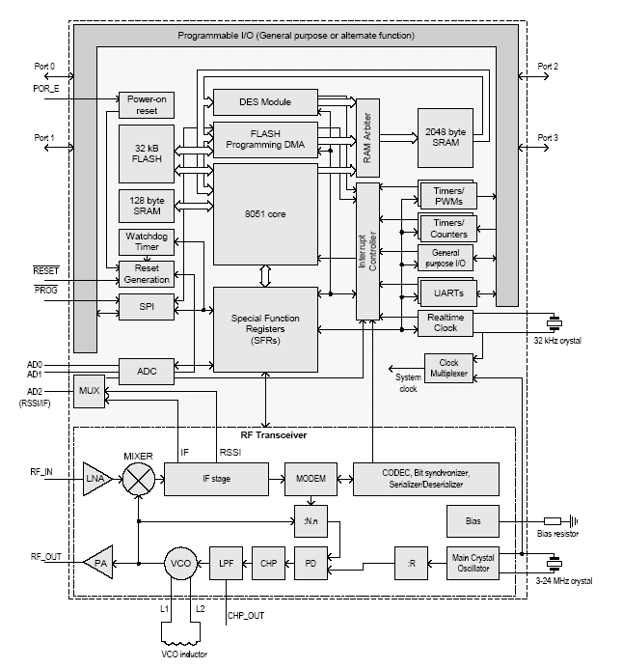
RF Transceiver Functional Blocks

Slide 8
8051 MCU Core
The microcontroller core is based on the industry-standard 8051 architecture.
The MCU core is 8-bit, with program and data memory located in separate memory spaces
The internal registers are organised as four banks of 8 registers each.
The instruction set supports direct, indirect and register addressing modes.
Program memory can be addressed using indexed addressing.
The core registers are comprised of an accumulator, a stack pointer and dual data pointer registers in addition to the general registers.
Data memory is split into internal and external RAM (the "external RAM" is internal to the chip).
The difference between external and internal is that external RAM can only be accessed by a few instructions. Therefore, frequently-accessed variables as well as the stack should be kept in internal RAM.

Slide 9
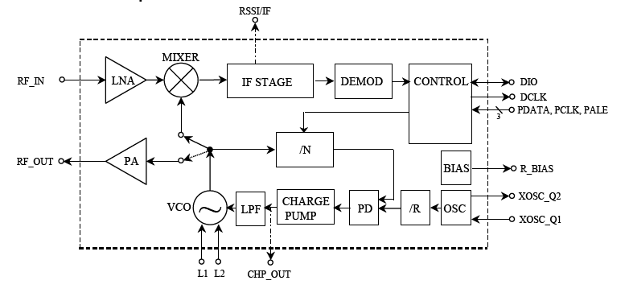
RF Transceiver Transmit Mode
In transmit mode the voltage controlled oscillator (VCO) output signal is fed directly to the power amplifier (PA).
The RF output is frequency shift keyed (FSK) by the digital bit stream fed to the pin DIO.
The internal T/R switch circuitry makes the antenna interface and matching very easy.
.
The frequency synthesiser generates the local oscillator signal which is fed to the MIXER in receive mode and to the PA in transmit mode
The frequency synthesiser consists of a crystal oscillator (XOSC), phase detector (PD), charge pump (CHARGE PUMP), VCO, and frequency dividers (/R and /N).
An external crystal must be connected to XOSC, and only an external inductor is required for the VCO.
The 3-wire digital serial interface (CONTROL) is used for configuration.

Slide 10
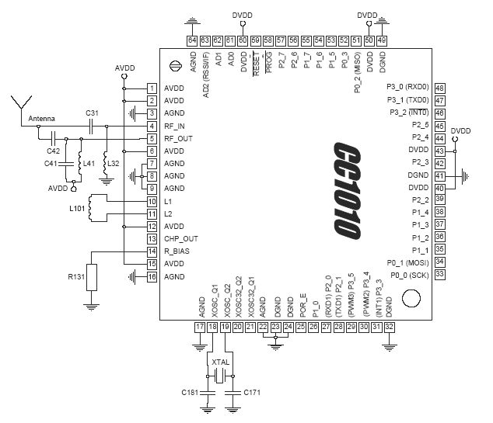
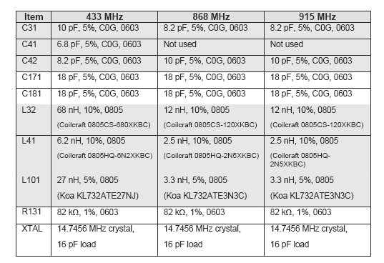
RF Transceiver External Components

Slide 11
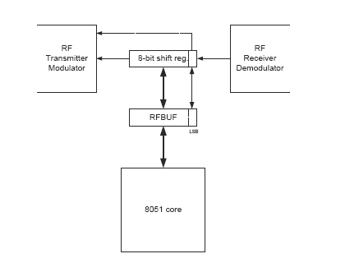
RF Transceiver to Microcontroller Data Buffering
In the Transparent or UART modes outgoing and incoming data is routed directly to the modulator in transmit mode and directly from the demodulator in receive mode.
In the NRZ and Manchester modes, however, data buffering occurs in RFBUF
This buffering has some repercussions that must be considered when receiving or transmitting data, particularly in bytemode.

Slide 12
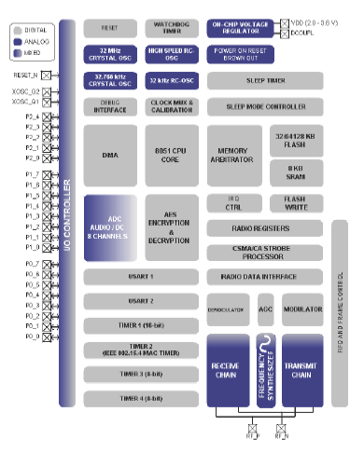
RF Transceiver to Microcontroller Data Buffering
The CC2430 is a true System-on-Chip (SoC) solution specifically tailored for IEEE 802.15.4 and ZigBee™ applications.
It enables ZigBee™ nodes to be built with very low total bill-of material costs.
The CC2430 combines theexcellent performance of the leading CC2420 RF transceiver with an industry-standard enhanced 8051 MCU, 32/64/128 KB flash memory, 8 KB RAM and many other powerful features.
Combined with the industry leading ZigBee™ protocol stack (Z-Stack)

Slide 13
System on a Chip for Wireless Application
High performance and low power 8051 microcontroller core.
• 2.4 GHz IEEE 802.15.4 compliant RF transceiver (industry leading CC2420 radio core).
• Excellent receiver sensitivity and robustness to Interferers
• 32, 64 or 128 KB in-system programmable flash
• 8 KB RAM, 4 KB with data retention in all power modes
• Powerful DMA functionality
• Very few external components
• Only a single crystal needed for mesh network systems
• 0.3 µA current consumption in stand-by mode,
where external interrupts can wake up the system
• Very fast transition times from low-power modes to active mode enables ultra low average power consumption in low duty-cycle systems
• CSMA/CA hardware support.
• Wide supply voltage range (2.0V – 3.6V)
• Digital RSSI / LQI support
• Battery monitor and temperature sensor
• ADC with up to eight inputs and configurable resolution

Slide 14
System on a Chip for Wireless Application
• AES security coprocessor
• Two powerful USARTs with support for several
serial protocols
• Watchdog timer
• One IEEE 802.15.4 MAC Timer, one general 16-bit timer and two 8-bit timers
• Hardware debug support
• 21 general I/O pins, two with 20mA sink/source
Capability
• Powerful and flexible development tools available
• RoHS compliant 7x7mm QLP48 package

