Slide 1

SLA - Sicurezza di luoghi pubblici affollati
IEEE802.15.4 and IEEE 802.11 Coexistence
Ing. Michele Ciabatti

Slide 2
IEEE802.15.4 and IEEE 802.11 Coexistence
IEEE 802.15.4 and IEEE 802.11 spectra
IEEE 802.11b (Wi-Fi)
  Up to14 unlicensed channels [2.412 GHz – 2.484 GHz]
  22 MHz bandwidth
IEEE 802.15.4
  16 unlicensed channels [2.405 GHz - 2.4835 GHz]
  3 MHz bandwidth

Slide 3
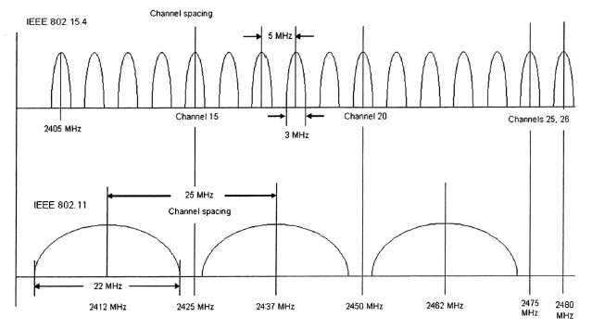
IEEE802.15.4 and IEEE 802.11 Coexistence
RF channel spectrum of
IEEE802.15.4 (ZigBee) and IEEE802.11b (WiFi)
Band overlapping ⇨ Interference

Slide 4
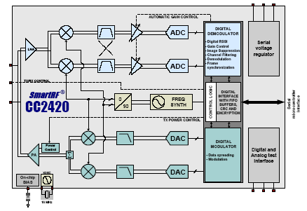
IEEE802.15.4 and IEEE 802.11 Coexistence
Transceiver schemes
Transmitter:
  Each symbol (4 bits) is spread using the IEEE 802.15.4 spreading sequence to 32 chips and output to the digital-to-analog converters (DACs).
Receiver:
  The received RF signal is amplified by the low-noise amplifier (LNA) and down-converted in quadrature (I and Q) to the intermediate frequency (IF). At IF (2 MHz), the complex I/Q signal is filtered and amplified, and then digitized by the ADCs. Automatic gain control, final channel filtering, de-spreading, symbol correlation and byte synchronization are performed digitally.

Slide 5
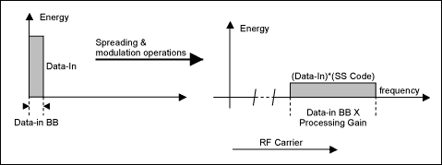
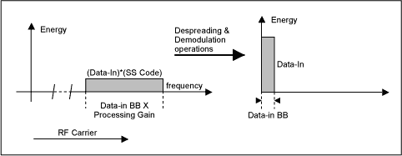
IEEE802.15.4 and IEEE 802.11 Coexistence
Bandwidth Effects of the Spreading
Bandwidth Effects of the Despreading

Slide 6
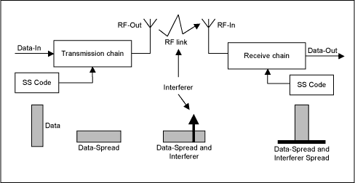
IEEE802.15.4 and IEEE 802.11 Coexistence
Resistance to Interference
Anti-jamming Effects
Resistance to Interception
Resistance to Fading (Multipath Effects)

Slide 7
IEEE802.15.4 and IEEE 802.11 Coexistence
Interference rejection
802.11 ⇨ 802.15.4
Low power spectral mask
BPF
Despreading
(low cross-correlation codes)
802.15.4 ⇨ 802.11
Low power spectral mask
BPF
Despreading
(low cross-correlation codes)

