Slide 1
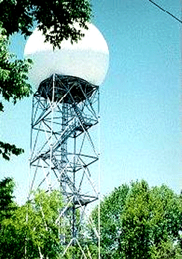
RADAR
RAdio Detection And Ranging
From http://ww2010.atmos.uiuc/(Gh)/guides/rs/rad/home.rxml

Slide 2
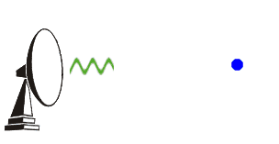
World War II
Was originally for military use
Sent out electromagnetic radiation
Bounced off an object and returned to a listening device
Timed the time it takes for the energy to travel to the target and back (echo)
Estimated a location of that object
Incidentally found the detection of clouds.
http://www.letxa.com/nexradintro.php

Slide 3

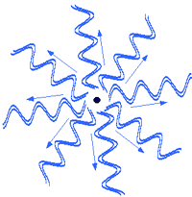
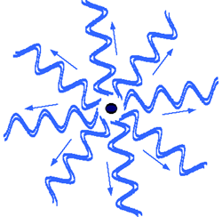
Reflectivity
Forward signal
Signal scatted by small particles
Signal scatted by large particles

Slide 4
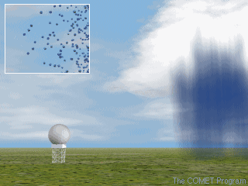
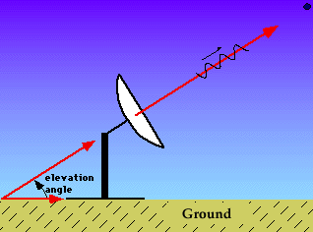
Application in Meteorology
Raindrops made excellent targets for
S-Band radar (~10cm),
no raindrops, no data!!!
Weather radar units were set up
across the United States in the mid
1960's (WSR-57, reflectivity only ).
No data
Courtesy of COMET

Slide 5
Radar
L band radars :
15-30 cm, 1-2 GHz
Clear air turbulence studies.
S band radars :
8-15 cm, 2-4 GHz
Not easily attenuated (far range)
Large antenna dish
C band radars :
4-8 cm, 4-8 GHz
Easily attenuated (short range)
Small antenna dish
X band radars :
2.5-4 cm, 8-12 GHz
Easier attenuated (shorter range)
detect smaller particles

Slide 6
Radar
The higher the frequency, the higher the resolution
The higher the frequency, the stronger the attenuation (shorter range)
The larger the antenna dish, the higher the resolution

Slide 7
Resolutions
 | Typical temporal frequency (resolution) | Approximate spatial resolution
Radar | Every scan ~ 6 min (provided every hour) | depending on distance (~ 1km)
Provide good observations for small
scale phenomena, (e.g.,
thunderstorms, hurricane eyewall)

Slide 8
Radar Measurements
Reflectivity (WSR-57)
Radial velocity (Doppler radar)
Particle identification
(solid or liquid; graupel, snow,
etc. dual polarized)

Slide 9
NEXRAD
Next Generation Weather Radar
WSR – 88D
Weather Surveillance Radar 88 Doppler
Originally deployed in Oklahoma City in
1988. http://www.letxa.com/nexradintro.php
S Band (~ 10 cm)
Reflectivity + radial velocity
Identify the conditions which lead to
severe weather such as tornados
About 230 km range
Scan time, very 6 min
Below 1 km, 72% missed

Slide 10
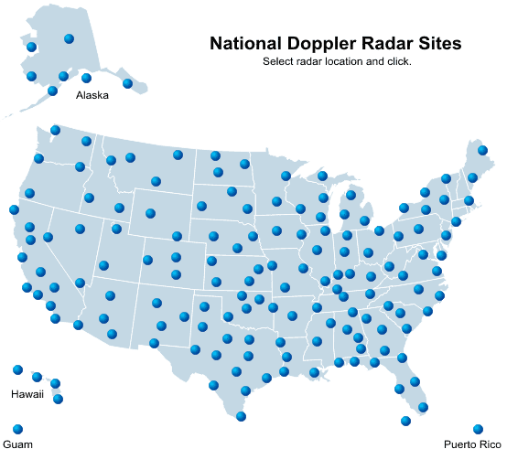
NEXRAD
158 radars

Slide 11
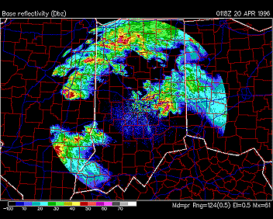
WSR-88D Radar image

Slide 12
CASA
Collaborative Adaptive Sensing of the
Atmosphere
X Band (2.5 – 4 cm)
Low power
Higher resolution
Small disk
Shorter range
Phased array radar, reduce scan time,
every min
Enable to collect data below 3 km

Slide 13
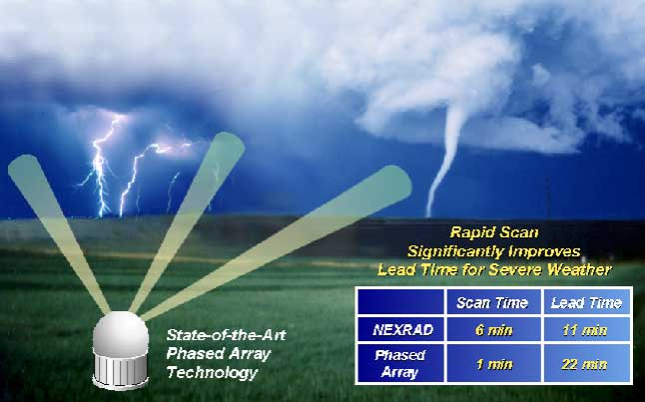
CASA
Scan quicker and to lower level

Slide 14
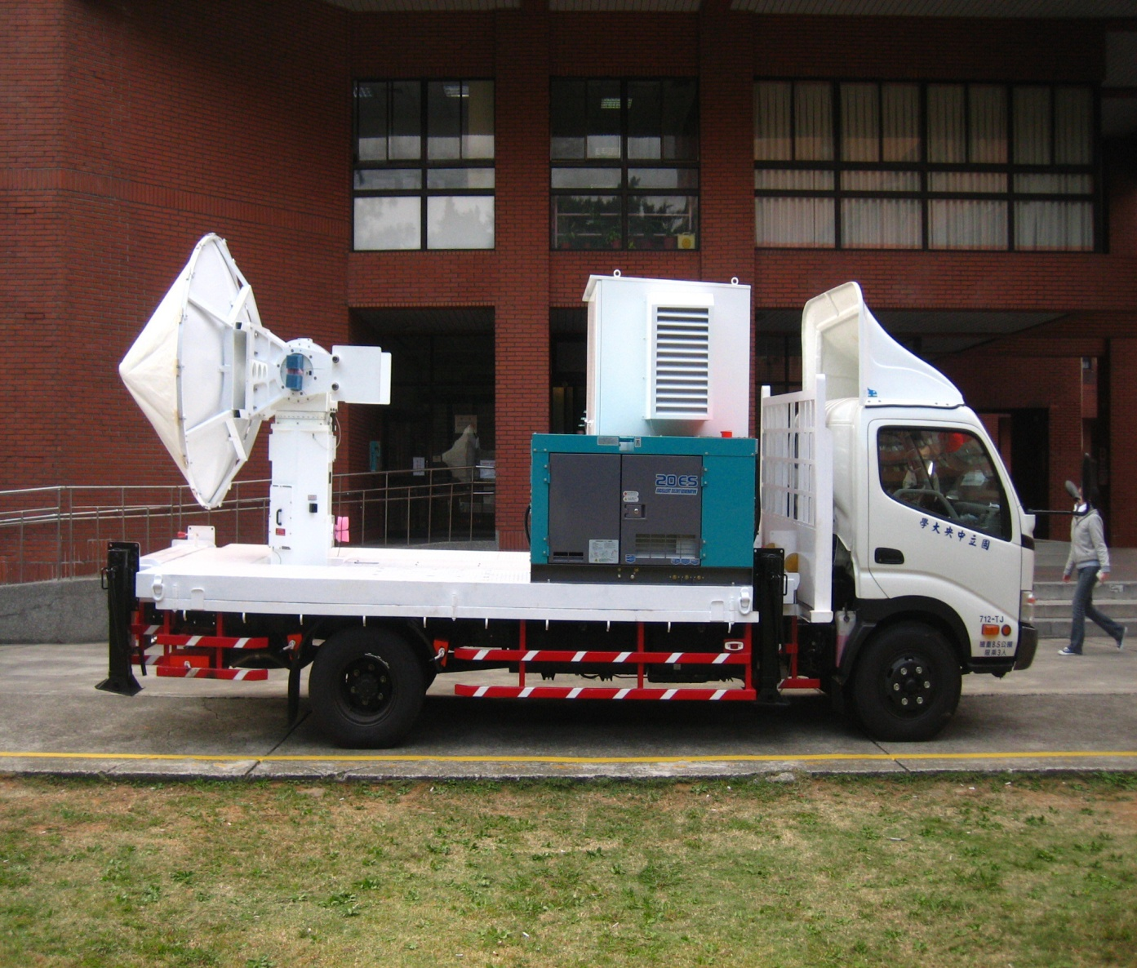
Mobil Radar
TEAM-R (Courtesy of Prof Liou)
X band, wave length = 3 cm
Scan about 40 km

Slide 15
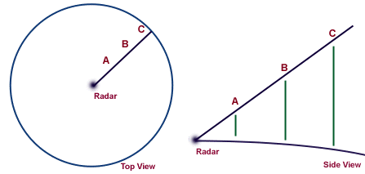
Elevation angle

Slide 16
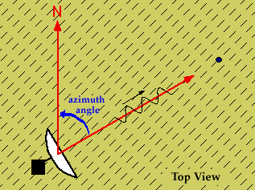
Azimuth angle

Slide 17
Plan Position Indicator (PPI)
Elevation angle = constant
Varies azimuth angle
Return is mapped on a horizontal plane
Scan 360^{o,} surveillance scan
Scan < 360º, sector scan

Slide 18
Plan Position Indicator (PPI)
Top view

Slide 19
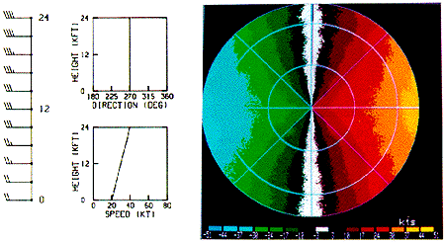
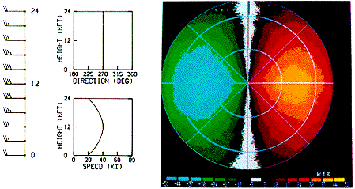
Plan Position Indicator (PPI)
Direction
Speed
Image
Wind bars
Blue – In Red – Out

Slide 20
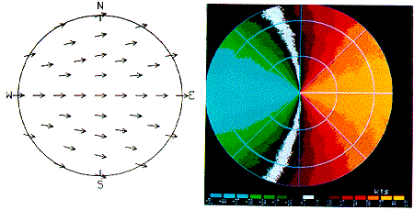
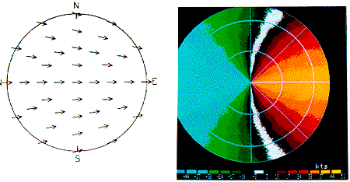
Plan Position Indicator (PPI)

Slide 21
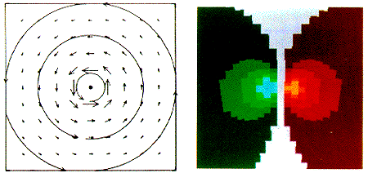
Mesocyclones
Where is the location of the radar?

Slide 22
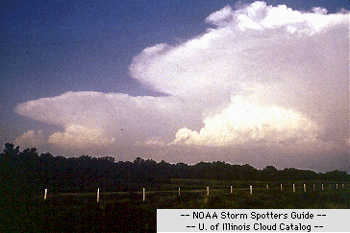
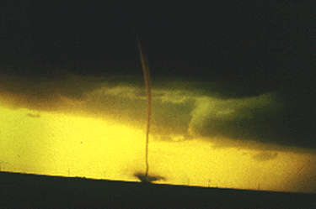
Cumulonimbus Clouds
Supercell
Won’t be able to see Tornados,
but can see the favorable
environment for tornado
development

Slide 23
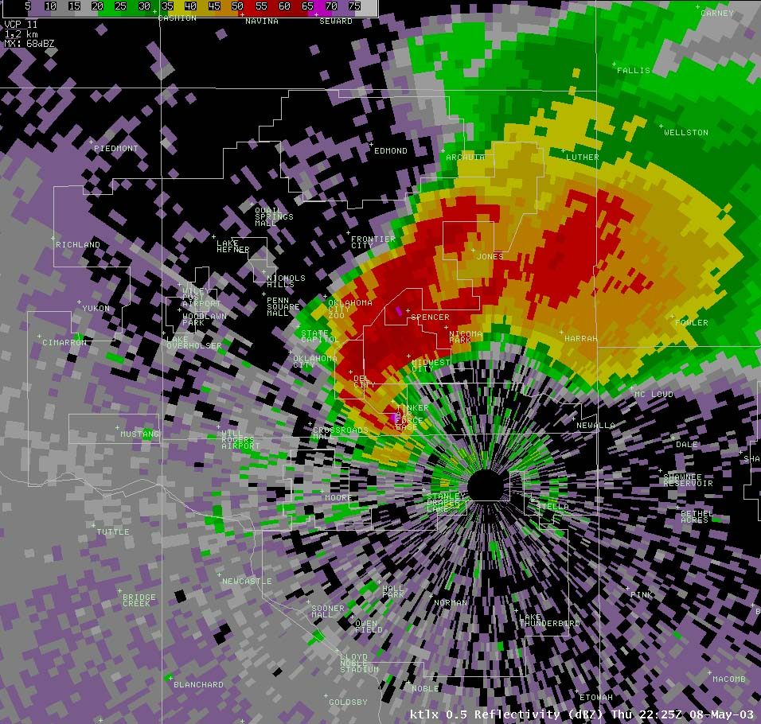
F4 Tornado, hook echo
May 8, 2003, Oklahoma City

Slide 24
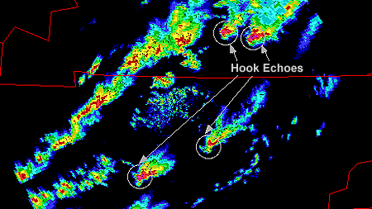
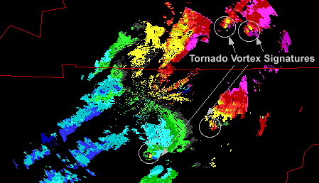
Tennessee and Kentucky
May 18, 1995

Slide 25
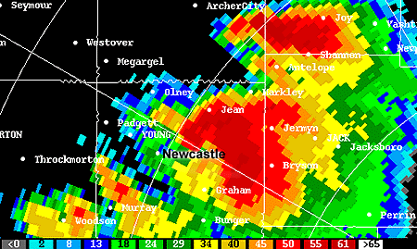
Texas, hook echo
May 29, 1995

Slide 26
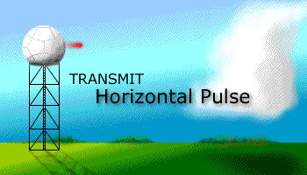
NEXRAD (non-polarimetric) Radar
Polarimetric Radar
http://www.nssl.noaa.gov/dualpol/
Parameter | Definition | Description
Z | ZHH | reflectivity (horizontal power return)
Z | ZVV | reflectivity (vertical power return)
V_{r} | V_{r} | radial velocity
W | (σ²)^{1/2} | spectrum width
Z_{DR} | 10log(ZHH/ZVV) | differential reflectivity
Φ_{DP} | Φ_{H} - Φ_{V} | differential phase
ρ_{HV} | ρ_{HV}=ρ_{HV}(0)exp^{jδ} | zero lag cross-correlation of horizontal (HH) and vertical (VV) waves
K_{DP} | dΦ_{DP}/dr | specific differential phase
L_{DR} | 10log(ZHV/ZVH) | linear depolarization ratio

Slide 27
Z_{DR} | 10log(ZHH/ZVV) | differential reflectivity
Differential Reflectivity – The differential reflectivity is a ratio of the reflected horizontal and vertical power returns. Among other things, it is a good indicator of drop shape (e.g., round like snowflakes or hailstones, or if they are somewhat flat like raindrops). In turn the shape is a good estimate of average drop size.
Correlation Coefficient – A statistical correlation between the reflected horizontal and vertical power returns. It is a good indicator of regions where there is a mixture of precipitation types, such as rain and snow.
Linear Depolarization Ratio – This is a ratio of a vertical power return from a horizontal pulse or a horizontal power return from a vertical pulse. It, too, is a good indicator of regions where mixtures of precipitation types occur.
ρ_{HV} | ρ_{HV}=ρ_{HV}(0)exp^{jδ} | zero lag cross-correlation of horizontal (HH) and vertical (VV) waves
L_{DR} | 10log(ZHV/ZVH) | linear depolarization ratio
http://www.nssl.noaa.gov/dualpol/

Slide 28
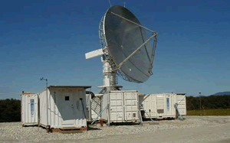
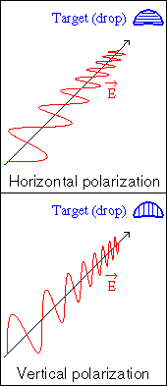
S-POL
http://www.eol.ucar.edu/rsf/spol/spol.html
Developed at NCAR/EOL, usually
used for field projects.
S-band, dual polarized
Reflectivity, radial velocity, and
particle ID
http://www.radar.mcgill.ca/define_dual_pol.html

Slide 29
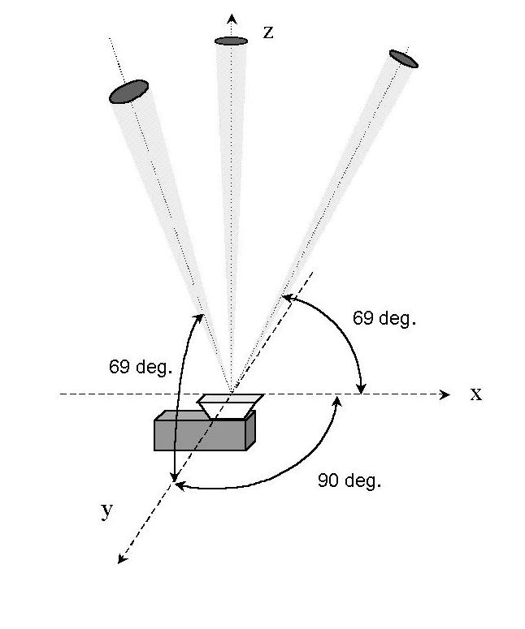


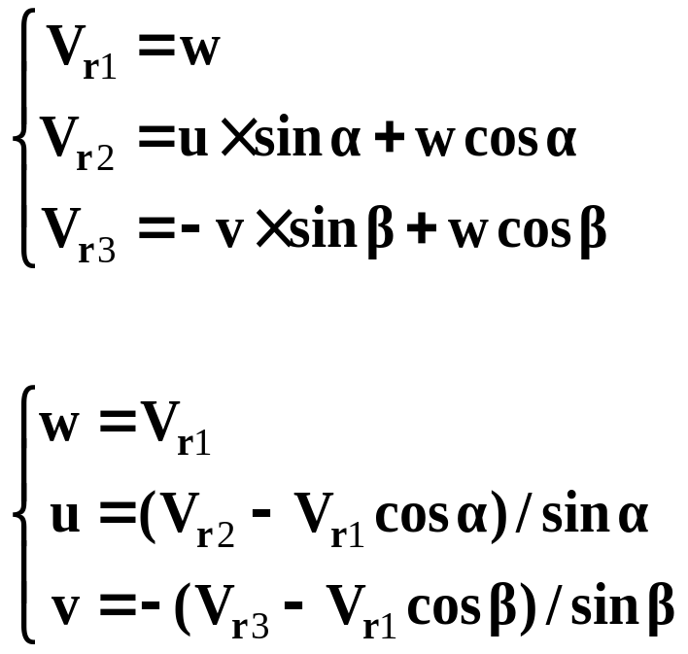
Wind Profiler
V_{r1}
V_{r3}
z
w
V_{r2}
v
y
x
u
Similar to Radar

Slide 30
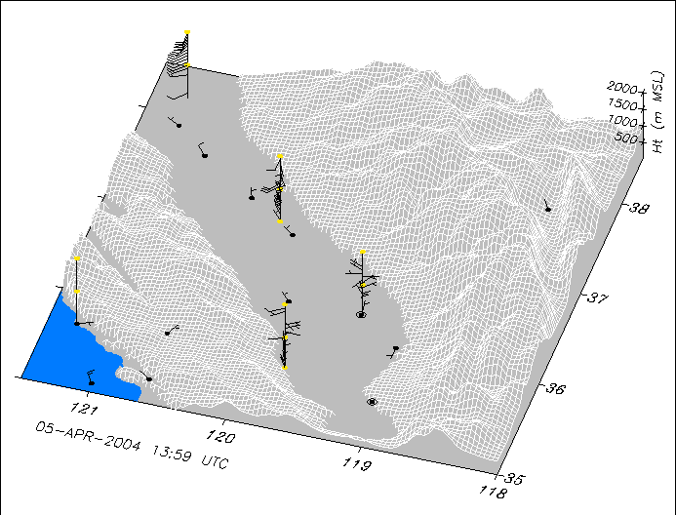
Wind Profiler

