Slide 1

DMV | AWS HQ2
October 18, 2024

Slide 2
How to Configure and Deploy a Static Website on S3
Neil Thorne, Web Developer, MS Cybersecurity, CISSP, 3x AWS Certified

Slide 3
What’s Ahead
What is a Static Website?
Application: Inspiration & Development
Deployment Process to AWS

Slide 4
What is a Static Website?
A static website is delivered to the user exactly as stored, in contrast to dynamic web pages which are generated by a web application.
https://aws.amazon.com/getting-started/projects/host-static-website/faq/

Slide 5


Static Website
S3
https://sixcorevalues.com
}
HTML
Javascript
CSS
Images
Video
Delivers Files
exactly as stored

Slide 6



Dynamic Website
authenticate user
RoR
https://example.com?invoices=true&department=accounting
enforce authorization
nginx
query db
}
HTML
JavaScript
CSS
Images
Video
Response from Server Varies
customize the returned view

Slide 7

Application: Inspiration
Well-being Theory
Positive Emotion
Engagement
Relationships
Meaning
Achievement

Slide 8

Application: Inspiration
Structured Approach to Discovering Top:
Acceptance | Competency | Freedom | Inner Harmony | Optimism | Self-Knowledge
Authenticity | Compromise | Friendships | Justice | Patriotism | Self-Respect
Achievement | Contribution | Fun | Kindness | Peace | Service
Adventure | Courage | Gratitude | Knowledge | Pleasure | Simplicity
Art | Creativity | Growth | Leadership | Poise | Solitude
Authority | Curiosity | Happiness | Learning | Popularity | Spirituality
Autonomy | Determination | Health | Love | Protect | Stability
Balance | Duty | Honesty | Loyalty | Provide | Success
Beauty | Fairness | Humility | Mastery | Recognition | Status
Boldness | Faith | Humor | Meaningful Work | Religion | Tolerance
Caring | Fame | Imagination | Mindfulness | Reputation | Tradition
Compassion | Family | Independence | Monogamy | Respect | Trustworthiness
Challenge | Fitness | Influence | Music | Responsibility | Virtue
Citizenship | Flexibility | Integrity | Nurturing | Security | Wealth
Community | Forgiveness | Intimacy | Openness | Self-Acceptance | Wisdom
Core Values

Slide 9
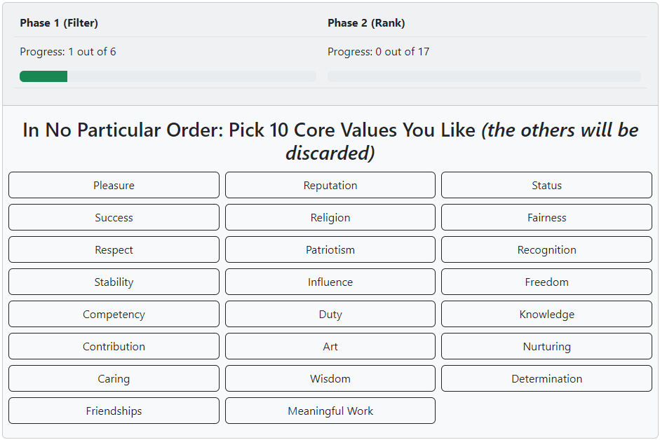
Application: Development

Slide 10
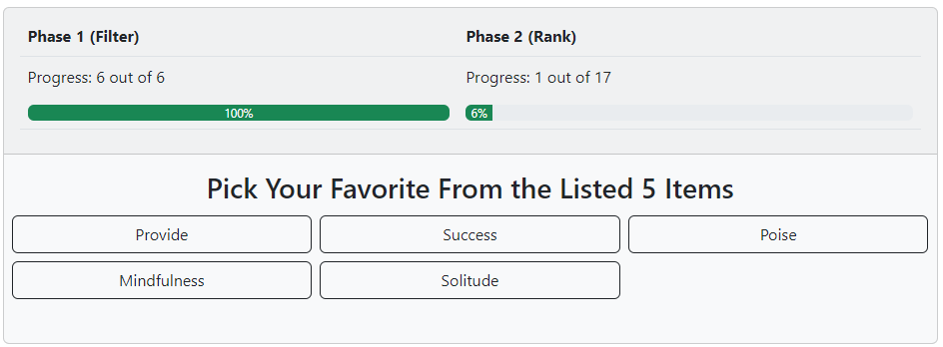
Application: Development
1st Place: +2
2nd Place: +1
3rd Place: 0
4th Place: -1
5th Place: -1

Slide 11
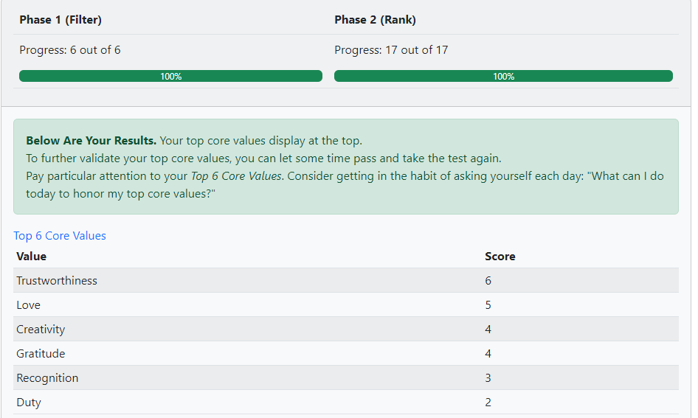
Application: Development

Slide 12




Application: Development

Slide 13
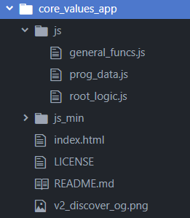
Application: Development
}
JS Minimized
Minimized JS put into index.html
Only two files uploaded to S3

Slide 14

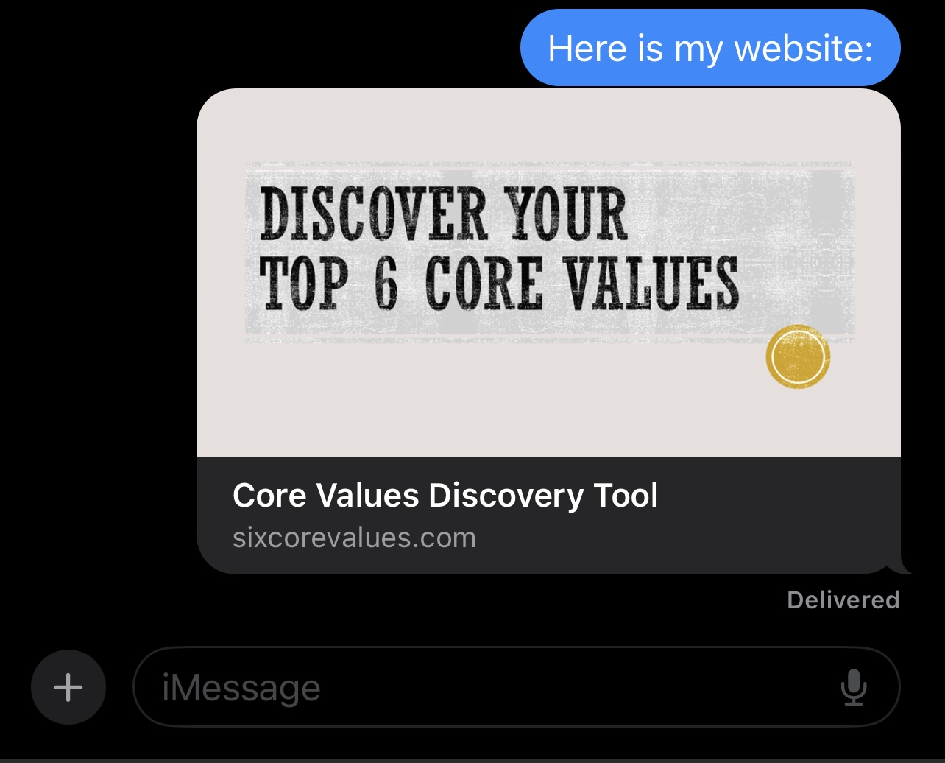

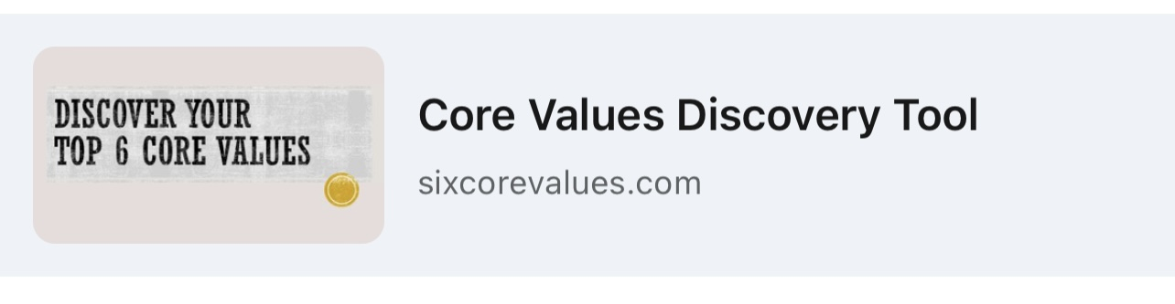
Application: Development
facebook
iMessage
Open Graph protocol
instagram
linkedin

Slide 15
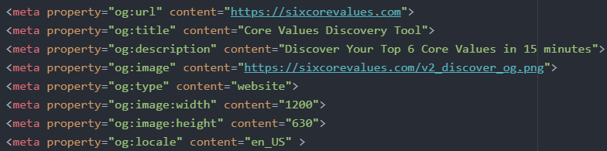
Application: Development
Only two files uploaded to S3

Slide 16
Deployment Process to AWS

Slide 17
Demo - Layered Approach
Guardrails
(AWS Budget)
HTTPS
(ACM, CloudFront)
Custom Domain (Route 53)
Static Website – S3

Slide 18
Static Website – S3

Slide 19
Demoing the upload of index.html to a bucket

Slide 20
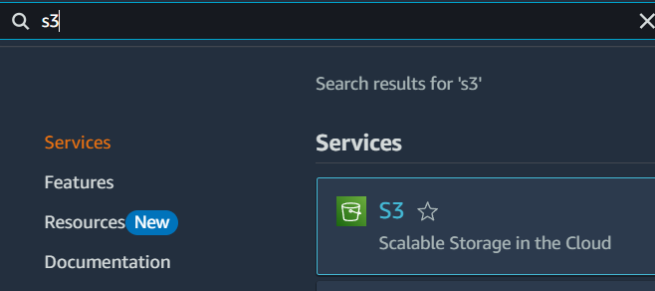

Find the S3 service
Click “Create bucket”
Click
Click

Slide 21

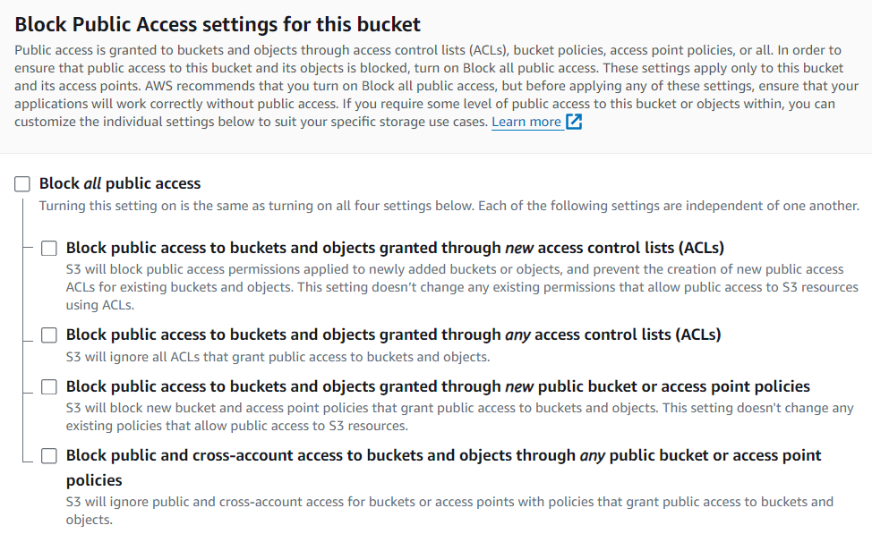

Name the bucket
Uncheck “Block all public access”
Keep all other defaults and click “Create Bucket”
Give Bucket a Name
*If you are not planning on using a custom domain name with your static website, name the Bucket whatever you want.
However, if you do want to use a custom domain name for your static website the bucket name must match exactly the domain name.
https://docs.aws.amazon.com/Route53/latest/DeveloperGuide/troubleshooting-s3-bucket-website-hosting.html
Uncheck “Block all public access”
Click

Slide 22

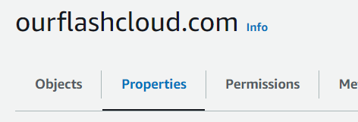
With the bucket created, we now need to enable “Static Website Hosting” for the bucket
Click the bucket name
Select “Properties on the bucket”
Click
Click

Slide 23
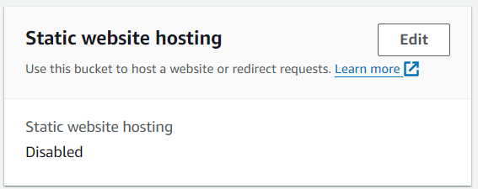
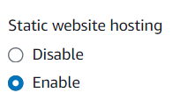
Click
Find the Panel labeled “Static website hosting” and select “Edit”
Select “Enable” radio button on the Static website hosting field.
Change to “Enable

Slide 24
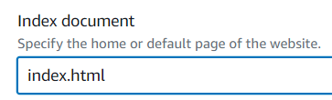

Within “Index document” specify the name of the file that you plan to upload which will become the root/main page of your app (convention is to name this file “index.html)
Keep all other defaults, click “Save changes”.
Enter Name of File that will be the “Root” of your app
Click

Slide 25
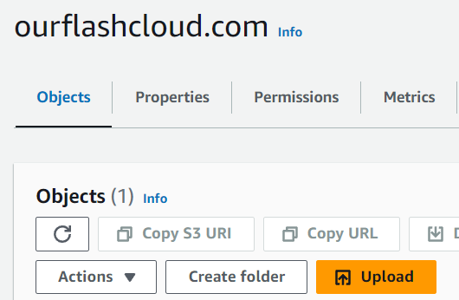
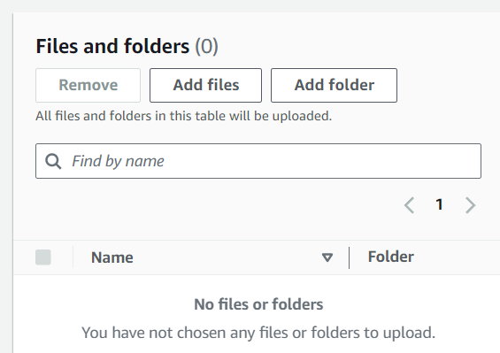
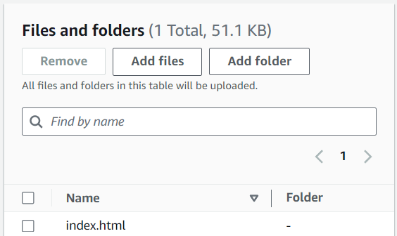

Now that the bucket is configured for static website hosting, upload the file(s) of your website.
Navigate to “Objects” within your bucket
Upload all your website files
Click
Click
Click

Slide 26
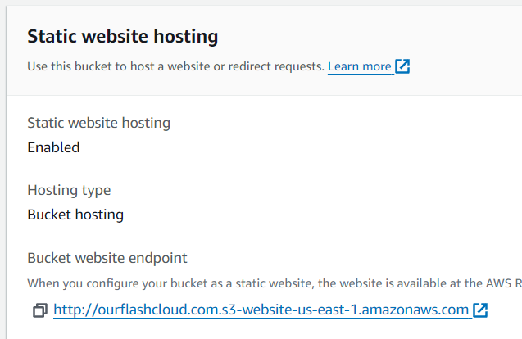
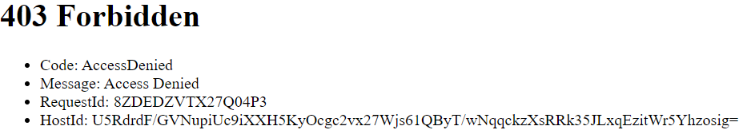
Once your static website files are uploaded, you can navigate back to your bucket → Properties → Static website hosting. A link will be there for your site. However, the Link will not work! This is because we need to attached permissions
Forbidden because S3 objects implement default deny
Click

Slide 27
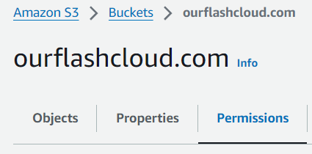
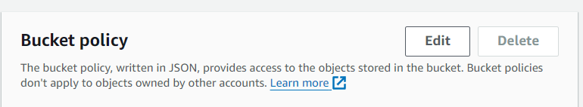
Within your bucket, navigate to Permissions
Within the “Bucket policy” panel, select “Edit”
Click
Click

Slide 28
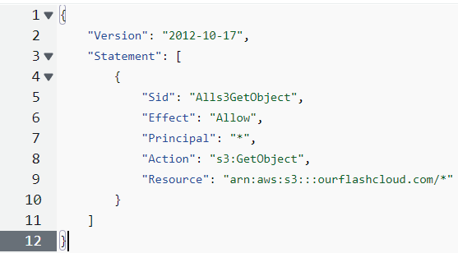

Define a policy to give anyone access the objects in your bucket, which effectively grants users access to your state website.
After defining your policy click “Save changes”
Click

Slide 29
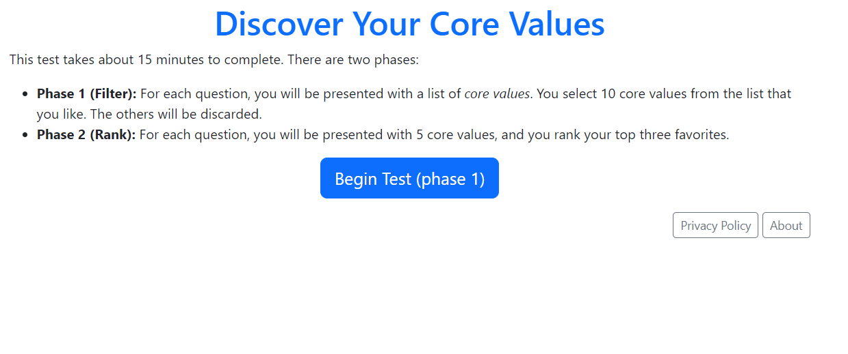
Now when you navigate to your bucket → Properties → Static website hosting panel and click the link: it will work!
Access to your static website works now because you granted permission on the bucket.
Click

Slide 30
Custom Domain (Route 53)

Slide 31
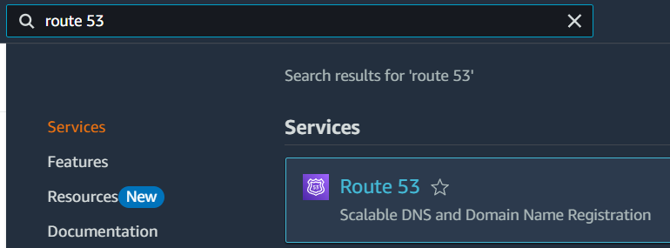
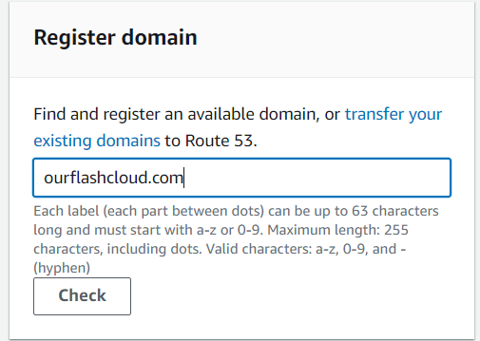
Search and Click on Route 53
Within the “Register domain” panel, enter your desired domain and click “Check”.
Click

Slide 32
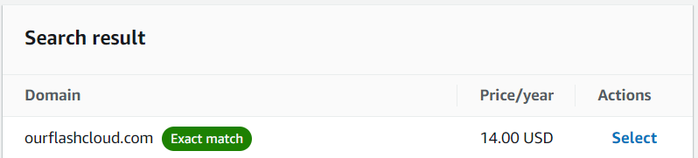
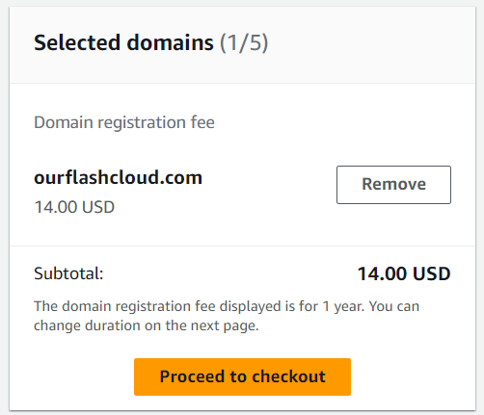
If your domain is not already claimed, it will be listed as available.
click “Select” for your desired domain
Click “Proceed to checkout”
Click
Click

Slide 33
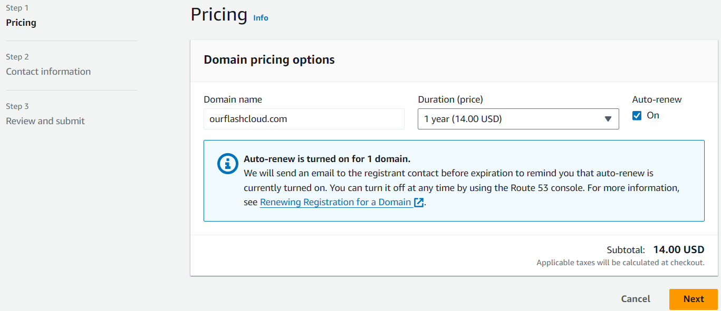
Work your way through the three-step wizard of claiming your domain
At the end of Step 3”, click “Submit” to make the request for the domain
At the end of Step 3, click “Submit”

Slide 34
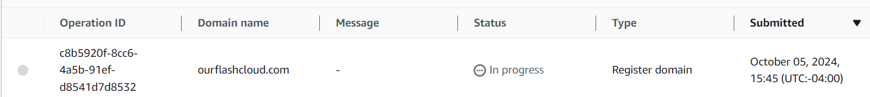
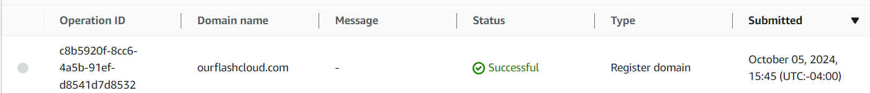
The request will take a few minutes. You’ll receive an email notification on the decision.
After submitting the request, this notice panel displays

Slide 35
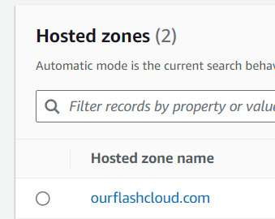
We now need to tell Route 53 that when a request comes in for our domain, route it to our static website
Within Route 53 →Hosted Zones, select your Hosted Zone name
Click “Create record”
Click
Click

Slide 36
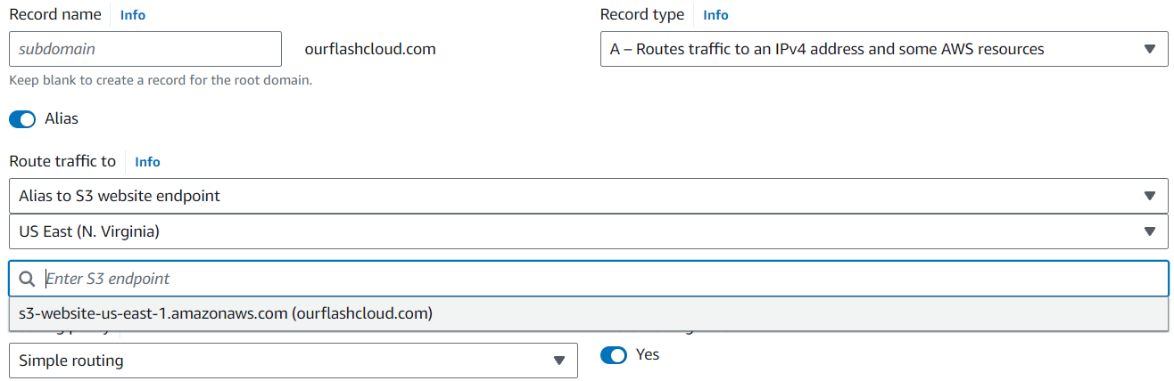
Toggle on
Select
Select region of your bucket
* If your bucket doesn’t populate as an option, it is likely because your bucket name does not EXACTLY match your domain

Slide 37
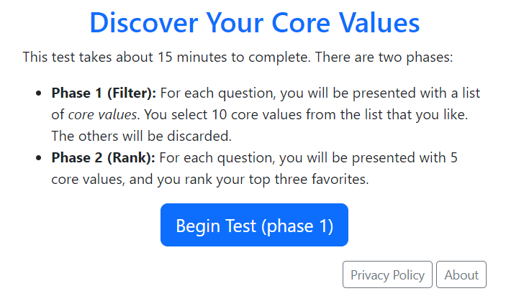
It Works!
However, the traffic for our request is not encrypted (using http)
Not encrypted

Slide 38
HTTPS (AWS Certificate Manager)

Slide 39
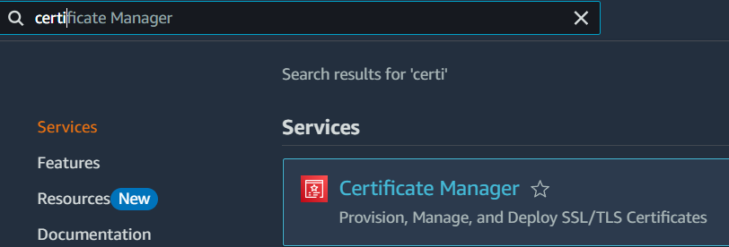

Search for Certificate Manager
Click “Request” to begin the process of creating a certificate
Click
Click

Slide 40
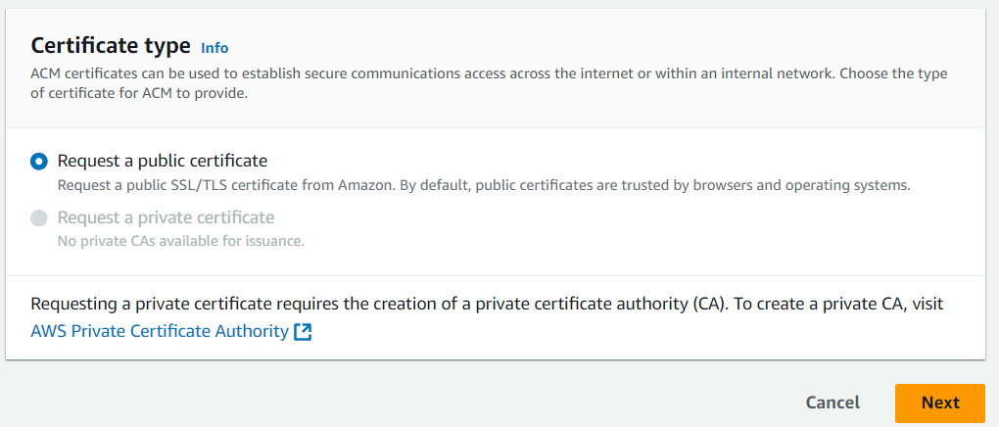
Leave the Default: we are creating a public certificate
Click “Next”
Leave Default
Click

Slide 41

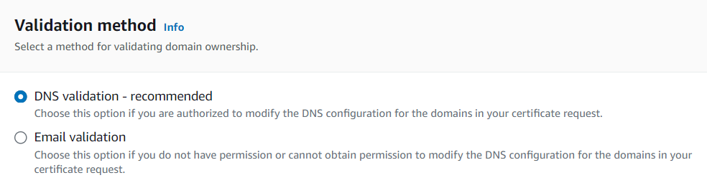

Specify the FQDN of your static website
Choose your Validation method
Keep remaining defaults and click “Request”
Click

Slide 42
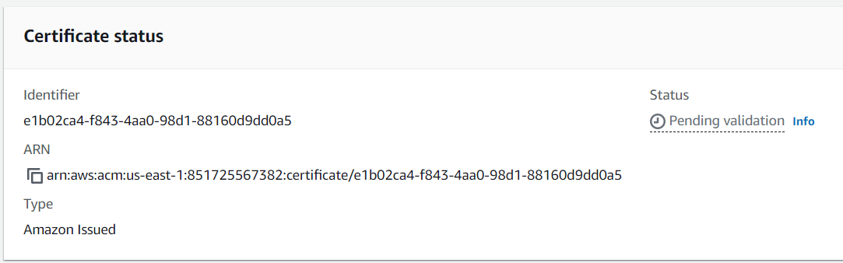
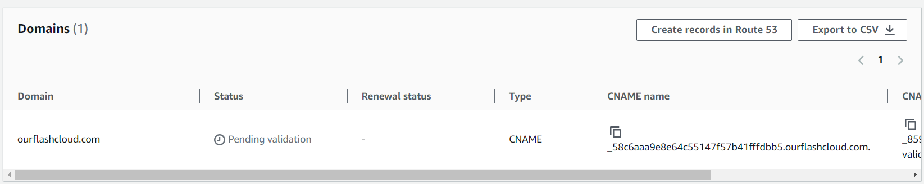
The request is not yet complete because we need to complete the validation process.
The validation process we chose was “DNS validation” so to do this:
Conveniently, within the “Domain” panel click “Create records in Route 53”. This will create the temporary CNAME record in route 53 for you.
Click

Slide 43
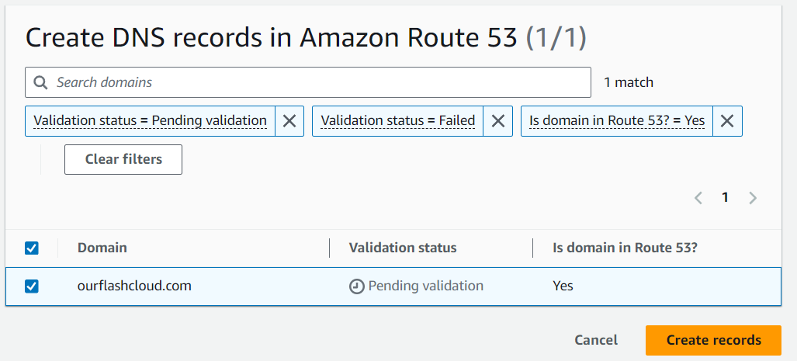
AWS makes it very easy to create this CNAME record. There is no manual entry to create this CNAME record. All you have to do is click “Create records”.
This is what the temporary CNAME record looks like once it is created
Click

Slide 44
Wait a few minutes in ACM for the status of the cert to change to “Issued”.
Once cert is finalized
Once the certificate is in the “Issued” status, you can then delete that temporary CNAME record. It is no longer needed since ACM verified you have authority over this domain.

Slide 45
HTTPS with CloudFront

Slide 46
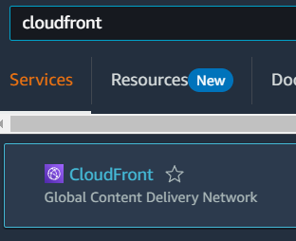

Search for CloudFront
Click “Create distribution”
Click
Click

Slide 47
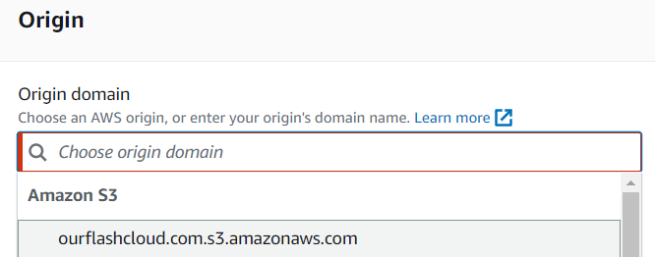
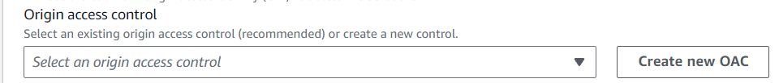

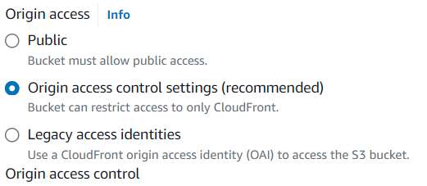
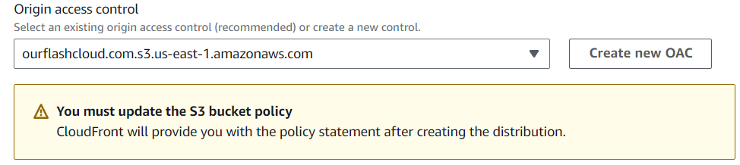
The Origin domain is our S3 static website endpoint
We want to control access to our origin (i.e. the static website). We only want people to access the static website by going through the CloudFront distribution
Thus we create an Origin Access Control (OAC)
Leave Defaults, click “create” to create the OAC
Will need to update our bucket policy later

Slide 48
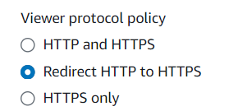
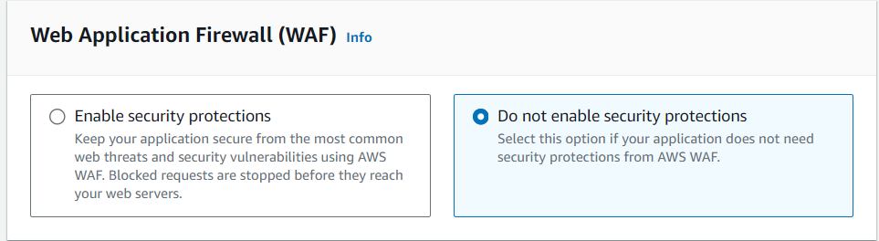
In “Viewer protocol policy” we want to always use HTTPS. If the viewer makes a request with HTTP, redirect the user to HTTPS
CloudFront has us explicitly deny setting up WAF
Required to explicitly say “No”

Slide 49
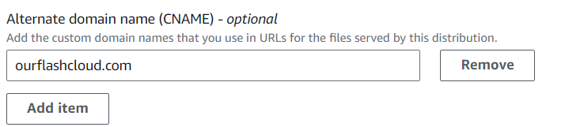
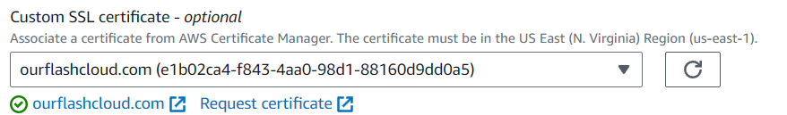
We want to use our custom domain for our CloudFront distribution, so within Alternate domain name (CNAME) we specify our custom domain
Within “Custom SSL certificate” we specify the certificate we set up earlier for HTTPS
Specify custom domain

Slide 50
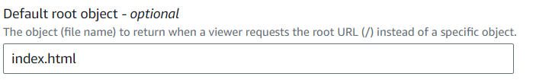

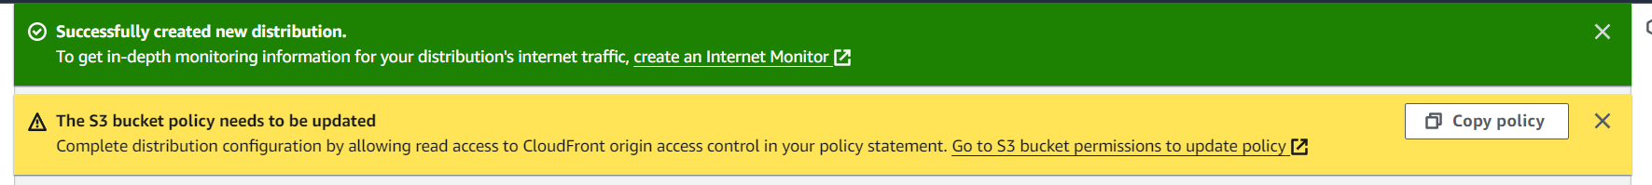
Within “Default root object” we specify the name of our file that is the root/main/index page. For us it is that index.html file.
Leave all other defaults and click “Create distribution”
We still need to update the bucket policy to only allow access to the Origin Access Control we specified within the CloudFront distribution. AWS helps us by letting us copy the exact policy we need
Click

Slide 51
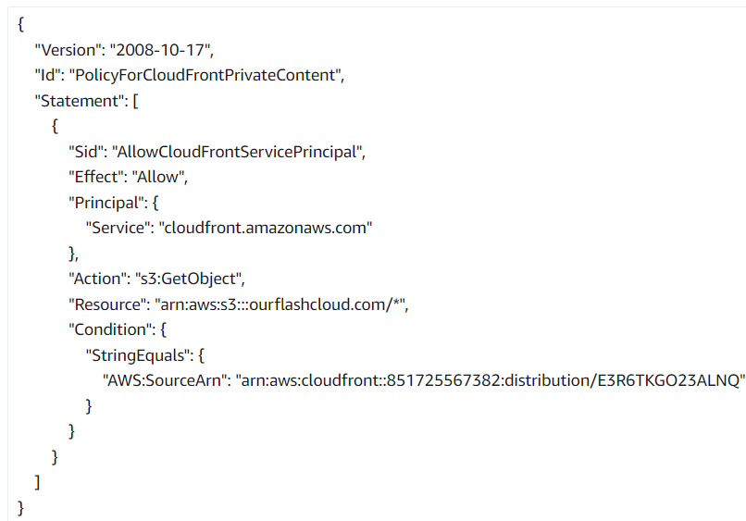

Go to the bucket that hosts the static website
Replace the existing bucket policy by pasting in the policy that AWS provided us.

Slide 52


We need to go to the hosted zone and update the “A” record. We need route 53 to associate the custom domain name to the CloudFront distribution instead of directly to the S3 website endpoint.
Click “Edit record” to modify the “A” record we setup earlier
change to CloudFront endpoint
select our CloudFront distribution
click save

Slide 53


Slide 54

SUCCESS!
Our static website is now being served over HTTPS by our CloudFront distribution.

Slide 55
Guardrails
(AWS Budgets and Automation)

Slide 56

Security/Budget Concerns
Botnet
Website Goes Viral!
AWS WAF
Bot Control
Rate limiting IP requests
IP Reputation
This is tougher...

Slide 57


AWS Budget

Slide 58



AWS Budget
AWS Budget
AWS Lambda
AWS SNS
Disable CloudFront Distribution
Budget Exceeded, Publishes Message to an SNS Topic
AWS Lambda is subscribed to the topic. Executes Lambda Function

Slide 59

Thank You! Any questions?
Connect with Me:
www.linkedin.com/in/neilsthorne
neilsthorne@gmail.com

