Slide 1
Chapter 1
Operations Management: Trends & Issues

Slide 2
Operations Management Definition
An operations system is defined as one in which
several activities are performed
to transform a set of inputs into useful output
using a transformation process
Operations Management is
a systematic approach to
address all the issues pertaining to
the transformation process that converts some inputs into output that are useful, and
could fetch revenue to the operations system

Slide 3
Operations Management (OM) Salient Aspects
OM is a systematic approach
using scientific tools & techniques and solution methodologies to analyze problems
OM is about addressing several issues
varying in terms of time horizon, nature of decisions
Transformation processes are central to Operations
Focusing on keeping costs to the minimum
Developing a set of measures to assess performance of the system

Slide 4
Video Insight 1.1 Operations Management Issues in a Healthcare System
Right click on the URL below to open the hyperlink in the web browser…
http://www.youtube.com/watch?v=Or9dvnuST-g

Slide 5
Corporate Sector of the Indian Economy Salient Aspects
Index of Industrial Production | 2009-10 | 2010-11 | 2011-12 | 2012-13
Manufacturing | 4.84 | 8.95 | 3.00 | 1.29
Capital goods | 0.99 | 14.75 | -3.97 | -6.04
Consumer goods | 7.65 | 8.57 | 4.37 | 2.43
Intermediate goods | 6.03 | 7.39 | -0.62 | 1.60
Corporate Sector Performance
Manufacturing Sector
Sales | 5.0 | 20.7 | 19.3 | 9.3
Operating Expenses | 4.8 | 22.3 | 19.6 | 10.1
RM Expenses | 6.9 | 25.1 | 21.5 | 8.3
Compensation to Employees | 10.9 | 15.0 | 9.1 | 12.7
Profit After Tax (PAT) | 43.1 | 15.4 | 18.4 | -4.6
No. of Companies | 8751 | 8320 | 5690 | 3978
Non-financial Services Sector
Sales | 8.3 | 15.7 | 13.6 | 2.7
Operating Expenses | 6.1 | 17.7 | 15.3 | 1.3
Compensation to Employees | 5.3 | 15.0 | 14.3 | 14.1
Profit After Tax (PAT) | 15.3 | -28.0 | -54.5 | -7.7
No. of Companies | 6137 | 6125 | 4328 | 3065
All number in the table represent growth % over the previous year
Data compiled from Economic Outlook of Centre for Monitoring Indian Economy (CMIE) using their time series data available at http://economicoutlook.cmie.com

Slide 6
The Service – Product Continuum
Product Domination
Service Domination
Materials, Assets, Products…
Services, People, Interactions…
Passenger Cars, Machine Tools
Facilities Maintenance, Turnkey Project Execution …
Logistics, Tourism, Travel and Entertainment Sectors
Health Care System (Hospitals)
Restaurants, Fitness Centres
Professional Consulting, Legal Services

Slide 7
Services Sector in India Share of GDP in percentage
 | 2008-09 | 2009-10 | 2010-11 | 2011-12 | 2012-13#
Service Sector Growth rates in GDP
Trade, Hotels, Transport, Communications | 16.9 | 16.5 | 17.2 | 18.0 | 25.1
Transport, Storage & Communications | 7.8 | 7.7 | 7.3 | 7.1
Financial Services, Insurance, Real Estate & business services | 15.9 | 15.8 | 16.0 | 16.6 | 17.2
Community, Social & Personal Services | 13.3 | 14.5 | 14.0 | 14.0 | 14.3
Construction | 8.5 | 8.2 | 8.2 | 8.2 | 8.2
Total (including construction) | 62.4 | 62.7 | 62.6 | 63.9 | 64.8
# Advanced Estimate
* Compiled from Chapter 10 on Services Sector in Economic Survey 2012 – 13, Government of India, Ministry of Finance, Economic Division. For more details see http://indiabudget.nic.in

Slide 8
Service Operations Salient Features
Tangibility: Services are performances and actions rather than objects, therefore having poor tangibility
Heterogeneity: High variability in the operation system performance
Simultaneous Production & Consumption: Degree of customer contact is very high
Perishability: Services cannot be inventoried as in the case of manufactured products.

Slide 9
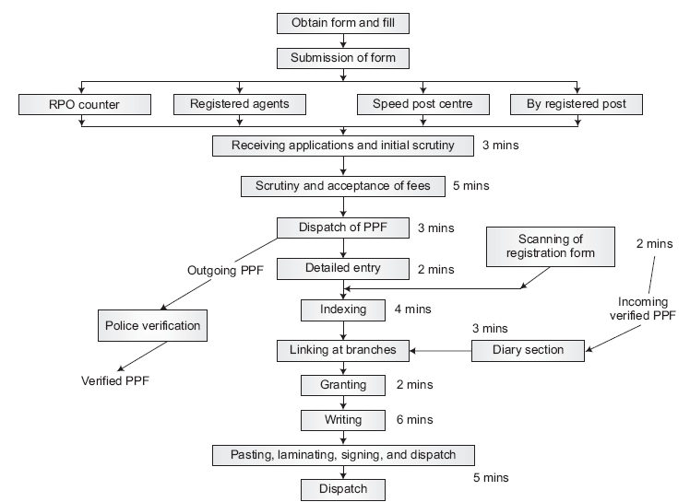
Operations Management in Services Process flow diagram for passport application processing
Source: Ravichandran, N and D. Bahuguna (2006), “Rule Bound Government Agency to Customer Centric Service Facility: Can Indian Passport Offices make the leap?” IIMB Management Review, 18(1), 59 – 66.

Slide 10
Manufacturing & Service Similarities & Differences
Manufacturing Organizations | Service Organizations
Differences
Physical durable product | Intangible, perishable product
Output can be inventoried | Output can’t be inventoried
Low customer contact | High customer contact
Long response time | Short response time
Regional, national, Intl. markets | Local markets
Large facilities | Small facilities
Capital intensive | Labour intensive
Quality easily measured | Quality not easily measured
Similarities
Is concerned about quality, productivity & timely response to its customers
Must make choices about capacity, location, layout
Has suppliers to deal with
Has to plan its operations, schedules and resources
Balance capacity with demand by a careful choice of resources
Has to make an estimate of demand

Slide 11
Operations A key functional area in an Organisation
Finance
Operations
Marketing
H R M

Slide 12
Operations Function Linkages with other functions
Operations Support Layer
Customer Layer
Marketing
Maintenance
Quality
Ultimate
Customer
Dealers
Retailers
Costing
Planning
Tooling
Material
I T
Design
I E
Core Operations Layer
Testing
Assembly
Layer of
Innovation
Fabrication
Machining
Innovation
Strategy
Supplier Layer
Service Delivery system
Research &
Development
Sub-contractors
Suppliers
Other service providers
Source: B Mahadevan, The New Manufacturing Architecture, Tata McGraw Hill, New Delhi, 1999.

Slide 13
Operations Management A systems Perspective
Forecasting
INPUT
PROCESSING
OUTPUT
Labour
Process &
Product
Design
Purchasing &
Inventory
Control
Goods
Material
Capital
Operations
Planning &
Control
Material &
Capacity
Planning
Services
Feedback
Quality
Management
Maintenance
Management
Process
Improvement

Slide 14
Video Insight 1.2 Manufacturing of Mahindra’s XUV 500
Right click on the URL below to open the hyperlink in the web browser…
http://www.youtube.com/watch?v=q5-7ZeORixk

Slide 15
Operations Management Functions
Design Issues | Operational Control Issues
Product & Service Design | Forecasting the Demand
Process Design | Operations Planning & Control
Quality Management | Supply Chain Management
Location & Layout of Facilities | Maintenance Management
Capacity Planning | Continuous Improvement of Operations
Design issues in Operations Management lay down overall constraints under which the operations system functions
Operational Control issues focuses on optimizing the use of available resources in the short-term while delivering goods and services as per plan under the given design constraints

Slide 16
Operations Management Challenges
Competitive Pressures due to economic reforms
Falling Prices
The on road price of a Hyundai Santro has not changed much between 2000 and 2014
Shrinking Delivery Quote
Textile Manufacturers are expected to cut their lead time from order placement to final delivery down to 2 months
Build-to-Order Requirements
Need systems that allows customers to self-configure, customize and visualize their own version of products & services

Slide 17
Operations Management Challenges
Growing customer expectations
Examples: Tariff plans and options provided by mobile operators, options in passenger car
Customers tend to demand more and refine their expectations
Manufacturing & Service organizations must learn to respond to these expectations
Need to develop capabilities to bring newer products and services faster and yet profitably

Slide 18
Operations Management Challenges
Today’s businesses are constantly challenged by the rapid technological advancements
Example 1: ATMs & Internet Banking. Customers need not visit a bank branch. Drafts and cheques replaced with electronic payment gateways & fund transfer mechanisms.
Example 2: Buying a train ticket. By visiting a Web site like http://www.irctc.co.in/, a customer can accomplish all tasks pertaining to ticket booking and cancellation at leisure.
Example 3: Procurement of goods & services. A manufacturing organization can procure goods & services by organizing a reverse auction on the Internet. In 3 to 4 hours, the best price for a component and the supplier willing to provide the component at a desired quality can be located.
Example 4: New Product Development. A team of design personnel from across different geographical locations can participate in new product development using technological tools.

Slide 19
Operations Management Challenges
Environmental Issues
When Government of India announced a scheme for special economic zones (SEZs), it generated controversies and social concerns.
Growing industrialization raises concerns regarding the depletion of natural resources and the waste generated from production systems and end-of-life products.
Growing urbanization creates societal problems arising out of scarcity of available resources and generation of solid wastes.
Consumption of energy and water in countries like India is on the rise. Such a situation requires better practices and newer methods of addressing these requirements using better operational practices.
Increasingly, firms are under pressure to take responsibility of restoring, sustaining, and expanding the planet’s ecosystem instead of merely exploiting it.
OM practices must address environmental concerns in order to ensure a sustainable world

Slide 20
Operations Management Implications & Priorities
Relate operations system to Customer/ Market
Acquire Capabilities to tolerate product proliferation
Develop systems and procedures that promote learning
Develop Green Manufacturing Practices

Slide 21
Operations Management: Trends & Issues Chapter Highlights
Operations Management is a systematic approach to address all issues pertaining to the transformation process that converts some inputs into useful output
Globally, India is emerging as an important manufacturing base.
Several recent studies point to emerging opportunities for Indian manufacturing to grow and attain a global presence.
From an operations management perspective, the notion of a ‘pure product’ and ‘pure service’ is just the two ends of the spectrum.
In reality, a vast majority of operations share a continuum of products and services.

Slide 22
Operations Management: Trends & Issues Chapter Highlights…
Despite several important differences between products & services, from an OM perspective there are several similarities between the two
Decision context in operations management can be broadly classified as
Design and operations control issues
Long term and short term decisions
Some of the challenges faced by operation firms include
Need to address increased competition due to economic reforms
Addressing the growing expectations of the customers
Rapid technological advances
Emerging environmental concerns

