Slide 1
Chapter 2
Operations Strategy

Slide 2
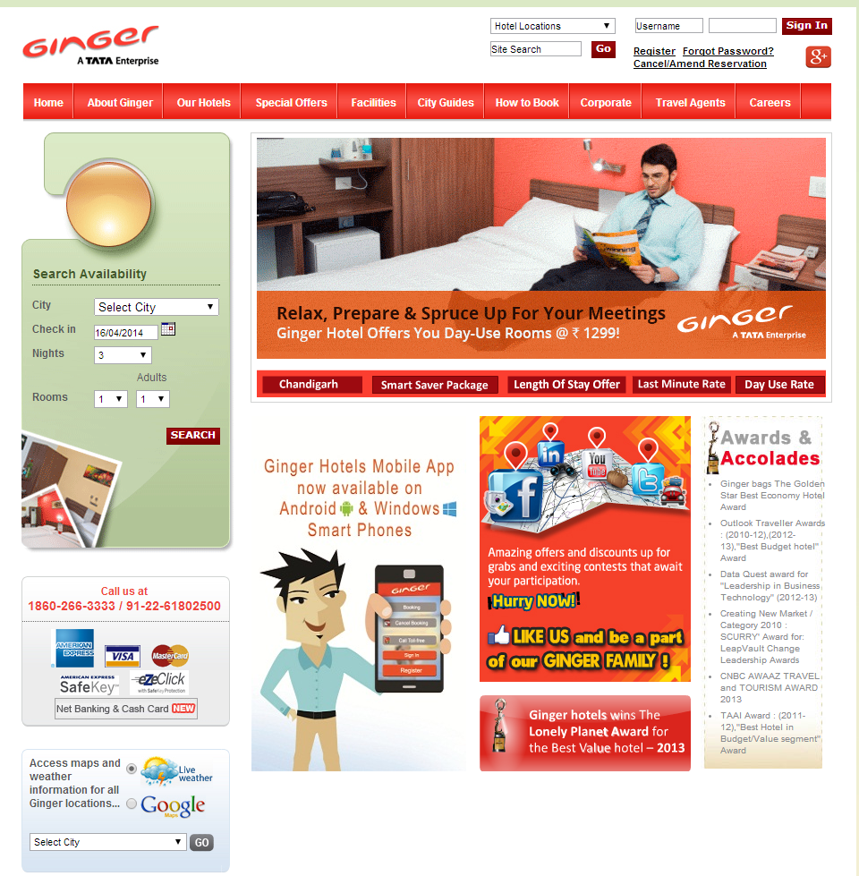
Operations Strategy An example from Hotel Industry
A Ginger hotel distinguishes itself in several ways in the manner these services are offered:
A limited à la carte menu at a nominal price
Some elements of self-service:
Self-Service Check-In
Give ‘n’ Take Counter:
Smart Get Set :
Smart Knick Knacks:
Smart Mart:
Source: http://www.gingerhotels.com

Slide 3
Operations Strategy Relevance & Context
Strategic planning exercise
Enables an organization to respond to the market needs in the most effective manner
By aligning various resources and activities in the organization
To deliver products & services that are likely to succeed in the market
Operations Strategy
Is a process by which key operations decisions are made that are consistent with the overall strategic objectives of a firm
Decisions in the operations function are made on the basis of the inputs from the overall corporate strategy

Slide 4
Need for Operations Strategy
Competitive dynamics & expectations of customers change with time
Due the changes in market place, competitive priorities for an organization is likely to change
While it was customary for people to book for a passenger car and wait for a few months to get delivery of the car, today a manufacturer of passenger cars cannot afford to make customers wait that long
ABB Ltd. reported that the price of a 33 KV circuit braker dropped from Rs. 275,000 in 1990 to Rs. 180,000 in 1999.
Triveni Engineering, a manufacturer of Turbines faced a 40% reduction in the price of turbines in the less than 3.5 million watts category over the last six years
Need a mechanism to systematically respond to these changes in the most effective way
Need to tune their operations to match with the competitive priorities

Slide 5
Strategy Formulation Process Steps
Step 1: Understanding the Competitive Dynamics at the Marketplace
Step 2: Identifying Order-Qualifying & Order-Winning Attributes
Step 3: Deciding on Strategic Options for Sustaining Competitive Advantage
Step 4: Matching the strategic options with resources, constraints, values & objectives to arrive at the overall Corporate Strategy
Step 5: Developing an Operations Strategy on the basis of the corporate strategy
Step 6: Selecting appropriate options for configuring an Operations systems & establishing relevant measures for operational excellence

Slide 6
Strategy formulation process
Competitive
Dynamics at
the marketplace
Order winners
Order Qualifiers
Strategic options for
Sustaining
competitive advantage
Generic Competitive Priorities
Quality, Cost,
Delivery, Flexibility
Firm level
Strengths &
Weaknesses
Corporate Strategy
Strategic decisions for
Operations System
Operations Strategy
Measures for
Operational Excellence

Slide 7
Order Qualifiers & Order Winners
Order qualifying attributes are the set of attributes that customers expect in the product or service they consider for buying
Order winning attributes are other attributes that have the potential to sufficiently motivate the customer to buy the product or service
What constitutes order winning and order qualifying might change from time to time
During the early 1980’s providing superior quality products was an order winning attribute. However, in the 1990’s quality became an order qualifying attribute as customers began to expect high levels of quality
Order winning attributes include efficient consumer response, speed, variety and convenience

Slide 8
Operational Excellence Performance Measures
Provide critical linkage between order winning and order qualifying attributes and choices made in operations
Help organisations evaluate how well the operations system is responding to the requirements at the marketplace
Serve a useful purpose in comparing performances amongst competitors and for benchmarking
Four generic options are useful for developing measures for operational excellence; this includes Quality, Cost, Delivery and Flexibility

Slide 9
Measures for operational excellence An example
Performance Criterion for Comparison (1987) | Japan@ | U.S.*
Production of vehicles (Million) | 4 | 8
Number of employees | 37,000 | 850,000
Parts on which detailed Engg. is done (%) | 30 | 81
No. of employees in purchasing | 337 | 6,000
Number of suppliers for upholstery | 1# | 25**
Design to customer delivery time (million Hrs.) | 1.7 | 3
Design to customer delivery time (months) | 46 | 60
@ - Data pertaining to Toyota; * - Data pertaining to GM
# - Single supplier; ** - 25 Suppliers were supplying components to seat building department.
Source: J. P. Womack, D. T. Jones, and D. Roos, The Machine That Changed the World (New York: Rawson Associates , 1990)

Slide 10
Operational Excellence Performance measures
Quality | Cost
First Pass Yield | Average days of inventory (No. of inventory turns)
Quality Costs | Manufacturing cost as percent of sales
Defects per Million Opportunities | Procurement costs, total cost of ownership
Number of suggestions per employee | Value of import substitution, cost reduction
Process Capability Indices | Target cost reduction efforts
Delivery | Flexibility
Lead time for order fulfillment | Number of models introduced
Procurement and Manufacturing Lead time | New product development time
On time delivery for supplies | Breadth and depth of the product and service offerings
Schedule adherence | Process flexibility
Indirect Measures
Indirect-labour to Direct-labour ratio | Number of suggestions per employee
Ratio of Lead time to work content | Non-value added content in processes
Process rate to sales rate ratio | No. of certified deliveries
Average training time per employee | Delivery quote for customised products and services

Slide 11
Video Insight 2.1 How to achieve Operational Excellence?
Right click on the URL below to open the hyperlink in the web browser…
https://www.youtube.com/watch?v=-C6_IdIbqR4

Slide 12
Strategic Decisions in Operations Options
Strategic Options for Operations
Product Portfolio
Process
Capacity
Tech-nology
Supply Chain

Slide 13
Operation Strategy Options Product Portfolio
Product portfolio pertains to decisions on
what products the organization wants to produce
the number of variations in each product line
the extent of customization offered to customers
Product portfolio as a strategic option
Wide product portfolio: Overall strategic objective is to provide highly differentiated set of products and services to the customer
Narrow product portfolio: Overall strategic objective is one of cost leadership
Examples in Services & Manufacturing
Air travel from Bangalore to Delhi: Indigo and Jet Airways differ vastly in terms of the service offered
Computer manufacturers, Dell and Lenova: Overall strategic objective of Dell appears to be one of providing highly differentiated products, Lenova appears to emphasize on robust and reliable computing power

Slide 14
Operation Strategy Options Process Choices
Three types of flow happen on account of process choices:
Continuous streamlined flow
Intermittent or batch flow
Jumbled flow
Choice of process will be consistent with product portfolio decisions
A manufacturer emphasizing on production volumes, fewer varieties and less cost will make process choices pertaining to continuous streamlined flow (Hero Honda)
An organization wishing to satisfy an objective of providing wide range of products to the customers will adopt batch/intermittent flow type
the need to provide a very large variety and practically a production volume of one or few will adopt jumbled flow (BHEL)

Slide 15
Operation Strategy Options Supply Chain issues
Supply chain refers to the network of entities supplying components and raw material to an organization as well as those distributing the finished goods of an organization to the customers through alternative channels
Designing an appropriate supply chain calls for a better understanding of the product profile for which the supply chain is configured
Two types of supply chains can be configured:
Efficient supply chain: objective is cost optimization and better utilization of resources employed in supply chain operations; typically used in the case of functional products (machine tools, engineered equipments)
Responsive supply chain: the key objective is to develop a capability to respond fast to the market requirements; typically used in the case of innovative products (iPhone, Fancy Garments, trendy Electronics Goods)

Slide 16
Operation Strategy Options Technology Choices
Technological advancements in recent years have given new opportunities for creating competitive advantage for firms
Case of Asian Paints utilizing technological advancements for mixing of basic pigments to distribute paints in large varieties of colours and in large assortment of sizes
Using new technology options for manufacturing processes, organizations can
react faster to customer needs
manage a wide portfolio of product offerings and
yet maintain high levels of productivity
Organizations making a strategic choice to operate in the manufacture of mid-volume, mid-variety products could utilize new technology

Slide 17
New Technology Options Strategic Advantages
Increased machine utilisation
Scheduling flexibility: Permits an organisation to have flexibility in scheduling thereby enabling the organisation to react to changes fast
Ease of engineering challenges: Changes in engineering design and process plans can be easily accommodated by use of technology based manufacturing and process design.
Ease of expansion: Provides volume flexibility to the organisation, making it much easier to expand in response to a growing market
Reduced manufacturing lead time
Lower in-process inventory: Several of the above benefits directly translate to lower work in process inventory and reduced cost of manufacturing

Slide 18
Operation Strategy Options Capacity
Capacity is defined as:
maximum number of units of goods that can be produced per unit time in the case of manufacturing system
the maximum number of service offerings that can be made per unit time in the case of a service system
Capacity decision influences the cost of goods & services offered in three ways:
Accrued cost advantage due to economies of scale
Ability to spread fixed costs over a larger capacity
additional cost advantages in procuring other factors of production

Slide 19
Breakeven analysis
F – Fixed costs of production
v – Variable cost of production of one unit
p – Selling Price of one unit of the product
c – Contribution of one unit of product towards the fixed costs
S – Sales volume (in terms of number of units)
BEP_{Sales} – Sales volume required to achieve breakeven
Contribution Margin (c) = p – v
BEP_{Sales} =

Slide 20
Breakeven Analysis Example 2.1
A company manufactures a certain component, which it is able to sell at Rs. 15 per component. The variable cost of the component is Rs. 10 per unit. If the company has made a total investment in fixed costs to the tune of Rs. 30,000, what is the breakeven sales for the component?
Solution
F – Fixed costs of production = Rs. 30,000
v – Variable cost of production of one unit = Rs. 10
p – Selling Price of one unit of the product = Rs. 15
Therefore contribution of one unit of product towards the fixed costs, C is computed as:
c = p – v = 15 – 10 = Rs. 5
BEP_{Sales} =

Slide 21
Breakeven Analysis A graphical representation

Slide 22
Flexibility – Cost Trade-off
Flexibility and Cost are often viewed as competing dimensions in Operations Strategy
Cost
Flexibility

Slide 23
World Class Manufacturing (WCM) Core building blocks
WCM firms perform very well in all the four parameters of Quality, Cost, Delivery and Flexibility at the same time using better operations management practices
The new operations management tools that form the core building blocks of WCM are:
Just in Time (JIT)
Total Quality Management (TQM)
Total Productive Maintenance (TPM)
Employee Involvement (EI)
Simplicity

Slide 24
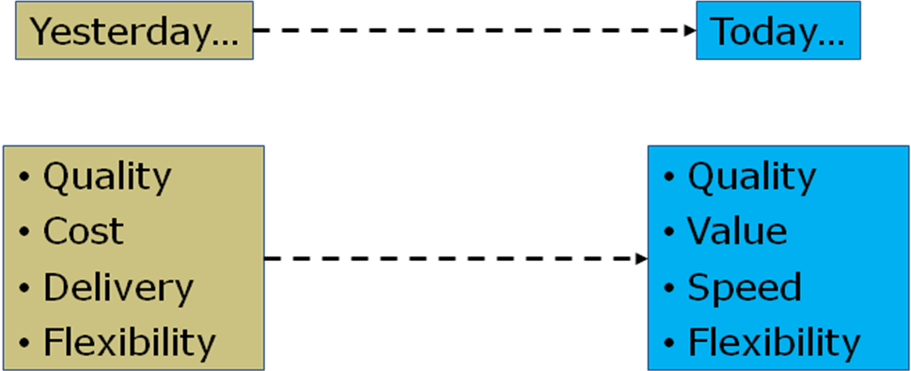
Changing Competitive Priorities for WCM
Weak companies are plagued by Trade-off obstacles
WCMs have gained an upper hand over the trade-off obstacles

Slide 25
Operations Strategy Emerging Trends & Implications
Trend 1: Globalization of Indian Economy
Cost pressures from overseas players and large scale dumping of goods (from low cost countries such as China)
Tougher terms from regional trading blocks such as EU, NAFTA and ASEAN
Chinese manufacturers are a major threat to Indian manufacturing firms as they have installed large capacities to benefit from capacity related cost advantages
Falling prices in the white goods industry
The cost of a 5-kg automatic washing machine fell from INR 8,000 in 2003 to INR 6,000 in 2005
A 1.5-tonne air conditioner that was available for INR 25,000 around 2001 was priced at just INR 15,000 in 2005
Chinese Phenomenon
When the vitrified-tile price in India was at INR 120 per square feet, Chinese suppliers offered it at INR 30 per square feet.
Ciprofloxacin, an active pharmaceutical ingredient, costs INR 1,200 per kg in India, but can be bought at INR 1,000 per kg from Chinese suppliers.

Slide 26
Operations Strategy Emerging Trends & Implications
Implications due to Globalization
Indian manufacturing firms can provide goods and services at a fraction of the cost of that in the developed countries due to factor cost advantages
India has a large installed base of technical manpower, manufacturing know-how and experience in manufacturing management
Indian manufacturing firms need to equip themselves with the required operations management practices to enlarge the global trading opportunities
Operations management practices in the country should focus on providing other advantages in addition to narrowing down the cost differentials with China

Slide 27
Competing in Global markets Some requirements
Identify a segment and create global scale
Develop and hone process skills and create operational excellence
Move from mere manufacturing of components to design and development through greater investment in research and development

Slide 28
Operations Strategy Emerging Trends & Implications
Trend 2: Outsourcing – a major wave
Business Process Outsourcing (BPO) is an arrangement by which some of the business processes are done by a third party on behalf of the organization
The key motivation for a firm to outsource some of its processes stems from three factors: Cost, Capacity and Core competency
Implications
Primary consideration for BPO is cost, operations strategy for BPO firms must emphasize on cost leadership
Since an organization often out-sources the entire operations pertaining to a business process to a third party, quality considerations are to be met with stringent norms.
Stringent delivery requirements may also have to be met as the processes may be in the intermediate stages of the value creation process.

Slide 29
BPO applications in Organizations: Process View
Consulting Services Change Management
Workflow Enhancements New Product Development
Brand Management E-business/E-governance
STRATEGIC
PROCESSES
Vendor Evaluation & Selection Stores Management
Asset Mgmt.
Accounts Receivables & Payables
R& D
Manufacturing
Fabrication
Assembly
Testing
Warehouse Management Market Survey Telemarketing
Installation & Servicing
Systems
Integration & Consulting,
OPERATIONAL PROCESSES
Employee welfare support, Facilities upkeep
IT Enabled Services
Recruitment & Training Services, Employee Surveys
Transaction Processing, Auditing of Books of accounts
Contract Labor, Marketing & Sales support
ENABLING
PROCESSES

Slide 30
Operations Strategy Emerging Trends & Implications
Trend 3: Collaborative commerce thru Internet
Collaborative commerce is defined as the electronic mechanism that enables the trading partners to transact several aspects related to commerce
Implication
Collaborative commerce opens up new areas for consideration in operations management
procurement and supply management practices
design and new product development
Trading partners can exchange vital production planning and other technical information between them for mutual benefit
Organizations are benefiting from greater efficiency and lower costs

Slide 31
Operations Strategy Chapter Highlights
A strategic planning exercise enables an organization to respond to the market by aligning the resources and activities in the organization to the market needs
Operations strategy is the process of making appropriate decisions in the operations function on the basis of inputs from the corporate strategy
A strategy formulation exercise enables an organization to identify order winners and order qualifiers.
Four generic performance measures are useful in any operations strategy exercise. These pertain to quality, cost, delivery & flexibility.

Slide 32
Operations Strategy Chapter Highlights…
Translating corporate strategy to operations strategy boils down to making appropriate choices with respect to product portfolio, processes, technology, capacity and supply chain.
World Class Manufacturing organizations feature five basic elements of operational excellence. These include Just in Time (JIT), Total Quality Management (TQM), Total Productive Maintenance (TPM), Employee Involvement (EI) and Simplicity.
Dismantling of trade practices demands that Indian manufacturing & service organizations equip themselves with the required operations management practices to tap global trading opportunities.

