Slide 1
Chapter 4
Project Management

Slide 2
Video Insight 4.1 Chatrapathi Shivaji Intl. Airport: Terminal 2 Project Management Issues
Right click on the URL below to open the hyperlink in the web browser…
https://www.youtube.com/watch?v=OBsSi6CgISg

Slide 3
Project Management Distinguishing features
Different from mainstream
No expertise currently available
Areas of competency not yet demonstrated
Product/Service Offered is Large Scale
Going from sub-system to total system (larger quantum of design, fabrication etc.)
Long-term period of operation (2 - 5 years)
High Degree of Customisation

Slide 4
Issues in managing projects
Unique
High Level of
Subcontracting
Risk & Uncertainty
Team Work

Slide 5
The Four Phases of Project Management
Conception
Conceptual Design
Budgeting
Planning
Work Breakdown Structure (WBS)
Setting Deadlines and Milestones
Implementation & Control
Resources Management
Materials & Contracts Management
Scope & Objectives
Project Appraisal
Organizational Breakdown Structure (OBS)
Cost Breakdown Structure (CBS)
Resources Planning (Equipment, Material, Labour)
Performance Appraisal/Control
Risk Management
Feedback
Post-project Appraisal

Slide 6
Project Management A framework
How well?
What?
Project Monitoring
& Control, Post-
Project Appraisal
Work
Breakdown
Structure (WBS)
Network
Representation
& Planning
Organisation
Breakdown
Structure (OBS)
Cost
Breakdown
Structure (CBS)
Who?
When?
How much?

Slide 7
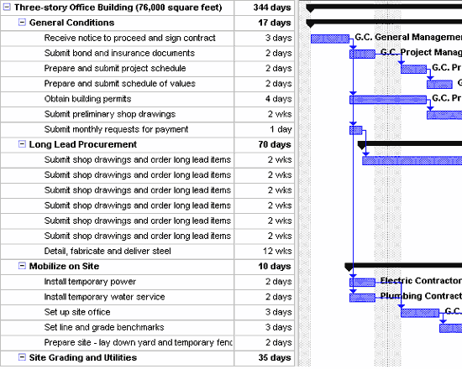
Work Breakdown Structure An illustration from a construction project

Slide 8
A matrix Organisation Structure

Slide 9
WBS – OBS – CBS A three dimensional perspective
WBS
Project
Design
Mechanical
Electrical
Integration
Finance
Works
A typical
work package
Company
CBS
Procurement
Material
OBS
Design
Labour
Total cost
Equipment
Adopted from: Harrison, F.L., (1992), Advanced Project Management, Gower Publishing company, 3rd Edition.

Slide 10
Project Planning using a Network Steps in the process
Developing a network representation of a project
Analysis of the network
Estimating completion & project duration
Addressing time and resource constraints in projects
Handling uncertainty in project completion

Slide 11
Network representation of a project
Network representation provides a visual aid to a manager to understand various activities & their interactions
Elementary unit of analysis in a project network is activity
Each activity consumes a set of resources and takes a finite amount of time for completion
Every activity may have certain technological or logical constraints that link it with its preceding and succeeding set of activities
Activity on Arc (AOA): activities are represented on the arc
Activity on Node (AON): each node represents the activity itself

Slide 12
AOA Network Example 4.1
a
b
c
e
g
1
2
3
4
6
8
d
h
f
5
7
Represents a dummy activity

Slide 13
AON Network Example 4.1
c
e
g
Start
a
b
End
h
d
f

Slide 14
AOA Network Example 4.2
4
F:2
D:2
A:8
B:12
E:8
I:2
J:2
1
2
3
5
7
8
C:4
G:3
H:2
6
* In the figure, the numbers following each activity represents the duration of the activity

Slide 15
Path Duration & Critical Path Example 4.2
Path 1: 1 – 2 – 3 – 5 – 7 – 8
Path 2: 1 – 2 – 3 – 4 – 5 – 7 – 8
Path 3: 1 – 2 – 6 – 7 – 8
Path 4: 1 – 2 – 3 – 5 – 6 – 7 – 8
Path 5: 1 – 2 – 3 – 4 – 5 – 6 – 7 – 8
Path 1: 32 weeks
Path 2: 28 weeks
Path 3: 15 weeks
Path 4: 35 weeks
Path 5: 31 weeks
The critical path is 1 – 2 – 3 – 5 – 6 – 7 – 8 (path 4)
The duration of the project is 35 weeks

Slide 16
Knowing more about activities Early and Late schedules & Slack
Start time for the project : S (usually 0)
Early start time, ES for activity “a”
If it is a beginning activity, ES(a) = S
Otherwise, ES(a) = max{EF(all predecessors of a)}
Early finish time, EF for activity “a”
EF(a) =ES(a)+t(a), where t(a) is the activity duration
Project Completion time T:

Slide 17
Knowing more about activities Early and Late schedules & Slack…
Late finish time, ES for activity “a”
If it is an ending activity, LF(a) = T
Otherwise, LF(a) = min{LS(all successors of a)}
Late start time, LS for activity “a”
LS(a) = LF(a) + t(a), where t(a) is the activity duration
The Total Slack, TS for activity “a”
TS(a) = LF(a) – EF (a) or LS(a) – LF(a)

Slide 18
Early & Late Schedules Example 4.2
Activity* | Description | Duration (weeks) | ES | EF | LS | LF | TS
A* | Design/Approval of plan | 8 | 0 | 8 | 0 | 8 | 0
B* | Foundation/Super-structure | 12 | 8 | 20 | 8 | 20 | 0
C | Select and order accessories | 4 | 8 | 12 | 27 | 31 | 19
D | Wiring for the building | 2 | 20 | 22 | 24 | 26 | 4
E* | Carpentry works | 8 | 20 | 28 | 20 | 28 | 0
F | Laying of roof | 2 | 22 | 24 | 26 | 28 | 4
G* | Wall Plastering/Laying floors | 3 | 28 | 31 | 28 | 31 | 0
H* | Fixing fittings (sanitary, electrical etc.) | 2 | 31 | 33 | 31 | 33 | 0
I | Wall, Door and Exterior painting | 2 | 28 | 30 | 31 | 33 | 3
J* | Final polishing, Hand over | 2 | 33 | 35 | 33 | 35 | 0
* Indicates these activities are on critical path

Slide 19
Early/Late schedules & Critical Path Example 4.2
4
Legends
N : Node
a:n : Activity name: Duration
(ES, EF) : (Early start, Early Finish)
[LS,LF] : [Late Start, Late Finish]
: Critical Path
: Non-critical path
(22,24)
[24,26]
[26,28]
F:2
D:2
(0,8)
[0,8]
(8,20)
[8,20]
(20,22)
(28,30)
[31,33]
1
A:8
2
B:12
3
5
I:2
7
8
E:8
J:2
(20,28)
[20,28]
[28,31]
(33,35)
[33,35]
G:3
(28,31)
[31,33]
C:4
H:2
(8,12)
[27,31]
(31,33)
6

Slide 20
Resource Loading (Early start schedule) Example 4.3

Slide 21
Resource levelled schedule Example 4.3

Slide 22
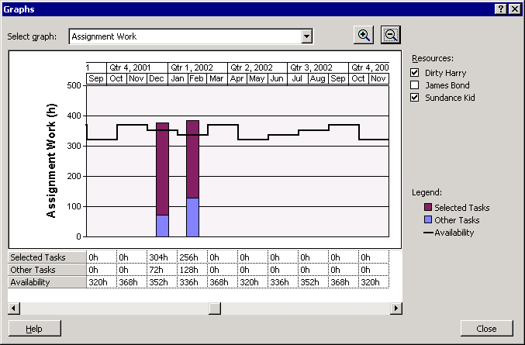
Resource Allocation Routine Sample screenshot from MS Project 2002

Slide 23
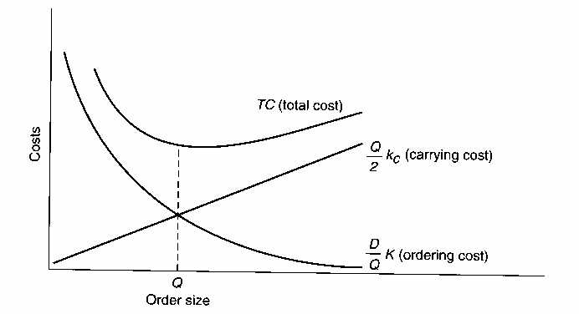
Project Management Time Cost Trade-offs
Direct costs
Indirect costs
Project Duration

Slide 24
Crashing Project Duration Example 4.4

Slide 25
Crashing Project Duration Example 4.4

Slide 26
Handling Uncertainty in Projects Basic Assumptions behind PERT
Project Evaluation & Review Technique (PERT) enables managers to analyse a network when uncertainties in time estimates exist
PERT relies on the subjective expertise of the mangers actively involved in such projects to estimate the activity duration
Three time estimates are made for each activity:
Most likely estimate of activity duration: t_{m}
Most optimistic estimate of activity duration: t_{o}
Most pessimistic estimate of activity duration: t_{p}
The activity duration follows a Beta distribution

Slide 27
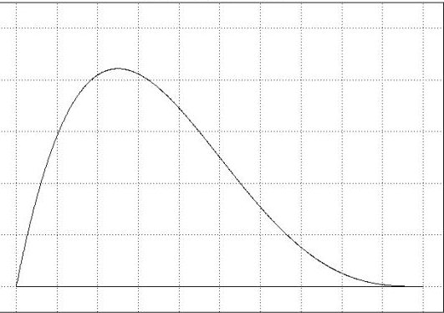
Beta Distribution for PERT
t_{o}
t_{m}
t_{p}

Slide 28
PERT Estimating activity durations
Expected activity duration is given by:
Variance of the activity duration is given:
Consider one path P, in a network consisting of 4 activities (a, b, c and d)
The expected duration for path P is given by:
.
The variance of duration for path P is given by:
The expected project duration T_{c} is the critical path:

Slide 29
Analysis using PERT Example 4.5
Activity | Optimistic | Most Likely | Pessimistic | Expected duration | Variance
A | 4 | 8 | 18 | 9 | 5.44
B | 11 | 12 | 25 | 14 | 5.44
C | 3 | 4 | 11 | 5 | 1.78
D | 1 | 2 | 3 | 2 | 0.11
E | 6 | 8 | 22 | 10 | 7.11
F | 2 | 2 | 8 | 3 | 1.00
G | 2 | 3 | 4 | 3 | 0.11
H | 1 | 2 | 3 | 2 | 0.11
I | 1 | 2 | 3 | 2 | 0.11
J | 1 | 2 | 3 | 2 | 0.11

Slide 30
Analysis using PERT Example 4.5
Path Description | Activities in the path | Expected duration (T_{p}) | Variance
Path 1: 1 – 2 – 3 – 5 – 7 – 8 | A, B, E, I, J | 37 | 18.21
Path 2: 1 – 2 – 3 – 4 – 5 – 7 – 8 | A, B, D, F, I, J | 32 | 12.21
Path 3: 1 – 2 – 6 – 7 – 8 | A, C, H, J | 18 | 7.44
Path 4: 1 – 2 – 3 – 5 – 6 – 7 – 8 | A, B, E, G, H, J | 40 | 18.32
Path 5: 1 – 2 – 3 – 4 – 5 – 6 – 7 – 8 | A, B, D, F, G, H, J | 35 | 12.32
The expected project duration is 40 weeks (Path 4)

Slide 31
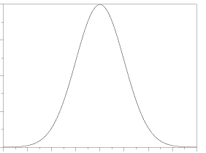
Probability of completion
Probability
of completion
Probability of completing
the project in 45 weeks
D = 45
T_{c} = 40
D=45
From standard normal table, the probability is obtained to be 0.879
Expected project
duration, T_{c}= 40 weeks

Slide 32
Project Management Chapter Highlights
Planning and control of operations in project organisations differ from other operating systems on account of high levels of uniqueness, risk and uncertainty in the former
Project management typically involves four phases. These include, conception, planning, implementation and control and post-project appraisal.
A structured approach to project management involves a three dimensional framework
Work breakdown structure
Organisational breakdown structure
Cost breakdown structure.

Slide 33
Project Management Chapter Highlights…
Projects can be graphically portrayed using Activity on Node (AON) or Activity on Arc (AOA).
Critical Path Method (CPM) helps understand several important aspects of controlling projects such as
the likely duration of the project,
activities that could be scheduled with some flexibility,
opportunities for resource leveling and
identifying activities that need to be crashed to reduce the project duration
PERT enables a project manager analyse projects that have high degree uncertainty with respect to activity durations

