Slide 1
Chapter 6
Facilities Location

Slide 2
The Akshaya Patra Foundation (TAPF) Mid-day Meals Logistics
Started in 2000, with 1500 children
Vision – “No child in India shall be deprived of education because of hunger”
Currently reaches out to about 1.3 million children in over 9000 schools across 9 states of India
Daily expenditure incurred – Rs. 26 lakhs
Distribution & logistics accounts for 19% of expenditure
Source: Source: Mahadevan, B., Sivakumar, S., Dinesh Kumar, D. and Ganeshram, K. (2013). "Redesigning Mid-day meal logistics of Akshaya Patra Foundation: OR at work in feeding hungry school children", Interfaces, 43 (6), pp 530 – 546.

Slide 3
Akshaya Patra Vasanthapura Operating Model
Cooking in centralized kitchens and distributing it to schools in the surrounding areas
Vasanthapura in South Bangalore had a cooking capacity of 50,000 meals a day
Delivered food to about 530 schools using a fleet of 35 vehicles
Cooking starts at 4 AM and the first batch of cooked food is available around 7 AM
The cooked food to be delivered at schools before 1 PM
The total daily trip length of Vasanthapura region as per their existing routing was about 1400 kilometers

Slide 4
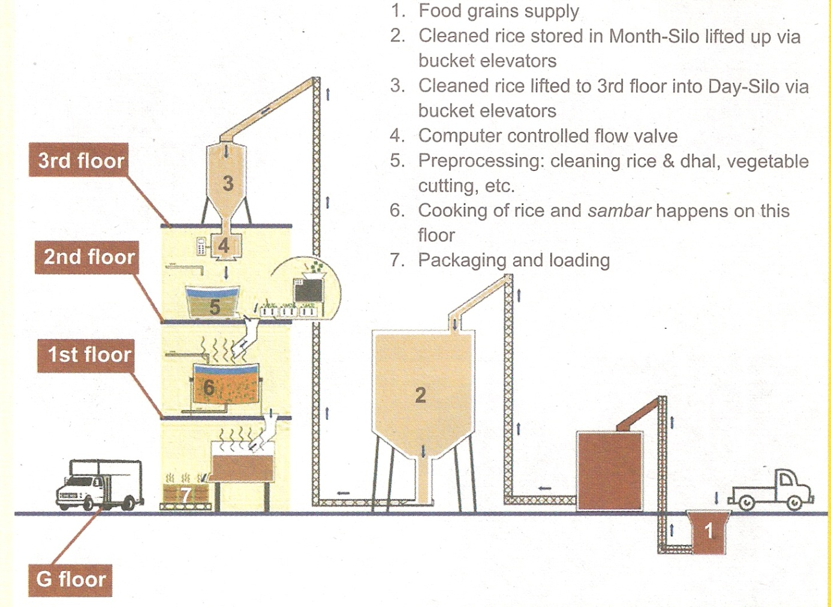
Vasanthapura Kitchen
Gravity kitchen
Serves around 530 schools
Feeds ~ 50,000 children everyday
26 routes
16 - 20 schools per route
Activities
Cooking
Packing
Loading
Despatch

Slide 5

Vehicles for food logistics
Mix of own & hired vehicles
Mixed fleet with varying capacity
Custom fitted with racks
Three types of vessels – small, medium & large
4 people for every route
Driver
Route supervisor
Loading/unloading boys

Slide 6
Facilities Location Growing importance
Factors promoting globalisation of operations
Regulatory & economic reforms
Factor Cost Advantages
Expanding markets in developing countries
Location issues have become more prominent in recent years due to globalisation
Location decision pertains to the choice of appropriate geographical site for locating manufacturing & service facilities of an organisation

Slide 7
Location Decision in an Organization Impact of Globalization
Saturation of
Developed Economies
High Cost Input
Legacy Cost Burden
Economic
Reforms
Impact on Location
Choice for Organizations
High Growth of
Newly Emerging Economies
(NEE)
Huge Capabilities in
NEE constantly discovered
& Exploited by the West
Multi-location (Globalized) Operations

Slide 8
Competitiveness of a location Three tier model
Country Competitiveness
Govt. budget & regulation Quality of judicial &
political institutions
Openness to
Intl. trade &
finance
Development
of financial Mkt. Extent to which a national environment is
Conducive or detrimental to business
Labour Sector Competitiveness Qlty of
Mkt. Flexibility Infrastructure
Quality
of Tech.
Extent to which a business sector offers potential for growth
and attractive return on investment
Company Competitiveness
Ability to design, produce, & mkt products
superior to competitors, Qlty. of business mgmt.

Slide 9
Doing Business in 2014 India – China Comparison
Rank in World Bank survey | China | India
Starting a business
Procedures (number) | 13 | 12
Time (days) | 33 | 27
Cost (% of per capita income) | 2.00% | 47.30%
Enforcing contracts
Procedures (number) | 19 | 46
Time (days) | 406 | 1420
Cost (% of debt) | 11.10% | 39.60%
Closing a business
Time (years) | 1.7 | 4.3
Cost (% of estate) | 22% | 9%
Recovery rate (cents on the dollar) | 36.00% | 25.60%
Source: “Doing Business 2014: Understanding Regulations for Small and medium Size Enterprises”, The World Bank, Washington DC, 2013

Slide 10
Location Decision Relevant Factors

Slide 11
Special Economic Zones Another dimension to location choices
The Special Economic Zones Act, 2005, was passed by Parliament in May, 2005 which received Presidential assent on the 23rd of June, 2005
Land for the 270 notified SEZs where operations have since commenced involved is approximately over 31,405 hectares
Every SEZ is divided into a processing area where alone the SEZ units would come up and the non-processing area where the supporting infrastructure is to be created
Benefits of SEZs include employment generation, increased exports, development of quality infrastructure
Nokia and Flextronics electronics hardware SEZs in Sriperumbudur providing employment to 14,577 and 1,058 persons respectively.
Hyderabad Gems SEZ for Jewellery manufacturing in Hyderabad has already employed 2,145 persons
Apache SEZ being set up in Andhra Pradesh will employ 20, 000 persons to manufacture 1 million pairs of shoes every month

Slide 12
Location Planning Methods
One facility – Multiple Candidates
Location factor rating
Centre of Gravity Method
Load Distance Method
Multiple Facility – Multiple Candidates
Transportation Model

Slide 13
Location factor rating Steps
Identify and list down all the relevant factors for the location decision
Establish the relative importance of each factor in the final decision
Rate the performance of each candidate location using a rating mechanism
Compute a total score for each location based on its performance against each factor and rank them in the decreasing order of the score

Slide 14
Example 6.1
A manufacturer of garments is actively considering five alternative locations for setting up its factory. The locations vary in terms of the advantages that it provides to the firm. Hence the firm requires a method of identifying the most appropriate location. Based on a survey of its senior executives the firm has arrived at six factors to be considered for final site selection. The ratings of each factor on a scale of 1 to 100 provide this information. Further, based some detailed analysis of both the qualitative and quantitative data available for each of the location, the rating for the locations against each factor has also been arrived at (on a scale of 0 to 100). Using this information obtain a ranking of the alternative locations.
Factor Ratings
Rating of each locations against the factors

Slide 15
Solution to Example 6.1
Overall rating for location 3 = 60*0.28 + 40*0.18 + 50*0.15 + 10*0.09 + 45*0.09 + 90*0.20 = 54.77

Slide 16
Centre of Gravity Method
All the demand points (or the supply points, if raw material is supplied from several locations) are represented in a Cartesian coordinate system
Each demand (or the supply point) will also have weight indicating the quantum of shipment
Therefore it is possible to identify the centre of gravity of the various demand (or supply) points
Notations:
The number of demand (or supply) points in the grip map: n
Co-ordinates of location i in the grid map: (x_{i},y_{i})
Quantum of shipment between existing demand (or supply) point i and proposed facility: W_{i}
Co-ordinates of the center of gravity in the grip map: (X_{C},Y_{C})

Slide 17
Example 6.2
A manufacturer of certain industrial component is interested in locating a new facility in a target market and would like to know the most appropriate place in the target market to locate the proposed facility. The manufacturer feels that there are no location constraints in the target market (i.e. any point in the target market is good enough).
There are four supply points A, B, C and D in the locality that will provide key inputs to the new facility. A two-dimensional grid map of the target market in which we would like to locate a new facility with distance coordinates of the four supply points is available.
The annual supply from these four points to the proposed facility is 200, 450, 175 and 150 tonnes respectively.
The situation is graphically shown in the two-dimensional plot in the figure. While the coordinates in the parentheses show the distance from the origin of the target map of each of the supply point, the number that follows is the annual shipment (in tonnes) from these points to the proposed facility.
Identify the most appropriate point in the grid map to locate the new facility.

Slide 18
Solution to Example 6.2 Grid Map
600
A (125,550), 200
500
B (350,400), 450
400
Distance in Kilometres
300
Centre of Gravity
(366,376)
D (700,300), 150
200
C (450,125), 175
100
100
200
300
400
500
600
700
Distance in Kilometres

Slide 19
Load Distance Method
Enables a location planner to evaluate two or more potential candidates for locating a proposed facility vis-à-vis the demand (or supply) points
Provides an objective measure of total load-distance for each candidate
Notations
Number of demand (or supply) points in the grid map: n
Index used for demand (or supply) points: i
Co-ordinates of demand (or supply) point i in the grid map: (x_{i},y_{i})
Quantum of shipment between demand (or supply) point i and proposed facility: W_{i}
Number of candidates for the proposed facility: m
Index used for the candidates for the proposed facility: j
Co-ordinates of candidate j in the grid map: (X_{j},Y_{j})
Distance measure for Cartesian coordinates between demand (or supply) point i and a candidate j for the proposed facility: D_{ij}
The load – distance for candidate j for the proposed facility: LD_{j}

Slide 20
Example 6.3
Consider example 6.2
Suppose the manufacturer came to know that there are constraints in locating the new facility.
Based on an initial survey of possible sites for the proposed facility, the manufacturer identified four candidates.
The figure has the location coordinates of the four candidates (numbered 1 to 4).
What is the best location for the proposed new facility?

Slide 21
Solution to Example 6.3

Slide 22
Solution to Example 6.3 Grid Map
Candidate for proposed facility
Existing Demand (or supply) point
600
A (125,550), 200
500
1 (300,500)
B (350,400), 450
400
Distance in Kilometres
2 (200,500)
3 (500,350)
300
D (700,300), 150
200
4 (400,200)
C (450,125), 175
100
100
200
300
400
500
600
700
Distance in Kilometres

Slide 23
Multi-facility location problem Transportation Model
Locating distribution centers for nation-wide distribution of products is one typical example belonging to this category
Decisions variables in a multiple location – multiple candidate problem
Identifying k out of n candidates for locating facilities
Which of the demand points will be served by each of these locations and to what extent
the problem is one of managing network flows of satisfying a set demand points using a combination of supply points
The transportation model is ideally suited for solving this combinatorial optimisation problem

Slide 24
Multiple facilities location problem Transportation table (Example 6.4)
Problem
Solution using
Vogal’s Approximation
Method (VAM)

Slide 25
Other issues in location planning
Recent trends in the international markets point to a shift towards fewer facilities that could serve markets worldwide
Example HP Desk Jet Printer, Dell PC
These developments point to two areas which could affect the location planning problem very significantly
availability of good transportation infrastructure
use of Internet and IT infrastructure
Location planning in the overall context of just-in-time manufacturing philosophy (suppliers located in the vicinity (20 – 40 Km radius) of the manufacturer)
Service quality depends on responsiveness of service delivery system. Locating service outlets, close to the demand point is an important requirement in a service system

Slide 26
Facilities Location Chapter Highlights
Location issues have become more prominent in recent years on account of globalisation of markets
Multi-national Corporations have more opportunities to identify candidate locations for their manufacturing facilities.
Factor cost advantages and expanding market in developing countries have made these nations attractive for locating new facilities
Simple qualitative methods are useful for quickly screening an initial set of candidates and narrowing down the choice to one or two

Slide 27
Facilities Location Chapter Highlights…
Load-Distance method and centre of gravity method helps evaluate the suitability of candidate solutions from a perspective of distance and quantum of items to be transported between a location and the demand points
Transportation method helps in optimally identifying a set of k locations out of n candidate solutions
Availability of good transport infrastructure and recent developments in the Internet technology suggests that it is possible to have fewer locations and still provide better customer service
Location decisions in service systems must address the requirement of speed of responsiveness. Therefore locating service outlets as close to the demand points may be highly desirable in service systems

