Slide 1
Chapter 10
Design of Service Systems

Slide 2
Setting up a Restaurant
Process design issues
Nature and level of interactions of the service provider with the customer
Alternatives available for positioning the service
Factors influencing service positioning and implications of this on the overall service delivery design
Overall level of technology to be used
Identifying the elements of a front office and back office of this service delivery system
Design of the dining and the kitchen areas
Layout of the service delivery system - areas that need greater attention with respect to look and feel
Capacity of the dining and the kitchen areas –
  Estimating this given a certain uncertainty in the arrival pattern and the demand for the restaurant services

Slide 3
Design of Service Systems
Different from manufacturing
Design of service operation systems typically involves making choices with respect to location, technology, capacity and layout of the system.
In most service systems customer participation in the conversion process is inevitable.
  It requires the designer to incorporate customer as an integral element in the design process.
  Designing services requires looking at tiny details that pleases the customer
  Another aspect of services is the need to address the issue of personalization

Slide 4
Process Design Issues
Service Systems
Customer contact signifies
  the extent to which customer participates in the preparation and consumption of service
  the nature and intensity of interaction that the customer has with the entities and service personnel
  the level of exposure that the customer has of the various facets of the service system while the customer is receiving the service
Degree of complexity refers to the steps and sequences in the process measured by the number and intricacy of the steps
Degree of divergence indicates the executional latitude or variability of these steps and sequences
All the three influence the service process design

Slide 5
Degree of Customer Contact
Design implications
Low: Quasi- Manufacturing
Medium: Mixed Service
High: Pure Service

Slide 6
Customer Contact
Implications
Efficiency of Operations
Capacity Decisions
Facility Location Choices
Control of Operations
Effectiveness Vs Efficiency Goals

Slide 7
Video Insight 10.1
Service System Tour: Maruti Showroom in Meerut
Right click on the URL below to open the hyperlink in the web browser…
https://www.youtube.com/watch?v=CGnR6wTHYxM

Slide 8
Degree of Complexity
An illustration
Full fare airline
Low cost airline
Provide alternative
options & Schedules
Provide alternative
options & Schedules
Ticketing
Schedule Selected
Schedule Selected
Seat Selection
Payment
Meal Preferences
Payment or
Miles Redemption
Obtain Boarding
Pass
Obtain Boarding
Pass
Check in & Board
Thru Check in
for onward Travel
Board Flight
Update Frequent
Flier Details
Use of Lounge
Facilities
Board Flight

Slide 9
Degree of Divergence
An illustration
Low cost Airline | Nature of the service | Full Fare Airline
Air Ticket, Insurance | Online Booking | Air Ticket, Insurance, Hotel, Airport Transfer, Cab for local travel
Low cost fare | Fare Options | Non-refundabe, APEX (Restricted), APEX (Normal), Economy, Full Fare
Economy | Cabin Class | Economy, Club Class, First Class, Business Class
On board sale of limited snacks | Meal Preferences | Asian Veg. meal, Non. Veg. Meal, Jain Meal, Diet Meal, Fruit Platter, Choice of Beverages
None | Airport Services | Valet, Lounge, Special Assistance

Slide 10
Degree of Complexity & Degree of Divergence: Another illustration
Low complexity/Divergence | Process Description | High Complexity/Divergence
No reservation | Table Reservation | Specific table selection options offered
Self seating, Menu on the board | Seating Guests, Offering Menus | Recite Menu, Describe in detail all starters & other special items in offer for the day
Eliminate | Serve Water & Starters at the beginning of the service | Assortment of salads, chips and fruit juices offered
Customer calls out his requirements | Order taking process | Order takers interact with the customers at the table in constructing the menu for the guests
Pre-prepared: Fixed set of offering | Salads, Papads | Individually prepared and served at the table as per request
Just 2 or 3 choices offered | Starters | Customers can choose from 20 alternatives
Only South Indian (Vegetarian) | Main Menu | South Indian, Jain, Tandoori, Chinese, Continental, Brazilian (Both vegetarian & non-vegetarian)
Payment at the counter while leaving (Cash only) | Cash Payment | Multiple choices of payments (Cash, Card, Coupons etc.)
Source: Adapted from Shostack, G.L., “Service Positioning through Structural Change”, Journal of Marketing, 51: 34 – 43.

Slide 11
Factors Affecting Design in Services
Divergence
Customization
Interaction
Customer Contact
Complexity
Labour Intensity

Slide 12
Video Insight 10.2
Service System Design & Operation: The Medanta, The Medcity
Right click on the URL below to open the hyperlink in the web browser…
http://www.youtube.com/watch?v=f9CVzpMqIIs

Slide 13
Service Positioning
An illustration
Low
Degree of Interaction
High
Low
No frill
Airlines
Fast-food
Joints
Restaurants
Online
Retailers
Airlines
Budget
Hotels
Internet & Phone
Banking
Ethnic & High End
Eating Places
Degree of Labour Intensity
Technology Push
For-profit
Hospitals
Five Star
Hotels
Traditional
Retailing
Traditional
Banking
Boutique
Hospitals
Personal
Banking
High

Slide 14
Service Positioning & Delivery System Design
Three parameters contact, divergence and complexity pertaining to the service we offer determine service delivery system design
Service positioning is the strategic choice a firm makes on the above three parameters
Service blue printing helps organisations to design, monitor, control and improve processes and the service delivery system on an ongoing basis

Slide 15
Service Blue Printing
An example from healthcare
Preliminary Activities
Meet the Doctor
Post-consultation
Front Office
Patient calls for
an appointment
Receptionist
Interaction
Patient meets
the Doctor
Advise
Prescription
Patient leaves
the hospital
yes
Line of
Interaction
Patient arrives
Registration
Payment
Cause
Clear?
Pharmacy
visit
Billing &
Payment
no
Patient waits
for his/her turn
Line of
Visibility
Diagnostic
tests done
Back Office
Receptionists checks
& confirms the appointment
Patient file
Extracted
Analysis
Reporting
Extract medicines
As per prescription

Slide 16
Capacity Planning under uncertainty
Use of waiting line models
Often demand placed on resources is uncertain making capacity requirement estimation difficult
In such cases, waiting line models
  make use of queueing theory fundamentals
  to analyse the impact of alternative capacity choices
  on important operational measures such as queue length, waiting time and utilisation of resources
In service systems, waiting time is an important operational measure that determines the service quality
  Computerised passenger reservation facility of Indian Railways
  Banking system or BSNL’s bill payment counters

Slide 17
Components of Queuing System
Calling
Population
Arrivals
Waiting Line
Server
Served
customers

Slide 18
Components of Queuing Systems
Infinite
Calling Population
Finite
Arrival Parameters
Rate
Markovian, General Distbn., Deterministic
Pattern
Single, Bulk, Special group
Queue Parameters
FCFS, LCFS, Random, Balk, Renege, Jog
Servers
Single, Multiple
System Structure & Parameters
Stages
Single, Multiple
Routing
Single, Serial, Network
Capacity
Finite, Infinite
Service Parameters
Markovian, General Distbn., Deterministic
Performance Metrics
Queue length, Waiting time, Utilisation, Cost based

Slide 19
Single-Channel Structures
Single-server, single-stage
Waiting line Server
Single-server, multiple stages
Waiting line
Servers

Slide 20
Multi-Channel Structures
Multiple-servers, single stage
Servers
Multiple-servers, multiple-stages
Waiting line
Servers

Slide 21
Single Server Queue
Formulae for L_{q}
L_{s} Average number of customers in the system (waiting to be served)
L_{q} Average number of customers in the waiting line
W_{s} Average time a customer spends in the system (waiting and being served)
W_{q} Average time a customer spends waiting in line
λ mean arrival rate
μ mean service rate
S Number of servers in a multi-server queue
Single server Queue
(Exponential service time)
λ²
L_{q} =
μ(μ − λ)

Slide 22
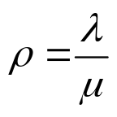
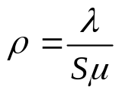
Performance Metrics
Relationships
Server utilisation
In the case of single server:
In the case of multiple servers:
Little’s Formula
Average time customer
spends in system
L_{s}
W_{s} =
λ
L_{q}
Average time customer
spends in queue
W_{q} =
λ
In the case of a Single Server
Average number of
customers in system
λ
L_{s} =
L_{q} +
μ

Slide 23
Example 10.2
The teller facility of a bank has a one-man operation at present. Customers arrive at the bank at the rate of one every 4 minutes to use the teller facility. The service time varies randomly across customers on account of some parameters. However, based on the observations in the past, it has been found that the teller takes on an average 3 minutes to serve an arriving customer. The arrivals follow Poisson distribution and the service times follow exponential distribution.
  What is the probability that there are at most three customers in front of the teller counter?
  Assess the various operational performance measures for the teller facility.
  Of late the bank officials notice that the arrival rate has increased to one every three and a half minutes. What is the impact of this change in the arrival rate? Do you have any observation to make?

Slide 24


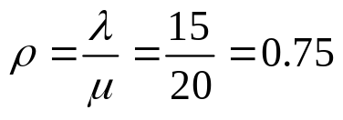
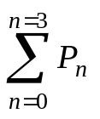

Solution to Example 10.2
Arrival rate at the bank: = 15 per hour
Service rate at the teller: = 20 per hour
Utilisation of teller facility:
Probability of at most three customers in the system =
Using equation 10.10, we compute P_{n} for values of n = 0 to 3
P₀ = (1- ) = 0.25; P₁ = 0.25*0.75¹ = 0.1875;
P₂ = 0.25*0.75² = 0.1406; P₃ = 0.25*0.75³ = 0.1055.
Probability of at most 3 customers =
  0.25 + 0.1875 + 0.1406 + 0.1055 = 0.6836

Slide 25
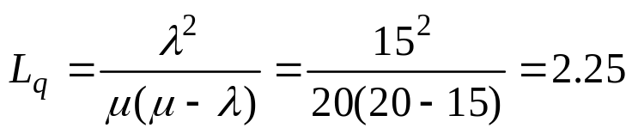
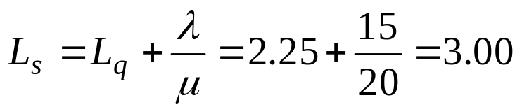
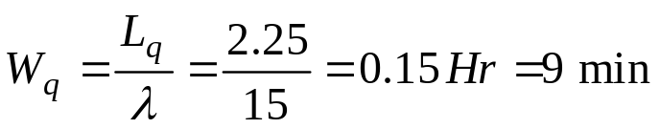
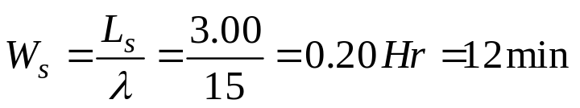
Solution to Example 10.2
Operational Performance Measures
  Avg. No. of customers in the waiting line:
  Avg. No. of customers in the system:
  Avg. time a customer spends waiting in line:
  Avg. time a customer spends in the system:

Slide 26
Solution to Example 10.2
Impact of Arrival Rate
 | Arrival rate = 15 per hour | Arrival rate = 17.143 per hour
Utilisation of the teller facility | 75% | 85.7%
Avg. number of customers in waiting line | 2.25 | 5.14
Avg. number of customers in the system | 3.00 | 6.00
Average time a customer spends waiting in line | 9 minutes | 18 minutes
Average time a customer spends in the system | 12 minutes | 21 minutes

Slide 27
Capacity Design issue Flexibility/Utilization Trade-off
High utilization
Low cost of operation
Poor service
Operational Performance
Measures
Low utilization
High cost of operation
Good service
0
100%
Utilization

Slide 28
Cost Relationship in Queuing
Total cost
Expected costs
Service cost
Waiting Costs
Level of service

Slide 29
Formulae For L_{q}
Three types of Queuing systems
λ²
Single server Queue
Exponential service time
L_{q} =
μ(μ − λ)
Single server Queue
General service time
λ² σ² + (λ / μ) ²
L_{q} =
2 ( 1 − λ / μ )
λ² 0 + (λ / μ) ²
Single server Queue
Deterministic service time
L_{q} =
2 ( 1 − λ / μ )
(λ / μ) ²
λ ²
=
=
2 ( 1 − λ / μ )
2 μ(μ − λ)

Slide 30
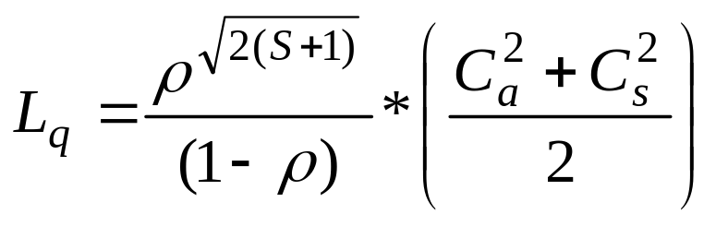
Multi-Server Queues
Approximation for L_{q} based on data
_
_
X_{a}
Mean Inter-Arrival Time (IAT)
_
X_{s}
Mean Service Time (ST)
S_{a}
Standard deviation of inter-arrival time
S_{s}
Standard deviation of service time
_
C_{a}
S_{a}/X_{a}
Coefficient of variation of IAT
=
_
C_{s}
=
Coefficient of variation of ST
_
S_{s}/X_{s}
1/
λ Mean arrival rate
=
_
X_{a}
μ Mean service rate
=
1/
X_{s}
ρ Utilisation of the ‘s’ servers
=
λ/Sμ
Source: Chase, R.B, F.R. Jacobs, and N. J. Aquilano, (2003), “Operations Management for competitive advantage”, Tata McGraw Hill, 10th Edition, pp 261 – 262.

Slide 31
Capacity Management
Services
Issue for consideration | Peak Hour | Non-Peak Hour
Operations strategy | Standard offering configure to order | Customized order
Service portfolio | Narrow offering | Wide offering
Demand mgmt. | Reservations | Special tariffs, offers
Resources management | Multi-skilled labour Adding temporary work force Increased working time | Dedicated tasks Training & development Reduced working time

Slide 32
Service Quality Measurement
Challenges in the process
Intangibility
  Performances rather objects, therefore precise specs. can be rarely set
  Cannot be counted, measured, inventoried, tested and verified in advance to assure quality
  Difficult to understand how consumers perceive & evaluate their services
Heterogeneity
  Performance vary from producer to producer, consumer to consumer, day to day
  Consistency of behaviour from service personnel is difficult to assure
  What firms intend to deliver may be different from what the consumer receives

Slide 33
Service Quality Measurement
Challenges in the process…
Simultaneity
  Not engineered in a plant and then delivered in tact to the consumer
  Quality occurs during service delivery while the consumer interacts with the service personnel
  Consumers’ input may be critical to quality
  The service firm may have less managerial control in real time

Slide 34
Service Quality
Some considerations…
Service quality is
  A measure of how well the service delivered matches with expectations
  Pre-dominantly is a function of perceptions of the customers
Quality evaluations are
  Not made solely on the outcome of the service
  They also involve evaluation of the process of delivery

Slide 35
Service Quality
The five gaps model
Expected Service
Gap 5
Consumer
Perceived Service
Firm
External Communications
to Consumers
Service Delivery
Gap 4
Gap 3
Translation of perceptions
into Service Qlty. Specs.
Gap 1
Gap 2
Management perceptions of
Consumer Expectations
Source: Parasuraman, A., Zeithhaml, V.A. and Berry, L.L., (1985), “A conceptual model of service quality & its implications for future research”, Journal of Marketing, 49 (4), 41 – 50.

Slide 36
Gaps in Service Quality
Why do they occur?
Gap 1: Service firm executives may not always understand
  What the consumer wants?
  What features a service must have?
  What levels of performance?
Gap 2: Means to meet the expectations absent
  Knowledge of consumer expectations exist but not the perceived means to deliver
  Absence of management commitment to quality
Gap 3: Variability in employee performance
  Standard Operating Procedure not existing
  Employee training issues
Gap 4: Problems arising out of communication
  Firms tend to promise more in communications than what they deliver in reality
  Firms tend to neglect to inform consumers of special efforts to assure quality that are not visible to consumers
Gap 5 = f (Gap 1, Gap 2, Gap 3, Gap 4)

Slide 37
Capacity Planning
Chapter Highlights
Process design of service systems differs vastly from that of manufacturing systems.
Degree of customer contact, degree of complexity and degree of diversity of service offerings have a significant bearing on process design in service systems.
Service positioning is the strategic choice a firm makes on the above three parameters
Service blue printing helps organizations to design, monitor, control and improve processes and the service delivery system on an ongoing basis

Slide 38
Capacity Planning
Chapter Highlights…
Waiting line models
  make use of queuing theory to analyze the impact of alternative capacity choice on operational performance measures such as waiting time, resource utilization and queue length.
  indicate that as resource utilization approaches 100%, queue length and waiting time becomes very large
Service systems
  tend to have plan for lesser resource utilization compared to manufacturing systems
  use alternative strategies for managing capacity during peak and non-peak hour
Service quality is hard to measure. Various gaps exist between delivered service and the expectations of the service receiver.

