Slide 1
Chapter 12
Total Quality Management

Slide 2
Quality Revolution in the 1980’s Salient features
Alternative ideas about what constitutes good quality
Newer methods to build quality in products and services
New tools to assess performance of an organisation with respect to quality
Changed roles of middle managers and supervisors from one of control to facilitation of the process of building quality into the products and services

Slide 3
Quality Management Changing Perceptions…
Yesterday…
It is often uneconomical to make
quality improvements since it brings down
productivity, increases cost and investment.
Today…
Productivity goes up and cost comes
down as quality goes up. This fact is
Known, but only to a selected few.

Slide 4
Quality Gurus
Willam Edwards Deming
Joseph M Juran
Philip B Crosby
Karou Ishikawa
Shigeo Shingo
Genichi Taguchi

Slide 5
Deming’s contributions
New perceptions to quality management
Plan – Do – Check – Act (PDCA) Cycle
14 point agenda for quality improvement
Considered father of Japanese Quality Management Systems
Highest Award in Japan named after him

Slide 6
Juran’s Quality Trilogy
Quality planning: the process of preparing to meet quality goals
Quality control: the process of making quality goals during operations
Quality improvement: the process of breaking through to unprecedented levels of performance

Slide 7
Philip Crosby Absolutes of Quality
I Absolute: Definition of quality is conformance to standards
II Absolute: The system of Quality is prevention
III Absolute: The performance standard is zero defects
IV Absolute: Measurement of Quality is the price of non-conformance
V Absolute: There is no such thing as Quality Problem

Slide 8
Other quality gurus
Karou Ishikawa
Cause & Effect (Fishbone) Diagram
Cause & Effect Diagram with Action Card (CEDAC)
Shigeo Shingo
Poka Yoke
Genichi Taguchi
Loss function
Design of experiments

Slide 9
Taguchi’s Loss Function
Customer Tolerance
Loss
Manufacturer Tolerance
Target
Performance Characteristic

Slide 10
Garvin’s Dimensions of Quality
Performance: Customer expects a certain level of performance from a product.
Features: Features provide additional attributes of enhancing the quality.
Reliability: Denotes the expectation that the product performs satisfactorily for a period of time.
Conformance: Meeting the specifications and standards of design
Durability: How long does the product lasts before it requires a replacement.
Serviceability: The ease with which the product can be serviced.
Aesthetics: Customers also value the aesthetics of the product.
Safety: Safety aspects denote the assurance to the customer that there are no hazards in using the product
Other perceptions: Customers may also have a host of subjective perceptions such as brand name, image, impact of advertising etc. in his/her assessment of quality.
Source: Garvin, D.A. (1984), “What does quality really mean?” Sloan Management Review, 26 (1), pp. 25 – 43

Slide 11
Alternative definitions of Quality

Slide 12
Total Quality Management Elements
Role of
Top Management
Quality
System
Employee Involvement
Training & Team Work
Tools & Techniques

Slide 13
Quality Management Tools A classification
Purpose f
or which the tool
Quality Control Tools
Management tools
is used
Highlighting problems
(a)
Control Charts
Identifying specific
(b)
Histograms
improvement
(c)
Check Sheets
opportunities
(d)
Pareto Diagrams
(e)
Scatter Diagrams
(f)
Graphs
Analysing problems &
(g)
Cause and Effect
(i)
Affinity Diagram
their root caus
es
(Fish bone) Diagram
(j)
Relationship
(h)
CEDAC
Diagram
Operational planning for
(k)
Tree Diagram
building quality into
(l)
Matrix Diagram
products/services
(m)
Matrix Data
Analysis
(n)
Process Decision
Program Chart
(PDPC)
(o)
Arrow Diagram
(p)
Pok
a Yoke
Strategic Planning
(q)
Quality Function
Deployment (QFD)
(r)
Quality Costing
1
In this chapter, we do not cover all the QC tools in detail. This is partly because some
of t
hem are fairly simple and straightforward to use. Moreover, there is a wide
published literature available on this topic. For a sample, readers are referred to
Ishikawa, K., (1991), “Guide to quality control”, Asian Productivity Organisation,
Second revise
d edition. Another useful source is Suzaki, K. (1993), “The New shop
floor management”, Free Press. Control charts are discussed in detail in the next
chapter.

Slide 14
Histogram An example

Slide 15
Pareto Diagram An example

Slide 16
Cause and Effect Diagram A generic representation
Materials
Work methods
Quality
Equipment
Labour
Ca
use
Effect

Slide 17
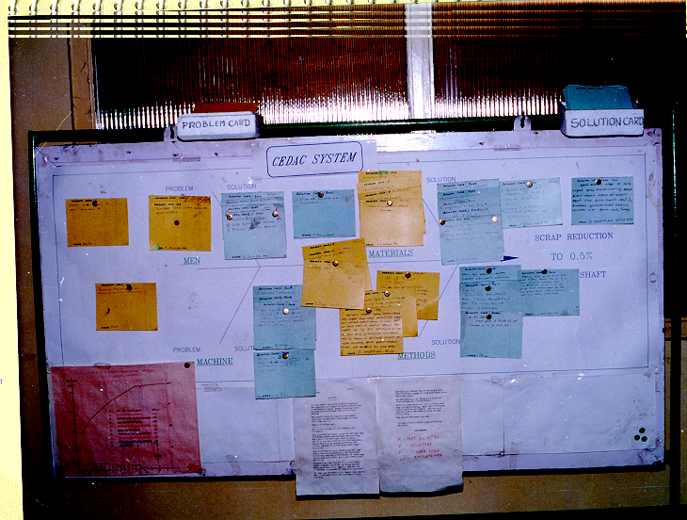
CEDAC An example

Slide 18
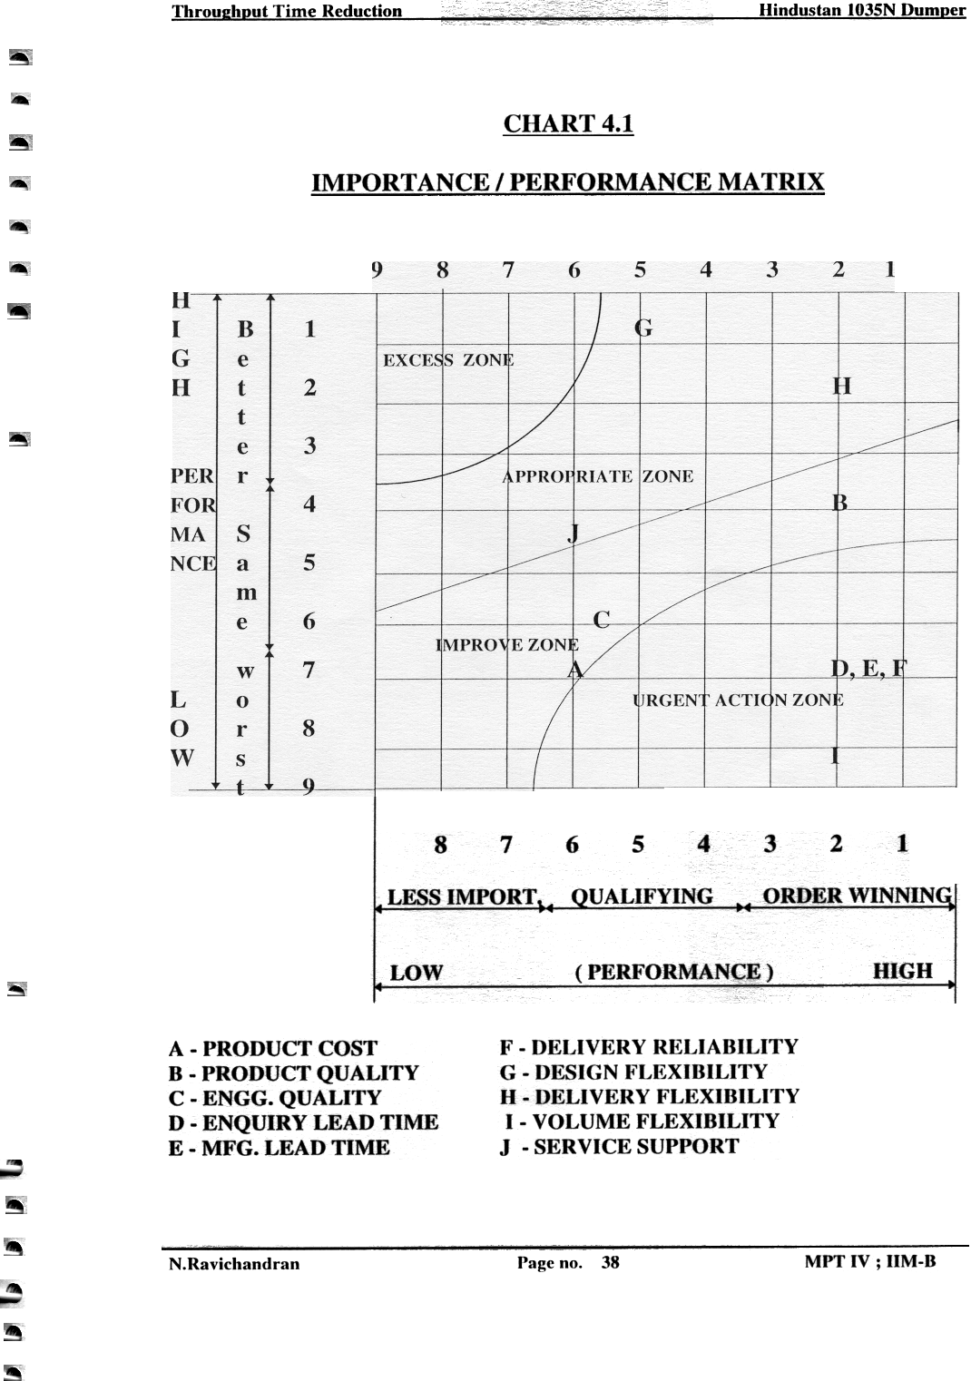
Matrix Diagram: An Example 1035N Dumper
Better
Same
Worst
Less
important
Qualifying
Order
Winning

Slide 19
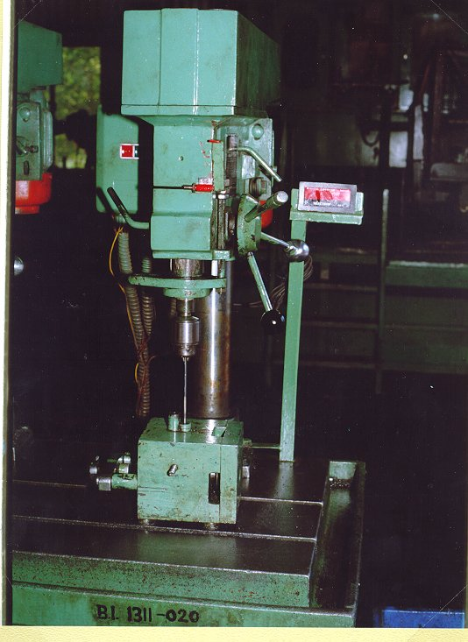
POKA YOKE An example
A pair of sensors for fail proof through drilling

Slide 20
Quality Function Deployment (QFD) The four houses of quality
Links
customer
needs to
design
attributes
Links
design
attributes to
actions firms
can take
Links
actions to
implement-
ation
decisions
Links
implement-
ation to
process
plans

Slide 21
Quality Costing Categories of Quality Costs
Quality Costs
Control Costs
Failure Costs
Prevention
Appraisal
Internal
External

Slide 22
Quality Certifications & Awards

Slide 23
The CII-EXIM Business Excellence Award Model
Enablers (500 Points)
Results (500 Points)
Leadership
100 Points
(10%)
People
100 points
(10%)
Processes,
Products &
Services
100 Points
(10%)
People Results
100 points
(10%)
Key Results
150 Points
(15%)
Strategy
100 points
(10%)
Customer Results
150 points
(15%)
Partnerships & Resources
100 points (10%)
Society Results
100 points (10%)
Source: Adapted from http://www.cii.in/uploads/SMB899.pdf

Slide 24
Certification Programs in Software Industry
Capability Maturity Model Integration (CMMI)
People Capability Maturity Model (P-CMM)
Software Acquisition Capability Maturity Model (SA-CMM)
Capability Maturity Model for Software (SW-CMM)
Systems Engineering Capability Maturity Model (SE-CMM)
Integrated Product Development Capability Maturity Model (IPD-CMM)

Slide 25
List of Deming Prize winners
Year | Name of the company
1998 | Sundaram-Clayton Limited, Brakes Division
2001 | Sundaram Brake Linings Ltd. (India)
2002 | TVS Motor Company Ltd. (India)
2003 | Brakes India Ltd., Foundry Division (India) Mahindra and Mahindra Ltd., Farm Equipment Sector (India) Rane Brake Linings Ltd. (India) Sona Koyo Steering Systems Ltd. (India)
2004 | SRF Ltd - Industrial Synthetics Business Lucas-TVS Indo-Gulf Fertilisers Limited
2005 | Krishna Maruti Limited, Seat Division (India) Rane Engine Valves Limited (India) Rane TRW Steering Systems Limited, Steering Gear Division (India)
2007 | Asahi India Glass Limited, Auto Glass Division (India) Rane (Madras) Limited (India) Reliance Industries Limited, Hazira Manufacturing Division
2008 | Tata Steels Limited
2010 | National Engineering Industries Limited
2011 | Sandan Vikas (India) Limited
2012 | SRF Limited, Chemicals Business Mahindra & Mahindra Limited, Farm Equipment Sector, Swaraj Division
2013 | RSB Transmissions (India) Limited, Auto Division (Jamshedpur Unit 1, Pune, Pant Nagar Plants)

Slide 26
Elements of a Quality Assurance System
Understand customer needs
Translate them to meaningful measures for the operating system
Top Management Commitment to Quality
Quality Certifications & Benchmarking exercises
Quality
Assurance
System
Documentation of all quality related initiatives for continuous learning & improvement
Mechanisms for identifying quality problems
Tools & techniques for the employees
For tracking problems to their root causes
Identifying corrective measures
Employee involvement for continuous focus on quality improvement
Methods for preventing recurrence of problems

Slide 27
Total Quality Management Chapter Highlights
The resounding success of Japanese manufacturing firms have invariably been linked to excellent practices in quality management in the last 30 years
Much of the progress that organizations made in quality and productivity management is attributed to the teachings of quality gurus such as Deming, Juran, Crosby, Taguchi, Shingo and Ishikawa
A good quality management system must
enable a manager to understand the qualitative attributes that influence a customer and
have a method of translating these into unambiguous quantifiable parameters for design and manufacturing

Slide 28
Total Quality Management Chapter Highlights…
A TQM program consists of four components:
top management commitment
employee involvement in continuous improvement initiatives
training and skill development
investment in robust systems
Several tools and techniques are available that help in
highlighting the problems
identifying specific improvement opportunities
analyzing problems and their root causes
operation and strategic planning for building quality into products and services
Alternative certification procedures and award mechanisms are available to recognize excellent quality management systems in organizations

